Slide 1
IOC Observation and Services Section
Global Ocean Observing System (GOOS) Update
Dr Joanna Post
IOC/GOOS

Slide 2
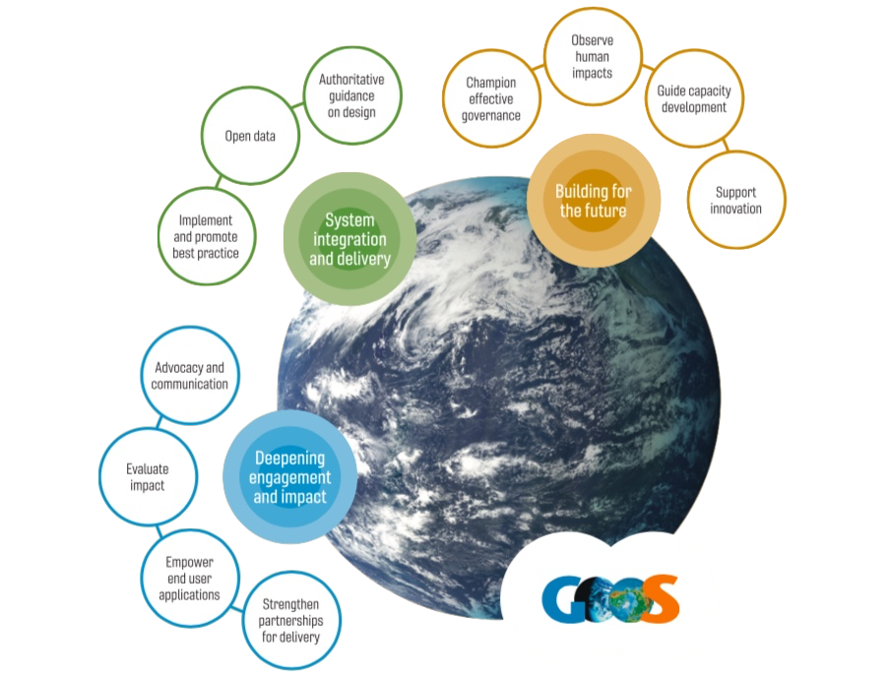
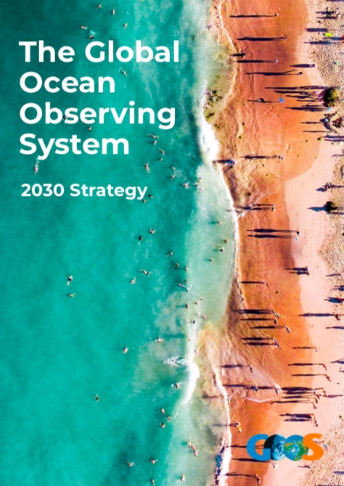
GOOS 2030 Strategy
Vision
A truly global ocean observing system that delivers the essential information needed for our sustainable development, safety, wellbeing and prosperity
Mission
To lead the ocean observing community and create the partnerships to grow an integrated, responsive and sustained observing system

Slide 3
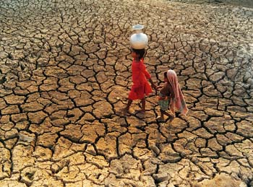

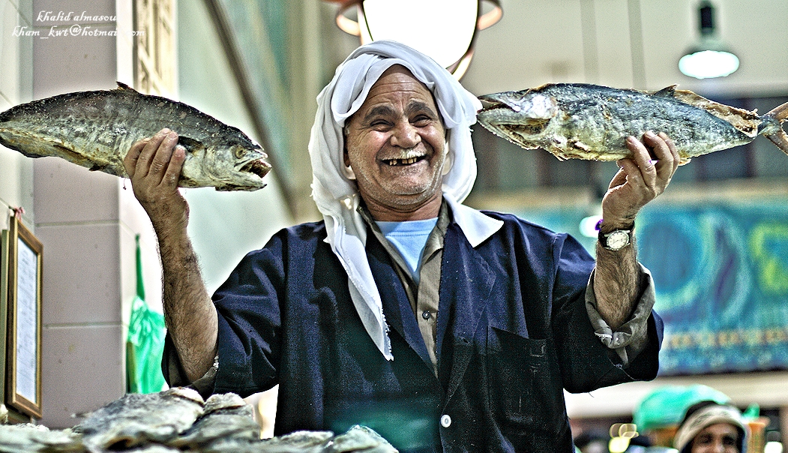
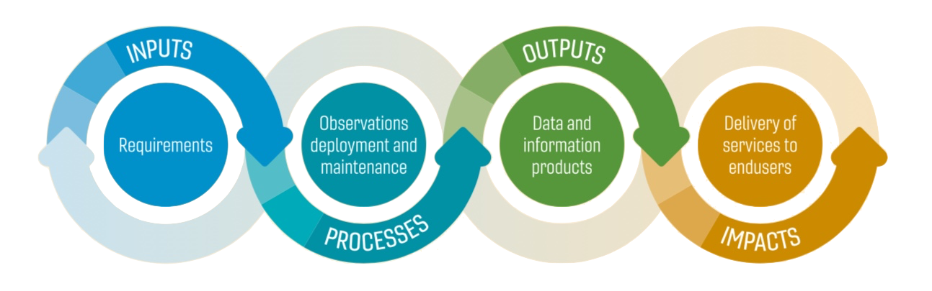
Delivery across 3 target application areas
Climate
Forecasting
Ocean health
mitigation and adaptation,
seasonal forecasts
supporting the marine economy
and reducing risk
sustainability of ocean
ecosystem services
Notes:
The system was developed to support climate science and to be the observational backbone for forecasting systems
Now focused on 3 delivery areas; Ocean Health, Climate and Operational Services

Slide 4
Member States | Users | Beneficiaries
Partners
IODE
GCOS
POGO
GOA-ON
GEO
DCO | Decade Programmes (3 GOOS-led + 8 Others) + 91 Projects
GOOS Projects: TPOS | DOOS | OBPS
Dialogues with Industry
OceanOPS
Coordination of information and metadata
Expert Team on Operational Ocean Forecast Systems (ETOOFS)
Bio-Eco data portal
Modelling & Data
Co-Design
Capacity Development
Data
Observations Coordination Group (OCG)
13 GOOS
Networks
+Emerging networks
16 GOOS Regional Alliances (GRAs)
76 National Focal Points
(NFPs)
Funding
“Ocean SOFF”
Observing coordination
3 Expert Panels
Physics and Climate (OOPC) |Biogeochemisty (BGC) | Biology and Ecosystems (BioEco)
WMO
RRR | WIGOS |GBON
GCOS
  Requirements
GOOS Management Team
Advocacy | Communication | Collaboration | Monitoring | Resource mobilization | Reporting | Ocean Observations Report Card
GOOS Steering Committee
  Sponsors
UNESCO – IOC | WMO | UNEP | ISC

Slide 5
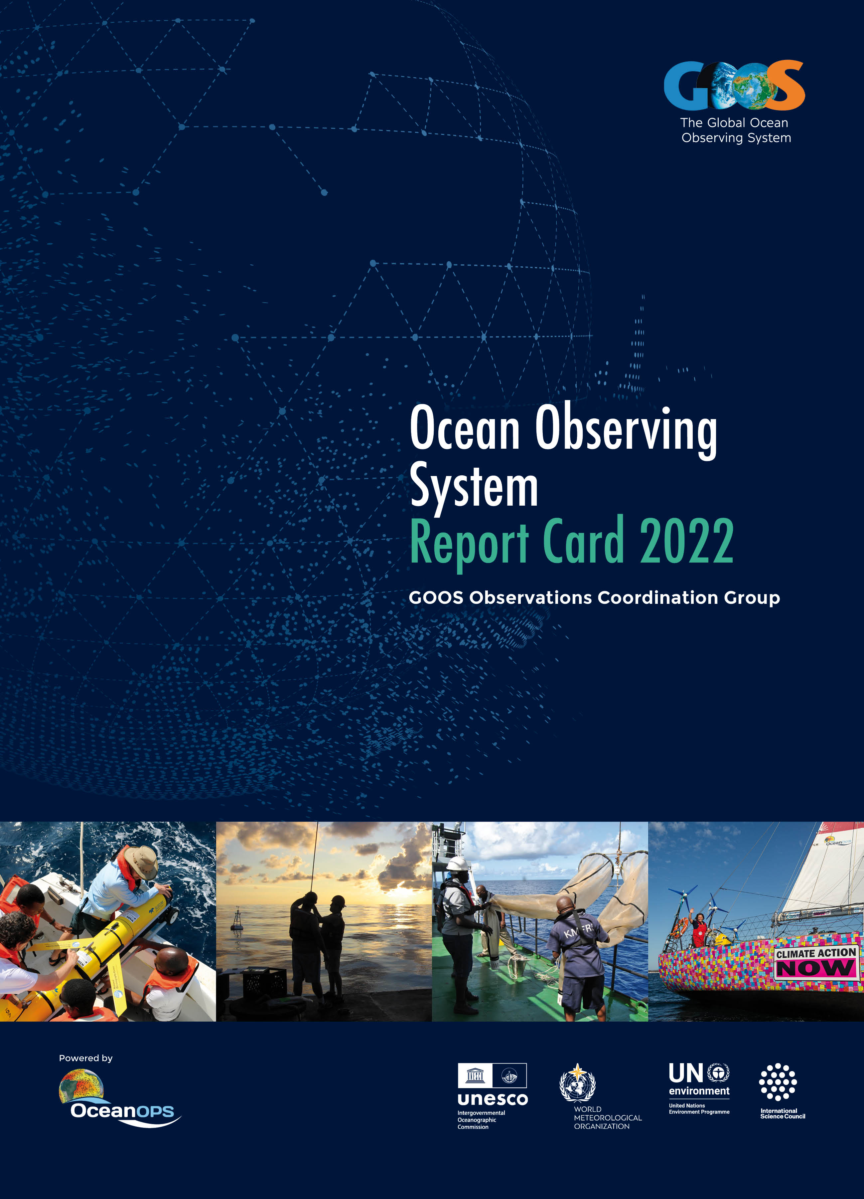
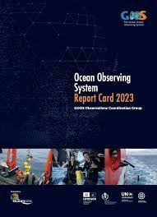
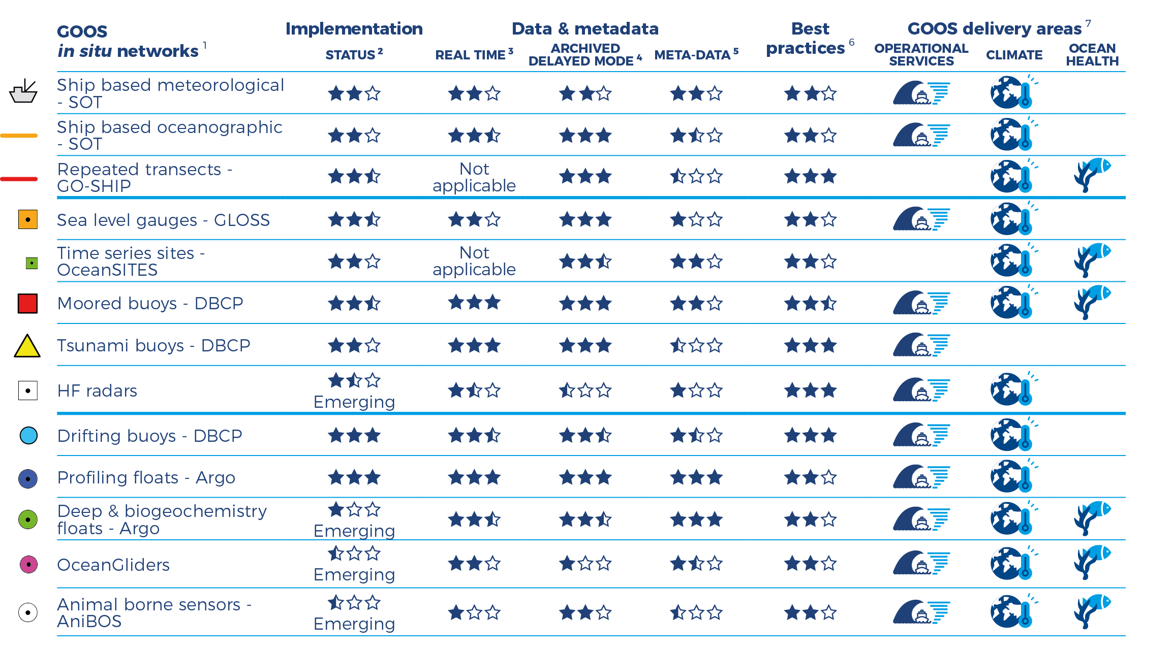
In-situ observing system status
Status: status of the implementation compared to the community widely adopted target when it exists; network self-assessed status when target doesn’t exist.
Real time: data freely available, without any restriction, on Global Telecommunication System of WMO and internet.
Archived delayed mode: data of the highest quality available for scientific analysis (e.g. climate studies)
Metadata: information required by OceanOPS
Best Practices: community reviewed and easily accessible documentation encompassing the observations lifecycle

Slide 6

1. Partnerships: Strengthening Regional alliances
Engaging with National focal points
2. Advocacy: COP28 good outcomes on ocean observations
Strong collaboration with WMO including on Global GHG Watch
3. Evaluate system: Observation report card 2023
4. Empower end- Operational Ocean Forecasting Guide
user applications:
8. Innovation: Dialogues with Industry
Webinars including on Ocean Decade
9. Develop capacity: Evolving marine cables network
10. Extend/Evolve Decade Programmes
system: Marine Debris Observing system (IMDOS)
11. Governance: Supporting Steering Committee (CL for new members) & JCB
Laying groundwork for evolving governance
5. Design: Strengthened structure and standards
EOV paper in process
6. Implementation: Continued coordination across GOOS
Decade Coordination Office Ocean Observing
7. Open Data: Data implementation strategy by OCG
BioEco Portal
Progress 2023

Slide 7
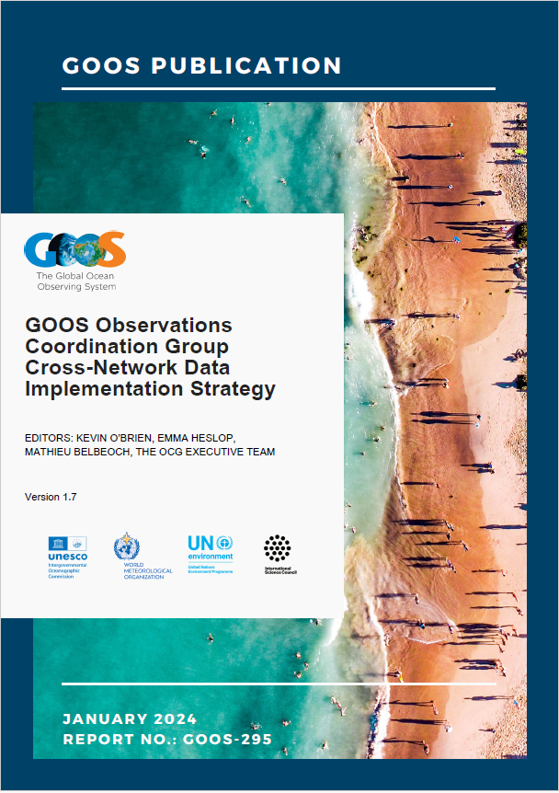
Cross-Network Data Implementation Strategy (GOOS-295)
OCG Data Vision
To provide integrated, interoperable, and FAIR-compliant access to the OCG Data System (encompassing data and metadata activities of the OCG networks, DACs, GDACs, OceanOPS and designated approved data access points) for international stakeholders, and to continue to improve access through innovation and stakeholder dialogue while engaging both with the OCG and international ocean data communities.
OCG Roundtable to mainly address the OceanOPS issues (online, 90 min, end of Feb/ early March 2024, TBC)
OCG-15 (13-17 May 2024, Victoria, British Columbia, Canada, hybrid)
                CIOOS workshop (indigenous + Coastal Ocean) -- 14 May 2024 morning
                Requirement implementations workshop -- 14 May 2024 afternoon
                Task Team on OCG Network Metrics workshop (TBC) -- 14 May 2024 afternoon
Upcoming OCG meetings
Notes:
OCG Data Goals
Enhance FAIR compliance of metadata, data and data services across all OCG networks
Provide access to data endpoints (ie, global repositories) for each OCG network which can be federated through common middleware (such as ERDDAP)
Ensure high quality data are available in near real time from the GTS and/or other data access services
Ensure high quality data/metadata are discoverable and harvestable
Ensure high quality data/metadata are available through identified global repositories
Ensure data are fully documented and required metadata is available through OceanOPS
Ensure data/metadata are properly archived and citable to maximize reuse
Next Steps
Adopt the Cross-Network Data Implementation Strategy
Work with Networks/Programs to identify specific areas of needed assistance
OCG Data and OceanOPS to work with Networks/Programs individually to:
Integrate ERDDAP services
Develop machine-to-machine processes for metadata exchange
Build Federated OCG ERDDAP system from distributed data (ERDDAP) endpoints
Better connection to GOOS RAs – Develop Cross-GOOS data team?

Slide 8
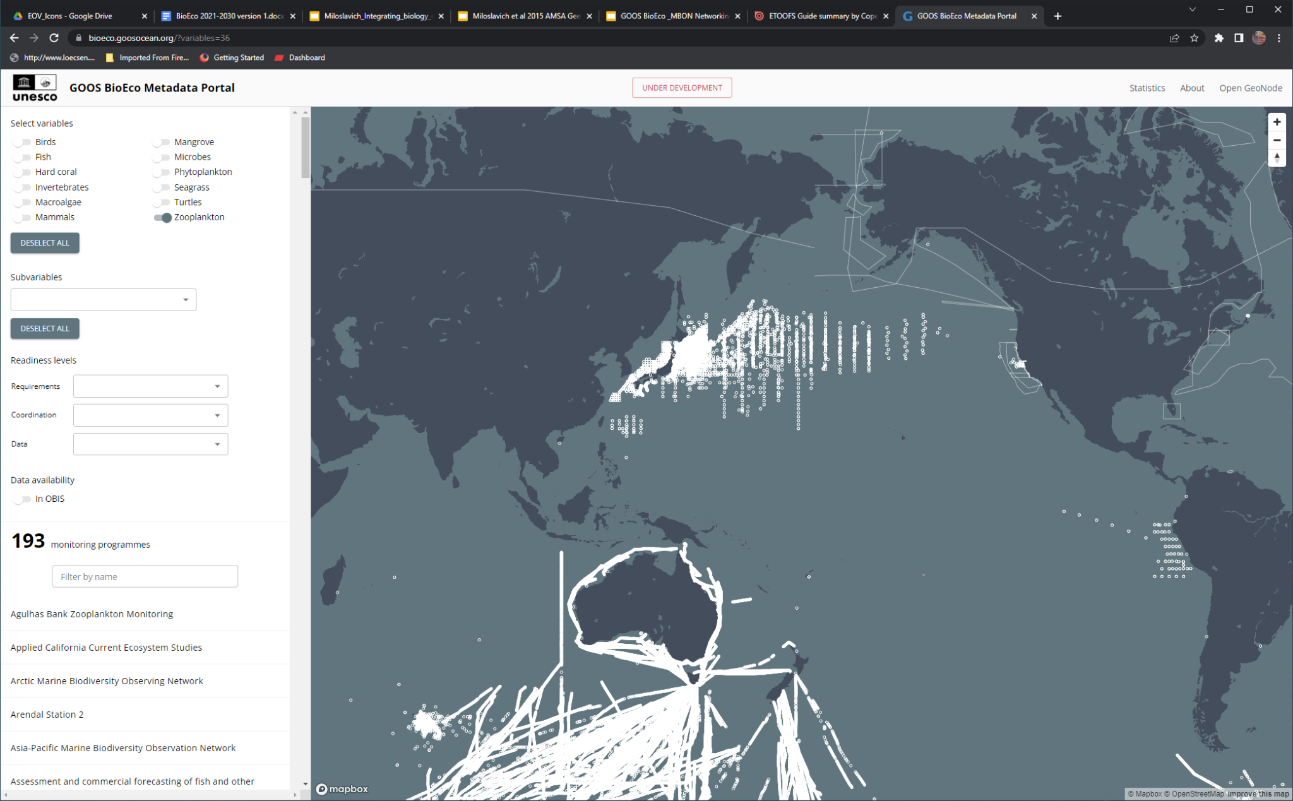
GOOS BioEco Portal: https://bioeco.goosocean.org/
Provides open access metadata and information on global ocean observations and monitoring programs involving biological and ecosystem EOVs
Currently holds metadata of 638 globally distributed active monitoring programs
Integration of EOV sub-variables and EBVs is in development
GOOS anticipates that the portal will be fully operational by 2025, contingent on resources to be in place.
Resources needed for
Continuous technical and content maintenance, bug fixing, helpdesk and community support
Creation of an automated flow of metadata from ocean observing programmes to the portal (via ODIS)
Development of connector and harvest routine between ODIS / Ocean InfoHub and the GOOS BioEco Portal
EU BioEcoOCean: part-time person to provide helpdesk and community support
EU MarcoBolo: part-time person to connect BioEco portal to ODIS
Need extra resources for technical maintenance and IT development

Slide 9
Conclusion BioEco Portal
We need funds for technical maintenance of the portal. A technical work plan needs to be developed jointly between OBIS, ODIS and OceanOPS. Online meeting is planned for end of Feb/March 2024.
We need funds for a joint IODE/OBIS+ODIS-GOOS/OCG-OceanOPS strategic in-person meeting.

Slide 10
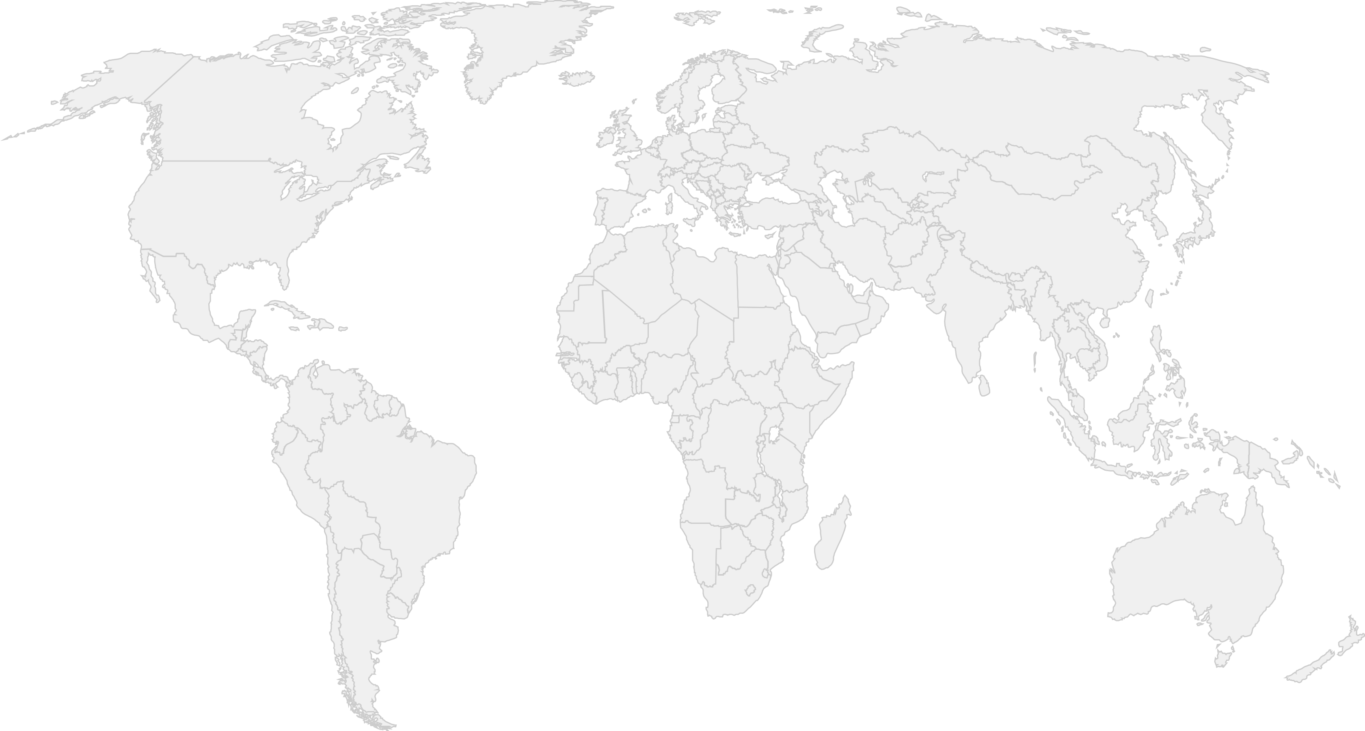
Regional Alliance & National Focal Points
GRA in process
SAON
New
EuroGOOS
CIOOS
Black Sea GOOS
NEARGOOS
US IOOS
MONGOOS
Reenergized engagement
IOCARIBE-GOOS
75 GOOS National Focal Points
SEAGOOS
GOOS-Africa
IOGOOS
PI-GOOS
OCEANTLAN
GRASP
IMOS
SAEON
Focused engagement
SOOS
Notes:
GOOS is a global network.
14 GOOS Regional Alliances – all very different in governance, scope and mandate – connected to 130 countries
Orange is in the network, Green is in dialogue
CIOOS: Canadian Integrated Ocean Observing System - adopted recently!
PI-GOOS: New hosting Office at SPC (Pacific Community, Fiji)
IOCARIBE-GOOS: Special session at the IOCARIBE meeting
GOOS Africa: Africa Roadmap Ocean Decade, new opportunities for support
Now have 76 GOOS NFPs – supported though the GOOS office. ToRs reviewed and adopted by SC in April.

Slide 11










  Global Ocean Observing System
  Ecosystem of providers
  Observation infrastructure
  Beneficiaries of ocean information
  GOOS coordination office and system
  Ocean observing community, partners
  Member States, Policy, Users, Investors, Research, Modellers, Services
Co-design
Notes:
GOOS structure and how we deliver
Connecting and coordinating
ocean observing projects around the world
Facilitating collaboration
by bringing international experts together
Setting global standards
by developing frameworks and best practices
Empowering solutions
through improved models and predictions

Slide 12
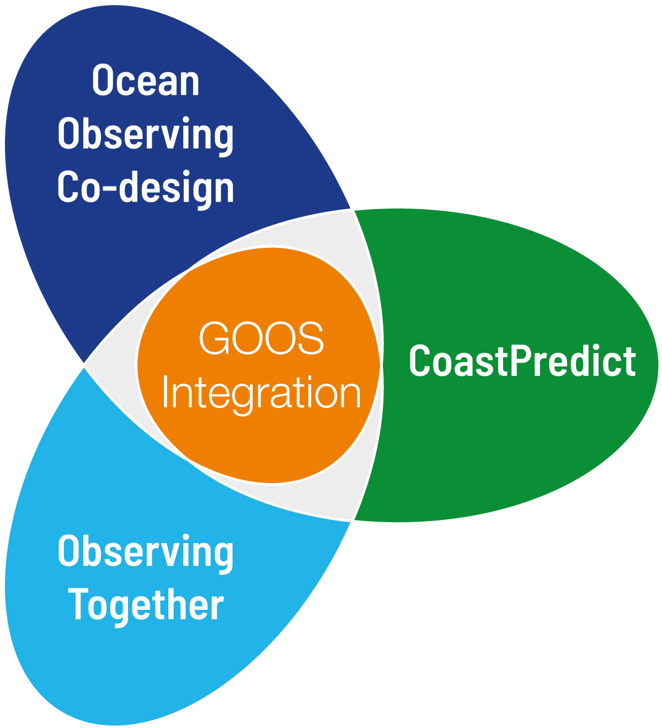
Strategic direction 2024 - 2025
Strengthen GOOS office support and system components
Respond to IOC Assembly mandates
    including OONJ, JCB, GCOS, governance
Continue to strengthen relationship with sponsors
and relevant organizations such as GEO, satellite community …
Respond to MLAs and other policy needs
    including UNFCCC, CBD, BBNJ
Evolve GOOS
Administer GOOS actions in the GCOS Implementation Plan
    including implementation plan for ocean C
Build engagement and advocacy
    including positioning IOC/GOOS as global voice on ocean observation needs in response to policy (e.g. 30x30, indicators, mCDR, new technologies etc)
Further develop regional coordination and build capacity at regional and national level
Synergize GOOS and UN Ocean Decade activities
We cannot act on what we do not measure
Notes:
Continue to build and strengthen GOOS system components
including developing capacity for BioEco networks / communities
Implementation plans – c
GOOS is only one that has the global view
Lift the system
GOOS governance
- Report for EC58 (SWOT / Report against 9 recommendations / prorities) – end April
- What needs to be addressed by TT / consultant
- Sponsor engagement
- Hold IOC member states accountable for delivery
- Report to SC/Sponsors/Assembly
- changes to existing structure – need to invest more people…
Decision
OONJ – invite those who havnt provided feedback to provide feedback – in order that the committee in its work has broadest input possible for its work
Governance
- support governance process

Slide 13
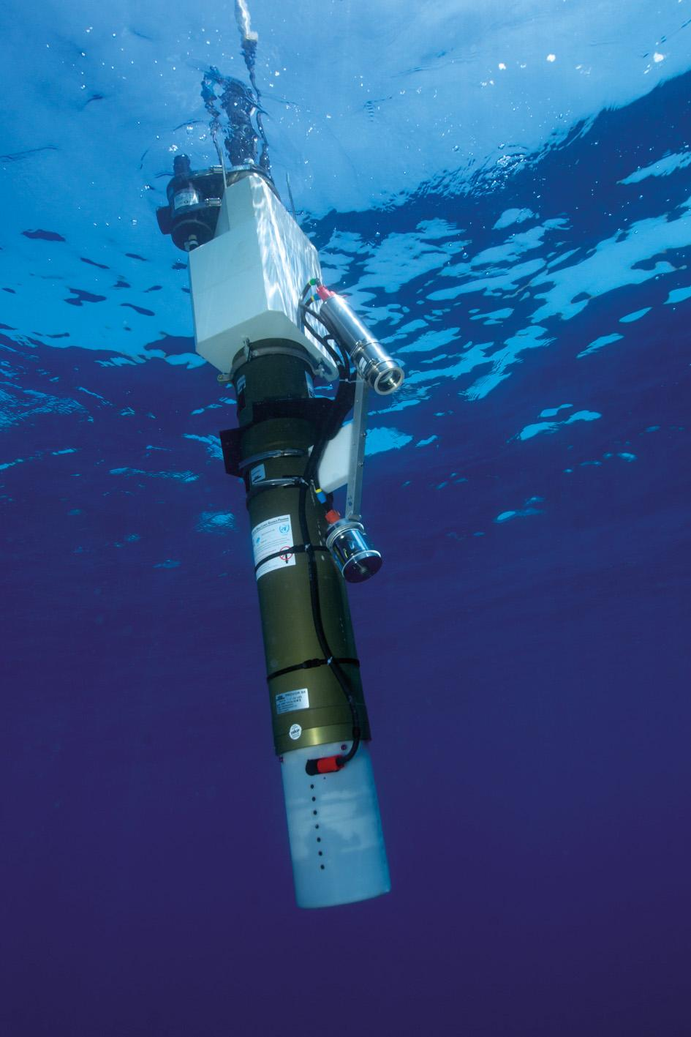
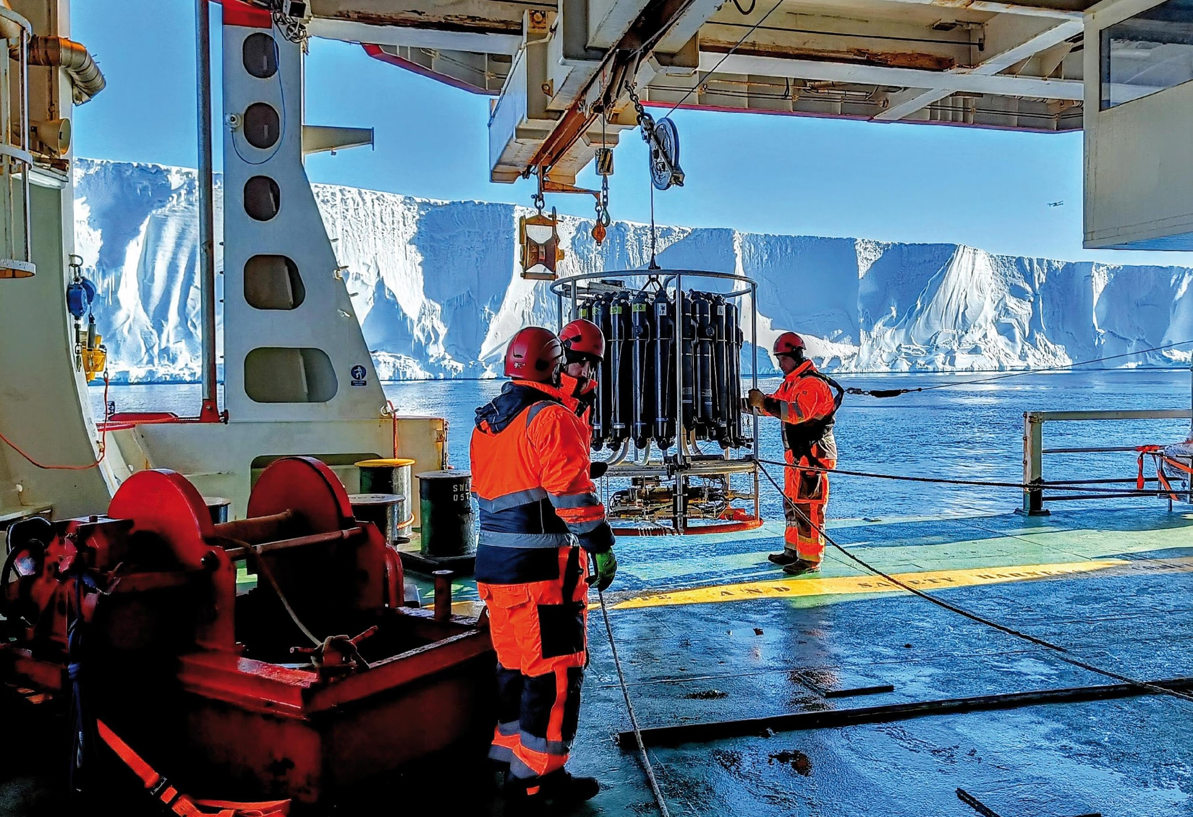
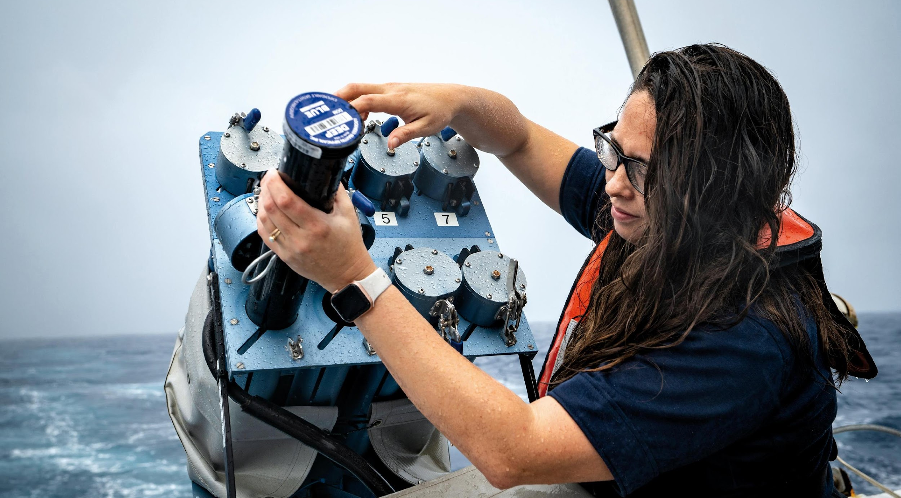
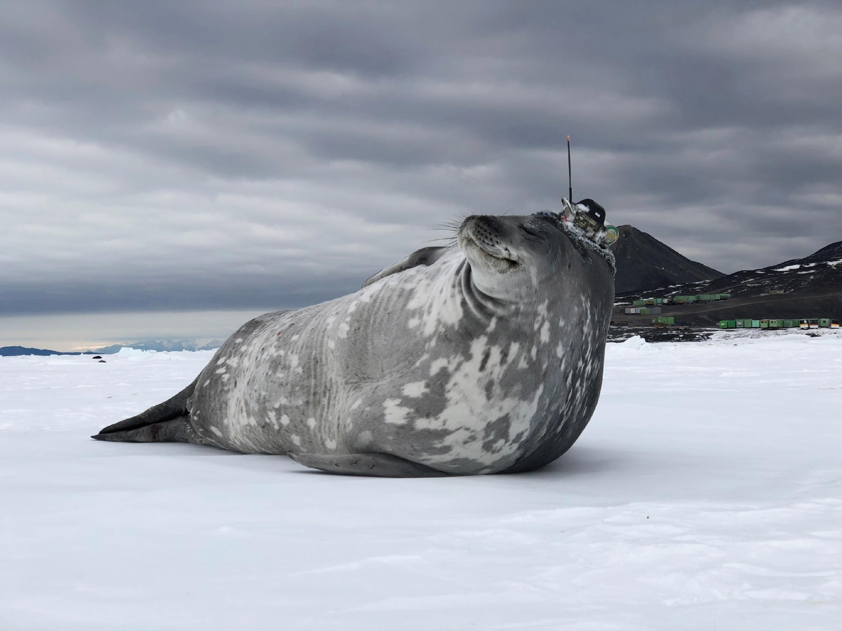
Thank you
goosocean.org

