Slide 1



Tsunami Service Provider
Hellenic National
Tsunami Warning Centre
Institute of Geodynamics
National Observatory Athens
18th session of the ICG/NEAMTWS
Paris, 6-8 February 2024

Slide 2
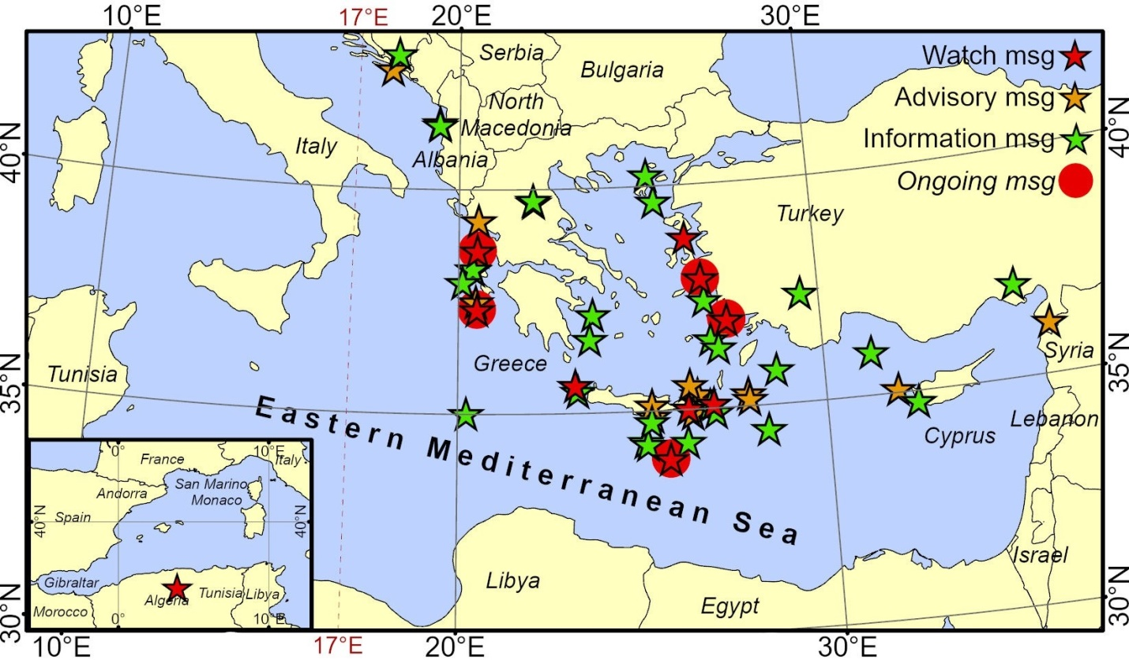
Operational activities
    3 Tsunami Warning Messages in 2023
no | Date | Time (UTC) | Region | Lat | Lon | Magnitude | Alert Level
50 | 25-Jan-23 | 12:37:05 | Eastern Mediterranean | 35.78 | 28.70 | 5.8 | Information
51 | 20-Feb-23 | 17:04:29 | Türkiye – Syria border region | 36.13 | 36.17 | 6.3 | Advisory
52 | 25-Jul-23 | 05:44:50 | Türkiye | 37.06 | 35.35 | 5.6 | Information

Slide 3
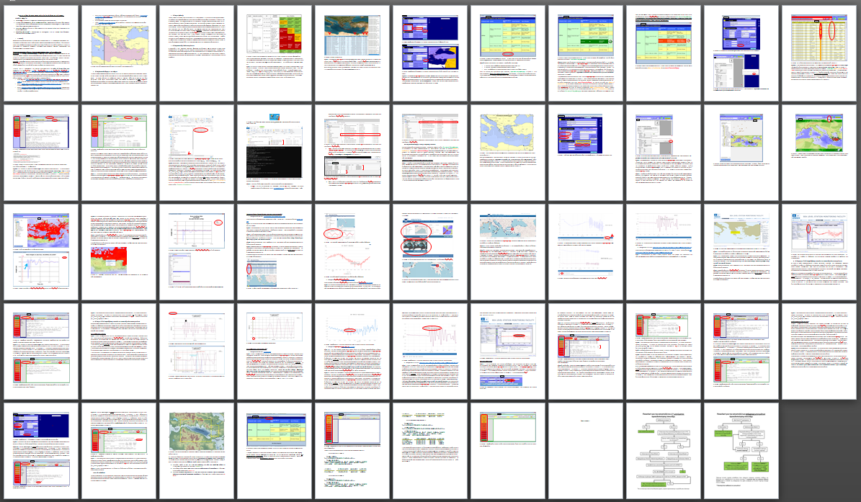
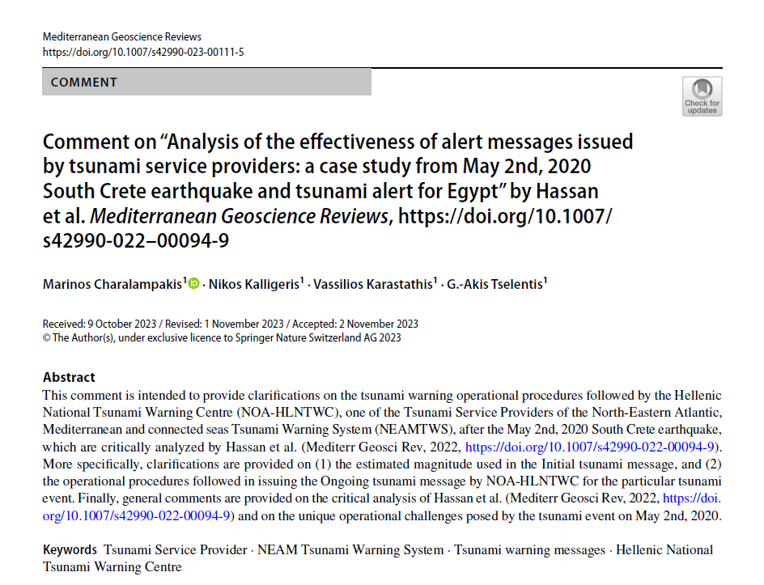
Operational activities
    Tide Gauge maintenance
    on a need-to and can-do basis
    Submission of a Comment
    for a publication regarding the response of TSPs for the May 2nd, 2020 South Crete earthquake and tsunami, to address the critical analysis of NOA’s operational procedures
    Update of the Standard Operational Procedures document for the duty officers in HL-NTWC
    Daily scenario-based tsunami drills
    for internal training
    of the duty officers in HL-NTWC

Slide 4
Scientific / Research activities
    HL-NTWC is participating in the following projects and initiatives:
    • Aristotle-eENHSP (2020- )
    • CoastWAVE (2022-2024)
    • Geo-INQUIRE (2022-2025)
    • Cyprus – tsunami inundation and evacuation map of Larnaka within CoastWAVE (2022-2023)
    • SUBMERSE (2023- 2025)
    • FSX MINOAS (2024)
    • EPOS Tsunami TCS (2021- )
    • new project proposal submissions …

Slide 5
Participation
    HL-NTWC participated in the following workshops and meetings:
    AGITHAR and AGITHAR project extension meetings: Prague, London, Rome.
    NEAMTWS inter-TSP meetings, organized by TT-Op. and TT-Doc.
    Other online participations, like in the TOWS TT-DMP meeting, the CoastWAVE progress or other project related meetings.
    WTAD 2023
    NEAMWave23 and local exercise in Samos

Slide 6
Developments
    Ongoing developments
    • A tender for the purchase of 12 new tide gauges is pending for 2024.
    • Preparation of local SOPs, following the guidelines and recommendations
    of the National SOP.
    • Development of a national tsunami warning page to publish information related to tsunami
    events for the public.
    Recommendations for NEAMTWS
    • Shortening and simplification of the tsunami warning messages.
    • NEAMWave – communication test for contact details verification before the exercise.

Slide 7
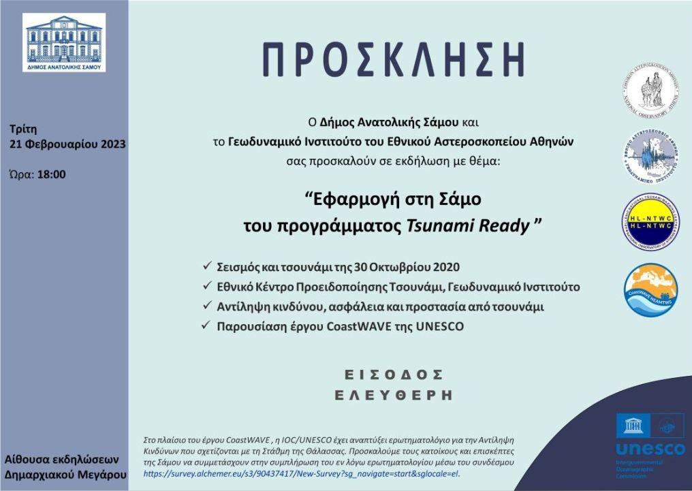
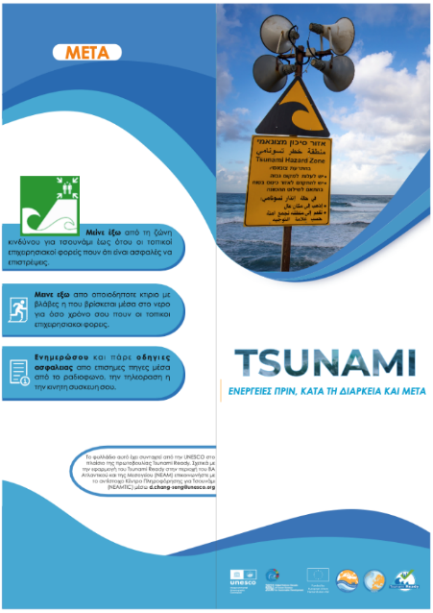
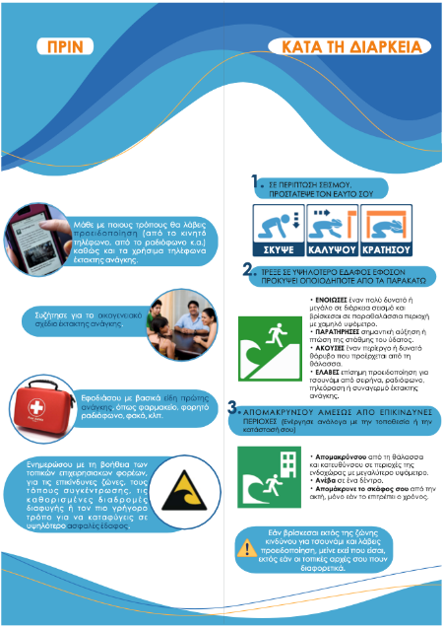
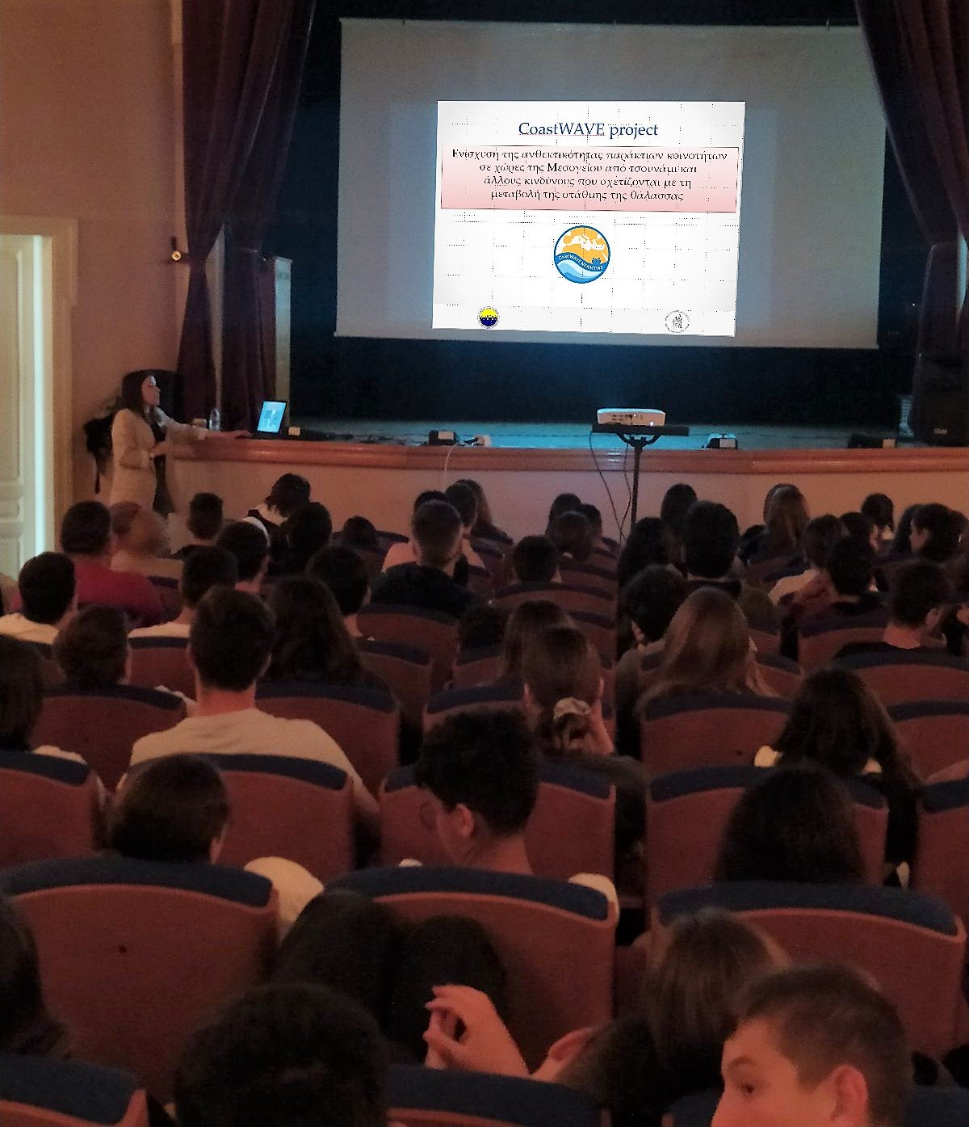
Awareness activities
  February 2023 – an event was organized in Samos to raise tsunami awareness of the general population and to present the TRRP through its local application within the CoastWAVE project.
  May 2023 – another tsunami awareness activity was organized targeting the education sector. Two high schools attended the event.
  Translation of the brochures developed by IOC-UNESCO within the CoastWAVE project.

Slide 8
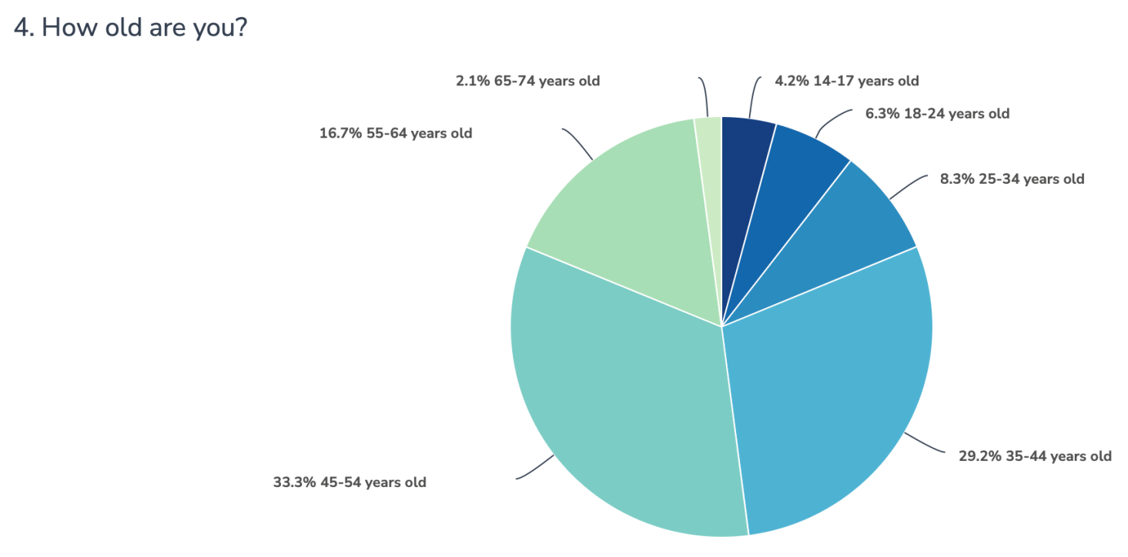

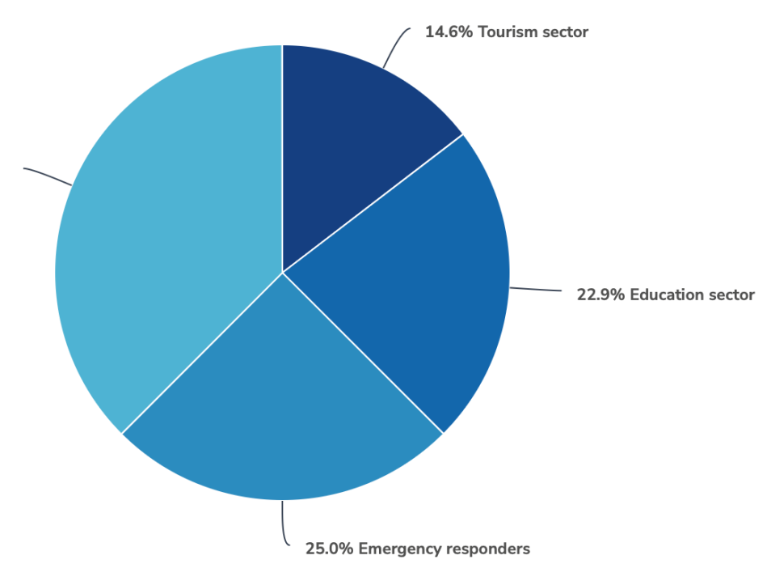

Risk Perception Survey
  Greece participated in the Sea Level Related Hazards Risk Perception Survey Questionnaire developed by IOC/UNESCO to better understand how coastal populations perceive these natural hazards and risks, and develop recommendations for enhanced risk communication strategies and products in the region.
  Are you part of one of the following sectors?
  How old are you?

Slide 9
Risk Perception Survey
  Most of the survey participants had experienced a tsunami in the past, most likely the 2020 Samos-Aegean tsunami. The majority believes that it is highly likely that the Mediterranean region and their community will experience a tsunami in the next 10 years. The majority also believes that a future tsunami will cause moderate impacts for both the coastal zones of the North-Eastern Atlantic and the Mediterranean Sea and in their community.
  A significant percentage (~40%) of the participants responded that a high impact is expected both at regional and local levels. In the question of what would be the approximate height of a tsunami that can happen soon (e.g., in the next 10 years) in coastal regions of NEAM, the majority of responses ranging between 0.5 – 5 m reflect the expected moderate to high impact from tsunamis and showcase a good understanding of the impact metrics by the participants.
  The overall relatively high tsunami awareness of the respondents was further highlighted by the responses on the question related to the expected arrival times of tsunamis in their community and the identification of natural signs of a tsunami and the majority of responses on self-evacuation following a strong shaking due to an earthquake.

Slide 10
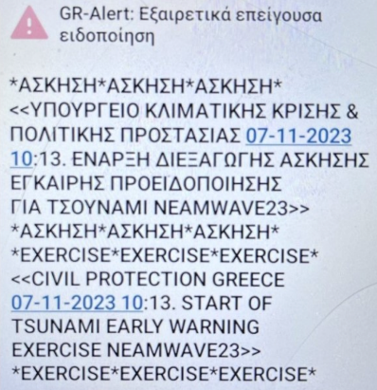
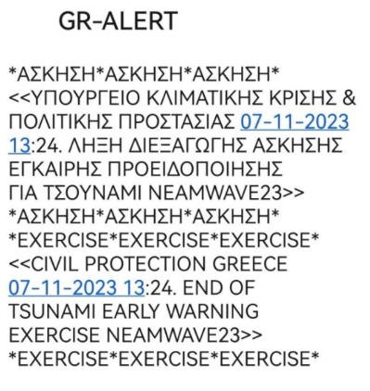
NEAMWave23
    Phase A
    • NOA-HLNTWC developed in cooperation with INGV and KOERI the joint scenario utilized for the second day of exercise.
    • Also transmitted the alert messages as TSP and received the messages of CAT-INGV and KOERI as TWFP of the NEAMTWS.
    Phase B
    • Through the upstream (NOA -> national CPA) and downstream components of the tsunami warning chain, NOA-HLNTWC’s messages were disseminated to national operational centers, but also to the Prefecture of North Aegean, the Municipality of Eastern Samos and local emergency services of Samos for the needs of the local TTX.
    • A cell broadcast message was also disseminated locally within the framework of NEAMWave23 and the local TTX.

Slide 11
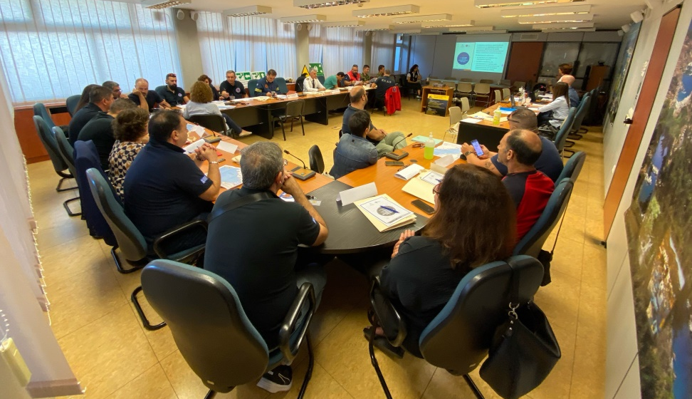

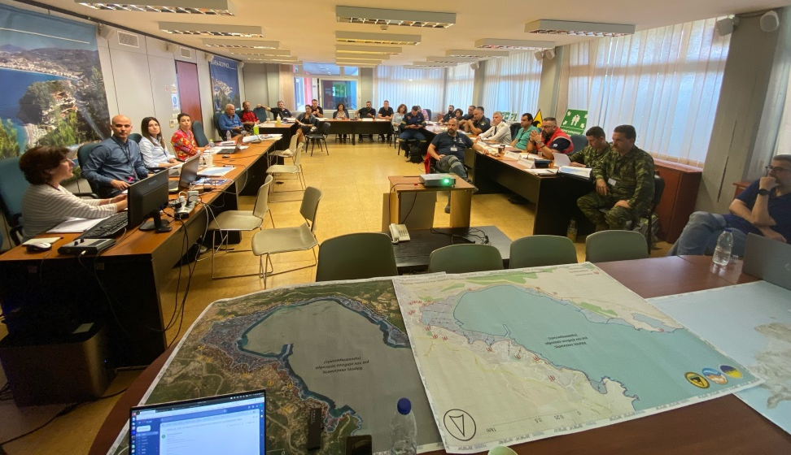
NEAMWave23 – local TTX in Samos
  A local TTX and a school drill was organized in Samos within the framework of NEAMWave23 and the CoastWAVE project.
  The local TTX organized by the Greek CoastWAVE team and the Municipality of Eastern Samos involved personnel from the Prefecture of North Aegean, the Municipality of Eastern Samos, the local emergency services, the Greek Army, and the local education sector.
  The aim of the local TTX was to:
    Test the local emergency and tsunami evacuation plans for the city of Samos prepared within the framework of the CoastWAVE project;
    Test the transmission and reception mechanisms for tsunami messages;
    Promote preparedness for earthquakes and tsunamis.

Slide 12
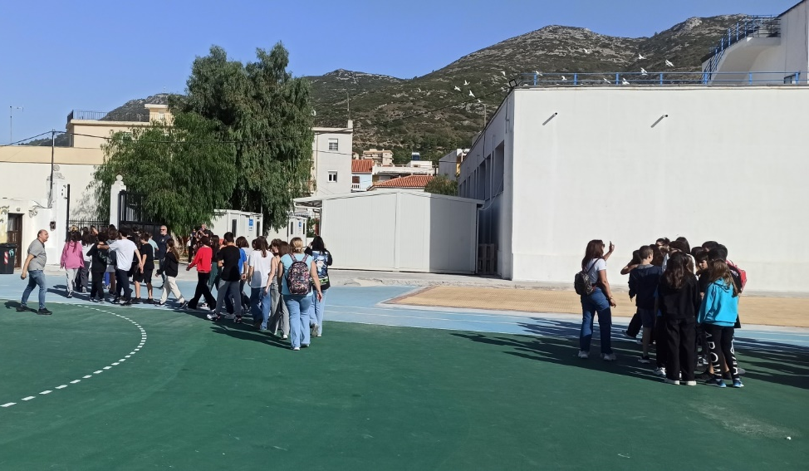
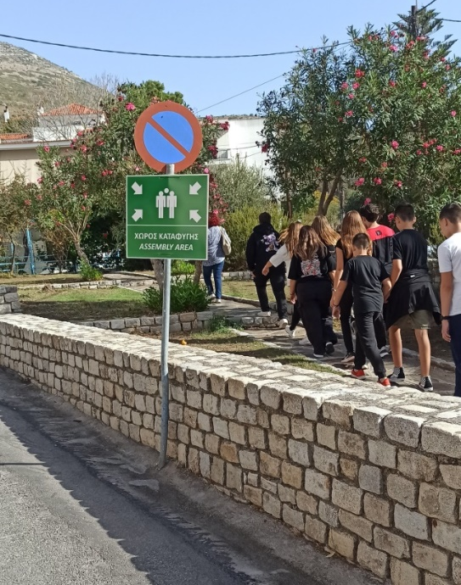
NEAMWave23 – school drill in Samos
  A local TTX and a school drill was organized in Samos within the framework of NEAMWave23 and the CoastWAVE project.
  The school drill involved two schools of Samos, namely the 1st experimental high school of Samos and the 2nd high school of Samos. The pupils were asked to follow the school protocol for earthquakes, and following the receipt of the tsunami warning through the cell broadcast message to move to the closest assembly area through a predefined escape route.
  The aim of the local TTX was to:
    Test the school emergency plan for earthquakes and the tsunami evacuation plan for the city of Samos prepared within the framework of the CoastWAVE project;
    Promote preparedness for earthquakes and tsunamis.

Slide 13
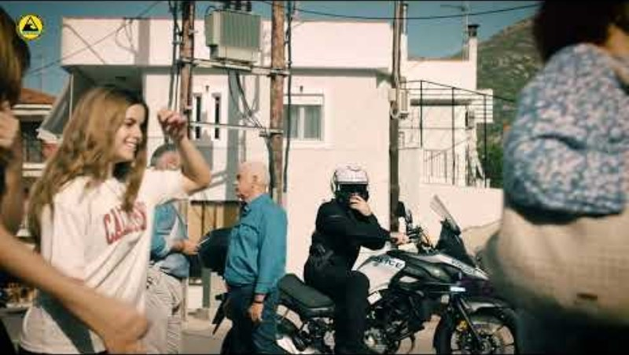
NEAMWave23 – SAMOSWAVE23-CW

Slide 14




*
18th session of the ICG/NEAMTWS
Paris, 6-8 February 2024

