Slide 1
8.1.1.: IOC Ocean Science Section and IODE
Title subtitle
Harmful Algal Information System – HAIS
SDG 14.3.1 Data Portal
Global Ocean Oxygen Data Atlas - GO2DAT

Slide 2
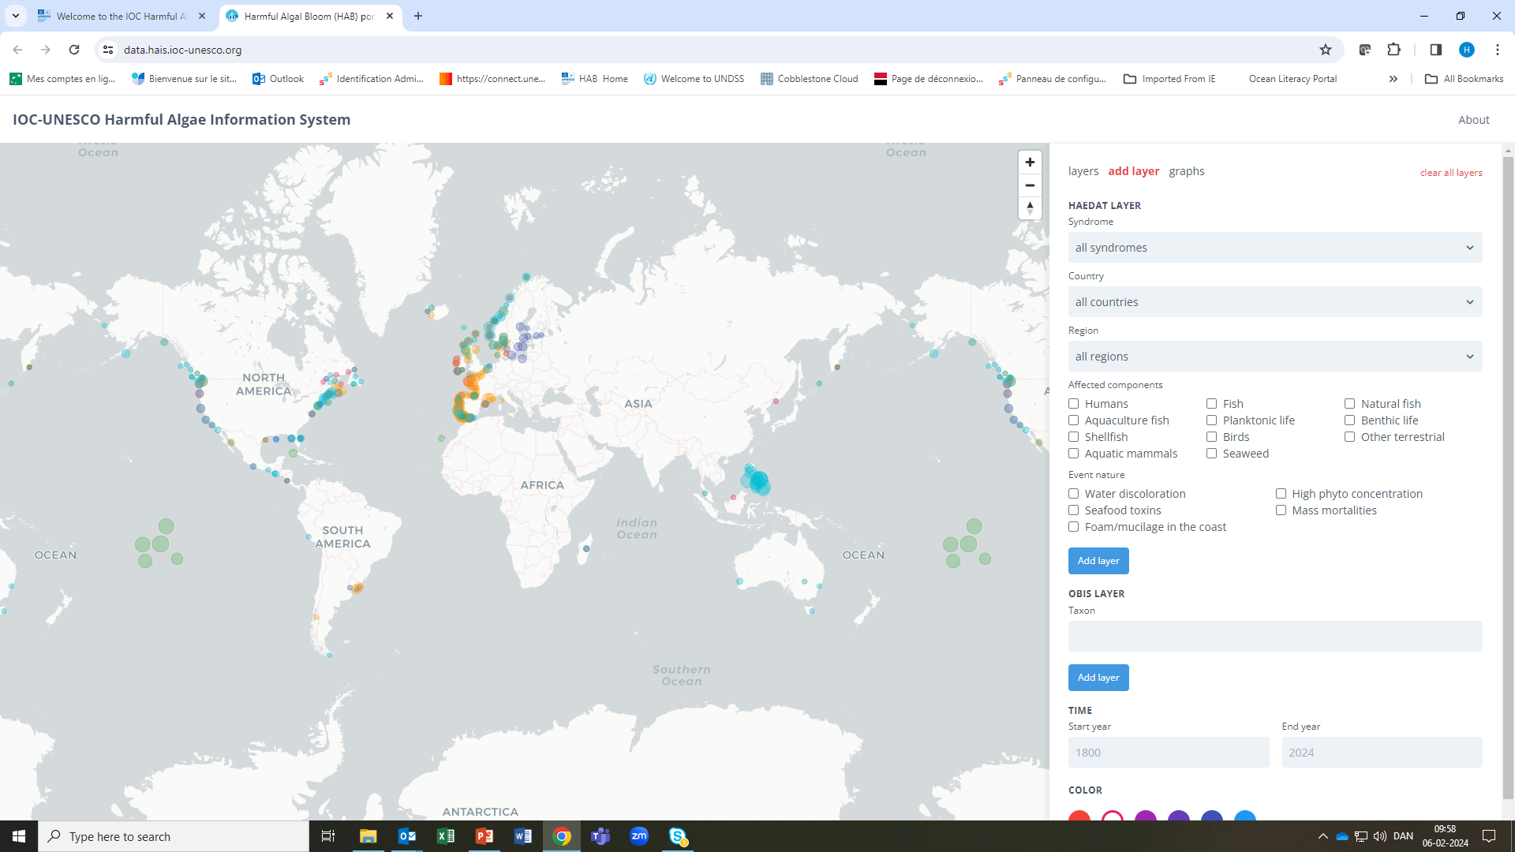
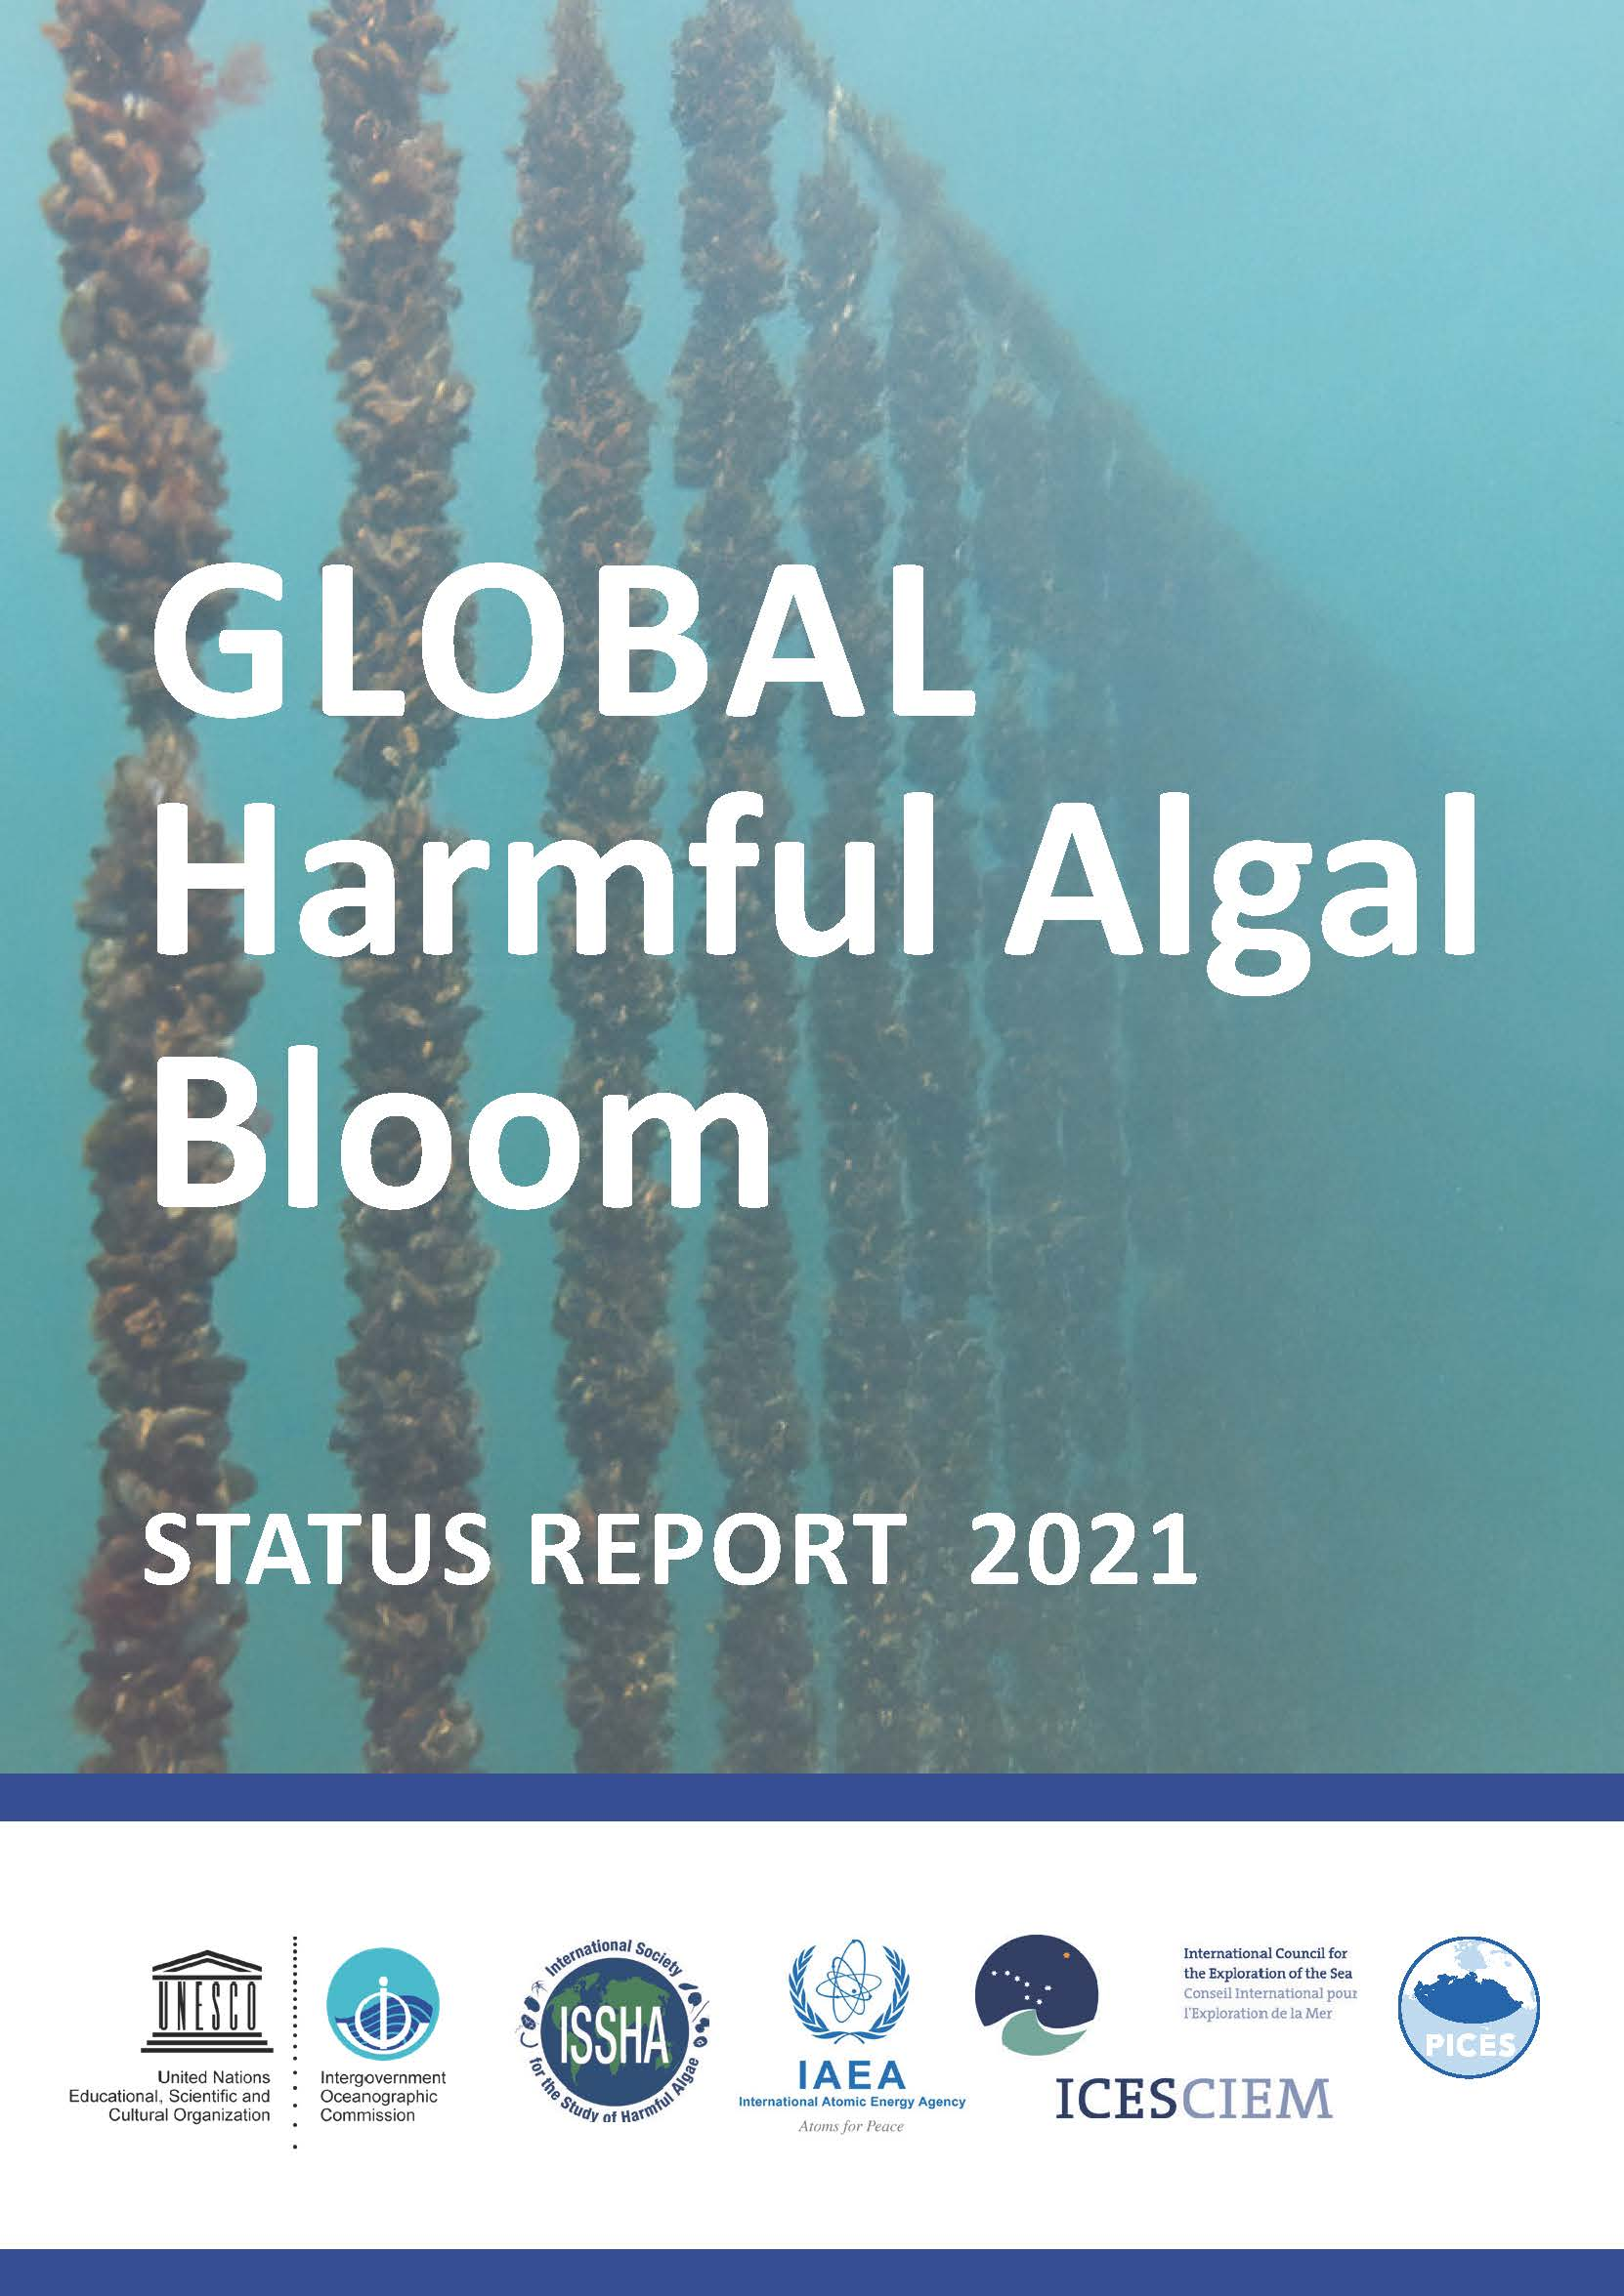

Slide 3
Decision IPHAB-XVI.3 (May 2023, reported to Assembly June 2023)
TASK TEAM ON THE HARMFUL ALGAL INFORMATION SYSTEM (HAIS) AND THE GLOBAL HAB STATUS REPORT (GHSR)
The IOC-FAO Intergovernmental Panel on Harmful Algal Blooms,
Recalling Decision IPHAB-IV.3 on ‘The Development of a Periodic Global HAB Status Report’, Decision IPHAB-XI.2 on the ‘Development of a Global HAB Status Report’, Resolution IPHAB-IX.2 on the ‘Development of the Harmful Algal Information System’ as a joint IPHAB-IODE activity, and Decisions IPHAB-XII.3, IPHAB-XIII.3, IPHAB-XIV.3 and IPHAB-XV.3 on an IPHAB Task Team on the Development of a Global HAB Status Report,
Recognizing the continued and long-term benefits to policy administrators, managers of regulatory monitoring programmes and scientists of a series of syntheses of high-quality information and future scenarios on the biogeography of harmful species and occurrence of harmful algal events, including their economic and societal impacts,
Notes with satisfaction the launch of the first Global HAB Status Report (GHSR) and its relevance for current and developing global assessments, such as the United Nations World Ocean Assessment, the UNEP Global Environmental Outlook, the Intergovernmental Science-Policy Platform on Biodiversity and Ecosystem Services (IPBES) global assessment on biodiversity and ecosystem services, the International Panel on Climate Change (IPCC) reporting, as well as for the United Nations Decade of Ocean Science for Sustainable Development (2021–2030);

Slide 4
Notes also with satisfaction the establishment of the ‘Harmful Algal Information System’ (HAIS) as an element of the GHSR and as a data portal integrating the data in IOC/IODE's Ocean Biodiversity Information System (OBIS) and Harmful Algal Event Database (HAEDAT);
Notes further with satisfaction the progress in data compilation in the intersessional period and the cooperation with ICES, PICES, the IAEA, and the IOC regional HAB groups and networks IOCARIBE/ANCA, FANSA, HANA, and WESTPAC/HAB, in this respect;
Expresses its appreciation for the support provided by the IODE programme in general, and by the technical OBIS staff in particular, for the development, hosting and technical maintenance of the HAIS and HAEDAT data systems;
Noting further that OBIS continues to provide the world's largest open access database on the diversity, distribution and abundance of marine species, including harmful algae, and that OBIS will contribute to HAIS through OBIS/HABMAP, and that it provides a main component of future editions of the GHSR;

Slide 5
Decides to continue the series of Task Teams on HAIS and GHSR as an editorial advisory group for HAIS/GHSR with the following terms of reference:
Advise the FAO and IOC secretariat/IODE Project Office and HAIS partners and define amendments required to update HAEDAT to facilitate proper data entry, extraction and quality control as well as improving recording criteria for HAB events such as ‘high biomass blooms’, ‘cyanobacteria events’, ‘ciguatera events’ and others raised by IOC regional groups. Identify areas for HAIS adjustments, geographical data gaps and website edits. Ensure standardization between HAIS and initiatives undertaken by TTs on Taxonomy and Biotoxins,
Advise and encourage regional groups and editors on data compilation, quality control and submission of HAB data to OBIS/HABMAP and HAEDAT and production of associated metadata documents,
Advise on and stimulate the use of HAIS data and data products, encourage the production of summary articles in Harmful Algae News and act proactively if GHSR/HAIS conclusions or data are misinterpreted or incorrectly referred to;
Develop a template, for FAO approval before the end of 2023, for a short and concise annual summary of HAEDAT with the view to submit such summaries annually to the FAO Committee on Fisheries (COFI) and the Subcommittee on Fish Trade (COFI-FT) and starting in 2024 covering the year 2023,

Slide 6
Identify the focus of the second Global HAB Status Report, identify priority drivers and associated relevant global datasets. Engage with working groups, groups of experts within and outside IOC (including IOC IGMETS, IOC TrendsPO, ICES WGPME, the marine sites of the International network on Long Term Ecological Research (I-LTER), EMODNET-Biology, and ICES-IOC WGHABD, GOOS/EuroGOOS), and individual scientists to identify time series of phytoplankton data including information on HAB species,
Investigate with GlobalHAB possibilities of organizing initiatives (such as workshops, interactive data analysis, courses) on HAB time series analysis in the context of environmental variability,
Work with IOC FAO IPHAB Task Teams to develop UN Decade Action – HAB solutions, identify partners for co-design initiatives and funding opportunities;
Decides also that the Task Team is chaired by Eileen Bresnan (UK) and comprises A. Zingone (Italy), Bengt Karlson (Sweden), the Chair of the IPHAB Task Team on Biotoxins, the Chair of the IPHAB Task Team on Taxonomy, the Chair IODE GE-BICH, and may invite representatives of the GlobalHAB SSC, the regional IOC groups ANCA, FANSA, HANA and WESTPAC/HAB, the ICES-IOC WGHABD, the PICES HAB Section, WoRMS, IAEA, FAO and ISSHA. The Task Team is supplemented by international advisors and experts G. Hallegraeff (AU) and may be expanded as required to fulfill the terms of reference;

Slide 7
Invites the IODE Programme and OBIS technical staff to continue its active role in HAIS incl. HAEDAT through its Ocean Biodiversity Information System (OBIS);
Notes that the task team will continue its work until otherwise decided by the Panel, and that it will work by correspondence and/or meet upon request by the joint IOC-FAO IPHAB Secretariat, and provide a progress report for the intersessional period to the Chairs of IPHAB and IODE prior to IPHAB-XVII and IODE-XXVI and XXVIII/XXIX.

Slide 8
The Decade Harmful Algal Bloom Solutions Programme HAB-S
HAB-S initiatives will include: 1) Preventing, controlling & mitigating HAB events, 2) Advancing HAB Observing tools & technologies, 3) Making HAB Data equitable & accessible, 4) Improving HAB Literacy.
Making HAB Data Equitable and Accessible
The HAB-S Data initiative will co-create and maintain equitable and accessible HAB information products with users and stakeholders in all regions of the world.
Co-develop open-access HAB databases on all HAB data types and related environmental data; user interfaces such as an interactive HAB data portal will provide platforms needed for the storage and integration of data (e.g., HAIS (HAEDAT and Toxin Database within IODE and OBIS; IOC UNESCO HAB Taxonomic Reference List (WORMS); INFOSAN of FAO).
Develop a toolbox for data acquisition with standardized methodologies for collection of HAB data to ensure global capacity to collect comparable data.
Conduct a systematic awareness campaign to engage data owners including scientists, researchers, and managers, to promote database contributions and sharing of information.
Address data gaps including unbalanced regional HAB monitoring and knowledge distribution, unbalanced forecasting and prediction efforts, and the lack of verifiable epidemiological data.
Address potential data inequities in HAB observing and prediction efforts in all regions of the world.
Develop on-line visualization platforms including HAB event risk maps.
HAB-S Outcomes
HAB-S initiatives will directly address UN Sustainable Development Goals (SDGs) by:
Advancing sustainable ocean economies, fisheries, and aquaculture to reduce poverty and hunger and increase food security, good health and well-being (SDGs 1-3 & 8);
Providing transformational HAB observing technologies and early warning systems to ensure availability and sustainable management of water (SDG 6) and coastal resources (SDGs 2 & 3);
Providing equitable and accessible data on HAB species, toxins, events, and effects, including indigenous and local knowledge (SDGs 10, 11, & 16); and
Increasing ocean literacy related to HABs (SDG 4) in general and in relation to the ocean-climate nexus (SDGs 13 & 14).
Notes:
##-AccessibilityAssistant: Skip layout check-##

Slide 9
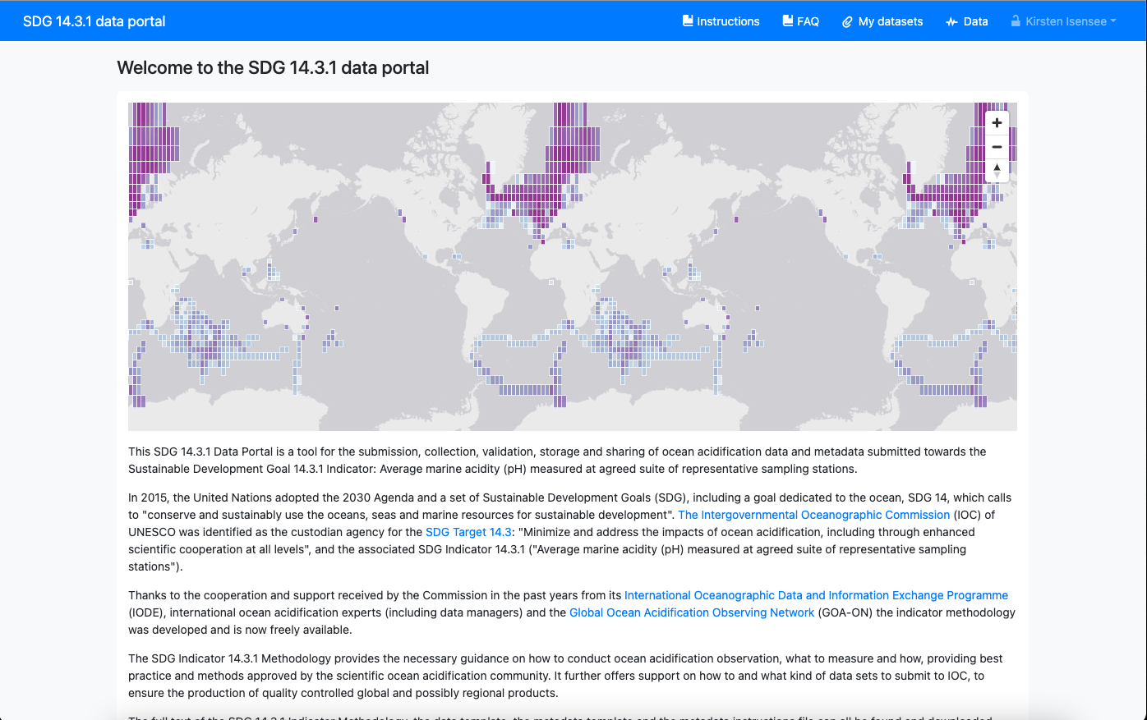
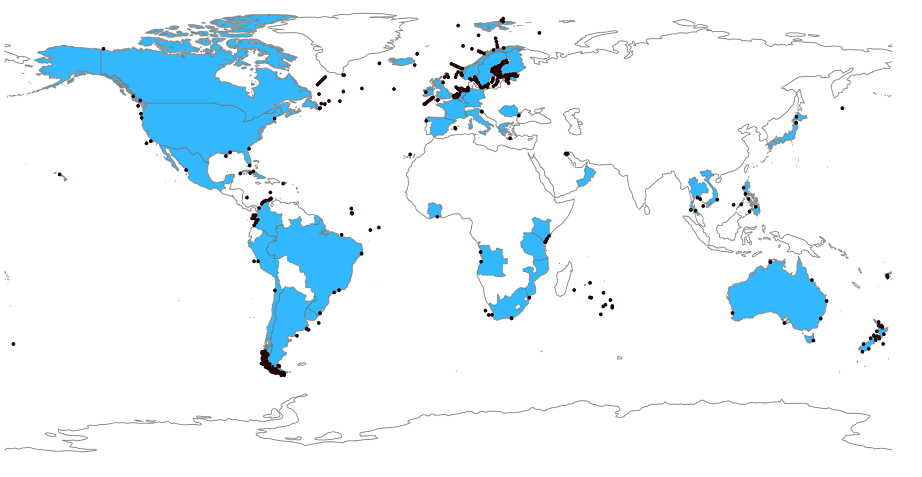
SDG 14.3.1 Data Collection
Title subtitle
SDG 14.3.1 Data Portal
SDG 14.3.1 Data Reporting
https://oa.iode.org/
The SDG 14.3.1 Data Portal, hosted by IODE for IOC, is a tool for the collection, storage and sharing of datasets submitted towards SDG 14.3.1 Indicator, facilitating the data submission process for NODCs, ADUs, NSOs, and other national agencies as well as individual scientists.
2019 – 8 countries submitted data and information
2020 – 28 countries submitted data and information
2021 – 37 countries submitted data and information
2022 – 41 countries submitted data and information
(539 stations in 41 countries reported data)

Slide 10
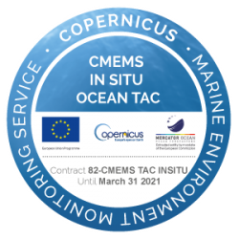
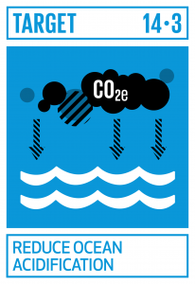
Federated data system
NODCs
OCADS
To avoid duplication of efforts among all relevant datacentres, the aim is to develop a federated data system to automatically exchange data with these other relevant databases on a regular basis using ERDDAP services.
Federated
Data
System
Notes:
To improve the data flow, not just for SDG 14.3.1 Indicator, but for a truly global ocean acidification data collection, the next steps are: Develop a federated data system that will connect existing data bases and allow the exchange of the relevant ocean acidification and ocean carbon data between the platforms. This way, data will only need to be submitted once, to one database, and will then automatically be available to other users.
In order to do this, there needs to be cooperation between the databases, and an alignment of the data and metadata requirements as well as the vocabularies. We are currently working on this, together with partners at national and international databases as well as some National Oceanographic Data Centres, NODCs.

Slide 11
GO2DAT
Global Ocean Oxygen Data ATlas
“The Committee welcomed the development of GO2DAT, the cooperation with the IOC WG GO2NE and GO2DAT Steering Committee.
The Committee encouraged Member States, NODCs and ADUs to support the development of GO2DAT financially and in-kind.”
Steering Committee with Members from the scientific community and NODCs, ADUs is established (e.g. Emodnet, ICOS, WOD)
Survey to analyze ocean oxygen measurement methodologies and data treatment, quality controls
Connections with ODIS, OceanInfoHub established
Manuscript summarizing the results of the survey and proposed concrete steps to guide the establishment of GO2DAT is drafted – next steps review with respective NODCs, ADUs
Potential funding via a new GEF project and support via private sector

Slide 12
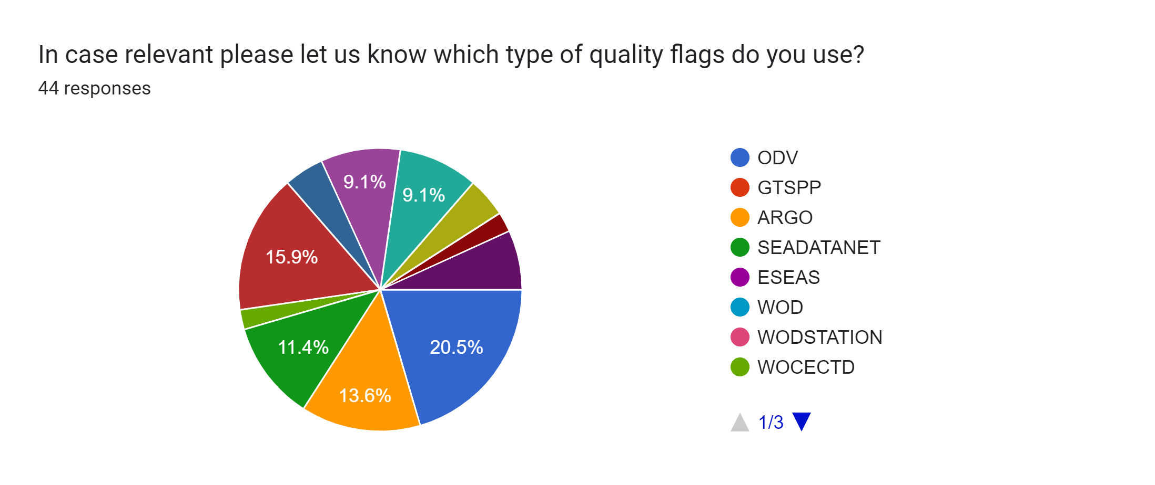
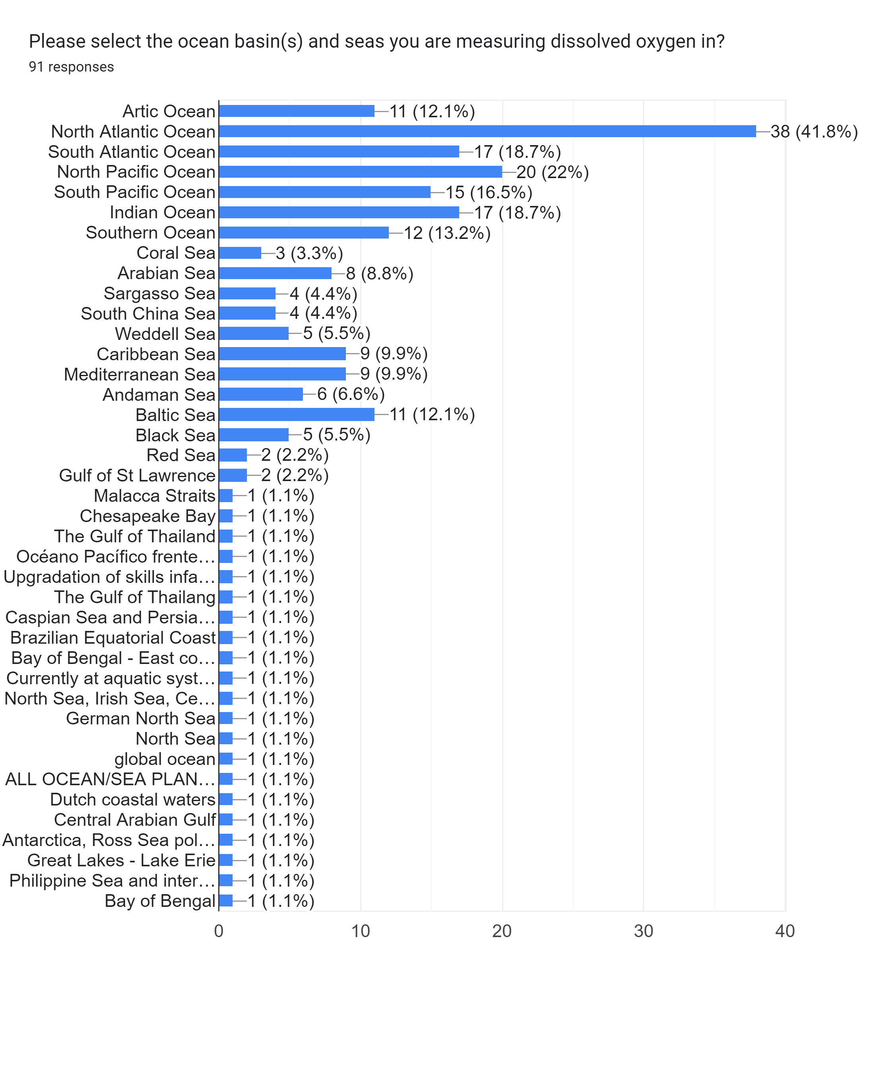
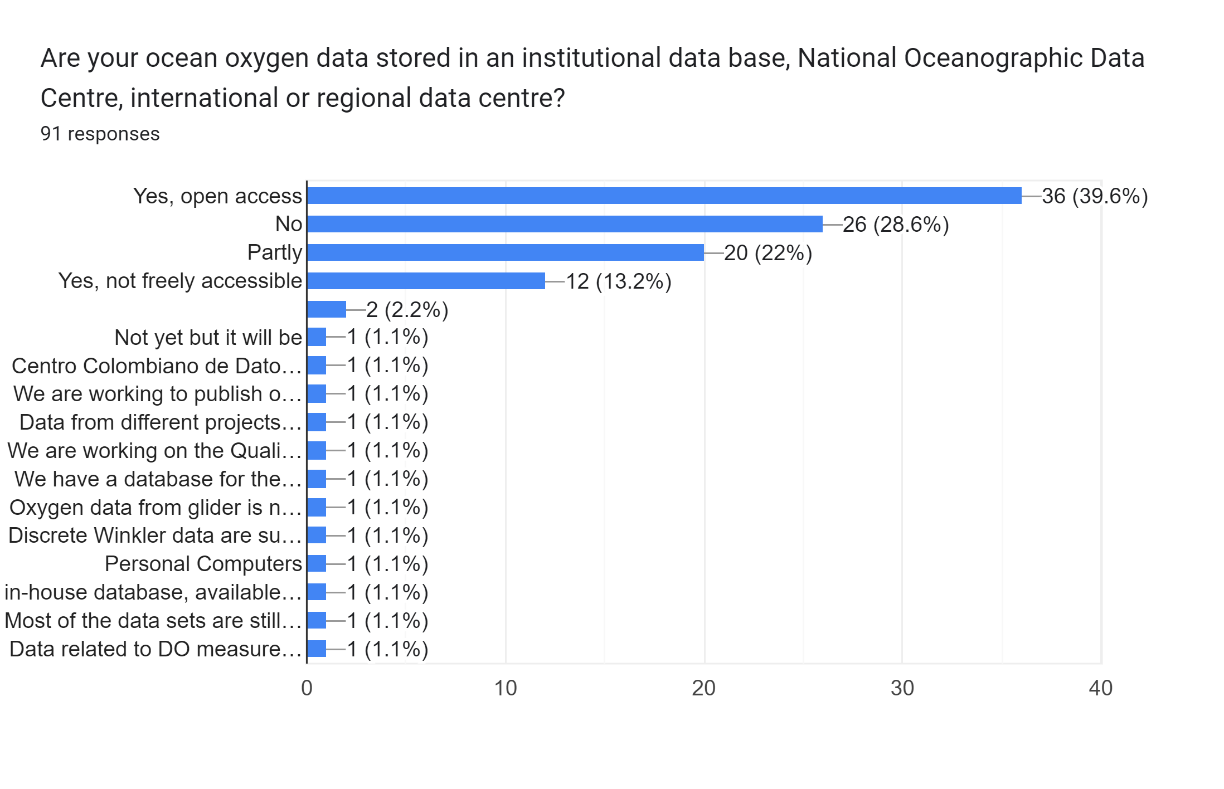
GO₂DAT
Global Ocean Oxygen Data ATlas

