Slide 1

4.6 Preliminary Report
on NEAMWave23 Exercise
Coordinated by Task Team on Tsunami Exercise
(co-chairs: Ceren Ozer Sozdinler - Marinos Charalampakis)
18th session ICG/NEAMTWS
6 – 8 February 2024

Slide 2

Opportunity for greater synergies within Tsunami Ready recognized communities.
IOC CL 2950: “For this exercise (NEAMWave23), a key objective is the involvement of Member States that participate in the CoastWAVE project, coordinated by UNESCO and those of other non-project countries (France, Italy). This exercise will test the efficiency and the abilities of the pilot UNESCO-IOC Tsunami Ready communities to respond in a complex and realistic situation, overcoming any challenges that may arise.”
Suggested Options:
i. Conduct a functional/full-scale exercise, on the day of NEAMWave23, with the scenario provided;
ii. Conduct a functional/full-scale exercise, on a different date, with the scenario provided for NEAMWave23;
iii. Conduct a drill/table-top exercise, on the day of NEAMWave23, with the scenario provided.
Date & Time | Scenario | Region | TSPs
6 November 2023 08:00 UTC (6 hours)* | 1761 Atlantic Earthquake [8.5 Mw] | North-Eastern Atlantic [35°N, 12°E, 10 km] | IPMA - CENALT
7 November 2023 08:00 UTC (3½ hours)* | Hellenic Arc [8.1 Mw] | Eastern Mediterranean [34.52°N, 24.57°E, 10 km] | INGV – NOA – KOERI
* Duration of message dissemination by TSPs
18th session ICG/NEAMTWS ● 6 – 8 February 2024

Slide 3
Steps of NEAMWave23
Phase A
Phase B
Emergency management activities at national level
(TWFP/NTWC – CPA)
Phase C
Detection of event and timely provision of alert messages
(TSPs)
International assistance request and provision
(CPA & ERCC)
Dissemination of exercise messages to the permanent and NEAMWave23 subscribers via e-mail, fax, GTS and optionally SMS and CAP-TSU.
Orientation workshop
Drill exercise Table Table top exercise
Functional exercise
Full-scale exercise
Test of CECIS
Test of procedures for the request of international assistance
18th session ICG/NEAMTWS ● 6 – 8 February 2024

Slide 4
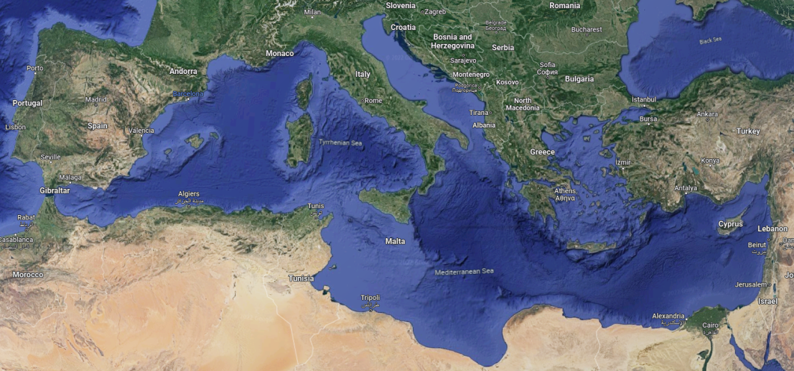
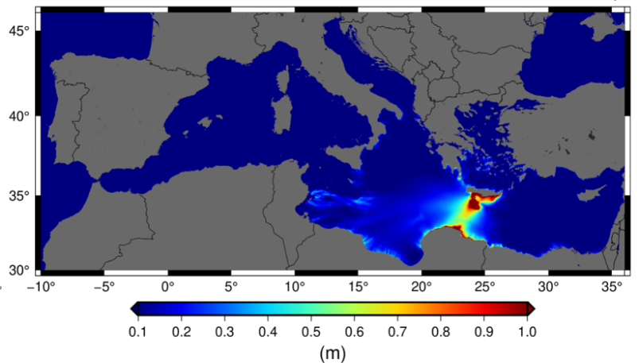
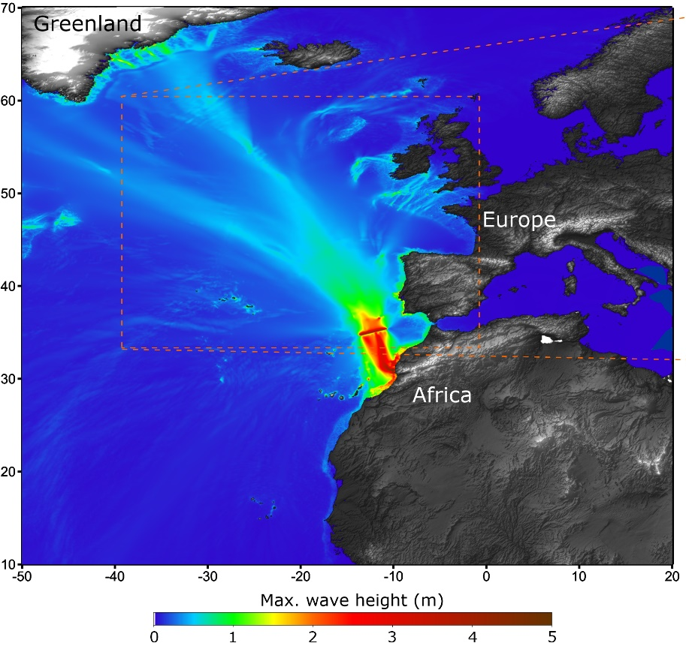
NEAMWave23 scenarios
North Eastern Atlantic
Joint scenario (Mw=8.5) by IPMA & CENALT
Eastern Mediterranean
Joint Scenario (Mw=8.1) by INGV, NOA & KOERI
18th session ICG/NEAMTWS ● 6 – 8 February 2024

Slide 5
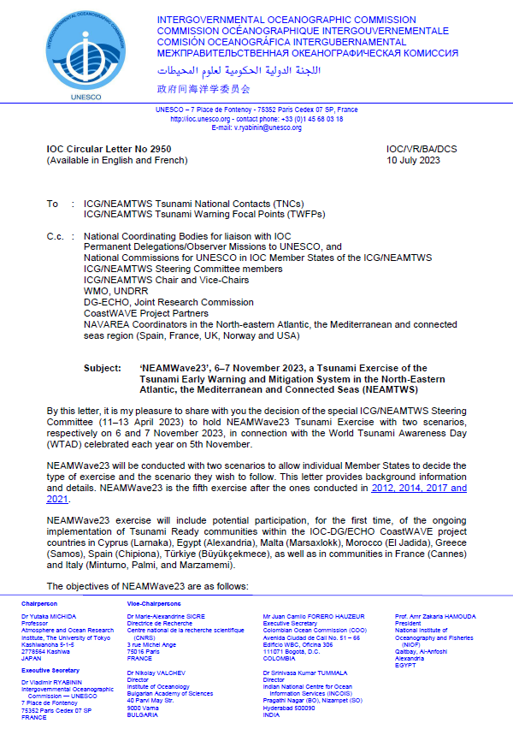
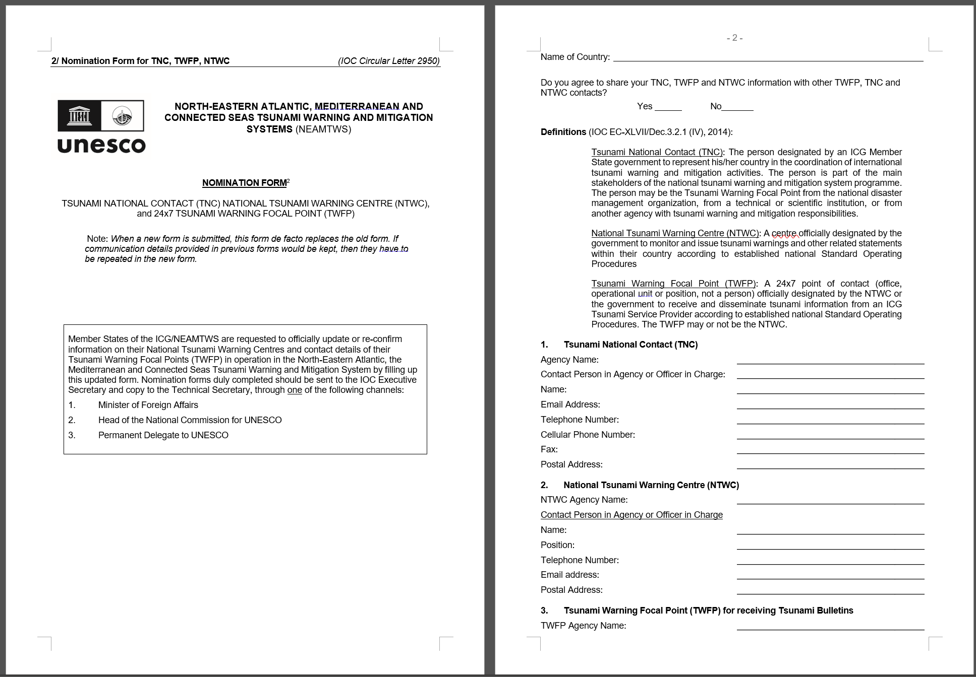
Announcements for NEAMWave23
IOC Circular Letter 2950 and 2950_form: on 10th of July, 2023
18th session ICG/NEAMTWS ● 6 – 8 February 2024

Slide 6
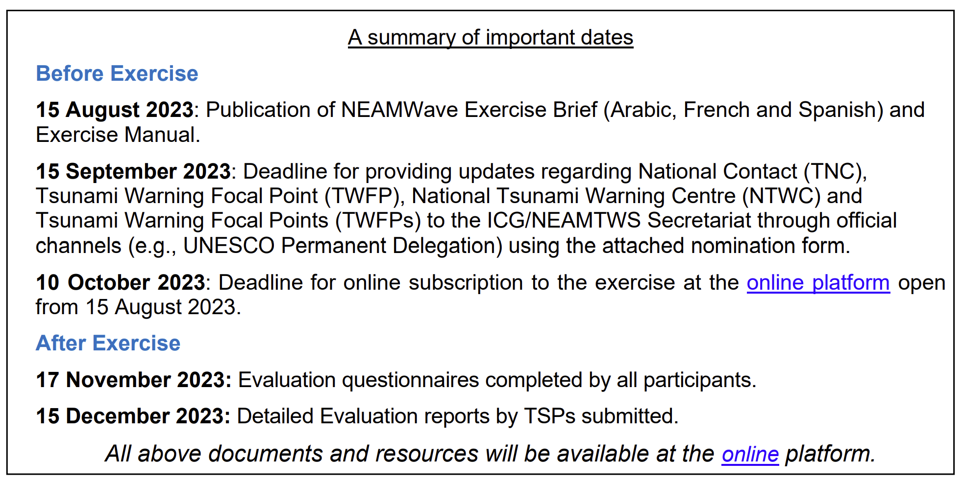
Announcements for NEAMWave23
18th session ICG/NEAMTWS ● 6 – 8 February 2024

Slide 7
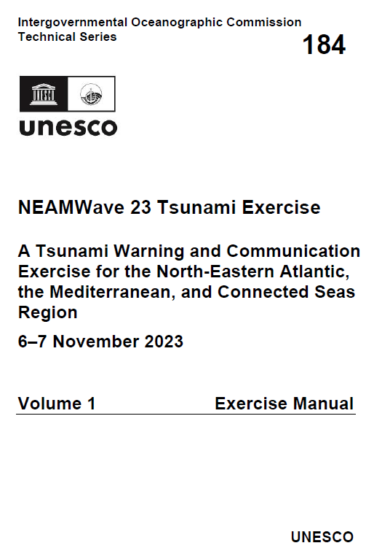
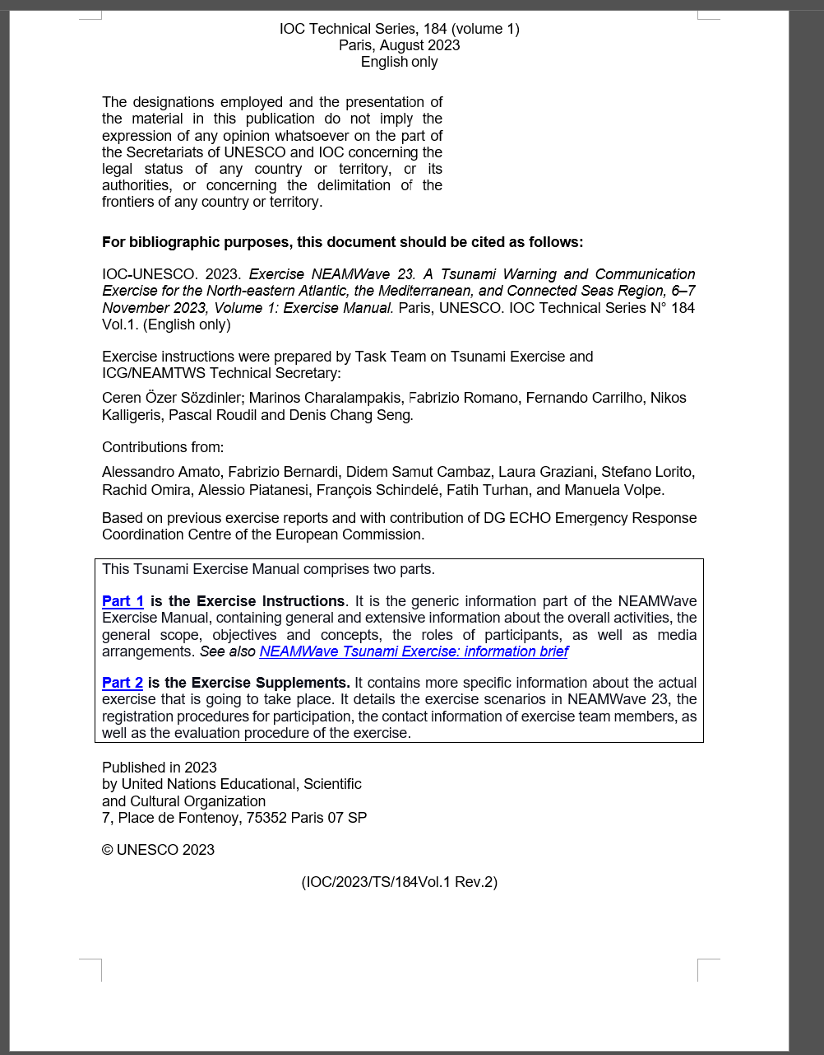
Announcements for NEAMWave23
Exercise Manual – Parts 1 & 2: Distributed to NEAMTWS Member States on 20th of September, 2023
18th session ICG/NEAMTWS ● 6 – 8 February 2024

Slide 8
Preparations for NEAMWave23
● A concept note to inform CPAs, NTWCs and other exercise actors about the general concept of NEAMWave - Done (Shared through Circular Letter and exercise online platform)
● Revision of online tools (subscription & evaluation) - Done
● Online meeting with CoastWAVE coordination team - Done
● Request Civil Protection Authorities (through TNCs) with experience in NW exercises to prepare a one-page guiding document to share with other non-experienced CPAs, describing their experience in implementing Phase B of NEAMWave Exercises – NO RESPONSE
18th session ICG/NEAMTWS ● 6 – 8 February 2024

Slide 9
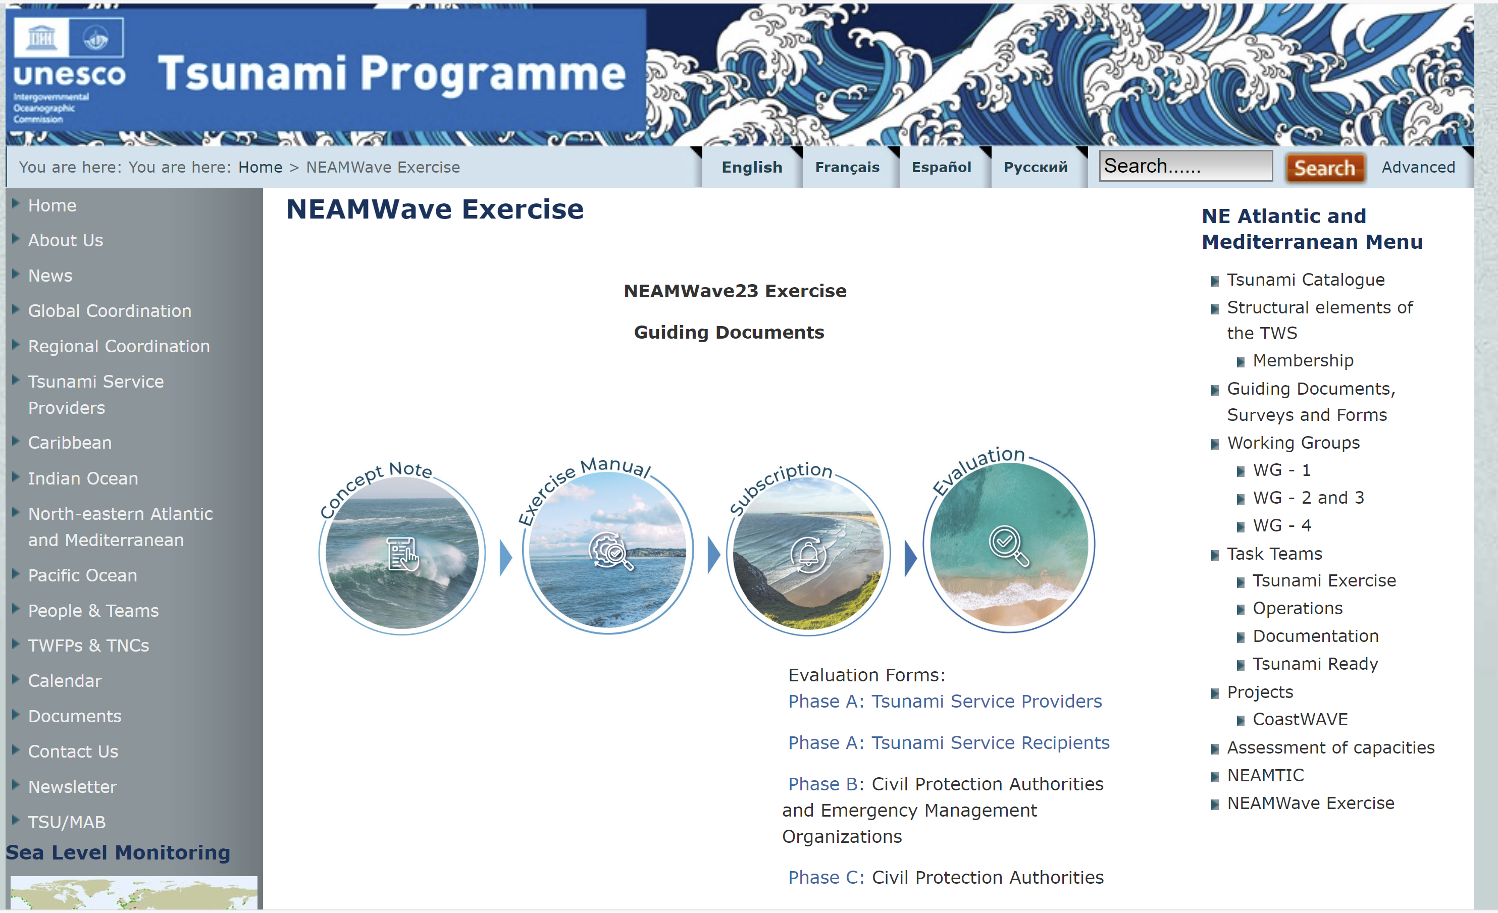
Preparations for NEAMWave23
18th session ICG/NEAMTWS ● 6 – 8 February 2024

Slide 10
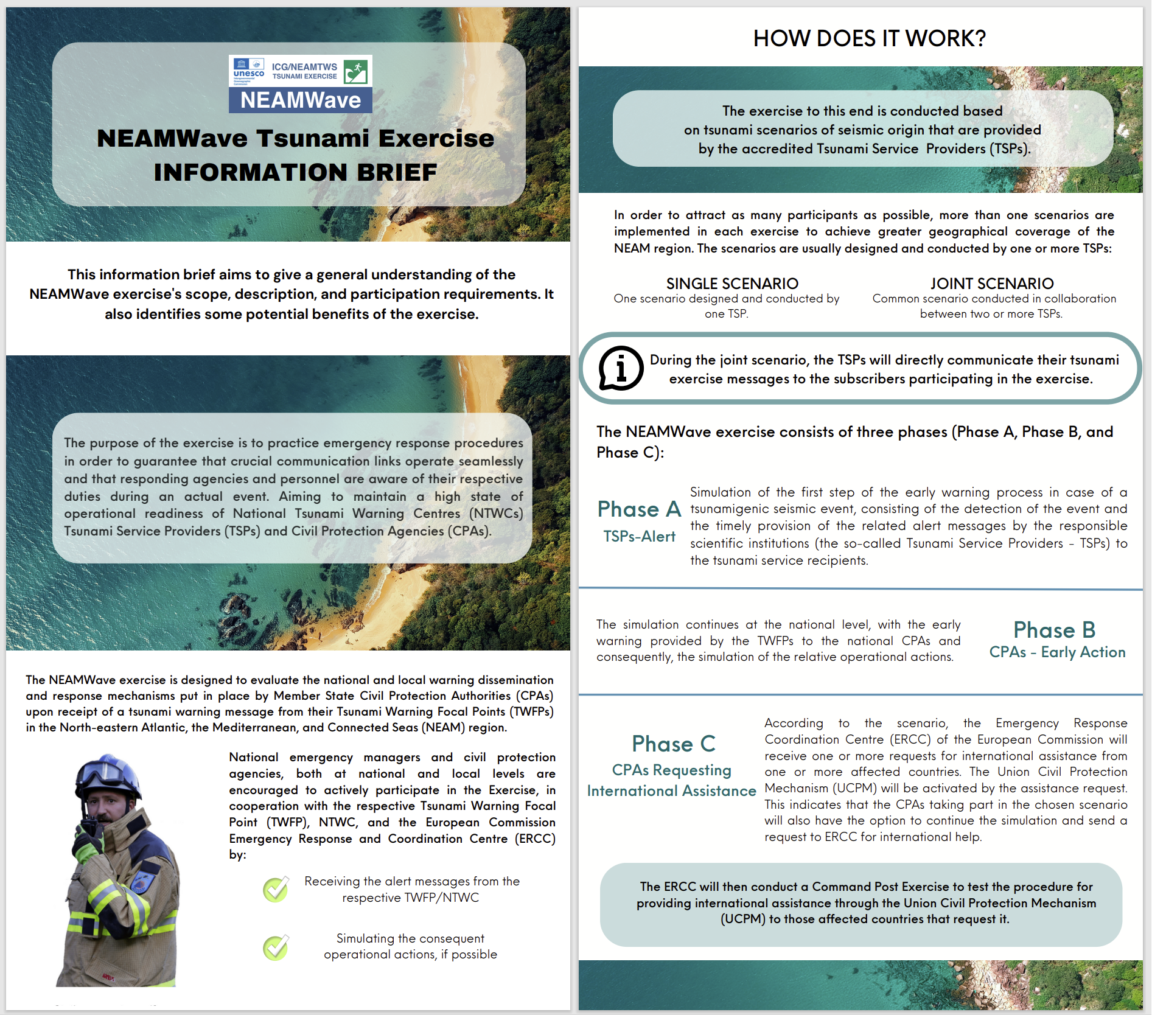
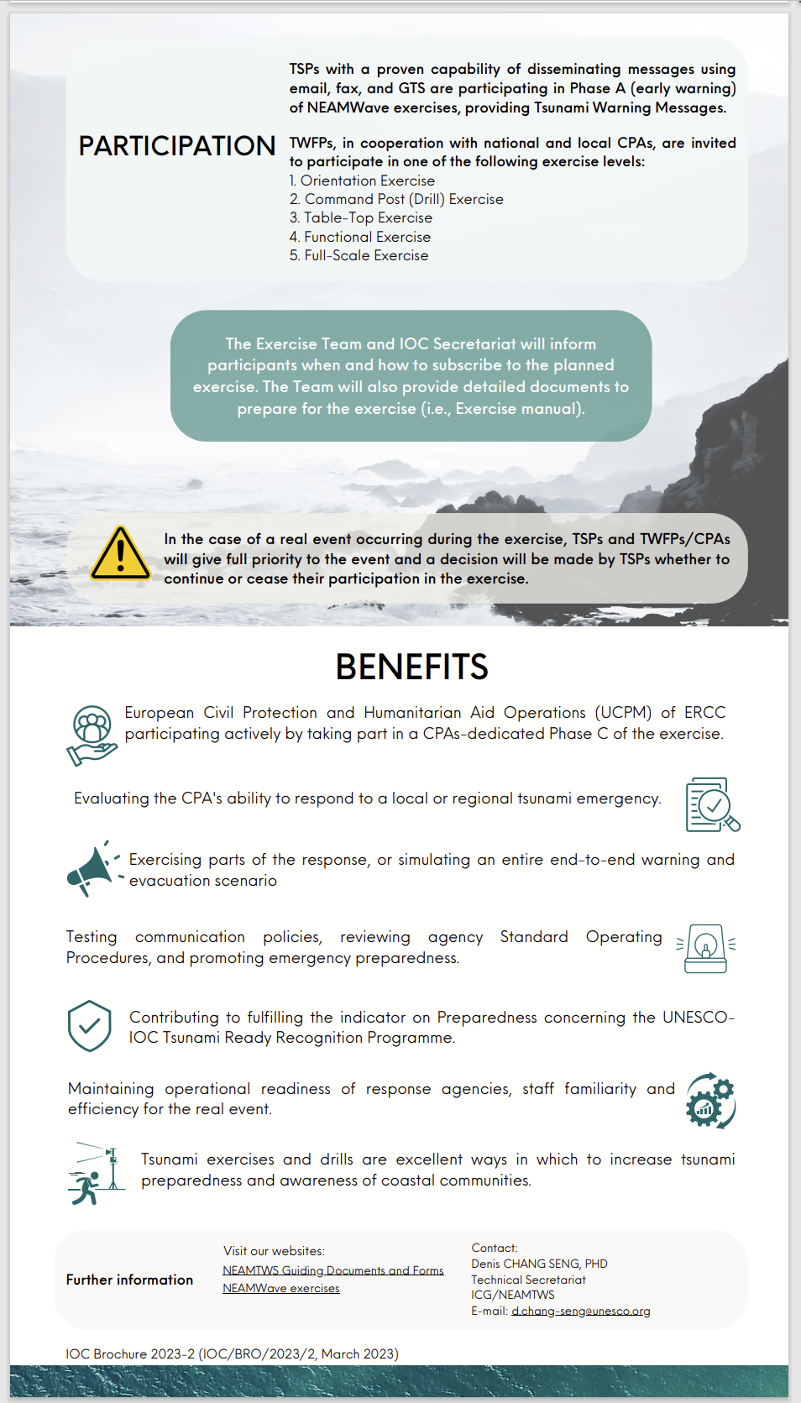
Preparations for NEAMWave23
Special thanks to Maria Camila León Duque!
18th session ICG/NEAMTWS ● 6 – 8 February 2024

Slide 11
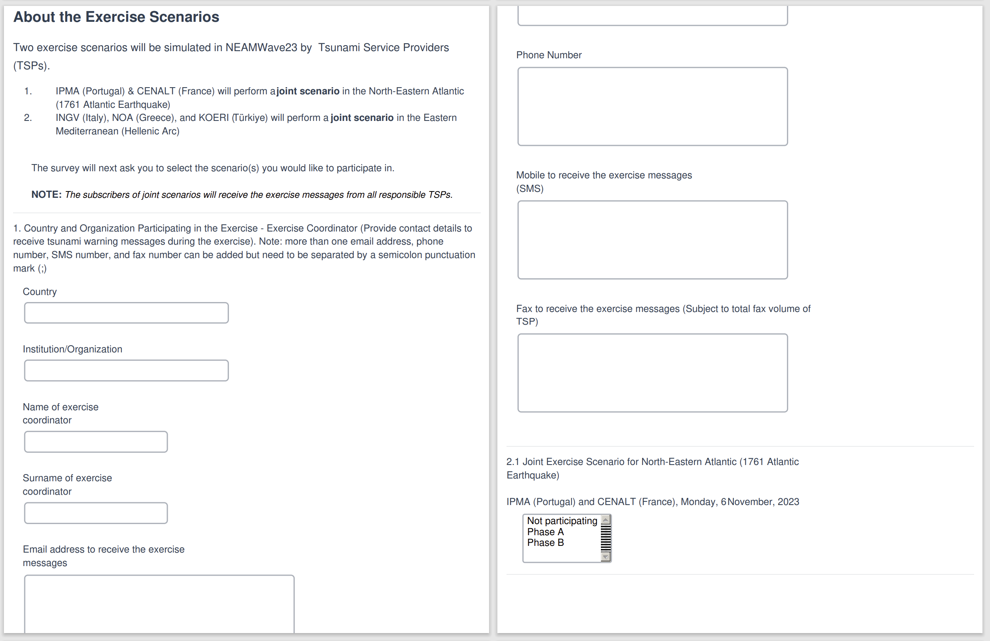
Updating online subscription form
Preparations for NEAMWave23
18th session ICG/NEAMTWS ● 6 – 8 February 2024

Slide 12
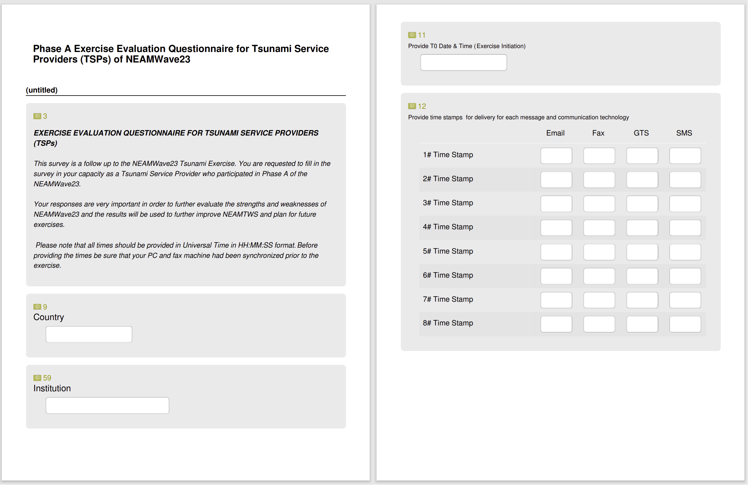
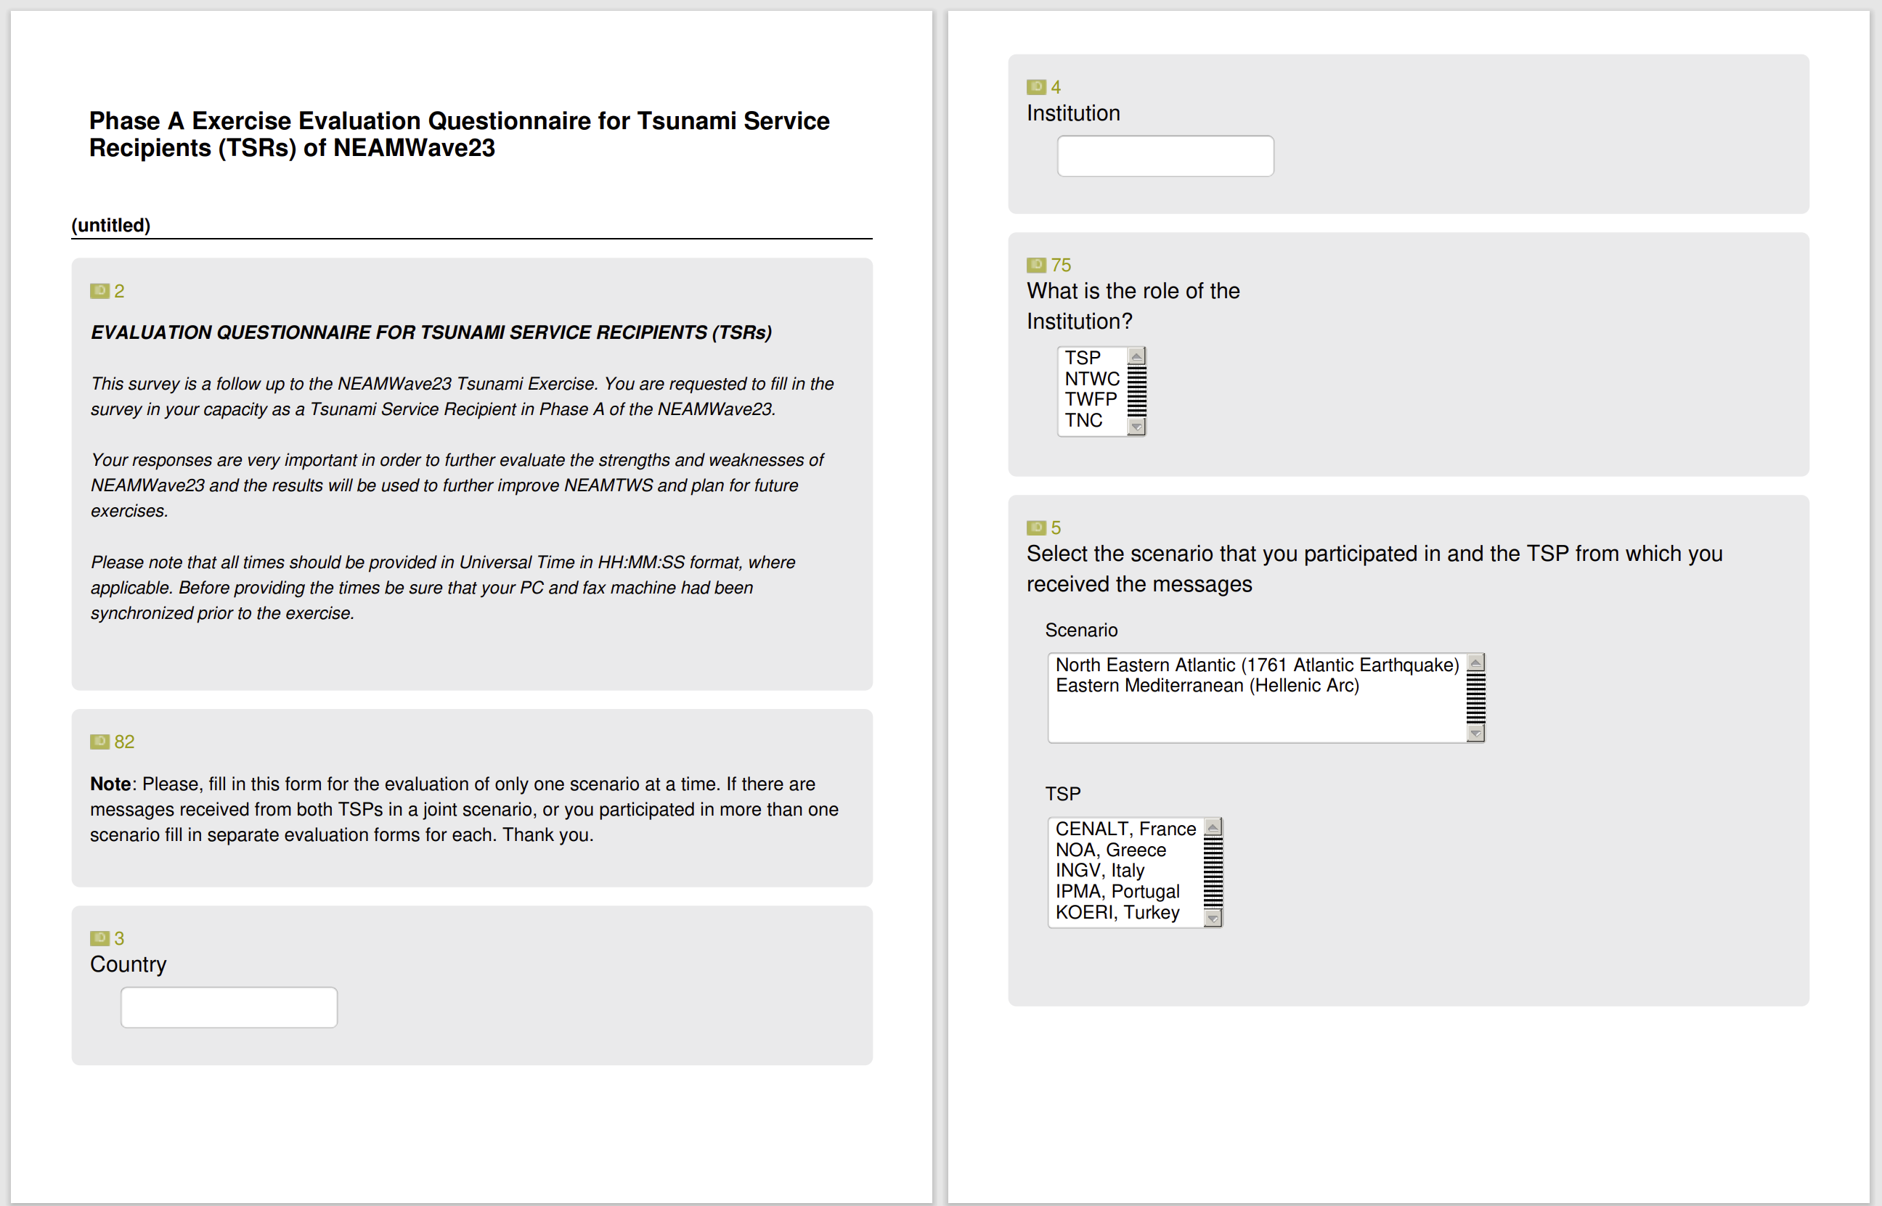
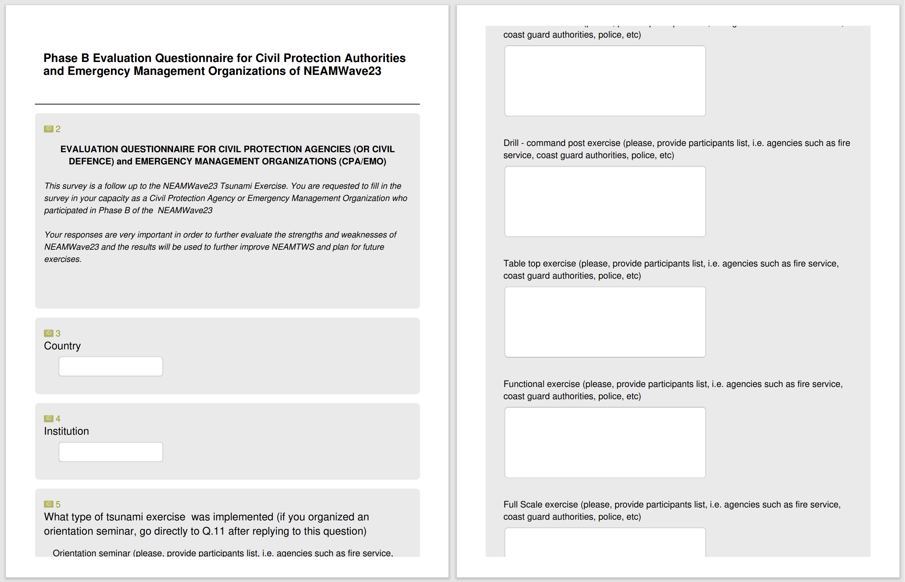
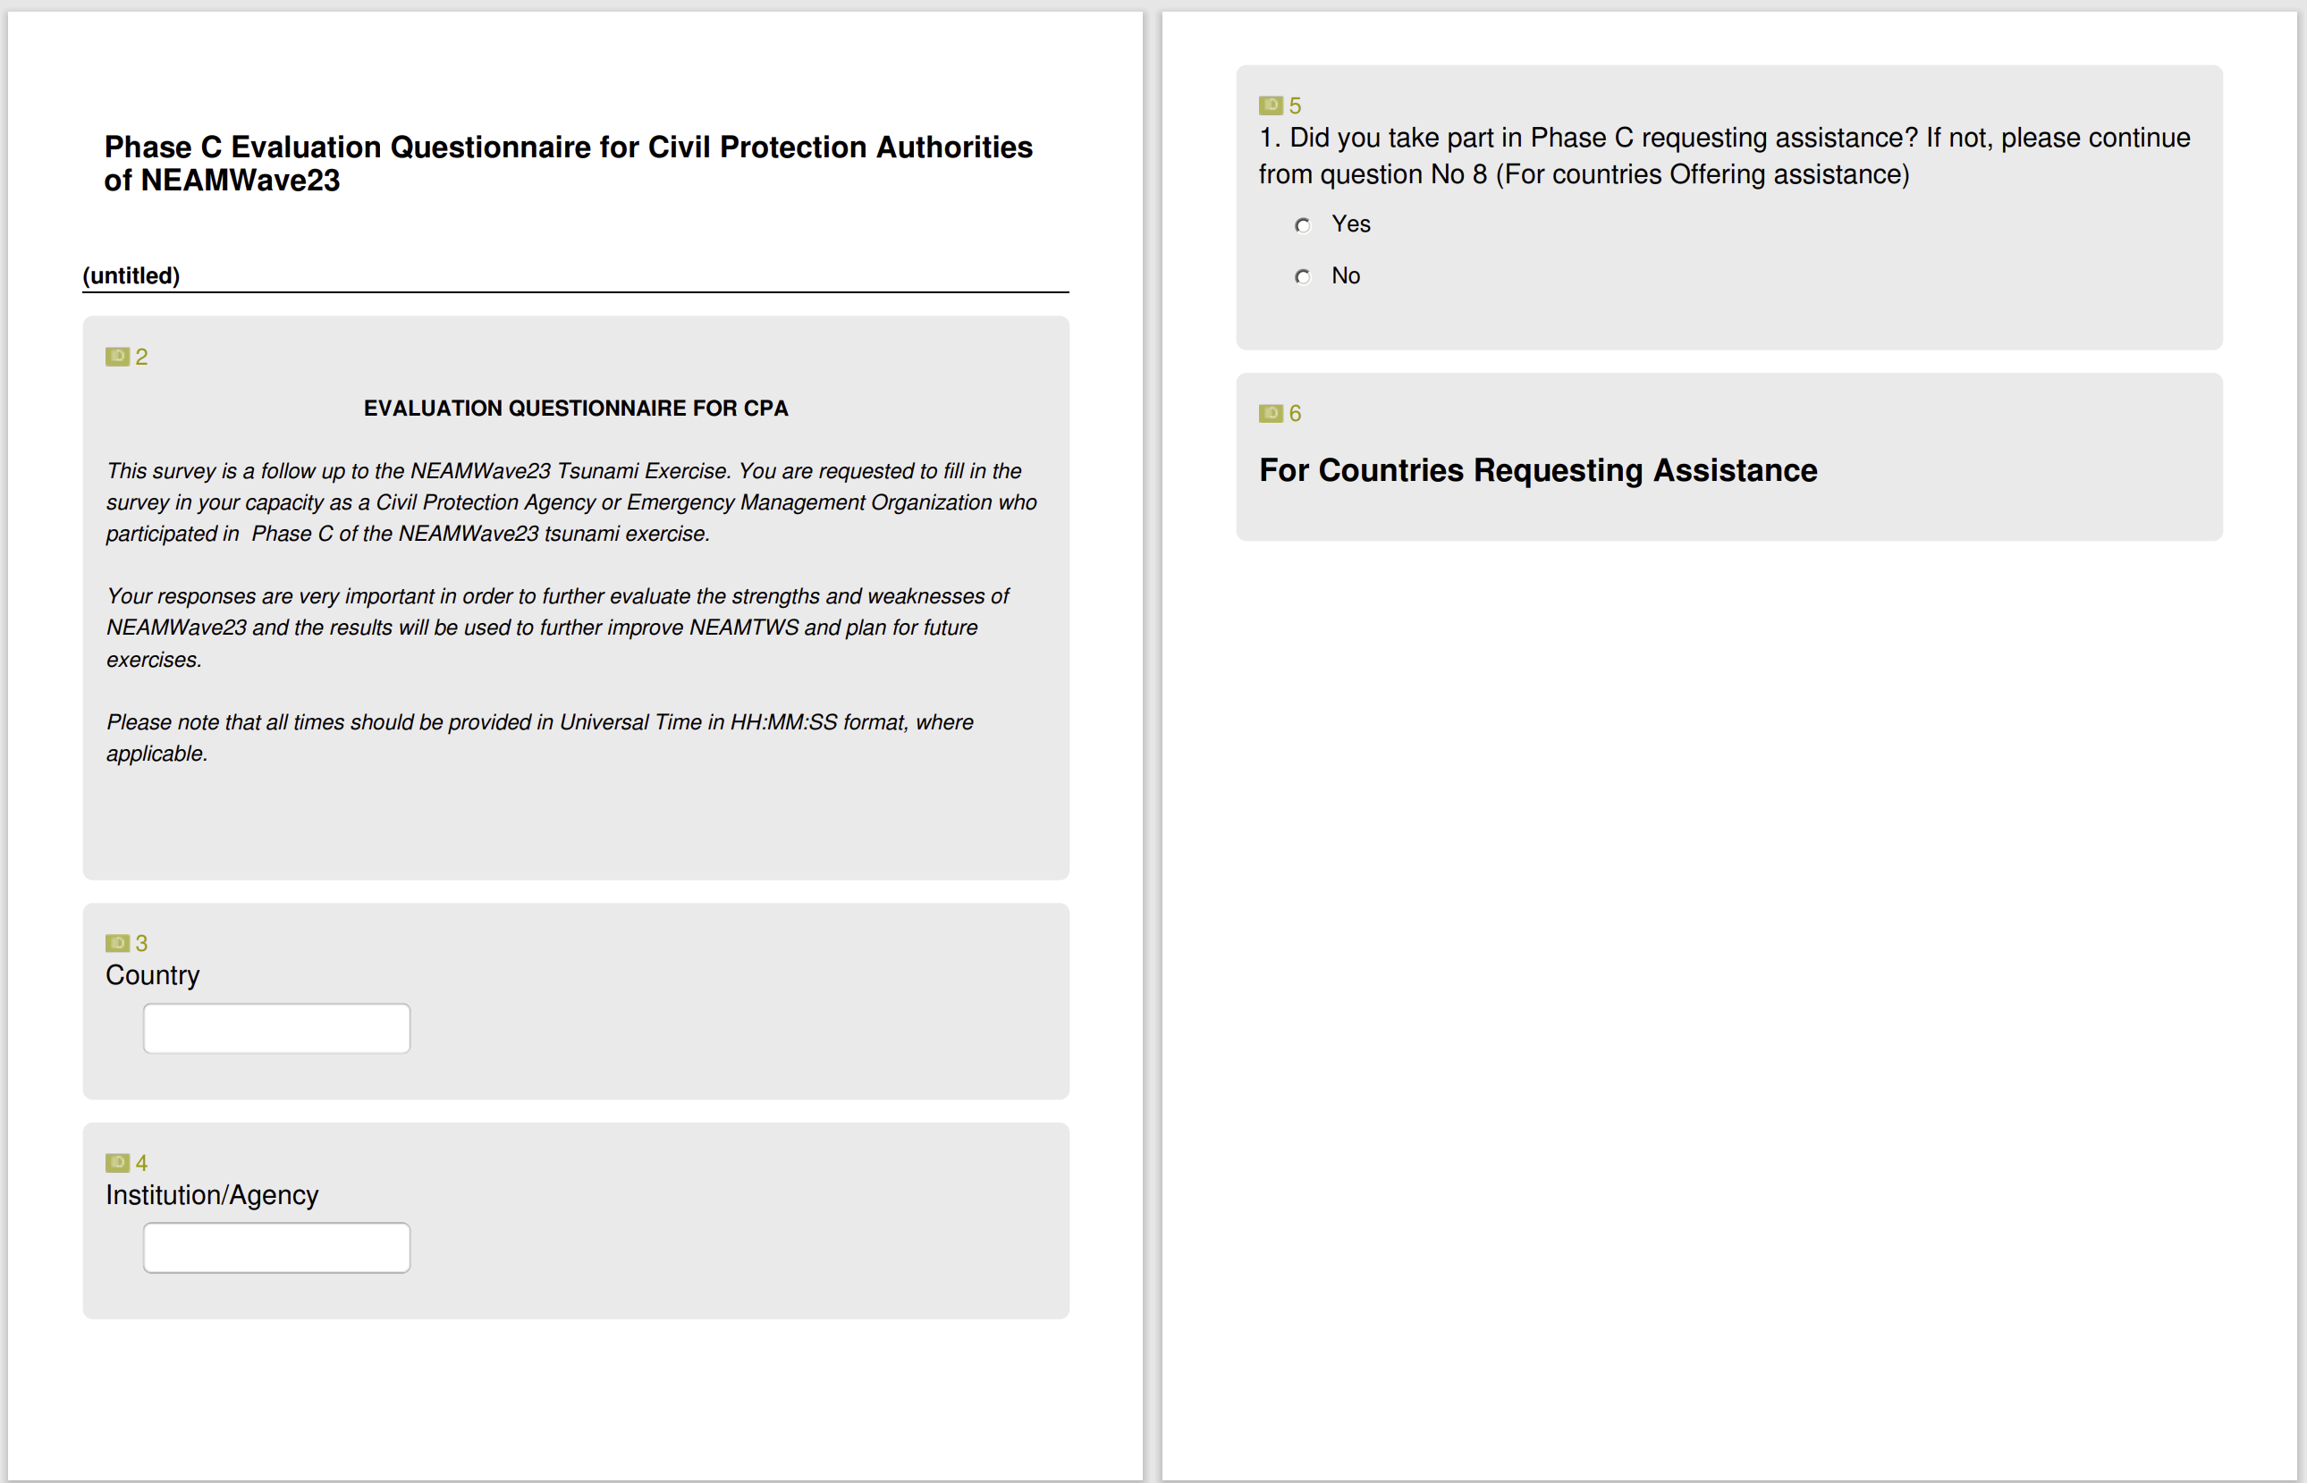
Updating online evaluation forms
Preparations for NEAMWave23
Special thanks to Alejandro Rojas Aldana!

Slide 13
Participation Statistics
IOC CL 2950: “Very importantly, Member States registered as recipients of a Tsunami Service Provider are urged to also subscribe to the exercise through the online form”.
18th session ICG/NEAMTWS ● 6 – 8 February 2024

Slide 14
Evaluation in numbers
44 Evaluation forms have been received.
Phase A (TSP): 5 Member States
France (CENALT), Greece (NOA), Italy (INGV), Portugal (IPMA) & Turkey (KOERI)
Phase A (TSR): 9 Member States and 1 International body
Cyprus, Finland, France, Greece, Italy, Portugal, Romania, Spain & Turkey and ERCC
Phase B: 14 Member States subscribed – 4 filled evaluation forms
Cyprus, Italy, Spain & Turkey
Phase C: 1 Member State
Finland
18th session ICG/NEAMTWS ● 6 – 8 February 2024

Slide 15
Phase A TSP first comments …
integration of several new coordinates and two more countries, showing the international interest for this exercise
useful to check the preparedness of the personnel on shift to manage the issuing of the messages
very helpful for testing in almost real conditions some new features in the analysis and reporting software.
an opportunity to implement distribution of messages to a lower level in the civil protection system, reaching directly some selected municipality levels and contributing to more effectiveness in the system.
very useful in terms of updating the communication channels, verifying the TSPs operational system and raising awareness among the end-user community; useful especially in terms of further validation of the message recipient details.
useful to test again both the procedures and the performance of the CAT-INGV TSP
problems in dissemination for messages through fax system mostly due to the non-uniqueness of the fax number from where they are emitted.
18th session ICG/NEAMTWS ● 6 – 8 February 2024

Slide 16
Phase A TSP first comments …
problem with the sending of emails, showing the need of multi-technology message transmission and of finalizing the implementation of a supplementary redundant service we are currently working on, using exterior email service provider.
Paperwork, meetings and the procedures in the preparation of the exercise can be reduced to diminish the workload that is needed for the preparation before the exercise.
the subscription mechanism needs to be improved
Special care should be taken in future exercises for local community participation.
a mechanism should be introduced that provides the option for TSPs to test the emails provided by the exercise subscribers prior to the execution of the exercise.
Something we should try to accommodate in the future, because for the NE Atlantic the tsunami propagation take long time to reach coast of some o the member states that subscribed the service.
The coordinates to implement only for the exercise should be given a little bit more in advance.
18th session ICG/NEAMTWS ● 6 – 8 February 2024

Slide 17
Phase A TSR first comments …
on top of managing our own crisis it would be interesting to have a resource that would integrate the messages of other TSPs.
very useful to verify operational readiness of our TSP as message recipient
Useful for assessing transmission delays and evaluation of messages associated to large tsunami events.
It was useful for my agency because we had immediate and efficient communication between all agencies. The communication between agencies was faster through emails than through fax.
Evaluation of operating procedures and manuals
The content of the tsunami bulletins was discussed with the rest of the agencies.
People in weather office are doing lot of remote work meaning they don't see FAX and SMS messages. So tsunami warnings via email are really important and also GTS network.
18th session ICG/NEAMTWS ● 6 – 8 February 2024

Slide 18
Phase A TSR first comments …
It might be interesting to have a discussion with the TSPs and TT-TE before or after the exercise so that they can explain the differences between their products. It might also be interesting for the scenario to be a little more complex, with, for example, an intermediate alert level rising to a higher level.
it would be useful to create a digital tool for managing and updating contacts both for preparing for the exercise and for managing new subscriptions
Consider that the propagation of a tsunami in the Atlantic could extend for many hours, much more than the typical time window of the exercise. This is important for NE Atlantic Member States with territory located far from the source area.
A Black Sea area scenario, to be more involved and directly "affected”.
18th session ICG/NEAMTWS ● 6 – 8 February 2024

Slide 19
Phase B first comments …
Improvement of National Messages, because it seems that they are not well understood at local/municipality level.
More municipalities to be included in future NEAMWave exercises.
Promote self-protection in sectors with activity on the coast and at sea, against tsunami risk.
It could be useful to have a dedicated meeting before the exercise, with the rest of countries participating in the exercise, as well as the involved TSPs and the Task Team on Tsunami Exercise.
A request for more complex scenarios, for example with evolving alert levels, or even different alert levels between TSPs.
There were also comments on the content of the messages:
  The number of forecast points is different between TSPs
  Tsunami Arrival Times are sometimes too different between TSPs
  Cartographic products are not harmonized
  The messages are lengthy.
18th session ICG/NEAMTWS ● 6 – 8 February 2024

Slide 20
Phase C first comments …
During the exercise the ERCC experienced a real problem of network, delaying the actions and creating communication problem with Finland that was the offering country. This allowed to highlight the importance of making sure that the contact list of the national contact points is always up to date.
The purpose of the phase C would be served better with the participation of at least one country requesting assistance and two or more offering. These could be set as minimum criteria for the conduct of phase C.
Better involve Civil Protection authorities.
The ERCC highlighted the complexity of the Tsunami messages and proposed at least to list the “affected country” by wave arrival time and not by country.
For the next exercise, they should enhance their efforts to inform well in advance the civil protection community and aim at a bigger participation to phase C.
18th session ICG/NEAMTWS ● 6 – 8 February 2024

Slide 21
NEAMWave23 & Tsunami Ready
Istanbul
NE Atlantic Scenairo
(Mw=8.5) by IPMA & CENALT
Chipiona
Minturno
Samos
El Jadida
Larnaka
Malta
Eastern Mediterranean Scenario (Mw=8.1) by INGV, NOA & KOERI
Alexandria
18th session ICG/NEAMTWS ● 6 – 8 February 2024

Slide 22
NEAMWave23 & Tsunami Ready
Cyprus - Table Top Exercise:
  Workshop: Larnaka Evacuation Maps 26-27 September 2023 (NOA-INGV-HLC)
  We began work on improving our knowledge of the physical phenomenon of the tsunami inundation modelling, as well as mapping out evacuation plans. This exercise was also an opportunity to start drafting the SOPs and to renew discussions with the municipality of Larnaka, the pilot site for the CoastWave project. PTHA was conducted for Larnaka as beyond CoastWAVE activities.
  Egypt – Drill:
  Evacuation of a middle school in Alexandria using Eastern Mediterranean Scenario. Agreement with the Directorate of Education to carry out this exercise in schools, due to concerns regarding children safety. Controlling the movement of students through the evacuation route was very challenging.
18th session ICG/NEAMTWS ● 6 – 8 February 2024

Slide 23
NEAMWave23 & Tsunami Ready
  Greece – Table Top Exercise and Drill:
  An earthquake and tsunami exercise, called SAMOSWAVE23-CW was organized in the city of Samos by the Municipality of Eastern Samos and NOA using Eastern Mediterranean Scenario. It included two components that unfolded in parallel: a. Table-Top Exercise, and b. Earthquake and Tsunami Preparedness Exercise in two Middle Schools of Samos.
Italy – School drill:
  Using NEAMWave23 Eastern Mediterranean scenario, a school drill was conducted in Minturno. A local nursery school participated in the drill by vertical evacuation of the children and staff to a higher floor of the building. The drill aimed to test the preparedness and response of the school community in case of a real tsunami event.
18th session ICG/NEAMTWS ● 6 – 8 February 2024

Slide 24
NEAMWave23 & Tsunami Ready
Malta – Full Scale Exercise:
  Tsunami Hazard Assessment and Evacuation Modeling/Mapping at Marsaxlokk. They involved in Eastern Mediterranean Scenario; development of sea level time series at Marsaxlokk individually in collaboration with Malaga University. Testing the communication protocols, mobile incident command unit, tsunami simulation and support system, and tsunami alert devices were the main achievements. The students evacuated from the shore to a safe zone after hearing the sirens. It was officially classified as Functional Exercise but better fit in Full Scale.
  Morocco – Full Scale Exercise:
  Preparation of tsunami inundation and evacuation maps at Jorf Lasfar El Jadida. They had social events, workshops and meetings to inform about the exercise. It is a community tsunami evacuation exercise in full scale with the involvement of local authorities, local people, and the forces. The main challenges were related to the lack of knowledge of the authorities, worries about the publics attitude and their fears. After several meetings, the exercise was conducted and evaluated.
18th session ICG/NEAMTWS ● 6 – 8 February 2024

Slide 25
NEAMWave23 & Tsunami Ready
  Spain – Full Scale Exercise:
  Evacuation of a school in Chipiona Municipality coordinated by the operational center of the Local Police to reach the meeting point. Previous outreach activities in Chipiona like Conferences, 'Tsunami Walk' to know the evacuation routes, and meetings with institutions involved in the exercise. Evacuation of a school in Chipiona Municipality coordinated by the operational center of the Local Police to reach the meeting point.
  Turkiye – Table Top Exercise:
  To monitor the dissemination chain during the NEAMWave23 Tsunami Exercise, KOERI led a Table Top Exercise related to the tsunami message dissemination chain of the Büyükçekmece, Istanbul) by inviting all the stakeholders such as Disaster and Emergency Management Department (AFAD), Istanbul Metropolitan Municipality, District Governorate and Municipality of Büyükçekmece, Middle East Technical University (METU), and Turkish Wireless and Radio Amateur Society (TRAC). Observers from the Office of Navigation, Hydrography and Oceanography (SHOD) and Boğaziçi University also involved in the exercise.
18th session ICG/NEAMTWS ● 6 – 8 February 2024

Slide 26
TT-TE first comments …
Submission of exercise evaluation forms is highly important for TT-TE to better evaluate the functionality of NEAMWave (Subscription forms are not the main reference for the preparation of final evaluation report).
New Exercise Online Platform was more functional and in NEAMWave23. Dissemination of exercise materials was delayed but was more effective due to the division of the exercise manual in two Parts.
A digital tool can be developed for managing and updating contacts both for preparing for the exercise and for managing new subscriptions.
The participation of CPAs is “indirectly” increasing with the synergy of CoastWAVE project.
Subscription and evaluation need to be improved to better capture the need of partners at local level (and not only NEAMTWS related, i.e. TSPs, TWFPs,…)
The link between NEAMTWS parts, i.e. TSPS & TWFP, and recipients like NTWCs and especially CPAs should be enforced. Informative meetings with the NEAMWave subscribers, TSPs and TT-TE prior to the exercise would be useful to explain the scenarios and procedures. This would also increase participation in Phase C.
Clarification is necessary for the definition of Phase B exercise types by discussing with CPAs and/or ERCC.
18th session ICG/NEAMTWS ● 6 – 8 February 2024

Slide 27
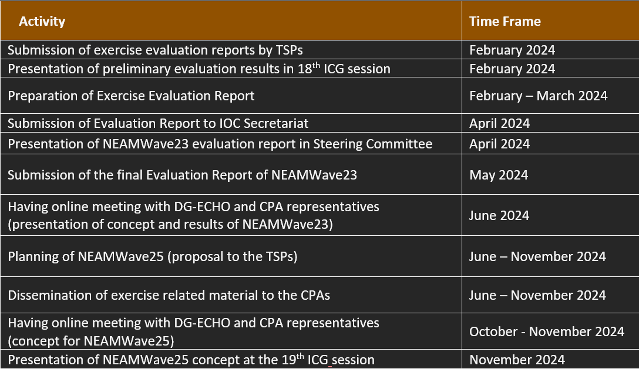
Next steps – PoA of TT-TE
18th session ICG/NEAMTWS ● 6 – 8 February 2024

Slide 28
Thank you!
Name | Surname | Institution
Ceren | Ozer Sozdinler | GTU, Türkiye
Marinos | Charalampakis | NOA, Greece
Pascal | Roudil | CENALT, France
Fabrizio | Romano | INGV, Italy
Fernando | Carrilho | IPMA, Portugal
Nikos | Kalligeris | NOA, Greece
Denis | Chang Seng | UNESCO IOC
Alejandro | Rojas Aldana | UNESCO IOC
18th session ICG/NEAMTWS
6 – 8 February 2024

