Slide 1
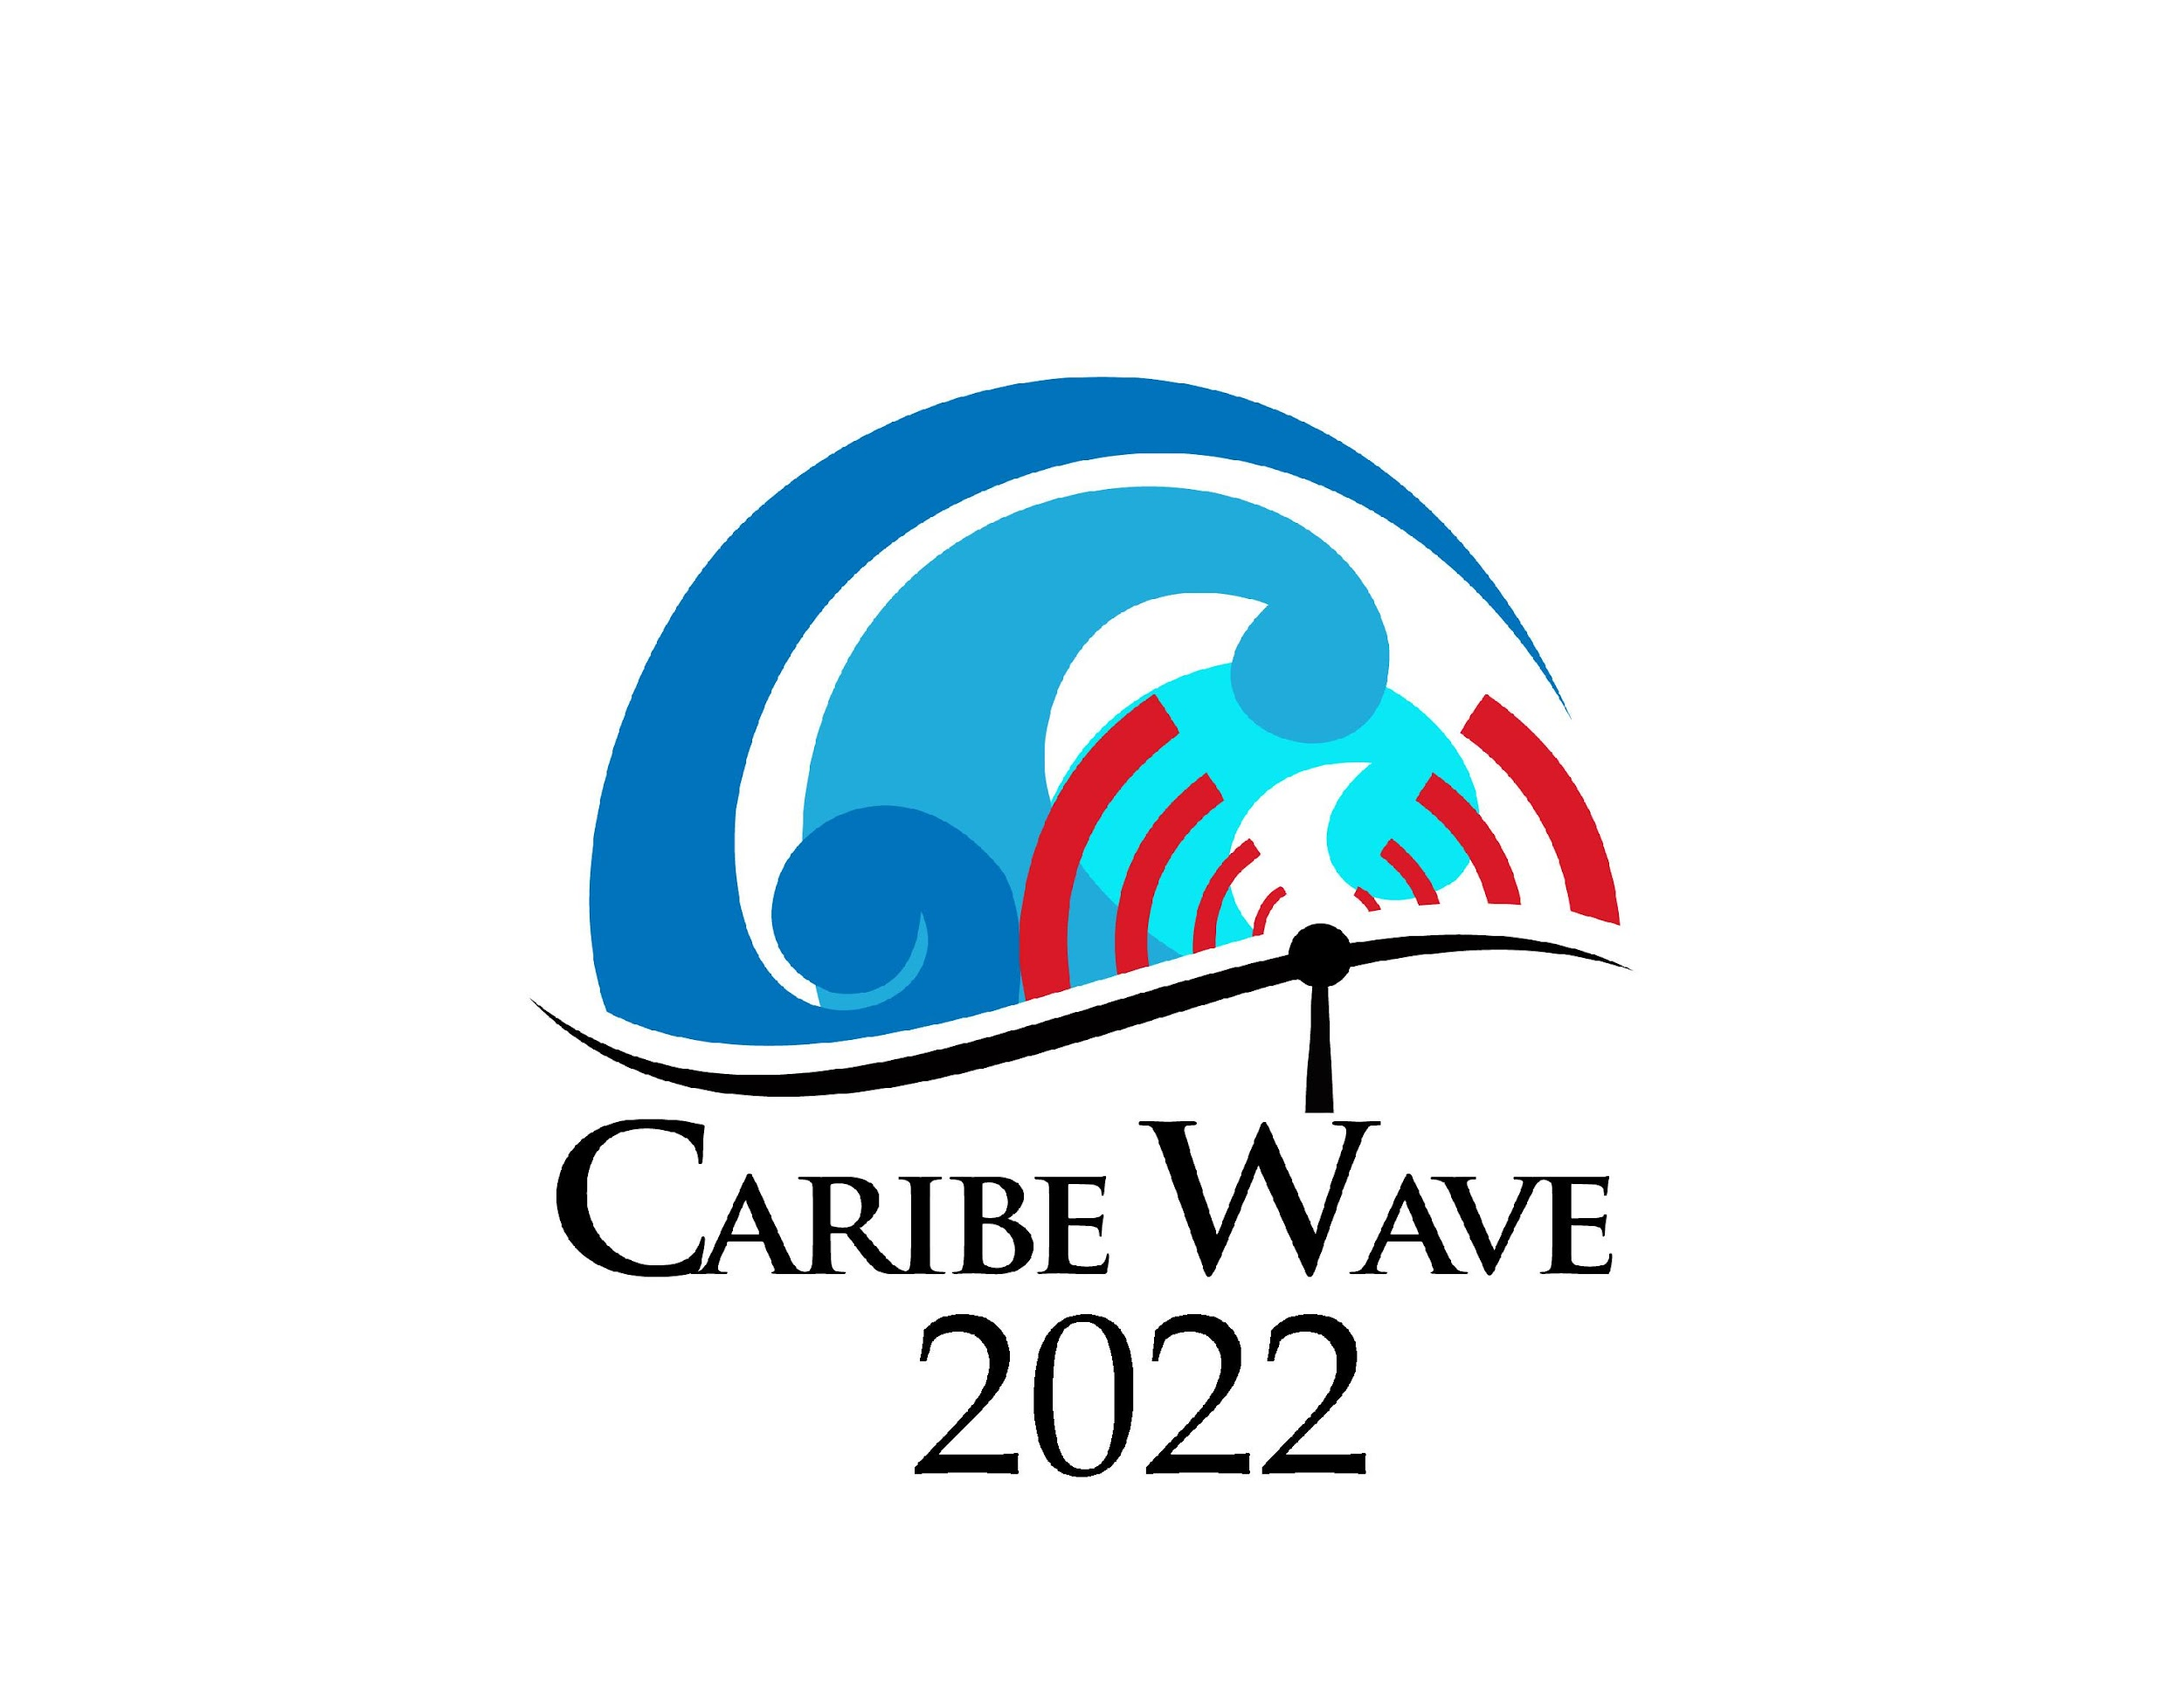
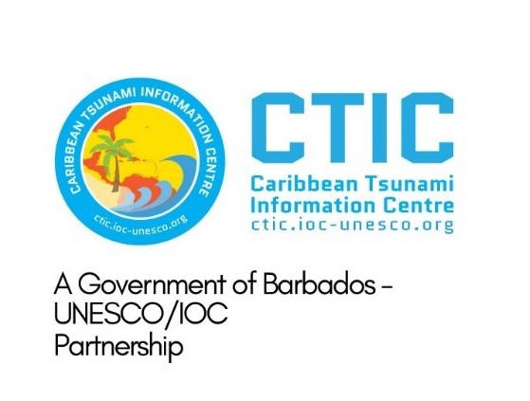




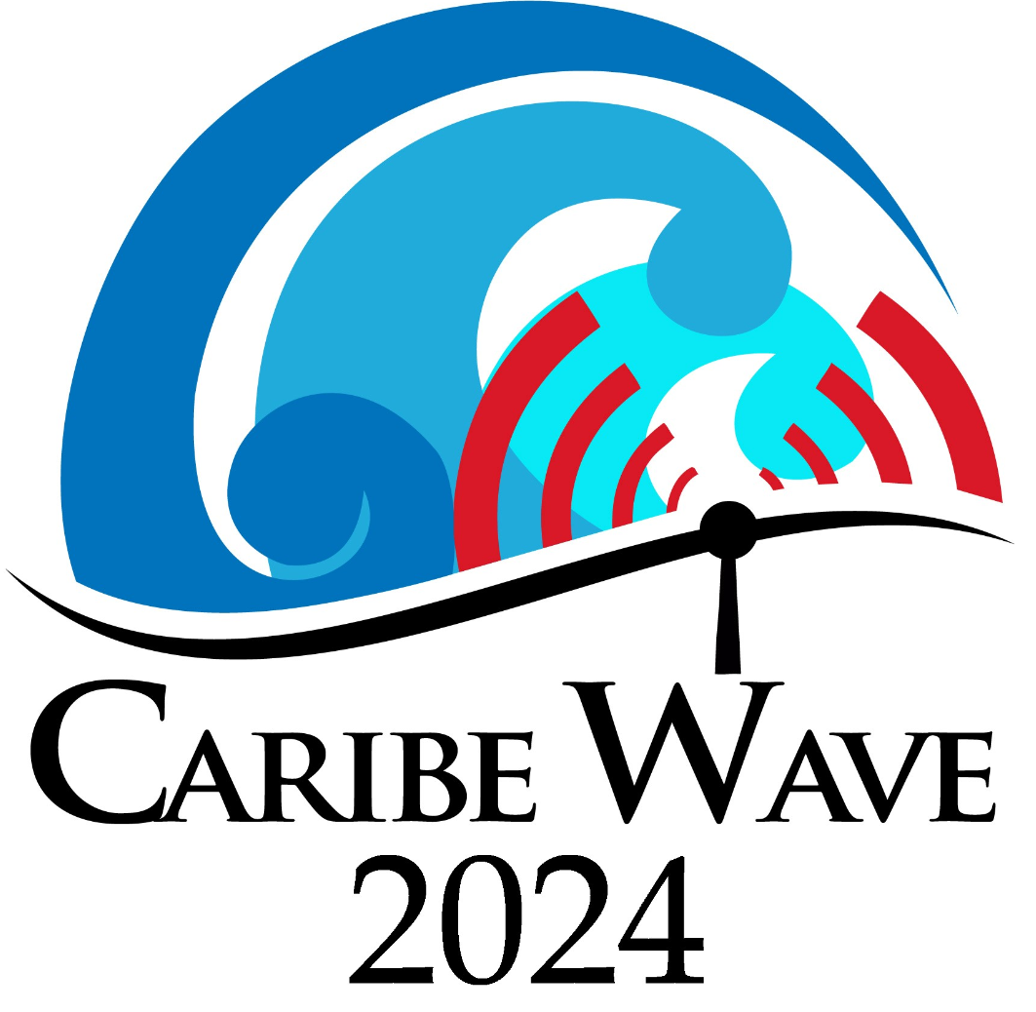
Caribe Wave Exercise Update
Antonio Aguilar
CARIBE WAVE Task Team Chair, FUNVISIS, Venezuela
Gisela Báez-Sánchez
CARIBE WAVE Task Team Vice Chair, Puerto Rico Seismic Network, USA
Christa G. von Hillebrandt-Andrade
Manager, ITIC Caribbean Office
ICG CARIBE-EWS WG III Chair
Kimberly Maisonet González
Student Contractor, ITIC Caribbean Office
2 february 2024
#CARIBEWAVE #TSUNAMIREADY

Slide 2
Timeline 2024
ACTION | TIMELINE
Circular Letter Issued by IOC to MS | ✓ October 2022
Handbook Draft Circulated among ICG CARIBE EWS, TWFP/NTWC contacts and TT CARIBE WAVE 23 | ✓ November 2022
Deadline for Comments | ✓ December 2022
Exercise Handbook Available Online | ✓ January 2023
1st Webinar CW (Overview, PTWC Products) | ✓ 23 January 2023 – English ✓ 24 January 2023 – Spanish ✓ 25 January 2023 – French
2nd Webinar CW (Update, Communication Methods, Registration, Questionnaire, Uploading Pictures/Videos ) | 27 February 2023 - English 28 February 2023 - Spanish 29 February 2023 – French
Countries Indicate Selected Scenario | 7 March 2023
Exercise | 21 March 2023
Hot-Wash | 2 April 2023
Exercise Evaluation Due | 11 April 2023
Final Draft Caribe Wave 23 Report April 19, 2023

Slide 3
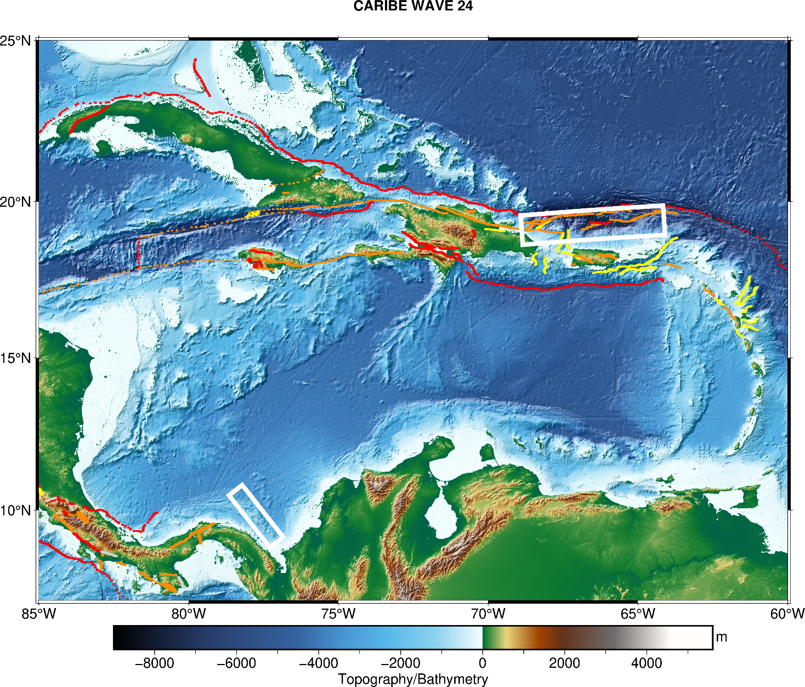
CARIBE WAVE 24
Earthquake and Tsunami Scenarios
Puerto Rico Trench
Note new time
Panama
Scenarios | Origin time | Mw | Epicenter
Puerto Rico Trench | 15:00:00 UTC 21 march 2024 | 8.7 | 19.25ºN, 66.5ºW
Panamá |  | 8.47 | 9.80ºN, 77.75ºW

Slide 4
Message Chronology issued by the PTWC
Puerto Rico Trench
Date | Time (UTC) | PTWC
 |  | Type of Product | Transmission Method
3/21/24 | 1500 | - - - - E a r t h q u a k e O c c u r s - - - -
3/21/24 | 1500 | Dummy | NWWS, GTS, EMWIN, AISR, Fax, Email
3/21/24 | 1505 | Initial Tsunami Threat Message #1 | Email
3/21/24 | 1535 | Tsunami Threat Message #2 with Forecast and Graphical Enhanced Products | Email
3/21/24 | 1600 | Tsunami Threat Message #3 | Email
3/21/24 | 1700 | Tsunami Threat Message #4 | Email
3/21/24 | 1800 | Tsunami Threat Message #5 | Email
3/21/24 | 1900 | Tsunami Threat Message #6 | Email
3/21/24 | 2000 | Tsunami Threat Message #7 | Email
3/21/24 | 2100 | Tsunami Threat Message #8 | Email
3/21/24 | 2200 | Final Tsunami Threat Message #9 | Email
Notes:
Will PTWC send Graphical Products in Messages 3-7?

Slide 5
Message Chronology issued by the PTWC
Panama
Date | Time (UTC) | PTWC
 |  | Type of Product | Transmission Method
3/21/24 | 1500 | - - - - E a r t h q u a k e O c c u r s - - - -
3/21/24 | 1500 | Dummy | NWWS, GTS, EMWIN, AISR, Fax, Email
3/21/24 | 1508 | Initial Tsunami Threat Message #1 | Email
3/21/24 | 1530 | Tsunami Threat Message # 2 | Email
3/21/24 | 1600 | Tsunami Threat Message #3 | Email
3/21/24 | 1700 | Tsunami Threat Message #4 | Email
3/21/24 | 1800 | Tsunami Threat Message #5 | Email
3/21/24 | 1900 | Tsunami Threat Message #6 | Email
3/21/24 | 2000 | Tsunami Threat Message #7 | Email
3/21/24 | 2100 | Tsunami Threat Message #8 | Email
3/21/24 | 2200 | Final Tsunami Threat Message #9 | Email

Slide 6
PTWC Message #2
ZCZC
WECA41 PHEB 211535
TSUCAX
TEST...TSUNAMI MESSAGE NUMBER 2...TEST
NWS PACIFIC TSUNAMI WARNING CENTER HONOLULU HI
1535 UTC THU MAR 21 2024
...THIS MESSAGE IS FOR TEST PURPOSES ONLY...
...TEST TSUNAMI THREAT MESSAGE TEST...
**** NOTICE **** NOTICE **** NOTICE **** NOTICE **** NOTICE *****
THIS IS A TEST MESSAGE. THIS MESSAGE IS ISSUED FOR INFORMATION
ONLY IN SUPPORT OF THE UNESCO/IOC TSUNAMI AND OTHER COASTAL
HAZARDS WARNING SYSTEM FOR THE CARIBBEAN AND ADJACENT REGIONS
AND IS MEANT FOR NATIONAL AUTHORITIES IN EACH COUNTRY OF THAT
SYSTEM.
THIS IS A TEST MESSAGE. NATIONAL AUTHORITIES WILL DETERMINE THE
APPROPRIATE LEVEL OF ALERT FOR EACH COUNTRY AND MAY ISSUE
ADDITIONAL OR MORE REFINED INFORMATION.
**** NOTICE **** NOTICE **** NOTICE **** NOTICE **** NOTICE *****
TEST... PRELIMINARY EARTHQUAKE PARAMETERS ...TEST
-------------------------------------------------
* MAGNITUDE 8.7
* ORIGIN TIME 1500 UTC MAR 21 2024
* COORDINATES 19.3 NORTH 66.5 WEST
* DEPTH 20 KM / 12 MILES
* LOCATION PUERTO RICO REGION
TEST... EVALUATION ...TEST
--------------------------
* THIS IS A TEST MESSAGE. AN EARTHQUAKE WITH A PRELIMINARY
MAGNITUDE OF 8.7 OCCURRED IN THE PUERTO RICO REGION AT 1500
UTC ON THURSDAY MARCH 21 2024.
* THIS IS A TEST MESSAGE. TSUNAMI WAVES HAVE BEEN OBSERVED.
* THIS IS A TEST MESSAGE. BASED ON ALL AVAILABLE DATA...
HAZARDOUS TSUNAMI WAVES ARE FORECAST FOR SOME COASTS.
TEST... TSUNAMI THREAT FORECAST...UPDATED ...TEST
-------------------------------------------------
* THIS IS A TEST MESSAGE. TSUNAMI WAVES REACHING MORE THAN 3
METERS ABOVE THE TIDE LEVEL ARE POSSIBLE ALONG SOME COASTS
-------------------------------------------------
OF
ANGUILLA... BERMUDA... DOMINICAN REPUBLIC... AND PUERTO
RICO AND VIRGIN ISLANDS.
* THIS IS A TEST MESSAGE. TSUNAMI WAVES REACHING 1 TO 3 METERS
ABOVE THE TIDE LEVEL ARE POSSIBLE ALONG SOME COASTS OF
ANTIGUA AND BARBUDA... GUADELOUPE... HAITI... SABA AND
SAINT EUSTATIUS... SAINT BARTHELEMY... SAINT KITTS AND
NEVIS... SINT MAARTEN... SAINT MARTIN... AND TURKS AND
CAICOS ISLANDS.
* THIS IS A TEST MESSAGE. TSUNAMI WAVES REACHING 0.3 TO 1
METERS ABOVE THE TIDE LEVEL ARE POSSIBLE FOR SOME COASTS OF
ARUBA... BAHAMAS... BARBADOS... BONAIRE... COLOMBIA...
COSTA RICA... CUBA... CURACAO... DOMINICA... GRENADA...
GUYANA... JAMAICA... MARTINIQUE... MEXICO... MONTSERRAT...
PANAMA... SAINT LUCIA... SAINT VINCENT AND THE
GRENADINES... SURINAME... TRINIDAD AND TOBAGO... AND
VENEZUELA.
* THIS IS A TEST MESSAGE. ACTUAL AMPLITUDES AT THE COAST MAY
VARY FROM FORECAST AMPLITUDES DUE TO UNCERTAINTIES IN THE
FORECAST AND LOCAL FEATURES. IN PARTICULAR MAXIMUM TSUNAMI
AMPLITUDES ON ATOLLS OR SMALL ISLANDS AND AT LOCATIONS WITH
FRINGING OR BARRIER REEFS WILL LIKELY BE MUCH SMALLER THAN
THE FORECAST INDICATES.
* THIS IS A TEST MESSAGE. FOR ALL OTHER AREAS COVERED BY THIS
MESSAGE... THERE IS NO TSUNAMI THREAT ALTHOUGH SMALL SEA
LEVEL CHANGES MAY OCCUR.
TEST... RECOMMENDED ACTIONS ...TEST
-----------------------------------
* THIS IS A TEST MESSAGE. GOVERNMENT AGENCIES RESPONSIBLE FOR
THREATENED COASTAL AREAS SHOULD TAKE ACTION TO INFORM AND
INSTRUCT ANY COASTAL POPULATIONS AT RISK IN ACCORDANCE WITH
THEIR OWN EVALUATION... PROCEDURES AND THE LEVEL OF THREAT.
* THIS IS A TEST MESSAGE. PERSONS LOCATED IN THREATENED COASTAL
AREAS SHOULD STAY ALERT FOR INFORMATION AND FOLLOW
INSTRUCTIONS FROM NATIONAL AND LOCAL AUTHORITIES.
TEST... ESTIMATED TIMES OF ARRIVAL ...TEST
------------------------------------------
* THIS IS A TEST MESSAGE. ESTIMATED TIMES OF ARRIVAL -ETA- OF
THE INITIAL TSUNAMI WAVE FOR PLACES WITHIN THREATENED
REGIONS ARE GIVEN BELOW. ACTUAL ARRIVAL TIMES MAY DIFFER AND
THE INITIAL WAVE MAY NOT BE THE LARGEST. A TSUNAMI IS A

Slide 7
PTWC Message #1
ZCZC
WECA41 PHEB 211508
TSUCAX
TEST...TSUNAMI MESSAGE NUMBER 1...TEST
NWS PACIFIC TSUNAMI WARNING CENTER HONOLULU HI
1508 UTC THU MAR 21 2024
...THIS MESSAGE IS FOR TEST PURPOSES ONLY...
...TEST TSUNAMI THREAT MESSAGE TEST...
**** NOTICE **** NOTICE **** NOTICE **** NOTICE **** NOTICE *****
THIS IS A TEST MESSAGE. THIS MESSAGE IS ISSUED FOR INFORMATION
ONLY IN SUPPORT OF THE UNESCO/IOC TSUNAMI AND OTHER COASTAL
HAZARDS WARNING SYSTEM FOR THE CARIBBEAN AND ADJACENT REGIONS
AND IS MEANT FOR NATIONAL AUTHORITIES IN EACH COUNTRY OF THAT
SYSTEM.
THIS IS A TEST MESSAGE. NATIONAL AUTHORITIES WILL DETERMINE THE
APPROPRIATE LEVEL OF ALERT FOR EACH COUNTRY AND MAY ISSUE
ADDITIONAL OR MORE REFINED INFORMATION.
**** NOTICE **** NOTICE **** NOTICE **** NOTICE **** NOTICE *****
TEST... PRELIMINARY EARTHQUAKE PARAMETERS ...TEST
-------------------------------------------------
* MAGNITUDE 8.5
* ORIGIN TIME 1500 UTC MAR 21 2024
* COORDINATES 9.8 NORTH 77.8 WEST
* DEPTH 25 KM / 16 MILES
* LOCATION NEAR THE NORTH COAST OF COLOMBIA
TEST... EVALUATION ...TEST
--------------------------
* THIS IS A TEST MESSAGE. AN EARTHQUAKE WITH A PRELIMINARY
MAGNITUDE OF 8.5 OCCURRED NEAR THE NORTH COAST OF COLOMBIA
AT 1500 UTC ON THURSDAY MARCH 21 2024.
* THIS IS A TEST MESSAGE. BASED ON THE PRELIMINARY EARTHQUAKE
PARAMETERS... WIDESPREAD HAZARDOUS TSUNAMI WAVES ARE
POSSIBLE.
TEST... TSUNAMI THREAT FORECAST ...TEST
-------------------------------------------------
* THIS IS A TEST MESSAGE. HAZARDOUS TSUNAMI WAVES FROM THIS
EARTHQUAKE ARE POSSIBLE WITHIN THE NEXT THREE HOURS ALONG
SOME COASTS OF
PANAMA... COLOMBIA... SAN ANDRES PROVID... COSTA RICA...
HAITI... ARUBA... BONAIRE... JAMAICA... CUBA... CAYMAN
ISLANDS... DOMINICAN REP... NICARAGUA... CURACAO... PUERTO
RICO... BAHAMAS... US VIRGIN IS... VENEZUELA... TURKS N
CAICOS... SABA... SAINT KITTS... MONTSERRAT... SINT
EUSTATIUS... GUADELOUPE... DOMINICA... SAINT LUCIA... SINT
MAARTEN... SAINT VINCENT... MARTINIQUE... BR VIRGIN IS...
MEXICO... HONDURAS... ANGUILLA AND GRENADA
TEST... RECOMMENDED ACTIONS ...TEST
-----------------------------------
* THIS IS A TEST MESSAGE. GOVERNMENT AGENCIES RESPONSIBLE FOR
THREATENED COASTAL AREAS SHOULD TAKE ACTION TO INFORM AND
INSTRUCT ANY COASTAL POPULATIONS AT RISK IN ACCORDANCE WITH
THEIR OWN EVALUATION... PROCEDURES AND THE LEVEL OF THREAT.
* THIS IS A TEST MESSAGE. PERSONS LOCATED IN THREATENED COASTAL
AREAS SHOULD STAY ALERT FOR INFORMATION AND FOLLOW
INSTRUCTIONS FROM NATIONAL AND LOCAL AUTHORITIES.
TEST... ESTIMATED TIMES OF ARRIVAL ...TEST
------------------------------------------
* THIS IS A TEST MESSAGE. ESTIMATED TIMES OF ARRIVAL -ETA- OF
THE INITIAL TSUNAMI WAVE FOR PLACES WITHIN THE REGION
IDENTIFIED WITH A POTENTIAL TSUNAMI THREAT. ACTUAL ARRIVAL
TIMES MAY DIFFER AND THE INITIAL WAVE MAY NOT BE THE
LARGEST. A TSUNAMI IS A SERIES OF WAVES AND THE TIME BETWEEN
WAVES CAN BE FIVE MINUTES TO ONE HOUR.
LOCATION REGION COORDINATES ETA(UTC)
------------------------------------------------------------
ALIGANDI PANAMA 9.2N 78.0W 1514 03/21
PUERTO CARRETO PANAMA 8.8N 77.6W 1525 03/21
CARTAGENA COLOMBIA 10.4N 75.6W 1532 03/21
PUERTO OBALDIA PANAMA 8.7N 77.4W 1539 03/21
PUNTA CARIBANA COLOMBIA 8.6N 76.9W 1545 03/21
SANTA MARTA COLOMBIA 11.2N 74.2W 1555 03/21
PROVIDENCIA SAN ANDRES PROVI 12.6N 81.7W 1556 03/21
SAN ANDRES SAN ANDRES PROVI 13.4N 81.4W 1600 03/21
COLON PANAMA 9.4N 79.9W 1605 03/21
BARRANQUILLA COLOMBIA 11.1N 74.9W 1608 03/21
PUERTO LIMON COSTA RICA 10.0N 83.0W 1609 03/21
BOCAS DEL TORO PANAMA 9.4N 82.2W 1621 03/21
JACAMEL HAITI 18.1N 72.5W 1634 03/21
ORANJESTAD ARUBA 12.5N 70.0W 1643 03/21
RIOHACHA COLOMBIA 11.6N 72.9W 1647 03/21
JEREMIE HAITI 18.6N 74.1W 1652 03/21
ONIMA BONAIRE 12.3N 68.3W 1653 03/21
KINGSTON JAMAICA 17.9N 76.9W 1656 03/21
SANTIAGO D CUBA CUBA 19.9N 75.8W 1657 03/21
CAYMAN BRAC CAYMAN ISLANDS 19.7N 79.9W 1658 03/21
SANTO DOMINGO DOMINICAN REP 18.5N 69.9W 1702 03/21
PUNTA GORDA NICARAGUA 11.4N 83.8W 1703 03/21
AWIPS ID
WMO ID

Slide 8
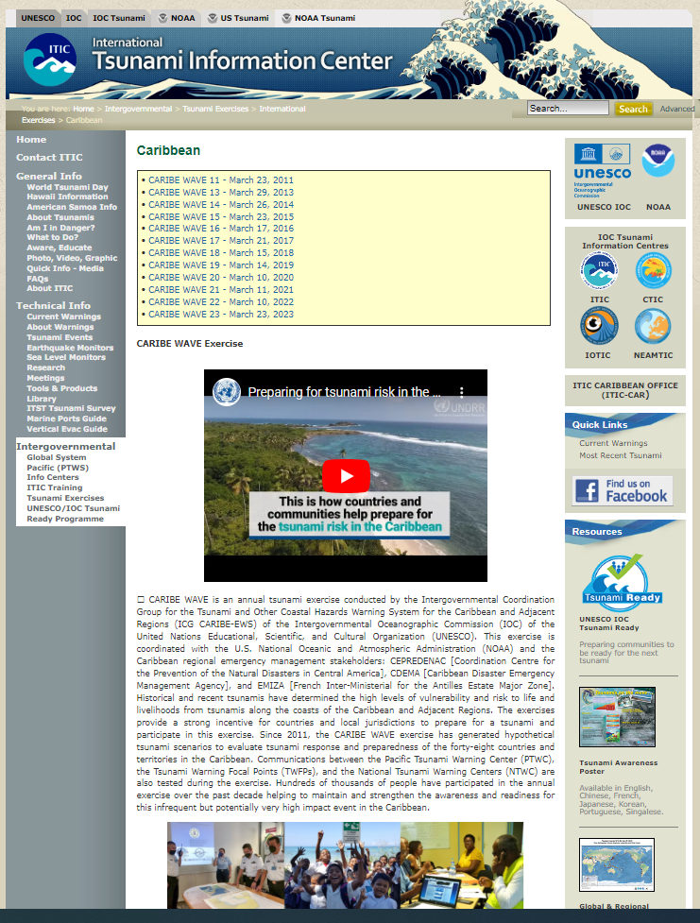
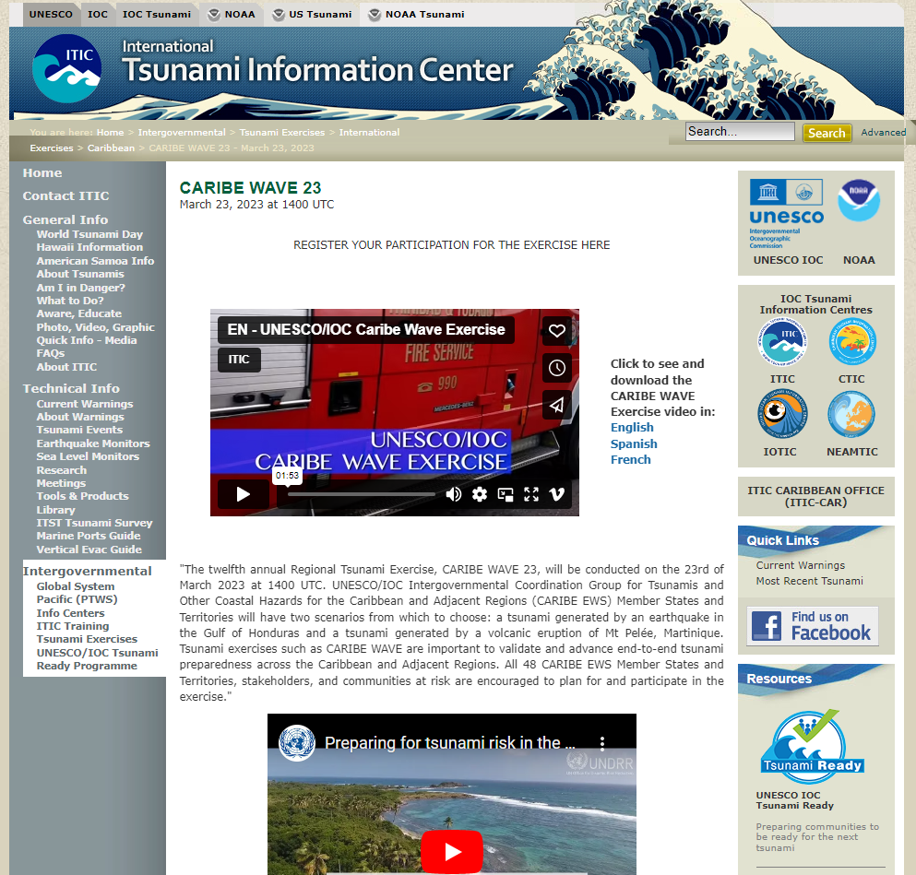
NEW CARIBE WAVE WEBSITE
Website
http://itic.ioc-unesco.org/index.php?option=com_content&view=category&layout=blog&id=2020&Itemid=2335

Slide 9
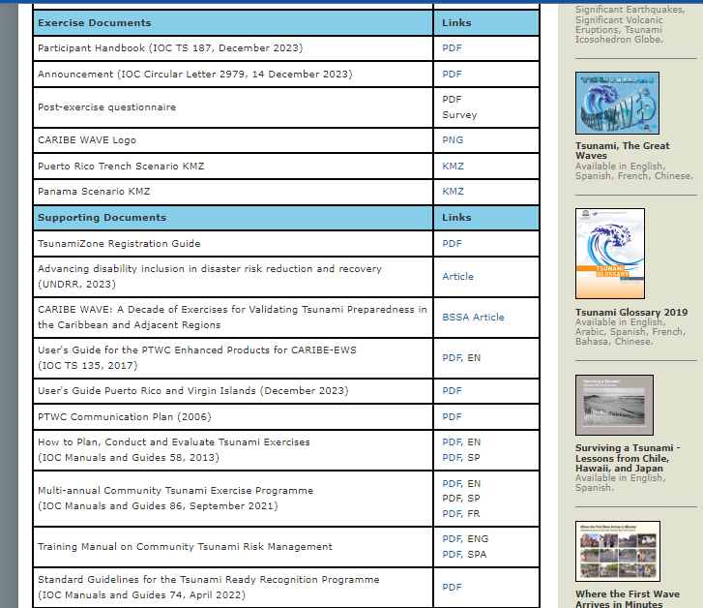
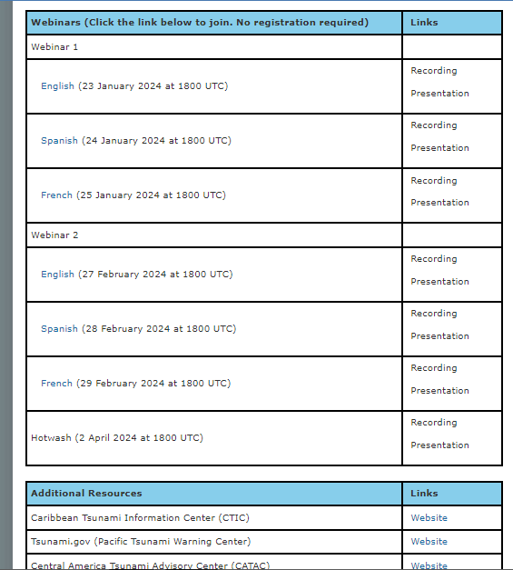
NEW CARIBE WAVE WEBSITE

Slide 10
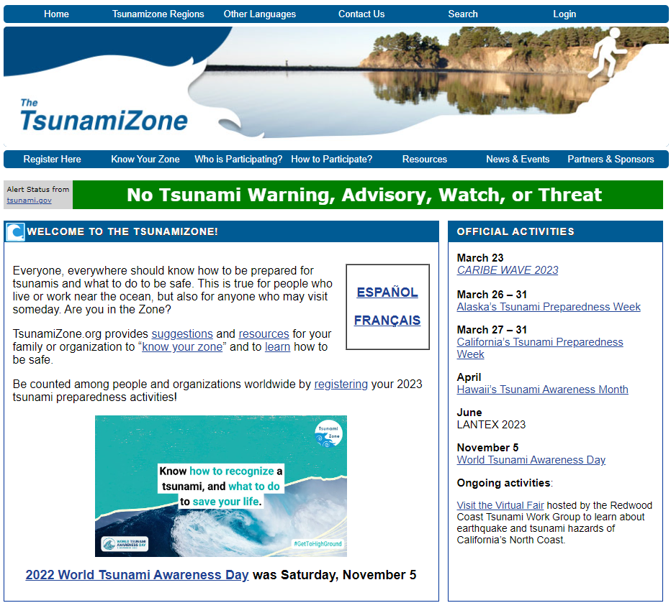
Member State Participation
The TsunamiZone Registration
TsunamiZone registration is used to track the number of people and organizations participating in the exercise.
TWFP and NTWC should register on TsunamiZone to be part of the statistical count. Independent of registering, they will receive the simulated bulletins from PTWC.

Slide 11
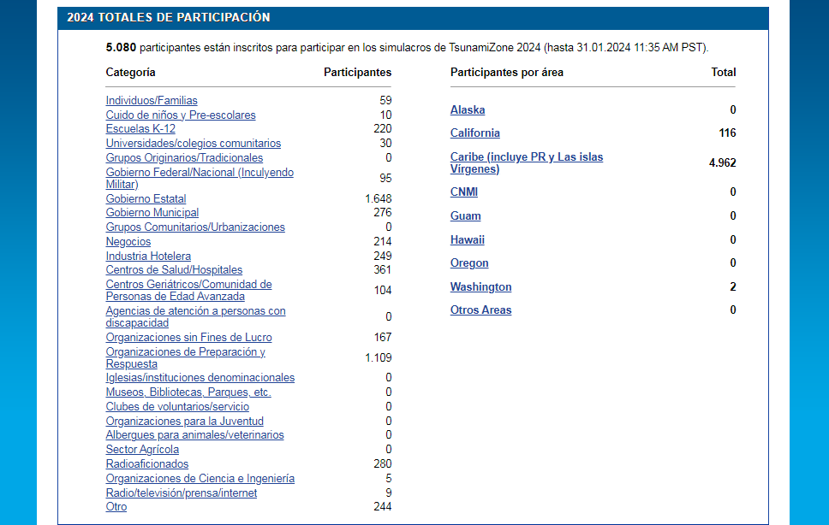

Slide 12
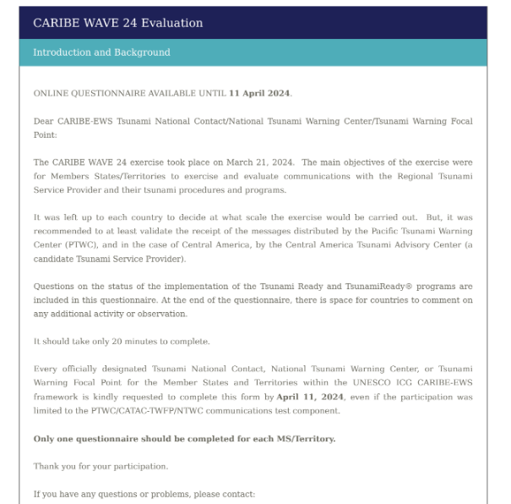
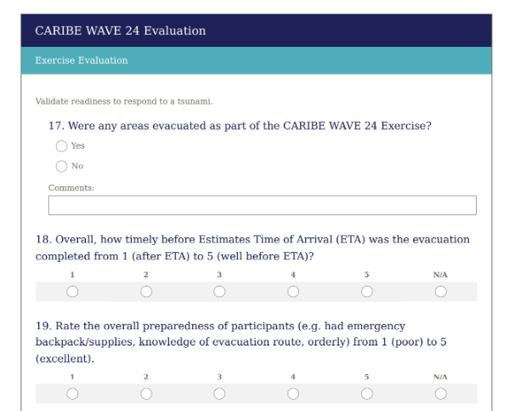
Caribe Wave 24 exercise evaluation survey update

Slide 13
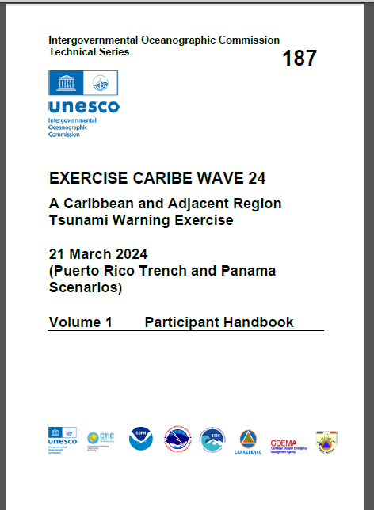
Need to make this document available in Spanish and French

Slide 14
Caribe Wave Exercise Update
Thanks for your attention
antoniodesastres@gmail.com gisela.baez1@upr.edu christa.vonh@noaa.gov
#CARIBEWAVE #TSUNAMIREADY

