Slide 1
Tsunami Service Provider Report
Pacific Tsunami Warning Center
Charles McCreery, Director
NOAA Pacific Tsunami Warning Center
charles.mccreery@noaa.gov

Slide 2
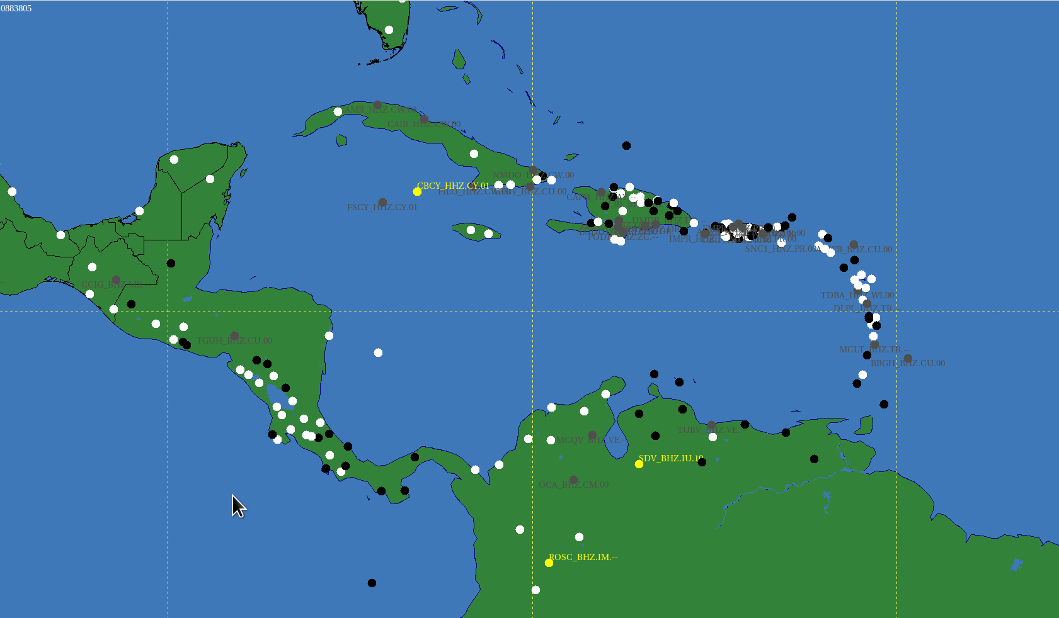
Sensing Network: Seismic – 02/01/24
Snapshot on 4/20/23
White Dots are Active

Slide 3
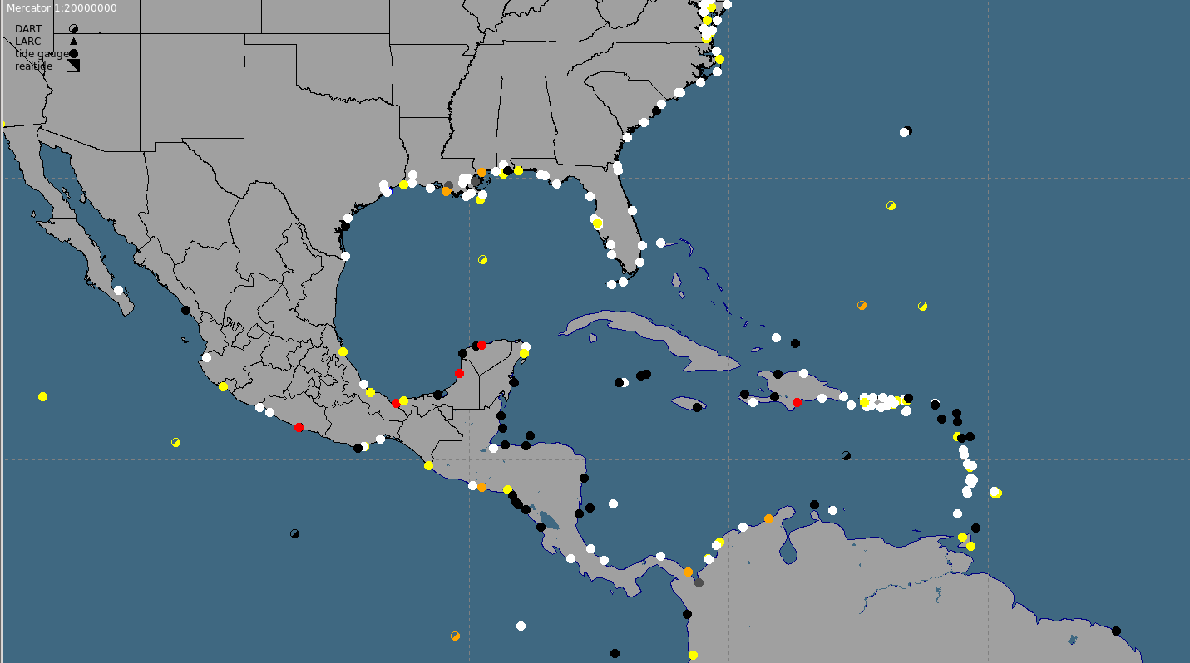
Sensing Network: Sea Level – 02/01/24
Half-Shaded Dots are DARTs
Snapshot on 02/01/24
White/Yellow/Orange Dots are Active

Slide 4
2 Message Events: 04/20/2023 – 02/01/2024
PTWC EARTHQUAKE PARAMETERS |  |  |  | PTWC PRODUCTS
Origin Time (UTC) | Location | Mw | Depth (km) | Type | # | Elapsed Time
05/25/2023 03:05 | PANAMA-COLOMBIA_BORDER_REGION | 6.5 | 13 | INFO | 1 | 00:05:06
07/10/2023 18:32 | NORTH_OF_THE_LEEWARD_ISLANDS | 6.6 | 14 | INFO | 2 | 00:06:24

Slide 5
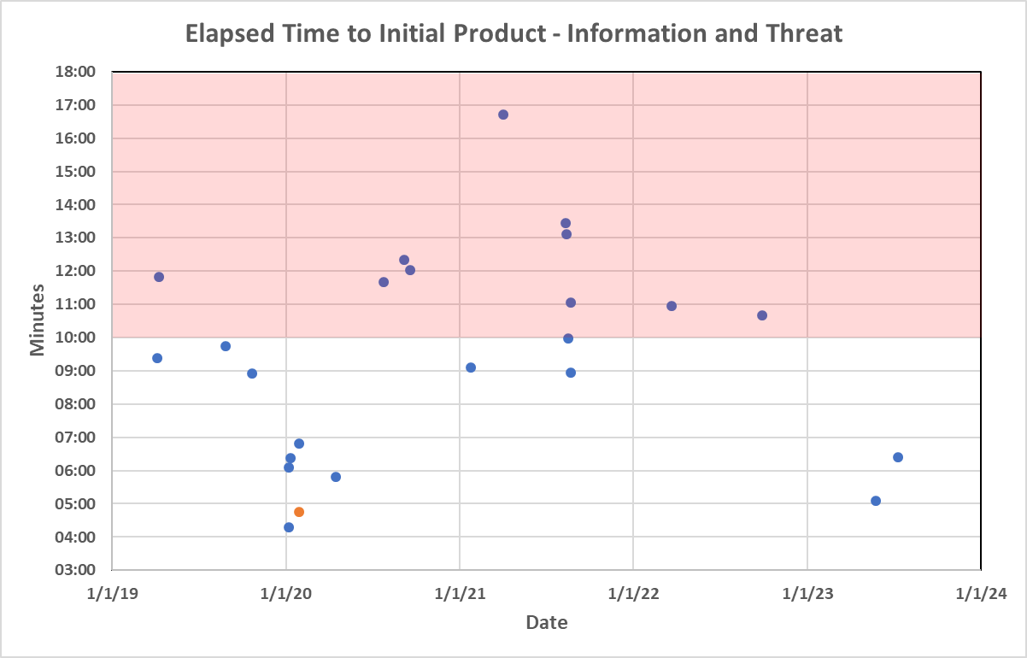
Elapsed Time to Initial Product - Since 2019
Blue dots are Information Statements Orange dots are Threat Messages

Slide 6
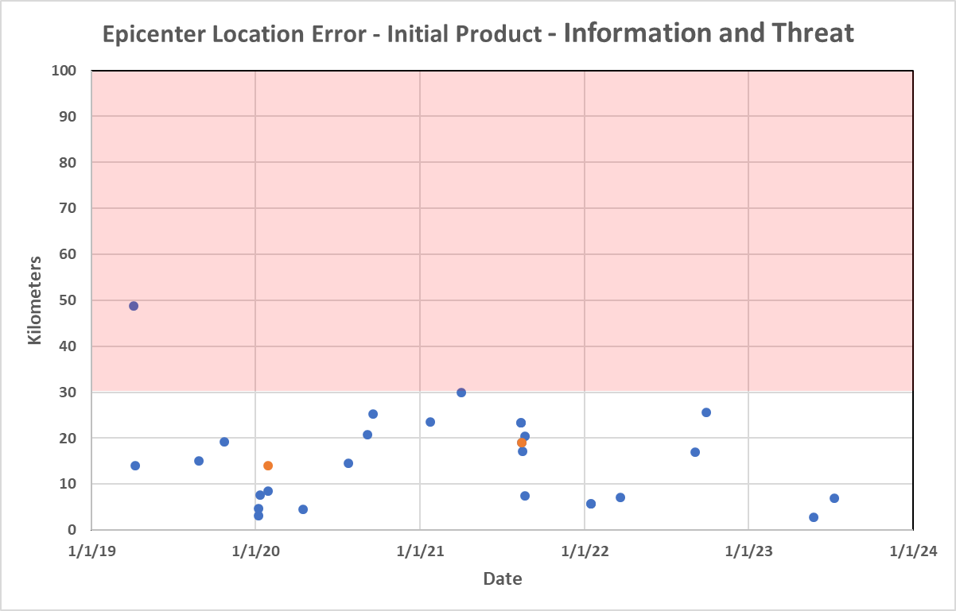
Epicenter Location Performance - Since 2019
Blue dots are Information Statements Orange dots are Threat Messages

Slide 7
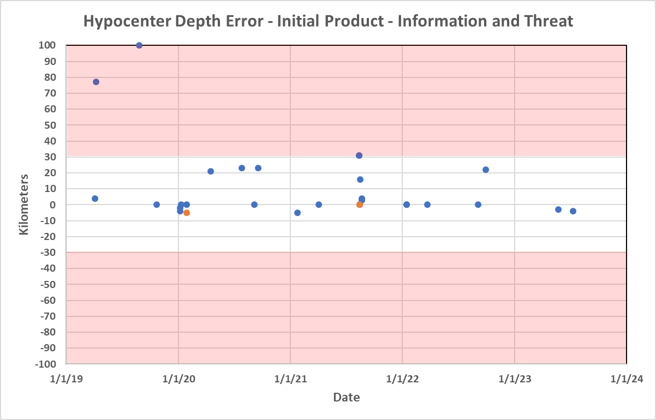
Depth Performance - Since 2019
Blue dots are Information Statements Orange dots are Threat Messages

Slide 8
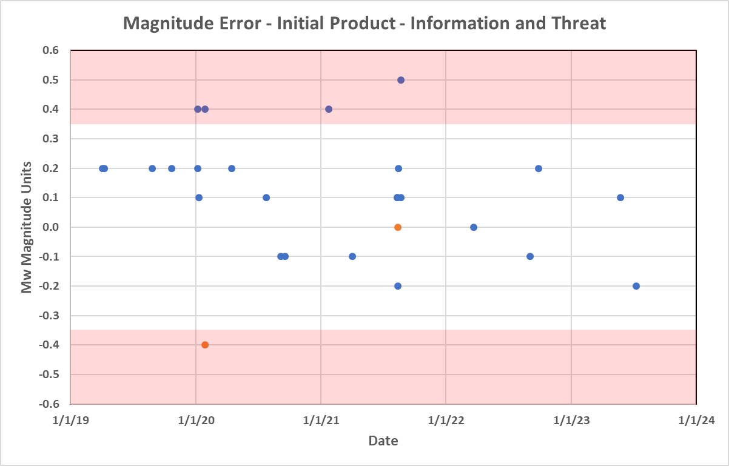
Magnitude Performance - Since 2019
Blue dots are Information Statements Orange dots are Threat Messages

Slide 9
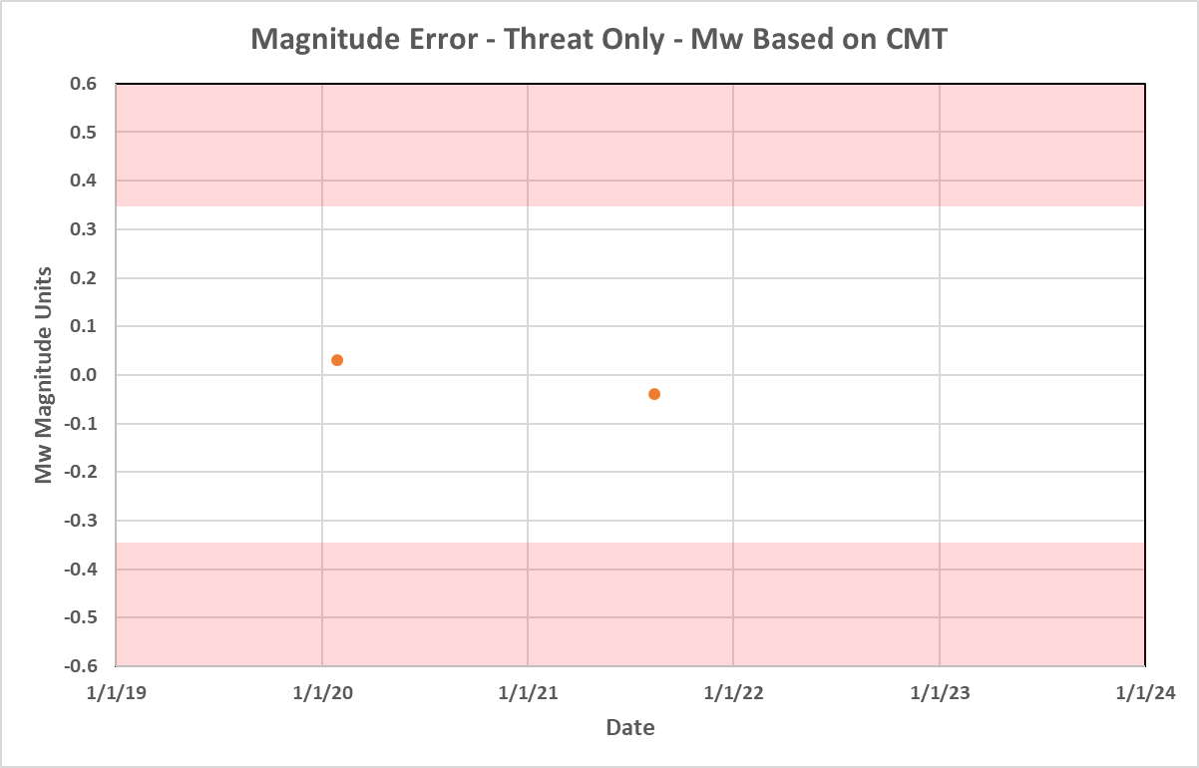
Forecast Magnitude Performance - Since 2019
Orange dots are Threat Messages

Slide 10
Tsunamis Generated by Volcanoes (TGVs)
Different Mechanisms for Tsunami-genesis by Volcanoes
(from the TOWS-WG Task Team Report on TGVs lead by Francois Schindele)

Slide 11
Tsunamis Generated by Volcanoes (TGVs)
Potentially Tsunamigenic Volcanoes
(from the TOWS-WG Task Team Report on TGVs lead by Francois Schindele)

Slide 12
Update of Users’ Guide to PTWC Products
Include description and example products with previously proposed product changes
Alphabetize country/territory names listed with a threat
Organize ETAs by country/territory
Organize observations by country/territory
Indicate type of marigram measurement made (crest-to-trough, mid-to-crest, mid-to-trough)
Define pre-forecast potential threat areas by time-to-impact versus distance to the epicenter (e.g., first arrival within one hour, two hours, or three hours)
Incorporate information from the 2006 Communication Plan and retire that Plan.
Prepare and distribute the updated Users’ Guide for review, comments, and approval prior to next ICG-CARIBE-EWS Meeting

Slide 13
Communication Tests
Routine unscheduled communication tests from PTWC with verification of message receipt from TWFPs and/or NTWCs help ensure that the system will work to save lives when an event occurs.
PTWC intends to resume unscheduled communication tests on a regular basis.
PTWC has been working with the Secretariat on a better method to conduct these tests, likely with a simple electronic form for responding and/or using electronic logs that can verify message receipt by various methods.
Goals of the new process are:
Minimize and simplify any work for TWFPs and/or NTWCs to respond
Enable an automated compilation of results that can be published regularly to Member States for action if necessary – not just reported at annual ICG meetings

Slide 14
Phasing Out Telefaxing of PTWC Products
PTWC is seeking ICG approval to phase out telefaxes as a method of product distribution. This was recently agreed to by the PTWS ICG for its four TSPs.

Slide 15
Thank You
Charles McCreery, Chair
NOAA Pacific Tsunami Warning Center
charles.mccreery@noaa.gov

