Slide 1
UN OCEAN DECADE TSUNAMI PROGRAMME
Meeting of the Officers of the Intergovernmental Coordination Group for the Tsunami
and Other Coastal Hazards Warning System for the Caribbean and Adjacent Regions
(ICG/CARIBE EWS)
1-2 Feb 2024
Mike Angove
Member; UNODTP Scientific Committee

Slide 2
TOPICS
Update: UNODTP Activities
Discussion: Implications for CARIBE EWS Implementation
Overview: Instrumentation Strategy
Video

Slide 3
UNODTP Update
Scientific Committee Meeting Highlights (23-24 Jan 2024)
Decade Collaborative Centers/Decade Coordination Offices
Provide targeted Decade support at the Thematic OR Regional Level
DCC-CR; DCC-PRED; DCC-IOR; DCO-CAR; DCO-PICT
TEN CHALLENGES (Tsunami is in #6—Increase Community Resilience to Ocean Hazards)
Vision 2030: Draft White Paper; Supported by DCC-CR/IOR
Engagement.
2nd UN Ocean Decade Conf Side event—Barcelona 10-12 April
2nd UNESCO IOC Global Tsunami Symposium—Banda Aceh, 11-14 Nov

Slide 4
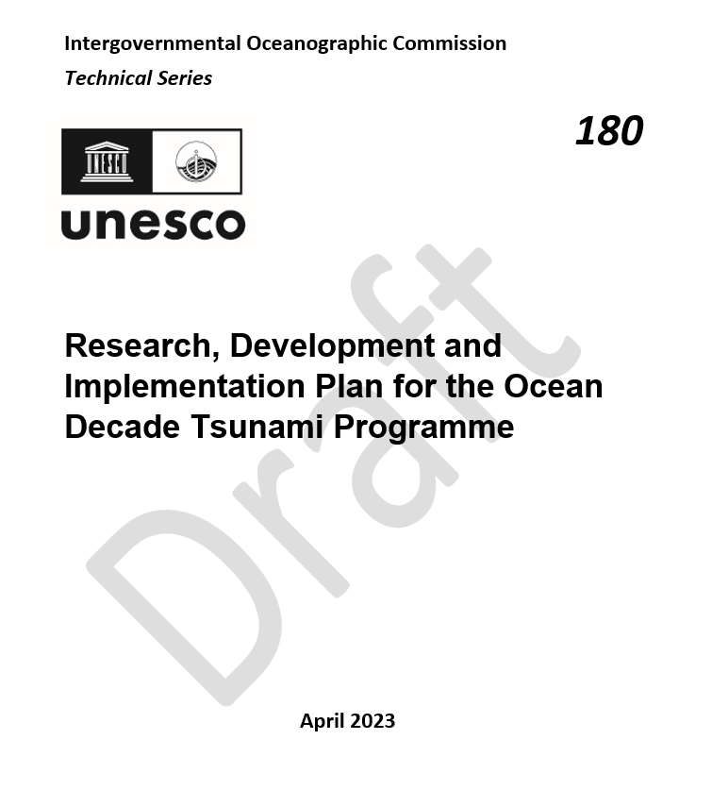
UNTODP Implementation Concept
Goal 1: Highest risk tsunami sources identified and catalogued
Goal 2: Tsunami Detection within 10mins of origin
Goal 3: 100% of the national authorities will be able to effectively warn population at risk.
Goal 4: 100% of communities at risk from tsunamis resilient to tsunamis by 2030
UNODTP:
Set Goals
DCC CR
DCC IOR
DCO CAR
Other S&T/R&D
WG1 Risk Knowledge
WG2 Detection and Forecasting
WG3 Dissemination and Communication
WG4 Prearedness nd Response
Member States: Provide contributions
Contribution 1
Contribution 2
Contribution 3
Contribution 4
New!
DISCUSSION: How will DCC/DCO support be coordinated w/in CARIBE EWS?

Slide 5
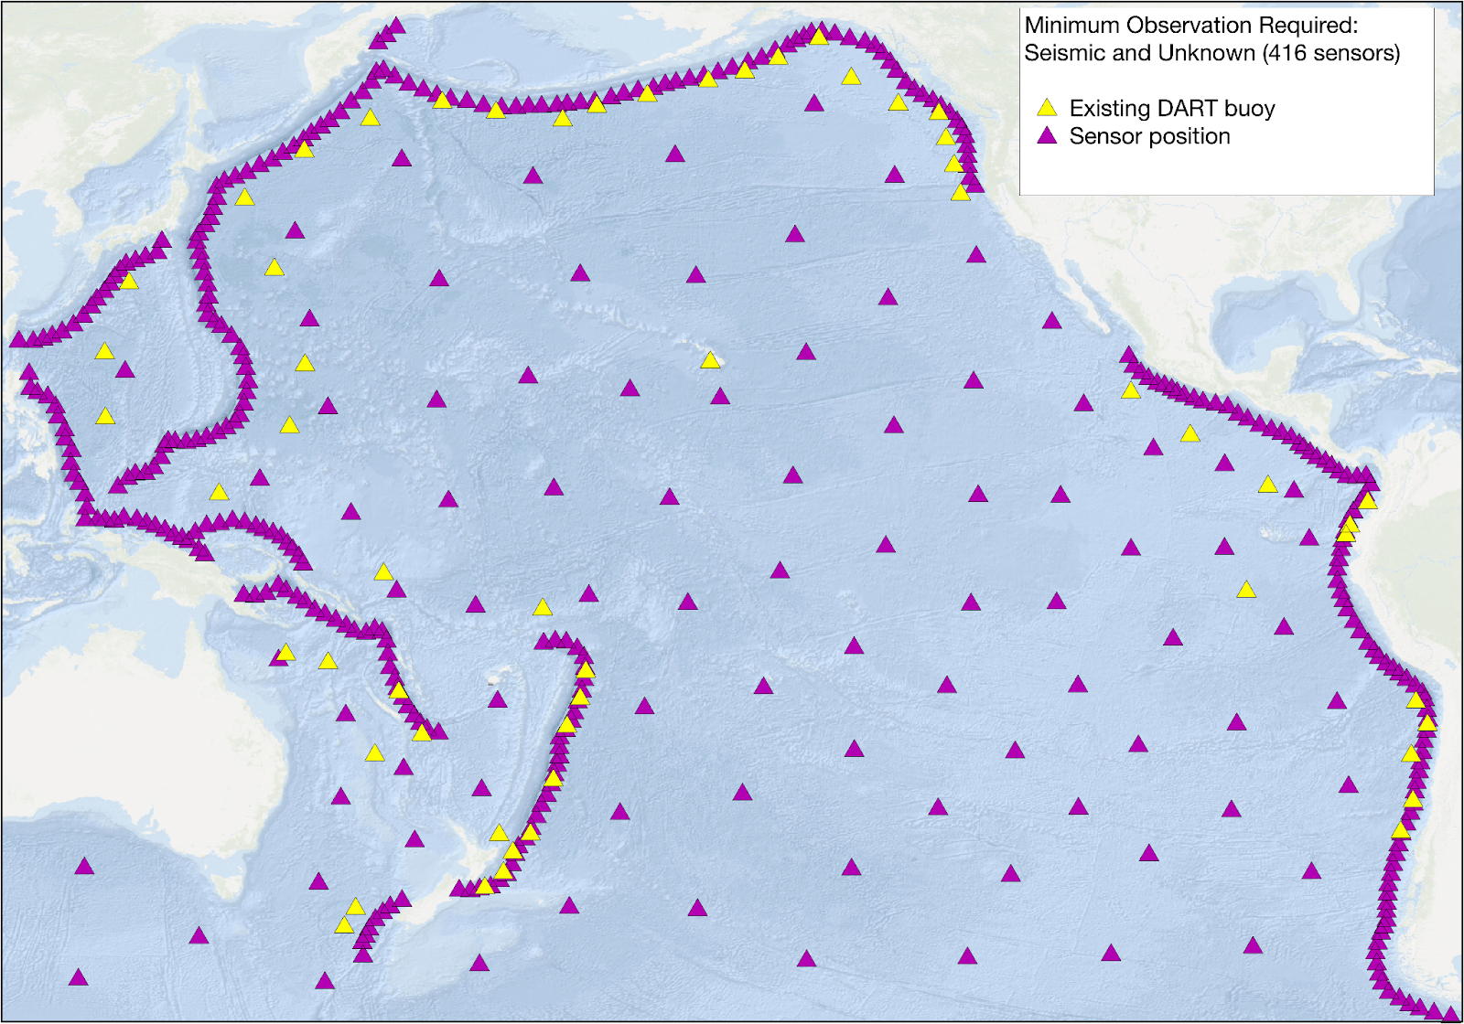
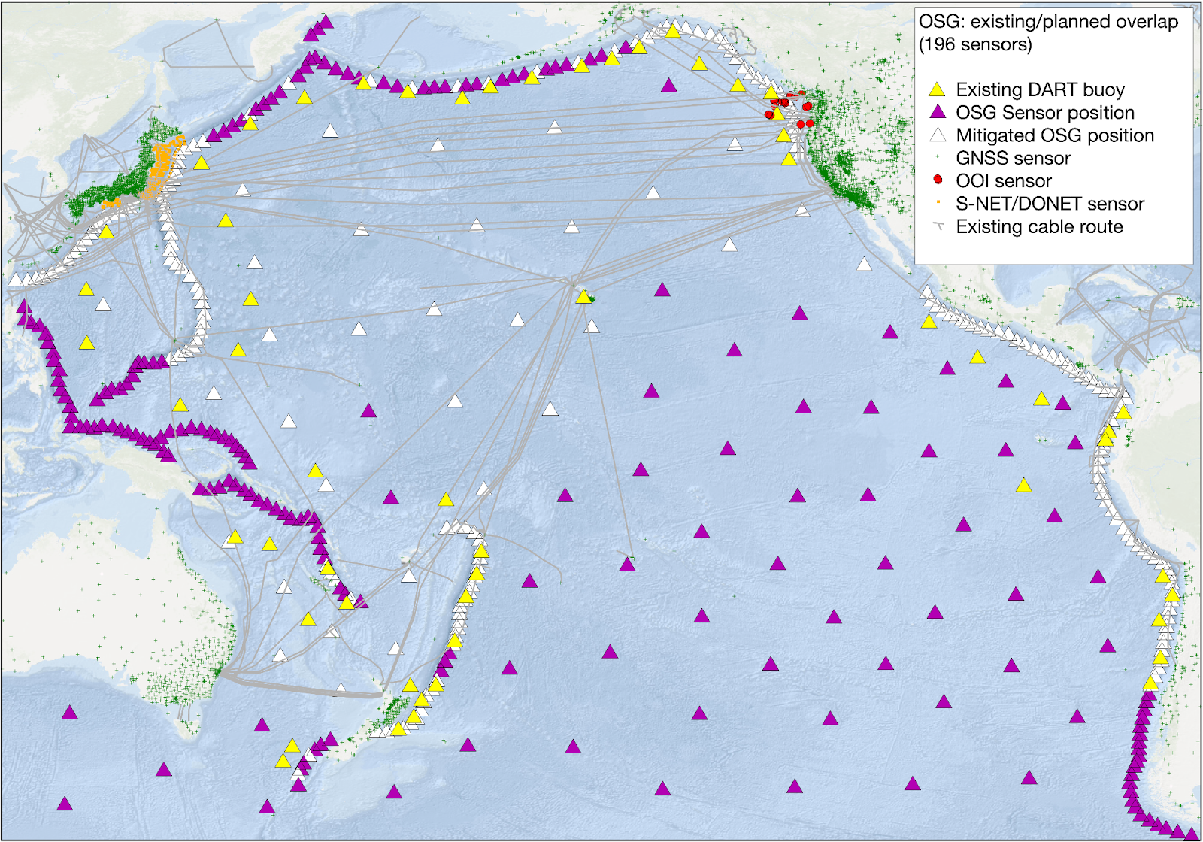
UNODTP Instrumentation Strategy
Needed OBS to reach UNODTP Goals
Optimized, Collaborative Grid

Slide 6
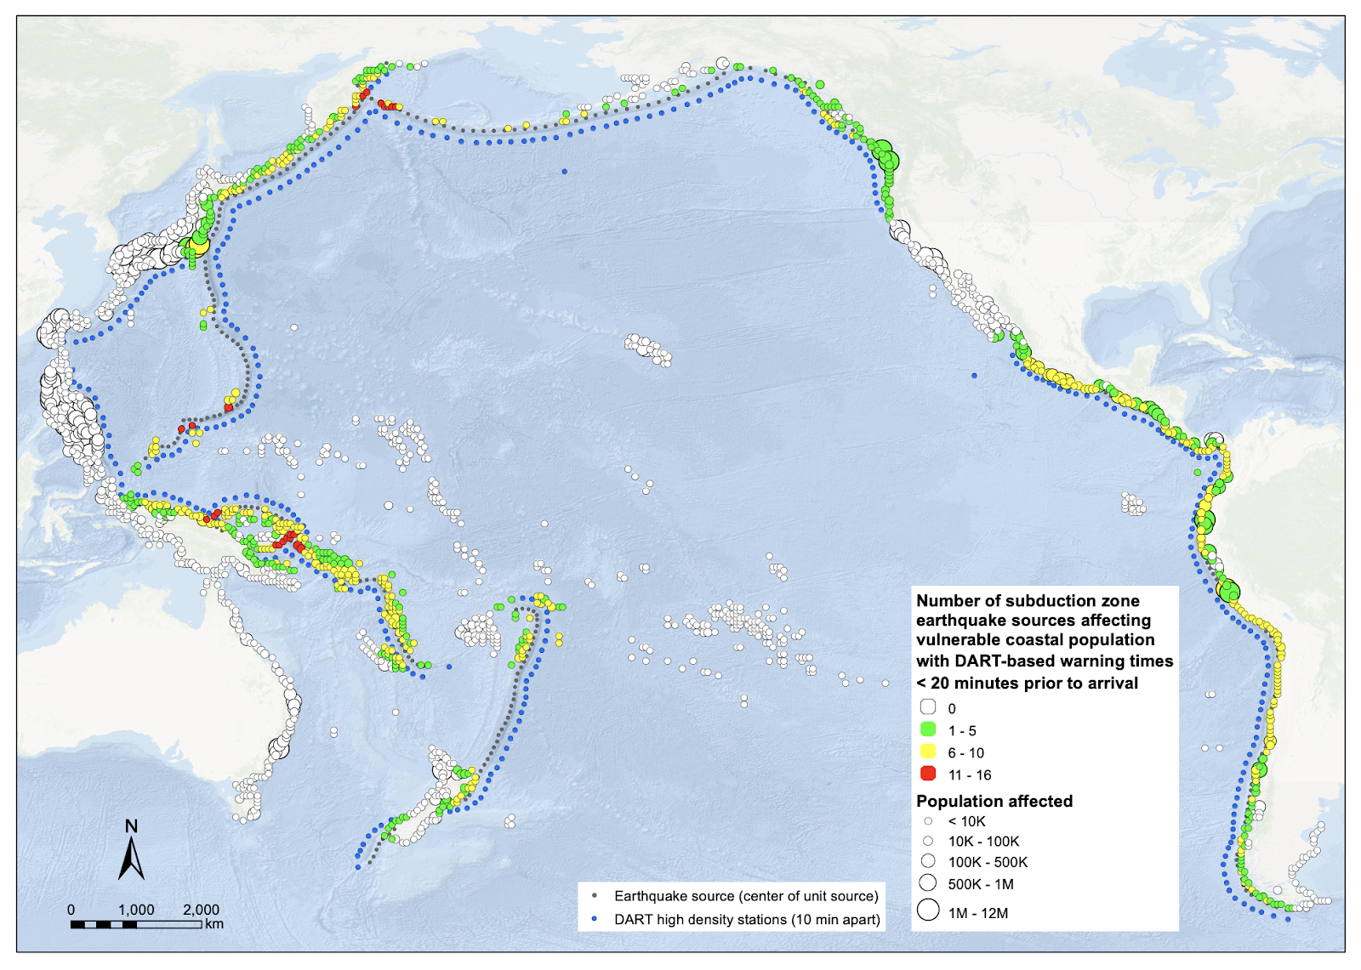
Exposure drives prioritization?

Slide 7
UNODTP Video
The Ocean Decade Tsunami Programme presentation video (English) (youtube.com)

