Slide 1

UNESCO/IOC
The Intergovernmental Coordination Group for the Tsunami and Other Coastal Hazards Warning System for the Caribbean and Adjacent Regions (ICG/CARIBE-EWS)
Mid Term Officers Meeting
4.3 WG3: Tsunami Warning Dissemination and Communication
Christa von Hillebrandt and Susan Hodge
February 1-2, 2024
#TSUNAMIREADY

Slide 2
Terms of Reference
Purpose: To examine current and developing capacities and advise the ICG about the definition and composition of early warnings and tsunami products and the methods and best practices for effective end-to-end dissemination and communication.
Tasks:
- Explore and document the dissemination capabilities and existing alert guidance in the countries of the region.
- Identify the difficulties and challenges existing in the region that hinder the impact of “end to end” dissemination and communication of early warnings.
- Establish strategies for the development and implementation of methods and technologies to strengthen the interaction with the media and dissemination of early warnings within the countries of the region.
- Evaluate communication tests and tsunami exercises, in order to identify weaknesses and make recommendations to help strengthen these delivery systems
- Create communication protocol and standardized information identifying the minimum acceptable levels for communication and dissemination of tsunami early warning in all countries for approval by the ICG.
- Provide feedback to the Tsunami Service Providers on its products and communication procedures.
- Serve as a reviewing and approving body for proposed changes to TSP products for the CARIBE-EWS, or determine if proposed changes warrant going to the ICG for review and approval.
- Present a progress report based on the Key Performance Indicators related to the UN ODTP.
- Promote the sharing of experience and expertise, and capacity building essential to effective tsunami warning dissemination and communication.
#TSUNAMIREADY

Slide 3
WG 3 Membership
SUSAN HODGE | ANGUILLA | DDM
RACQUEL DAVIS | BARBADOS | BMS
SIMON BOXALL | CAYMAN ISLANDS | HM
CARLOS BURITICÁ | COLOMBIA | GMD
ANTHONY MURILLO-GUTIERREZ | COSTA RICA | NU
KRISTEL ESPINOZA HERNÁNDEZ | COSTA RICA | NU
EVA MERCERON | FRANCE | MF
JOSÉ ANTONIO TOJIL JIMÉNEZ | GUATEMALA | INSIVUMEH
PABLO DANIEL MARTÍNEZ ZECEÑA | GUATEMALA | INSIVUMEH
JUNIOR AIMABLE | ST. LUCIA | NEMO
KAZA HIPPOLYTE | ST. LUCIA | STLFS
MABIUS FRANCIS | ST. LUCIA | STLFS
ASIM FRETT | U.S. VIRGIN ISLANDS | USVI
CHARLES MCCREERY | USA | PTWC
CHRISTA G. VON HILLEBRANDT-ANDRADE | USA | ITIC-CAR
MARIA TORRES | USA - PR | PRSN
WILFRIED STRAUCH | NICARAGUA | CATAC
MIGUEL FLORES | NICARAGUA | CATAC
Ex Officio – Dr. Ocal Necmioglu, Alison Brome
Invited Expert
UNDRR Representative Jair Torres TBC

Slide 4
Activities
  Received and Reviewed Membership – December 2023
  Meeting of Chair and Vice Chair – December 7, 2023
  Inventory of Tsunami Warning Dissemination and Communication
  First WG 3 Meeting – January 11
      Presentation of Draft of Inventory
      CARIBE WAVE 24 - review of activities related to dissemination and reception
      Updates from TSPs PTWC and CATAC

Slide 5
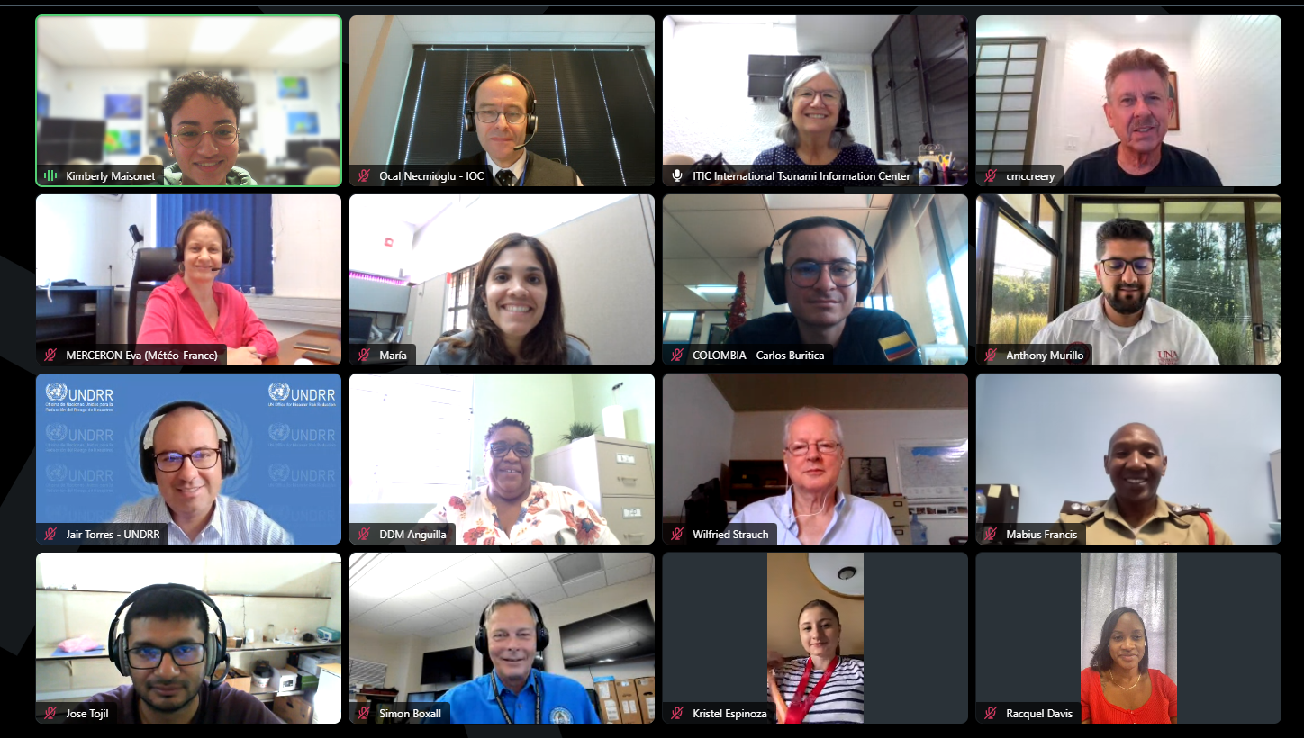
Participants in January 11 Meeting

Slide 6
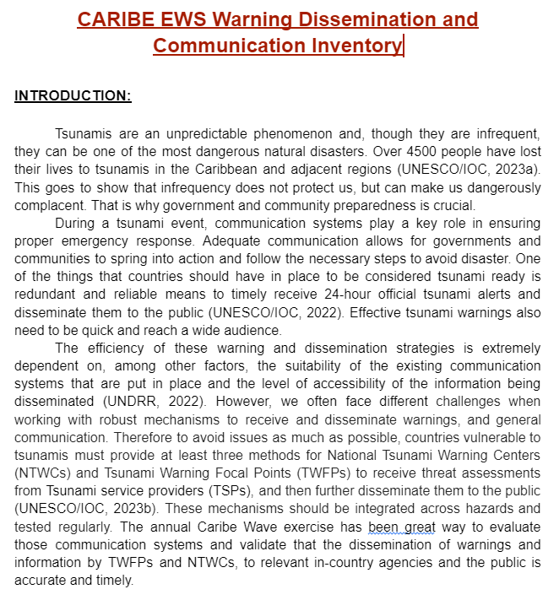
Working Group 3 with support of ITIC-CAR
Inventory different systems available for the dissemination and communication of tsunami warnings and other related products.
Overview of the systems and mechanisms used at different level and agencies from TSP’s through national authorities down to the private sector, media and communities and local governments.
Challenges of redundant and robust methods.
Systems for people with disabilities.
#TSUNAMIREADY

Slide 7
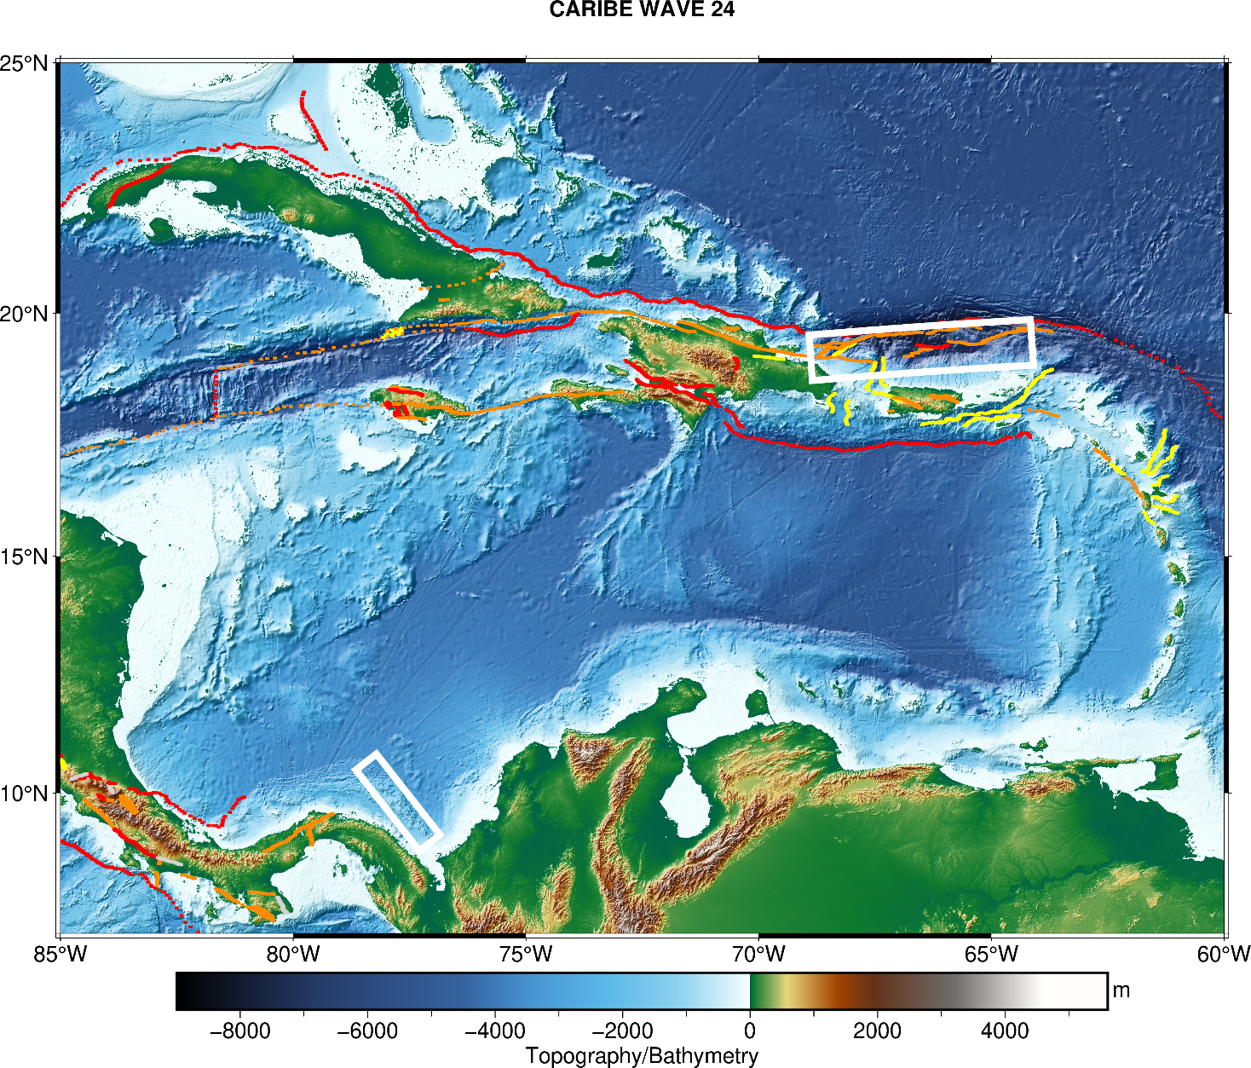
CARIBE WAVE 24
Earthquake and Tsunami Scenarios
#TSUNAMIREADY
Puerto Rico Trench
Panama
Scenario | Origin Time | Mw | Epicenter
Puerto Rico Trench | 15:00:00 UTC 21 March 2024 | 8.7 | 19.25ºN, 66.5ºW
Panama |  | 8.47 | 9.80ºN, 77.75ºW

Slide 8
Post-Exercise Evaluation Form
Each CARIBE-EWS member state and territory is requested to provide feedback on the exercise.
  This feedback will assist the ICG/CARIBE-EWS in the evaluation of CARIBE WAVE 24, the development of subsequent exercises, and help response agencies document lessons learned.
  To facilitate feedback, the online evaluation survey can be accessed at the following link: https://www.surveymonkey.com/r/CaribeWave24.
  The deadline for completing the evaluation is 11 April 2024.
    This questionnaire includes feedback on PTWC, CATAC, Risk Knowledge and SOPs, Tsunami Ready.
    It contains 38 questions, 12 pages, and should take no more than 20 minutes.
#TSUNAMIREADY

Slide 9
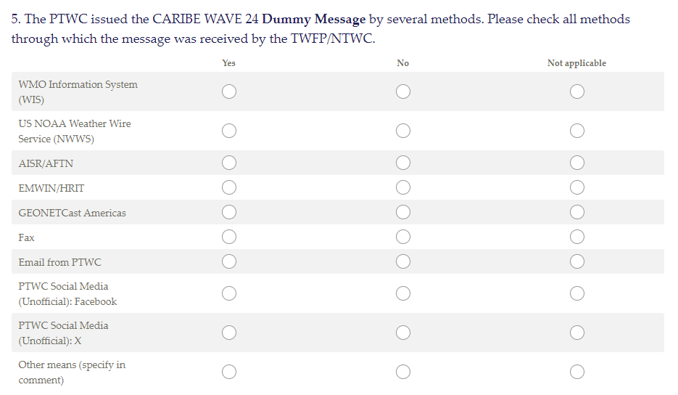
Post Evaluation Survey – Due April 11 https://www.surveymonkey.com/r/CaribeWave24
#TSUNAMIREADY

Slide 10
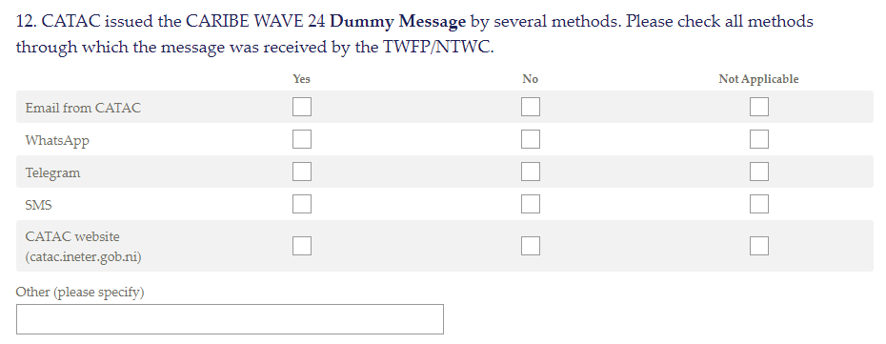
Post Evaluation Survey
#TSUNAMIREADY

Slide 11
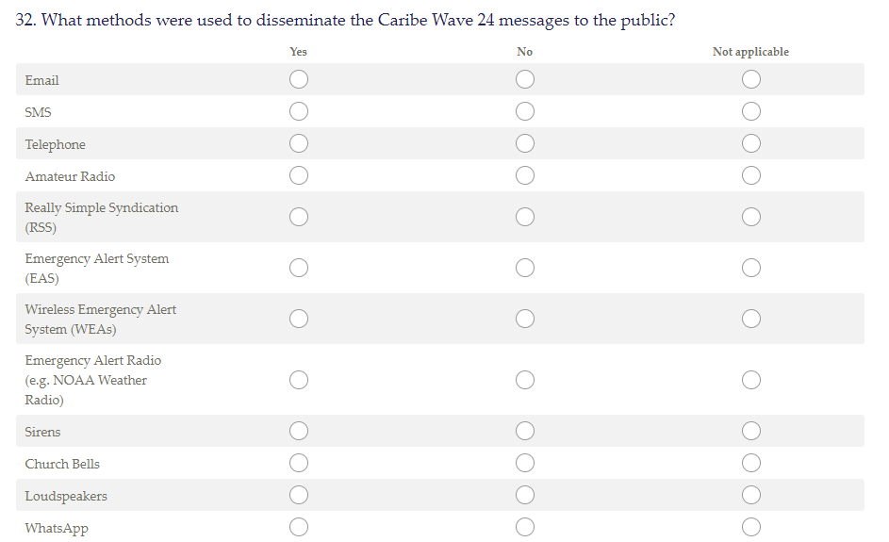
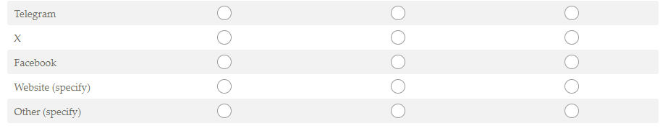
Post Evaluation Survey

Slide 12
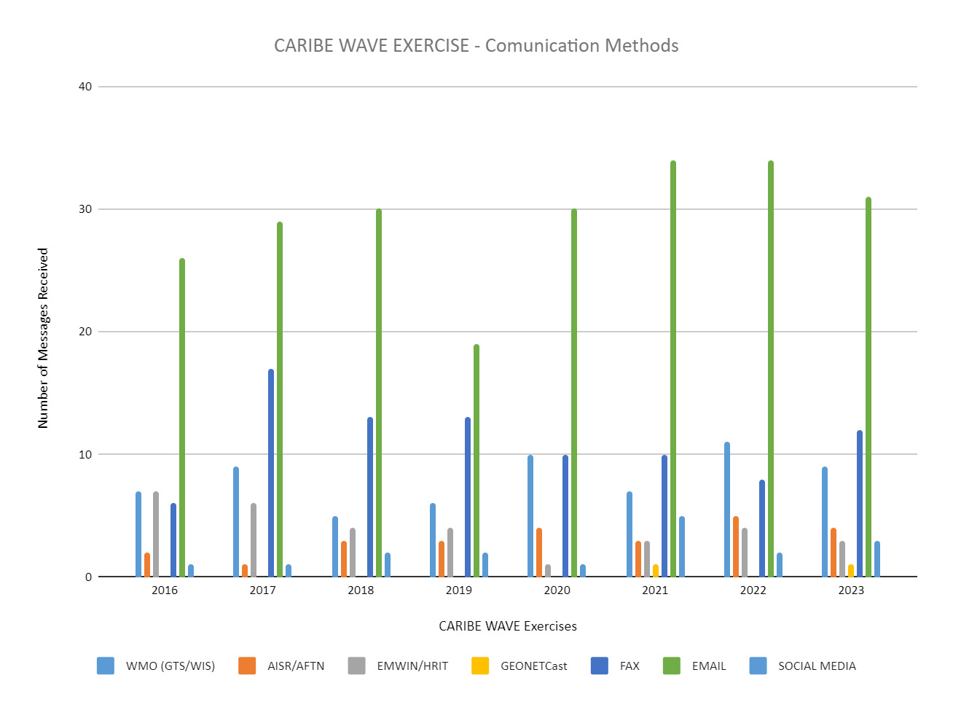
Caribe Wave
#TSUNAMIREADY

Slide 13

CARIBE-EWS Training
Tsunami Products
Video link: https://vimeo.com/showcase/8956022
Password: training
Tsunami warning dissemination systems
?
#TSUNAMIREADY

Slide 14
Report of TSPs PTWC and CATAC
CATAC:
  Creating awareness of services with the Central America warning authorities,
  Relies on Email, Web, Messaging and Social Media
  No capacity to generate GTS messages
PTWC
  consolidating into one Users Guide the 2006 CARIBE EWS Communication Plan and the PTWC Enhanced Products User's Guide (IOC TS 135, October 2017)
  hoping to resume unannounced communication tests
  Evaluating Slack as a Potential resource for communication with TWFP/NTWC during events
  Tsunami.gov being updated
#TSUNAMIREADY

Slide 15
Present a progress report based on the Key Performance Indicators related to the UN ODTP.
Review of KPI of CARIBE EWS - Based on Status Implementation Plan
  Establishment of additional regional tsunami warning centres to support MS, and integrated with the Caribbean Tsunami Warning Center. – Needs to be updated, PTWC (TSP) and CATAC (Experimental TSP)
  Develop regional training for the new products, including the development of standard operating procedures securing that at least 2 national officers of each Member States get trained – ITIC (PTWS/CARIBE EWS in 2024 in Chile), National Trainings as part of Tsunami Ready, last regional training in 2017
  Collect information on conventional and alternative means and communication platforms for receiving and disseminating tsunami warning messages in institutions and communities- Ongoing, supported by ITIC-CAR
  Produce a resource guide on communication and technologies for use by communities in the dissemination of tsunami information alerts, in support of the guideline requirements- Ongoing, supported by ITIC-CAR

Slide 16
Present progress report based on the Key Performance Indicators related to UN ODTP (cont).
  To promote and supervise the implementation of actions as a basis for communications in case of emergency, the criteria established in the tsunami awareness and education strategy for the Caribbean and the adjacent regions. Need Clarification, Post CARIBE WAVE questionnaires
  Establish a research and development team of web technologies 3.0 applied to early warning systems, emergencies and disasters – Need clarification, update?
  Organize a training workshop on vulnerability assessment tools applicable to tsunamis. – Does not fit with WG 3
  Promote the incorporation of amateur radio organizations in the region, to local and regional systems of early warning system and disaster response, as a strategic resource. CARIBE WAVE
Review of Ocean Decade Tsunami Programme Research & Development Implementation Plan
  Due in 2024: Review of Tsunami Watch Operation Global Service Document (IOC Technical Series 130) TBD

Slide 17
Next Meeting: April, 2024
Thank you
#TSUNAMIREADY

