Slide 1
WG2: Tsunami Detection, Analysis and Forecasting
E.A. Vanacore

Slide 2
Tasks of the Group: General
Support the operations of a fully interoperable regional tsunami warning system.
Support and integrate the work of the subgroups.
Present a progress report based on the Key Performance Indicators related to the UN ODTP.
Establish strategies to enhance the warning system by including the detection, analysis and forecasting of other coastal hazards.
Promote the sharing of experience and expertise, and capacity building essential to effective tsunami source characterization, detection and forecasting.

Slide 3
2.1 Tsunami Source Detection, Identification and Characterization
Ensure the effectiveness of the observational system by promoting the open exchange of seismic and other relevant data in real time.
Advise member states on the monitoring and detection capabilities of tsunamigenic sources needed for operating national tsunami warning centre.
Assure the compliance with the agreed standards for the detection systems.

Slide 4
Tsunami Wave Detection
Ensure the effectiveness of the observational system by promoting the open exchange of sea level data in real time.
Advise member states on the tsunami monitoring and detection capabilities needed for operating national tsunami warning centres.
Assure the compliance with the agreed standards for the tsunami detection systems.

Slide 5
Tsunami Forecasting
Define the operational requirements for the monitoring and forecasting systems.
Provide guidance on tsunami forecasting tools to TSPs, NTWCs and provide actionable information to emergency managers.
Explore, experiment and test novel approaches for tsunami forecasting.

Slide 6
Current Representation of WG Member
USA (Mainland-7, PR-4, and USVI-1)
Colombia (3)
Costa Rica (3)
Cuba (3)
St. Lucia (3)
France (2)
Guatemala (2)
UK (1)
Venezuela (1)

Slide 7
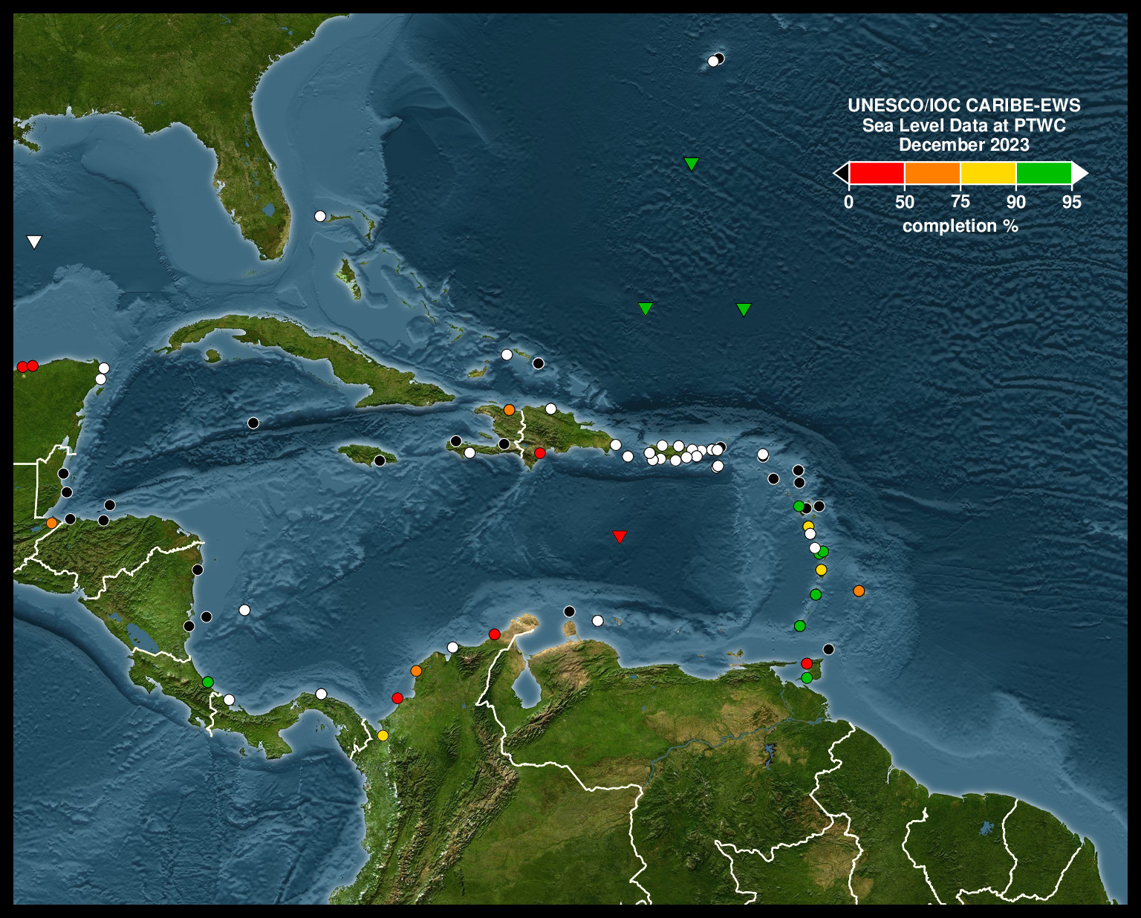
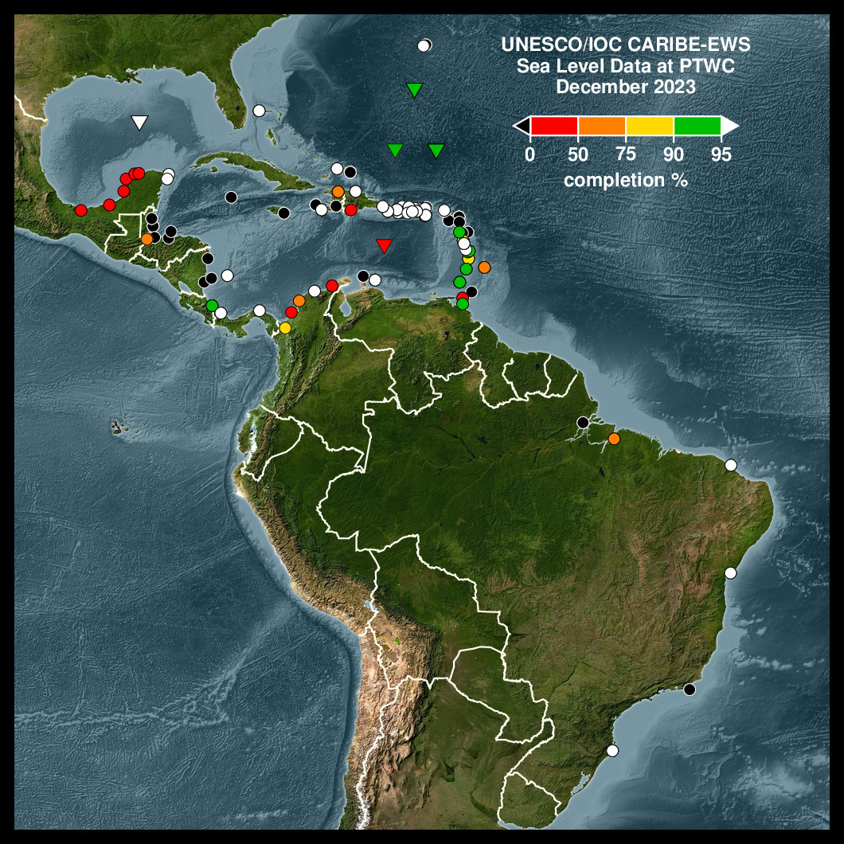
Sea Level Station Issue: Critical

Slide 8
Reccomendations from Last ICG
Recommends a study to quantify the impact of outages on tsunami detection parameters and messaging performance (Seismic and Sea Level)
Recommends exploring the possibility of densifying seismic network instrumentation with new sea-floor cable technologies (SMART )
Recommends a survey of sea-level network operator status updates by WG1 and ITIC-CAR with the goal of improving the uptime of sea-level network,
Recommends that seismic and sea-level network operators seriously consider the experience from Hurricanes Harvey, Irma, Maria and Nate to increase the resilience of sea level facilities to powerful hurricanes;
Recommends adding and upgrading the GNSS stations needed to achieve earthquake detection requirements with sufficient redundancy;
Recommends WG2 work with Secretariat to organize an Experts Meetings on “NonSeismic Sources of Tsunamis for the Caribbean and Adjacent Regions”

Slide 9
Reccomendations from Last ICG Cont..
Recommends WG2 compile and prioritize a list of non-seismic sources; encourages models of scenarios to be available, when possible

Slide 10
IOCARIBE GOOS -TAC-OOFS Initial Working Group Meeting Jan 27, 2024
Opprotunity for tsunami community directly interface with ocean observing data centers
Based on the Jan 27 meeting currently looking for volunteers
Possible avenue to standardize data and metadata formats for sea level data.

Slide 11
Next steps
Currently organizing meetings.
Priority will be the highlighted tasks from the last ICG.

