Slide 1
Intergovernmental Coordination Group for the Tsunami Early Warning and Mitigation System in the North-eastern Atlantic, the Mediterranean and connected seas
4th Scientific Meeting Ocean Decade Tsunami Program
Paris 25,26 January 2024

Slide 2
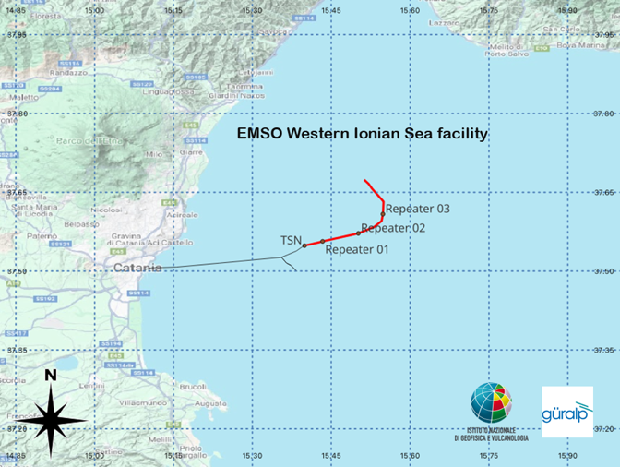
SMART CABLES INITIATIVES MEDITERRANEAN InSEA project
Güralp Systems Ltd has successfully designed, manufactured and deployed a 21 km ‘SMART’ cable 30 km off the coast of Catania in Sicily, Italy.
This area has been prone to past events including the major earthquake and tsunami in 1693 that caused ~60,000 casualties in Catania (Tonini et al., 2011).
The SMART cable (Science Monitoring and Reliable Telecommunications), is an innovative system developed by Güralp in partnership with Istituto Nazionale di Geofisica e Vulcanologia (INGV), for the Italian InSEA SMART cable Wet Demonstrator project which will measure seismic risk off the coast of Sicily.
The InSEA project, funded by the Italian Ministry of Research and managed by the Istituto Nazionale di Geofisica e Vulcanologia (INGV).
Courtesy of G. Marinaro, INGV

Slide 3
SMART CABLES INITIATIVES

Slide 4
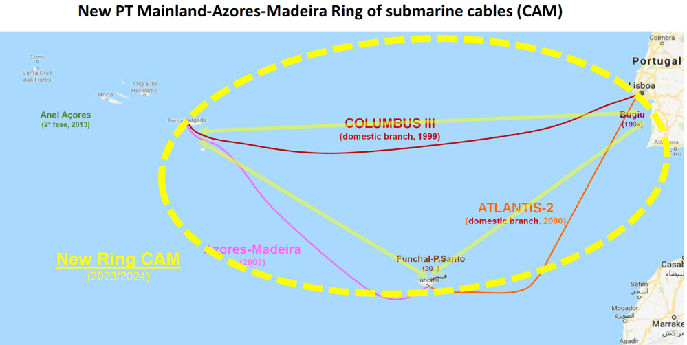
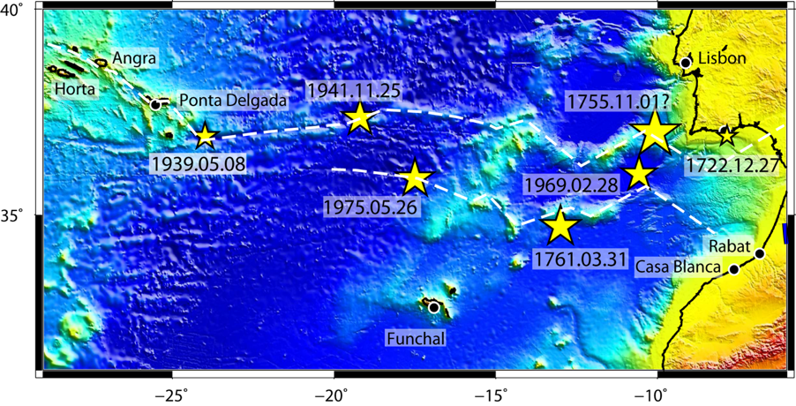
SMART CABLES INITIATIVES NORTH EASTERN ATLANTIC
The North-Eastern Atlantic was home of two ocean-wide tsunamis in 1755 and 1761
In the 20th century three earthquakes of magnitude greater than 7 occurred between Iberia and Azores (1941, 1969 and 1975)

Slide 5
SMART CABLES INITIATIVES NORTH EASTERN ATLANTIC
Timeline of SMART Atlantic CAM
December 2022. IP launches the SMART Atlantic CAM RfT.
Next steps:
13. Mid of 2023. Signature of contract.
14. 2nd half of 2025. SMART Atlantic CAM will be operational.
15. End of 2025. Old CAM Ring will be disconnected (> 25 years lifetime).

Slide 6
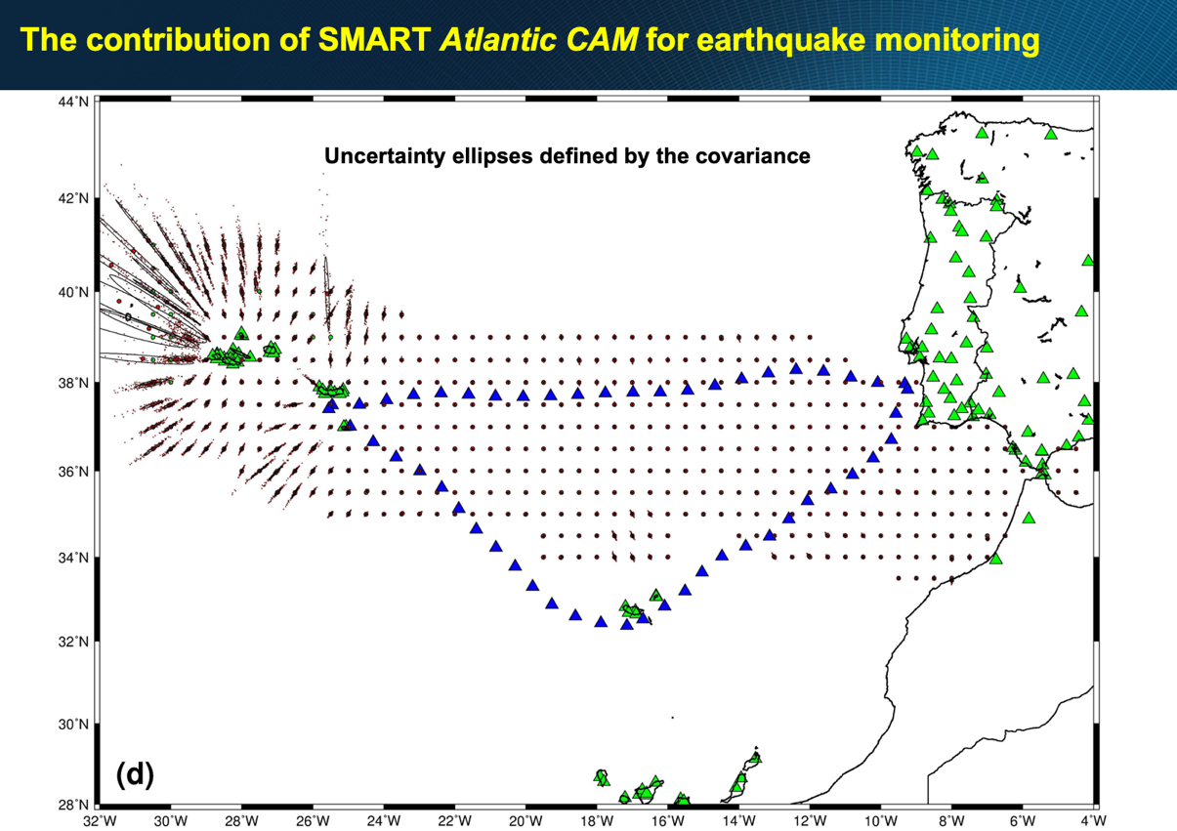

Slide 7
SMART CABLES INITIATIVES NORTH EASTERN ATLANTIC

Slide 8
GTM GLOBAL TSUNAMI MODEL INITIATIVE

Slide 9
GTM GLOBAL TSUNAMI MODEL INITIATIVE
Collective and non-exclusive initiative for improved understanding of tsunami hazard and risk
✓Highlight tsunami relevance at stakeholders and decision-makers level
✓Improvement of analysis methodologies and tools

Slide 10
GTM GLOBAL TSUNAMI MODEL INITIATIVE
Leadership:
Prof Joern Behrens
Dr Finn Løvholt

Slide 11
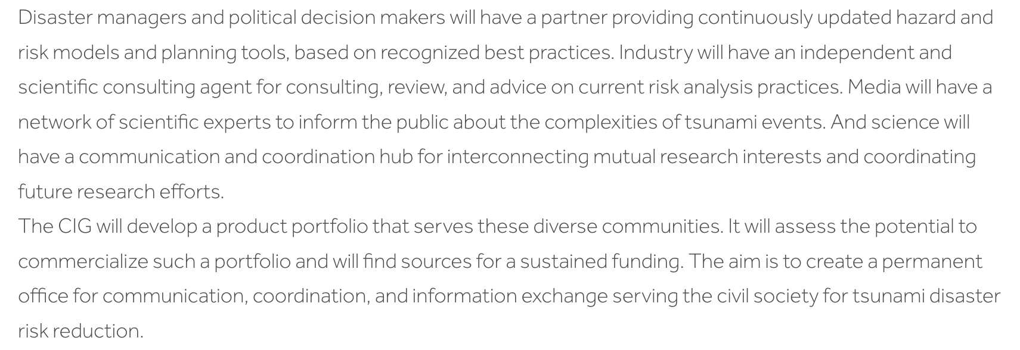
GTM GLOBAL TSUNAMI MODEL INITIATIVE
General assembly will take place in Lisbon 18-20 March

Slide 12
THANK YOU !
This work was funded by the Portuguese Fundação para a Ciência e a Tecnologia (FCT) I.P./MCTES through national funds (PIDDAC) – UIDB/50019/2020 (https://doi.org/10.54499/UIDB/50019/2020), UIDP/50019/2020 (https://doi.org/10.54499/UIDP/50019/2020) and LA/P/0068/2020 (https://doi.org/10.54499/LA/P/0068/2020).

