Slide 1
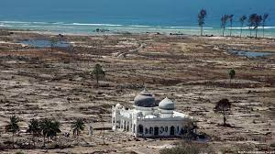
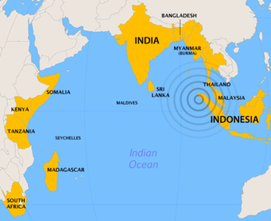
2nd UNESCO IOC Global Tsunami Symposium “The Two Decades Post 2004 Indian Ocean Tsunami: A Reflection and Way Forward”
Monday 11th - Thursday 14th November 2024
in BANDA ACEH, INDONESIA

Slide 2
PRE-EVENT Venue: USK Banda Aceh | 2nd UNESCO IOC Global Tsunami Symposium Venue: Banda Aceh Convention Hall |  |  |  | POST-EVENT Venue: BMKG Jakarta
International Workshop (9 -10 Nov 2024) | Day 1 (11 Nov 2024) | Day ( 12 Nov 2024) | Day 3 (13 Nov 2024) | Day 4 (14 Nov 2024) | ICG IOTWMS XIV Session
Hosted by IABI in collaboration with TDRMC, IGI Location: USK | Opening Ceremony | Session 3 | All Day Excursion | Session 7
 |  | Session 4 |  | Session 8
 | Lunch Break (12:00 – 14:00) | Lunch Break (12:00 – 14:00)
 | Session 1 | Session 5 |  | Closing Ceremony
 | Session 2 | Session 6
Side Events: Exhibitions, Posters, Ignite Stages and “Rumah Resilience Indonesia” located at Banda Aceh Convention Hall | Side Events: Exhibitions, Rumah Resilience Indonesia, Posters, and Ignite Stages

Slide 3
2nd UNESCO IOC Global Tsunami Symposium “The Two Decades Post 2004 Indian Ocean Tsunami: A Reflection and Way Forward”

Slide 4
Aims and Scope
Aims:
To commemorate 2 decades after 2004 Tsunami
To reflect what has been achieved in two decades
To decide way forward in compliance with global challenges and global commitments
Scopes:
Session 1-6 open to public + Session 7-8 for formulation of way forward action.
Invited speaker for the sessions will be nominated/selected by POC from global and local prominent academia, engineers, practician, politician and public figures.
Participants (500-800) of the first 2 days are open to public, who can express or give intervention during discussion in Session 1 to 6)
Participants (100) for Session 7 + 8 are by invitation
Each session will be chaired by 1 Chair Session supported by 1 Rapporteur + 1 Timekeeper
Chair Session and Rapporteur will be nominated by POC
Exhibitions, Poster Sessions, Ignites Stage, Rumah Resileince and local elementary school drawing competition will be organized by BMKG, Government of Banda Aceh, IABI, USK, IGI
Video Competition will be organized by IOTIC
Book of Commemoration as output of Global Symposium writer will be from all speaker – editor HPR, DA and RH
Extensive Promotion should start soon

Slide 5
Host
Government of Indonesia – BMKG (Host)
UNESCO IOC - Tsunami Resilient Section (Co-host)
IUGG (International Union of Geodesy and Geophysics) – Joint Tsunami Commission (Co-host)

Slide 6
Steering Committee
To guide the Programme Organizing Committee on the substance of symposium: the themes, topics, programme, expertise and speakers, etc.
Government of Indonesia:
Head of BMKG: Prof Dwikorita Karnawati
Head of BNPB: Letjen Suharyanto
Representative of Ministry of Foreign Affairs: (TBD)
UNESCO Jakarta Office:
Director and Representative: Ms. Maki Katsuno-Hayashikawa
UNESCO IOC:
Tsunami Resilient Section: Mr. Bernardo Aliaga
IUGG-JTC:
Chair of Join Tsunami Cooperation: Prof. Tanioka
Notes:
We are also currently discussing other potential members for the steering committee

Slide 7
Programme Organizing Committee
To coordinate and organize the 2nd Global Tsunami Symposium on the detailed planning of the program and agenda
Chair : Dr Harkunti Rahayu (UNESCO IOC-TOWS WG-TTDMP)
Co Chair 1: Dr. Yuji Nishimae (UNESCO IOC-TOWS WG-TTWO)
Co-Chair 2: Ms. Suci Dewi Anugrah (BMKG)
Members:
Dr. Srinivasa Kumar Tummala (Chairperson of the Scientific Committee for the UN Ocean Decade Tsunami Programme - SC-ODTP)
Mr. Hanif Andi (Deputy of Geophysics of BMKG)
Mr. Rick Bailey (Secretariat of ICG/IOTWMS)
Dr. Laura Kong (International Tsunami Information Centre)
Denis Chang-Seng (Northeast Atlantic and the Mediterranean Seas TIC)
Allison Broom (Caribbean Tsunami Information Centre)
Ardito M Kodijat (Indian Ocean Tsunami Information Centre)
Nora Gale (Secretariat of ICG/IOTWMS)
(tbd)

Slide 8
National Committee Indonesia
In collaboration with Programme Organizing Committee, to coordinate, support, and manage the technical arrangement and organization of the symposium nationally and in Banda Aceh.
Advisor: Deputy of Geophysics
Head of Technical Committee : Director of Earthquake and Tsunami
Members:
Mitigation Division and other Division of Center for Earthquake and Tsunami BMKG
Intl Cooperation BMKG
Public Affairs Division BMKG
Communication and Networks Division BMKG
Aceh Geophysical Station BMKG
Regional Centre Medan BMKG
BNPB (NDMO)
Indonesian Ministry of Foreign Affairs
BPBA Province Nangroe Aceh Darussalam (LDMO)
BPBA Kota Banda Aceh (LDMO)

Slide 9
Agenda of 2nd Global Tsunami Symposium (11-14 November 2024)
 | Day 1 (11 Nov 2024) | Day (12 Nov 2024) | Day 3 (13 Nov 2024) | Day 4 (14 Nov 2024)
Morning (09:00–12:00) | Opening Ceremony | Session 3 | All Day Excursion | Session 7
 |  | Session 4 |  | Session 8
Lunch Break (12:00 – 14:00)
Afternoon (14:00–17:00) | Session 1 | Session 5 |  | Closing Ceremony
 | Session 2 | Session 6
 | Side Events: Exhibitions, Posters, Ignite Stages and “Rumah Resilience Indonesia”

Slide 10
Day 1: Monday 11 Nov. 2024 Opening Ceremony
Day 1 Morning: Opening Ceremony’
Indonesian Anthem
Prayer
Moment of Silent (Video) + eyewitness
Opening Performance (Saman Dance)
Remarks
Welcoming Remarks
Governor of Nangroe Aceh Darussalam Province
Head of BMKG.
ADG/ES of UNESCO-IOC (If not attending, Director of UNESCO Office Jakarta).
The UN Resident Coordinator for Indonesia (TBC)
Special Representative of the Secretary-General for Disaster Risk Reduction (TBC)
Opening Remark
Coordinating Minister for Maritime and Investment (TBC)
Keynote Speech by the Newly Elected President (TBC)
Group Photo

Slide 11
Day 1: Monday 11 Nov. 2024 Plenary Session
Day 2 Afternoon:
Plenary Session I: Review of the Tsunami Warning Systems in the past 2 decades (90 min - invited speakers)
The gaps and challenges in detection, warning and dissemination
The gaps and challenges in tsunami risk, awareness, and preparedness
Plenary Session 2: Non-Seismic Tsunami (to response to UN Ocean Decade Tsunami Programme) (90 min - invited speakers)
Emerging challenges on Non-Seismic Sources
Non-Seismic Tsunami Monitoring and Detection System: A State of the Art

Slide 12
Day 2: Tuesday 12 Nov. 2024 Plenary Session
Day 2 Morning:
Plenary Session 3: State of the Art and Strategic Plan of Standard Operating Procedure for Tsunami early Warning System (90 min - invited speakers)
Seismic Generated Tsunami (Local vs Distant)
Non-Seismic Generated Tsunami(Local vs Distant)
Plenary Session 4: Tsunami Disaster Governance, Policy, and Justice (90 min - invited speakers)
Learning from Mega Tsunamis : 2004 Indian Ocean Tsunami and 2011 Tohoku Tsunami
Contribution of TEWS to global initiatives: UN Ocean Decade, SDGs, SFDRR, COP27, UNDRR-EWS4ALL

Slide 13
Day 2: Tuesday 12 Nov. 2024 Plenary Session
Day 2 Afternoon:
Session 5: Achieving 100% Communities at Risk to be Prepared for and Resilient to tsunami by 2030 (90 min - invited speakers)
Progress of UNESCO IOC Tsunami Ready recognition programme
Accrediting national programme initiatives for tsunami preparedness
Tsunami Ready Coalition
Linkage with other Global Frameworks and initiatives, (SDG, SFDRR, EWA for ALL, Resilient City, etc.)
Session 6: Other Critical Issues (90 min - invited speakers)
Social and Human perspective in Tsunami Science and Tsunami Early Warning System
Critical infrastructure ready to tsunami: design and implementation
Mainstreaming DRR into Urban Planning
MHEWS
Cascading and compound hazards, systemic risk
Banda Aceh Declaration (in one powerful sentence)

Slide 14
Day 3: Wednesday 13 Nov. 2024 Excursion
Day 3 : All Day Excursion
Museum Tsunami Aceh
Tsunami Ready Village: Inauguration Tsunami Ready and Tsunami Drill
…

Slide 15
Day 4: Thursday 12 Nov. 2024 Plenary Session
Day 4 Morning:
Session 7: UN Ocean Decade Tsunami Programme Research, Development & Implementation Plan (2021-2030) (90 min - invited speakers)
…
Session 8: Wrap up /Synthesis/Way Forward
Clear link to an outcome document, drawing upon achievements, gaps, challenges from each session, including pre-event. → Coordinate with Pre event and 8 session chairs?
Declare: Wrap up /Synthesis and Way Forward

Slide 16
Day 4: Thursday 12 November 2024 Closing Ceremony
Day 4 Afternoon: Closing Ceremony
Indigenous Story-Teller – Pak Ngah
Hand-over price to the Indian Ocean Youth Tsunami Conversation and Campaign (IOYTCC) Winners (4 Indian Ocean competition regions)
Winner announcement for best poster presentation
Closing Remark:
Representative of the Local Government
Representative of UNESCO IOC
Representative of the Government (Officially Closed the event)

Slide 17
Potential Invited Speakers
USA:
Prof. Hiroo Kanamori (California Institute of Technology)
Prof Emile Okal (Northwestern University)
Prof. Costas Synolakis (University of South Carolina)
Prof. Hermann Fritz (Georgia Institute of Technology)
Prof. Thorne Lay (University of California Santa Cruz)
Dr. Stuart Weinstein (NOAA)
Dr. Elena Suleimani (University of Alaska Fairbanks)
Dr. Bryan Atwater (USGS)
Prof. Louise Comfort (Univ of Berkley)
AUSTRALIA:
Prof. Charita Pattiarachi (University of Southwest Australia)
Dr. Gareth Davies (Geoscience Australia)
JAPAN
Prof. Shunichi Koshimura (Tohoku University)
Prof. Fumihiko Imamura (Tohoku University)
Prof. Yuichiro Tanioka (Hokkaido University)
Prof. Kenji Satake (University of Tokyo)
Prof. Yoshihiro Okumura (Kansai University)
Prof. Yushiro Fujii (Univ of Tokyo)
Prof. Megumi Sugimoto (Kyushu University)
SINGAPORE
Prof. Philip Liu (University of Singapore)
RUSIA:
Dr. Vasily Titov (NOAA Center for Tsunami Research)
Prof. Efim Pelinovsky (Russian Academy of Sciences)
UK:
Mohammed Heiderzadeh (Univ of Bath)
Prof. Dilanthi Tumaratungga (Univ of Huddersfield)
Prof. Richard Haigh (Univ of Huddersfield)
ITALY:
Dr. Laura Graziani (Institute of Geophysics and Volcanology)
Dr. Maurizio RIPEPE (Univ of Florence)
SPANYOL:
Prof. Elisa Buforn (Universidad Complutense Madrid)
PNG:
Prof. Hugh Davies (University of Papua New Guinea)
INDONESIA:
Prof. Dwikorita Karnawati (BMKG)
Dr. Dimas Salomo Sianipar (BMKG)
Suci Dewi Anugrah (BMKG)
Dr. Harkunti P. Rahayu (ITB)
Prof Syamsul Maarief (former Head of BNPB)
Prof Yan Sophaheluwakan (UI)

Slide 18
Side-Event: Booth and Poster Exhibition and Stages

Slide 19
Side-Event: Booth and Poster Exhibition and Stages (11-14 November 2024)
Rumah Resiliensi – Resilience House
“expo from us to us”
Aims to provide platform for
Tsunami and DRR players to show product, result, and innovation on Tsunami Mitigation, Tsunami Preparedness, Tsunami Awareness, Tsunami Early Warning, etc.
Youth and young professionals (i.e. early career researcher and scientist) to showcase their research and activities on Tsunami Risk Reduction
For donor and sponsors to participate and showcase their engagement in the symposium

Slide 20
Side-Event: Booth and Poster Exhibition and Stages (11-14 November 2024)
Rumah Resiliensi – Resilience House
“expo from us to us”
Format
Exhibition booth
Poster Exhibition
Ignite stage
Eyewitnesses or Survivor of 2004 Tsunami
Interested party who wants to take the stage must register and will be given max 10 minutes to talk or present on the stage.
Schedule: During Coffee Breaks, Lunch Breaks and 1 hour after the end of day of the main event activities.

Slide 21
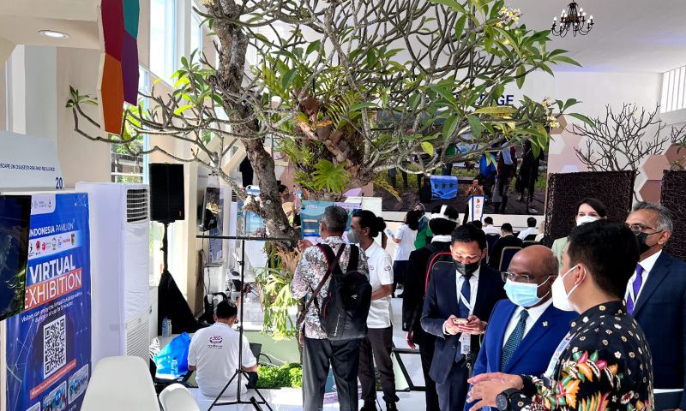
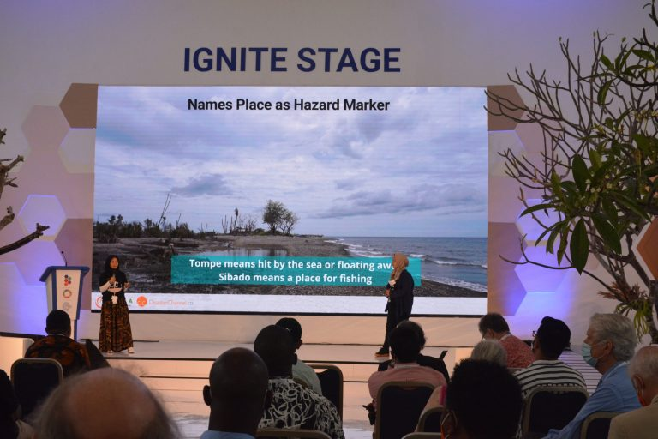
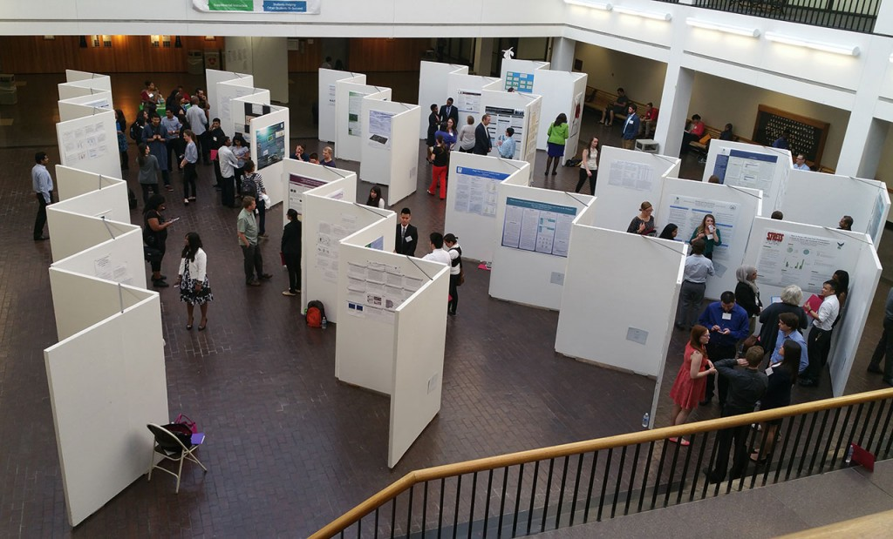
Side Events: 9-12 November 2024
1. Exhibitions
2. Ignite Stage:
Invited institutions/organization
Invited experts
3. Poster Session: open to public to participate for Global Tsunami Symposium

Slide 22
Side Event Technical and Scope Guidelines
Exhibition
...(tbd)
Poster Session:
...(tbd)
Ignite Stages:
...(tbd)
Rumah Resilience:
...(tbd)
Drawing Competitio:
...(tbd)

Slide 23
Venues

Slide 24
Venue
Auditorium – University of Syiah Kuala
Banda Aceh Convention Hall
Hermes Hotel

Slide 25
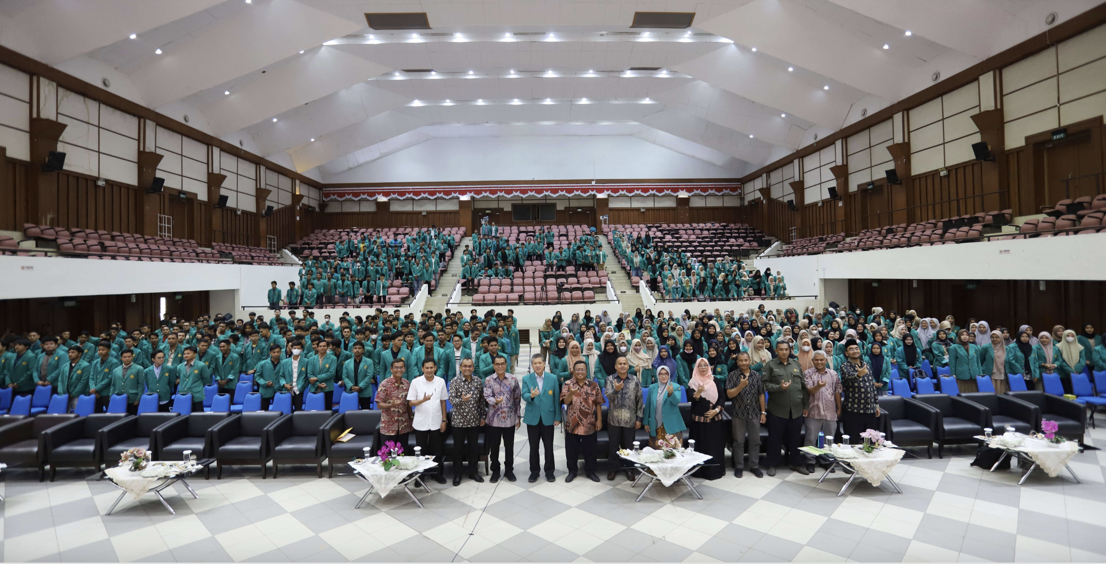
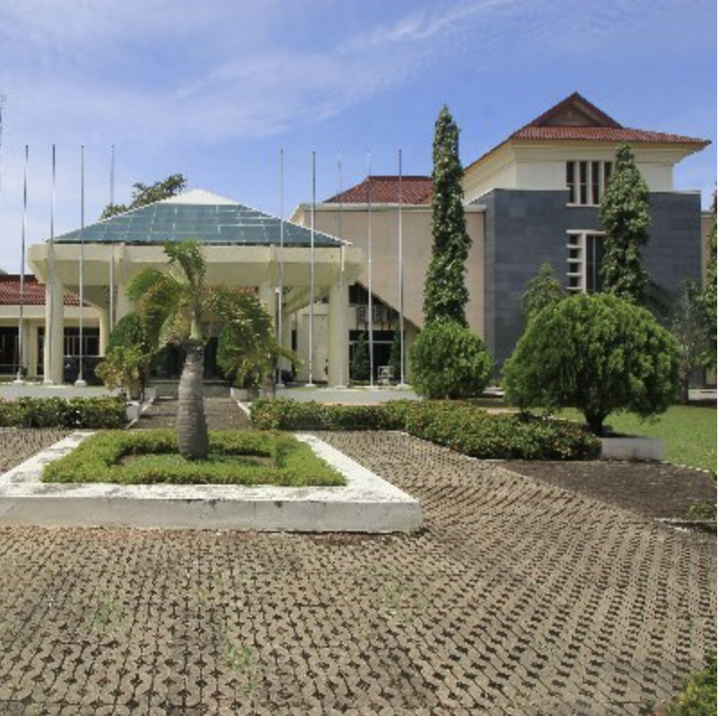
Pre-Event Venue 9-10 November 2024
AAC Dayan Dawood Auditorium –
University of Syiah Kuala
Capacity: 1,000 people

Slide 26
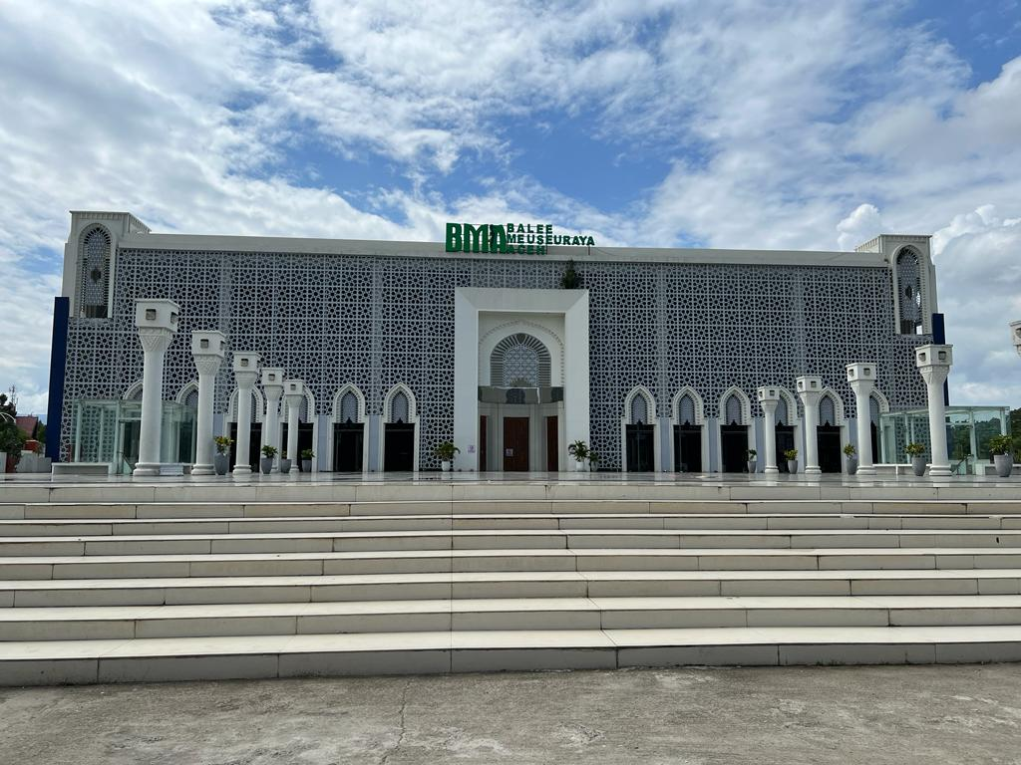
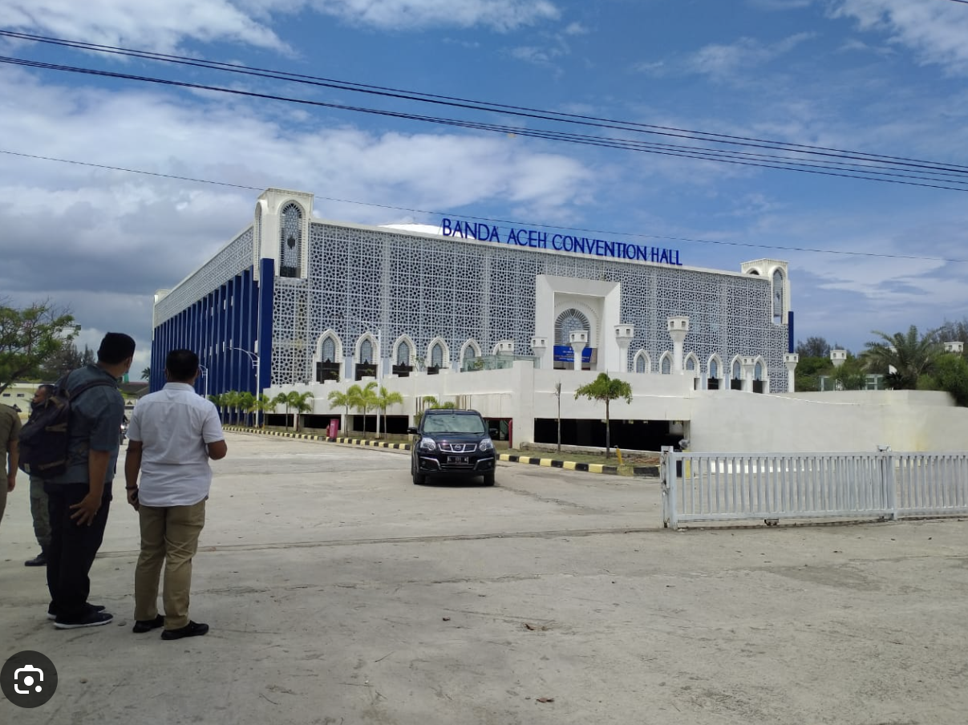
Main Event Venue 11-12 November 2024
Banda Aceh Convention Hall
Opening, Closing, Plenary and Side event activities
Capacity:1,000 people

Slide 27
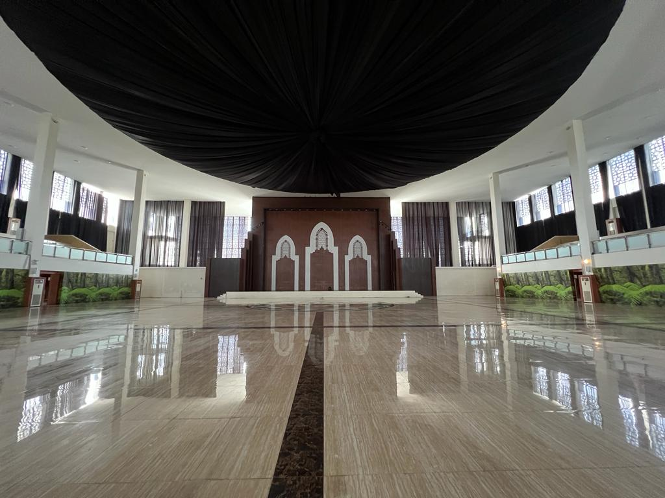
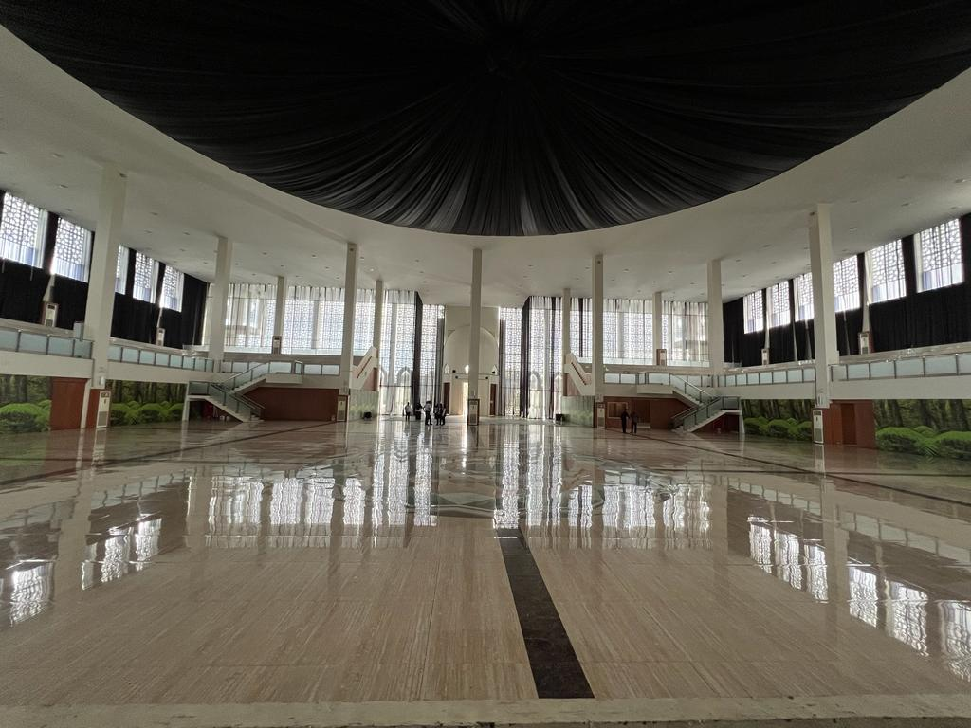
Main Event Venue 11-12 November 2024
Banda Aceh Convention Hall
Opening, Closing, Plenary and Side event activities
Capacity:1,000 people

Slide 28
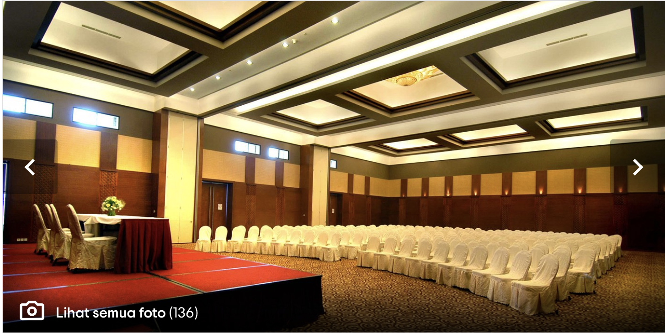
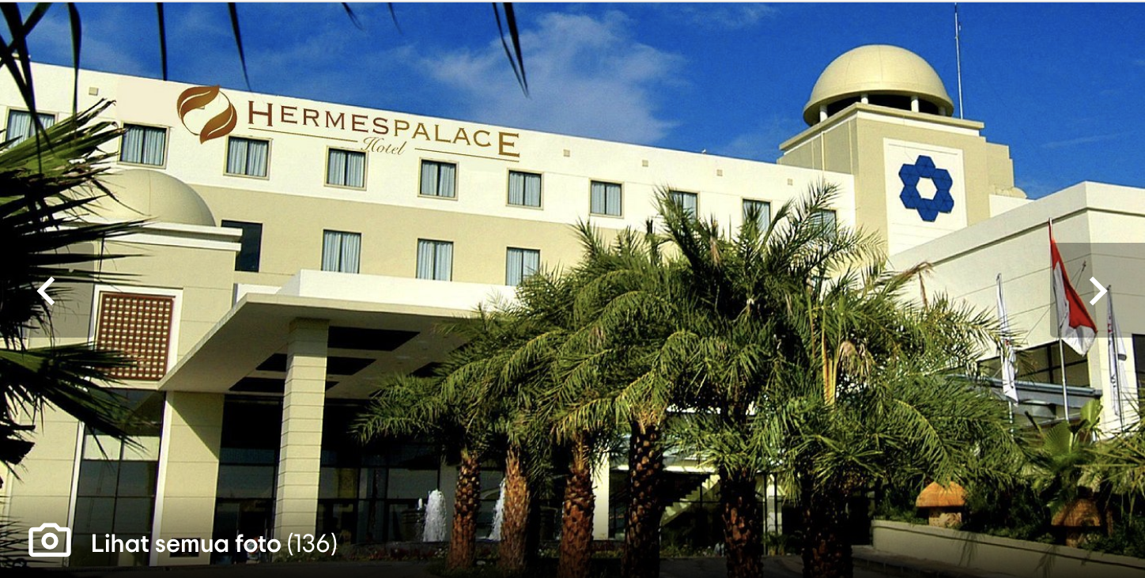
Session 7 & 8 Venue
Hermes Hotel
Session 7 & 8 and Closing Ceremony
Capacity: 400 people

Slide 29
Preparation Done
Follow up Meeting after TOWS WG Meeting
Discussed with Prof Dwikorita (Head of BMKG), Prof Syamsul Maarief (Former Head of BNPB/NDMA) (March 2023)
Discussed with BMKG and BNPB core team (March and April)
Discussed with IABI (April 2023)
Meeting with Prof Tanioka (May 2023)
Meeting with IABI and IGI (August 2023)
Meeting with BMKG, IOTIC, University Syiah Kuala, Government of Aceh (September 2023)
Hand over PIT IABI from UB in 2023 to USK 2024 (27-28 November 2023)
Symposium Technical Meeting with BMKG, BNPB, IOTIC, and Ministry of Foreign Affairs (8 December 2023)
Online meeting with Program Organizing Committee
Site Visit to Banda Aceh by Chairs (HPR and SA) and BMKG team (20 December 2024)
Several meeting conducted in January 2024 online and offline

Slide 30
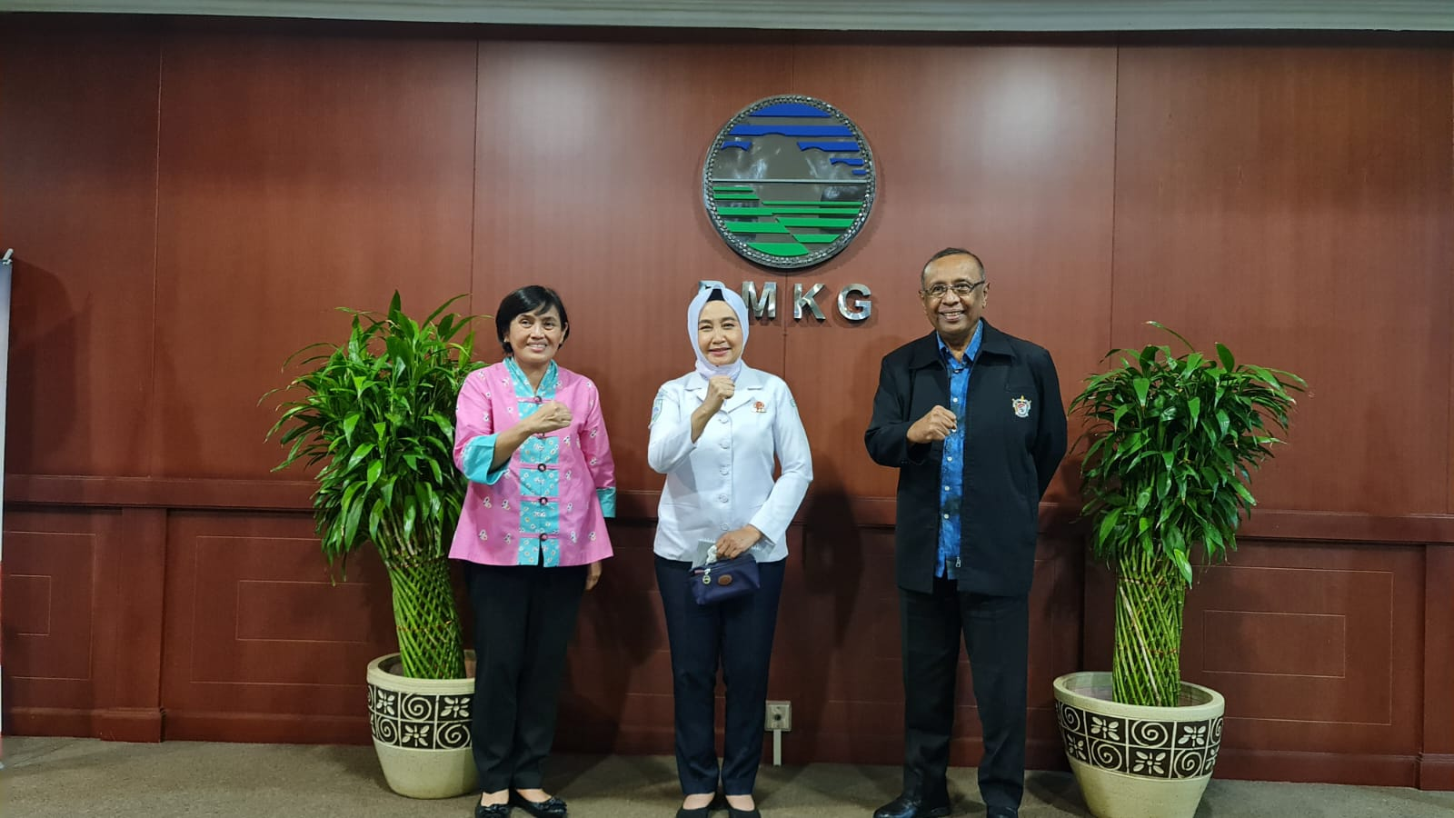
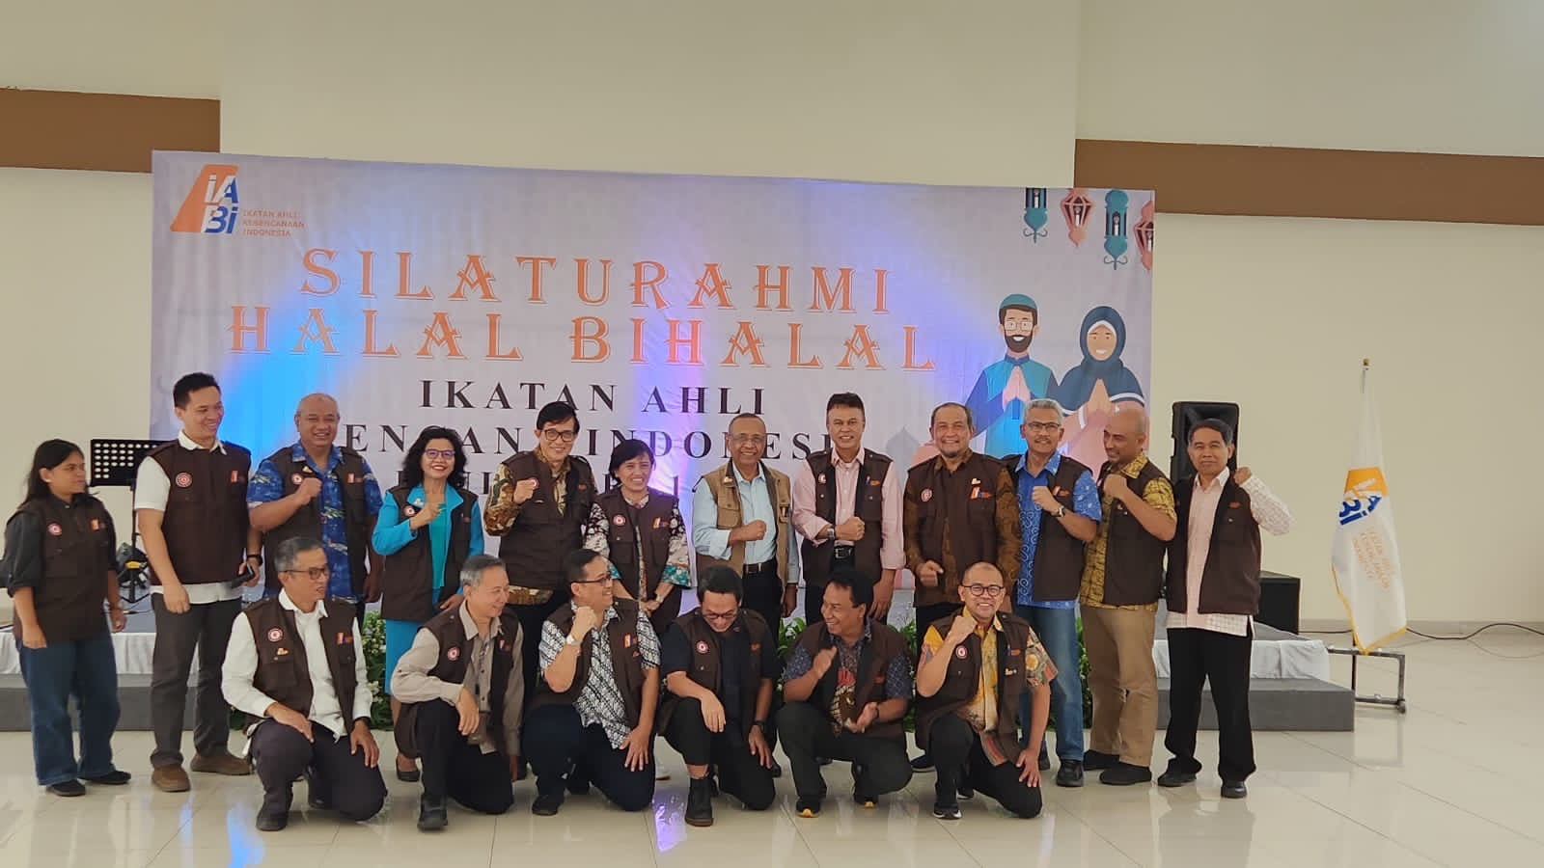
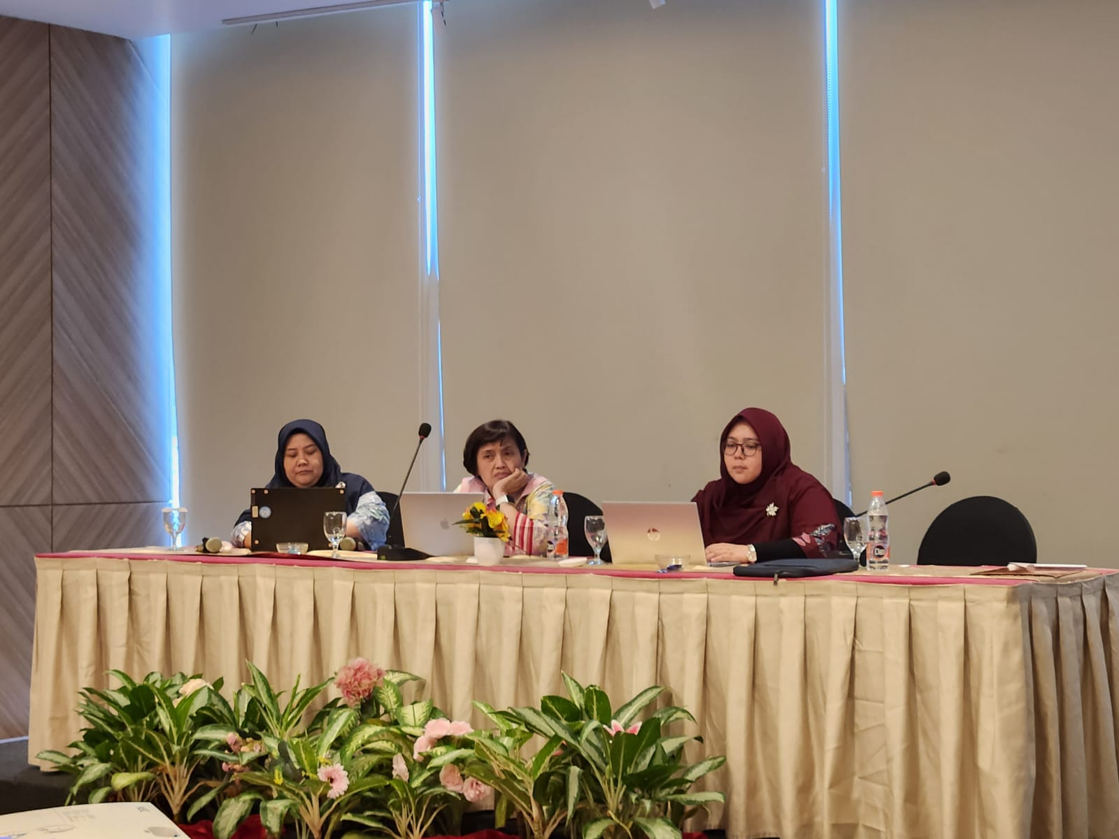
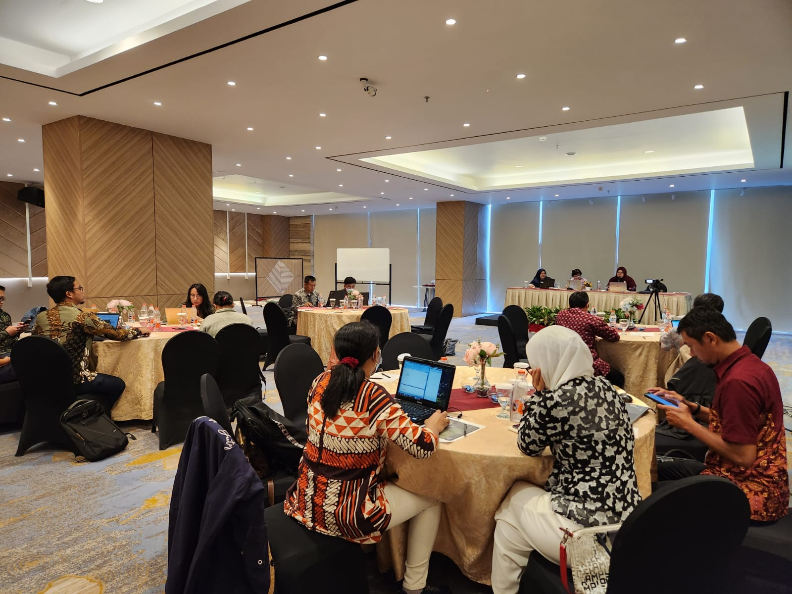
Preparation Meetings
March 2023
April 2023
August 2023
8 December 2023

Slide 31
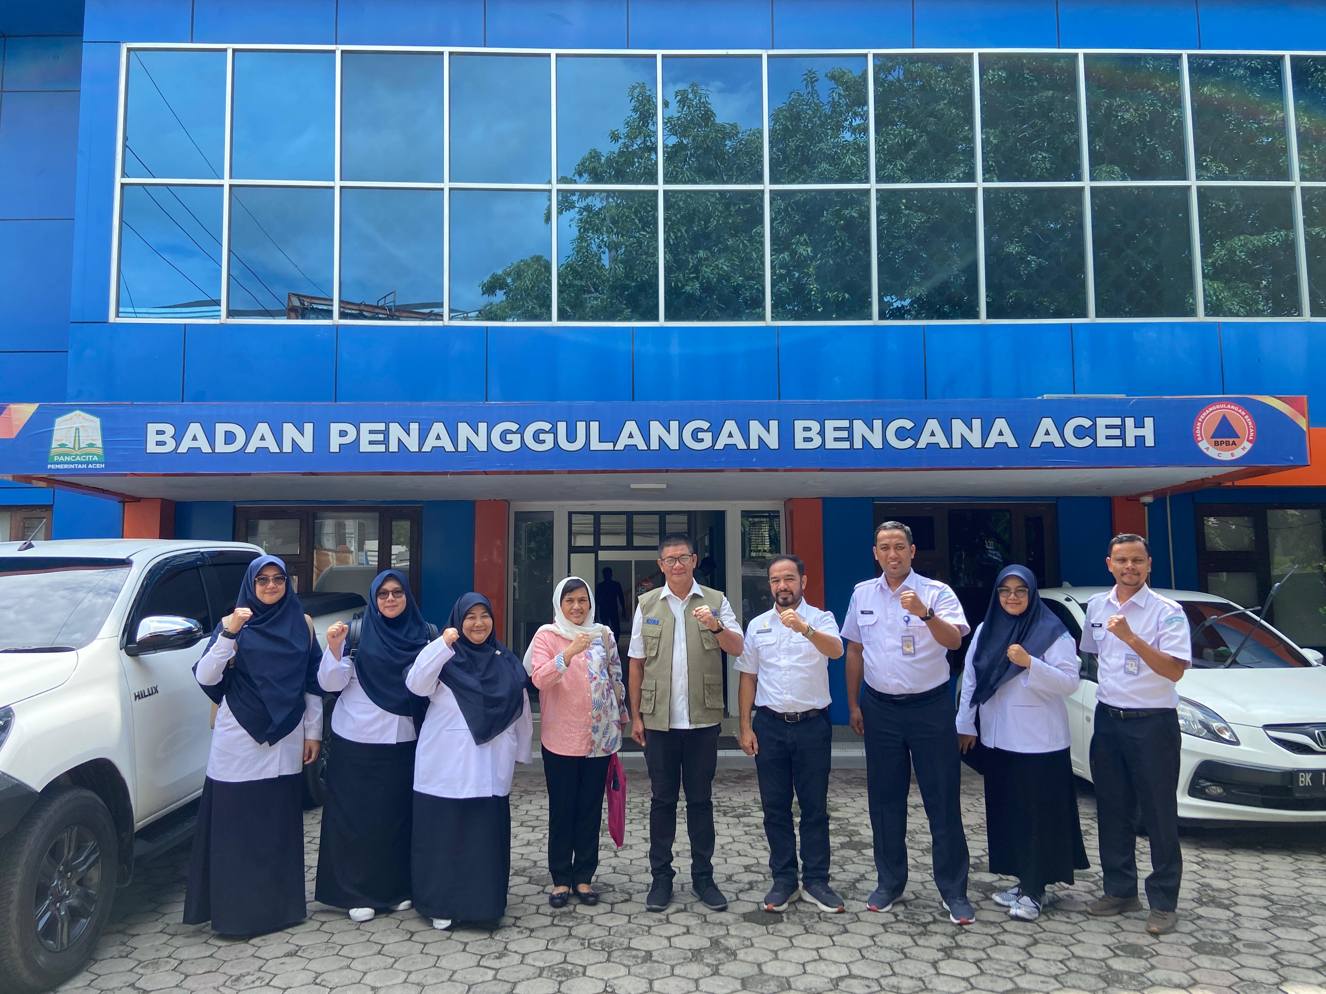
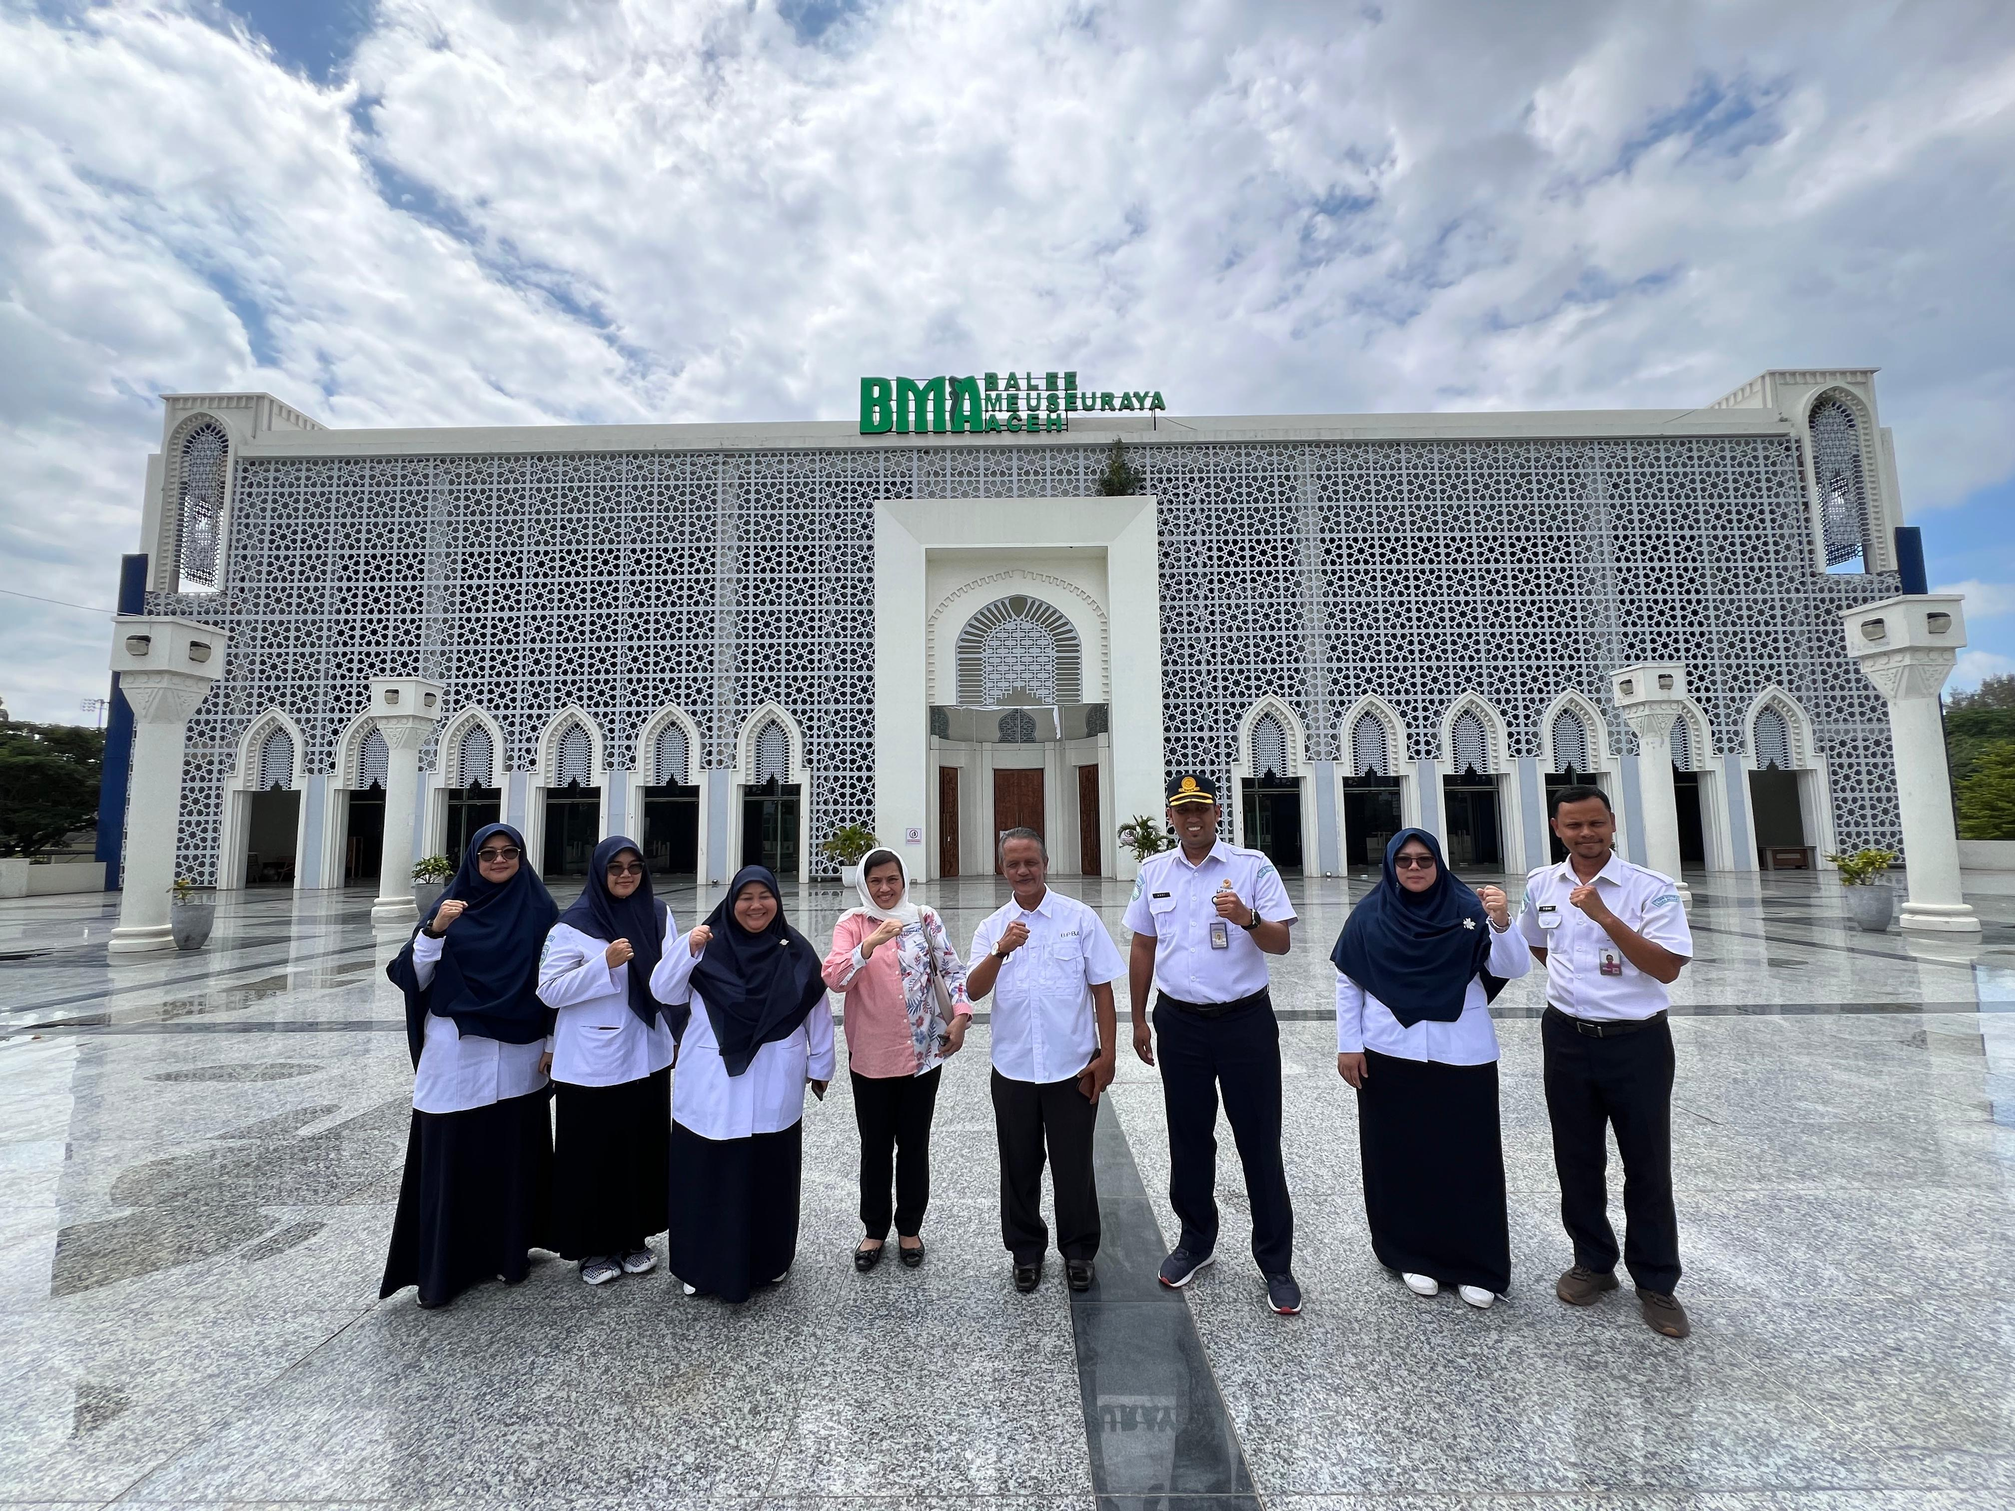
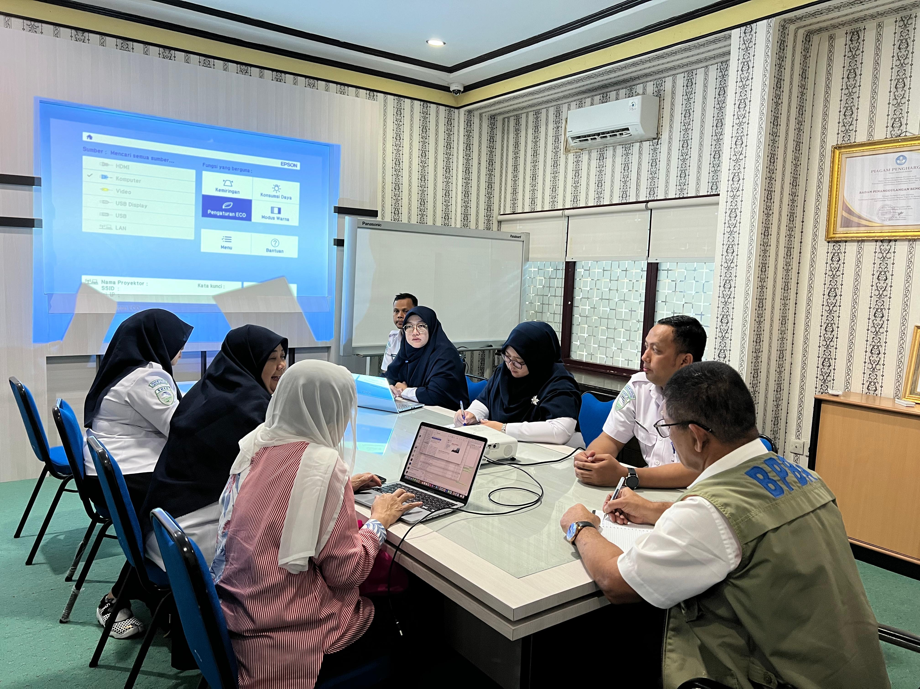
Courtesy Local Governments and Site Visits (19-21 December 2024)
Courtesy to Vice Rector of USK and TDRMC
Courtesy to Vice Rector of USK and TDRMC

Slide 32
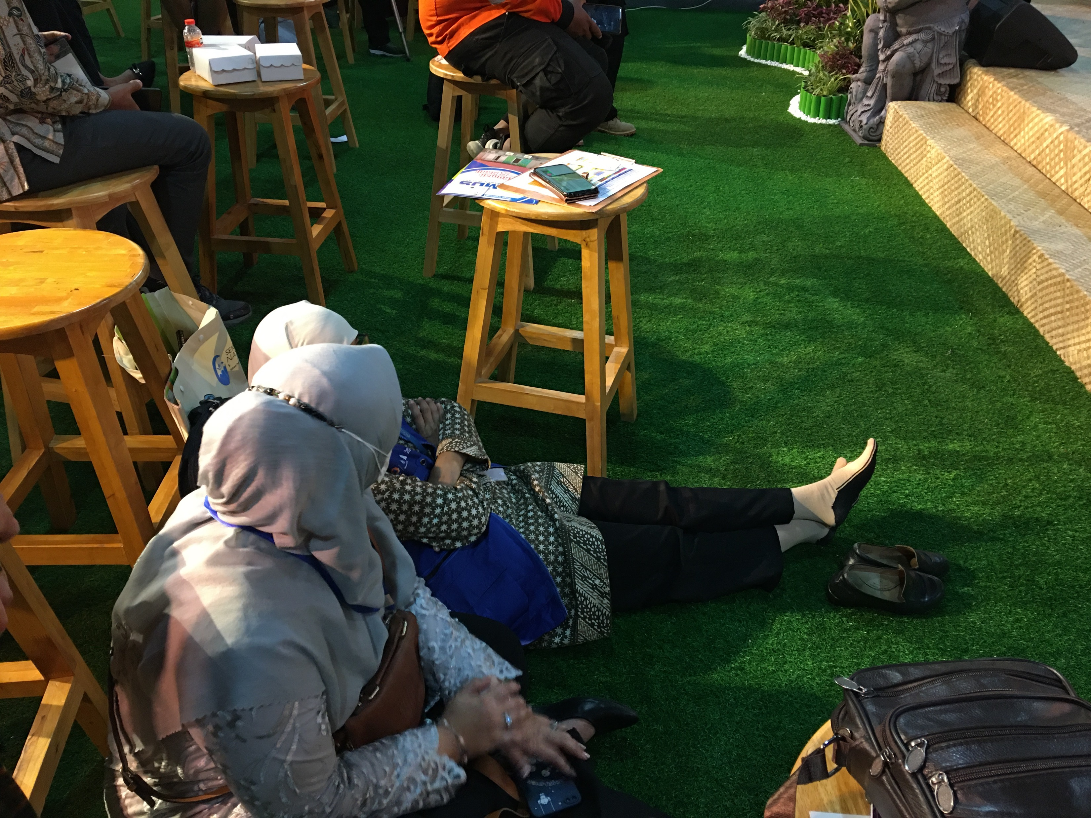
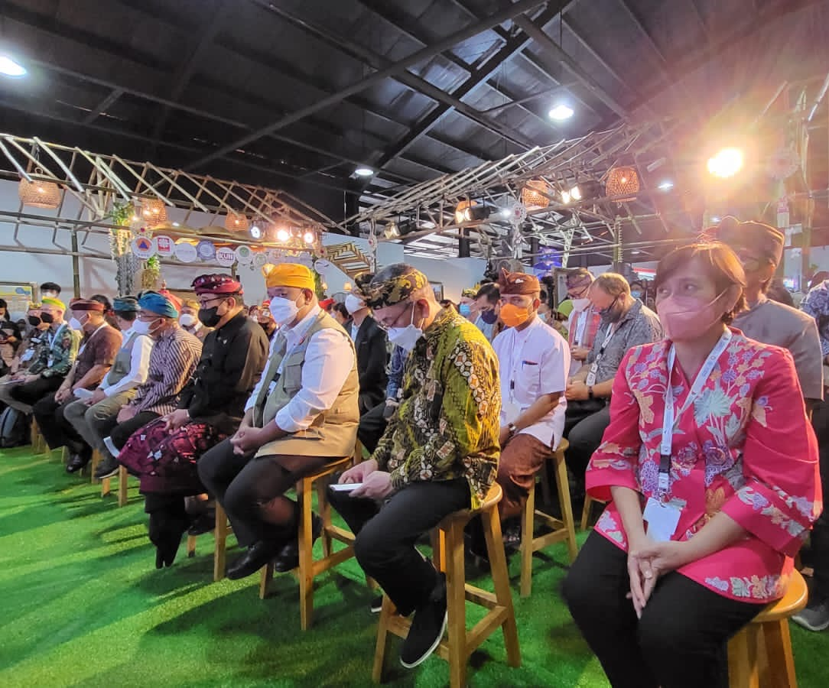
Example of Rumah Resilience Indonesia @GPDRR

Slide 33
Hotel and Accommodations

Slide 34
Hotels
Alternatives Hotel for Delegation/Participants
Hermes Hotel (4 star)
Kyria (4 star)
Many 3 star hotels

Slide 35
Pre-Event: International Scientific Workshop
Hosted by IABI collaborated with TDRMC – USK and IGI

Slide 36
Pre-Event: International Scientific Workshop 9-10 November 2024
Aims:
To commemorate 2 decades post 2004 Tsunami
To conduct PIT IABI 2024 collaborate with AIWEST
To accommodate International and National Public to present their works/thoughts before participate the UNESCO IOC Global Symposium
Scope:
Call for papers for Scientific Workshop
Pre event scientific workshop Book of abstracts, Indexing proceedings, Special issue of journals
Open to global scientific and practician communities

Slide 37
Post Event: UNESCO IOC/ICG IOTWMS XIV
In BMKG Jakarta
16-19 November 2024 (tbd with Chair of ICG IOTWMS)

