Slide 1
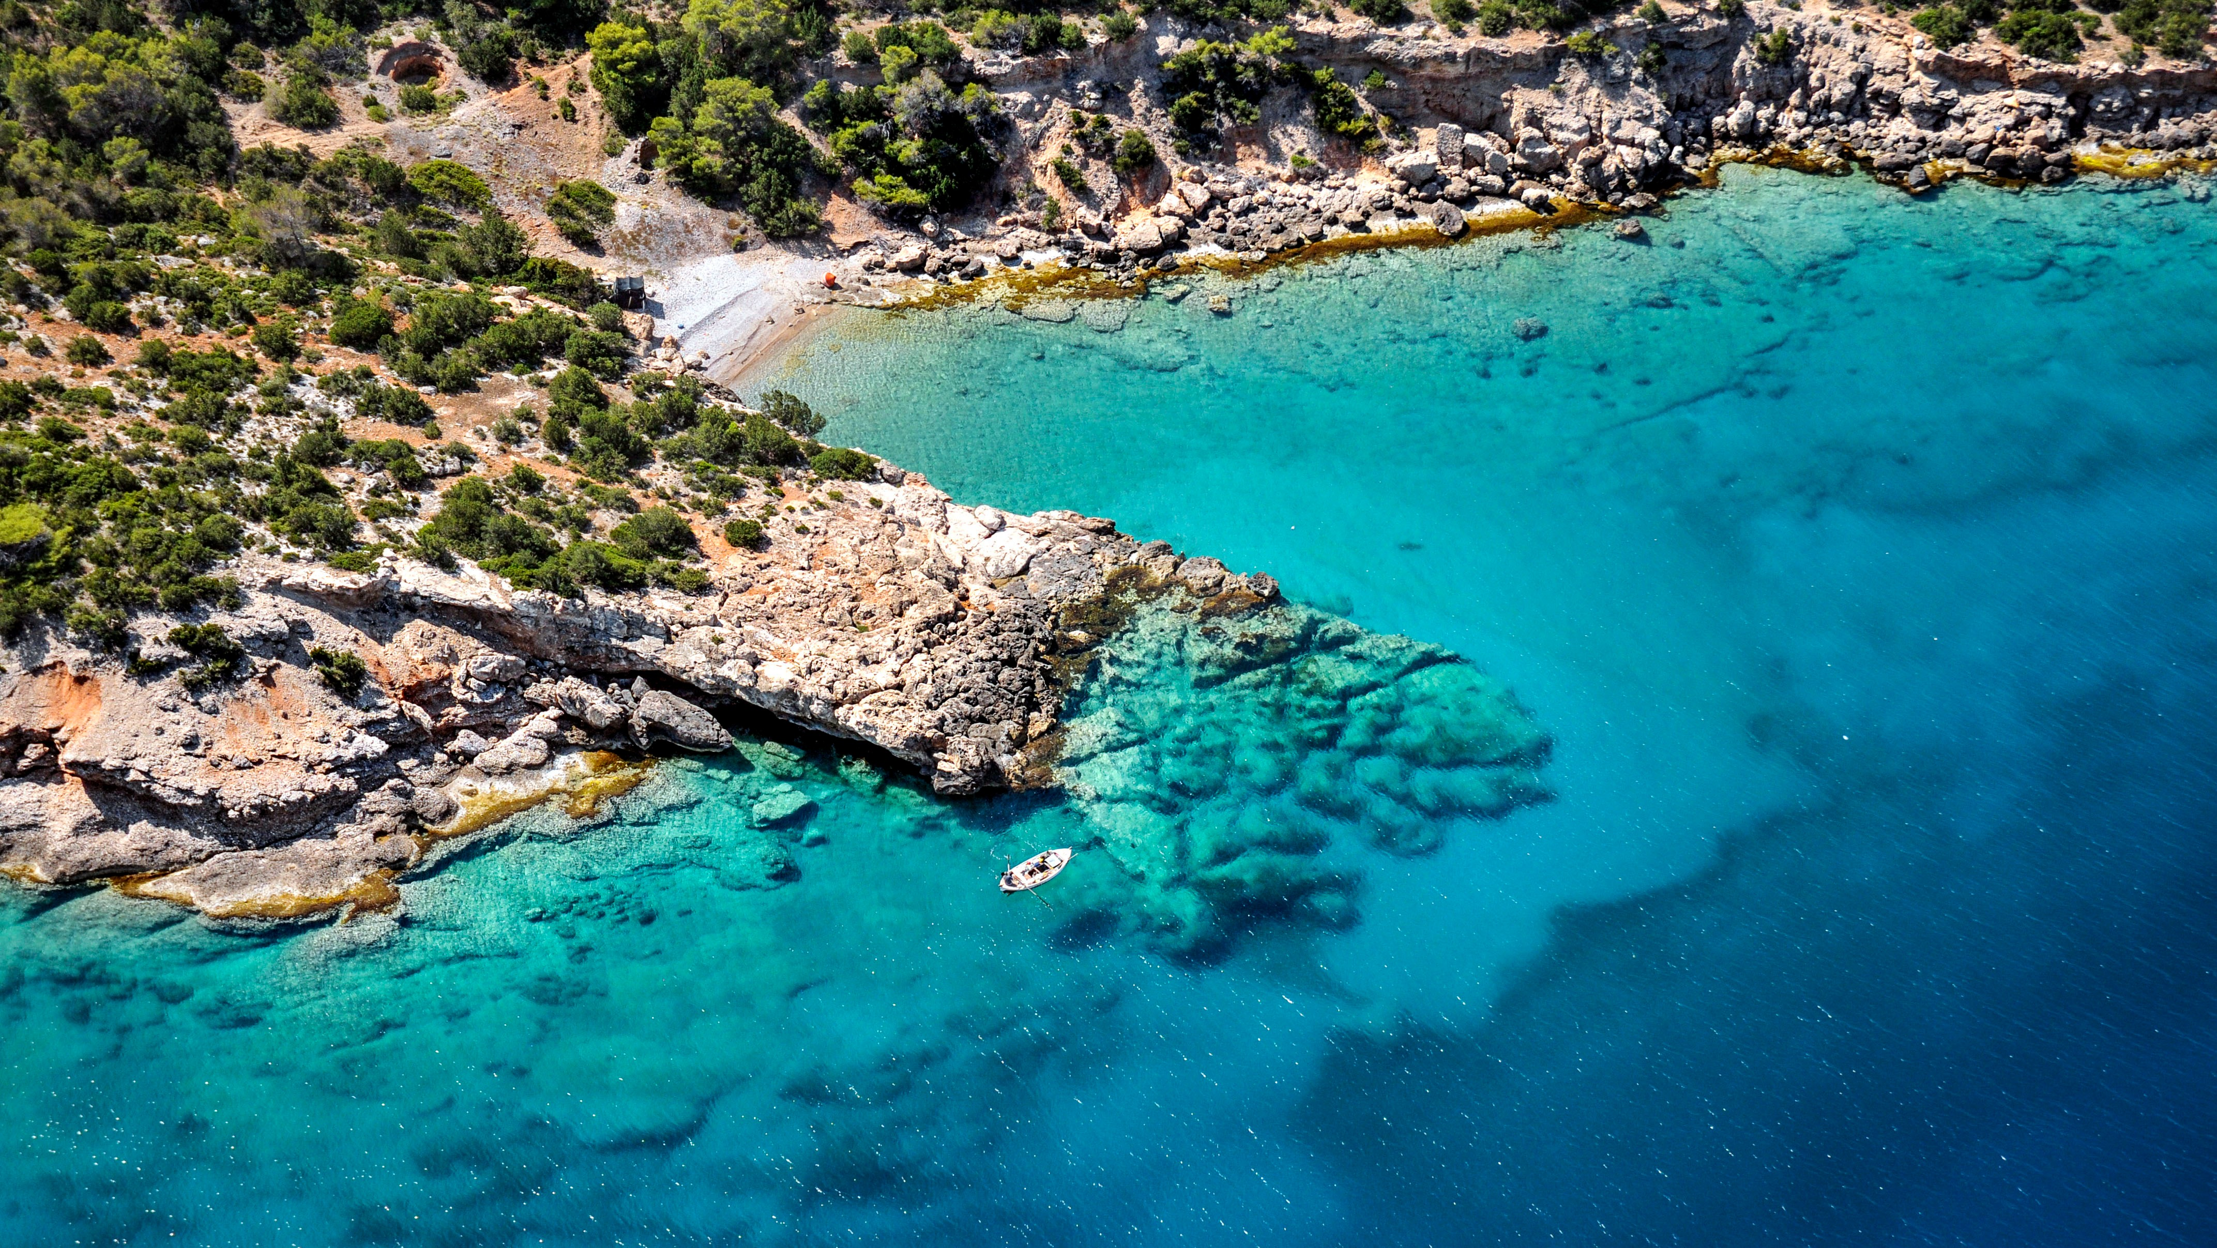

Vision 2030 – Draft White paper of WG-6: Increase Coastal Resilience to Ocean Hazards
Presented by
Srinivasa Kumar Tummala, DCC-IOR & Nadia Pinardi, DCC-CR (Online)
Agenda Item 2D
4th Meeting of Scientific Committee for the UN Ocean Decade Tsunami
Programme
UNESCO-IOC, Paris, France 25 - 26 January 2024
© Katerina Katopis / Ocean Image Bank

Slide 2

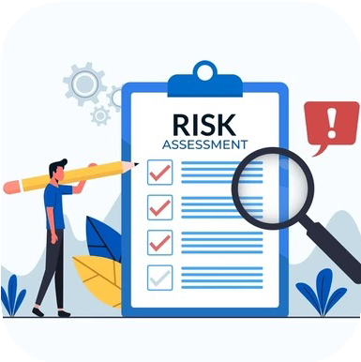

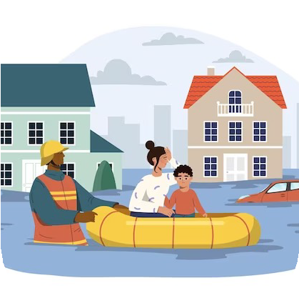




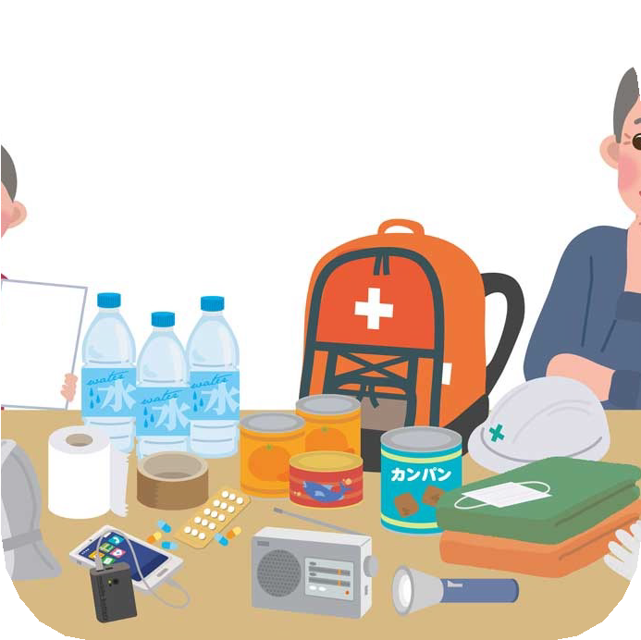

Assessment (science-based information, indicators of efficiency)
Coastal Resilience?
Challenge 6 of the Ocean Decade aims at enhancing people-centered multi-hazard early warning services and adaptation planning for all geophysical, ecological, biological, weather, climate, and anthropogenic related ocean and coastal hazards, and mainstream community preparedness and resilience (Ocean Decade, 2023).
Planning (Stakeholder engagement)
Recovery
Prevention and protection (Nature based solutions and actions)
Coastal resilience is the capacity of the socioeconomic and natural systems in the coastal environment to cope with disturbances, induced by factors such as sea level rise, extreme events, and human impacts, by adapting whilst maintaining their essential functions
Response
Preparedness

Slide 3
Vision 2030
Priority datasets
Strong demand from Decade community to jointly shape a common vision and design the ‘science we need’ to enhance collective impact and measure progress to achievement of Ocean Decade Challenges.
Indicators to measure progress
Technology & innovation
Elements of a ‘strategic ambition’
What does success look like for this Ocean Decade Challenge at the end of the Decade?
Capacity development
Infrastructure
What milestones / targets do we need to achieve throughout the Decade to be on the path for success for this Challenge?
Partnerships & resources
Knowledge

Slide 4

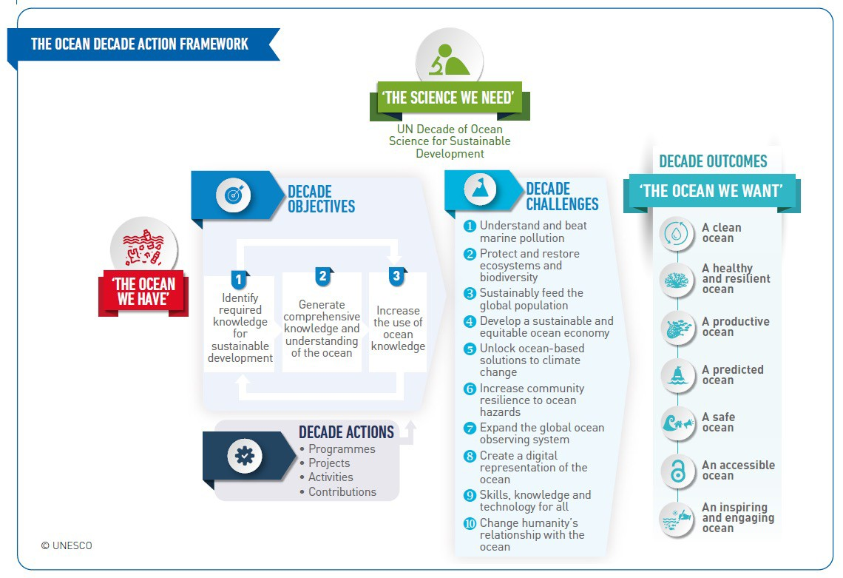
Vision 2030
Operational M&E
Framework with Decade Actions (underway)
Vision 2030 Process White papers to be presented at the Barcelona Conference
State of the Ocean Report (underway)

Slide 5
WG-6 Members
Co-chairs:
  Nadia Pinardi (Decade Collaborative Centre for Coastal Resilience, University of Bologna, Italy)
  Srinivasa Kumar Tummala (Decade Collaborative Centre for Indian Ocean Region, Indian National Centre for Ocean Information Services, India)
Members:
  Joseph Ansong (University of Ghana, Ghana)
  Alessandra Burgos (Oregon State University, United States)
  David Cabana (Helmholtz-Zentrum Hereon, Climate Service Center, Germany)
  Purificació Canals (MedPAN, Spain)
  Giovanni Coppini (Euro-Mediterranean Centre on Climate Change Foundation, Italy)
  Loreto Duffy-Mayers (Caribbean Alliance for Sustainable Tourism)
  Enrique Alvarez Fanjul (OceanPrediction Decade Collaborative Center, Mercator Ocean International, Fance)
  Mitchell Harley (UNSW Sydney, Australia)
  Juliet Hermes (South African Environmental Observation Network, National Research Foundation, South Africa)
  Jason Holt (National Oceanography Centre, UK)
  Dwikorita Karnawati (Indonesia Agency for Meteorology, Climatology and Geophysics, Indonesia)
  Hellen J. Kizenga (Institute of Marine Sciences, University of Dar es Salaam, Tanzania)
  Sunanda Manneela (Indian National Centre for Ocean Information Services, India)
  Iris Monnereau (Food and Agriculture Organization of the United Nations)
  Martina Müller (United Nations Office for Disaster Risk Reduction)
  Joel Kamdoum Ngueuko (Naturalia Environment, France)
  Antoine Queval (Alcatel Submarine Networks, France)
  Martin D. Smith (Nicholas School of the Environment, Duke University, United States)
  Andrea Valentini (Decade Collaborative Centre for Coastal Resilience, University of Bologna, Italy)

Slide 6
Relevant Ocean and Coastal Hazards
Geophysical/
Geological related
Biological
Local Anthropogenic
The challenge in coastal resilience is devise information systems and practical methods to consider a complexity of hazards together with proper vulnerability and exposure information
Tsunamis, Landslides, Subsidence, Volcanic eruptions, Coastal Erosion, Earthquakes
Algal Blooms, Invasive Species, Aquatic diseases, Nuisance blooms
Urbanization Wastewater Marine Chemical Overfishing, nuclear agricultural tourism
pressures, system, Pollution,
spills,
Ocean weather, hydrology and climate
Ecological
Oil spills, waster, runoff,
sea-level surges, coastal
rise, storm- meteo-tsunami, flooding, high
Wetland Degradation, acidification, de- oxygenation, loss of biodiversity, loss of seabed habitats, Coral bleaching, Eutrophication, connectivity
pressures,
political interference and corruption, maladaptive planning
waves and waves runup,
currents, Waves,
Marine Glacial
Heat Melt,
heavy rainfall, river discharge, Intrusions
droughts, Saltwater
6

Slide 7



Coastal Resilience Components and Elements
Risk Assessment
Multi-hazard evaluation frameworks
Multi-level, multi- sector risk analysis
Exposure and vulnerability analysis
Risk Reduction
Governance/ Institutional/Social
Marine and Maritime Spatial Planning
Governance Framework
Disaster recovery planning
Equitable coastal resilience
Government investments, financing and insurance
Capacity building
Corporate social responsibility
Monitoring, Forecasting and Early warning systems (multi-hazard)
Warning Dissemination & Communication
Preparedness & Response
Sectoral medium to long term planning (zoning, infrastructure),
Nature-based solutions,
Digital twins

Slide 8
Current work in the Ocean Decade
Decade Collaborative Centres dedicated to Coastal Resilience and Ocean Predictions, both contribute to the coordination of existing initiatives
As of November 2023, Challenge 6 is the focus of
4 Programmes
  Covering all ocean basins, but polar oceans are less represented at the Programme level
  3 Led by European-based institutions and One led by an Asia-based institution
24 Projects
  North Atlantic Ocean is the most represented, while the Southern Ocean is the least represented
  Europe dominates in representation, while Africa, Small Island Developing States (SIDS) and Australia in the Pacific region lack both Projects and Programmes
6 Contributions addressing specific components within the challenge

Slide 9
White paper: Decade outcomes for Challenge 6
Emphasizes a holistic approach to resilience, considering hazards from both ocean and coastal perspectives
Outcome: safe ocean where life and livelihoods are protected from ocean-related hazards
Design ‘people-centered’ multi-hazard early warning systems
Some key characteristics of people-centered warning systems include a focus on stakeholder engagement and responsibility sharing, accessible communication supported by technological innovations, and institutional capacity building, including strong inter-agency collaboration
Design adaptation planning strategies to increase coastal resilience
Use the new data from the Ocean Decade to prepare updated plans and solutions also in view of the Marine Spatial Planning process.

Slide 10
Users and stakeholders
Intermediate stakeholders
Downstream stakeholders
Upstream stakeholders
Use information for risk reduction and governance:
Knowledgeable users that customize products for specific needs:
Collect observations and produce analysis and forecast:
Research
Op. centres
Business
Indigenous and local communities
NGOs
National defence org.
Gov/Public authorities
Coast Guards/Civil prot.
Indigenous and local
communities
Education institutions
Media/Opinion Leaders
General Public
Research
Business
NGOs
National Defense
Organizations
10

Slide 11
Preliminary User Needs for Coastal Resilience Components
Priority Issues
Vital Role of Observations: Observations are essential inputs for early warning systems, especially in predicting high-impact weather and ocean hazards within a few days
Global Data Sharing: Early warning systems depend on countries freely sharing data globally, using advanced computing centers for processing
Crucial Datasets for Warnings: these datasets are a suitable combination of past information (observations) and predictions by numerical modelling or AI
Adaptation Planning Data: Adapting to climate change requires downscaling climate scenarios and carry out impact modeling

Slide 12
Annex 3: Priority Data Sets
Thematic data set |  |  | Variables
Meteorological Data |  |  | Real-time weather data from both instruments and numerical models, including temperature, humidity, wind speed, and wind direction, precipitation and atmospheric pressure.
Seismic and Geophysical Data |  |  | Earthquake data from seismometers, strong motion accelerometers to detect seismic activity, Global Navigation Satellite System (GNSS) data to monitor ground deformation due to earthquake, volcanic activity, landslide etc.
Hydrological Data |  |  | River discharge for water levels and flow rates from gauges and from hydrological modelling, and soil moisture data to assess landslides and flooding risk. Dissolved chemicals in water and their loading, sediment mass balance at the river-estuary interface with the coastal ocean.
Oceanographic Data |  |  | Sea level data to monitor for potential tsunamis, Sea level from in situ, satellite and numerical models for storm surges, wave buoy data and numerical model outputs for high-waves and swells etc., sea temperature and salinity, and marine current data from satellite, in situ and numerical oceanographic models to track heat anomalies and transport of pollutants and sediments. Biogeochemical variables from satellite, in situ and numerical models including phytoplankton, PH, oxygen, dissolved and particulate chemical species.
Human activities |  |  | Population density and distribution data, Vulnerability and exposure data, Vessel traffic density, Marine Protected Area domain extension and number, aquaculture and mariculture sites, fishing intensity, housing stock, transportation, energy, public safety, wastewater treatment, and educational infrastructure.
Seabed habitat Data |  |  | Seagrass meadows, mangroves, and coral covers.
Bathymetry, geological data | terrain | and | Digital elevation model data combining terrain and bathymetry, classification and sedimentation rates, submerged landscapes. | seabed sediment grain size, | substrate
Climate downscaled scenarios |  |  | Downscaled IPCC climate scenarios for all hydrological, meteorological, ecosystem and oceanographic thematic variables listed above.
Human health |  |  | Water quality monitoring to detect microbial contamination, monitoring for pollutants such as heavy metals, pesticides, and industrial chemicals, harmful algal blooms monitoring, mosquito and tick surveillance, monitoring and reporting of waterborne, foodborne, and other communicable diseases in coastal communities

Slide 13
Preliminary User Needs for Coastal Resilience Components
Knowledge generation and sharing
  Systematic Risk Knowledge Building: Building risk knowledge relies on collecting data systematically and communicating region-specific hazards and vulnerabilities to communities
  Obstacles Due to Deficient Knowledge: Lack of disaster risk knowledge, attributed to factors like limited data, interdisciplinary gaps, and insufficient research, poses obstacles to creating resilient communities
  Initiatives for Enhanced Risk Knowledge: Primary initiatives involve investing in interdisciplinary research, leading to innovative tools for data analytics, risk mapping, and accessible repositories.
  Dissemination: training programs are essential. Examples include initiatives such as the WMO Global Multi-hazard Alert System (GMAS), the UNESCO-IOC International Tsunami Information Center (ITIC) training program, and the Ocean Teacher Global Academy (OTGA) of UNESCO-IOC.

Slide 14
Preliminary User Needs for Coastal Resilience Components
Infrastructure requirements for early warning systems
Optimal Global Monitoring Network: To boost coastal resilience to ocean hazards, establish a diverse global observing network with computational facilities for forecasting and climate downscaling.
Improved Data Management: Tackle challenges of ocean hazards by enhancing data sharing infrastructure, adopting best practices, and maintaining effective data management.
Technological Adoption: Utilize technologies like the Common Alert Protocol (CAP), establish standard communication formats (especially for diverse abilities), and use broadcast and social media for widespread dissemination.
Infrastructure Details: Detailed requirements for coastal resilience in dealing with different ocean hazards are listed in Annex 4.

Slide 15
Preliminary User Needs for Coastal Resilience Components
Partnerships and resources
Collaborative Approach for Resilience: Boosting coastal resilience involves partnerships at various levels, following SDG 17. Collaboration with entities like Decade Collaborative Centres (DCC) provides global insights.
National Engagement: Crucial collaboration nationally includes Early Warning Centers, academia, and emergency managers. Partnerships with government, non-profit organizations, private companies, and communities create a comprehensive strategy.
Community Involvement: Initiatives like the Fisherman Field School Program engage local communities actively. Practices such as the Tsunami Ready Recognition program enhance community awareness and preparedness.
Holistic Partnerships: Collaborative Ocean Acidification (OA) Action Plans and partnerships with organizations like FAO, UNEP, UNDP, WWF contribute to a comprehensive approach. Detailed requirements are outlined in Annex 4.

Slide 16
Preliminary User Needs for Coastal Resilience Components
Capacity development and exchange needs
Challenges in Risk Understanding: Effective monitoring and forecasting alone don't guarantee community understanding and appropriate response to warnings. Public awareness and preparedness empower individuals to protect themselves and adapt to growing risks.
Local Capacity-Building: Communities need initiatives that build their capacity to understand, prepare for, and respond to ocean hazards.
UNESCO-IOC’s Role: UNESCO-IOC assists Member States with marine environment management through networks and a new Capacity Development Strategy (IOC-CD, 2023). Programs like the IOC Ocean Decade Tsunami Programme aim for resilient communities by 2030.
Collaborations: Collaboration among scientists, policymakers, and practitioners is vital for a collective understanding of coastal resilience. Partnerships with organizations like FAO, UNEP, UNDP contribute to a holistic approach in various scientific fields.

Slide 17
Preliminary User Needs for Coastal Resilience Components
Technology and innovation solutions
Technology for Resilience: Advanced sensors, satellites, and AI/ML is vital for early warnings against ocean hazards, following F.A.I.R. principles. Numerical modeling and Digital Twin Frameworks improve forecasting.
Climate-Resilient Infrastructure: Mix grey and green infrastructure with smart technologies for climate resilience. Innovations in sand mobilization, sustainable aquaculture, and waste management contribute to overall resilience.
Renewable Energy Integration: Include offshore wind and wave energy for sustainable power solutions. Resilient microgrids ensure continuous power during and after hazards.
Effective Communication with ICT: Use emerging ICT technologies, such as cellphone apps, for efficient early warnings, especially in vulnerable communities. Detailed technology requirements are listed in Annex 4.

Slide 18
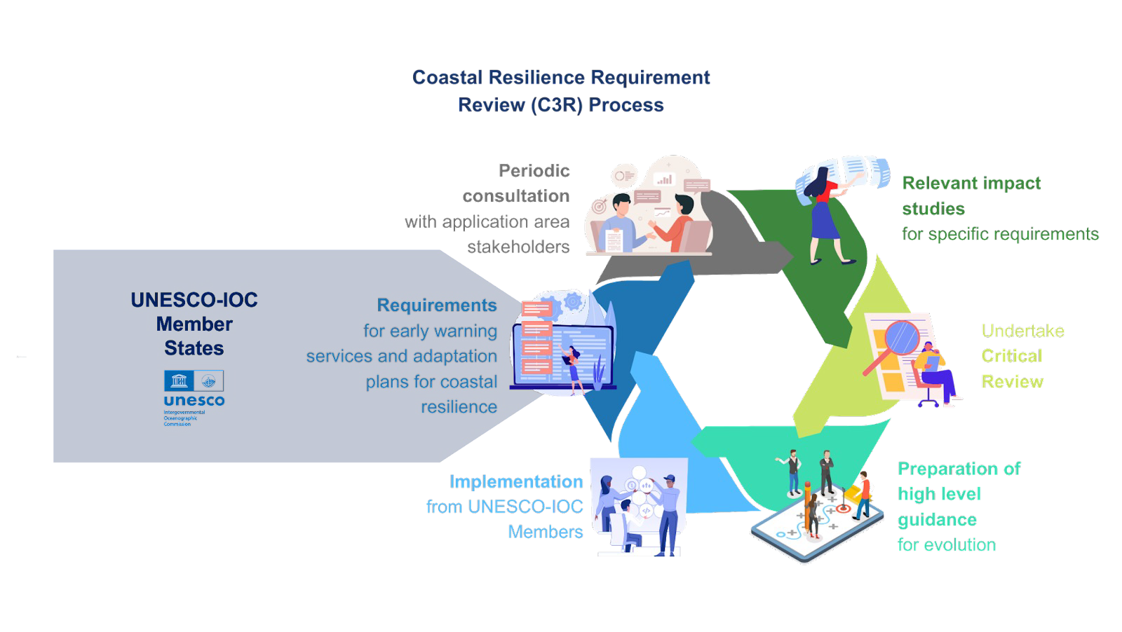
The Coastal Resilience Requirement Review Process
The indicators need to be fine-tuned according to the goals and objectives during each periodic assessment of the Coastal Resilience Requirement Review process

Slide 19



The Coastal Resilience Requirement Review Process
Characterize relevant Coastal Stakeholder Groups
Coastal Cities and Ports,
Delta and Estuaries
Small Islands
Transitional coastal waters and
Iced coastlines
Establish a Coastal Resilience Requirement Review (C3R) process
Urban planning, infrastructure
Ecosystem preservation, water management, and infrastructure resilience
Adaptive strategies, sustainable development, and community engagement
Conservation and protection actions, nature- based solutions and sustainable food production
Coastal erosion, loss of biodiversity and changes in economic activities
Plan Periodic Consultation Mechanisms
Key indicators of resilience specific to each typology of coastal environment
Aligning these indicators with relevant SDGs targets/indicators
Establishing regular consultations to gather feedback, assess progress, and adapt strategies based on evolving needs and challenges
19

Slide 20
Indicators to track the achievements
Metrics offer a comprehensive perspective on the advancements made in the Coastal Resilience Requirement Review
Indicators that demonstrate the improvement of knowledge related to the identification and comprehension of coastal multi-hazard, encompassing cascading effects
Indicators for best practices in data sharing for early warning systems
Indicators of the advancement in best practices and standards for risk reduction
Indicators of successful capacity building and educational practices
Indicators reflecting the successful development of international partnerships
Indicators of changes in institutional and legislative frameworks supporting coastal resilience

Slide 21
Enhancing coastal resilience brings numerous benefits, aligning with most of the SDG targets.
Coastal resilience aligns most strongly with Goal 13 “Climate Action” and all its targets
Goal 14 "Conserve and sustainably use the oceans, seas, and marine resources for sustainable development" is expected to be positively impacted
Challenge 6 will also support the Goal 17 through the design of responsive, inclusive, participatory, and representative risk management and decision-making across national boundaries
Current SDGs lack a comprehensive acknowledgment of targets associated with coastal resilience.
The assessment and readiness for coastal risks should be more systematically incorporated into the sustainable development agenda.
Importance and Relevance to Sustainable Development Goals (SDGs) and other Challenges

Slide 22
Challenge 6 is linked to all Decade challenges. Improving early warnings helps alert communities about pollutants (Challenge 1) and safeguards coastal ecosystems (Challenge 2)
Timely alerts enhance sea safety, supporting fishing communities and sustainable practices (Challenge 3). Early warnings impact the sustainability of ocean economic activities (Challenge 4).
Knowing the Ocean-climate connection (Challenge 5) informs climate adaptation planning and warnings about changing coastal conditions.
Challenges 6 and 7 work together, providing a foundation for effective early warnings and contributing to high-fidelity modeling (Challenge 8). Capacity development (Challenge 9) enhances awareness for adaptive measures and a sustainable relationship with the ocean (Challenge 10).
Importance and Relevance to Sustainable Development Goals (SDGs) and other Challenges

Slide 23

Working Group 6
Increase Community Resilience to Ocean Hazards
Contacts:
Nadia Pinardi – nadia.pinardi@unibo.it Srinivasa Kumar - srinivas@incois.gov.in

