Slide 1
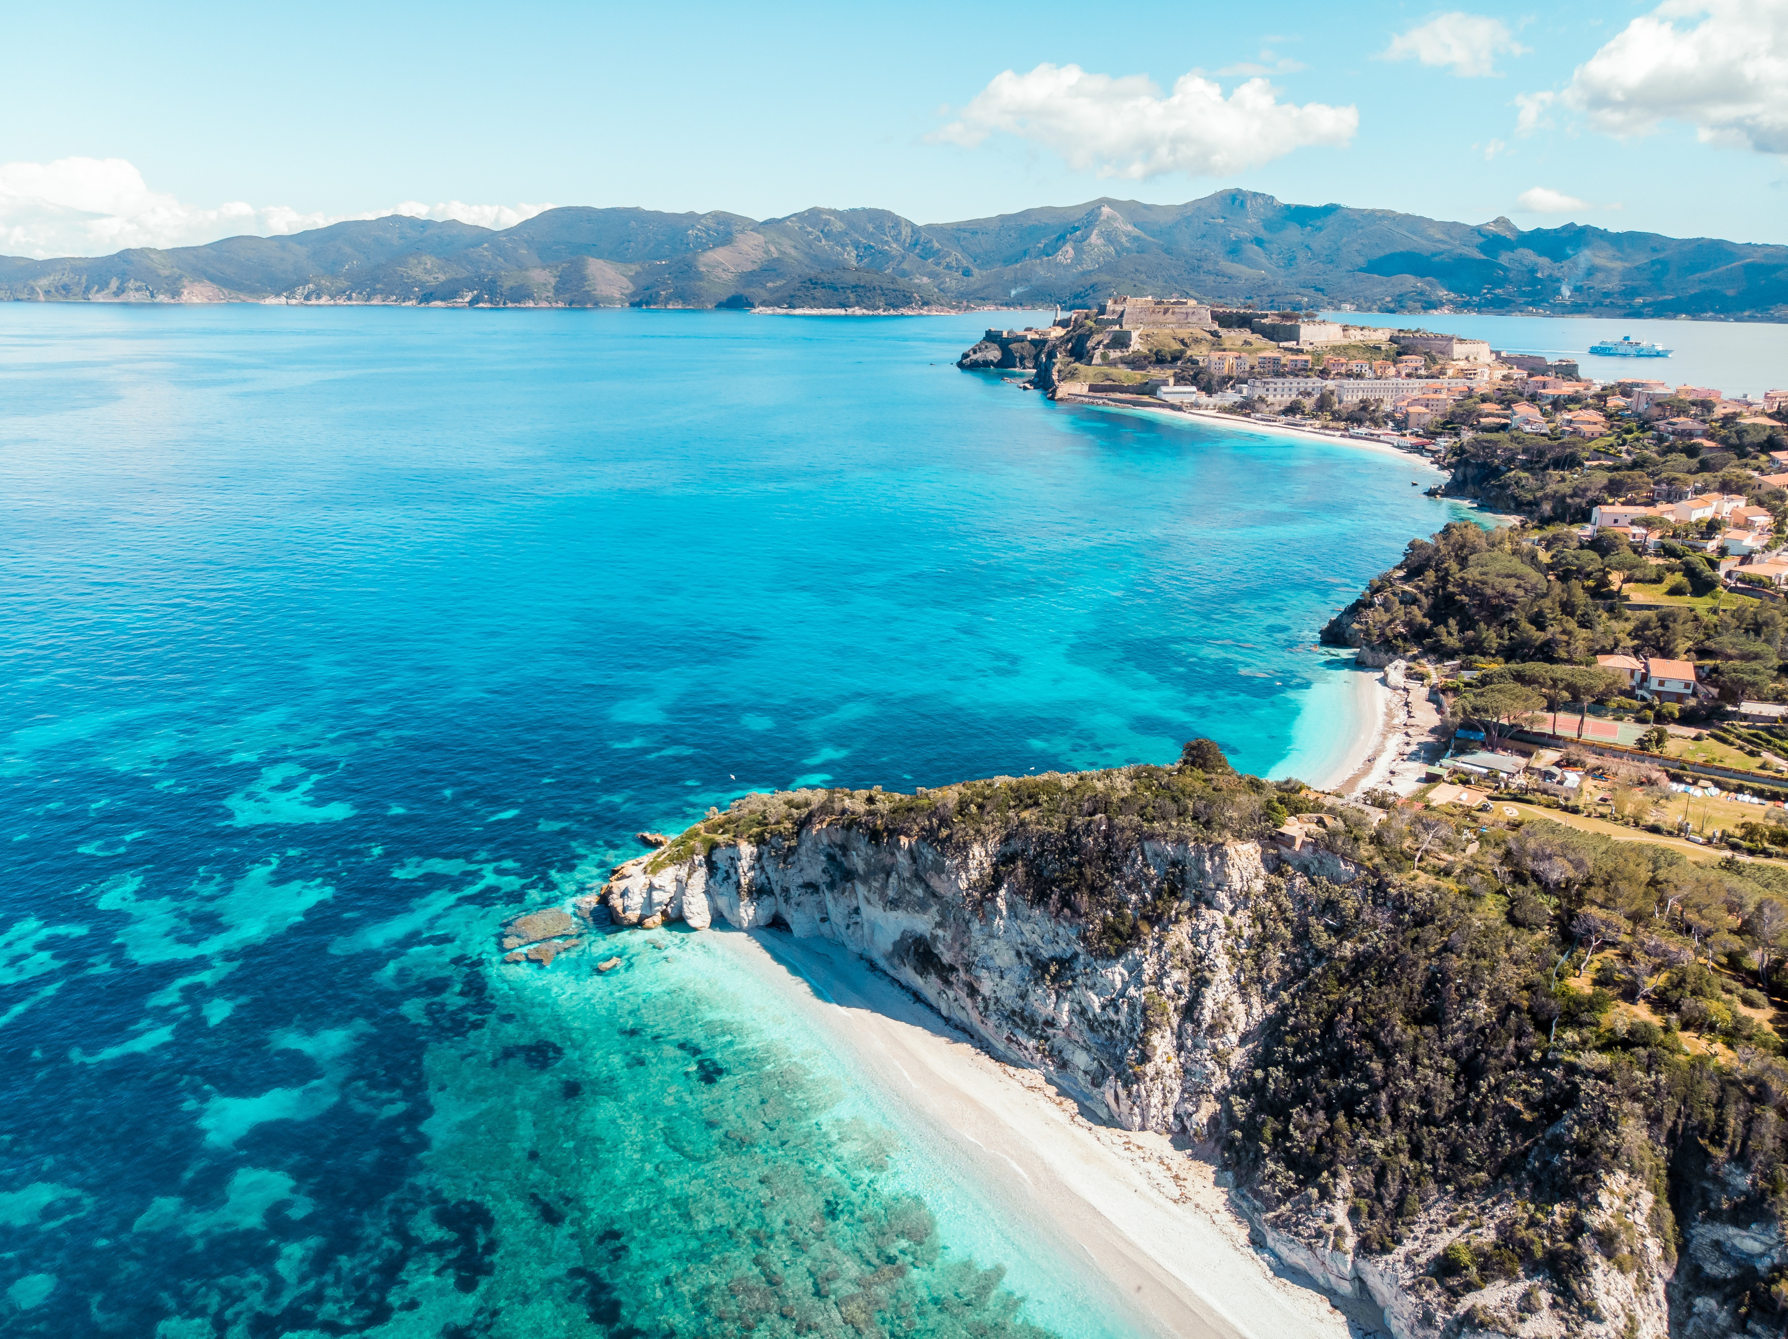






UN Decade Collaborative Centre for Coastal Resilience
Nadia Pinardi, DCC-CR Director
25 January 2024

Slide 2
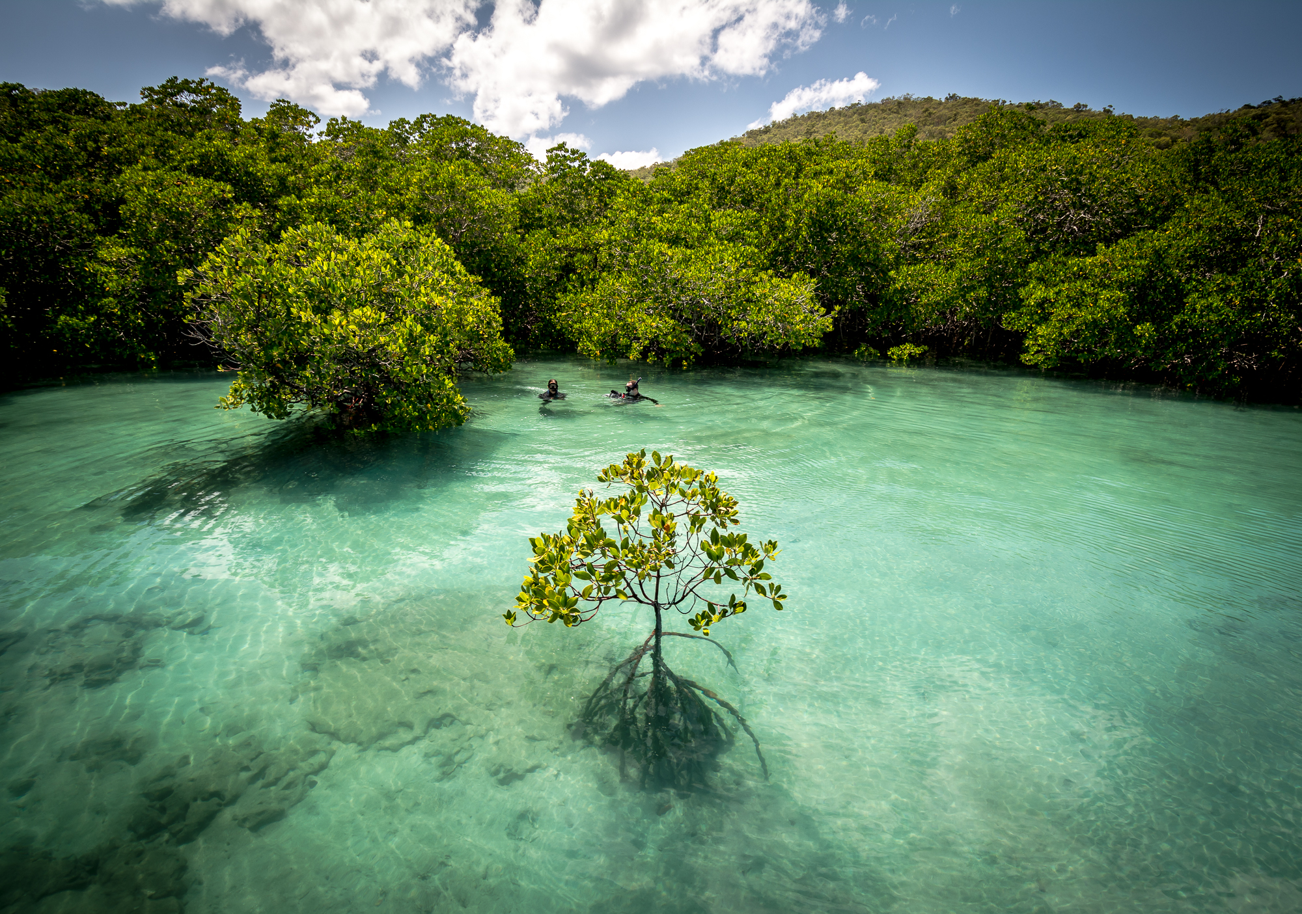
DCC-CR’s Mission
The main mission of the DCC-CR is to strengthen the connection between the new science and technology developed in the Ocean Decade and coastal stakeholders, implementing innovative co-design practices for coastal resilience.

Slide 3

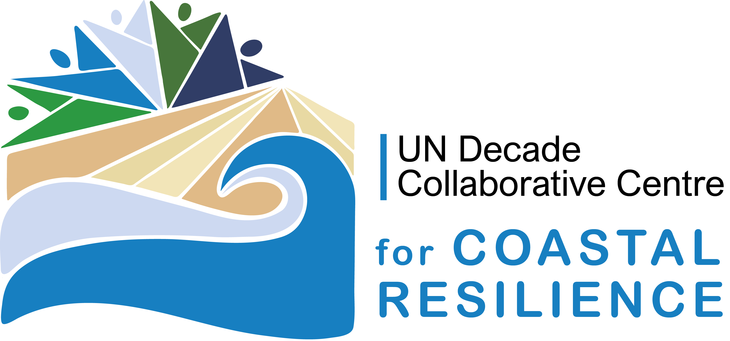
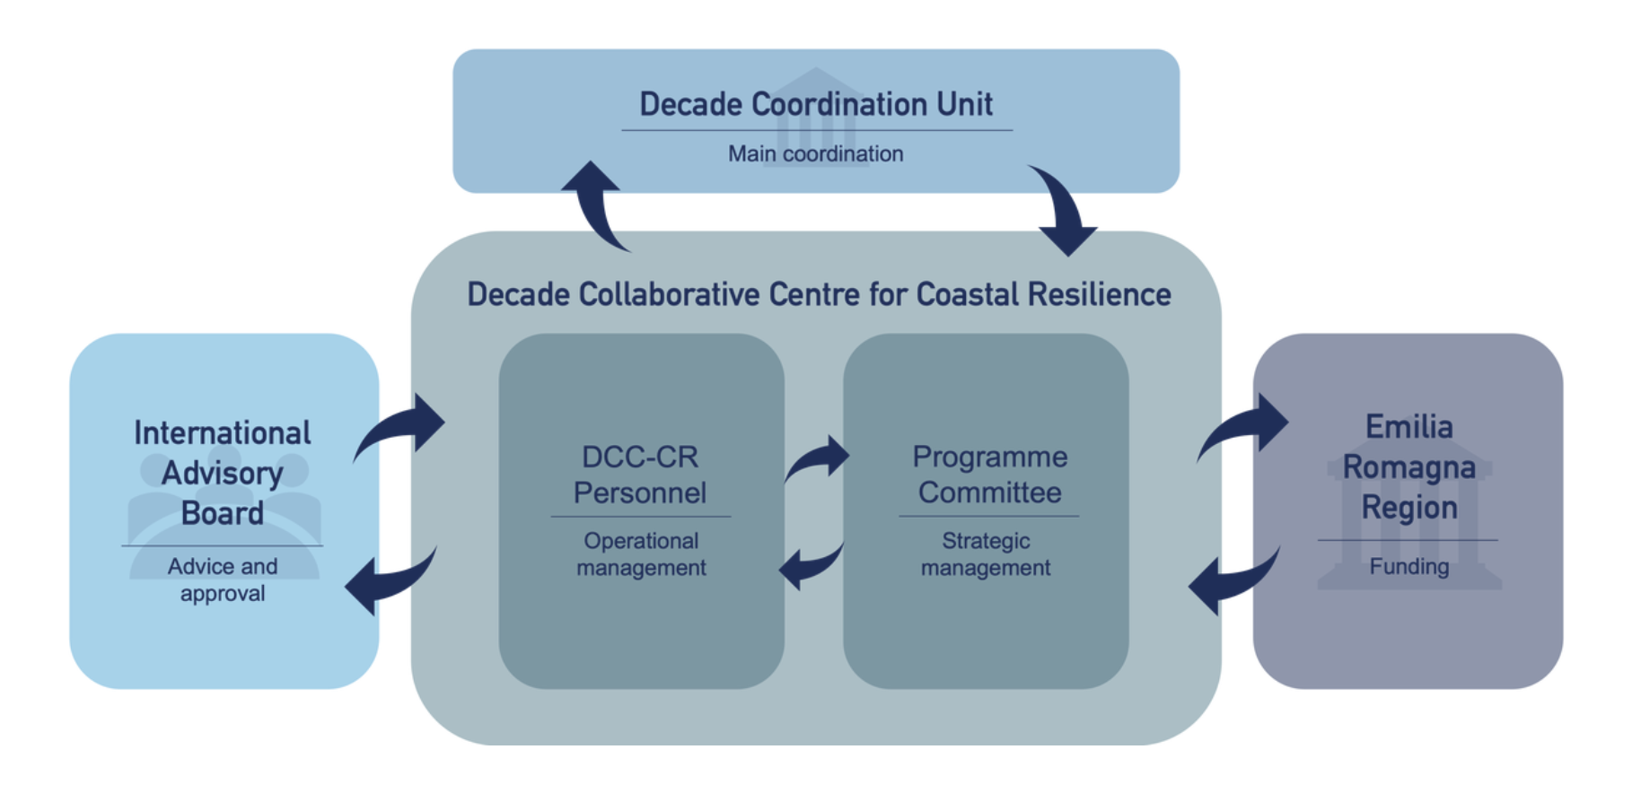
DCC-CR Governance
Notes:
Titles: DIN Alternate
Body texts: Arial

Slide 4
DCC-CR affiliated Decade Programmes
Global Estuaries Monitoring Programme
City University of Hong Kong
MegaDelta Programme
East China Normal University
The Ocean Decade Tsunami Programme
IOC-UNESCO
Ocean Cities Network
Institut de Ciències del Mar (Spain)
Global Ocean Corps and Conveyor
University of Michigan (USA)
SciNMeet
Italian Oceanographic Commission (COI)
SMARTNET
ICES/PICES (Denmark/USA)
CoastPredict
University of Bologna/CMCC
Ocean Biomolecular Observing Network
Partnership for Observation of the Global Ocean (POGO)
Blue Climate Initiative
Blue Climate Initiative/Tetiaroa Society
Global Ocean Oxygen Decade
GEOMAR (Germany)
SUPREME
NOAA (USA)
Global Ecosystem for Ocean Solutions
Ocean Visions and Future Seas (USA)
Observing Together: Meeting Stakeholder Needs and Making Every Observation Count
GOOS (UNESCO)
FishSCORE 2030
Gulf of Maine Research Institute (USA)
4

Slide 5
DCC-CR Affiliated Decade Contributions
Inundation Signatures on Rocky Coastlines
Williams College (USA)
NSF Coastlines and People
NSF (USA)
Committee on Earth Observation Satellites – COAST
NOAA (USA)
Multinational Image Classification Assessing Coastal Habitats
NOAA (USA)
Coastal livelihoods: preserving oceans to strengthen coastal resilience
AXA Research Fund
5

Slide 6




DCC-CR‘s strategic objectives
Improve science information for all
Enhance stakeholder engagement
Promote equitable education
Uphold environmental justice for coastal communities

Slide 7
Enhance Stakeholder Engagement Activity
A coastal resilience stakeholder survey has been prepared
Collaborative work between DCC-CR and DCC-IOR
Some questions:
How vulnerable is your coastal area to the following coastal/ocean hazards?
How prepared is your coastal region to manage the following coastal/ocean hazards?
Are there any plans/strategies/actions that contribute to improving coastal resilience
Are the implemented coastal resilience plans/strategies/actions integrated and adapted to changing conditions
How would you rate the overall effectiveness of the risk assessment and management strategies for coastal resilience in your area?
How accessible are financial resources for recovering from damages
How much do you agree with the following statement: “The governance of coastal resilience should go beyond supporting environmental, social and economic sustainability through reactive adaptation and move to an openly transformative approach to manage both sudden and slow onset coastal events”.
SOON TO BE LAUNCHED, STAY TUNED!

Slide 8
Promote Equitable Education Activity
Next Course for Winter 2024
"Resilient Coastal Business:
Sustainability, growth and human capital"
Who is this course for:
Post-graduate and early-career course for professional development and continuing education (25 students max)
Target audience:
coastal consulting companies
coastal managers and operators
environmental protection agencies
civil protection

Slide 9




Promote Equitable Education Activity
Hybrid Format:
+
4+ weeks online (with homework for case studies)
7 days in presence (to analyse case studies)
Computing and software made available on the cloud with a specific focus on the value chain access and use

Slide 10
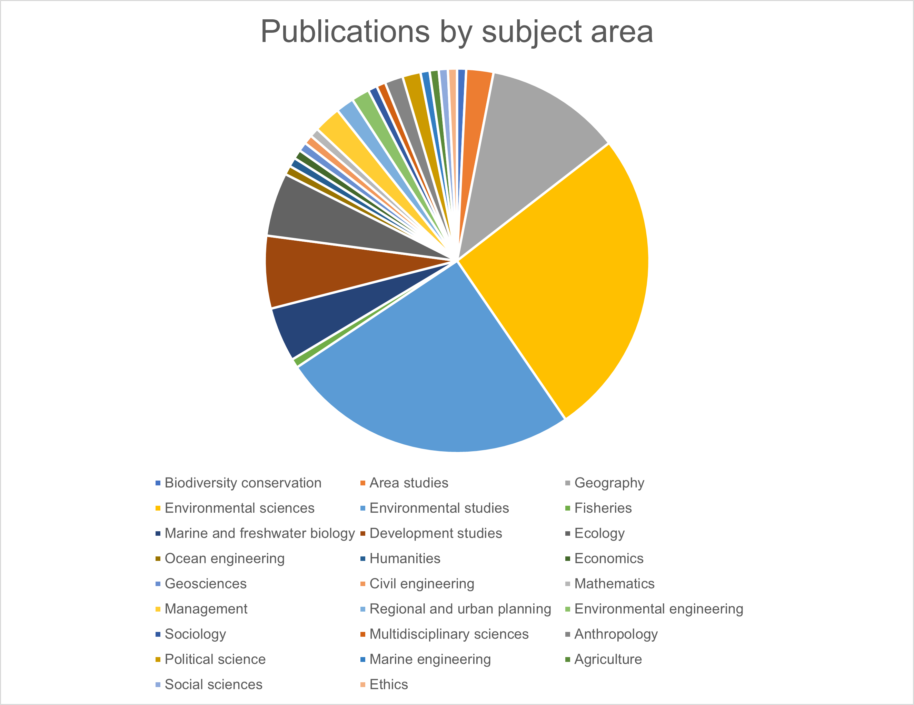
Uphold Environmental Justice for Coastal Communities Activity
Mapping of existing literature on coastal (environmental) justice
Search on Web of Science and Scopus
Database with 135 journal articles (1995-)
Material to be published on DCC-CR website

Slide 11
DCC-CR‘s Cross-cutting activities
Global
South
Coasts
Cities
with the
Ocean
Ocean
Decade
Vision 2030
COP on Coastal Ecosystem and Community Resilience
GlobalCoast
Experiment

Slide 12

Cross-cutting: Cities with the Ocean – UN Ocean Decade Initiative
Connecting coastal urban development and the Ocean Decade community to enable coastal cities around the world to take up ocean science and give the ocean a key role in their sustainable development.

Slide 13
DCC-CR organised a Town Hall session at Ocean Sciences 2024
A Dialogue on Coastal Cities
and Coastal Community Resilience
Date: Tuesday, February 20th 2024 at 12:45pm CST
Speakers:
  Vanessa Sarah Salvo (Ocean Cities Network-UN Decade Programme)
  David Behar (PEERS Coalition, San Francisco)
  Janelle Kellman (Center for Sea Rise Solutions, San Francisco)
  Representative from New Orleans Major Office
  Villy Kourafalou (CoastPredict Programme and City of Miami)
  Theophile Bongarts (SEA’TIES UN decade Project)
  Themes:
    Translation of scientific findings into actionable science
    Urban coastal ecosystem restoration and the role of citizen science
    Nature-based solutions applications through digital twin method
    Different types of science are needed in different contexts

Slide 14
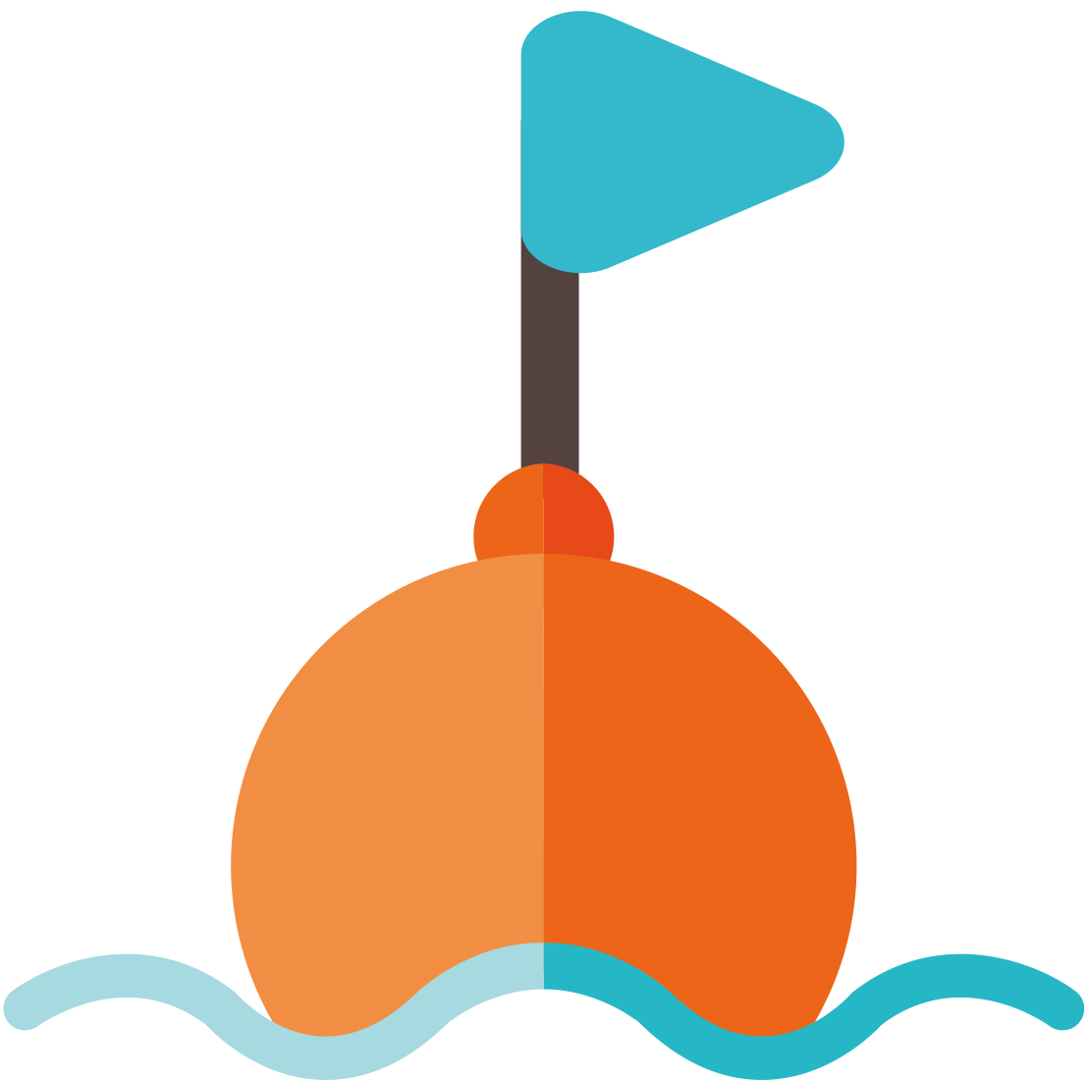
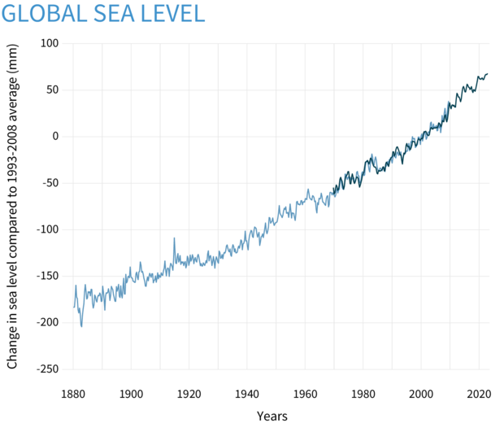
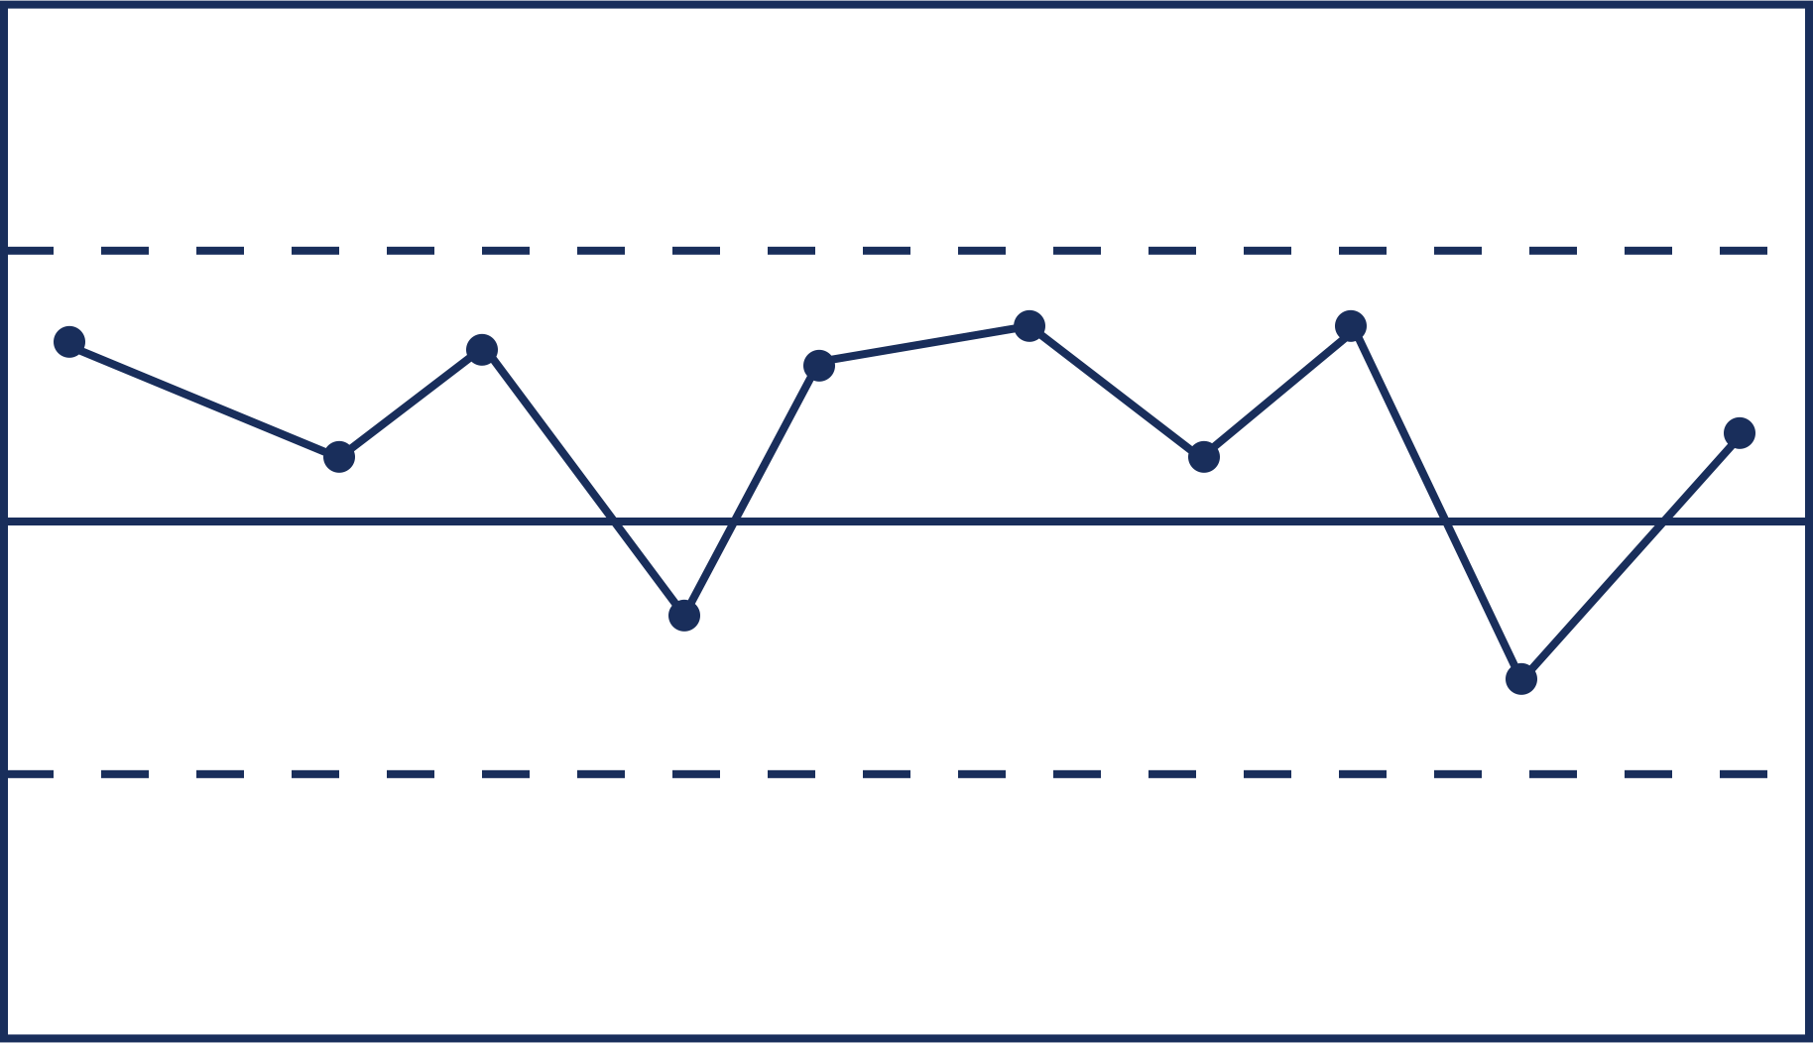

Cross-cutting: GlobalCoast Initiative
GlobalCoast is a CoastPredict initiative that will advance knowledge, innovative products and services to support coastal community resilience.
01. New observing technologies
03. 100 years projections
for the coastal observing system will be implemented, innovated and tested at each pilot site to validate/calibrate regional coastal models
will be produced by implementing regional to coastal climate limited area and AI-based models to downscale climate scenarios
02. Regional-coastal limited area models & AI-based models
04. High resolution reanalysis to instruct AI networks
will be implemented to assess the range of predictability and understand uncertainties, and provide an impact ensemble framework
will be produced at the coastal scale

Slide 15

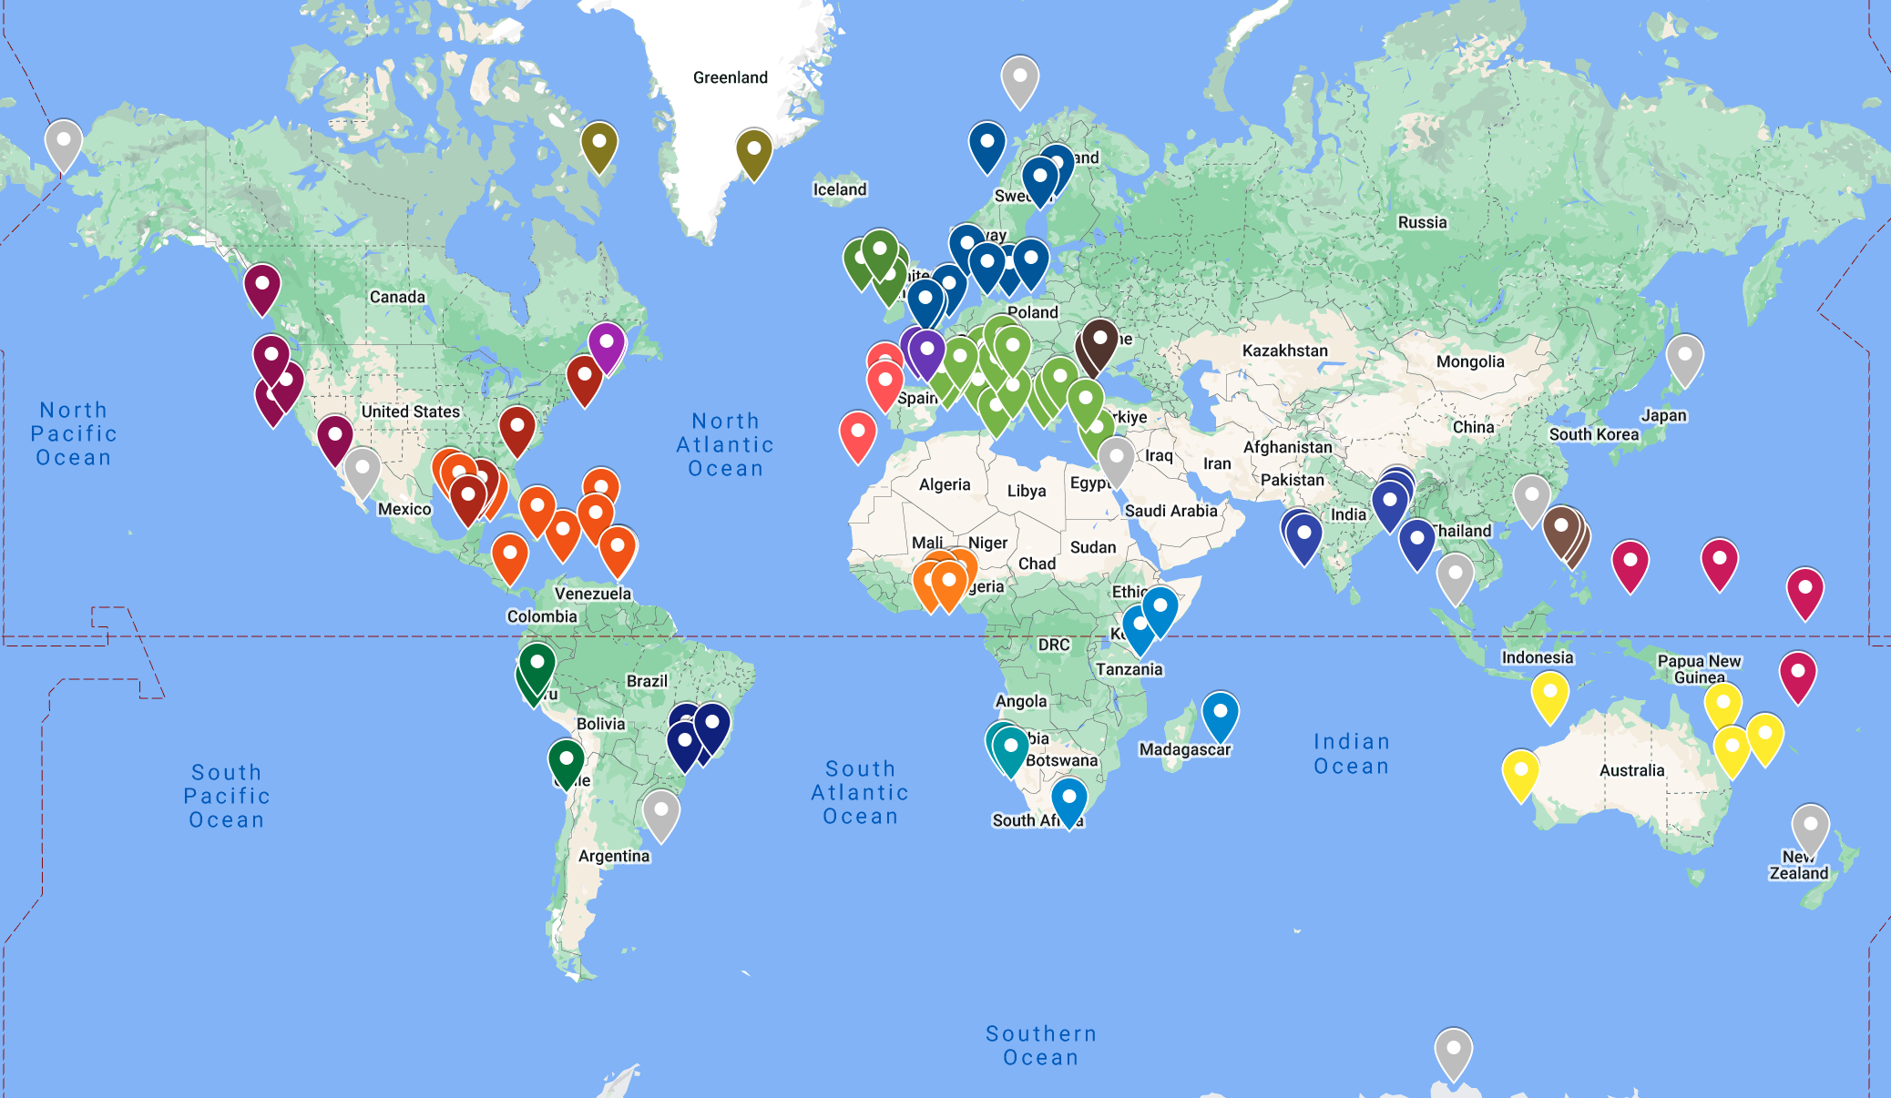


GlobalCoast survey insights
119
Pilot Sites
29
Regions of the Global Coastal Ocean
227
institutions
in 64 countries

Slide 16
Pilot Site locations*
*subject to change - some locations to be verified

Slide 17
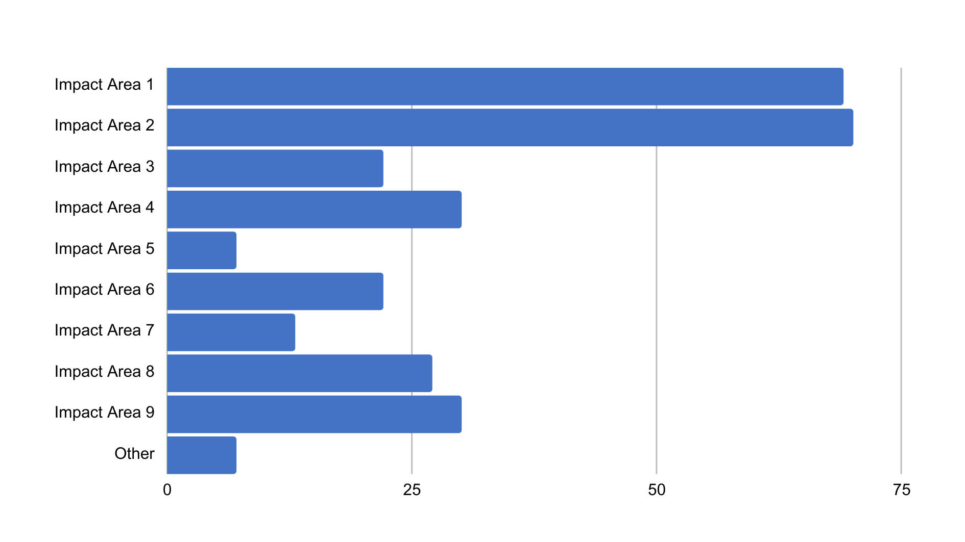
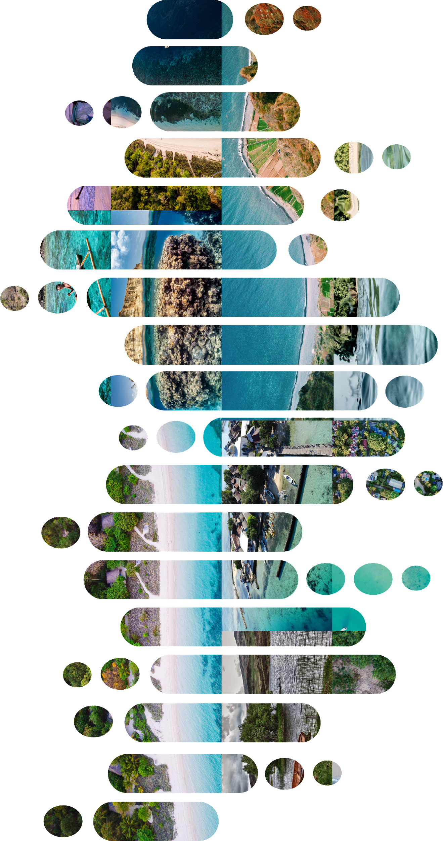
PRIORITY IMPACT AREAS
Q: Select up to three impact areas that will be addressed in your Pilot Site
IMPACT AREA 1
Capacity in disaster risk reduction - real-time forecasting of extreme events
IMPACT AREA 2
Support adaptation to/mitigation of impacts of climate change on coasts incl. indicators of sea level, temperature, biochem, biodiversity
IMPACT AREA 3
Prevention/mitigation of pollution impacts - hazard/risk mapping & forecasting at coastal scales
IMPACT AREA 4
Minimise climate & shorter-term impacts on morphodynamics
Improve urban oceanography science & planning
IMPACT AREA 5
Reduce impact of climate change through blue carbon monitoring, carbon dioxide uptake enhancement, NBS, ecosystem restoration
IMPACT AREA 6
Sustainable food production through coastal mariculture support system
Increase capacity on environmental awareness for all operations at sea - maritime safety, Search and Rescue
IMPACT AREA 7
Improvement in Integrated Coastal Zone Management & / or
Marine Spatial Planning
IMPACT AREA 8
IMPACT AREA 9

Slide 18
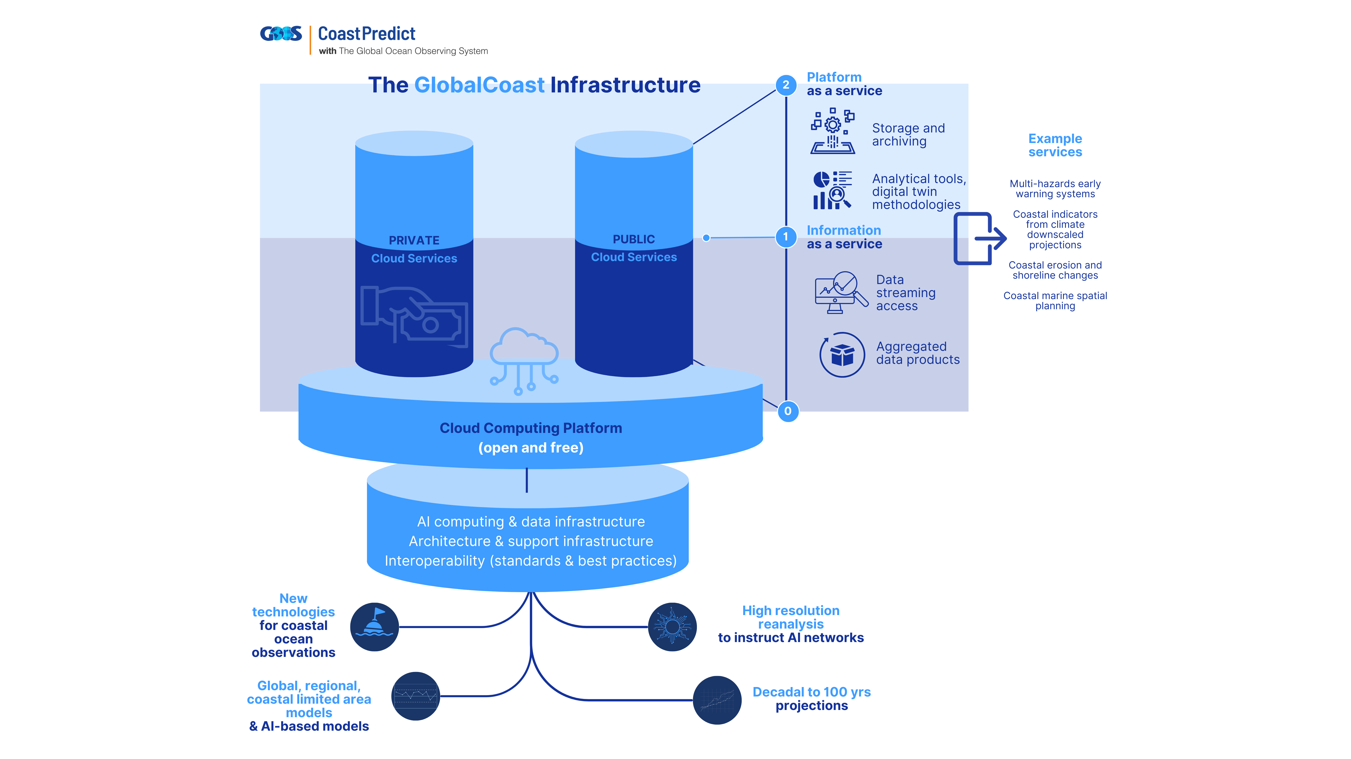
DCC-CR and GlobalCoast: Implementation and funding Strategy
IMPACT AREA 1
IMPACT AREA 4
IMPACT AREA 5
IMPACT AREA 6
IMPACT AREA 7
IMPACT AREA 8
IMPACT AREA 9

Slide 19
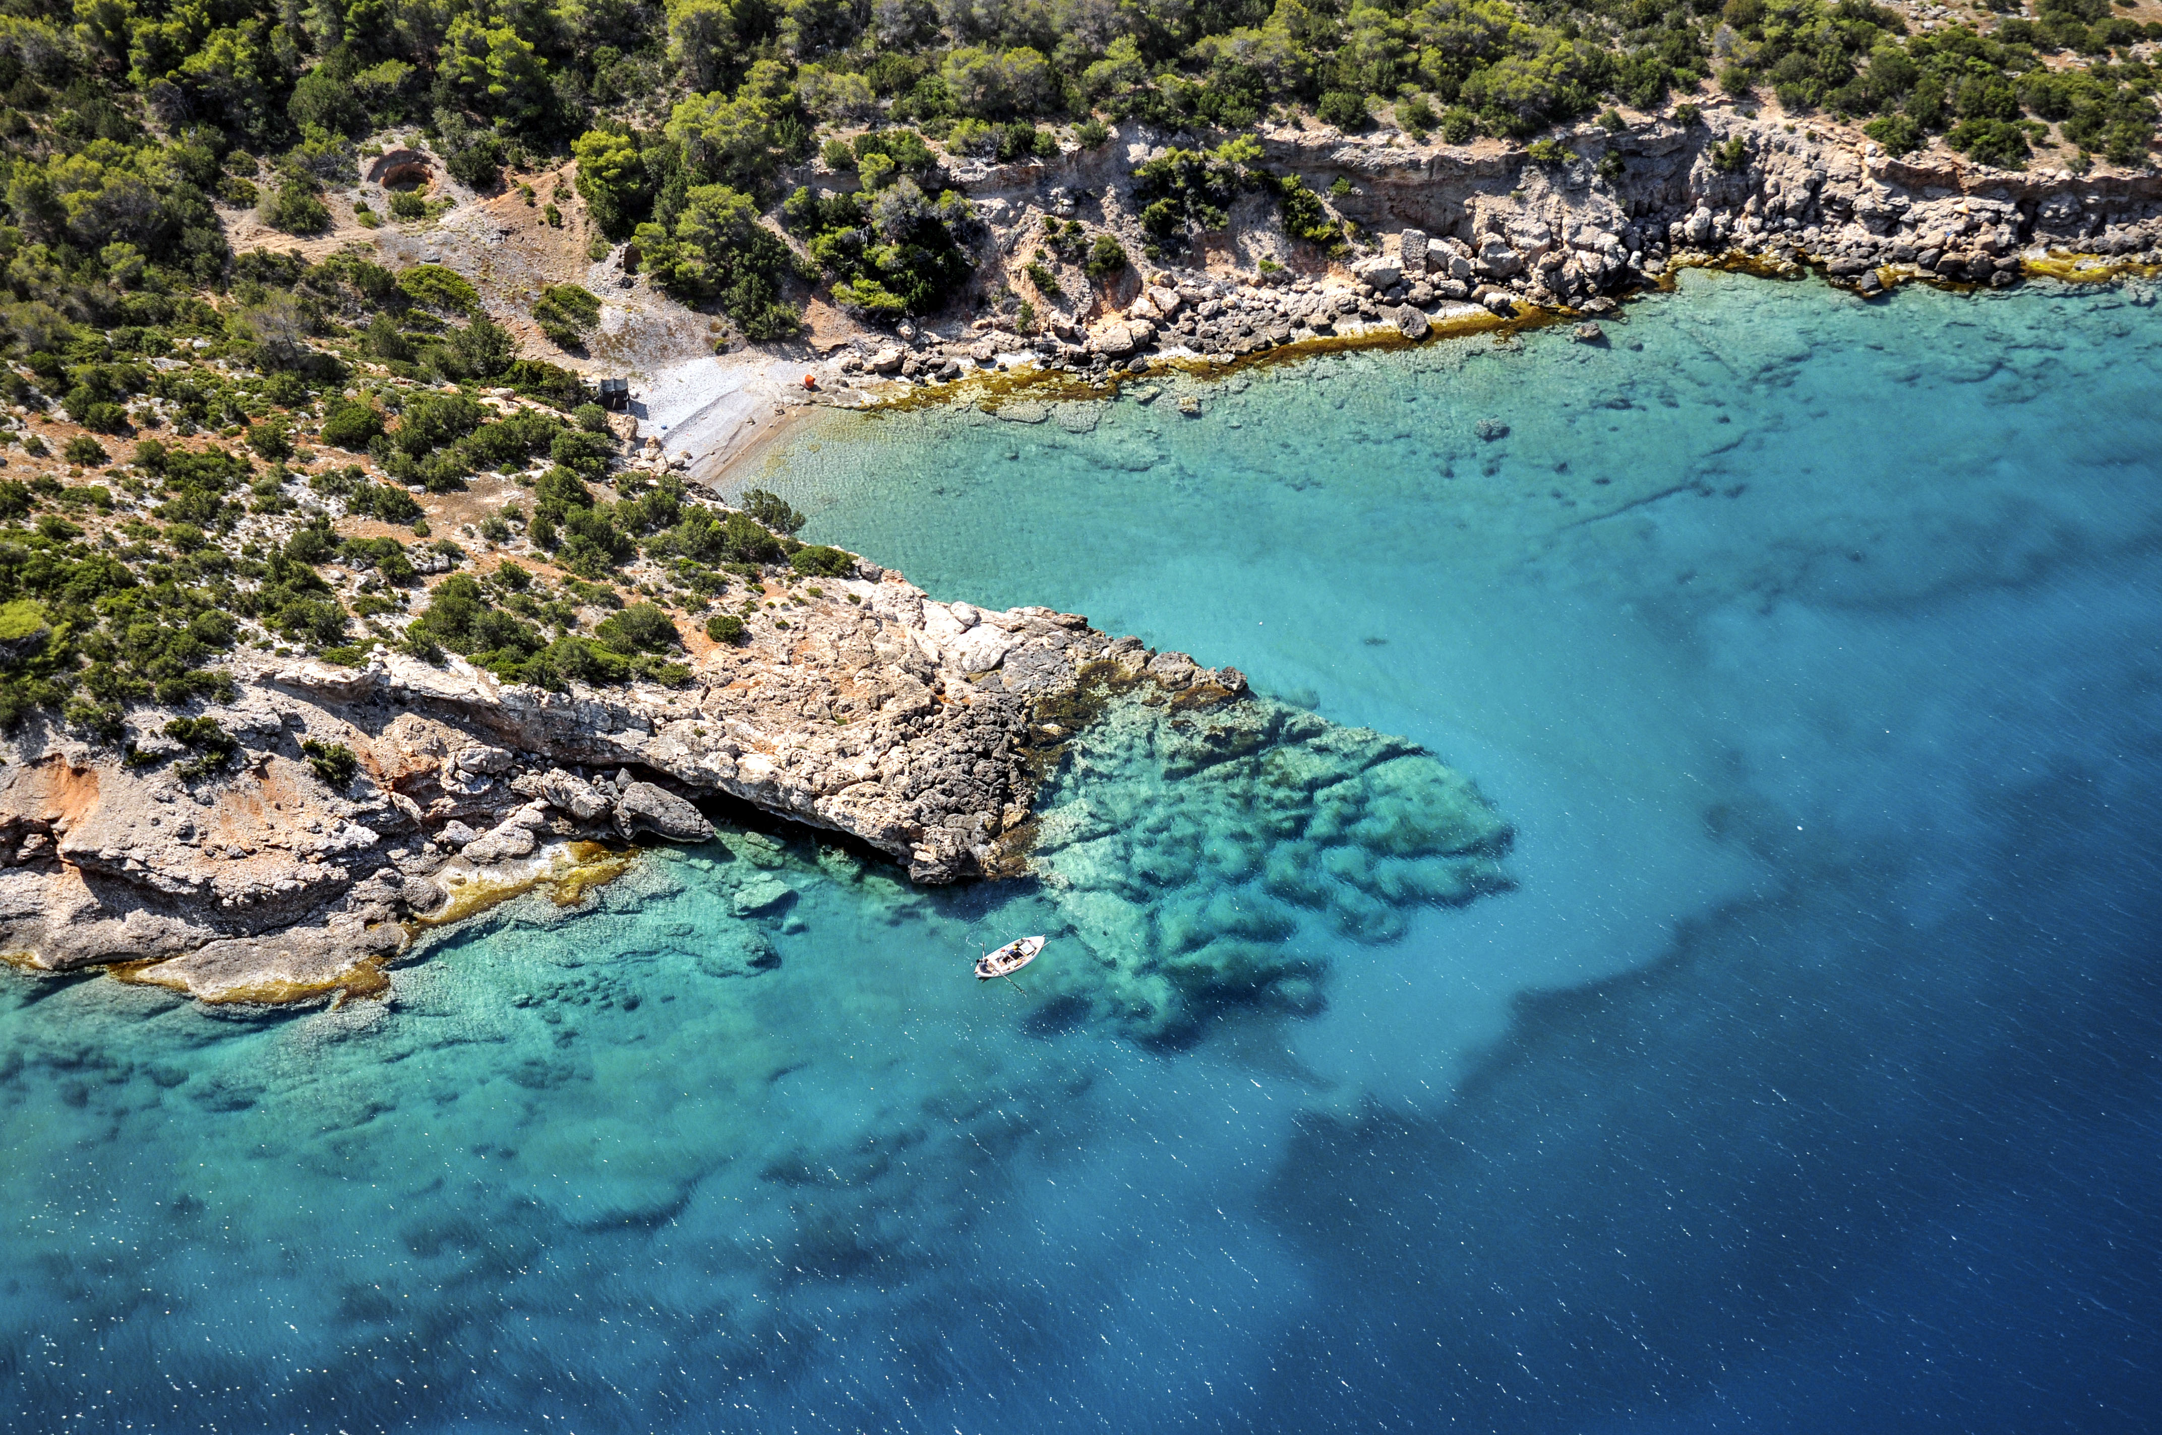
Cross-cutting: Vision 2030 Challenge 6, Increase resilience to coastal hazards
Nadia Pinardi and Srinivasa Kumar co-chairing the Vision 2030 White Paper
The final version of the White paper will be presented at UNODC 2024.
Design ‘people-centred’ multi-hazard
early warning systems
Design adaptation planning strategies
to increase coastal resilience
GOAL:
A safe ocean where life and livelihoods are protected from ocean-related hazards
Characteristics:
Stakeholder engagement
Responsibility sharing
Accessible communication
Institutional capacity building
Use the new data from the Ocean Decade to prepare updated plans and solutions, also in view of the Marine Spatial Planning process

Slide 20


Get in touch
DCCs and DCOs network will build the next generation infrastructure for the UNESCO-IOC contribution to the Sustainable Development Goals.
Connection with the Tsunami Programme is essential for coastal resilience and we look forward to work with you in this direction
How to Engage
DCC-CR website
https://shorturl.at/bhzI9
Subscribe to our
Newsletter
https://shorturl.at/fzAO7

Slide 21

https://centri.unibo.it/dcc-cr/en
difa.dcc-cr@unibo.it
The Decade Collaborative Centre for Coastal Resilience is a departmental centre of the University of Bologna and it is funded by the Emilia-Romagna Region.

