Slide 1

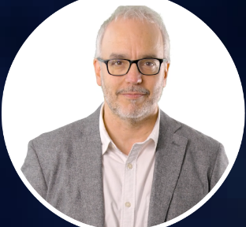

OceanPrediction DCC
Connecting the world around ocean forecasting
SC-ODTP: Introduction to OceanPrediction DCC.
Enrique Alvarez Fanjul
Technical coordinator of OceanPrediction DCC
Mercator Ocean International

Slide 2

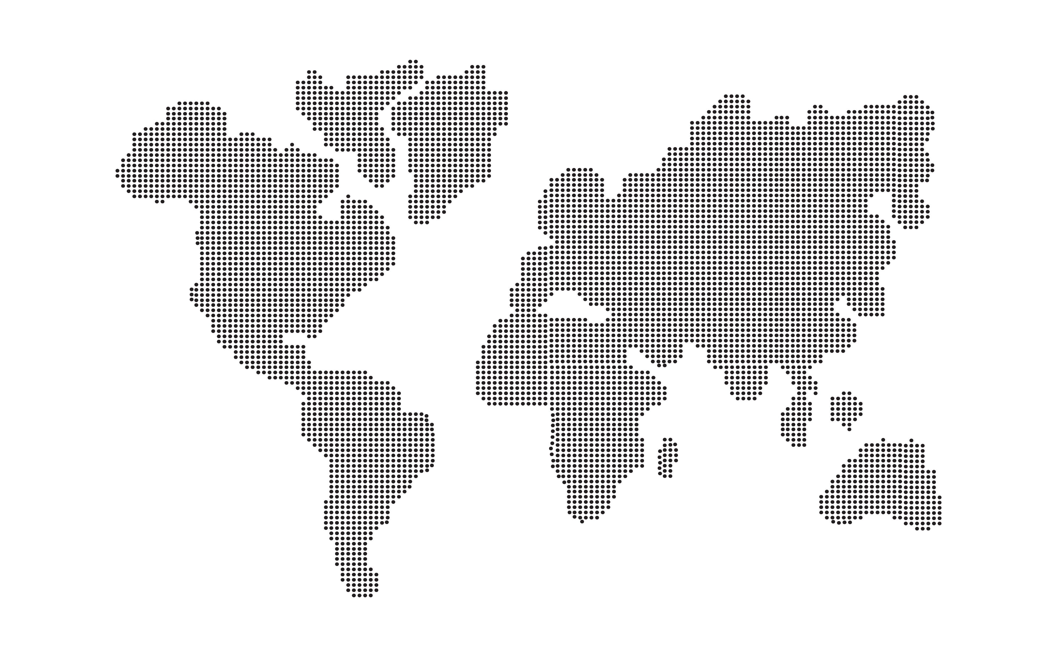

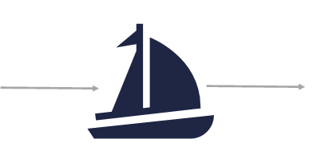

The OceanPrediction DCC voyage
2020: THE OCEAN FORECAST WE HAVE
2030: THE OCEAN FORECAST WE WANT
OceanPrediction DCC VESSEL
Captain: UN Ocean Decade
Chief engineer: Decade actions and DTO
Crew: OceanPrediction DCC community
Navigator: OceanPrediction DCC
Useful but partially disconnected services
Poor presence in developing countries
Connected community and services
Many robust systems worldwide

Slide 3


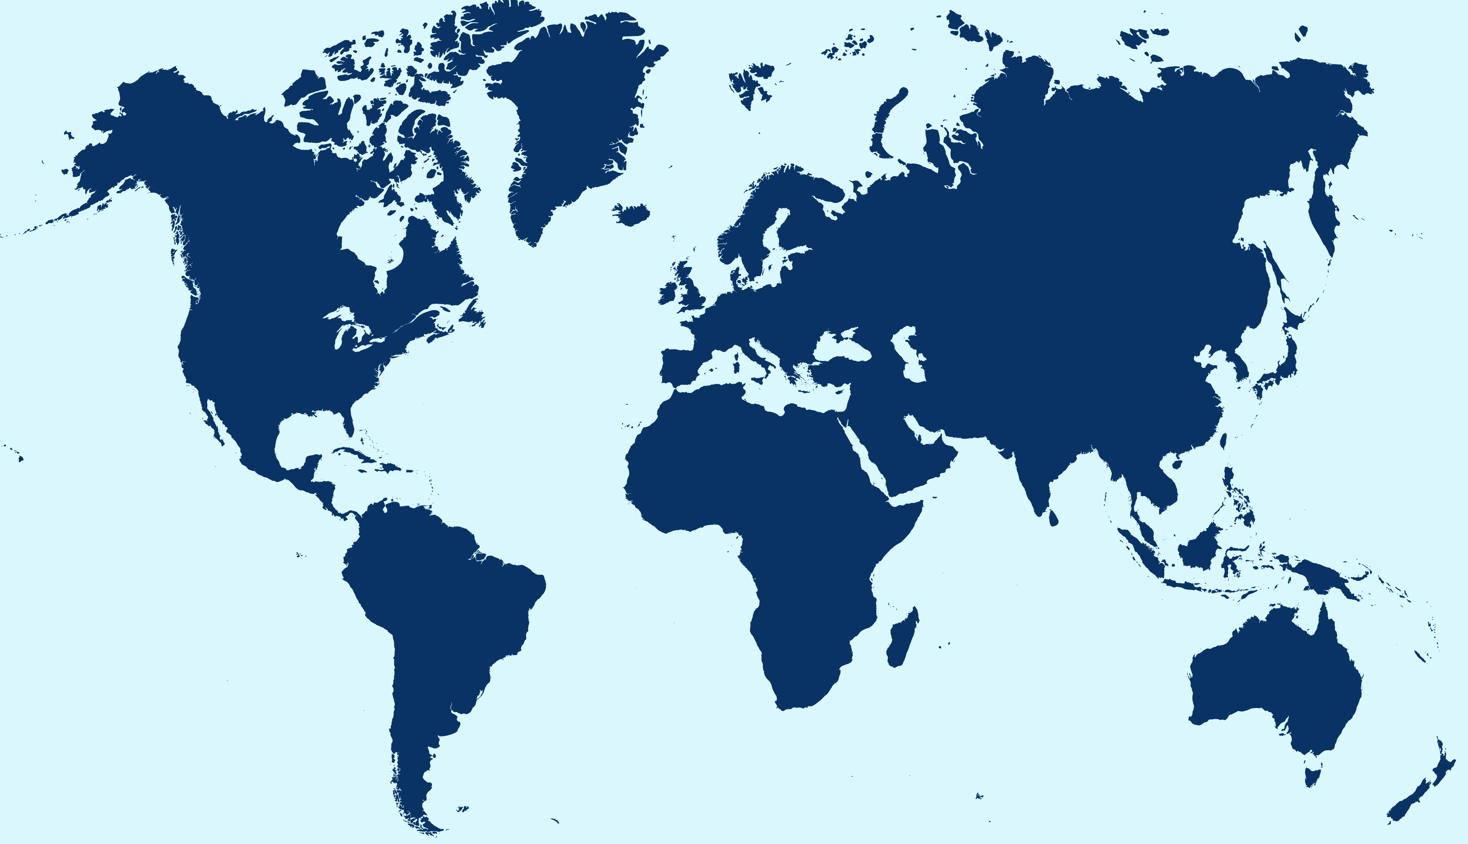


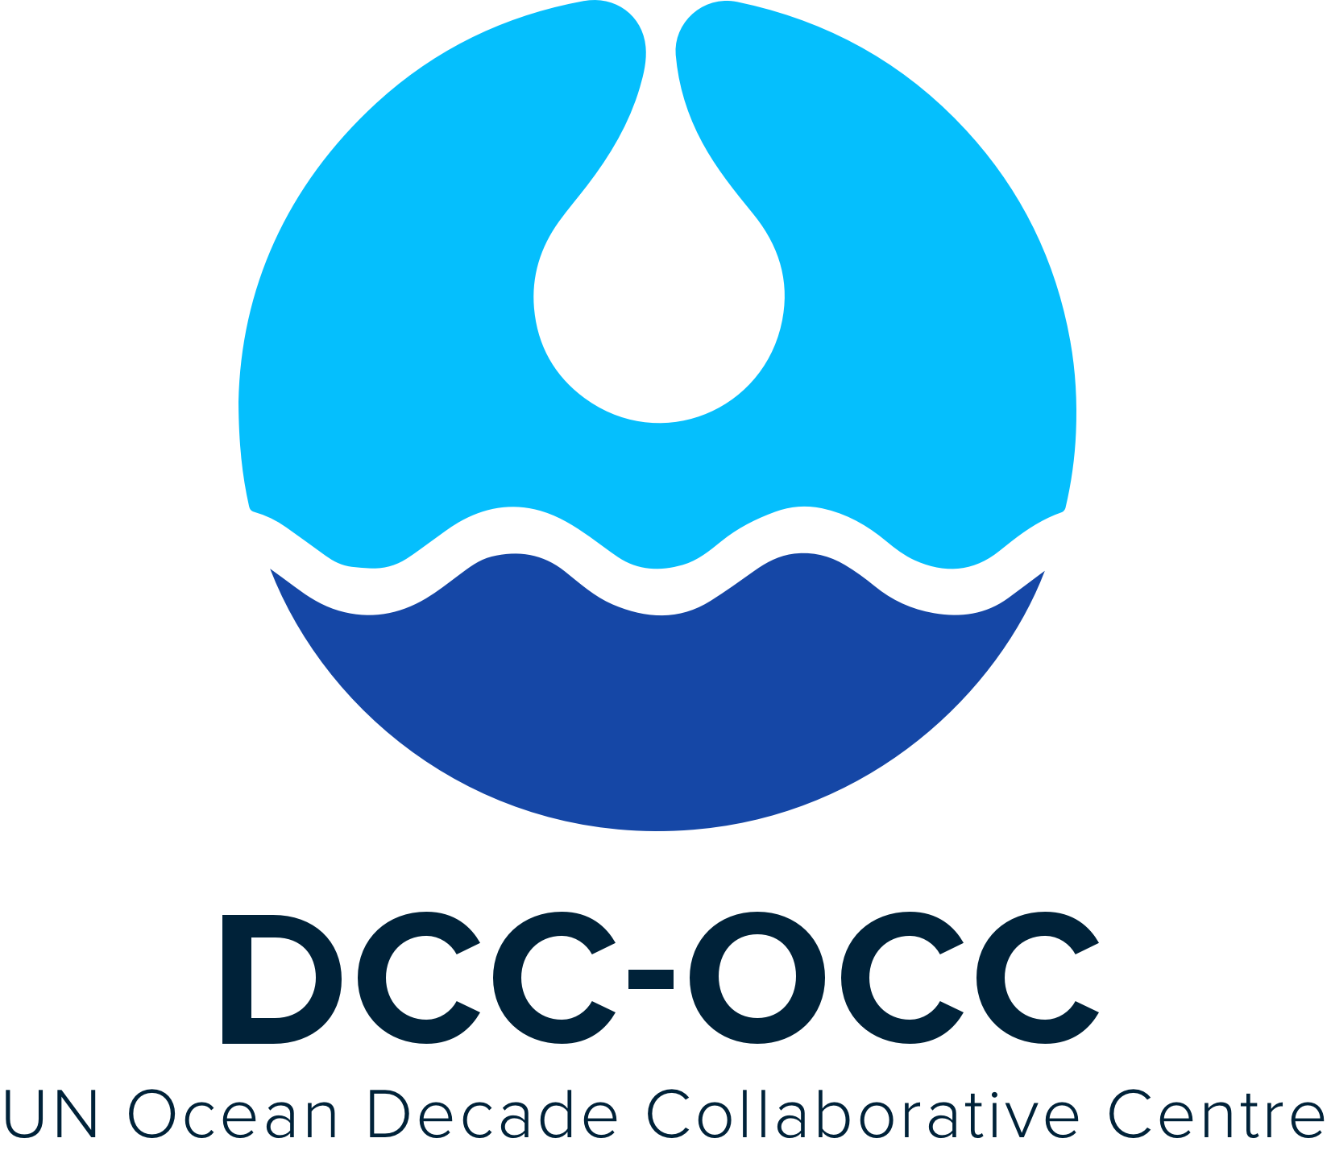





Working alongside other Coordinating Offices across disciplines
Ocean-Climate
Nexus DCC
Western Pacific DCC
Pacific Islands Region of the Pacific Ocean
Connecting People and Ocean DCC
Southern Ocean DCC

Slide 4






Programmes primary endorsed to OceanPrediction DCC
GEMS
OCEAN
NASA Sea Level Change Team

Slide 5
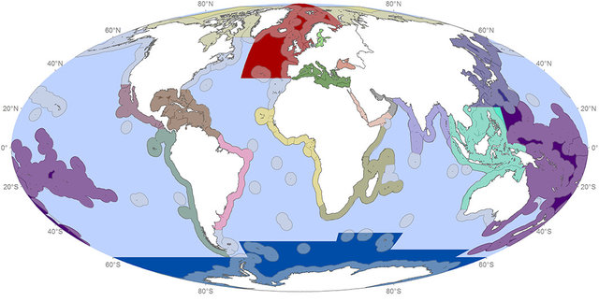
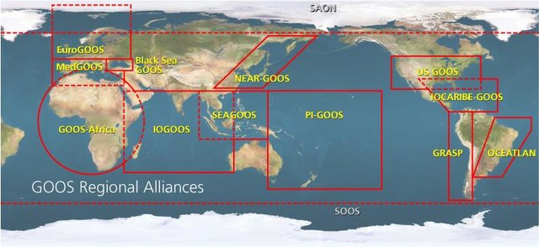
Oceanprediction DCC regional teams: Promoting the implementation and use of ocean forecasting systems worldwide
Pillars (1/2): A global and transversal community
Region 1: West Pacific and MSEA
Region 2: Indian seas
Region 3: African seas
Region 4: Mediterranean and Black Sea
Region 5: North-East Atlantic
Region 6: South and central America
Region 7: North America
Region 8: Arctic
Region 9: Antarctic
UNEP regional seas
GOOS regional alliances
“Boots on the ground” work:
  Identify and attract a wide community: scientist, users, private sector, NGOs, etc…
  Support decade actions related to ocean forecasting
  Identify gaps and ways forward
  Capacity building
  Advocate for implementation of Best Practices, Standards and Tools
  …

Slide 6

Update on Community building activities
Governance of Regional Teams
Bio
Climate
Physics
AI
Digital Twins
Observations
…
Observations
Physics
Bio
Climate
AI
Digital Twins
…
Observations
Physics
Bio
Climate
AI
Digital Twins
…
Region 1
Region 2
Region 3
ToR main components:
  A Regional focal point
  A Steering team
…

Slide 7
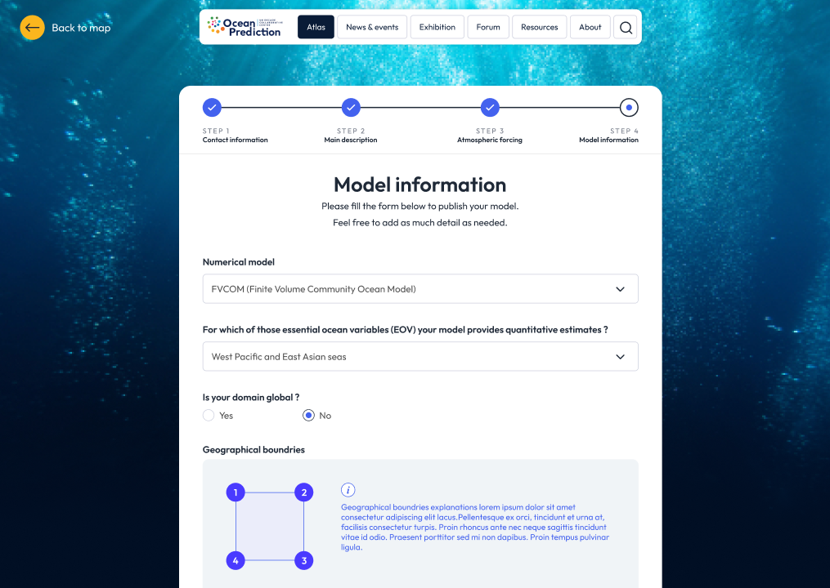
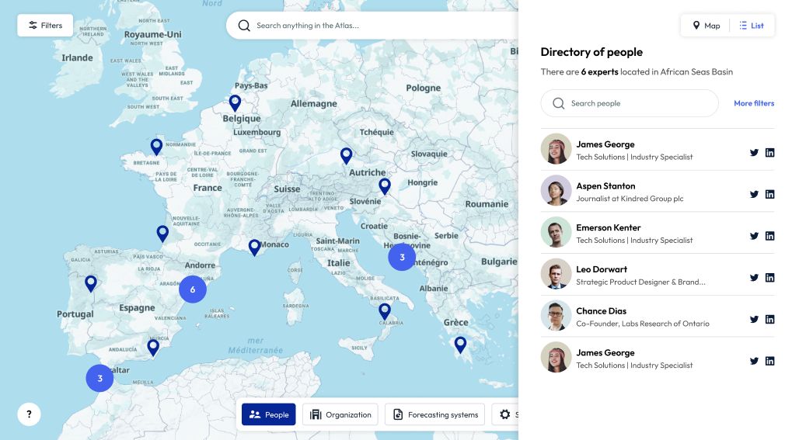
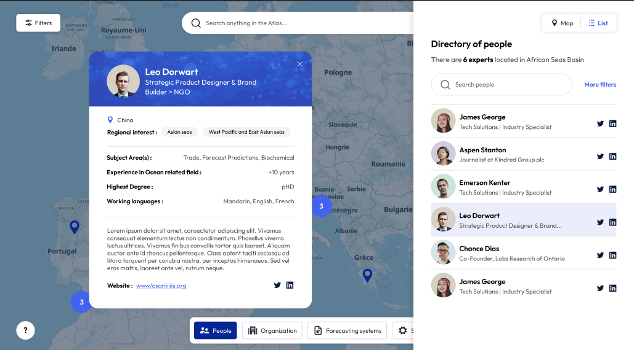
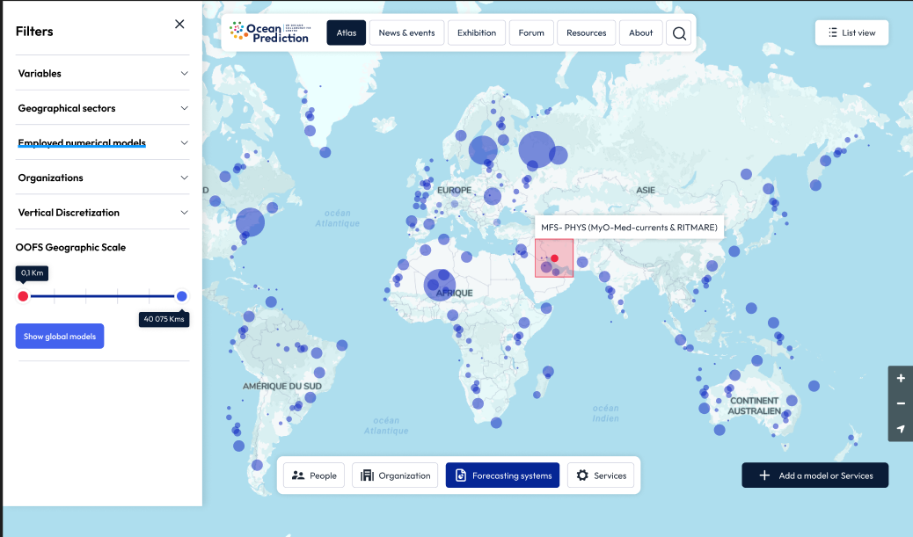
Our community: Who is who?
An Atlas to identify our community
An online atlas to locate:
  OOFS
  Individuals
  Institutions
  Services
A source of information for our activities and a way to find partners
An interface will be available to allow community to add and modify the information

Slide 8
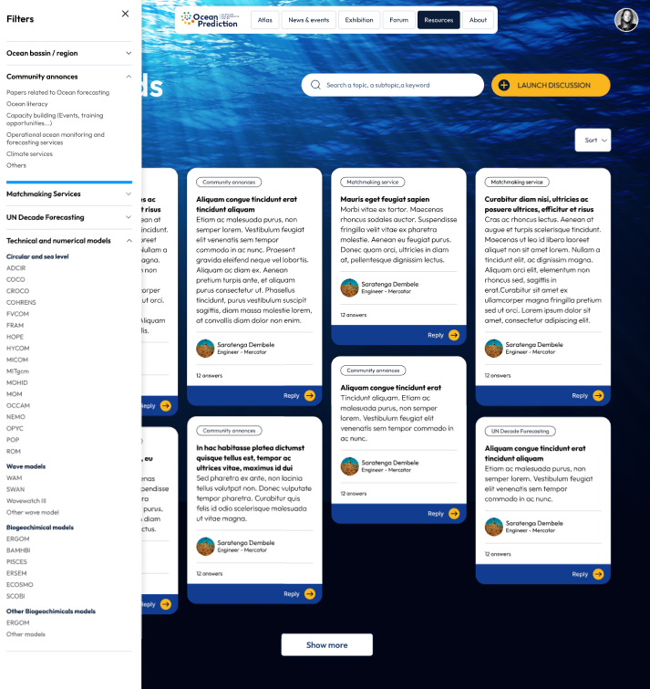
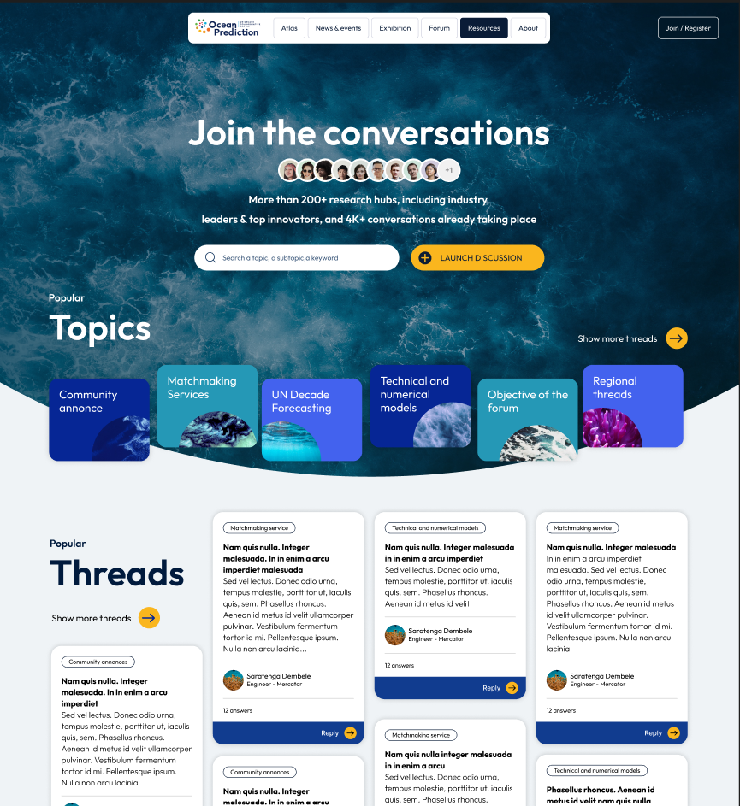
The OceanPrediction Forum
Community focal point
A focal point/forum for communication and matchmaking to be operated in close cooperation with Foresea/OceanPredict:
  Community announces
  Contact a partner, Matchmaking service
  Ocean forecasting Activities related to the decade programmes
  Regional Forums
  Technical forum for specialized announces and doubt solving
Administration of relevant sections could be done by Regional Team.

Slide 9
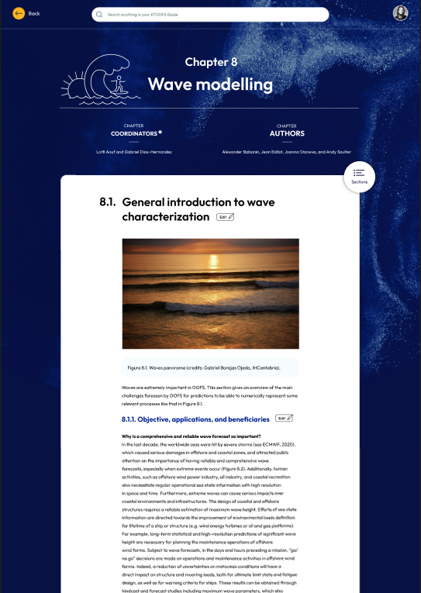
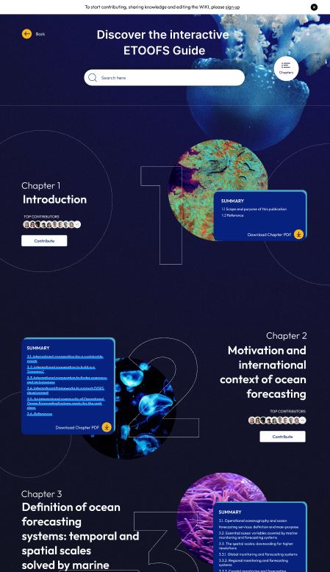
Building the Technical Scenario
Upgrade of ETOOFS guide
ETOOFS guide converted to wiki site:
  A new consolidated version of the guide every 3-4 years
  New section on Biological modeling (higher trophic) and Tsunami
  Improvements needed in several sections, like rivers contribution

Slide 10
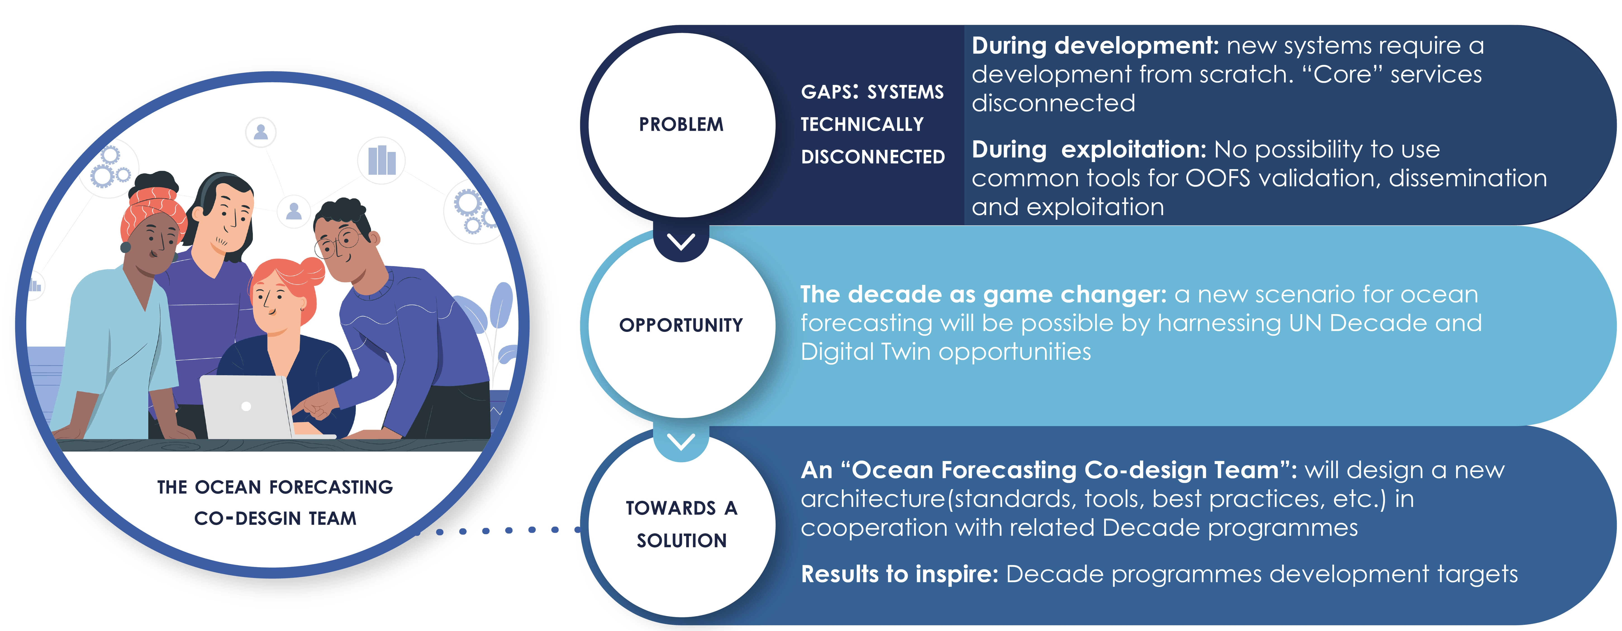
Pillars (2/2): The ocean forecasting co-design team

Slide 11
OceanPrediction Science-to-Service approach through co-designed Value Chains
Forecasting Engines
Intermediate Users
OceanPrediction A
OBS
ENS
COU
VAL
Forecasts
ATM
RIV
VIS
Users
No digital Twin; interoperable
OM
DAS
MOD(s)
Bathy
Tools
Forecasting Engines
VIS +
Tools
OceanPrediction B
OBS
ENS
COU
Digital Twin
Intermediate Users
ATM
Data Lake
RIV
Digital Twin to facilitate interoperability and processing
OM
DAS
MOD(s)
+Tools
Users
Bathy
VAL
OBS
Forecasting Engines
Digital Twin
VIS +
Tools
OceanPrediction C
ATM
ENS
COU
Intermediate Users
RIV
Data Lake
OM
+Tools
Full Digital Twin
Bathy
DAS
MOD(s)
Users
VAL

Slide 12
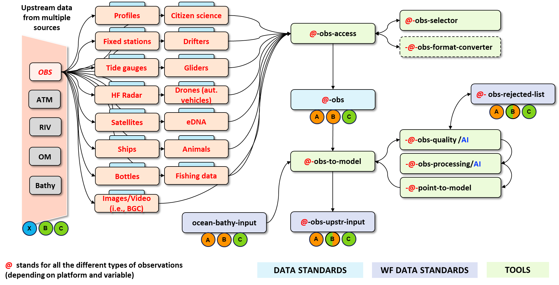
Wiring diagrams to define in detail architectures A to C based on tools and data standards: one example (upstream observations data access)

Slide 13
Operational Readiness Levels (ORL)
5
#1: Operationality
4
1
#2: System Validation
#3: Product Dissemination
3
2
Benefits of ORL:
Promote the adoption of tools, standards and Best Practices
A mechanism to endorse services to join common frameworks
A way to guide and stimulate services development

Slide 14

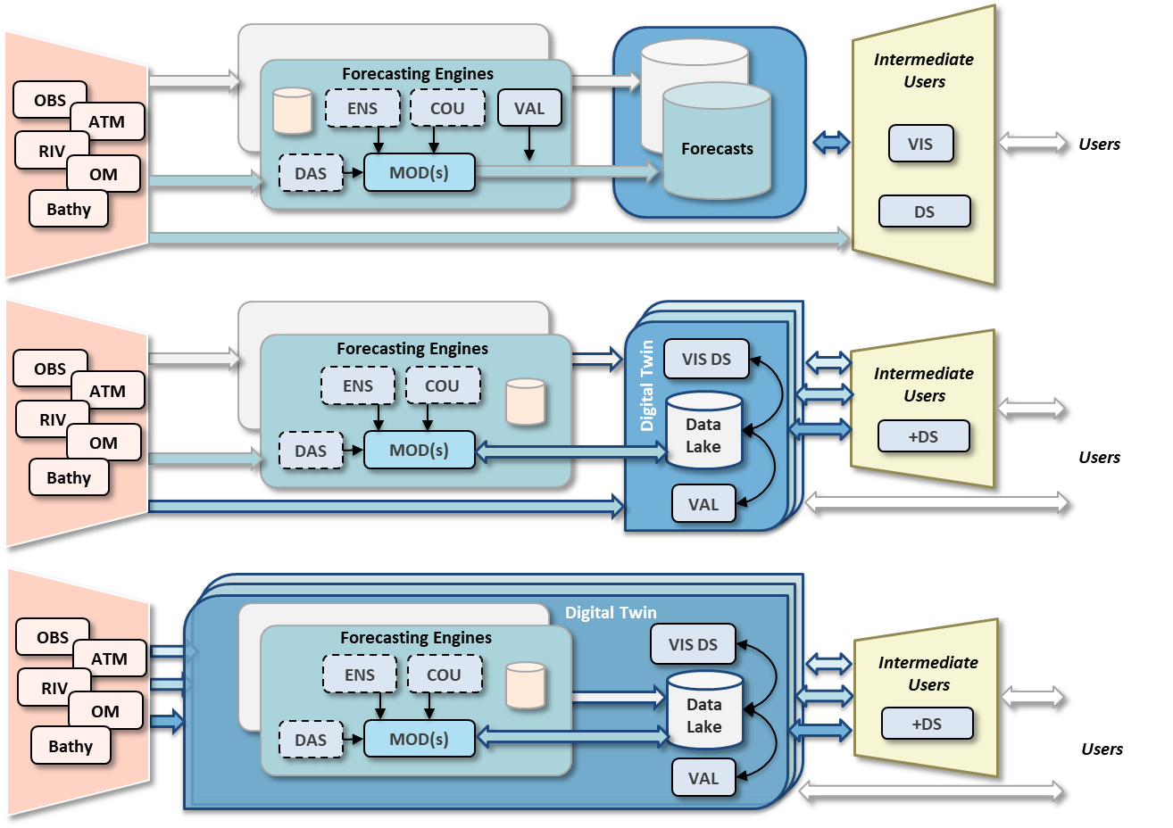
Capacity development
Building our community: ongoing efforts
Capacity development
ETOOFS Guide
Capacity
development
Basic knowledge Building
Framework for development
Implemen-tation
Delivering as one
Fully integrated towards delivering as one
ETOOFS guide and OFCT major assets
OceanPrediction
architecture
GEMS
OCEAN

Slide 15


CONCLUSIONS
OceanPrediction DCC has to pillars: 1) Community building and 2) developing a technical framework to support delivering as one.
First tangible results from OceanPrediction DCC are starting to be available: Regional Teams structure, web page, architecture, ORL, …
These results are a relevant assets for SC-ODTP. How?… to be defined.
Connecting the world around
Ocean Prediction

