Slide 1


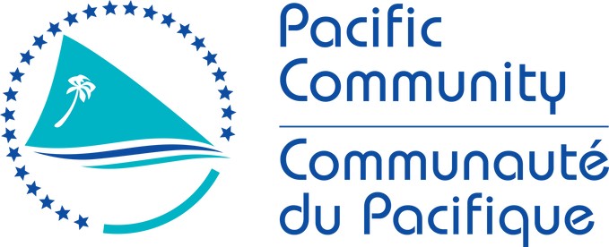

DCC Pacific Islands
Jerome Aucan, Head of the Pacific Community Center for Ocean Science
4th Meeting of Scientific Committee for the UN Ocean Decade Tsunami Programme (ODTP-SC)
25-26 January 2024. HQ, Paris,
IOC Meeting room (4th floor Japanese Garden building)

Slide 2




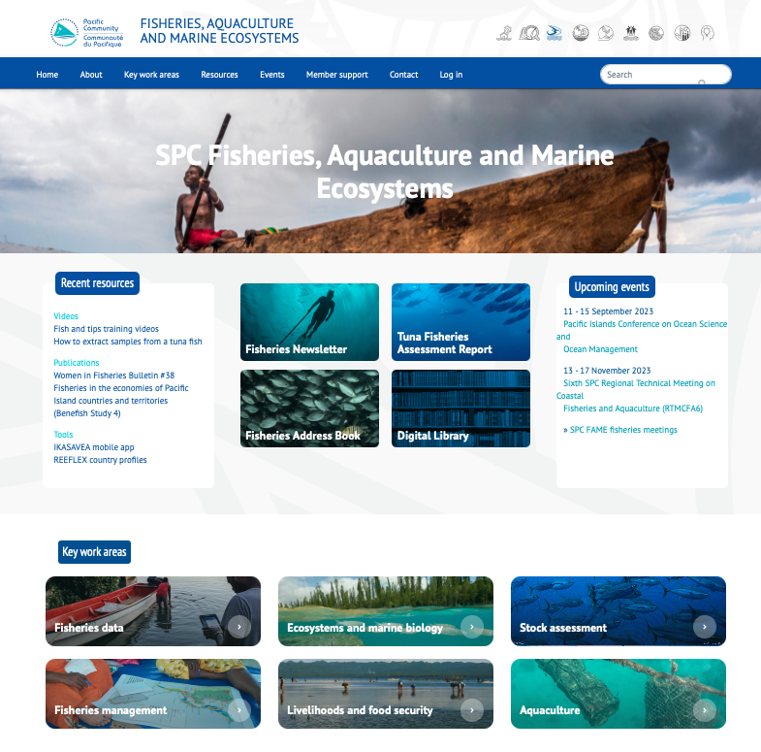
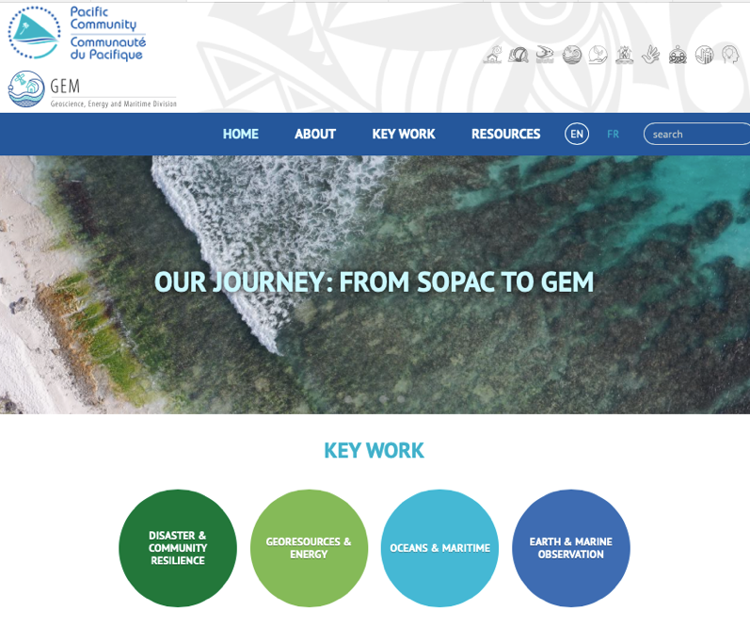

Slide 3
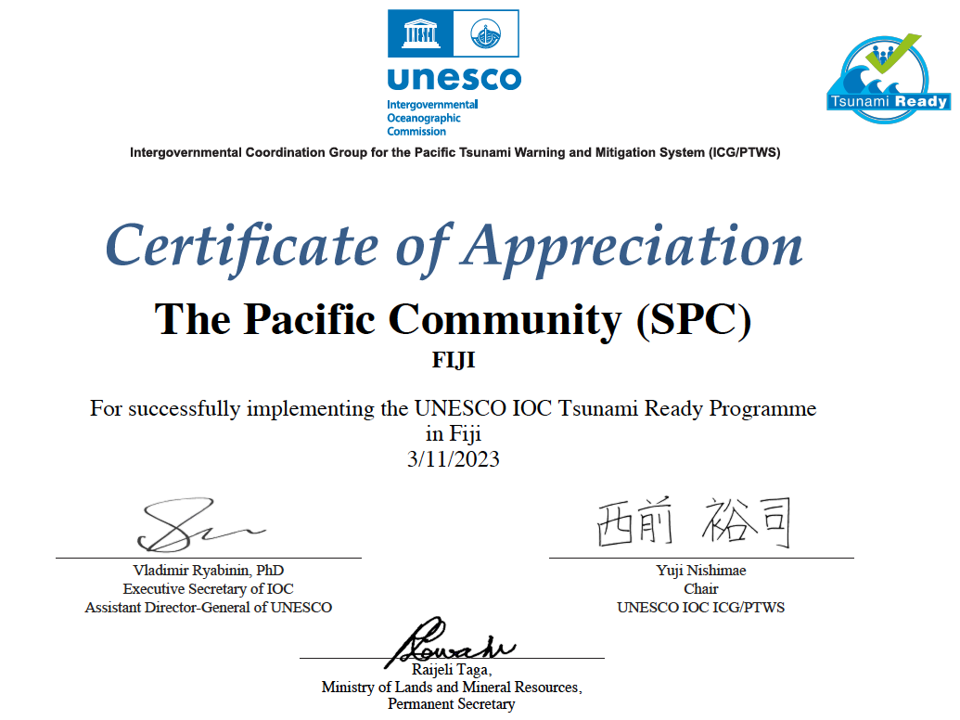

Slide 4
PCCOS : The Pacific Community Center for Ocean Science
2017 : The 10th pacific community conference agreed to establish the pacific community centre for ocean science (PCCOS) to be hosted at SPC and become a true flagship for scientific excellence and a dedicated regional science information and knowledge hub.
2019 : Inception of PCCOS with MFAT funding. Laying the foundation at GEM,
Early 2021 : Implementation of PCCOS
2022 : PCCOS is fully operationnal, and adds 3 main projets (PIOAC, IOM and MSP)
2023 : PCCOS is designated to coordinate the Decade Collaborative Center for the Pacific Islands and the rejuvenation of PIGOOS
2024 : Phase II

Slide 5
PCCOS 3 broad goals :
PCCOS aims at facilitating and promoting cross-divisional engagement and cooperation internally at SPC for a better-integrated service to its members and continued building of ocean science excellence at SPC.
PCCOS will actively contribute to strategic partnerships in ocean science with a large number of institutions and initiatives at the national level, regionally (particularly with other CROP agencies) and internationally.
PCCOS will coordinate the approach with government agencies responsible for implementing ocean policies and tracking progress against SDG 14.

Slide 6
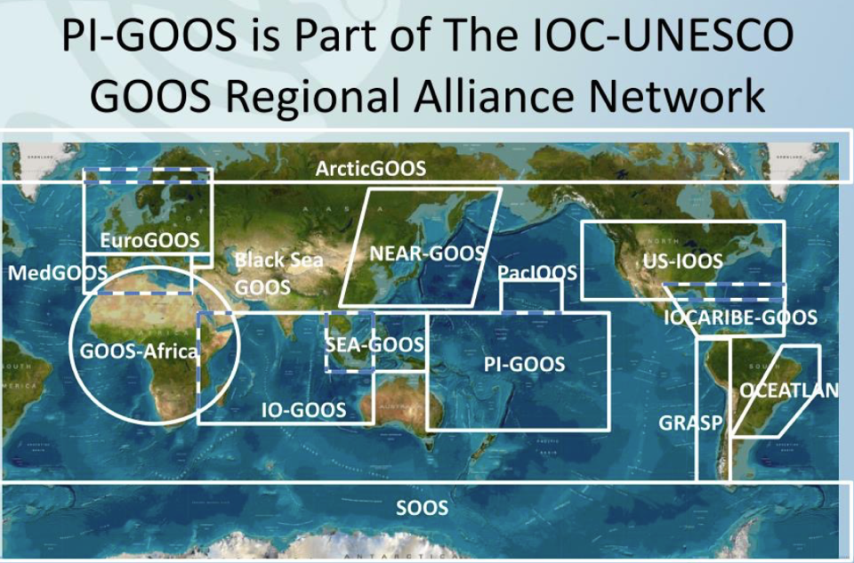

Starting in 2023, SPC will coordinate the rejuvenation of PI-GOOS

Slide 8
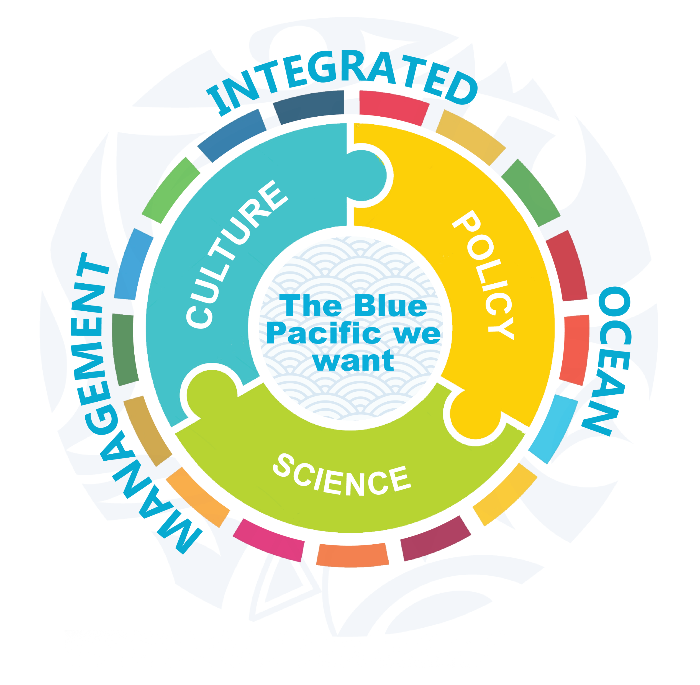

Pacific solutions for a healthy Blue Pacific Continent: Integrated Ocean Management to sustain livelihoods today and into the future
Integrated Ocean Management
CULTURE & TK:
Actions are inclusive of traditional knowledge
LAW & POLICY:
Robust legal instruments and policy frameworks
Officially Endorsed Action
SCIENCE: Improved decision support systems
Notes:
Focus:
Support the implementation of national ocean policies and a joined-up approach to Integrated Ocean Management (IOM) across the Pacific
Objective:
Harnessing science and knowledge (including Traditional Knowledge) for IOM
Outcomes:

Slide 9

Decade Collaborative Centres play a coordination and catalysis role for Decade Actions at the regional or thematic level by providing support for:
Scientific coordination and planning;
The identification of collaboration opportunities;
Awareness raising and stakeholder engagement;
Technical and scientific capacities
Notes:
Status of the Ocean Decade in the region with highlights of some challenges and opportunities including reference to key conclusions of 2019 regional planning meeting
Presentation of DCC including role and connections with global, regional and national partners
Role of DCC in the coordination of a regional roadmap
Finishes with a perspective on some key priorities for consideration in the roadmap
Brief history of submission, Noumea 2019,
IOM
Scope of DCC
Importance and relevance for the region
“you hear me say this a lot, but this will contribute to greater coordination and collaboration in the region”
We hope it can also leverage additional ressources, in country and at the region level.

Slide 10
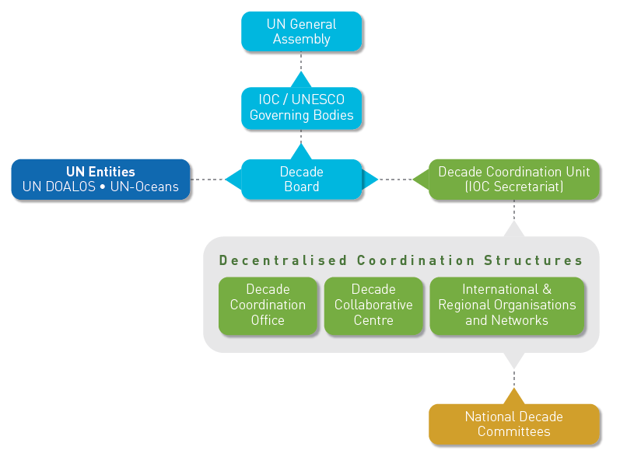

Governance and Coordination Framework

Slide 11
Scope of the Pacific Islands Ocean Decade Collaborative Centre
The DCC has a regional focus addressing the interests of the 22 SPC island member countries and territories. The geographic area covered represents approximately 30% of the Pacific Ocean.
The DCC would also include New Zealand in its scope given the strong alignment in ocean science priorities and the strong ongoing partnership between SPC and New Zealand in the region.
All Decade Actions that are being fully or partially implemented in the region will be included in the scope of the DCC. This includes Actions being implemented in the EEZ of the above member countries or in areas beyond national jurisdiction in the region.
Thematically, the DCC will address the ten Decade Challenges, in partnership with its members, other Pacific regional organizations, the private sector, communities and civil society.
Notes:
Status of the Ocean Decade in the region with highlights of some challenges and opportunities including reference to key conclusions of 2019 regional planning meeting
Presentation of DCC including role and connections with global, regional and national partners
Role of DCC in the coordination of a regional roadmap
Finishes with a perspective on some key priorities for consideration in the roadmap
Brief history of submission, Noumea 2019,
IOM
Scope of DCC
Importance and relevance for the region
“you hear me say this a lot, but this will contribute to greater coordination and collaboration in the region”
We hope it can also leverage additional ressources, in country and at the region level.

Slide 12
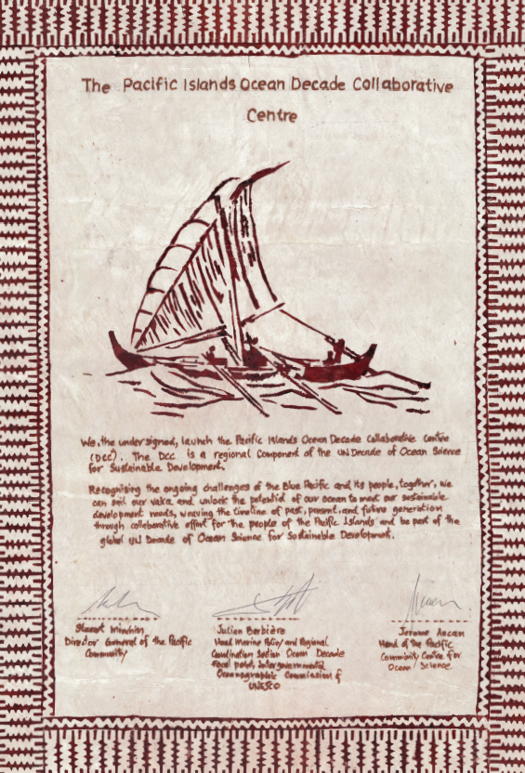

Slide 13
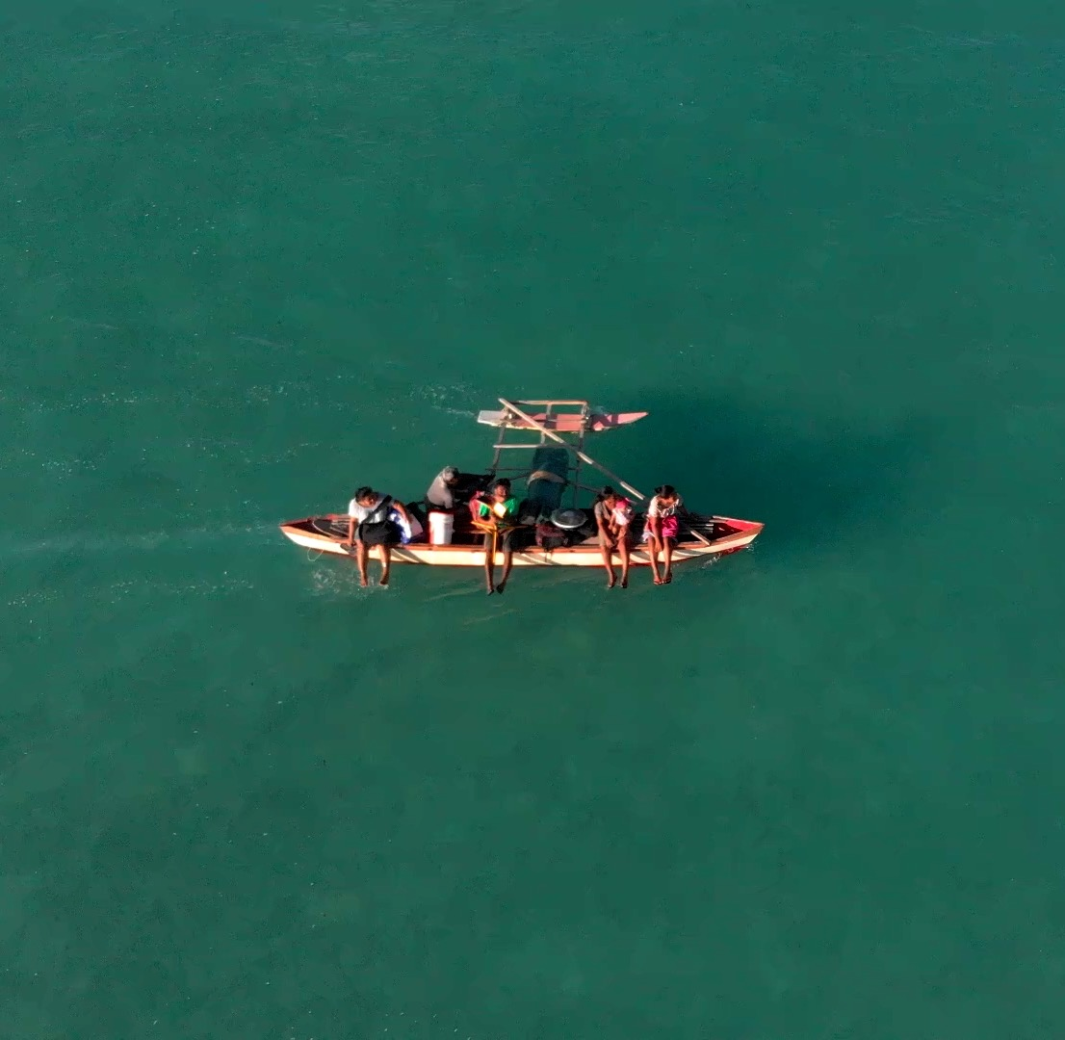
Thank you

