Slide 1
STATUS OF
INTERGOVERNMENTAL COORDINATION GROUP
INDIAN OCEAN
TSUNAMI WARNING & MITIGATION SYSTEM
(ICG/IOTWMS)
IOC Officers Meeting, Paris, January 2023

Slide 2
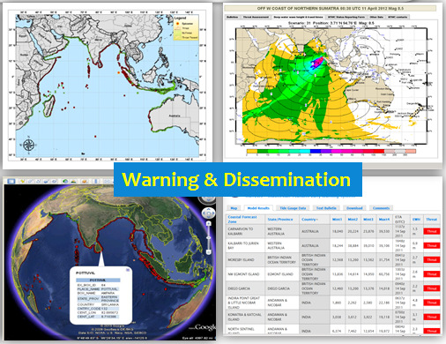
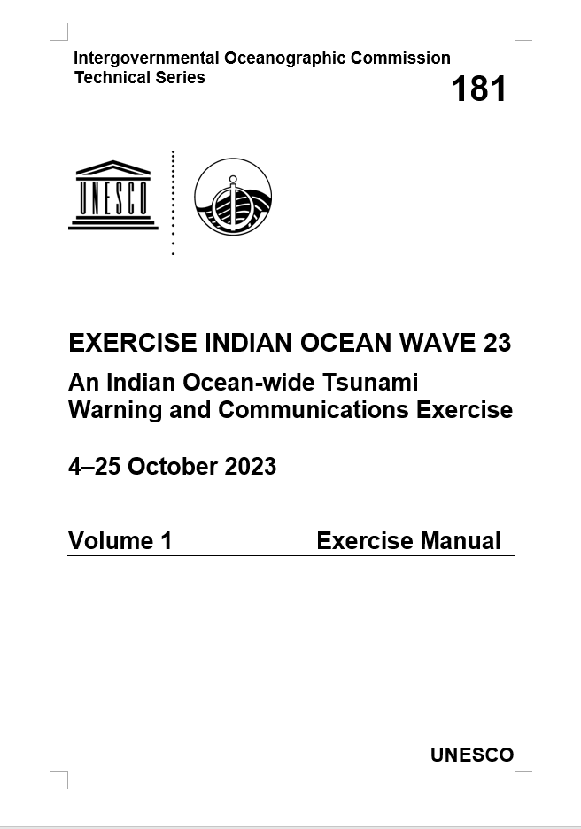

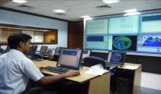
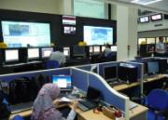




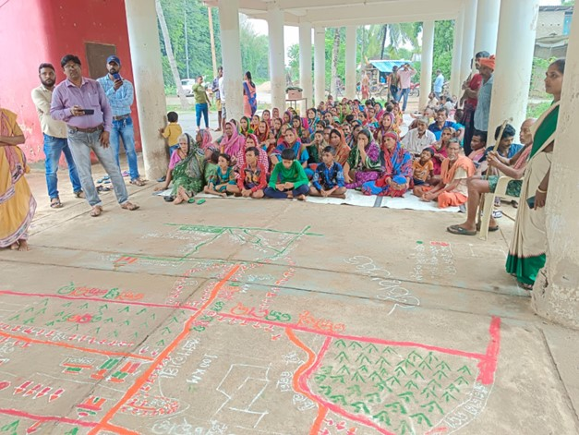
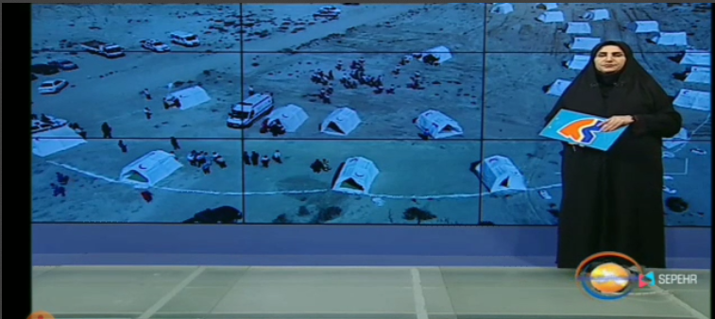
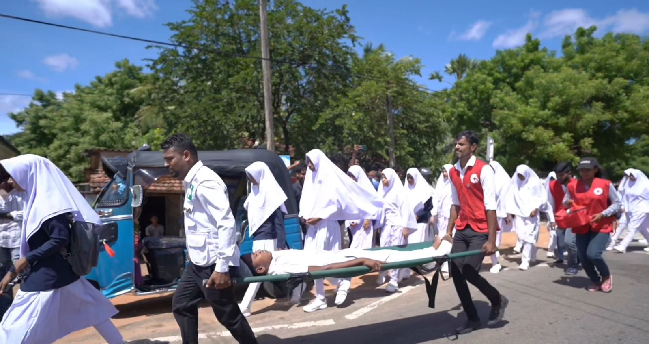
Indian Ocean Tsunami Warning & Mitigation System (IOTWMS) Highlights (1)
24 Active Member States UNESCO-IOC Intergovernmental Coordination Group
Exercise IOWAVE23 during Oct23 with 4 different scenarios, with 19 Member States participating and around 50,000 involved in community drills
Review of national tsunami warning chains and SOPs for seismic, non-seismic, and complex source tsunamis with training workshops Jul23 to help meet Early Warnings For All 2027 UN target
ISO compliant Tsunami Service Providers (TSPs) for IOTWMS providing threat information: ISO 9001 (Australia and India) and ISO 22328-3 (Indonesia)
Threat information provided for Indian Ocean for non-seismic source tsunamis by TSP-Australia from Oct 2023
Routine 6-monthly tsunami warning communication tests Jun and Dec every year (email, GTS, SMS, Fax)
Maritime products for NAVAREAs to be trialed & implemented by TSPs from 2024
Gov of Australia extended support for ICG/IOTWMS Secretariat Office for further 4 years (2024-27) (USD$310K/yr + office)
2

Slide 3

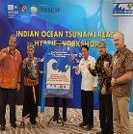
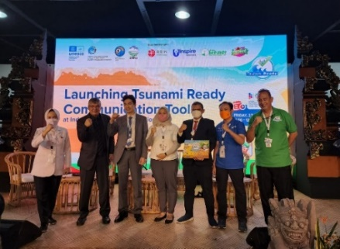
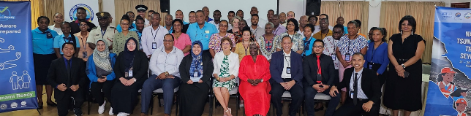
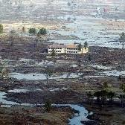
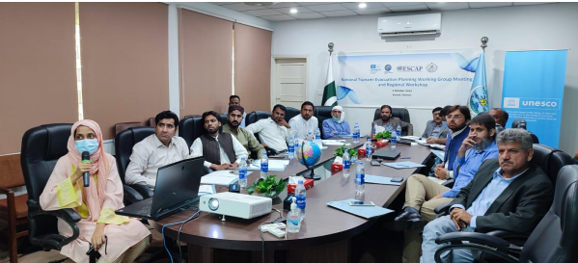
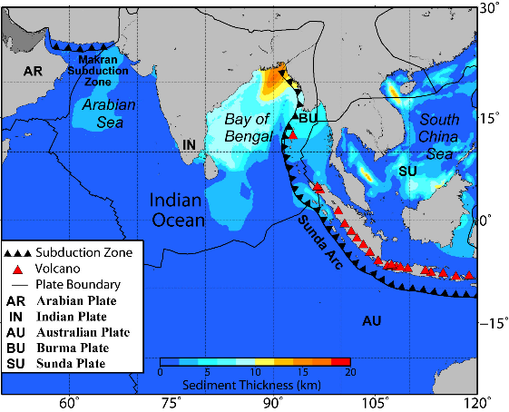
Indian Ocean Tsunami Warning & Mitigation System (IOTWMS) Highlights (2)
Eleven Communities now Tsunami Ready Recognised in India and Indonesia, with Australia, Iran, Maldives, Oman, Pakistan, Seychelles, Sri Lanka, Thailand, and Timor Leste planning to implement
Tsunami Ready training Timor Leste (Jun23) and Seychelles (Nov23)
Probabilistic Tsunami Hazard Assessment (PTHA) for NW Indian Ocean completed with funding from UNESCAP
Inundation mapping and training evacuation planning for NW Indian Ocean started Nov23 with funding from UNESCAP
Govt of Indonesia extended funding for Indian Ocean Tsunami Information Centre (IOTIC) for further 5-years (2022-26) (USD$130K/yr+ office, staff)
3rd IOTWMS Capacity Assessment in 2024 to guide future development in collaboration with UNESCAP and funding support from Asian Development Bank and Govt. of Switzerland
2nd Global Tsunami Symposium to commemorate 20th Anniversary Indian Ocean Tsunami 2004, 11-14 November 2024 in Banda Aceh, Indonesia, back-to-back with 14th Session ICG/IOTWMS, 18-21 November 2024 in Jakarta
Banda Aceh 2004
3

