Slide 1
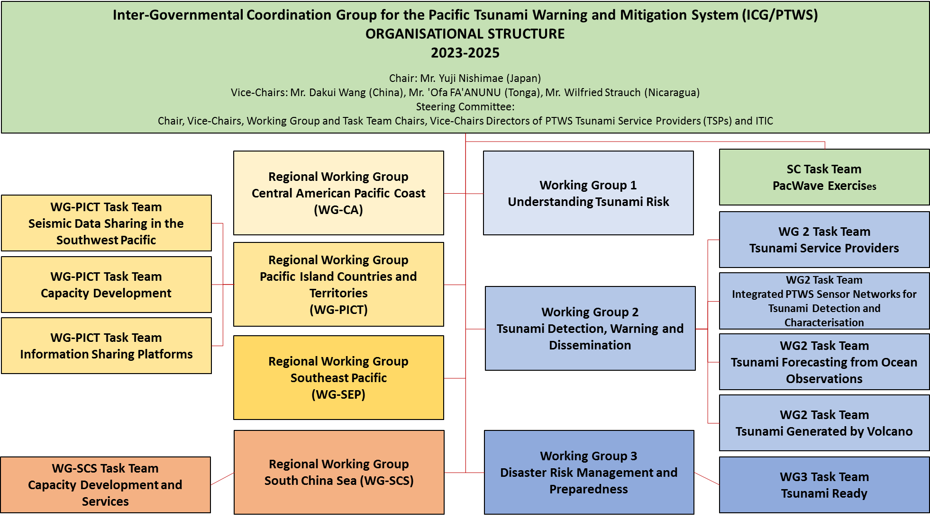
PTWS Organisational Structure (as of ICG/PTWS-XXX 11-15 September 2023)
Chair: Mr. Yuji Nishimae (Japan)
Vice-Chairs: Dr. Dakui Wang (China)
Dr. Wilfreid Strauch (Nicaragua)
Mr. ‘Ofa Fa’anunu (Tonga)
Technical Secretary: Dr. Öcal Necmioğlu (as of 1 September 2023)
Dissolved Task Teams;
Task Team on UN Ocean Decade,
Task Team on Future Goals and Performance Monitoring,
WG2 Task Team on the Minimum Competency Levels for National Tsunami Warning Centre (NTWC) Operations Staff
Established Task Teams;
WG2 Task Team on Tsunami Generated by Volcanoes (TGV)
WG2 Task Team on Forecasting from Ocean Observations (TT-FOO)
WG3 Task Team on Tsunami Ready
Pacific Island Countries and Territories Working Group Task Team on Information Sharing Platforms

Slide 2
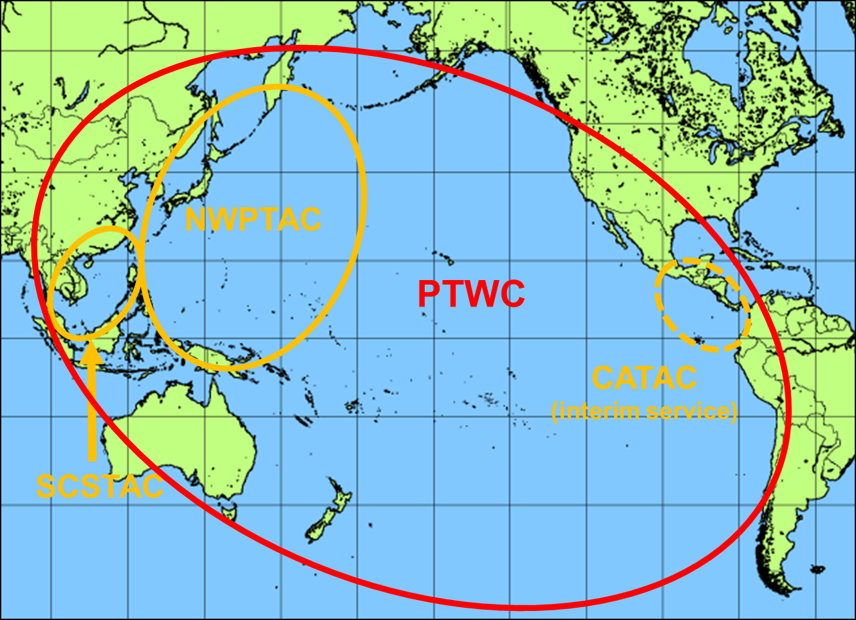
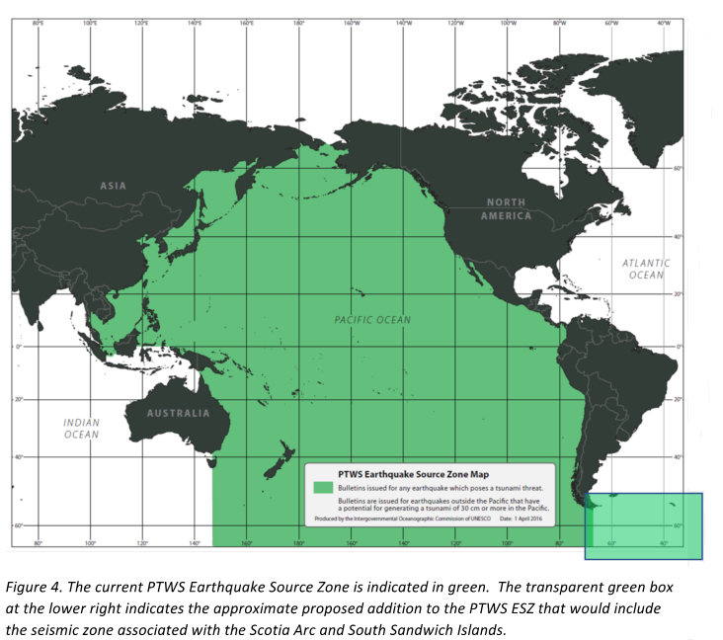
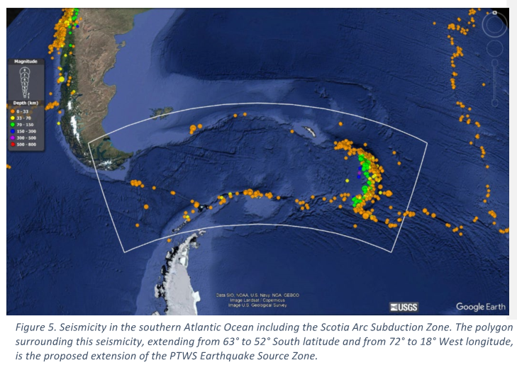
PTWS Tsunami Service Providers
Pacific Tsunami Warning Center (PTWC) operated by USA
Northwest Pacific Tsunami Advisory Center (NWPTAC) operated by Japan
South China Sea Tsunami Advisory Center (SCSTAC) operated by China
Central America Tsunami Warning Center (CATAC) operated by Nicaragua
The CATAC is fully operated (24/7) on the interim service.
Decision in the ICG/PTWS-XXX session
Decides to expand the PTWS Earthquake Source Zone to include an area from 63º to 52º south latitude and from 72º to 18º west longitude to include the Scotia Arc and its adjacent seismic zones.

Slide 3
PTWS Meetings/Workshops/Trainings in 2023 & 2024
2023
09 - 13 January Cook Islands Tsunami Warning and Emergency Response: review and update of SOPs.
30 January - 01 February Fiji Tsunami Ready training : Regional Training on the UNESCO/IOC Tsunami Ready Recognition Programme
02 - 03 February Ninth Meeting of the WG-PICT- PTWS Regional Working Group on Tsunami Warning and Mitigation for Pacific
Island Countries and Territories
06 - 09 March ICG/PTWS Steering Committee Meeting
24 April ICG/PTWS-WG-CA VI : Sexta reunion del Grupo de Trabajo Regional para America Central del ICG/PTWS
21 - 25 August Tsunami Hazard Assessment meeting of experts Chile-Peru - UNESCO-IOC Meeting of Experts on tsunami sources and hazard in southern Peru and northern Chile
11 September 8th Joint ICG/PTWS– IUGG/JTC Technical Workshop in association with the ICG/PTWS sessions
Understanding and lessons learned from the tsunami generated by the Hunga Tonga-Hunga Ha'apai volcano eruption on 15 January 2022 for development of Tsunami Warning and Mitigation System for tsunamis generated by volcanoes and other non-seismic sources
11-15 September ICG/PTWS-XXX Nuku’alofa, Tonga
25-26 September 11th Meeting of the Regional Working Groupon Tsunami Warning and Mitigation System for the South China Sea Region
(SCS-WG-XI) Guangzhou, China
6 December ICG/PTWS WG-PICT Task Team Seismic Data Sharing in the Southwest Pacific
13 December ICG/PTWS Officers Meeting (online)
2024
March (TBD) ICG/PTWS SC Meeting (online)
19-30 August ITP-2024 Chile
September (TBD) ICG/PTWS SC Meeting (Hawaii, USA)
Nov ember (TBD) 12th Meeting of the Regional Working Groupon Tsunami Warning and Mitigation System for the South China Sea Region
(SCS-WG-XII)
TBD Scientific meeting of experts to understand tsunami sources, hazards, risk and uncertainties associated with the New Hebrides, San
Cristobal and New Britain Subduction Zones

Slide 4
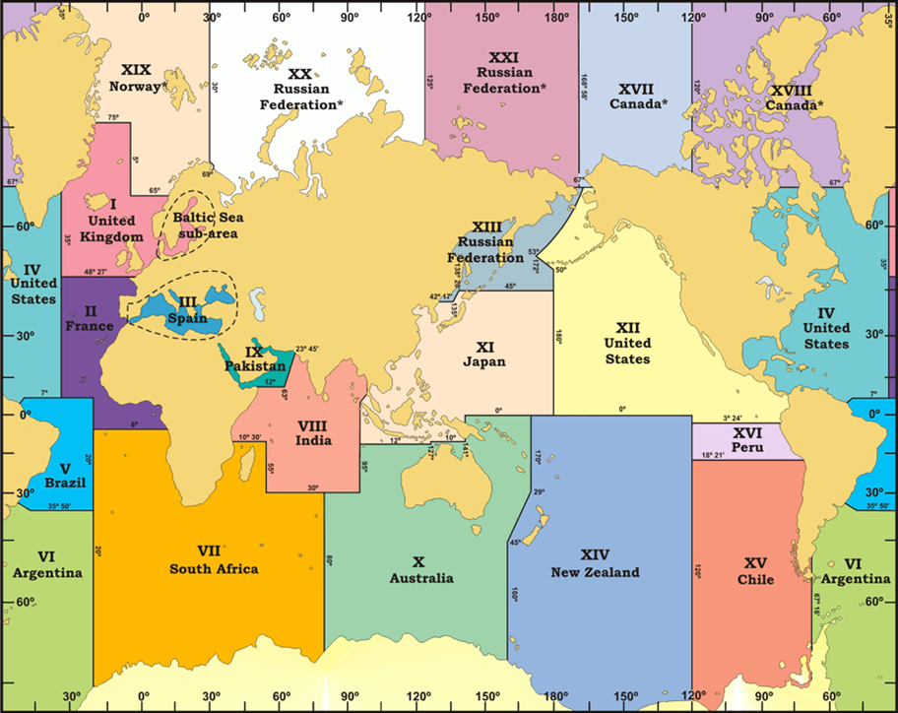
PTWS ICG/XXX Recommendation Highlights
Recommends the PTWC to finalize necessary preparations to provide special tsunami maritime safety products specifically for ships for all NAVAREA Coordinators in the Pacific and in the Southwest Atlantic (e.g. NAVAREAs VI, X, XI, XII, XIII, XIV, XV, and XVI) to transmit to the NTWCs to be forwarded to the NAVAREA Coordinators of their countries, or upon their request directly to the NAVAREA Coordinators in the absence of a NTWC,
Decides to admit the start of the official full functional operations of CATAC, starting after the IOC governing body meeting in 2024, with the specific starting date to be decided after the coordination with the ICG/CARIBE-EWS
Recommends the approval of the PTWS National Tsunami Warning Centre competencies, framework, and training requirements, as described in IOC ICG/PTWS-XXX Working Document (Agenda 4.5) Report from the Task Team on the Minimum Competency Levels for National Tsunami Warning Centre (NTWC) Operational Staff.
Decides to establish permanent HTHH monitoring and warning procedures based on the products and methods in use by PTWC since March 2022 and presented in the CL 2882 and CL 2902.
PACWAVE 24
September to November 2024 to support IDDRR (13 Oct. 2024) and WTAD (5 Nov. 2024) Live Communications Test from the PTWS TSPs on 5 November
ICG/PTWS-XXXI
Beijing, China
April 2025
ICG/PTWS-XXXII
Nouméa, New Caledonia
2027

Slide 5
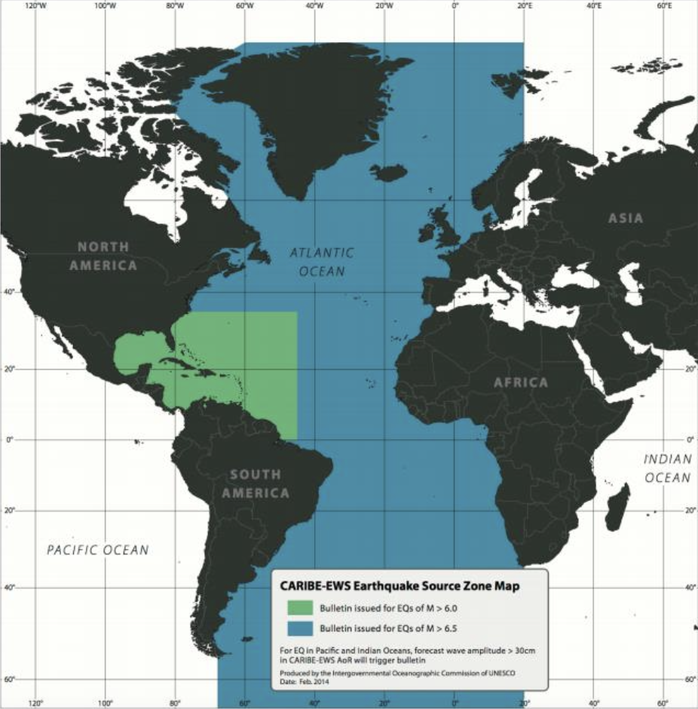
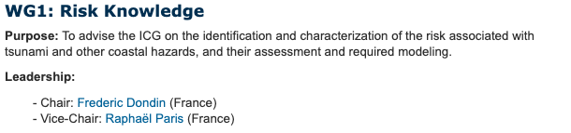
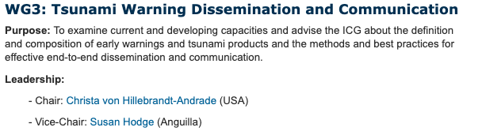
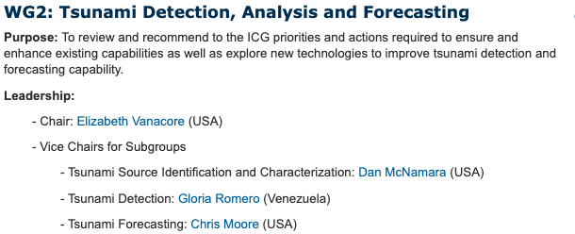
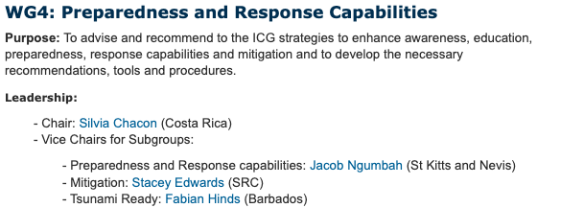
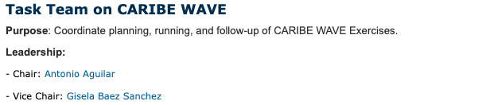
CARIBE EWS Organisational Structure (as of ICG/CARIBE EWS 25-28 April 2023)
ICG/CARIBE EWS-XVI decided to realign the ICG/CARIBE-EWS Working Groups (WG) around the Sendai Framework for Disaster Risk Reduction, the UN Early Warnings for All Initiative (EW4ALL) and the ODTP pillars, including capacity development functions for all:
• WG1 on Risk Knowledge
• WG2 on Detection, Analysis and Forecasting
• WG3 on Warning Dissemination and Communication
• WG4 on Preparedness, Response Capabilities and Resilience
Chairperson: Mr Gerard Metayer (Haiti)
Vice-Chairpersons:
Ms Regina Browne (US Virgin Islands)
Mr Anthony Murillo Gutierrez (Costa Rica)
Ms Marie-Noëlle Raveau (Martinique)
Technical Secretary: Dr. Öcal Necmioğlu (as of 1 September 2023)

Slide 6
CARIBE EWS Meeting / Trainings / Exercises
2023
23 March CARIBE WAVE 23 (Honduras Gulf ND Mount Pelee eruption scenarios – 720.000 participants)
25–28 April ICG/CARIBE EWS-XVI (San José, Costa Rica)
13-17 November Training course on the general principles of installation and maintenance of sea level stations and the use of tide gauge data
(Costa Rica)
2024
1-2 February Officers – WGs/TT Meetings (online)
21 Mar CARIBE WAVE 24 (2 scenario from Puerto Rico Trench and North Panama Deformed Belt)
TBD ICG/CARIBE EWS-XXVII (no Host Country identified yet)
TBD Experts Meeting on “Non-Seismic Sources of Tsunamis for the Caribbean and Adjacent Regions""
TBD Experts Meeting on "Seismic Sources in the Northwest Caribbean"
2025
TBD CARIBE WAVE 25 (1962 Jamaica & 1755 Lisbon Scenarios)

Slide 7
UNESCO/IOC Tsunami Ready PTWS and CARIBE EWS
PTWS Tsunami Ready
30 communities subject to UNESCO/IOC Tsunami Ready Recognition Programme
Recognition of 2 communities in 2023
12 communities with recognition valid as of 2023
Recognition of 8 communities in progress
TRR planning continues for 3 communities
Renewal for 7 communities is delayed
[ICG/PTWS-XXX] Established a Task Team for Tsunami Ready under WG3
[ICG/PTWS-XXX] Recommends WG3 develop formal PTWS guidelines following the 'Tsunami Ready Equivalency Approach’ for recognition of tsunami readiness of communities not implementing the IOC Tsunami Ready Recognition Programme
CARIBE EWS Tsunami Ready
[ICG/CARIBE EWS XVI] requested CTIC with WG4 Subgroup on Tsunami Ready and Member States determine the target number of communities in the CARIBE-EWS for Tsunami Ready recognition by 2030.
[ICG/CARIBE EWS XVI] recommended the IOC Working Group on Tsunamis and Other Hazards related to Sea-Level Warning and Mitigation Systems (TOWS-WG) to identify a mechanism to cross credit other Members States assessment, preparedness and response efforts with the UNESCO-IOC Tsunami Ready programme.
23 communities subject to UNESCO/IOC Tsunami Ready Recognition Programme
Recognition of 2 communities in 2023
11 communities with recognition valid as of 2023
Expression of interest of 1 community received
Recognition of 3 communities in progress
Renewal of 1 community is foreseen in 2024
Renewal for 7 communities is delayed

