Slide 1
Ocean Best Practice System GOOS and IODE Input
Steering Group Meeting
Paris, December 2023

Slide 2
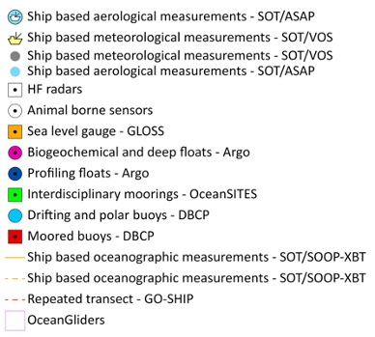
GOOS Today
84 countries, 8,700+ observing platforms, 13 global networks
More than 100,000 observations per day - delivering an accessible, safe and productive ocean
Global observing networks, e.g. Argo, GO-SHIP, Drifting Buoys, plus emerging networks, e.g., OceanGliders, HF Radar.
“The weather forecasting systems will run off the rails if they don’t have the surface pressure information over the ocean to constrain them” - Lars Peter Riishojgaard, Director of the Earth System Branch WMO
www.ocean-ops.org/reportcard2023
Notes:
In the last 30 years, GOOS developed -
Mature networks drifting buoys, moored buoys, voluntary observing ships, tide gauges, Argo floats, and emerging networks; HF Radar, ocean gliders
Ocean Observing is big science

Slide 3
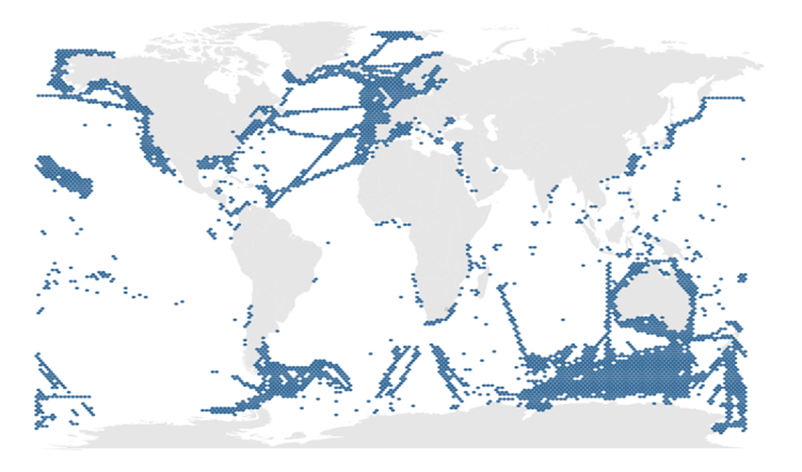
12 BioEco EOV communities
500+ sustained BioEco observing programmes …and more out there..
Only 7% of the ocean surface has an identified active monitoring program
Some of the biggest gaps are in areas of high biodiversity and high human pressure
Satterthwaite et al. (2021) Frontiers in Marine Science - GOOS news
Notes:
EuroSea 520 programmes identified in 1 year – real base to work from

Slide 4
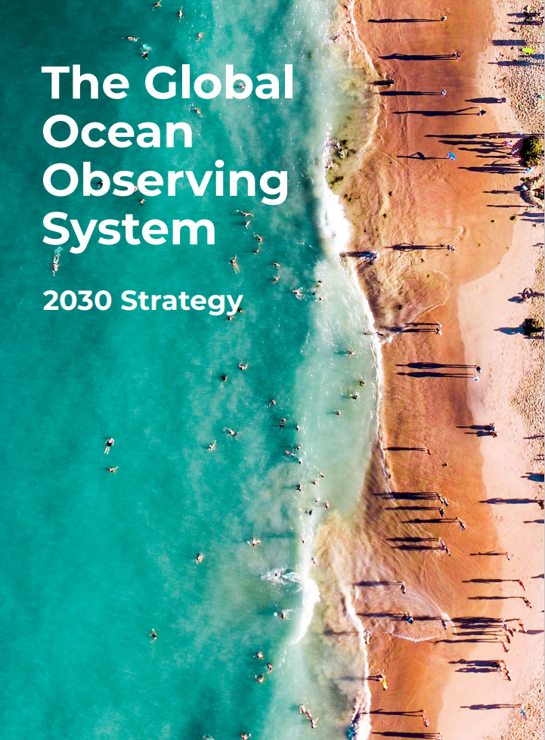
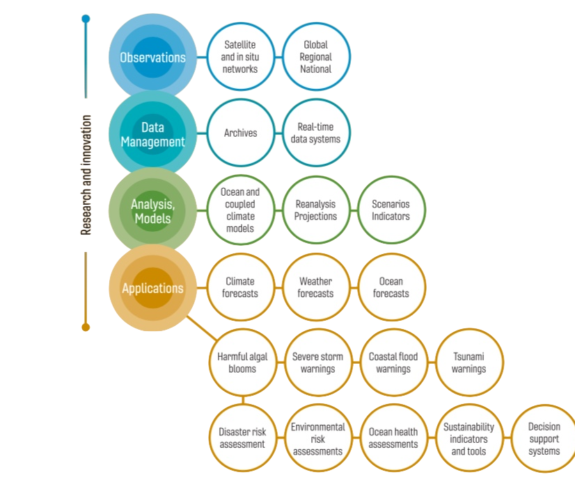
Underpinning a wide range of applications
Vision: A truly global ocean observing system that delivers the essential information needed for our sustainable development, safety, wellbeing and prosperity
Notes:
2019 IOC Assembly adopted a Global Ocean Observing System 2030 Strategy which now informs our work
Ambitious – need a step change to deliver a fit-for-purpose system
Eleven Strategic Objectives guide our planning
System integration and delivery are the ‘core’ of GOOS ‘business’ today
Deepening engagement and impact are key priority - only achievable through partnership with key stakeholders
Going to look at 3 important axis of this partnership with stakeholders – co-design of fit for purpose system, increasing partnership with private sector and across the UN

Slide 5
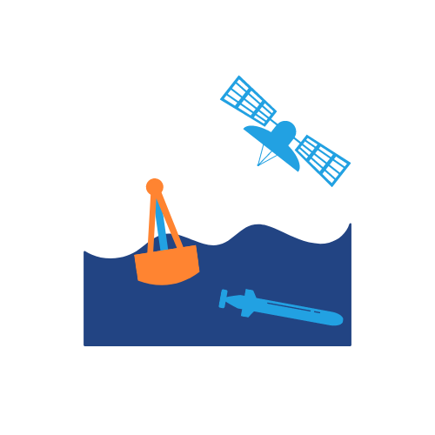
Providing global coordination
Ecosystem of providers Observation infrastructure
Infrastructure and
global coordination
Beneficiaries of ocean information
Ocean observing community, partners
GOOS core and components
Users, end-users, investors, the public
3 Expert Panels
Observation Coordination Group, OceanOPS, networks
Regional Alliances & National Focal Points
Expert Team Operational Ocean Forecasting
Notes:
GOOS structure and how we deliver
Connecting and coordinating
ocean observing projects around the world
Facilitating collaboration
by bringing international experts together
Setting global standards
by developing frameworks and best practices
Empowering solutions
through improved models and predictions

Slide 6
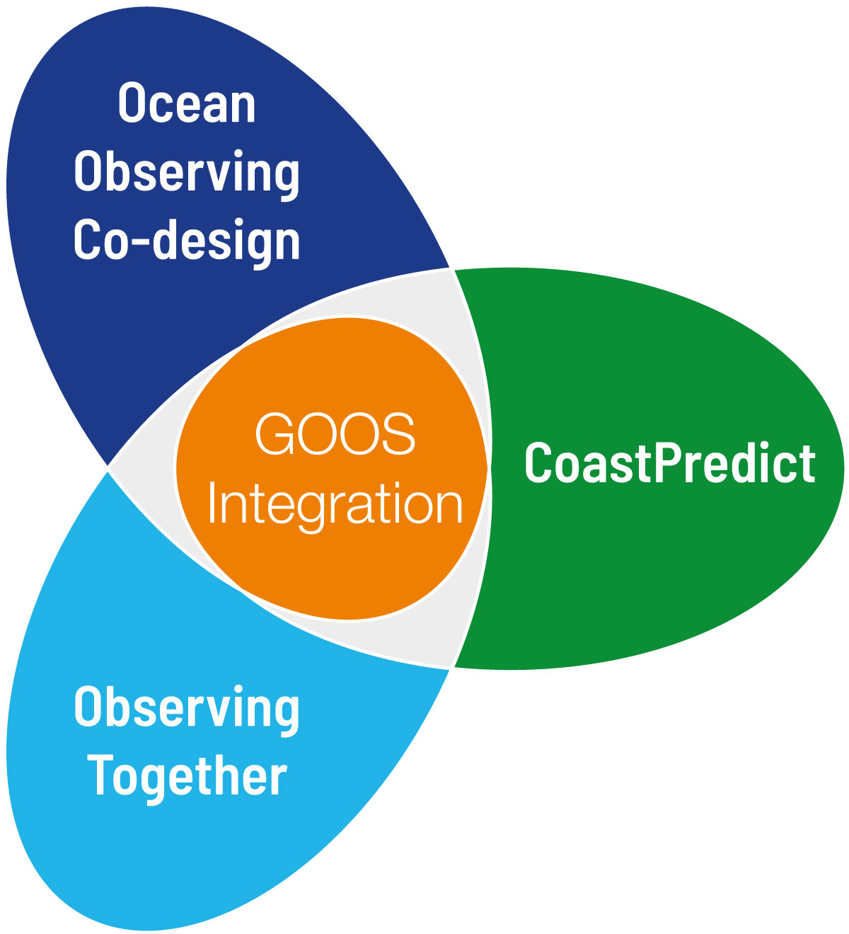
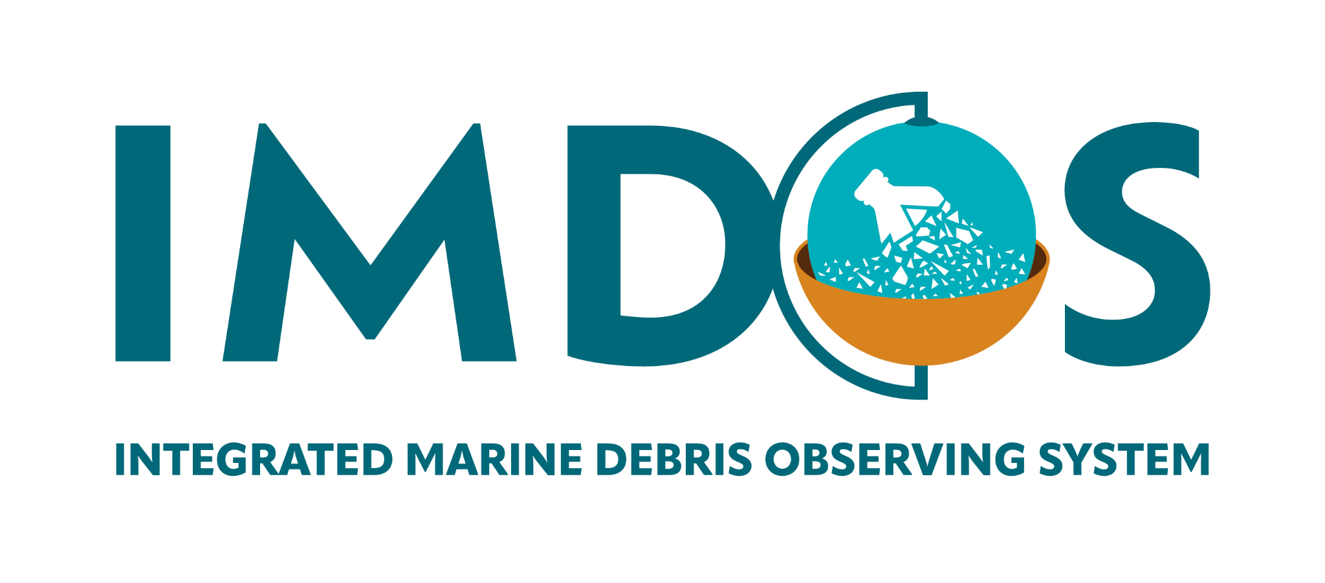
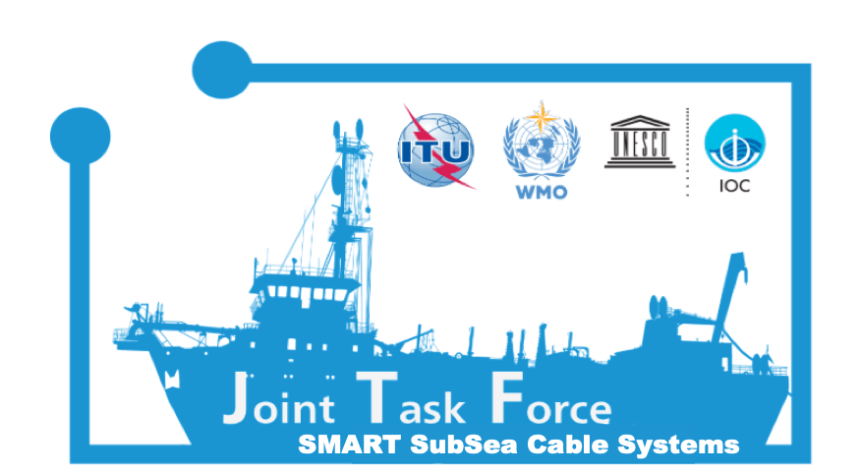
Transformation & Innovation
3 Major Ocean Decade Programmes & DCO
6 GOOS Projects
Projects: ideal characteristics
Focus on developing long-term sustained infrastructure - including coordination mechanisms
Funding support and interest of agencies
Technical infrastructure
Clear objectives and expected results within a sufficient, but limited period of time
Fundable: engages potential sponsors early
Strategy to prove value
Potential to be repeatable / scalable / reusable
Engages developing countries
Notes:
Add a link to the ToRs, (chapeo) check if it is the short version of chapeo. —-yes
Bullets on 7 points, with simple word, one or two
David did a summary of the NFP role, so we can use that.

Slide 7
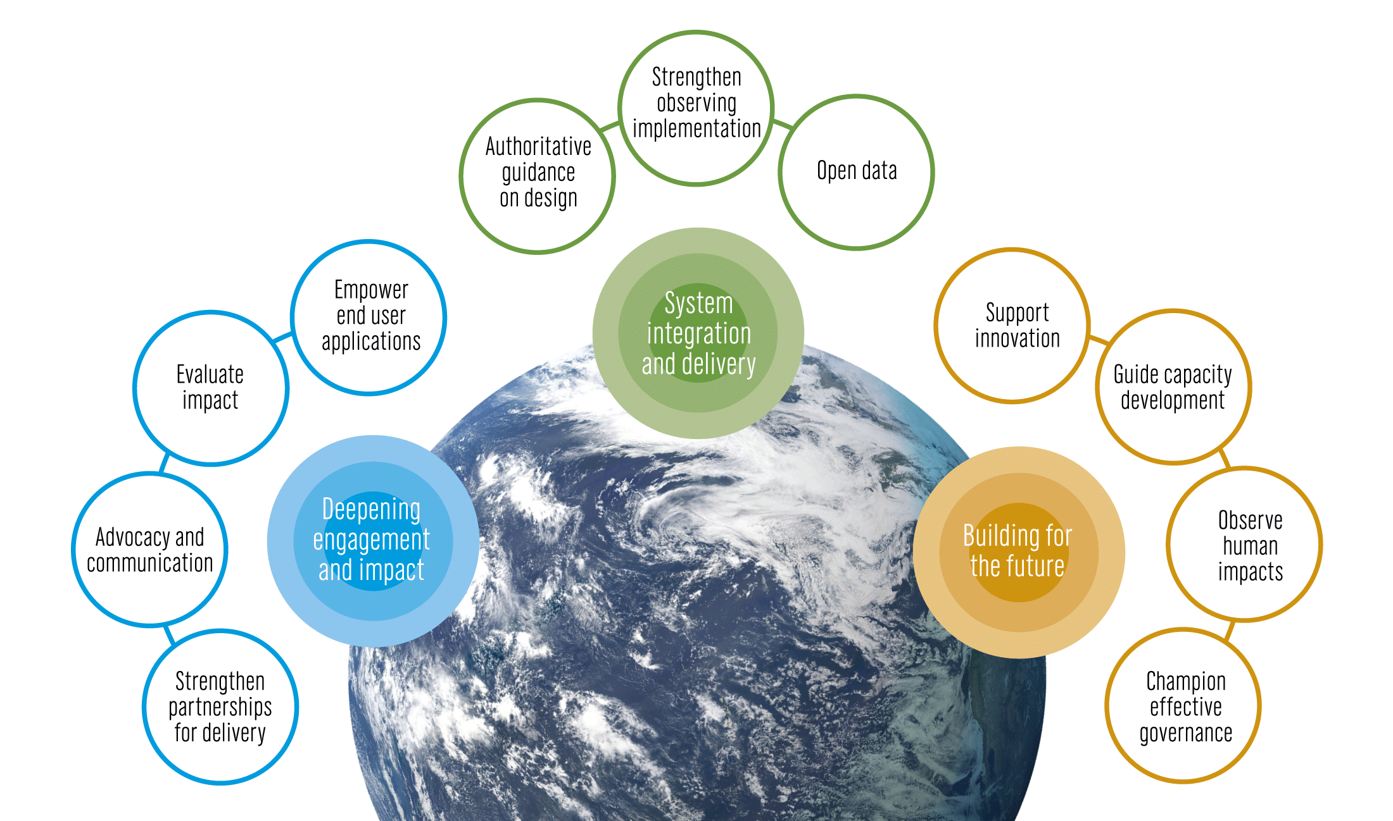
The GOOS 2030 Strategy
Mission
To lead the ocean observing community and create the partnerships to grow an integrated, responsive and sustained observing system
Notes:
The Global Ocean Observing System or GOOS is led by the Intergovernmental Oceanographic Commission of UNESCO and is co-sponsored by the World Meteorological Organization (WMO), United Nations Environment Programme UNEP and the international science council
The IOC Assembly in 2019 adopted a Global Ocean Observing System 2030 Strategy which now informs our work.
[vision] [mission]
Suite of Strategic Objectives which have become important to our planning:
System integration and delivery are the ‘core’ of GOOS ‘business’ today
Deepening engagement and impact are key priority areas for work – including developing partnerships for delivery, advocacy and communications
Building for the future are about building the additional pieces we need for a fully integrated system, including capacity development and innovation, and leading the development of a governance system for the future system that includes say partners and other stakeholders

Slide 8
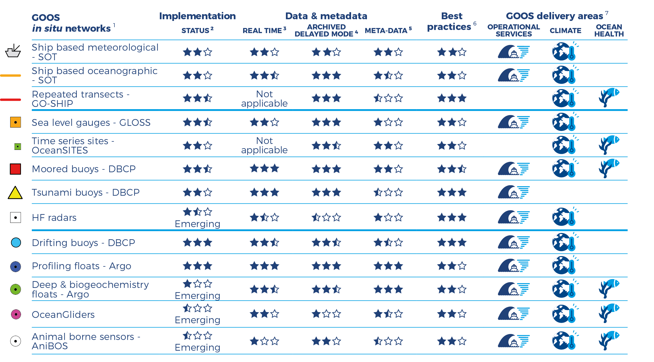
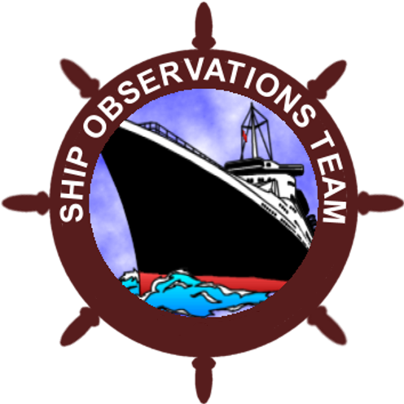
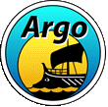
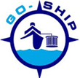
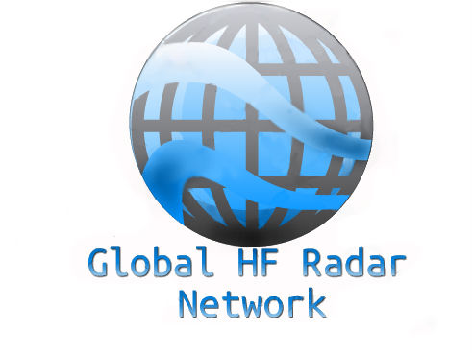
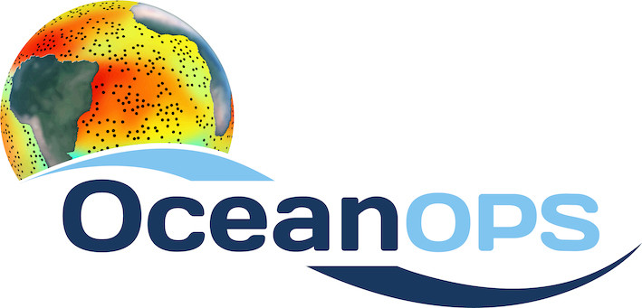
GOOS global and emerging networks
www.ocean-ops.org/reportcard2020

Slide 9
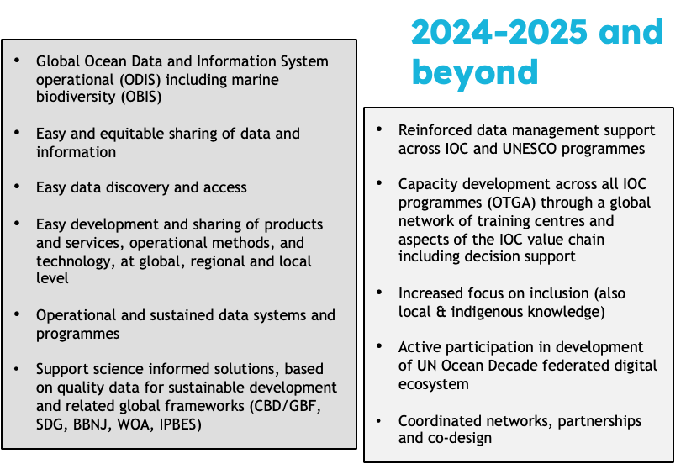
IODE transformation

Slide 10
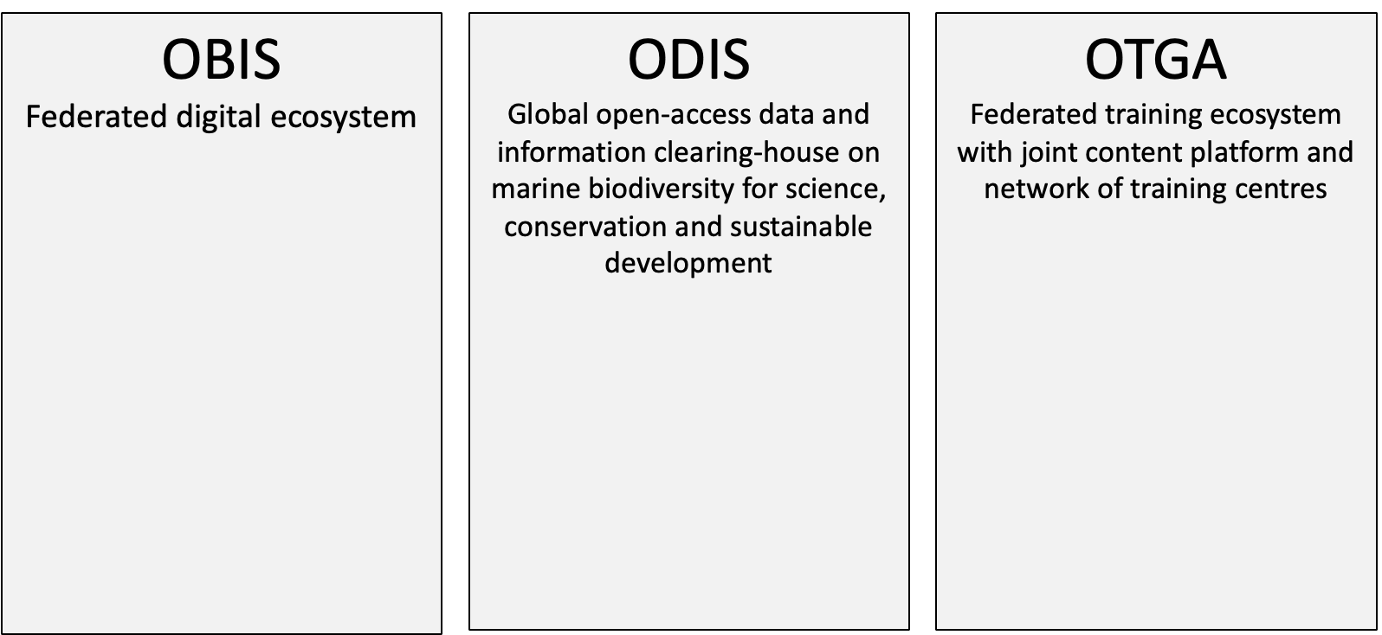
2023: The new IODE structure
3 Programme component, programme activities and projects
33 OBIS nodes
PacMAN
eDNA Expeditions
MARCO-BOLO
DTO-BioFlow
MPA Europe
eDNAquaPlan
BioEcoOcean
GOOS BioEco Portal
HAB portal
17 regional and specialized training centres
Close cooperation with IOC Capacity development Unit
28 partners
World Ocean Database
GODAR
GTSPP
GOSUD
IQuOD
AquaDocs
OceanExpert
ICAN
OBPS (jointly with GOOS)
QMF

Slide 11
Ocean Data and Information System (ODIS)
And its Ocean Information Hub

Slide 12
What is our objective with ODIS

Slide 13
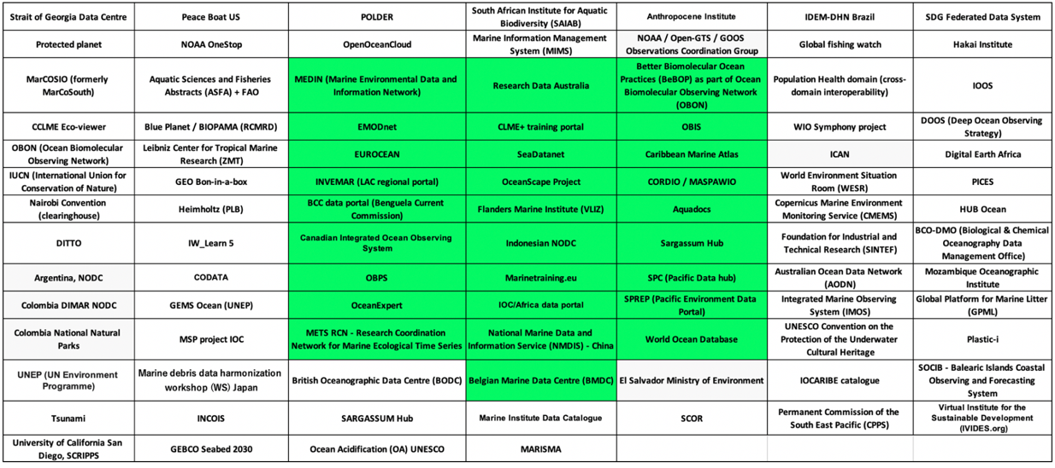
Partners currently indexed by ODIS/OIH

Slide 14
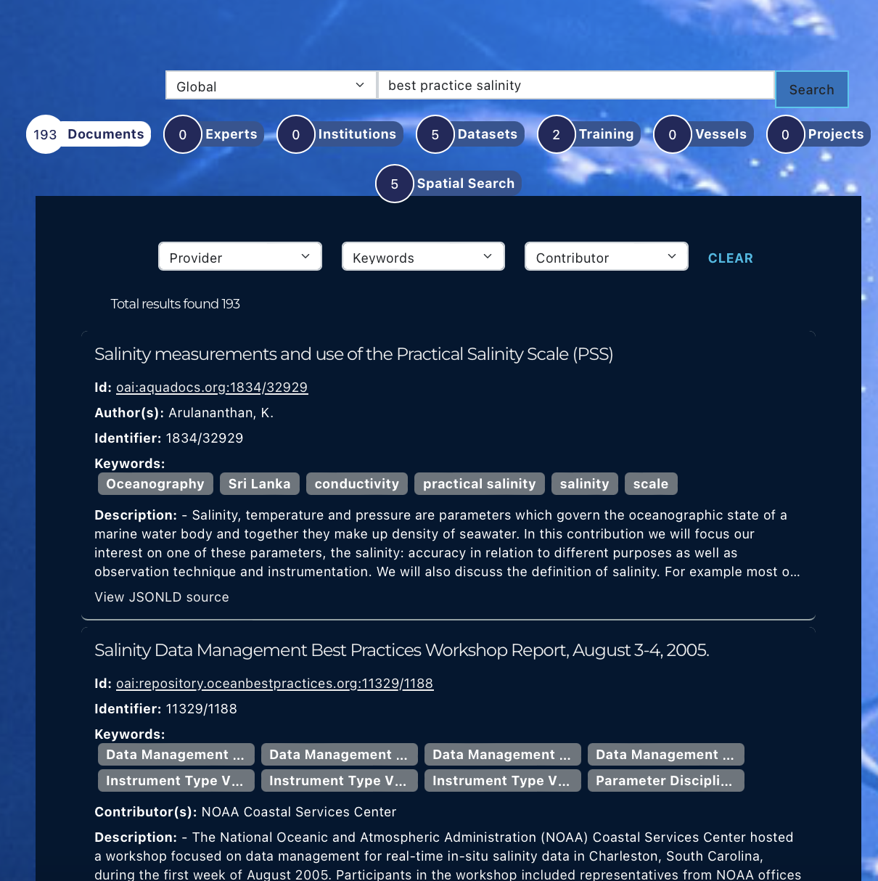
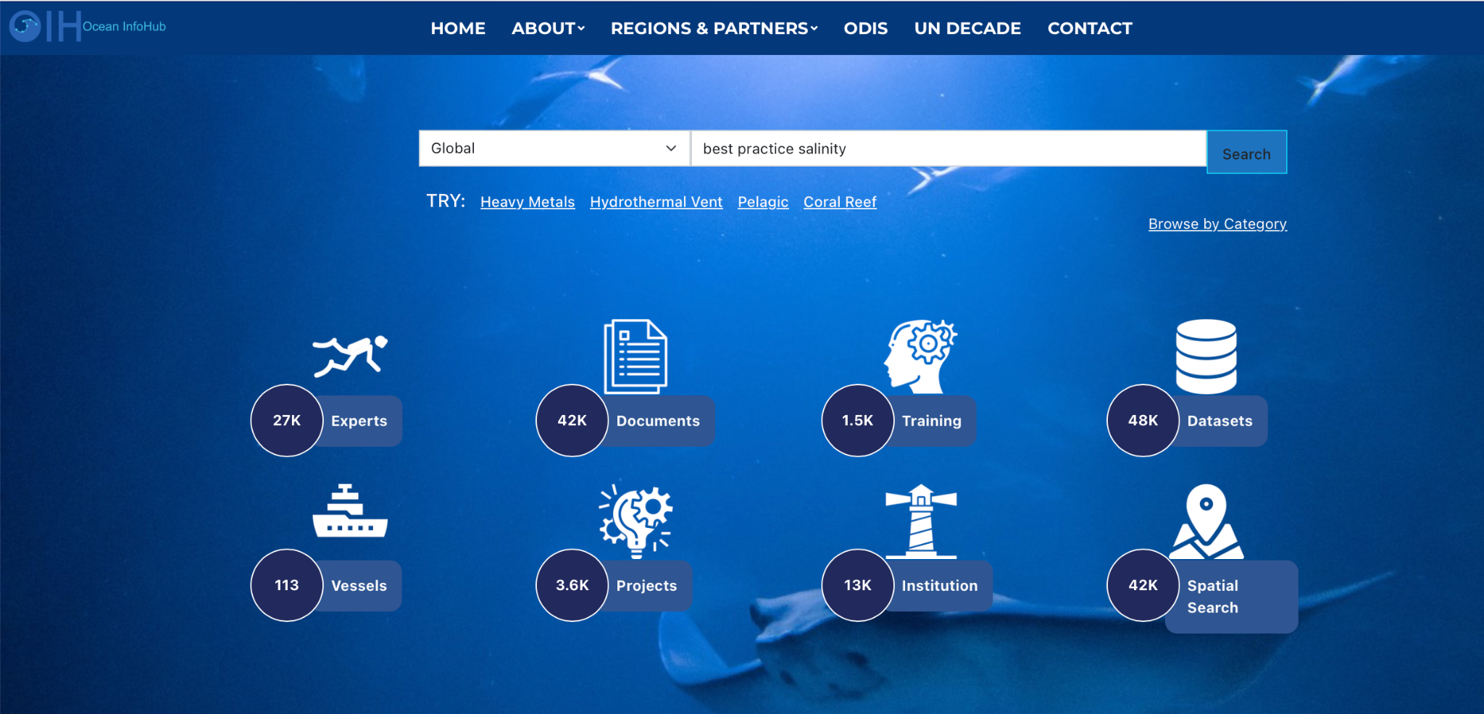
ODIS portal today

Slide 15
Timeline
2017
2018
2019
2020-2021
GOOS (and IODE) engages (Juliet, Emma, OCG) First OBPS Assembly, Paris.
Definition Best Practice, benefits, and advice on evolution/features
Meeting Mallorca, mission, vision, targets (flyer) - 5 elements (repository, journal, technology, communications, interface/templates).
Designated GOOS/IODE Project IOC Assembly, 500 records. First Steering Group Meeting
Notes:
Add a link to the ToRs, (chapeo) check if it is the short version of chapeo. —-yes
Bullets on 7 points, with simple word, one or two
David did a summary of the NFP role, so we can use that.

Slide 16
Timeline
2022
2023
GOOS Endorsement process
Notes:
Add a link to the ToRs, (chapeo) check if it is the short version of chapeo. —-yes
Bullets on 7 points, with simple word, one or two
David did a summary of the NFP role, so we can use that.

Slide 17
OBPS Today
1851 out of 2043 Practices on the OBPS identify as ocean observing
9 GOOS endorsed practices
14 out of 2043 Practices on the OBPS identify as “IODE” practices
OBPS raised the profile and provided a global home for BP
takes of order 1-2 years to develop GOOS endorsed practice
BP creation low importance at institutional level (Revelard et al. 2022)
imbalance with other parts of the value chain
many are not best practices or practices/methods
Notes:
In the last 30 years, GOOS developed -
Mature networks drifting buoys, moored buoys, voluntary observing ships, tide gauges, Argo floats, and emerging networks; HF Radar, ocean gliders
Ocean Observing is big science

Slide 18
GOOS/IODE Recommendations
Develop scalability of the OBPS to other ocean related disciplines
Create guidelines for the submission, review and entry of practices into the repository
Agree rules that allow a “practice” to be elevated to “best practice”, and for endorsed practice or BP
Review of search technology
User feedback process initiation
Advocacy for Best Practices
Assured future support by the host programmes
Notes:
Add a link to the ToRs, (chapeo) check if it is the short version of chapeo. —-yes
Bullets on 7 points, with simple word, one or two
David did a summary of the NFP role, so we can use that.

Slide 19
Importance of evolution
GOOS projects evolve - integrated into GOOS or become part of sustained infrastructure
IODE: restructuring of IODE has evolved OBPS into an IODE programme activity under the ODIS Programme component providing more sustained support and integration into the IOC ocean data ecosystem
Notes:
A couple of bullet points ( no more than 5 words, how GOOS sees the importance of the NFP)
Advocacy of ocean observing to national sustainability, hazard, and adaptation needs - sustained support
Locus/hub for national connections - ocean observing, WMO, data, modeling, government, stakeholders - increase in-country coordination
Strengthen fit-for-purpose, integrated, sustained national ocean observing
Communicate with GOOS around national needs
Promote GOOS activities & capacity building
Visibility for national ocean observing contribution to the global

Slide 20
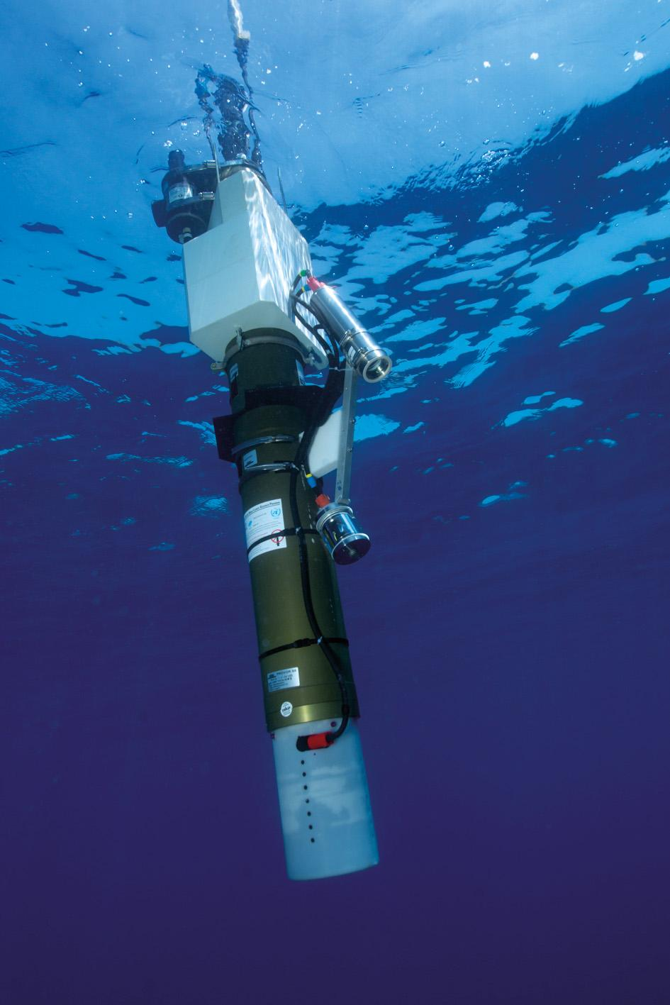
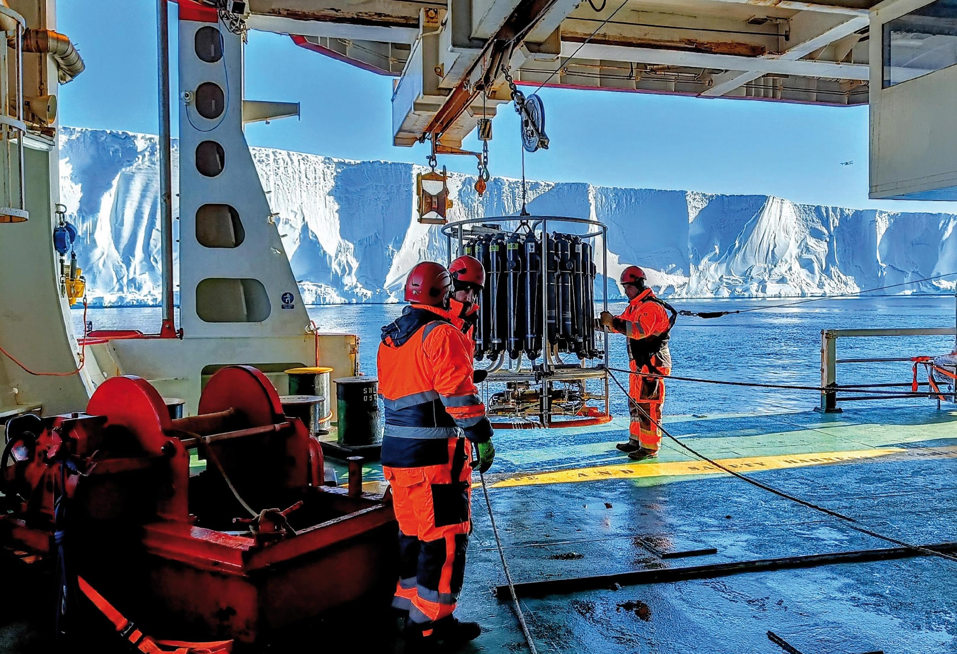
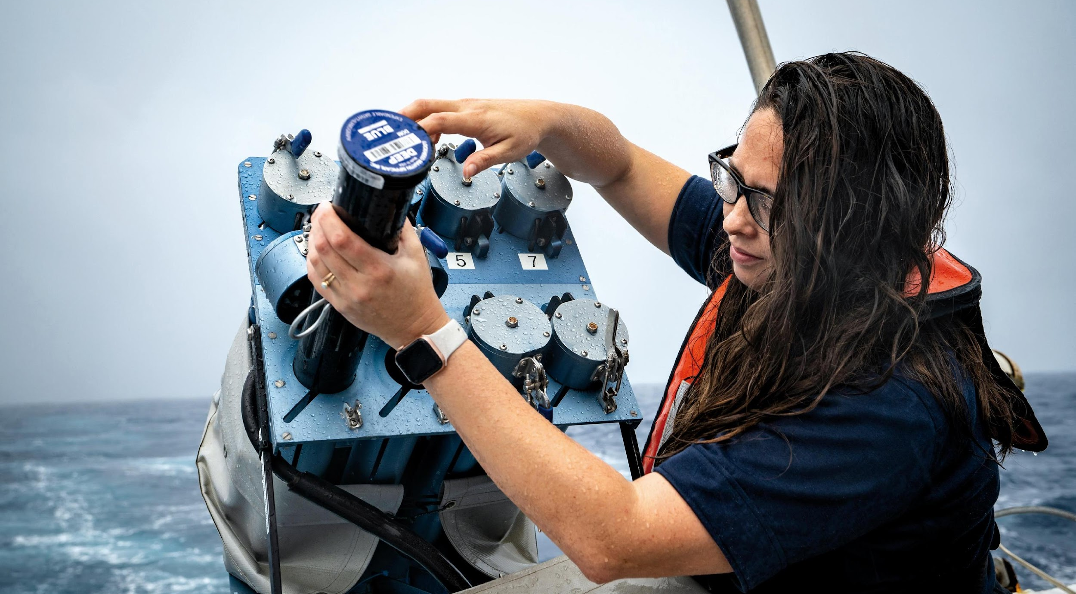
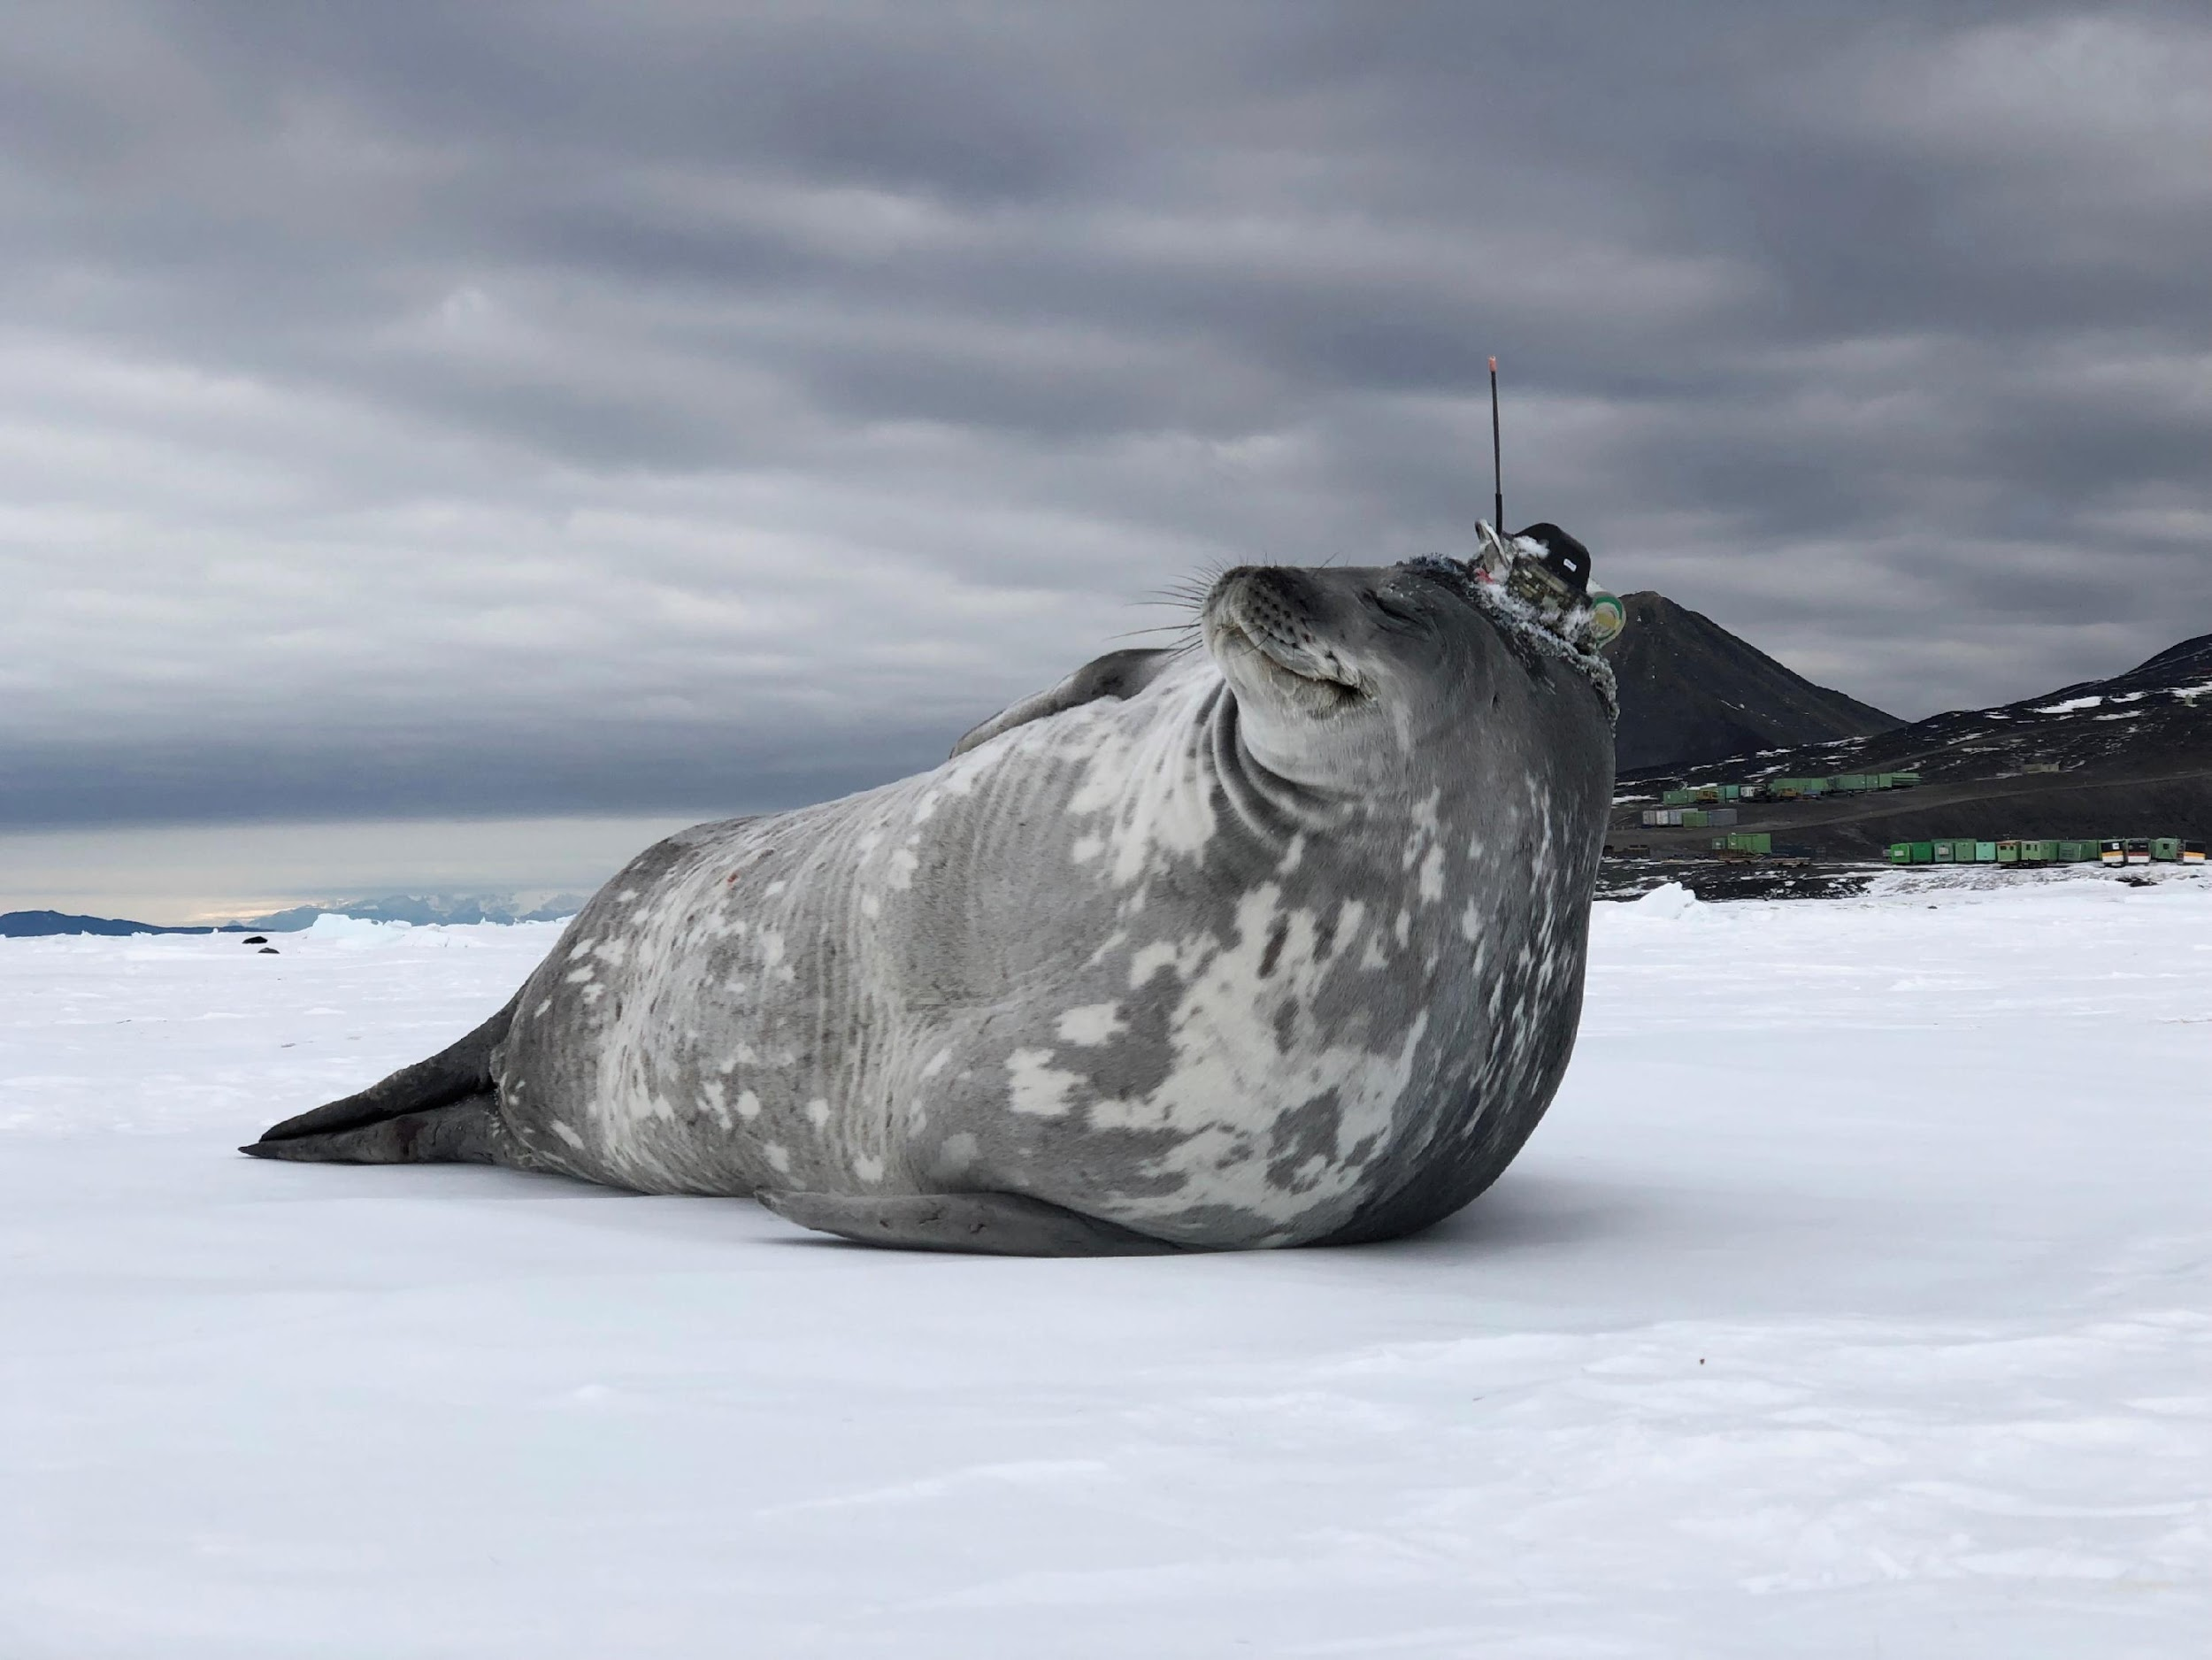
Questions?
goosocean.org

Slide 21
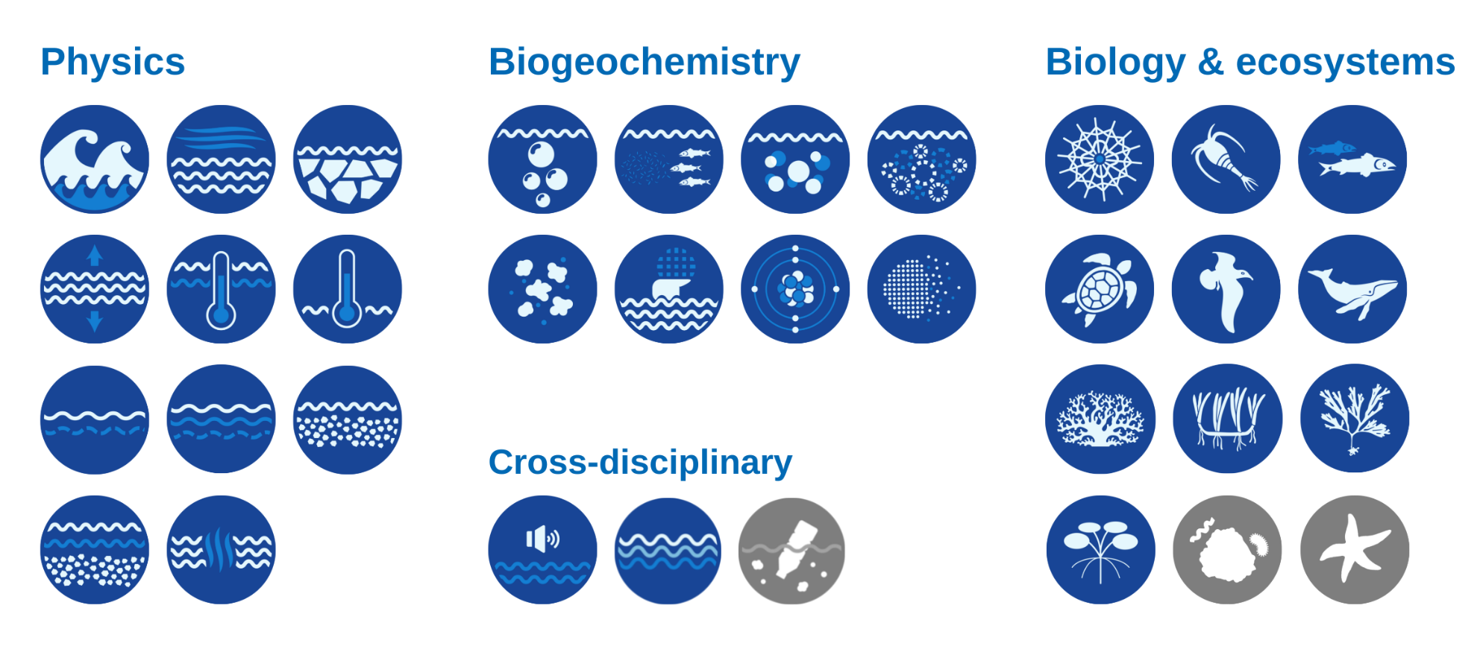
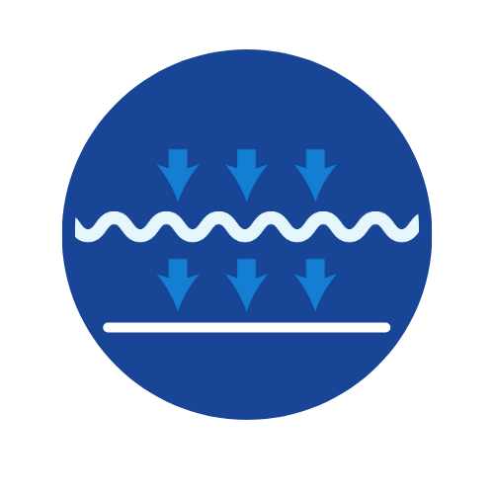
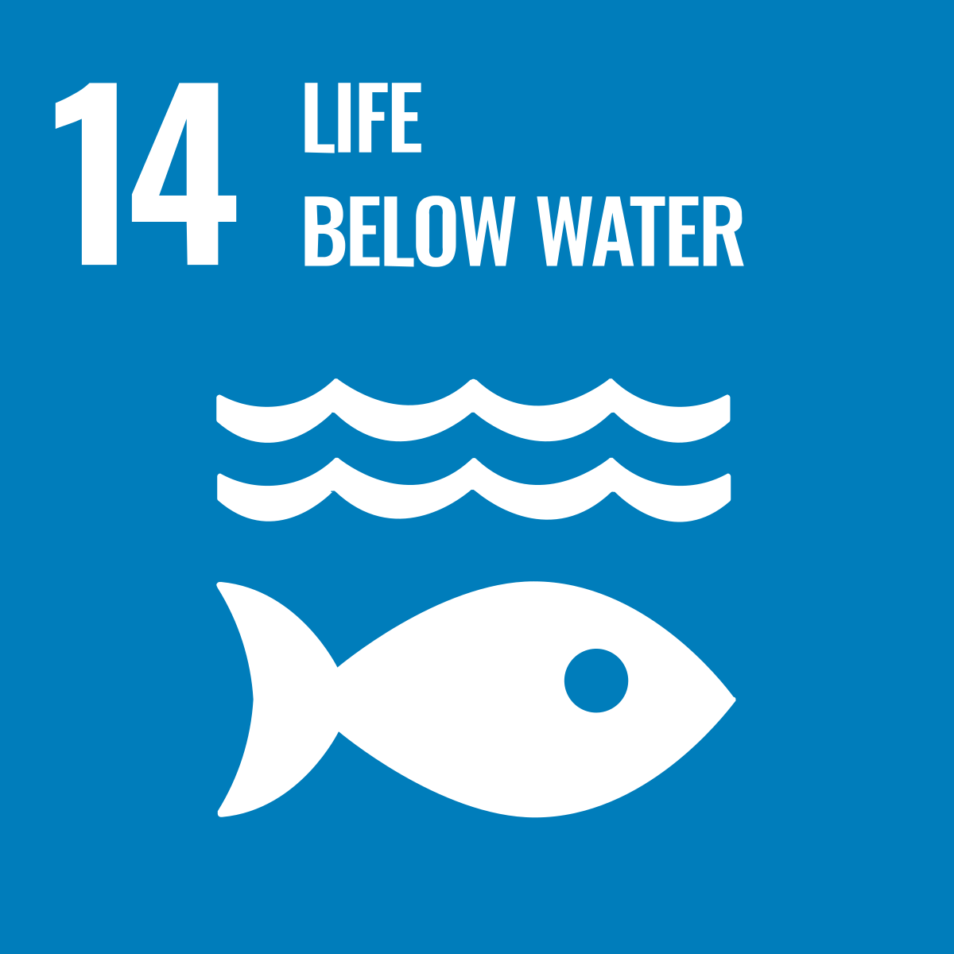
35 Essential Ocean Variables (EOVs)
Post-2020 Biodiversity Framework
International Legally Binding Instrument on Plastic Pollution 2024
+ Biodiversity Beyond National Jurisdiction
Notes:
GOOS establishes frameworks,
EOVs underpin nations’ action and reporting to international agreements, and
GOOS does work through its expert Panels - Physics & Climate, Biogeochemistry, BioEco

Slide 22
GOOS : Regional & National Alliances
SAON
EuroGOOS
CIOOS
Black Sea GOOS
NEARGOOS
US IOOS
MONGOOS
IOCARIBE-GOOS
Plus 76 GOOS National Focal Points
SEAGOOS
GOOS-Africa
IOGOOS
PI-GOOS
OCEANTLAN
GRASP
IMOS
SAEON
SOOS
Notes:
GOOS is a global network.
14 GOOS Regional Alliances – all very different in governance, scope and mandate – connected to 130 countries
Orange is in the network, Green is in dialogue
CIOOS: Canadian Integrated Ocean Observing System - adopted recently!
PI-GOOS: New hosting Office at SPC (Pacific Community, Fiji)
IOCARIBE-GOOS: Special session at the IOCARIBE meeting
GOOS Africa: Africa Roadmap Ocean Decade, new opportunities for support
Now have 76 GOOS NFPs – supported though the GOOS office. ToRs reviewed and adopted by SC in April.

Slide 23
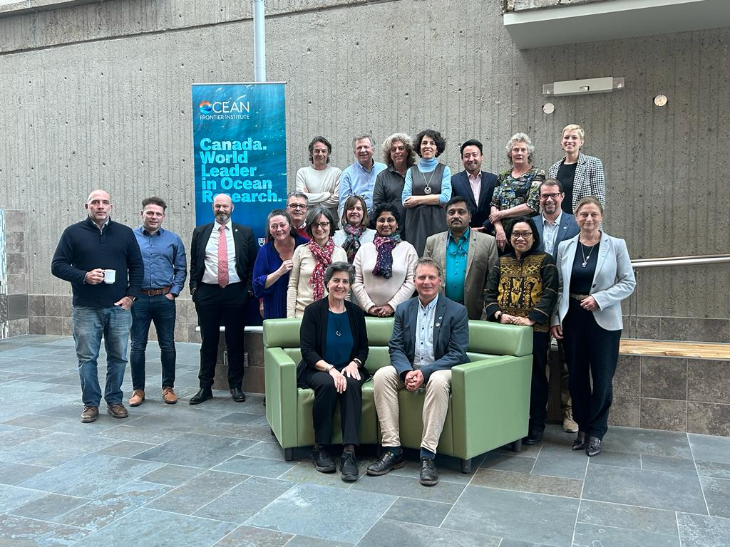
GOOS Steering Committee April 2023
Focus areas for the next period:
Communications and advocacy
Regional coordination
UN Ocean Decade - Co-Design
Evolving GOOS Governance - key 2023
Strengthening GOOS core support is absolutely vital
Plus, updated NFP ToRs approved

