Slide 1
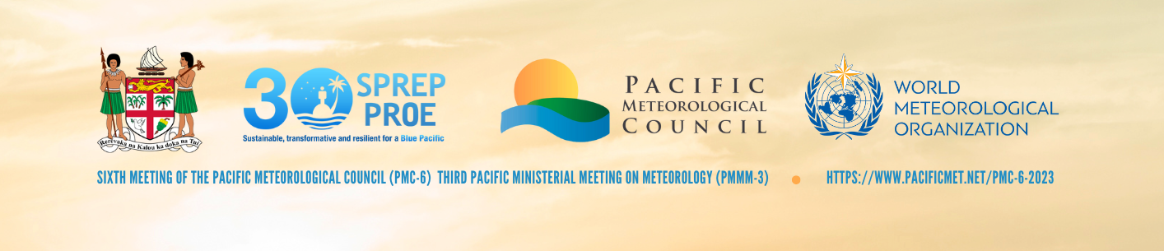
Agenda Item: 8.1 Title: Progress and Update on the Weather Ready Pacific Program
Presenter: Ofa Fa’anunu

Slide 2
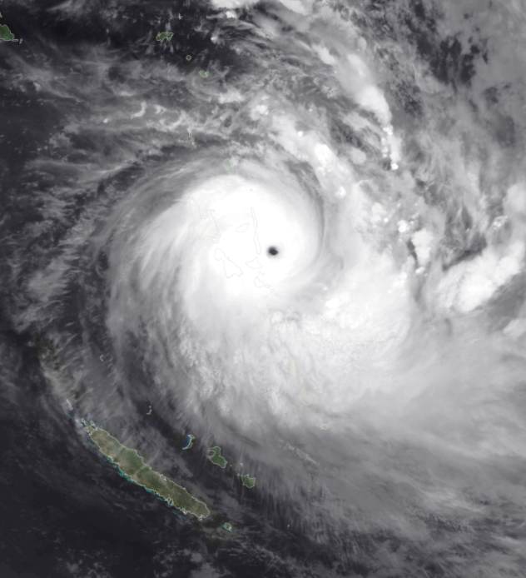
Pacific Islands are highly vulnerable to extreme weather, hydrological and ocean events
Economic losses from cyclones and flooding in the South Pacific region in 2020 were around $1 billion with at least 71 lives lost. Annual average losses are around $500M
Climate change will exacerbate extreme events
Meteorological and Hydrological services in the region face some critical gaps in governance, observation networks, forecasting, delivering impact-based messages to communities, capacity and training
Long Term Coordination -Many programs ongoing in the Pacific, especially in relation to climate (e.g. COSSPac, PREP, GCF, RESPAC), but a regional, long-term approach to building NMHS capacity in extreme events is needed.
Too many projects implemented in silos – resulting in fragmented implementation and overburdening NMHSs
Context

Slide 3
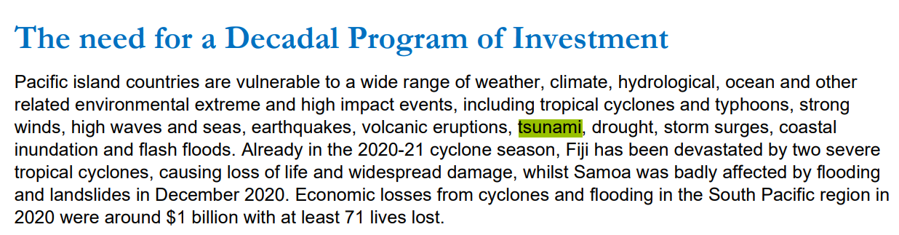

Slide 4
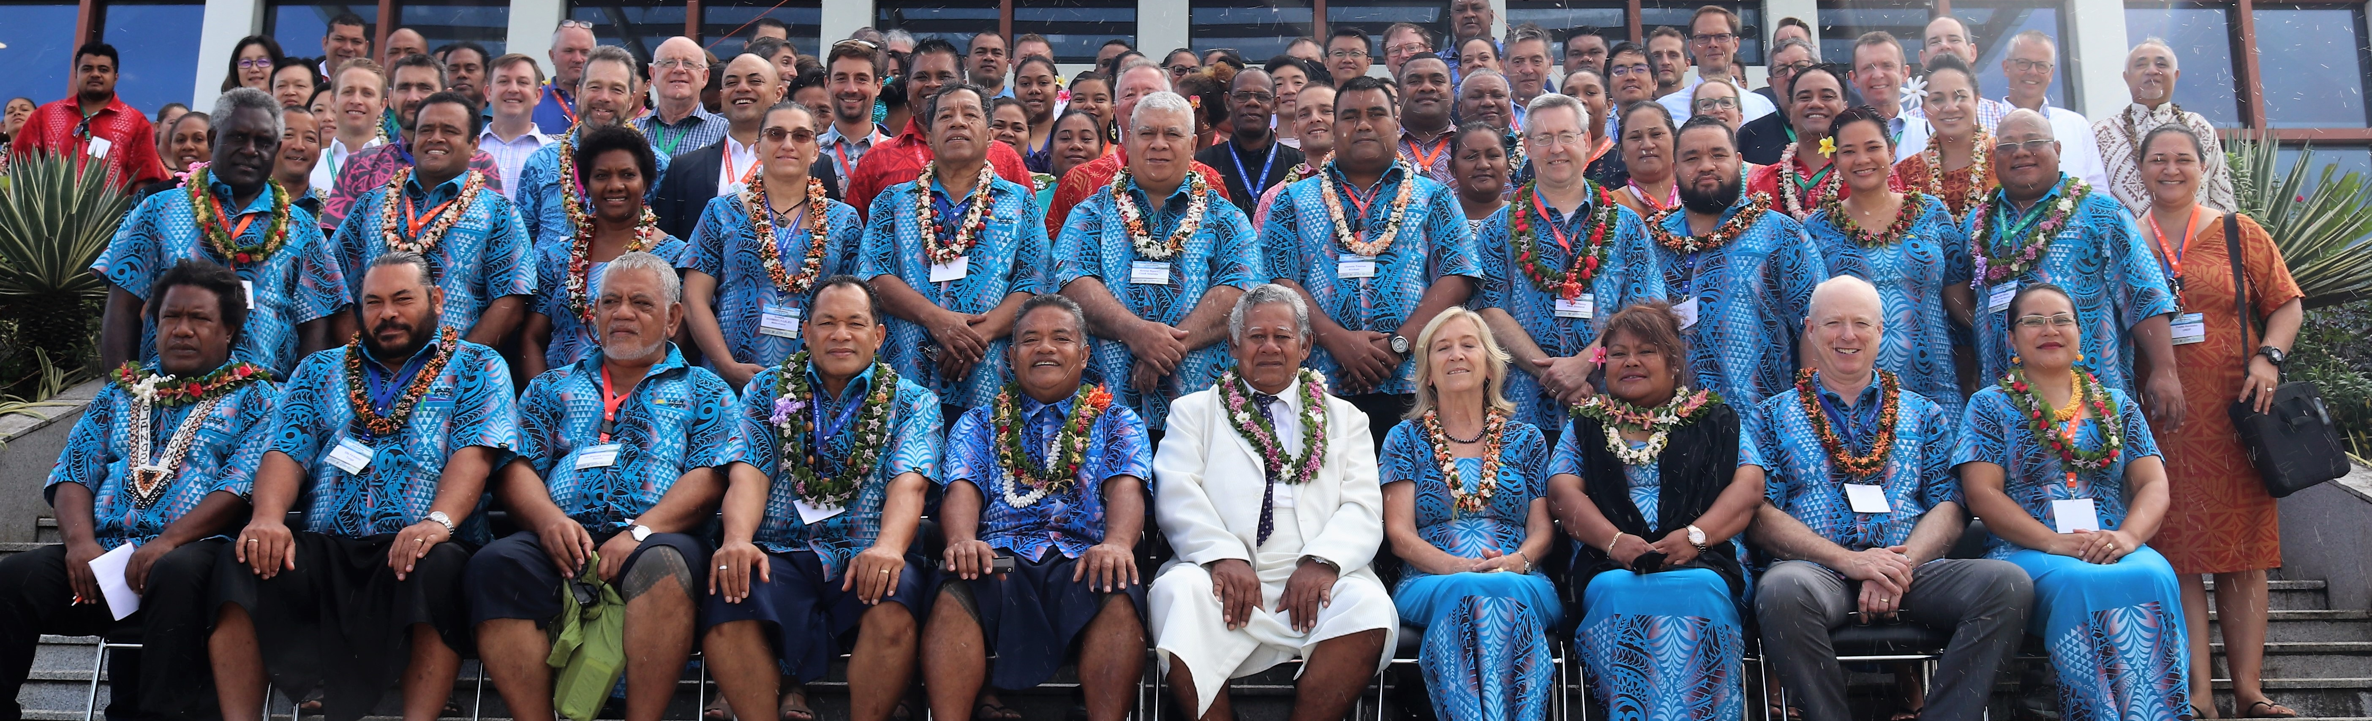
PMC-5 Decision 2019
Building the capacity of Pacific Island States to respond to Extreme, Weather, Water, and Ocean events
The Meeting:
Noted the importance of ensuring information to support preparedness and response to extreme weather events, water and ocean risks;
Noted the need for long-term strategic investment in capability that supports critical gaps in preparedness and response at short time scales;
Agreed to commission through SPREP, in cooperation with members, WMO and other CROP agency partners to undertake a study to scope a decadal Pacific regional extreme weather, water and ocean response program initiative; and
Agreed to use the outcomes of the scoping study to inform deliberations at the next PMC Ministerial Meeting.

Slide 5






Protecting communities: Communities will
be able to make decisions based on knowing more, earlier, about conditions in their particular location. They will understand what the weather will do rather than what the weather will be.
Strengthening security: Better access to reliable weather information will support the region's maritime surveillance and fisheries management initiatives, and enable better preparedness for events that could lead to political and/or social destabilisation – eg energy management, food and water security.
Strengthening the region's resilience to the impacts of severe weather events – tropical cyclones, tsunamis, droughts, storm surges, flash floods.
Weather Ready Pacific
Supporting economies: improved forecasts and warnings will support timely and targeted preparedness measures, limiting the economic impact of severe weather events (securing infrastructure, relocating stock and supplies etc); for some countries, strengthened industry engagement will leverage enhanced productivity (agriculture, energy etc).
Enhancing connectivity: by strengthening the Pacific’s integration into the global meteorological system, the region will be less vulnerable to peaks and troughs in resourcing and support, and have a stronger voice internationally.
USD167Mill for 10 years

Slide 6
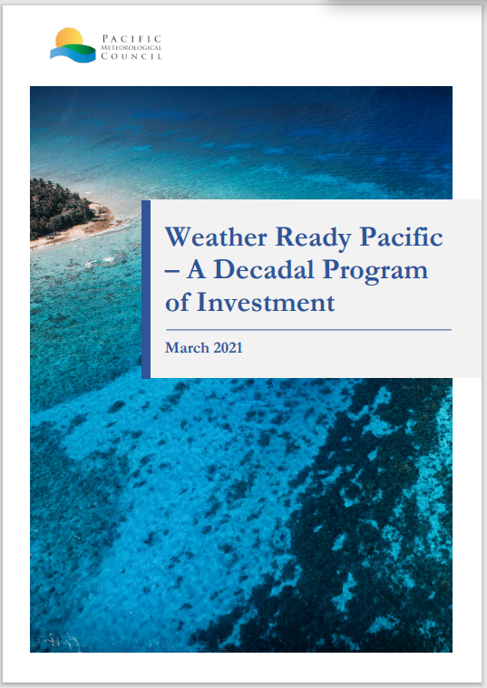

Slide 7
Governance and leadership
(a) Establish a Pacific Meteorological Leadership Program
Infrastructure
Investment in observational infrastructure targeted to local needs:
Forecast and warning production
(a) Investment in use of NWP and satellite products in a cascading forecast process
Communication and delivery
(a) End-user workshops
Capacity
(b) Establish Management and Advisor Team for Program who sit with PMDP and help coordinate across many donor programs and with PMC and its Panels
(a) Weather radars (b) Flood gauges (c) Upper air measurement
(d) Ocean observations (e) Equipment long-term maintenance schedule
(f) Investment and upgrade of ICT equipment, bandwidth and data
(b) Strengthening RSMCs
(c) Develop Pacific Weather Exchange
(d) Investment in ensuring observations are delivered to GBON
(b) Developing and communicating impact-based warnings
(c) Enhanced NMHS/NDMO collaboration
(a) RTC established for BIP-MT training (b) Establish a hybrid BIP-M training program
(c) Training for hydrologists & hydrographers (d) Professional development workshops
(e) Twinning program to mentor NMHS staff
1
2
Summary Investment Priorities Areas
3
4
5

Slide 8
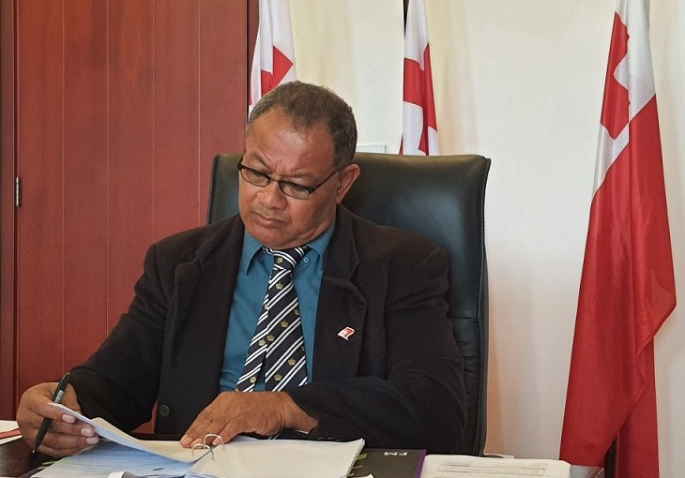
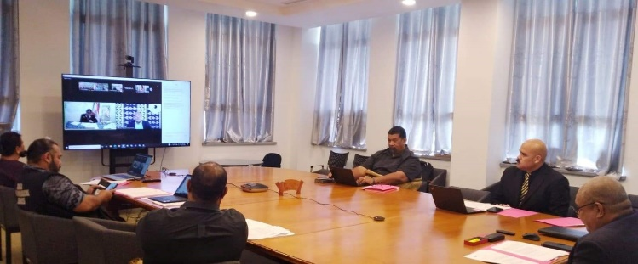
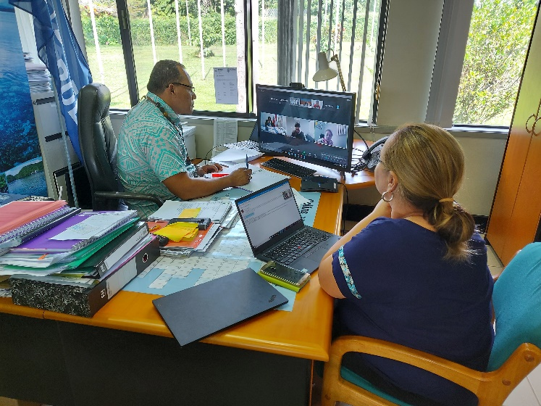
Country Paper by the Government of Tonga to present the WRP on behalf of the PMC to the Pacific Leaders Forum: Decisions by the Leaders
20. Tonga presented paper on strengthening disaster readiness to severe weather, water and ocean events across the Pacific.
21. Forum Foreign Ministers:
(i) endorsed the Weather Ready Pacific Decadal Programme of Investment, which seeks to reduce the human and economic cost of severe weather, water and ocean events across Pacific Island communities, by strengthening national meteorological and hydrological organisations and their partnerships with national disaster management organisations;
(ii) recognised that the Decadal Programme of Investment is a comprehensive approach and responds to the needs of the Pacific region;
(iii) directed the Secretariat to bring the Decadal Programme of Investment to the attention of Leaders for their endorsement, and for sharing with Forum Dialogue Partners; and
(iv) requested SPREP as the secretariat of PMC to continue to seek funding for the Weather Ready Pacific Decadal Programme of Investment, and report back to FOC on progress.
On 6 August 2021
Leaders endorsed the Weather Ready Pacific Decadal Programme of Investment, which seeks to reduce the human and economic cost of severe weather, water and ocean events across Pacific Island communities, by strengthening national meteorological and hydrological organisations and their partnerships with national disaster management organisations.
Tonga’s Chief Secretary and Secretary to Cabinet presenting
the WRP to the FFMM, 27 July 2021
Tonga Head of Delegation presenting the WRP to the Pre-Forum
Meeting 23 July 2021
SPREP participating at the Forum Foreign Ministers Meeting

Slide 9
Approach and Progress
2 March 2021
Briefing for Ofa Fa’anunu and Andrew Johnson as the main PMC Leads to get comments
20 March 2021
Send to all PMC Members, Partners (WMO, SPC, etc)
31 March 2021
Briefing with PMC members and Partners
16 April 2021
FINALISE the Investment Plan
05 May 2021
Out-Of-Session PMC Meeting to Discuss and endorse the recommendations
20-16 April 2021
Experts to meet 1:1 with NMHSs and Partners
27 October 2020
Meeting with PMC members to discuss the TOR and the introduce the consultants
Nov 2020 – Feb 2021
Consultations with the NMHSs and partners
May-Sept 2020
SPREP secure fund, discussions with BoM to assist and LoA signed, Secure consultants
22-23July 2021
PIFS Forum Officials Committee (FOC) Meeting Approved the WRP. Paper presented by Tonga
27 July 2021
Forum Foreign Ministers Meeting (FFMM) endorsed the WRP presented by Tonga
7-9 Sep 2021
SPREP Council noted and acknowledge the WRP
8 Nov 2021
SPREP promoted the WRP at the COP26 side event
2022
Fundraising (Feasibility)-UNOC/COP27/DRR/NMHSs/MFAT/DFAT engagement
March 2023
DFAT-AUD30Mill/MFAT indicated support
August 2023
Presentation to PMC-6
April-July 2023
Governance Structure
August-Nov 2023
Review and implementation plan
Nov 2023
PIFS Leaders Meeting
August 2019
PMC-5 recommended the scoping study
14 May 2021
Tonga Cabinet Submission

Slide 10
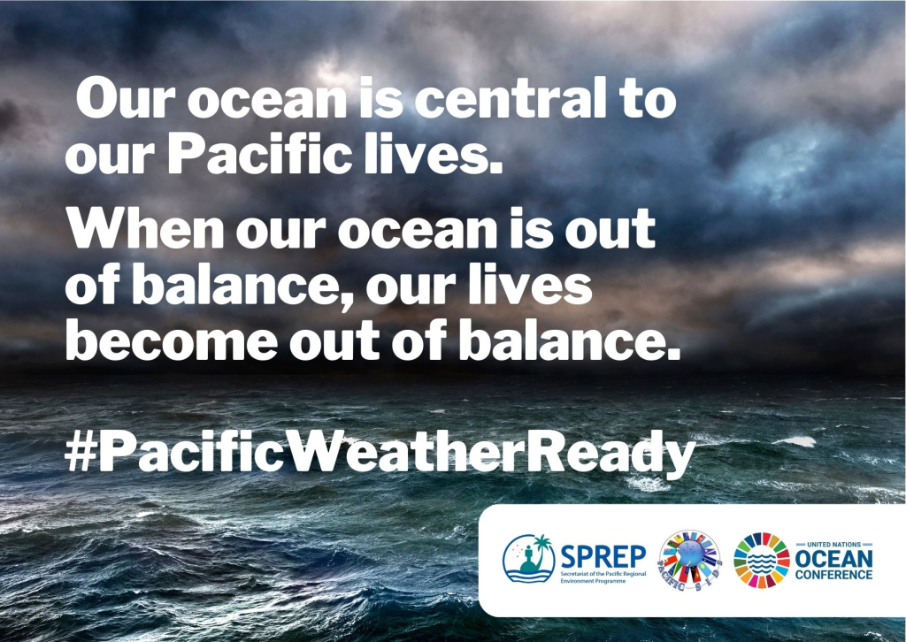
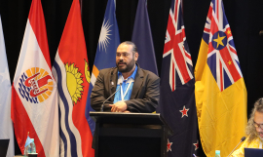
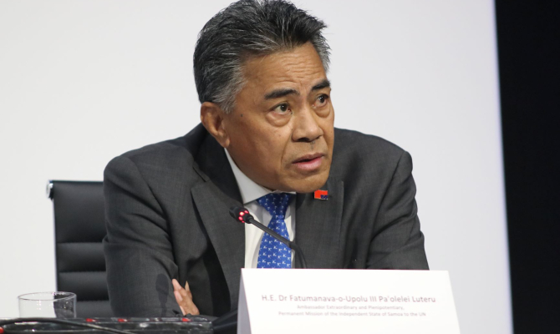
Weather Ready Pacific in global and regional forums
SPREP and all members of the Council supported to raise awareness on the initiative
Presented at numerous forums including the;
SPREP Meeting in 2020, 2021 and 2022,
Project meetings
UNFCCC COP 26 and 27,
UN Ocean Conference,
Inaugural Pacific Ministerial for Disaster Risk Reduction,
Asia Pacific Ministerial Conference on DRR
QUAD Meeting (Leaders of US, Australia, Japan, India)
Discussed with Development Partners and Donors (Australian DFAT, New Zealand MFAT, UK, Irish,other Development Partners, Multilateral Donors and UN Agencies)
Featured in numerous News articles

Slide 11
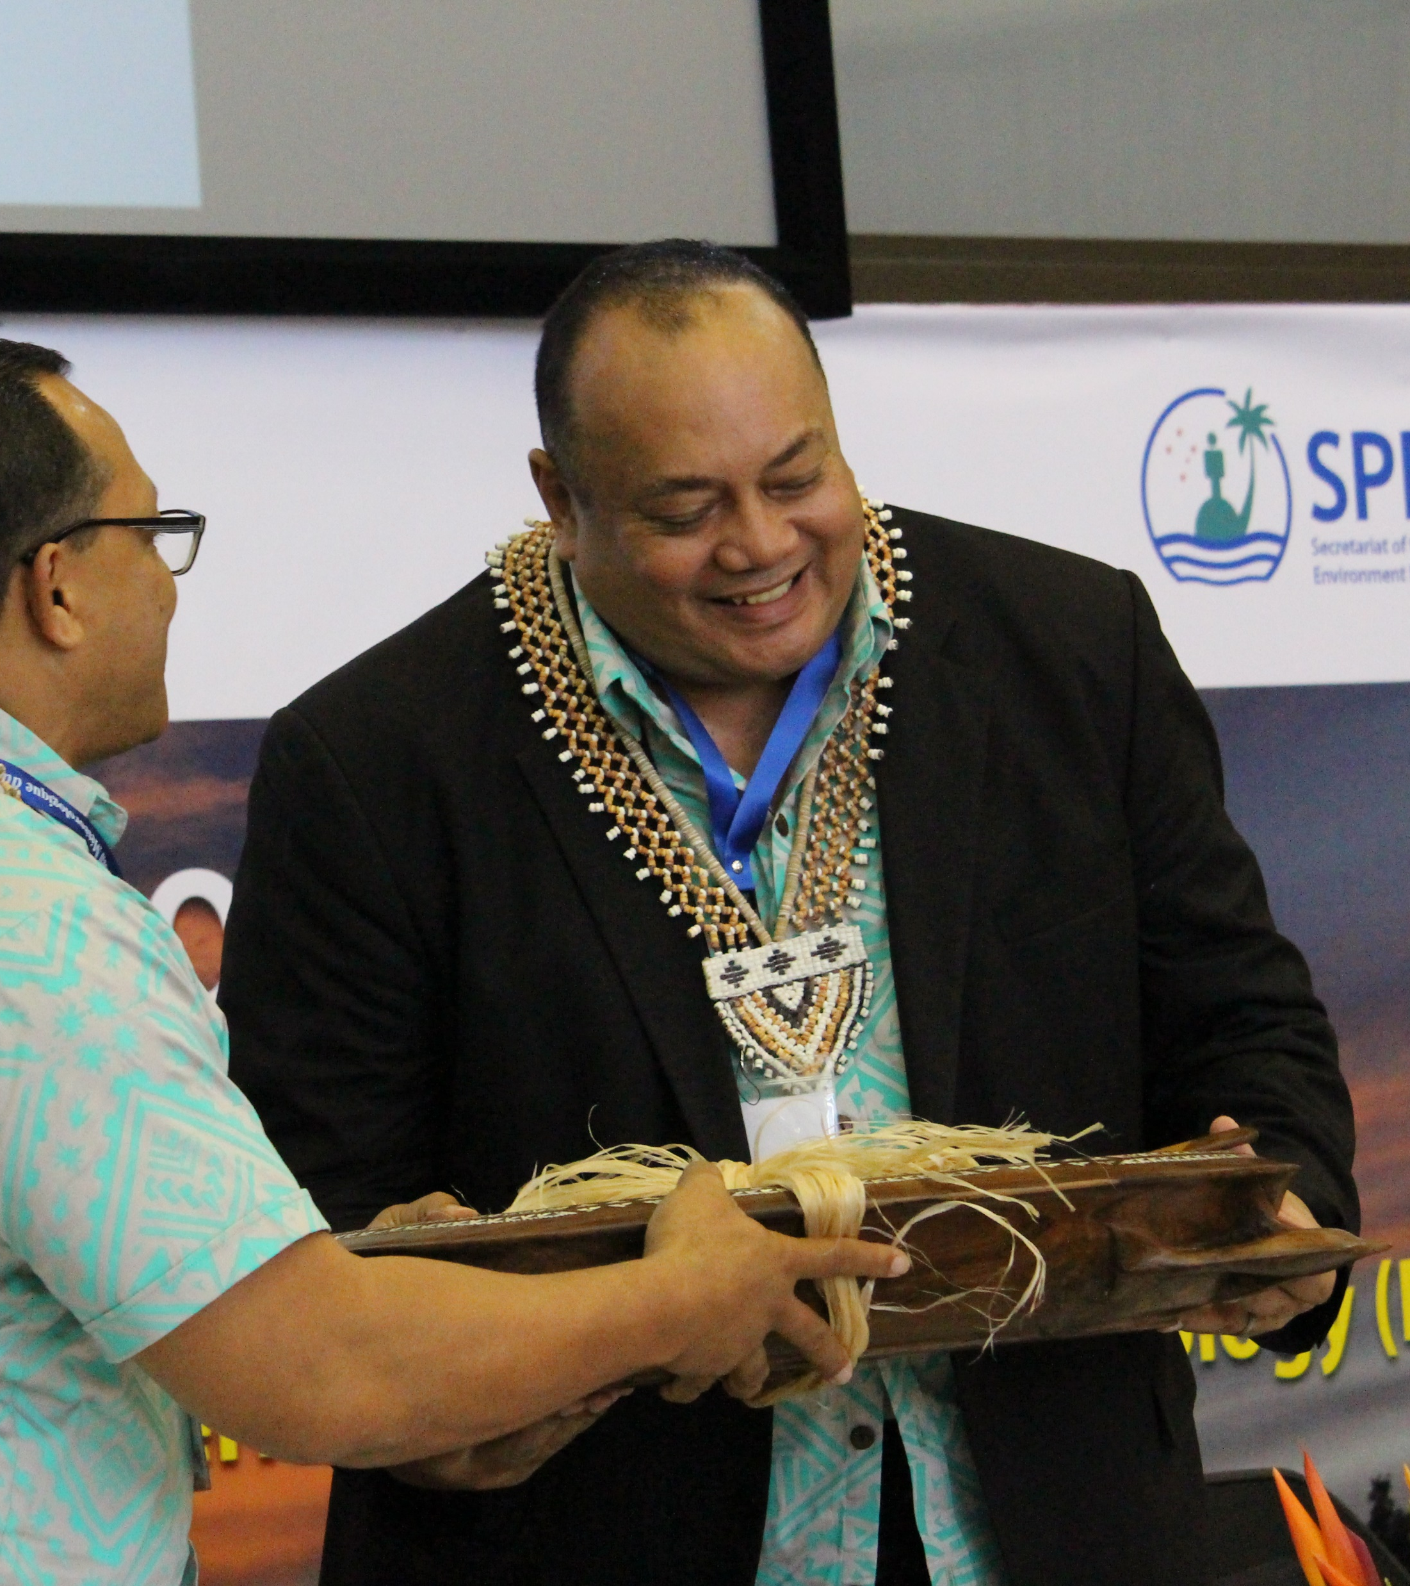
A Pacific-led initiative
WRP is a Vehicle to deliver people-centered end-to-end multi-hazard early warning systems for all Pacific island countries and territories
Initial investment by Australia for AUD30 million and support from New Zealand
The Governance Structure to be presented at the PMC-6
Review the WRP and development of an implementation plan

Slide 12
Recommendations:
The Meeting is invited to:
Note the significant progress made on the Weather Ready Pacific to date and encourage members to continue working towards program implementation.
Acknowledge the Government of Tonga for presenting the Weather Ready Pacific to the Leaders meeting in 2021
Acknowledge the effort and support of SPREP, Government of Australia including the Australian Bureau of Meteorology, Government of Tonga including the Tonga Meteorological Service, the Government of New Zealand and Members of the Council for progressing the work of the Weather Ready Pacific Initiative.
Acknowledge with appreciation the Government of Australia for providing the initial funding support of AUD30 million and invite development partners and donors to invest in this decadal program.
Recognise that the Infrastructure investment under the Weather Ready Pacific is critical for addressing the climate emergency in the Pacific.
Recommend for the Weather Ready Pacific to be established as a program to coordinate the wider implementation of people-centered end-to-end multi-hazard early warning systems for all Pacific island countries and territories.

Slide 13
Agenda Item: 11.4 Update on Pacific Tsunami Warning and Mitigation System (PTWS) Pacific Island Countries and Territories' Regional Working Group
Presenter: Ofa Fa’anunu, Tonga Meteorological Service (PIMOS Panel)

Slide 14
Objectives
To inform the meeting on PTWS response to the Hunga-Tonga Hunga Ha’apai
To highlight challenges and barriers in strengthening PTWS among PICTs
Inform PMC on the Ocean Decade Tsunami Programme (ODTP)
Inform PMC on the outcomes of the 9th meeting of PTWS WG-PICT in January 2023 and 7th ORSNET meeting in October 2022 Nukualofa, Tonga.
Encourage PMC to strengthen tsunami activities coordination within the PIMOS Panel and support the increase of resource mobilization towards strengthening PTWS among PICTs.

Slide 15
Background Pacific Islands Meteorological Strategy 2017-2026, PRIORITY 2: DISASTER RISK REDUCTION, PACIFIC KEY OUTCOME (PKO) 4 In June 2021, the IOC Assembly approved, through IOC Decision A-31/3.4.1(III) (Warning Mitigation Systems for Ocean Hazards), the development of an IOC Ocean Decade Tsunami Programme (ODTP) in the framework of the United Nations Decade of Ocean Science for Sustainable Development (2021–2030). UNESCO/IOC ICG/PTWS WG-PICT met on 03 February, 2023 and its Task Team on Capacity Development met on 02 February, 2023 in Nadi, Fiji following the first Regional Training on UNESCO/IOC Tsunami Ready Programme on 30th January – 1st February 2023. The Seventh meeting of the Oceania Regional Seismic Network on 17th -19th October, 2022 in Nuku’alofa, Tonga. ORSNET collates seismic data from 47 National stations in 7 PICTs. Thirtieth Session of the Intergovernmental Coordination Group for the Pacific Tsunami Warning and Mitigation System ICG/PTWS – XXX meeting 11-15th September, 2023, Nuku’alofa, Tonga.

Slide 16
Recommendations:
Recommend PMC to increase sustainable financial assistance through Weather Ready Pacific Decadal Programme of Investment and other financing programme facility toward the PTWS among PICTs including the Oceania Regional Seismic Network (ORSNET) and UNESCO/IOC Tsunami Ready Recognition Programme (TRRP) under the Ocean Decade Tsunami Programme (OTDP).
Consider Weather Ready Pacific Decadal Programme of Investment to support mutually beneficial areas between tsunami and weather ready programmes among PICTs
Encourage PMC PIMOS Panel to dedicate a Task Team on activities of PTWS WG-PICT and ORSNET.
Note the recommendations of the 9th Meeting of WG-PICT on 2nd January, 2023 in Nadi, Fiji and 7th ORSNET Meeting on 17-19th October, 2022 in Nuku’alofa, Tonga.
Recognize the Draft ORSNET Strategic Roadmap
Encourage participation of NHMS/NTWC and NDMO at the XXX Session of ICG/PTWS on 11-15th September, 2023 in Nukualofa, Tonga

Slide 17
Recommendation to ICG/PTWS
To recongnise the Weather Ready Pacific Program as vehicle for tsunami work in the PICT and
Recognize that tsunami activities of the Pacific Meteorological Council is delivered through the Pacific Islands Marine and Ocean Service Panel (PIMOS) of PMC as per the Pacific Islands Meteorological Strategy 2017-26
Invite the PICT-WG of ICG/PTWS to collaborate with PIMOS to synchronize efforts including resource mobilization

