Slide 1
Pacific Islands Countries and Territories Regional Working Group on Tsunami Warning and Mitigation System -
WG-PICT
Rennie Vaiomounga-Tonga

Slide 2
Notes:
Last Reporting Period December 2021

Slide 3
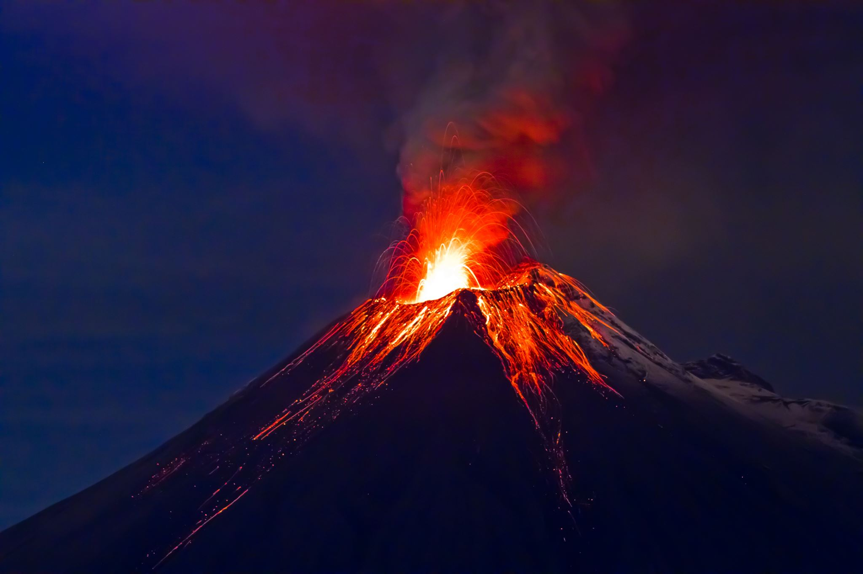
HUNGA TONGA HUNGA HAAPAI VOLCANO/TSUNAMI 15TH JANUARY 2022 –
RESPONSE & RECOVERY
Notes:
1. One month after the ICG/PTWS- XXIX in December 2021- HTHH Volcano Erupted on 14th January and Exploded on 15th January 2022

Slide 4
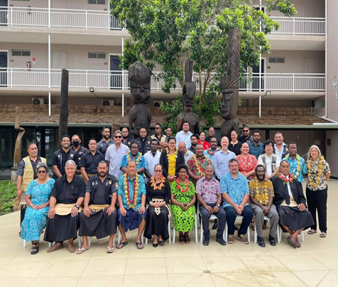
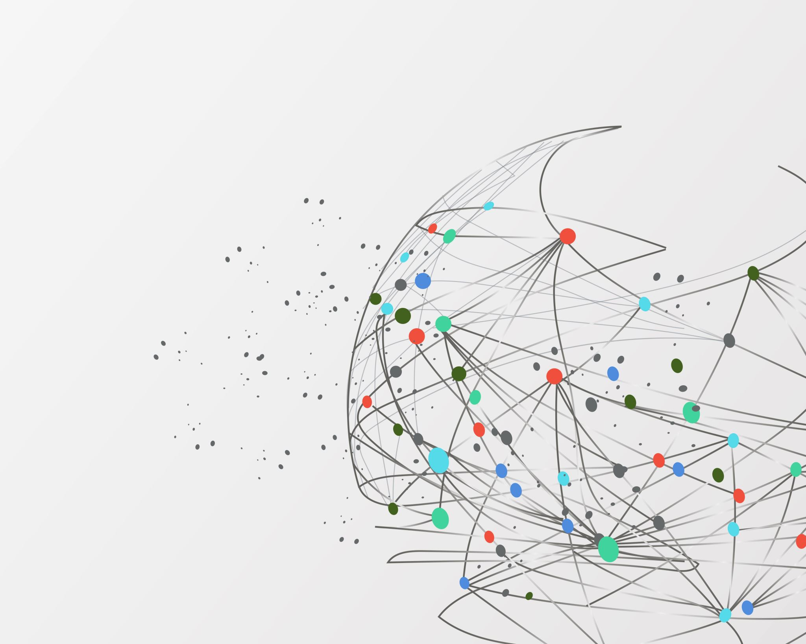
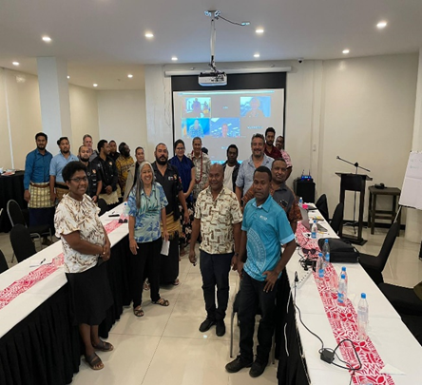
7TH ORSNET MEETING
&
WG 2 TASK TEAM SEISMIC DATA SHARING IN THE SOUTHWEST PACIFIC.
17TH -21ST OCTOBER 2022 –NUKU’ALOFA TONGA
Notes:
First In-person meeting supported by SPC PREP PROJECT and UNESCO/IOC held in Nuku’alofa, Tonga on 17th -21st October, 2022
7th ORSNET Meeting
8th Task Team Seismic Data Sharing in the SouthWest Pacific
HTHH Learning Event

Slide 5
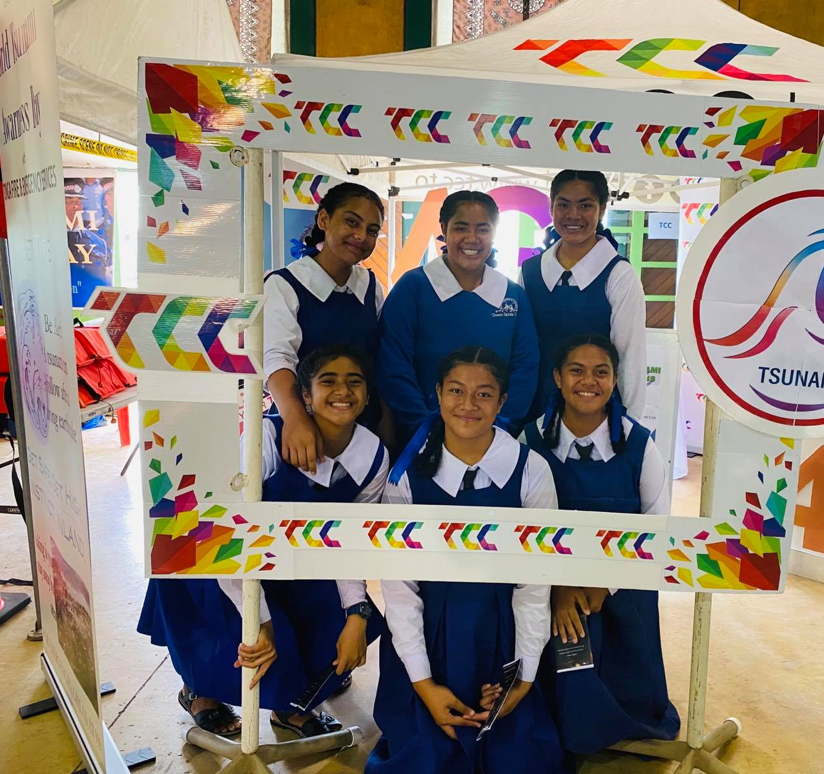
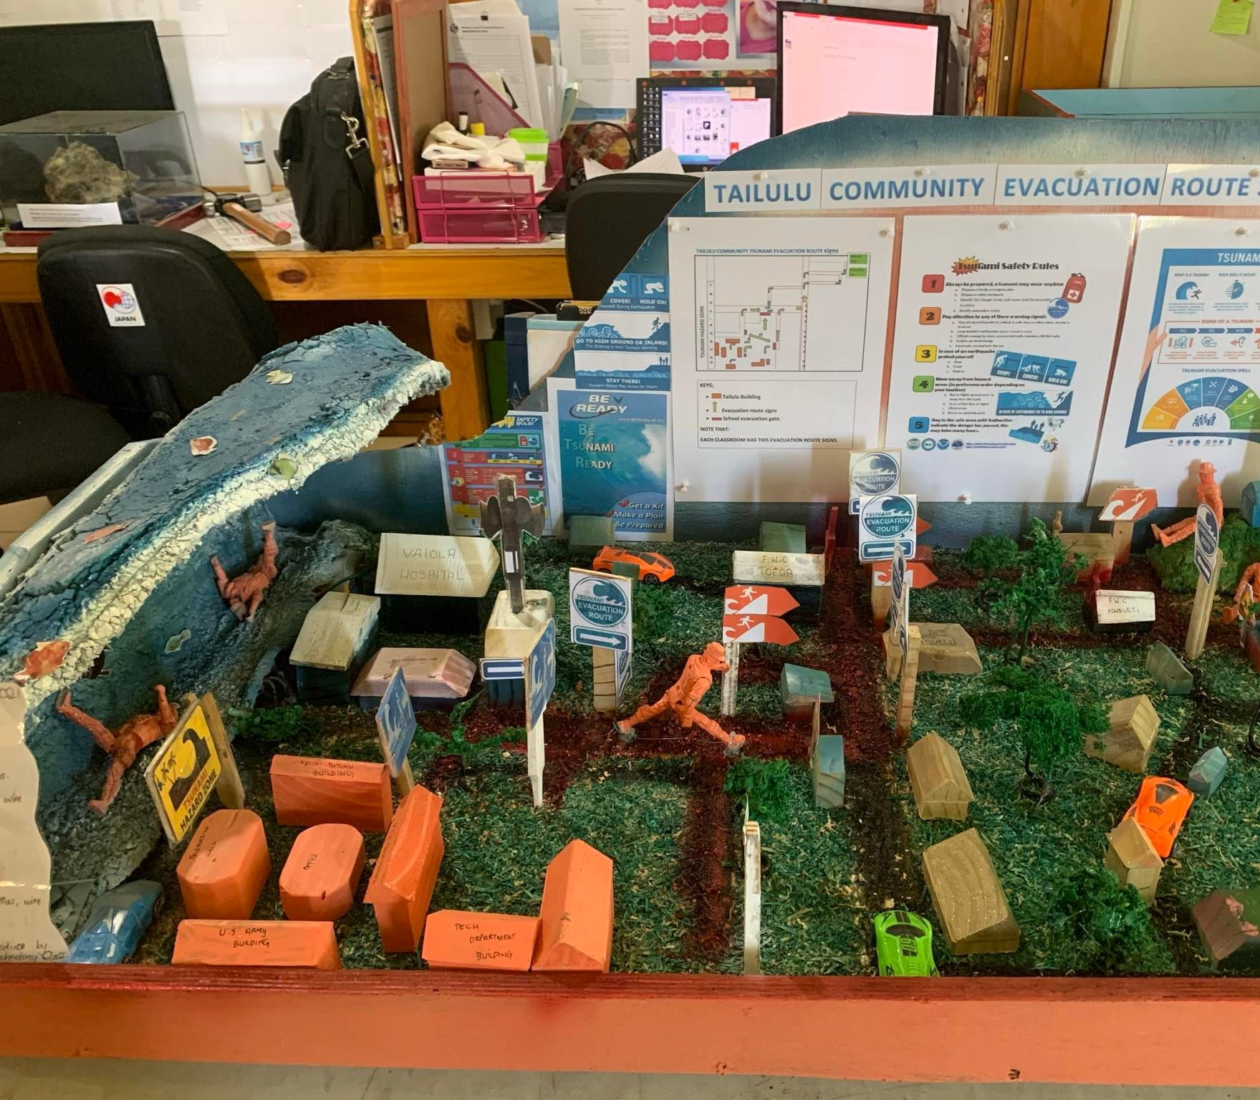
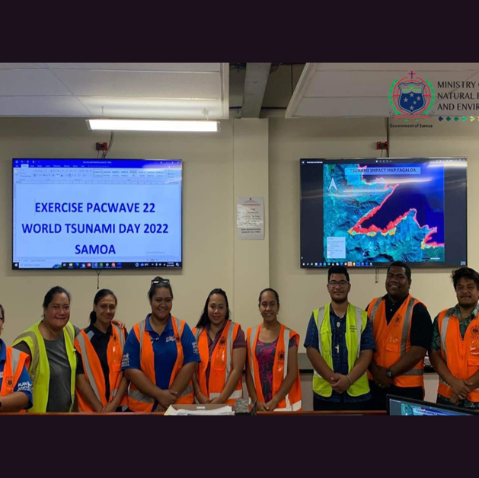
Notes:
WORLD TSUNAMI AWARENESS DAY 2022 ON 5TH NOVEMBER 2022

Slide 6
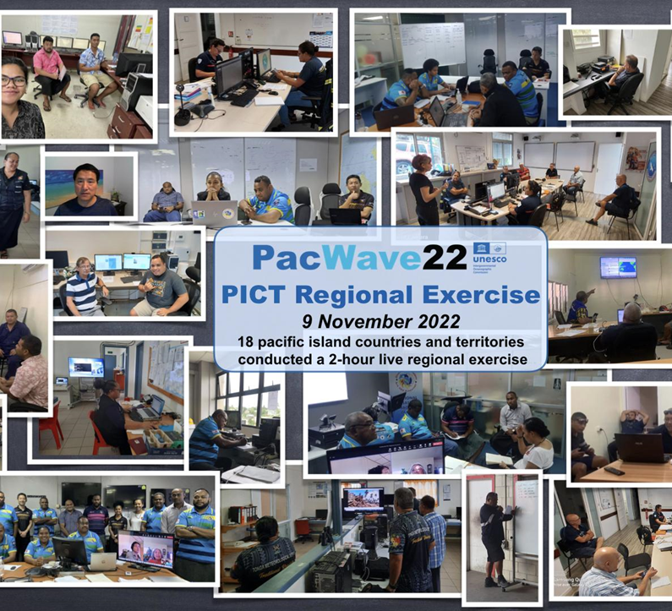
FIRST PACIFIC ISLANDS REGIONAL EXERCISE -9th November 2022
http://itic.ioc-unesco.org/index.php?option=com_content&view=article&id=2224&Itemid=2333
Notes:
Exercise Pacific Wave 2022
First Pacific Islands Countries and Territories Regional Exercise 2022
18 Countries participated in a 2hr live exercise
NTWC and NDMOs
To Test the HTHH Interim Procedures
Using WhatsApp, Email Listserve and HF Radio
Thank support of ITIC on hosting a Website and Listsever

Slide 7
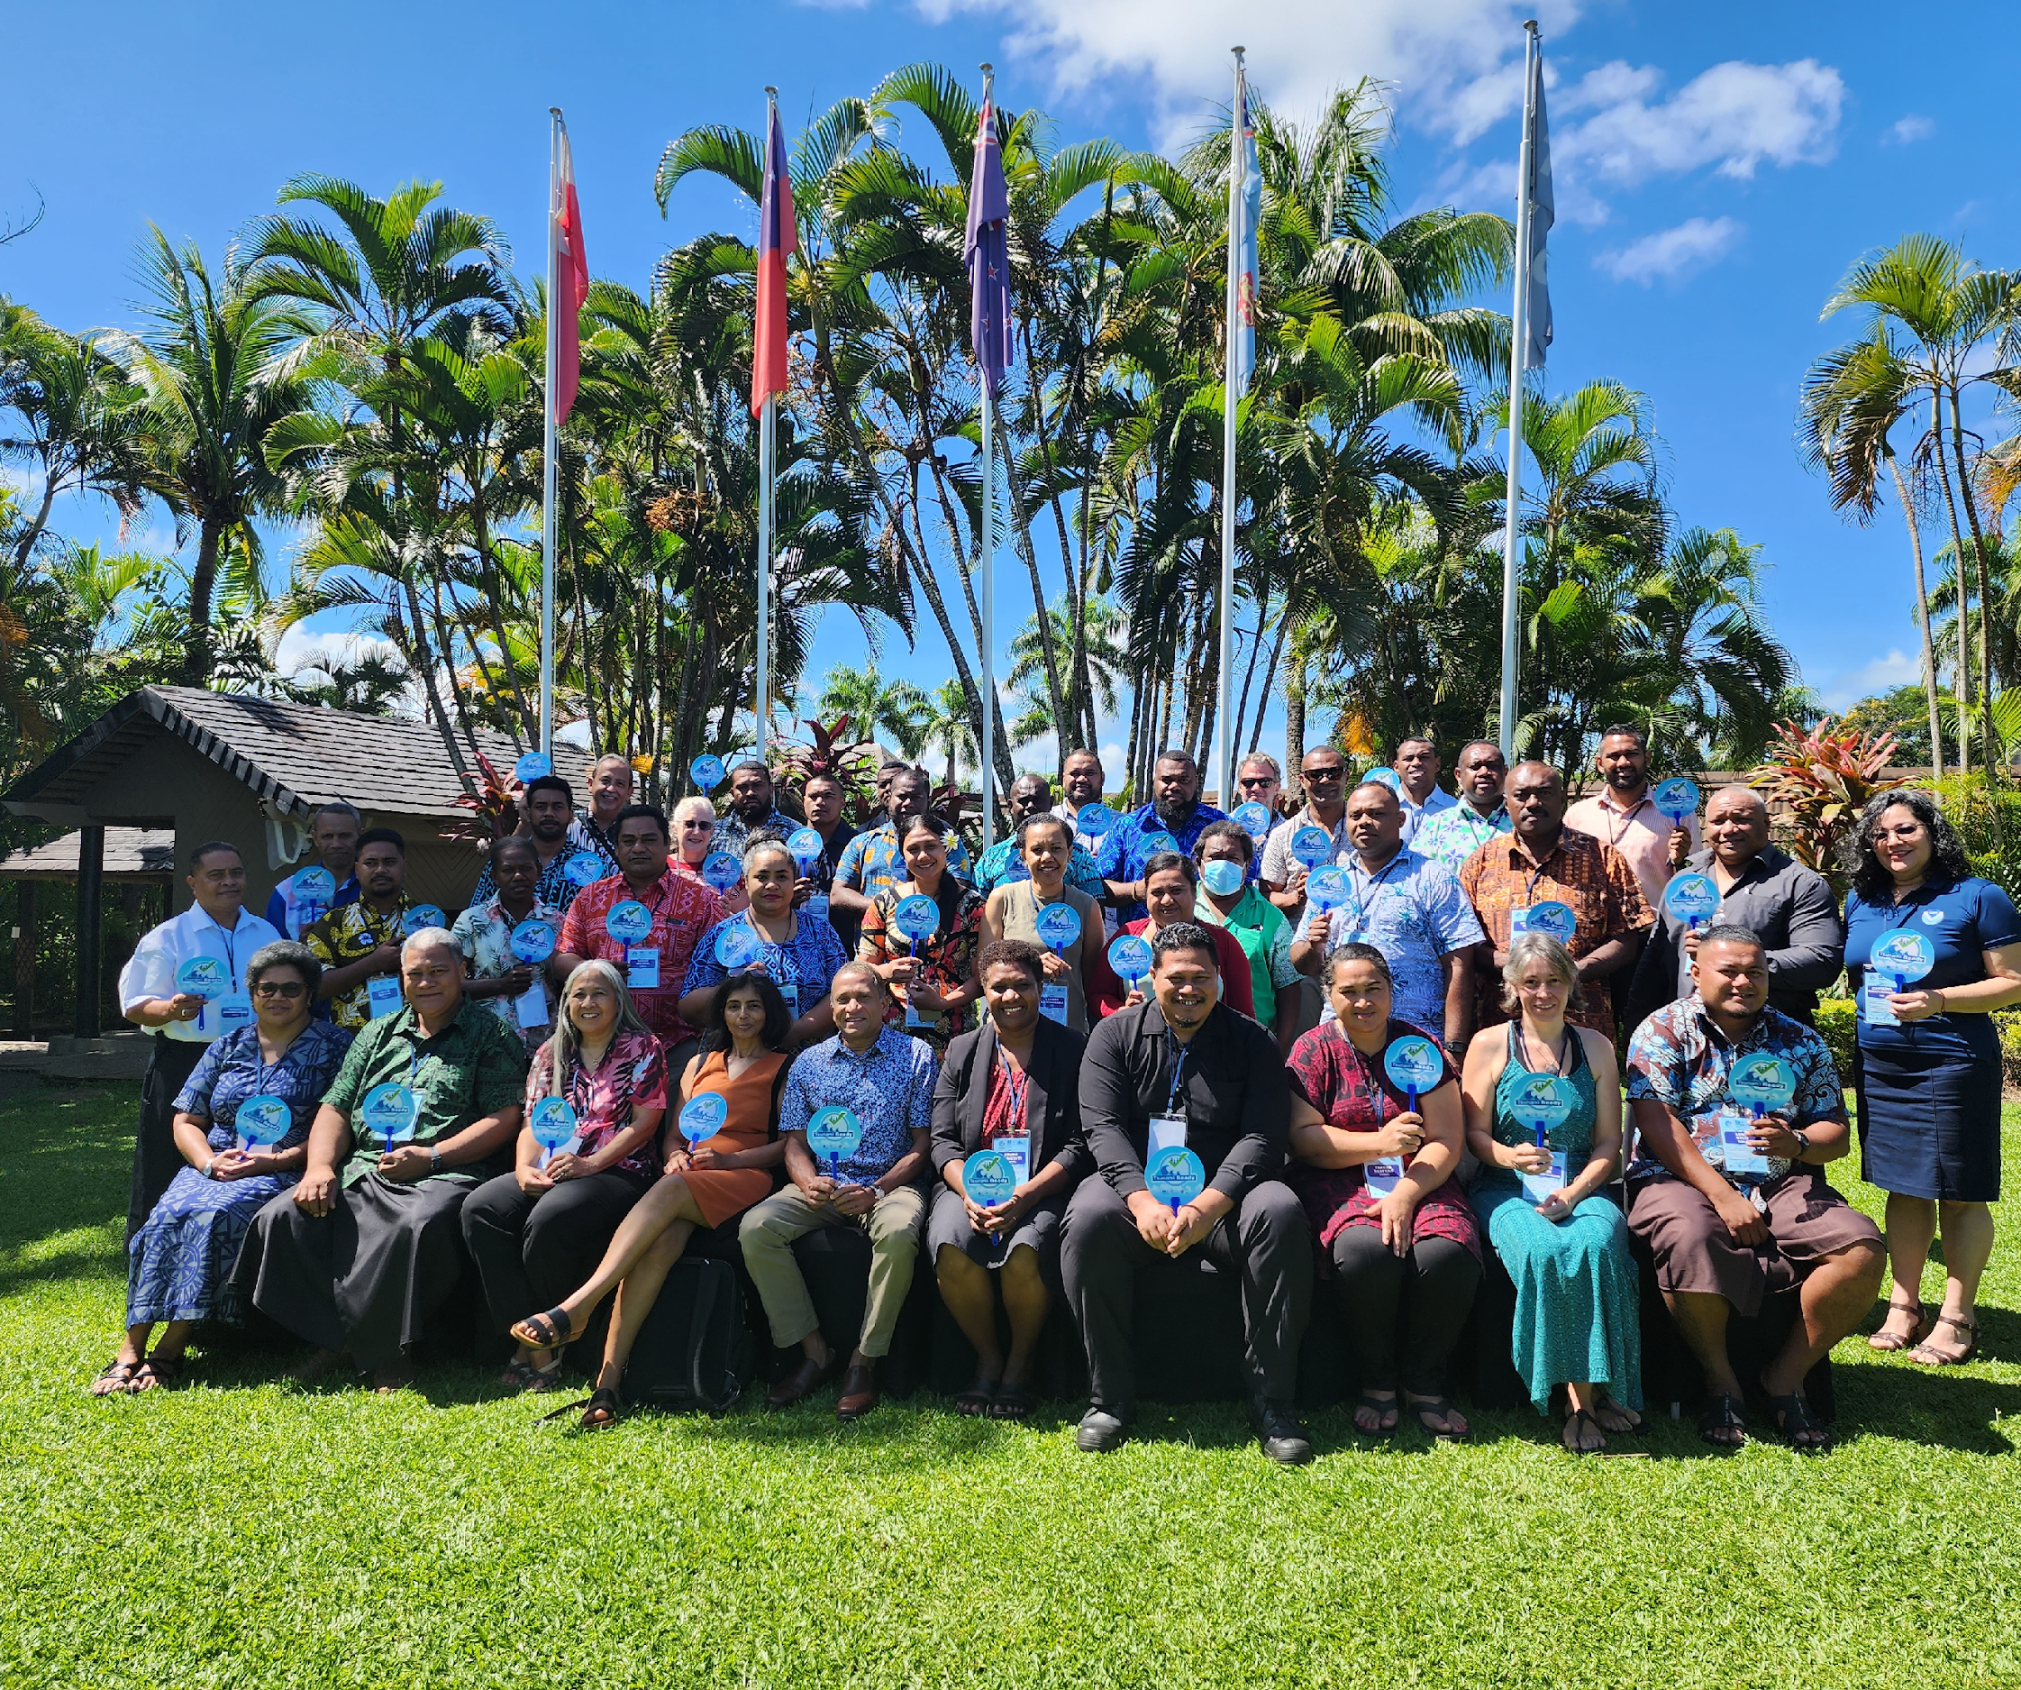
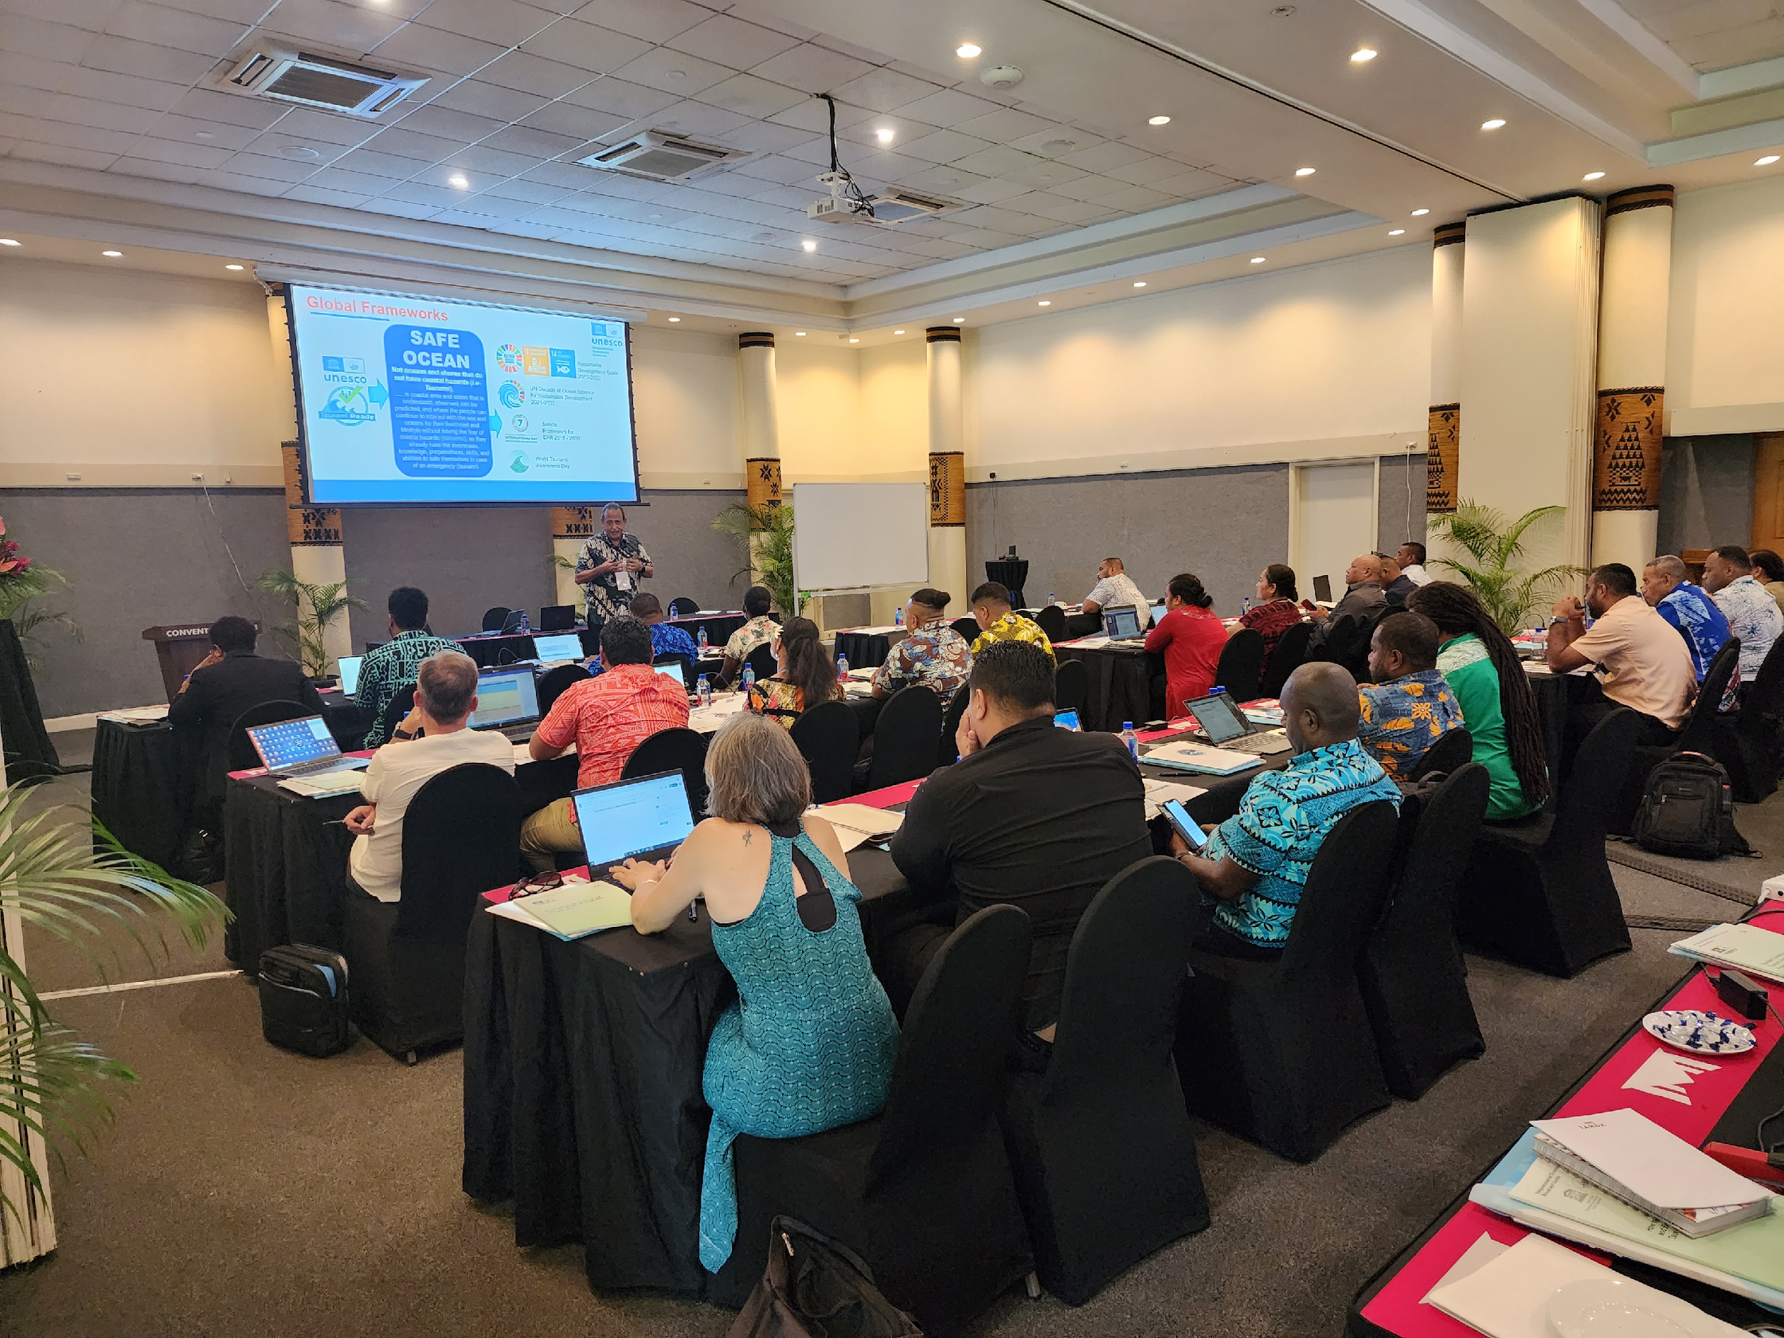
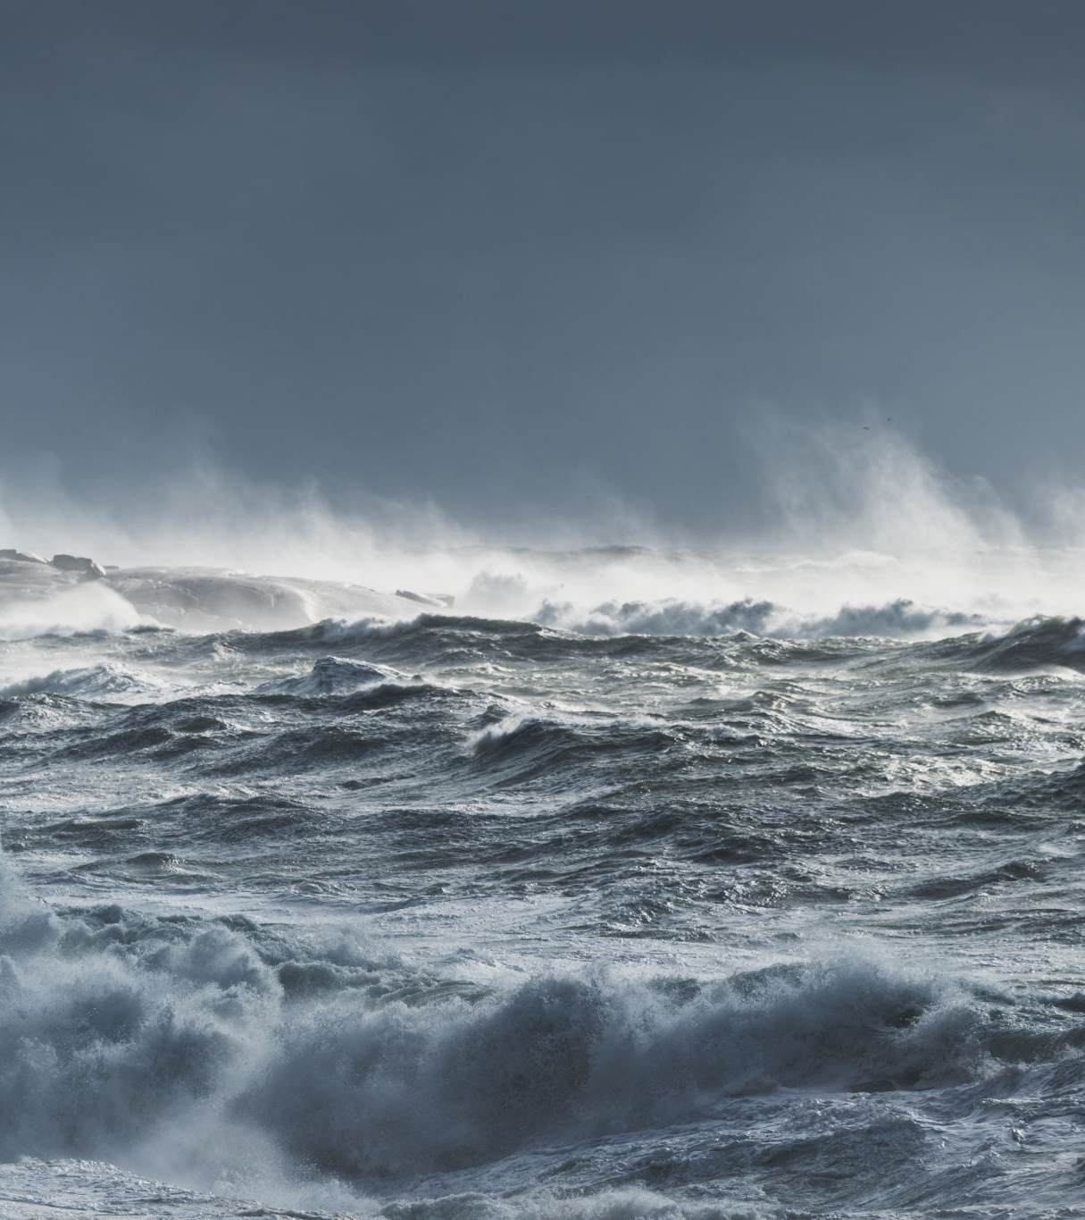
FIRST REGIONAL TRANING ON UNESCO/IOC TSUNAMI READY RECOGNITION PROGRAMME
30TH January – 1st February 2023
Notes:
First Regional Training on UNESCO/IOC TSUNAMI READY RECOGNITION PROGRAMME n Nadi, Fiji on 30th January -1st February, 2023
Attended by 13 PICTs

Slide 8
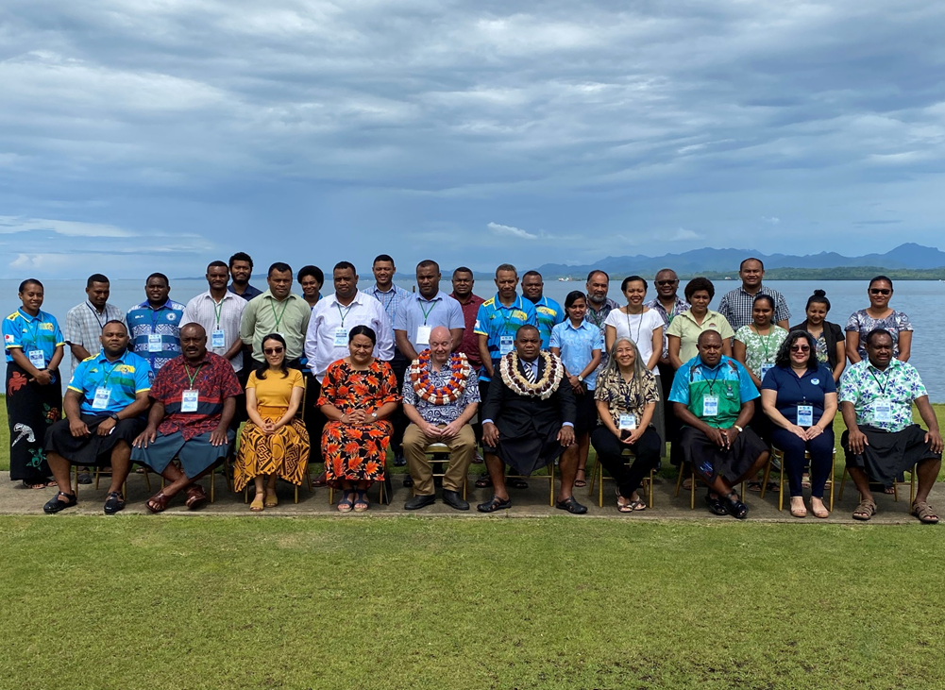
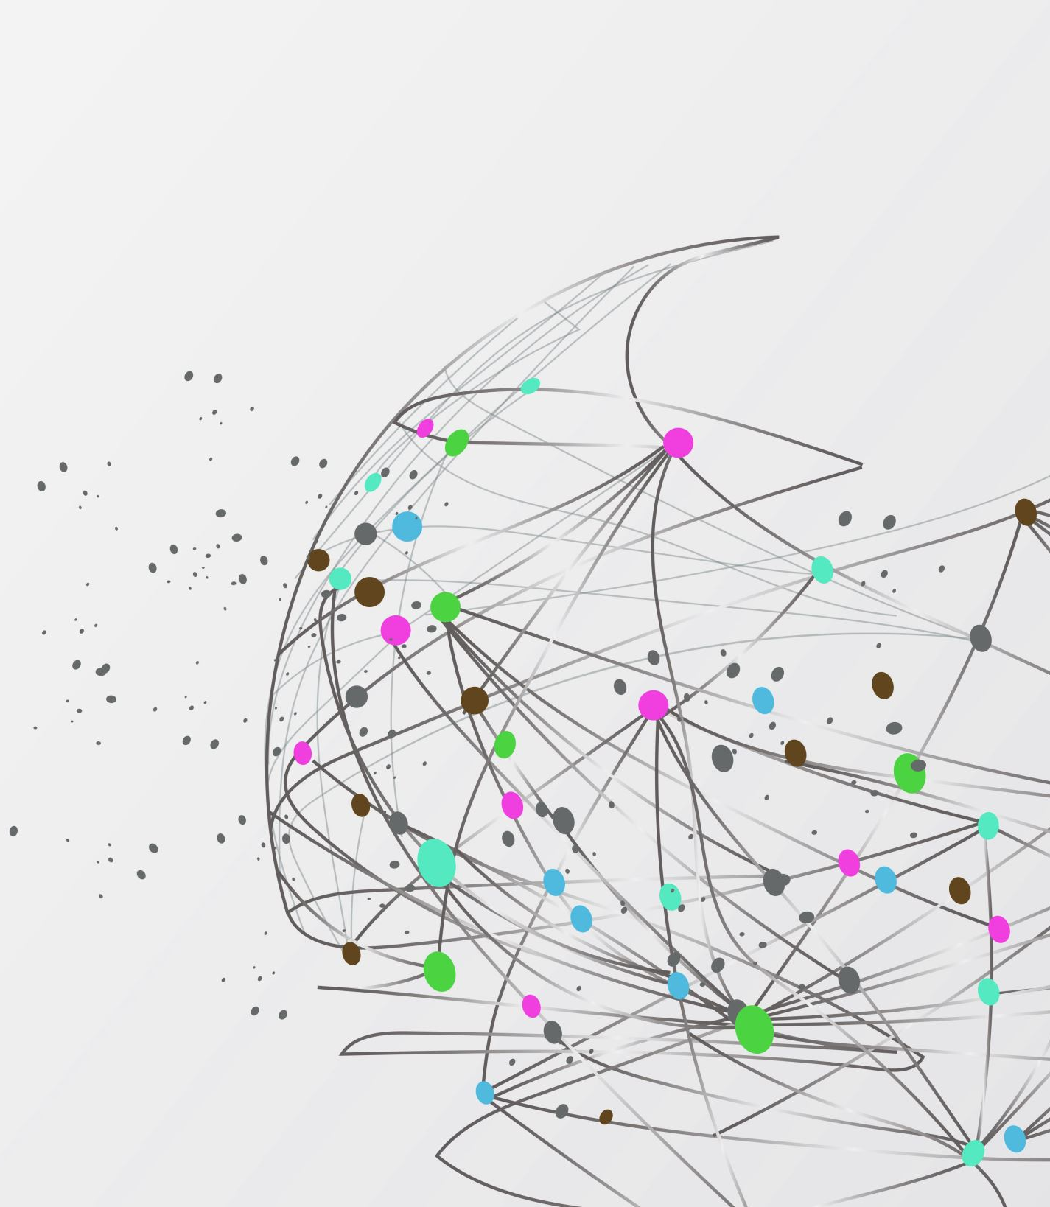
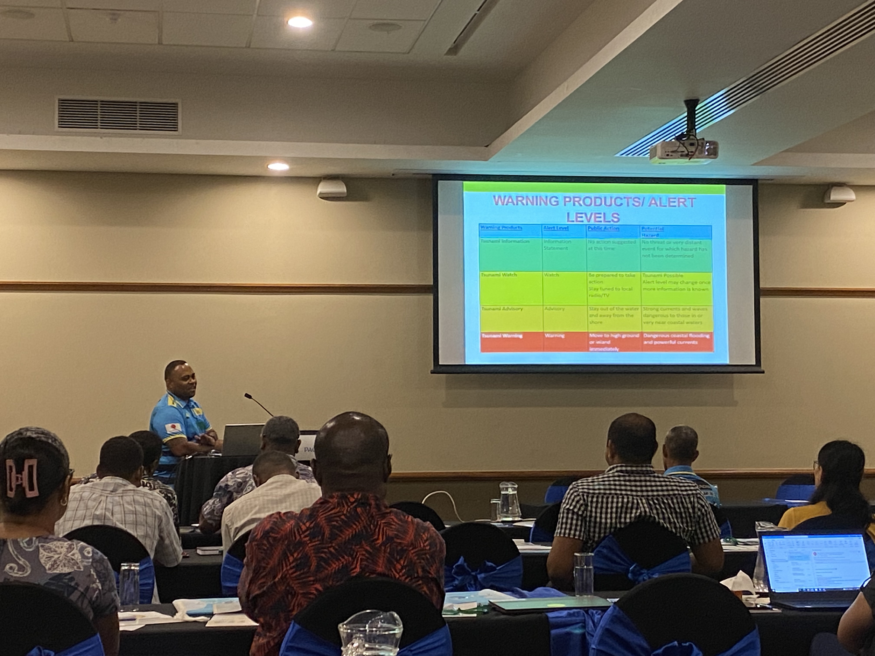
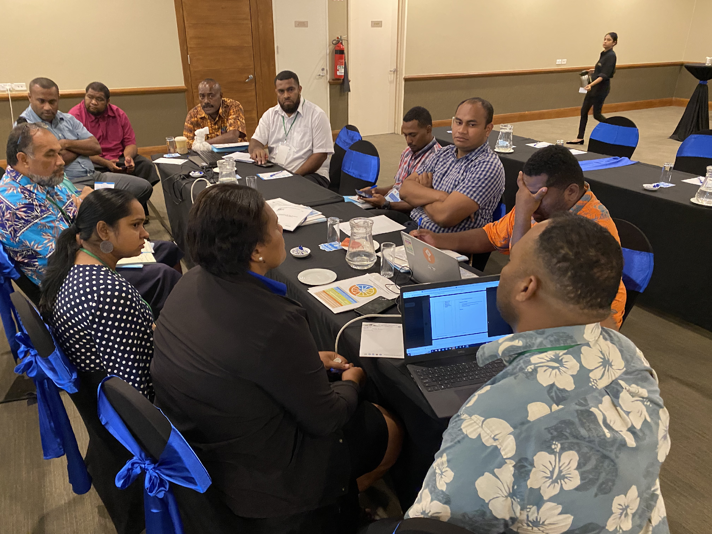
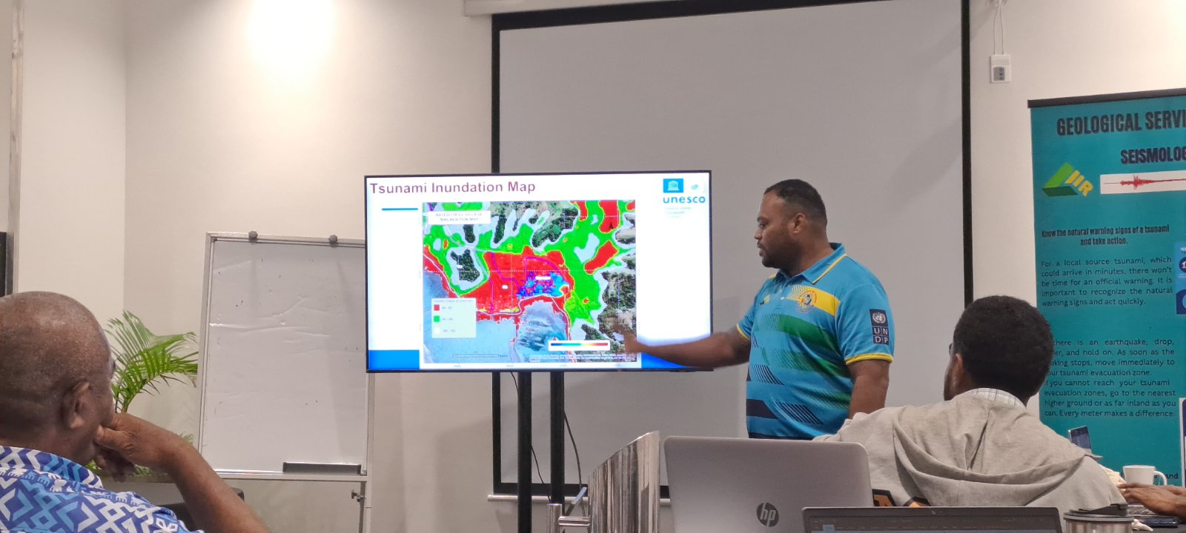
NATIONAL UNESCO/IOC TSUNAMI READY RECOGNITION PROGRAMME
– FIJI, RMI, FSM, PALAU
Notes:
In 2023, National Workshops on UNESCO/IOC Tsunami Ready Recognition Programme in Fiji, RMI, FSM and Palau
Target at least one community to be formalized Tsunami Ready in 2023

Slide 9
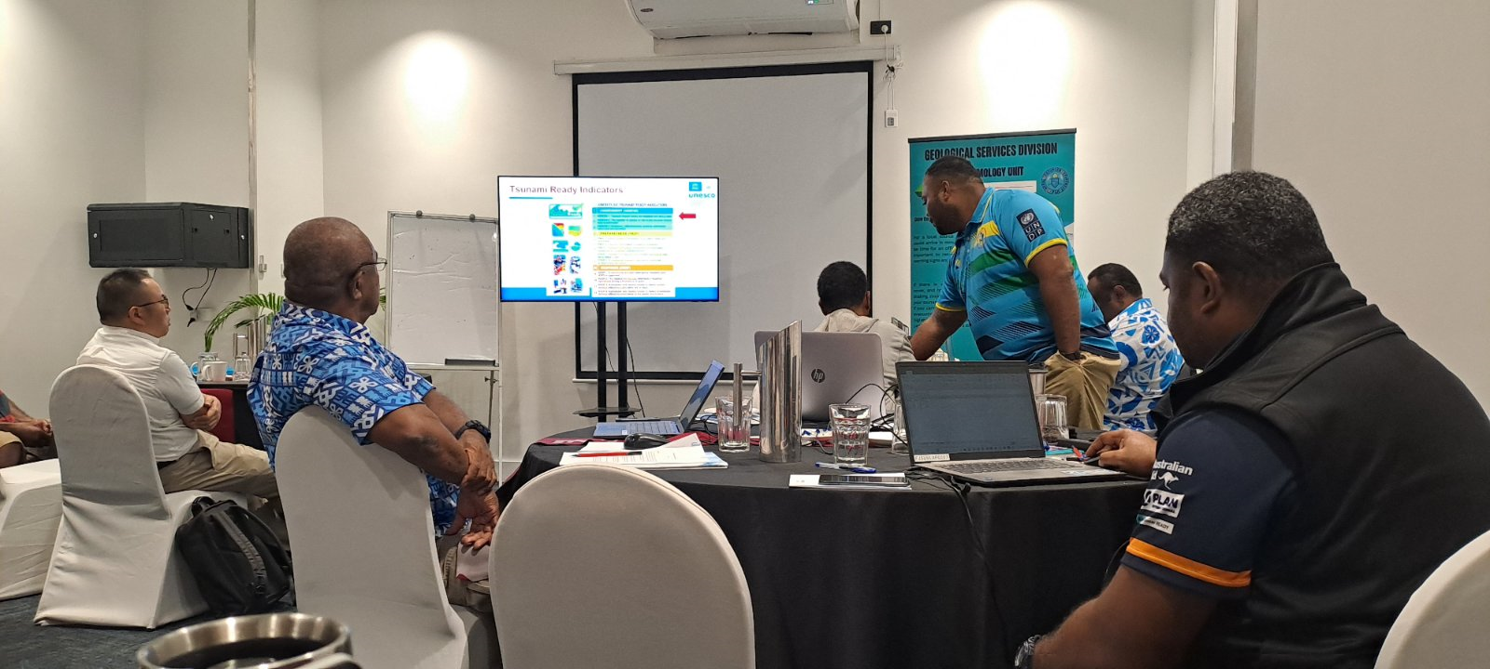
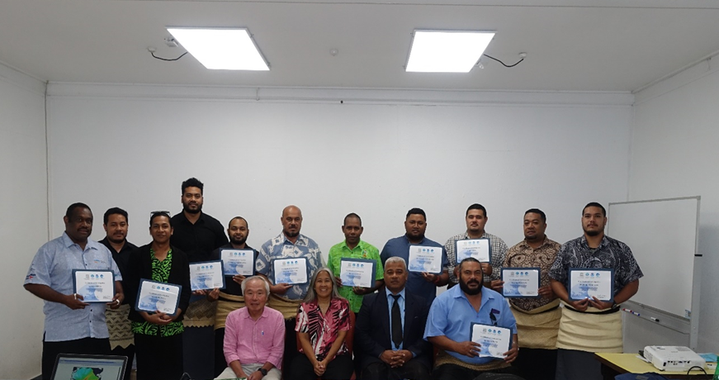
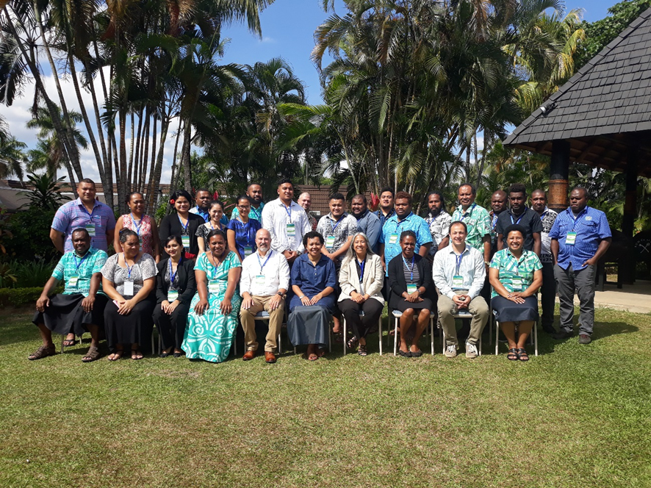
ON-GOING REVIEW OF TSUNAMI WARNING AND RESPONSE SOP & UPDATE OF NATIONAL TSUNAMI RESPONSE PLAN
VANUATU, TONGA, COOK ISLANDS, SOLOMON ISLANDS, FIJI
Notes:
On-Going Review and Update of Tsunami SOP and National Tsunami Response Plan
Vanuatu, Tonga, Cook Islands, Solomons Islands, Fiji

Slide 10
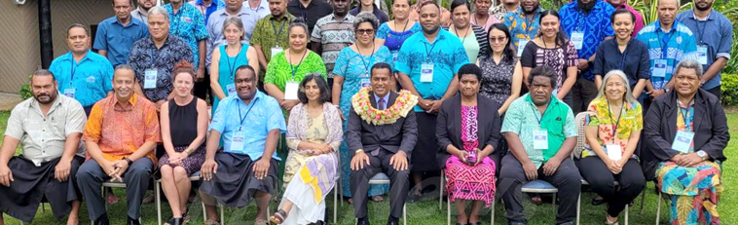
BACKGROUND
On 3rd February, 2023, the 9th WG-PICT meeting was attended by representatives of Australia, Cook Islands, Fiji, French Polynesia, Kiribati, Nauru, New Caledonia, New Zealand, Papua New Guinea, Samoa, Solomon Islands, Tonga, Tuvalu and Vanuatu as well as the Intergovernmental Oceanographic Commission of UNESCO (UNESCO/IOC), IOC International Tsunami Information Centre (ITIC), United Nations Office for Disaster Risk Reduction (UNDRR), Plan International and the Pacific Community (SPC).
Notes:
9th WG-PICT meeting on 3rd February 2023

Slide 11
TERMS OF REFERENCE | PROGRESS UPDATE | 9TH WG-PICT MEETING & Task Team Capacity Development RECOMMENDATIONS TO ICG/PTWS-XXX
(i) To continually review and evaluate capabilities of, and evaluate capabilities of, and make recommendations for improvements to countries in the Pacific Islands and Territories (PICT) Region for providing end-to–end tsunami warning and mitigation services within the MHEWS framework. | WG-PICT Regional Exercise PacWave22 Evaluations PacWave22 Evaluation | ITIC to review the existing survey of warning and mitigation capabilities in PICTs in-consideration of recent events and provide feedback of the Task Team Secretariat to annually administer online capability survey.
(ii) To support the involvement and contribution of PICT in the activities of the ICG/PTWS. | HTHH Volcanic Eruption and Tsunami Post –Event Assessment in Feb 2022 PTWS Post- HTHH Event Brief I, II, & III in Feb 2022 Exercise Pacific Wave 2022 WG-PICT Regional PacWave Exercise – November 2022 New Task Team name and TOR completed in August 2023 “Task Team Information Sharing Platforms” | Lessons and learnings from HTHH are shared and considered in the revision of Tsunami SOP by PICTs; Learning from the Hunga Tonga Hunga Ha’apai event, develop guidelines for requesting post event technical assistance to include: the assessment of tsunami warning capability; harmonisation with disaster management protocols for the deployment of goods, personnel and services; and development of National Post-Tsunami Field Survey Guide for PICTs

Slide 12
TERMS OF REFERENCE | PROGRESS UPDATE | 9TH WG-PICT MEETING & Task Team Capacity Development RECOMMENDATIONS TO ICG/PTWS-XXX
(iii) To promote and facilitate the tsunami hazard and risk studies in the PICT region. | HTHH Inundation impact report and papers Tsunami Runup and Inundation in Tonga from the 15 January 2022 eruption of Hunga Tonga-Hunga Ha’apai Volcano. Now published | SPC to support the stock-take of topographic and bathymetric data for inundation mapping
(iv) To facilitate cooperation in the establishment and upgrading of earthquake and tsunami monitoring networks in the region and the interoperability of these systems in accordance with ICG/PTWS requirements. | Volcanic hazard monitoring and consider data sharing of emerging technologies such as infrasound All ORSNET MS upgraded from SC 4 to SC 5, through SPC PREP Project Newly developed ORSNET Website Development of ORSNET Strategic Plan with the support of SPC PREP Project Local Source Tsunami Guideline received further considerations from the Task Team Capacity Development | Proposed inclusion of volcano monitoring network into ORSNET via VIDAP and JICA technical assistance taking into consideration the WMO initiative on Volcano hazard on Marine Services Convene the 9th ICG/PTWS Working Group 2 Task Team Seismic Data Sharing in the Southwest Pacific after the 30th UNESCO-IOC ICG/PTWS in September 2023 ORSNET Strategic Plan to be endorsed in the next ORSNET meeting in November 2023.

Slide 13
TERMS OF REFERENCE | UPDATES | 9TH WG-PICT MEETING & Task Team Capacity Development RECOMMENDATIONS TO ICG/PTWS-XXX
(v) To facilitate training and capacity building in the end-to-end tsunami warning and mitigation system in the region. | ITP-ITIC Training on Tsunami SOP conducted in Cook Islands in January 2023 ITP-ITC Hawaii Training in August 2023 attended by Fiji, Tonga, Vanuatu, Solomon Islands and RMI Finalization for the NTWC Competency Framework in August 2023 SeisComP5 Training conducted by SPC Consultant | WG 2 Task Team Minimum Competency Levels for National Tsunami Warning Centre (NTWC) Operations Staff to consider including Volcano. WG-PICT to endorse French Polynesia to join Task Team Capacity Development to assist the Competency Framework
(vi) To encourage the sharing of tsunami information, including but not limited to the free and open exchange of data. | Set-up of New Task Team on Information Sharing Platform ORSNET Data Sharing Agreement signed By Fiji, PNG and Tonga Reccomend, the use of a World Meteorological Organization (WMO) dissemination method through the Global Telecommunication System (GTS) and Common Alert Protocol (CAP) in order to share national tsunami warnings between countries. | Proposed Task Team to undertake the following actions and report progress to inform the WG-PICT report at the ICG/PTWS XXX; Develop TOR Develop Task Team Name Review PacWave 2022 Objectives and propose WG-PICT PacWave24 Objectives Use of GTS and CAP will be piloted by Solomon Islands and Tonga

Slide 14
TERMS OF REFERENCE | UPDATES | 9TH WG-PICT MEETING & Task Team Capacity Development RECOMMENDATIONS TO ICG/PTWS-XXX
(vii) To facilitate tsunami awareness in school curricula, and development and dissemination of public educational materials | World Tsunami Awareness Day 2022 Activities Development of Education and Awareness Materials | Secretariat to collate all MS WTAD22 reports and awareness materials for dissemination
(viii) To work in cooperation with PTWS Working Group 1, 2, & 3 and relevant task teams, especially on activities that strengthen country capacity in tsunami warning, risk mitigation & emergency response. Support the implementation of Tsunami priorities under the UN Decade. | WG-1 – Tsunami Hazard Assessment conducted in Fiji and Marshall Islands with support of PMEL and ITIC WG-2 –All ORSNET MS upgraded from SC 4 to SC 5, inclusion of volcano monitoring network into ORSNET WG3 – UNESCO/IOC Tsunami Ready Programme underway in Fiji and Marshall Islands, Palau and FSM Member States encouraged to send their interest | ITIC/IOC support to provide Technical Assistance in developing Terms of Reference for hiring Tsunami Ready national consultants. SPC to support the stock-take of topographic and bathymetric data for inundation mapping

Slide 15
Proposed Task Team Information Sharing Platform
Terms of Reference:
Propose a WG-PICT regional PacWave24 objective;
1. Based on Pacwave22 report, re-evaluate early /anticipatory information to be shared between NTWC & NDMO and which platform would be more adapted for each kind of information.
2. WhatsApp Guidelines;
- Maintain the mobile contact list up to date in order to keep the PacWave22 group alive;
- Obtain official mobile numbers of NTWC and NDMO (handle by IOC/UNESCO Secretariat)
- guideline for messages sent on WhatsApp
3. HF- Radio Guidelines :
- Fecth feedbacks from monthly test and recommend preliminary guidelines.
- Membership of the task team is open to any technical communication expert on this platform
4. Email Listerv Guidelines :
- guideline for messages shared by email (no acknowledgement , etc)
- Update and add new e-mail into the Pacwave22 listserv handled by ITIC

Slide 16
Proposed Task Team Information Sharing Platform
Terms of Reference:
5. Email Listerv Guidelines :
- guideline for messages shared by email (no acknowledgement , etc)
- Update and add new e-mail into the Pacwave22 listserv handled by ITIC
6. Identify and list new and relevant platform for Information Sharing
- Other social media (Signal, …)
- Mobile App Broadcast system
- Dedicated (private) broadcasting information web-page.

Slide 17
RECCOMENDATIONS TO ICG/PTWS
Endorse the New Task Team under WG-PICT and its TOR – Task Team Information Sharing Platforms Co-Chaired by French Polynesia and Solomon Islands
Request PTWC to extend first bulletin to report (forecast and ETA) to 6 hrs. (not 3 hrs.’).
Note, progress of WG 2 Task Team Seismic Data Sharing in the Southwest Pacific especially effort of ORSNET and its recommendations .

Slide 18
RECCOMENDATIONS TO ICG/PTWS
5. Note, progress of Task Team Capacity Development and its recommendations
6. Reccomend, the use of a World Meteorological Organization (WMO) dissemination method through the Global Telecommunication System (GTS) and Common Alert Protocol (CAP) in order to share national tsunami warnings between countries. This will be piloted by Solomon Islands and Tonga
7. Continue WG-PICT TOR and Membership for next intersession
8. Endorse re-appointment of WG-PICT Officials for the next intersessional period ; Chair Ms Esline Garaebiti (Vanuatu) and Vice Chair Mathew Moihoi (PNG)

Slide 19
Malo & Thank you for your kind attention

