Slide 1

ICG/PTWS XXX Nuku’alofa 11 - 15 September 2023
3.8 Exercise Pacific Wave 2022 Report
Margarita Martinez, SENAPRED, Chile
Emilio Talavera, INETER, Nicaragua
Co-Chairs, Task Team on PacWave22

Slide 2
Summary of Activities: 2021-2023
Update the Exercise Manual
Conduct two Informational Webinars: English and Spanish
Coordination of follow up meetings (10)
Create separate evaluation forms and corresponding links: Live TSP Communications Test and Post National & Regional Exercises.
Endorse the PacWave22 Exercise: September-November 2022
Support the 2 regional PACWAVE22 exercises for SW et SE Pacific
Promote timely submission of surveys (Deadline shifted to 10th of February).
Elaborate the Report of PacWave22

Slide 3
Aim and Objectives
Test PTWS TSP arrangements, country preparedness arrangements and operational procedures to respond to and recover from a destructive tsunami
Test communications from PTWS Tsunami Service Providers (TSP) to the Tsunami Warning Focal Points (TWFP) and National Tsunami Warning Centres (NTWC) of the Member States concerned.
Test national communication and cooperation, and readiness within each of the participating countries.
Test regional communication and cooperation between Member States of the tsunami warning system.
Support the development of tsunami procedures and products by the Central America Tsunami Advisory Centre (CATAC), a potential new TSP (pending endorsement of full functionality by IOC governing bodies)

Slide 4
Evaluations
Tsunami Service Provider communications test.
The live communication implemented at 0000 on 13 of October 2022.
Regional/National exercises:
Countries chose a date for the execution of their exercises. At the same time, the implementation of regional exercises was promoted.
Notes:
The aim of the webinars is to answer questions related to the conduct of PacWave22, the ITIC and IOC will host PacWave22 informational webinars on 17 August 2022, 1900 UTC 24 August 2022, at 0300 UTC. Connection details will be sent to all PTWS TNCs and TWFPs via email
We need to discuss the topics that we want to address in the webinar
What things do you think we can talk about in the seminars
Regarding the speakers
Spanish: Margarita and Emilio
English : Carolina/Laura
French: Antoine
I know you have a lots of experience with tsucat, so do you think it could be a good topic to talk about
Emilio do you thin you could take care of catac matters.
iuta I would like to ask you if you could be a speaker a webinar

Slide 5
TSP Communication Test - 28 countries and territories
Australia
Brunei Darussalam
Chile
Colombia
Cook Islands
Ecuador
El Salvador
Fiji
France
French Polynesia
New Caledonia
Wallis et Futuna
Guatemala
Hong Kong, China
Japan
Malaysia
Mexico
New Zealand
Nicaragua
Papua New Guinea
Perú
Philippines
Republic of Korea
Russian Federation
Samoa
Singapore
Solomon Island
United Kingdom
United States
Notes:
The aim of the webinars is to answer questions related to the conduct of PacWave22, the ITIC and IOC will host PacWave22 informational webinars on 17 August 2022, 1900 UTC 24 August 2022, at 0300 UTC. Connection details will be sent to all PTWS TNCs and TWFPs via email
We need to discuss the topics that we want to address in the webinar
What things do you think we can talk about in the seminars
Regarding the speakers
Spanish: Margarita and Emilio
English : Carolina/Laura
French: Antoine
I know you have a lots of experience with tsucat, so do you think it could be a good topic to talk about
Emilio do you thin you could take care of catac matters.
iuta I would like to ask you if you could be a speaker a webinar

Slide 6
Regional/National Exercises participants - 19 countries + 3 territories
Australia
Chile
China
Colombia
Costa Rica
Ecuador
El Salvador
Fiji
France
French Polynesia
New Caledonia
Wallis et Futuna
Hong Kong, China
Japan
Mexico
New Zealand
Palau
Panamá
Perú
Russian Federation
Solomon Island
Tonga
Thailand
Notes:
The aim of the webinars is to answer questions related to the conduct of PacWave22, the ITIC and IOC will host PacWave22 informational webinars on 17 August 2022, 1900 UTC 24 August 2022, at 0300 UTC. Connection details will be sent to all PTWS TNCs and TWFPs via email
We need to discuss the topics that we want to address in the webinar
What things do you think we can talk about in the seminars
Regarding the speakers
Spanish: Margarita and Emilio
English : Carolina/Laura
French: Antoine
I know you have a lots of experience with tsucat, so do you think it could be a good topic to talk about
Emilio do you thin you could take care of catac matters.
iuta I would like to ask you if you could be a speaker a webinar

Slide 7
Objective 1 : TSP Communication Test
Tsunami Service Providers (PTWC, NWPTAC, SCSTAC, CATAC) to Member States/Countries.
Did your country Tsunami Warning Focal Point receive TSP’s Exercise Dummy message?
No reports for EMWIN
Notes:
Two responses:
No notification of the exercise was received at this focal point in Mexico
Maybe it needs to double-check the list of the distribution email to make sure we are still on the bench (Samoa).

Slide 8
Objective 1 : TSP Communication Test
Tsunami Service Providers (PTWC, NWPTAC, SCSTAC, CATAC) to Member States/Countries.
Did your country Tsunami Warning Focal Point receive TSP’s Exercise Dummy message?
No reports for EMWIN
All the alert test messages were received in a timely manner
Notes:
Two responses:
No notification of the exercise was received at this focal point in Mexico
Maybe it needs to double-check the list of the distribution email to make sure we are still on the bench (Samoa).

Slide 9
Objective 1 : TSP Communication Test
Tsunami Service Providers (PTWC, NWPTAC, SCSTAC, CATAC) to Member States/Countries.
Email was the most common method to receive the test message (89%).
Followed by: Fax (48%)
GTS (44%)
AFTN (15%)
No reports for EMWIN.
19% responded other methods (i.e.: AISR is AFTN replacement, WA)
Notes:
Majority of countries received the message on October 13th at 00:00 UTC Time. The first message was received instantaneously, and the last message was reported two minutes later (by -email). Some respondents informed that fax presented significant delays.
Objective 1 Comments
Several countries stated that objective one PacWave22 was accomplished, among these Papua New Guinea, Fiji, Nicaragua, Perú, Philippines, Philippines, El Salvador, Malasya, Samoa, among others. Countries highlighted that e-mail was the most reliable means of communications between TSP and states members. However, challenges still remains regarding the use of fax.
Messages were well received through multiple channels.
The communication test was received on time, through email and fax.
Test message received fine.
Communication test went well for e-mail & GTS. Fax may be a little delayed - received 0022UTC.
All the alert test messages were received in a timely manner

Slide 10
Objective 2a : National communication and cooperation
Notes:
The most of participants in the exercise disseminated the warning message to emergency services (47%) and other national government agencies (53%). At lesser extent local government – provincial/regional level (42%). Followed by a 37% of respondents which indicated that disseminated the message to local government city/district level. In contrast, few respondents (21%) indicated that the warning message was shared with science agencies/universities involved in assessment. Similarly, few respondents (16%) provided the warning message to the public as part of the exercise.

Slide 11
Objective 2a : National communication and cooperation
Notes:
The most of participants in the exercise disseminated the warning message to emergency services (47%) and other national government agencies (53%). At lesser extent local government – provincial/regional level (42%). Followed by a 37% of respondents which indicated that disseminated the message to local government city/district level. In contrast, few respondents (21%) indicated that the warning message was shared with science agencies/universities involved in assessment. Similarly, few respondents (16%) provided the warning message to the public as part of the exercise.

Slide 12
2.2 What time was warning sent to the agency or agencies or Public listed in Q2.1?
 | Country | Day | Time
1 | Chile | 20 of October 2022 | 14:23 UTC
2 | China | 04 of November 2022 | 02:00 UTC
3 | Colombia | 27 of October 2022 | 14:24 UTC
4 | Costa Rica | 13 of October 2022 | 00:00 UTC
5 | Ecuador | 27 of October 2022 | 14:15 UTC
6 | El Salvador | 22 of November 2022 | 15:55 UTC
7 | Fiji | 09 of November 2022 | 23.20 UTC
8 | Hong Kong, China | 11 of November 2022 | 01:05UTC
9 | Mexico | [No info] | 10 minutes after alert
10 | New Caledonia | 21 of November 2022 | 21:31 UTC
11 | New Zealand | PacWave 22 was developed over five dates: 24 October 2022 27 October 2022 31 October 2022 01 November 2022 08 November 2022 | 20:09 UTC
12 | Perú | 12 October | 19:00 UTC
13 | Russian Federation | [No info] | 00:02 UTC
14 | Solomon Islands | 10 of November 2022 | 23:20UTC
15 | Tonga | 09 of November 2022 | [No info]
Notes:
The most of participants in the exercise disseminated the warning message to emergency services (47%) and other national government agencies (53%). At lesser extent local government – provincial/regional level (42%). Followed by a 37% of respondents which indicated that disseminated the message to local government city/district level. In contrast, few respondents (21%) indicated that the warning message was shared with science agencies/universities involved in assessment. Similarly, few respondents (16%) provided the warning message to the public as part of the exercise.

Slide 13
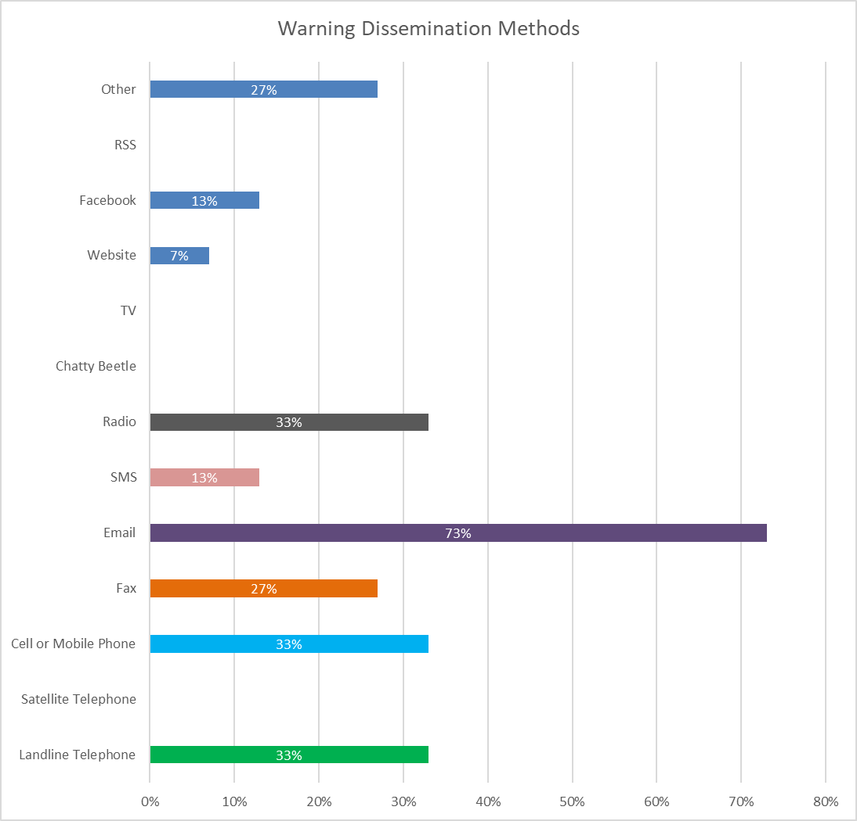
2.3 How did you send the warning to emergency, national, science, and
local government agencies in Q2.1?
Most used:
Email
Landline telephone
Mobile phone
Radio
Fax
Notes:
The message was disseminated by the majority of the participants by e-mail (73%), followed by landline telephone and cell or mobile phone (33% each method). It was also used fax (27%) and other methods (27% - Sirens, WhatsApp, Telegram). At a lesser extent was used Facebook and SMS (13% each method). Few respondents used website (7%) and none respondents indicated the use of TV and Chatty beetle.

Slide 14
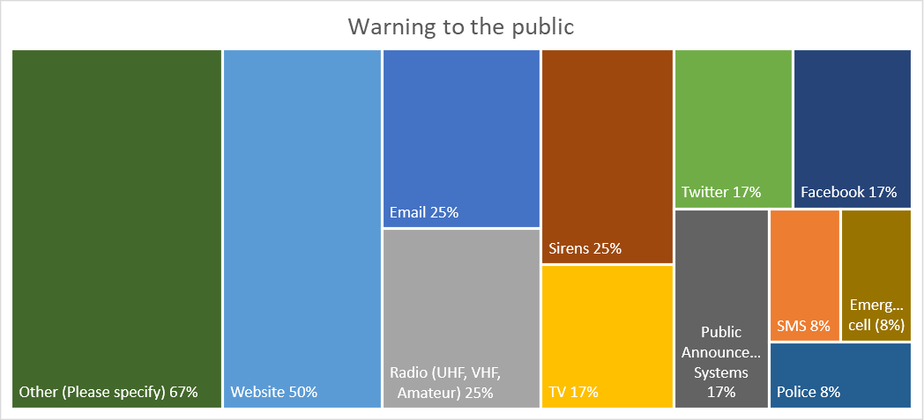
Objective 2a : National communication and cooperation
Most used:
Other (Wechat, Weibo, WhatsApp, Telegram, Town screen)
Website
Radio, Email and Sirens
Notes:
The message was disseminated by the majority of the participants by e-mail (73%), followed by landline telephone and cell or mobile phone (33% each method). It was also used fax (27%) and other methods (27%, Wechat, Weibo, WhatsApp, Telegram, Town screen). At a lesser extent was used Facebook and SMS (13% each method). Few respondents used website (7%) and none respondents indicated the use of TV and Chatty beetle.

Slide 15

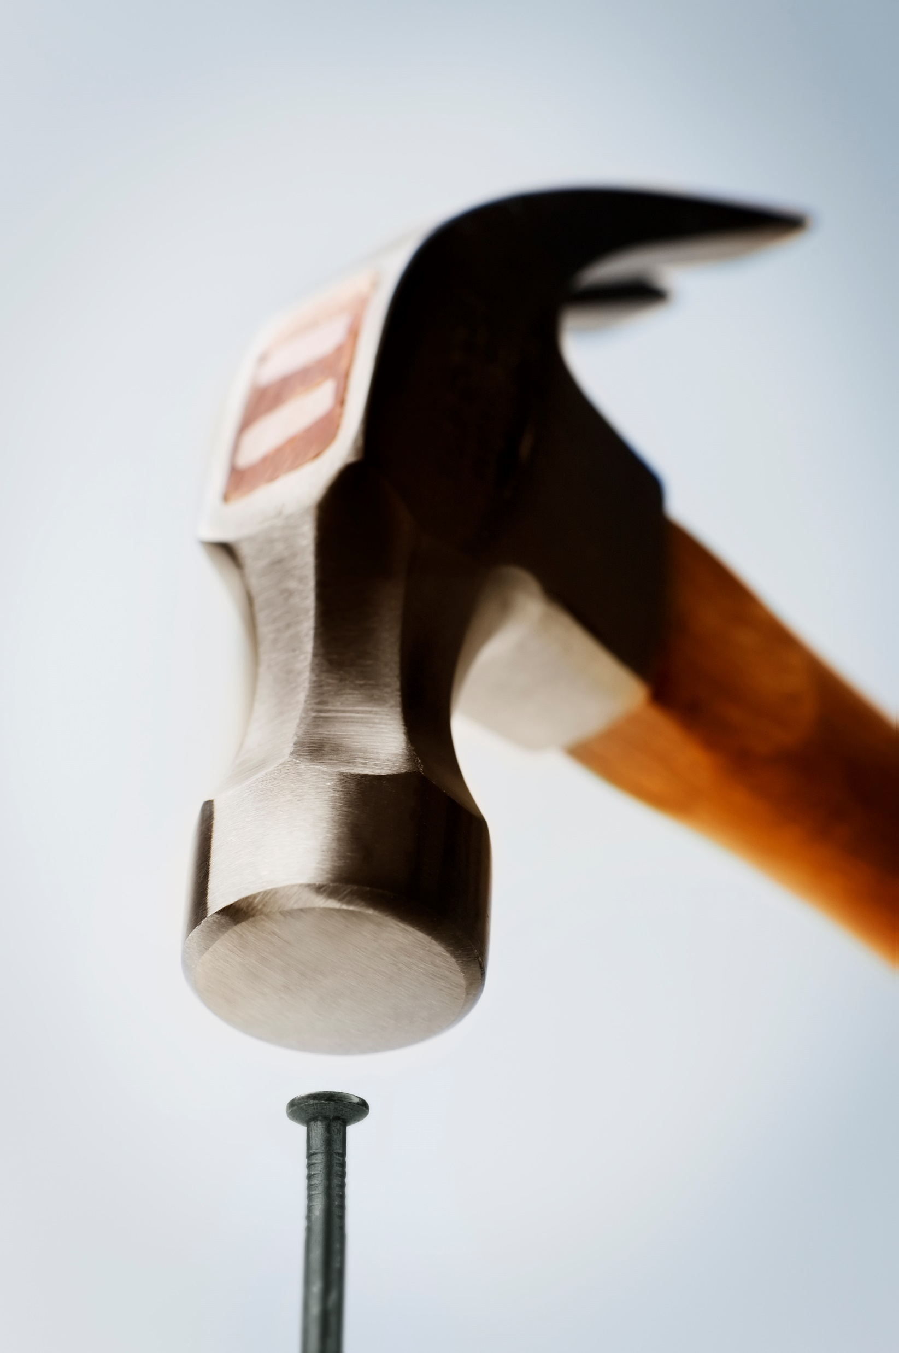

Methods and Messages: Feedback from Agencies
100% Methods timely appropriate
93% Accurate an clear
80% Positive feedback
Notes:
The next section of the report will address the following: Methods of communication characteristics such as respondents indicated if the methods and messages were or not, timely and appropriate; accurate and clear and if the communication involved participation of NDMO with NTWC. Most respondents 93% considered that the communication methods used during the exercise were timely and appropriate and 80% of respondents submitted positive feedback from NTWC/NDMO, these indicated that messages used during the PacWave22 were accurate and clear. Six respondents skipped these two questions, some of them didn’t disseminate the message to NTWC/NDMO and others didn’t submit an answer

Slide 16

Objective 2b: To test national readiness within the country
NTWC/NDMO has an activation and response process (standard operating procedures) in place for the receipt of tsunami warnings
NTWC/NDMO knows its specific response role in the event of a tsunami
NTWC/NDMO has, prior to the exercise, engaged in tsunami response planning
Notes:
Objective 2b: To test national readiness within the country.
In this section will be addressed the following issues: The NTWC/NDMO has an activation and response process (standard operating procedures) in place for the receipt of tsunami warnings; the NTWC/NDMO knows its specific role response role in the event of a tsunami, the NTWC/NDMO has, prior to the exercise, engaged in tsunami response planning.
100% of respondents agreed that activation and response procedures are in place; it was also established that in all the countries the NTWC/NDMO knows its response role in the event of a tsunami. Respondents confirmed that in 100% of the countries the NTWC/NDMO has engaged in prior tsunami response planning. Its important to note that two countries skipped questions related to these.
There are not negative questions registered by the respondents. therefore, its assumed that all of them have planification instruments which contains activation and response from the organizations involved in tsunami response, NTWC/NDMO. Two respondents skipped these questions.
These issues were asked as follows: 2.9 The NTWC/NDMO has an activation and response process (standard operating procedures) in place for the receipt of tsunami warnings?; 2.10 The NTWC/NDMO knows its specific response role in the event of a tsunami?; 2.11 The NTWC/NDMO has, prior to the exercise, engaged in tsunami response planning?

Slide 17
Objective 2b: To test national readiness within the country
NTWC/NDMO
84% - has undertaken activities to increase its capacity and capability to support a national tsunami response.
100% - has an appropriate management structure identified and documented to support tsunami response.
53% has a national tsunami mass coastal evacuation plan
95% arrangements to assemble the in-country disaster management group relevant to decision-making on tsunami warning and response were in place before the exercise
2.16 A country tsunami emergency response plan (standard operating procedures) for tsunamis exists?
Notes:
A country tsunami emergency response plan (standard operating procedures) for tsunamis exists in 19 out of 21 countries that answered this question, two countries skipped this question. Following are the details: 100% of the respondents indicated that the SOAP its aimed for regional (1-3 hours arrival time), 95% for a distant (greater than 3 hours and 89% for local sceneries (less than 1 hours).
This question was asked as fllows: 2.16 A country tsunami emergency response plan (standard operating procedures) for tsunamis exists? Tick all that apply.
Next it will be presented if the response plan includes processes to issue Safe-to-Return (All-Clear) notices and if Tsunami exercises are routinely conducted in-country. 84% of respondents indicated that their tsunami emergency response plan includes processes to issue Safe-to-Return (All Clear) notices. Similarly, 84% of respondents confirmed that tsunami exercises are routinely conducted. Three respondents do not conduct regular exercises.

Slide 18
Tsunami Preparedness
95% indicated that tsunami-related public education and awareness materials have been developed and disseminated in their country.
37% indicated the existence of tsunami-related curriculum programmes are in place for all levels of education.
Most of the countries (74%) indicated that tsunami-vulnerable communities don’t have elements of tsunami preparedness, such as evacuation maps, signage, assembly points for evacuation.

Slide 19
PacWave22 Report: Global assessment
100% of countries indicated that stakeholder agencies have a better understanding of the goals, responsibilities, and roles in case of tsunami emergencies.
94% of countries indicated that gaps in capability and capacity have been identified.
63% of countries indicated the community have a better understanding of their tsunami risk and are better prepared for tsunami events
41% of countries indicated that news media participated and covered the exercise

Slide 20
Objective 3: To test national readiness within the country
63% indicated that their countries engaged in communication and cooperation with other countries in the region for PacWave22.
50% indicated that the NTWC communicated with other countries during the event.
Only 11% indicated that the NDMO communicated with other countries during the event.

Slide 21


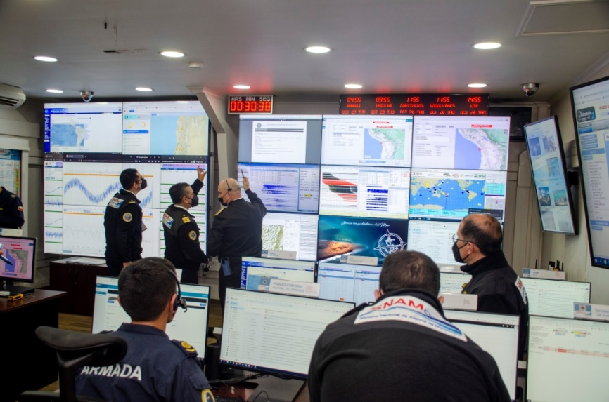
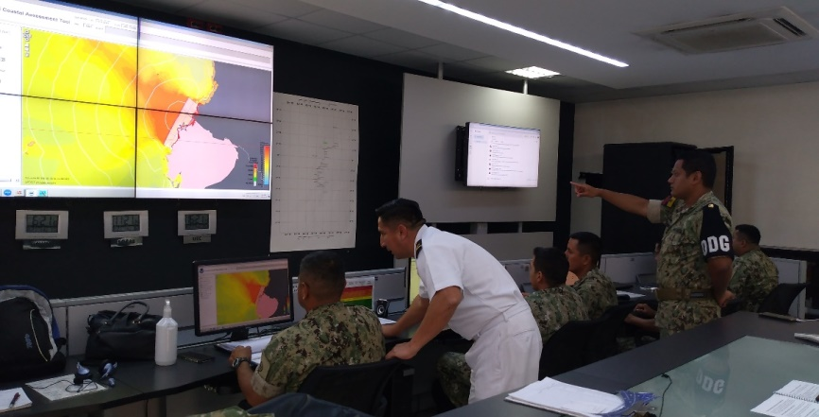


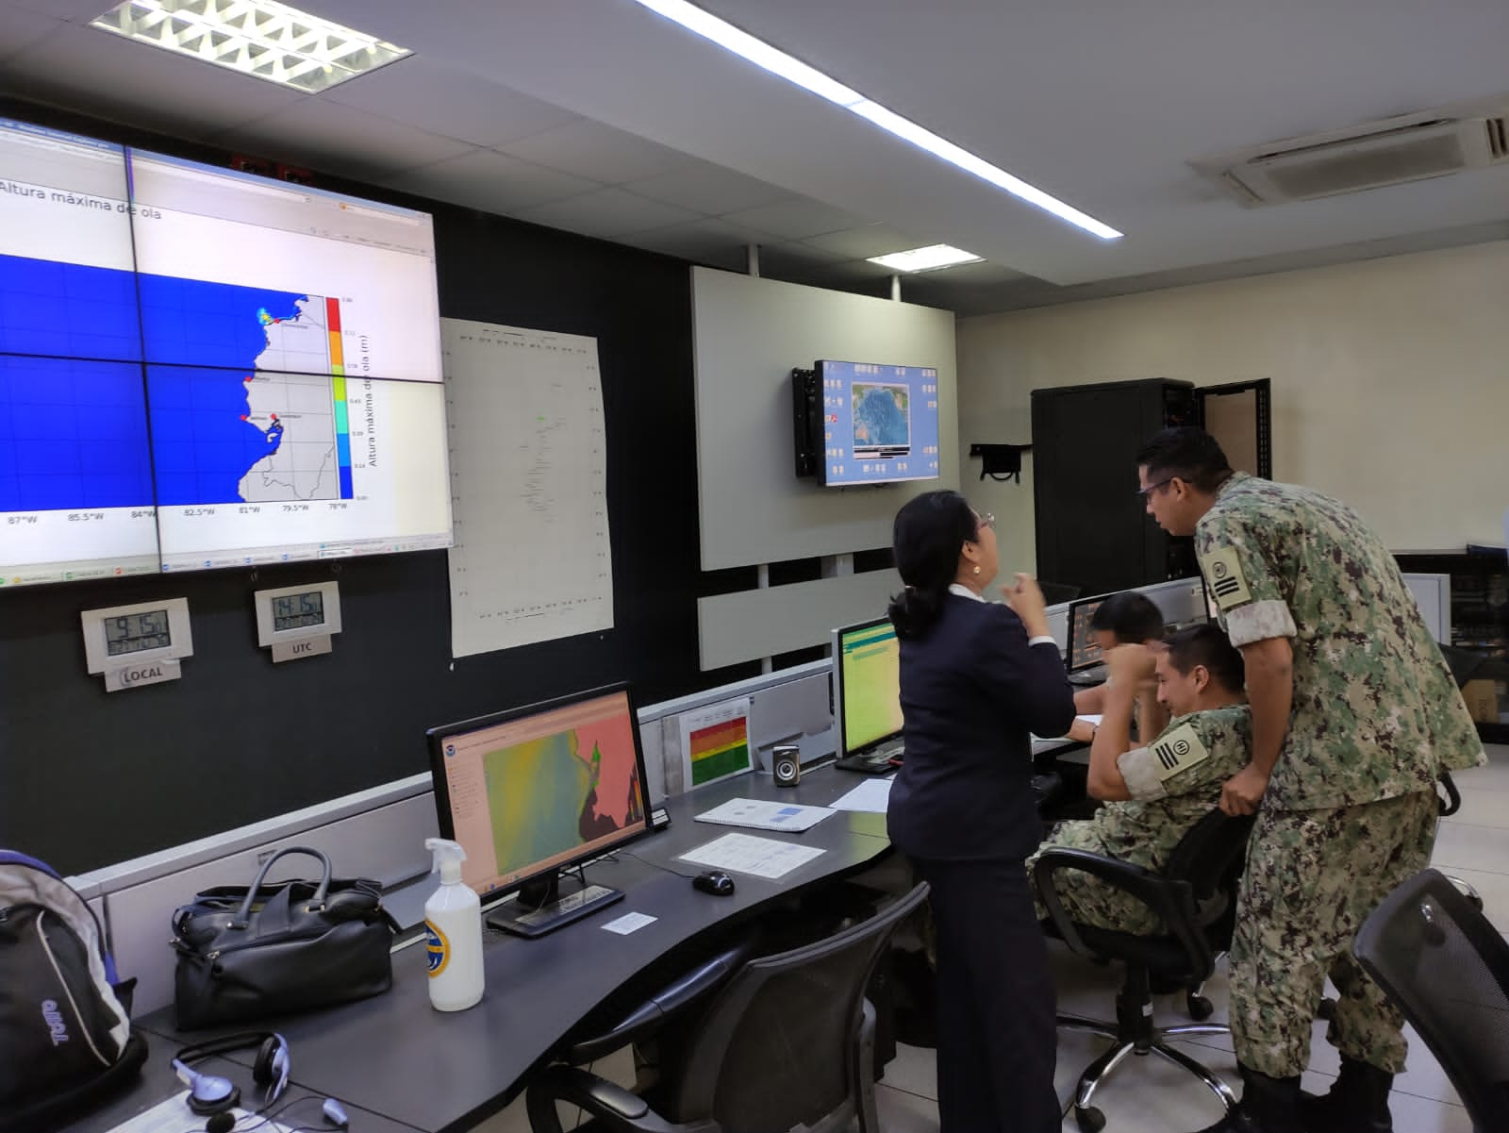
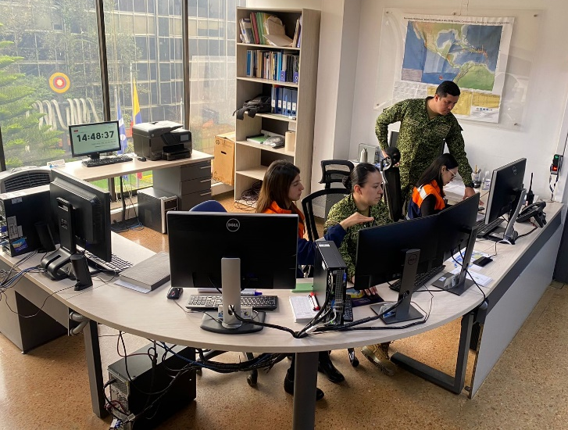

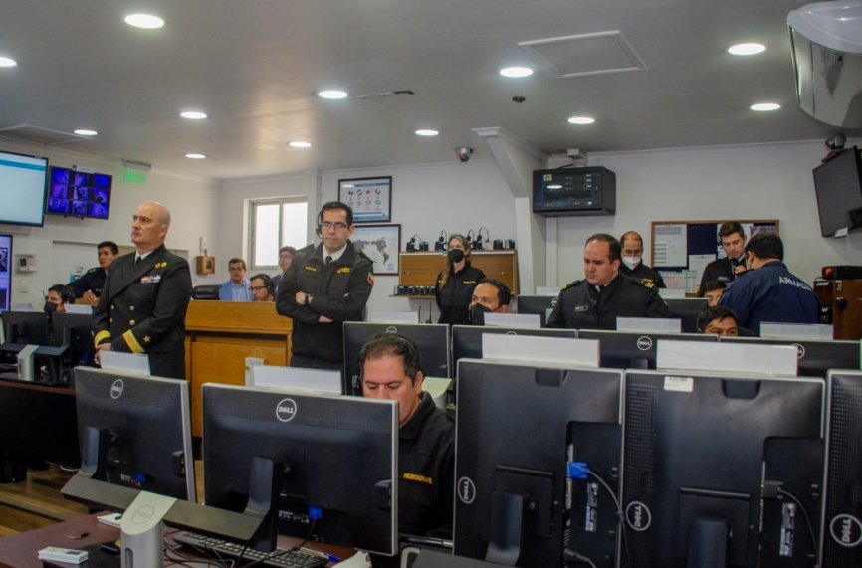



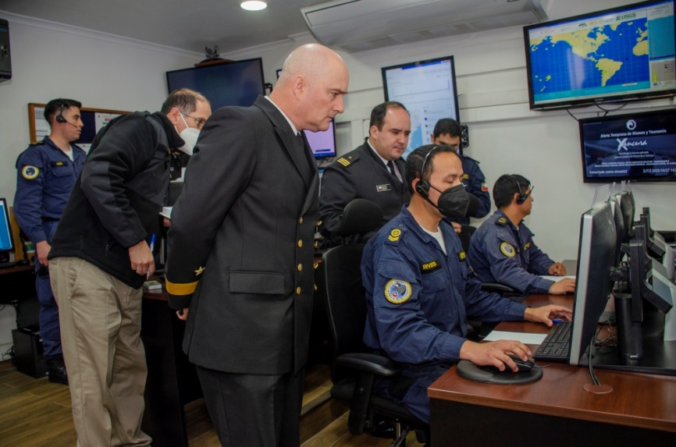
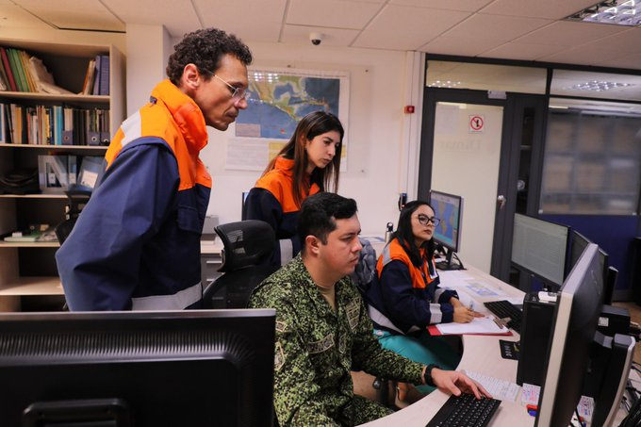
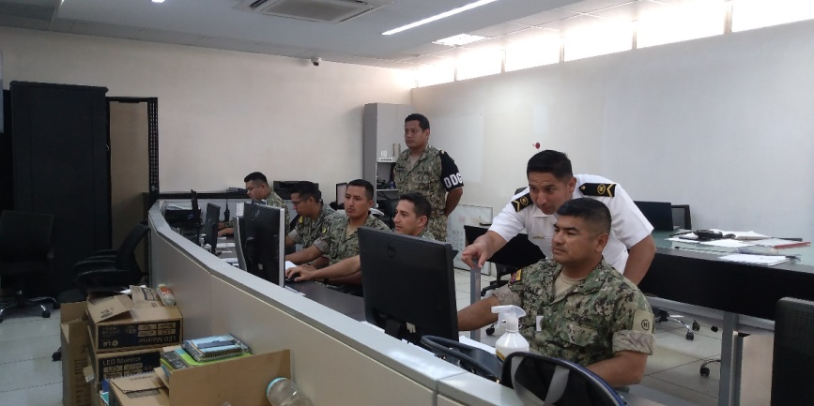
PacWave22: South East Regional Exercise

Slide 22
PacWave22: South East Regional Exercise
Objectives
To implement and evaluate the Regional Communication Protocol between National Tsunami Warning Centers in the Southeast Pacific.
To test the communication channels set out in the regional protocol.
Activate and test each NTWC internal procedures for near-field events, including distribution of sea level information.
Measure the preparedness and response capability of the Centers' personnel in each country.
Identify opportunities for improvement in terms of operational procedures and articulation between countries.

Slide 23
PacWave22: South East Regional Exercise
Scenarios
The coordination of the II Regional Tsunami Exercise was in charge of the National Tsunami Warning Centers of the Hydrographic and Oceanographic Service of the Chilean Navy (SHOA) and the Directorate of Hydrography and Navigation (DHN) of Peru. The following aspects were considered::
The exercise was divided into 2 phases, which were executed on different days, each with a specific scenario:
Phase I scenario: Tsunami generated by an earthquake of a preliminary magnitude 7.6 off the coasts of Chile and Peru on October 20, 2022, with a start time of 14:00 UTC.
Phase II scenario: Tsunami generated by an earthquake of magnitude 8.8 with an epicenter off the coasts of Colombia and Ecuador on October 27, 2022, with a start time of 14:00 UTC.
Each participating country tested the operational procedures and capabilities of their NTWC.

Slide 24
PacWave22: South East Regional Exercise
Conclusions and recommendations
The incorporation of earthquakes simultaneously with Phase I of the exercise meant that the personnel on duty had to be meticulous and orderly in receiving the information.
The importance of continuing to carry out this type of regional exercise is highlighted since it allows testing both the regional protocol and the internal procedures of each Center, linking the other entities that are part of the tsunami warning systems in each country, identifying improvement actions and is the mechanism to maintain the articulation between the tsunami warning centers of the region.
Regional exercises executed in phases are an excellent way to prepare NTWC personnel and thus strengthen response capabilities, especially considering the strategy of selecting scenarios that affect countries partially, so it is suggested that this way of developing regional exercises continue to be coordinated.
Exercises improve response capabilities and although they may seem repetitive, they are the best way to keep NTWC personnel prepared for real events.
Applying these multi-scenario exercises is recommended to work efficiently through the frequent use of different means of communication. Satellite telephony is an essential means of communication for regional and local events.

Slide 25
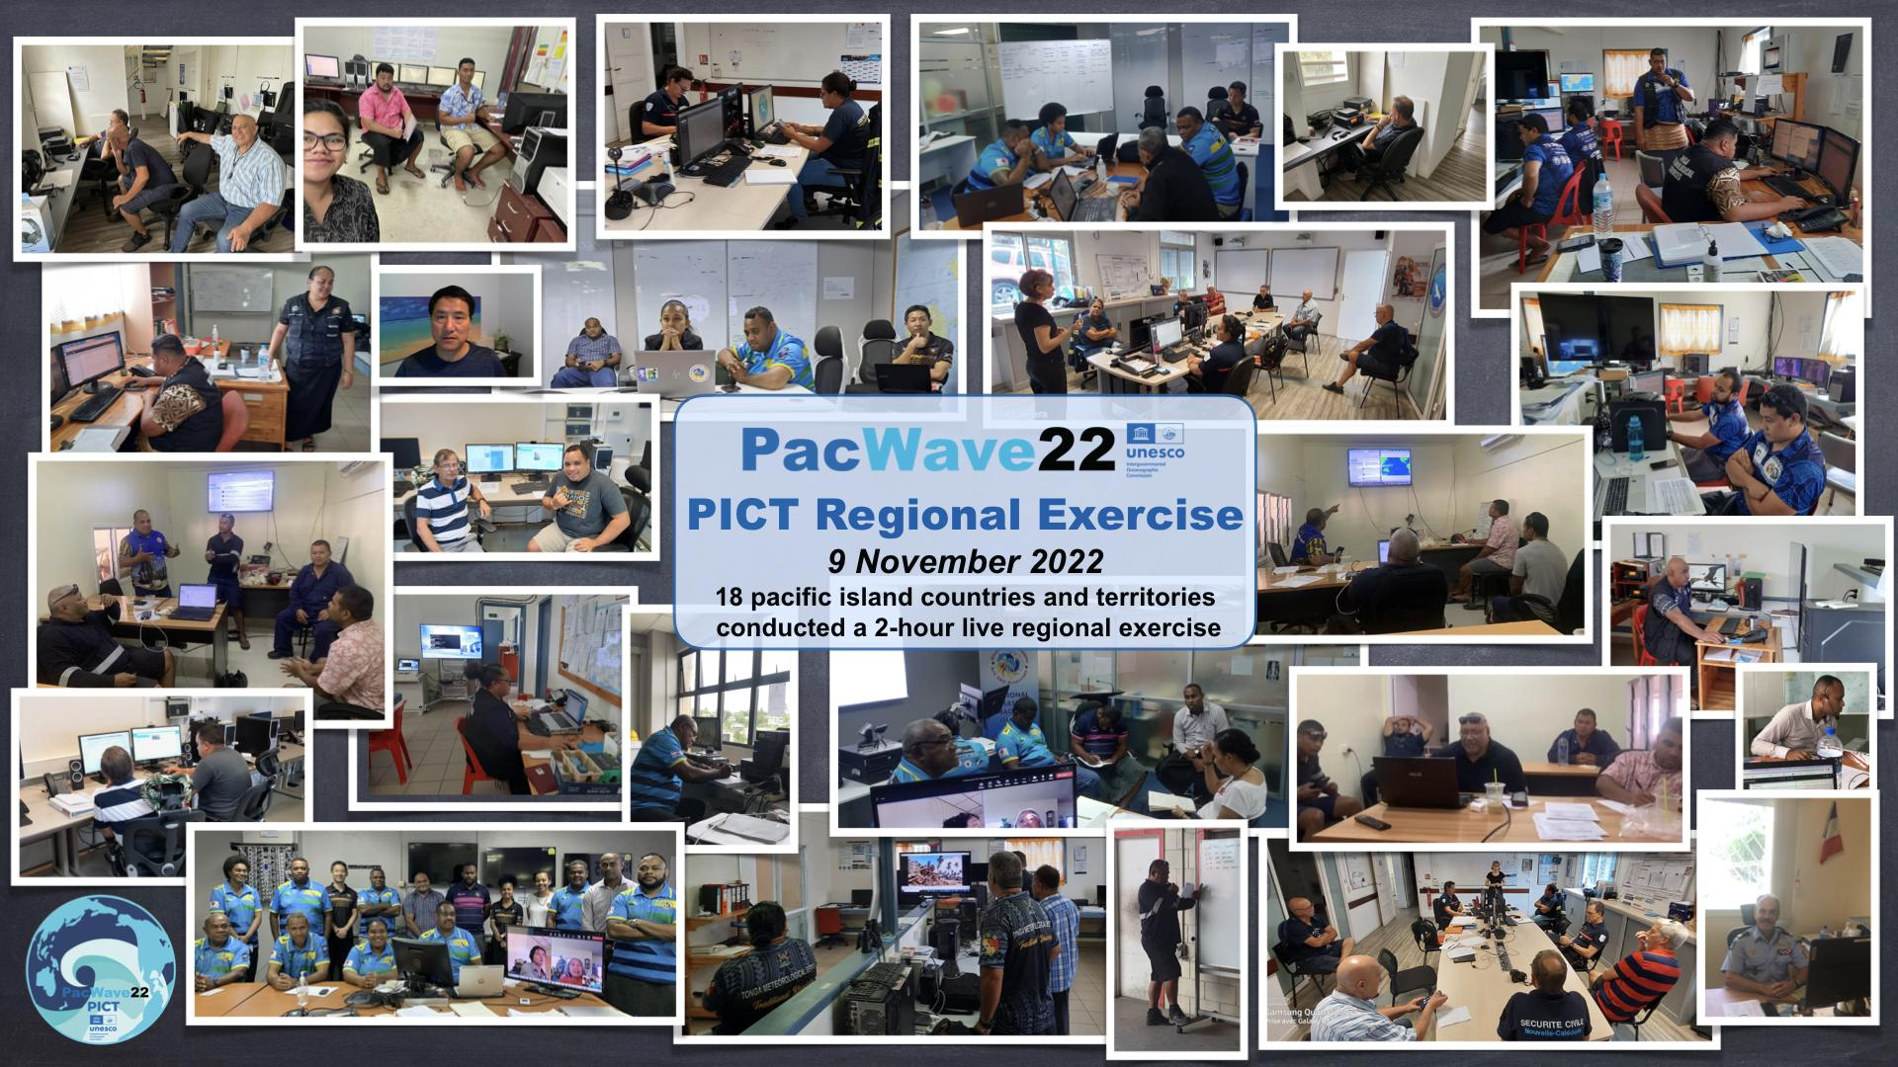
PacWave22: PICTS Regional Exercise
Objectives

Slide 26
PacWave22: PICTS Regional Exercise
Objectives and scenario
Objectives
Test the HTHH PTWC Interim Procedures and PTWS Products (IOC Circular Letter 2902), and whether the HTHH PTWS products are interpreted by PICT Member States accurately and in a timely manner, and
Test regional communication and cooperation between PICT Member States, and the value of information sharing in facilitating national tsunami alert decision-making. (Dedicated E-mail Listserv, PacWave22-PICT WhatsApp group chat, HF Radio)
The scenario was a realtime replay of the 15 January 2022 HTHH event. The exercise was conduct on the 9th November 2022 (WTD); Almost 80 persons from PICTs national stakeholders (National Tsunami Warning Centres - NTWC - and National Disaster Management Offices - NDMO) tested sharing event information through multiple informal communications modes:

Slide 27
PacWave22: PICTS Regional Exercise
Objective 1 : Feedback & recommendations
PacWave22-PICT involved 18 PICTs and was a first of its kind for this region.
The HTHH PTWC interim products were found useful by all participants. Some comments and requests were shared by PICTs :
Scaled forecast heights are useful for issuing warning, upgrade, downgrade and cancellation.
Explore the viability to have more forecast points in the text bulletin, especially for PICTs with many islands.
Request to PTWC the possibility to conduct a broader assessment for their first bulletin (TTT: 6h instead of 3h) to include those countries and territories located far from the source.

Slide 28
PacWave22: PICTS Regional Exercise
Objective 2 : Feedback & recommendations
The exercise highlighted the need to keep building regional cooperation and direct links between NTWC and/or NDMO.
WhatsApp (86 messages),
electronic mail listserv (63 messages),
HF Radio (6 PICTs involved).
Guidelines will be developed for the use of non-traditional methods like WhatsApp as unofficial communication channel for exercises and tsunami warning operations; noting the need to distinguish from the official and shared content for operations (must consider the establishment of a dedicated task team under the WG-PICT).
ToR to be accepted for the WG-PICT Task Team on information sharing platform
The PTWS Secretariat will facilitate monthly testing of non-traditional communication systems as HF radio, WhatsApp, satellite phones between countries

Slide 29
PacWave22 Task Team Members
Mr Emilio Talavera, Nicaragua, Co-Chair emilio.talavera@gf.ineter.gob.ni ; emilio.talavera@ineter.gob.ni
Ms Margarita Martinez, Chile, Co-Chair
Dr Charles McCreery, PTWC, USA charles.mccreery@noaa.gov
Dr Laura Kong, ITIC, USA laura.kong@noaa.gov
David Coetzee, New Zealand david.coetzee@nema.govt.nz
Mr Lianda Zhao, China zld@nmefc.cn
Jorge Matus, SHOA, Chile jmatus@shoa.cl
Carolina Henriquez, Chile chenriquez@shoa.cl
Laura González, Colombia l.gonzalez@dimar.mil.co
Jo Guard, New Zealand
Silvia Chacon, Costa Rica, CA-PAC Chair
Jasón Pérez, Colombia contaminacion.marina@cco.gov.co
Anthony Jamelot, French Polynesia jamelot@labogeo.pf
Céline Barre, France celine.barre@gouv.nc
Francois Schindele, France francois.schindele@gmail.com
Rodolfo Alvarado, Guatemala ralvarado@insivumeh.gob.gt
Yuji Nishimae, Japan nishimae@met.kishou.go.jp ; nishimae-yxmbtjh20vw@outlook.com
Jorge Rodriguez, Panama jfrodriguez@pancanal.com
Eric Chichaco, Panama echichaco@yahoo.com ; eric.chichacor@up.ac.pa
Carolina Hincapie, ITIC, USA carolina.hincapie@noaa.gov
Sara Mitchell, New Zealand sara.mitchell@nema.govt.nz

