Slide 1
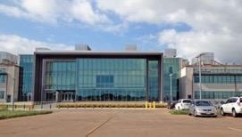
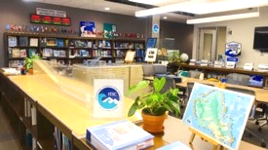
Agenda 8
International Tsunami
Information Center (ITIC) Report
ITIC
Dr. Laura Kong
Director, ITIC, USA NOAA
Cdr. Carlos Zuniga Christa von Hillebrandt
Associate Director, ITIC, Chile SHOA Deputy Director, ITIC, USA NOAA
Manager, ITIC Caribbean Office
https://vimeo.com/192771669

Slide 2



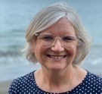




ITIC – Who we are
ITIC - established 1965 (IOC-IV.6), USA agreed to host
Support Member States (Technical improve TW (timely accurate), Capacity Building, Awareness, Event / Post-Tsunami data coll)
  OFFICE - US NOAA NWS
    Director – Dr. Laura Kong
    Deputy Director, ITIC Caribbean Office - Christa von Hillebrandt-Andrade
    Support CTIC, CARIBE-EWS (eff Sept 1 2021, former Caribbean Tsunami Warning Prog, est. 2010)
    Scientist (Oceanographer) - vacant
    Technical Information Specialist - vacant
    Information Technology Specialist – Tammy Fukuji
    Admin Support Assistant – Art Sonen
    Student interns (part, full-time): 1-2 year-round, 2-4 Summer
  ASSOCIATE DIRECTOR – established 1974 (IOC/ITSU-IV.1, non-USA)
    Cdr. Carlos Zuniga (Chile, SHOA Navy), 2013 (Chile since 1998)

Slide 3

ITIC Mandate (1977) – Intersessional Activities
www.tsunamiwave.org
http://itic.ioc-unesco.org/index.php
Monitor, recommend improvements
  Events – improving warning and response
  Tsunami Warning Decision Support Tools
Assist in establish/strengthen national, regional systems
  Capacity Building, Training
  IOC Wave Exercises
  UN Decade for Ocean Science for Sustainable Development
Information resource - preparedness / education (create, compile, share)
  Guides, Manuals, Best Practices, Awareness materials
Information resource - historical tsunamis (collect, compile, share)
  Database, global and regional hazard, post-event surveys

Slide 4
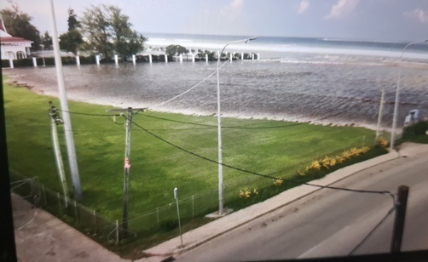
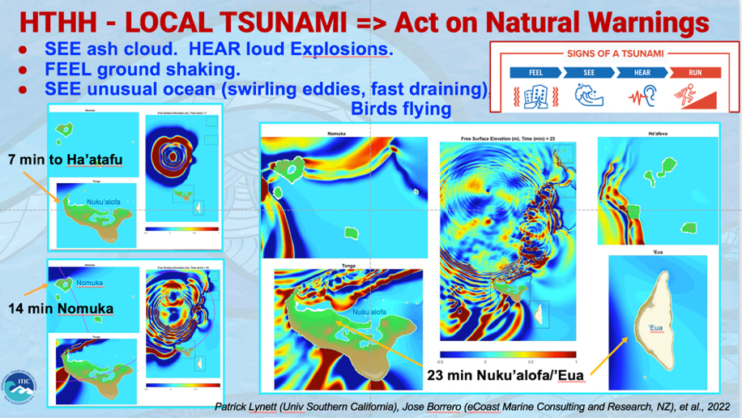
Improving TW:
15 Jan 2022 – Hunga Tonga – Hunga Ha’apai
Unprecedented – massive eruption and tsunami
3 PTWS Briefs (20 Jan, 3 Feb, 10 Feb 2022)
Post-Event Assessment (PAE 31 Jan, IOC CL 2877) – pending IOC
ITIC expert/facilitate support to Tonga (ensure best technical effort with minimum duplication), 1st call 25 Jan => April (30+ virtual meetings, IOC hosted) – (Situational EQ/Volcano activity, HTHH interim procedures, equipment install / repair and post-tsunami survey (NZ, AU, US, SPC)
PTWS HTHH Interim Products and Procedures
Post-Tsunami Field Surv (runup, inundations)
  http://itic.ioc-unesco.org/index.php?option=com_content&view=article&id=2226:international-tsunami-survey-team-tonga&catid=2709&Itemid=3327

Slide 5

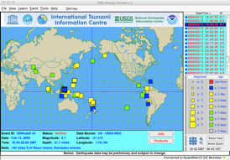

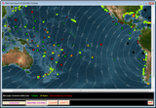


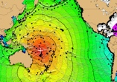
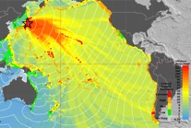
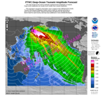
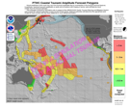

Tsunami Warning Decision Support Tools
ITIC-distributed, supported
Listserv (IOC TWFP, NTWC, TNC) – TSP emerg broadcast, Other needs
Tsunami Bull Board (ITIC, 1995) 473 science/tsu/govt (Sep 2023)
ADDR FOR POSTING: tsunami_bb@list.woc.noaa.gov
Real time EQ Display (CISN, USGS / NTHMP, 2005), 346+ v3.9.193 (Feb 2023) NO PTWS EQ Observatory message. NO registration code required so cannot track nbr users
Real-time Sea Level monitoring
  Tide Tool – TWC operations monitoring (PTWC, 2005) v10.70
  IOC Sea Level Monitoring web site (IOC, 2008)
Tsunami Travel Time Software (ITIC, NGDC, 2007) – SDK4.0.1, with PC GUI
Tsunami Historical Database Online (WDS-NCEI), Offline (TsuDig, NCEI, ITIC, 2009)
Tsunami Hazard Assessment Tools (2017) – PMEL, ITIC
  ComMIT/MOST => OTGA TEMPP hybrid late 2023-2025
  Tsu Coastal Assessment Tool (TsuCAT v4.3.2, Sep 2023) => Community Exercise injects

Slide 6
ITIC Mandate (1977) – Intersessional Activities
www.tsunamiwave.org
http://itic.ioc-unesco.org/index.php
Monitor, recommend improvements
  Events – improving warning and response
  Tsunami Warning Decision Support Tools
Assist in establish/strengthen national, regional systems
  Capacity Building, Training
  IOC Wave Exercises
  UN Decade for Ocean Science for Sustainable Development
Information resource - preparedness / education (create, compile, share)
  Guides, Manuals, Best Practices, Awareness materials
Information resource - historical tsunamis (collect, compile, share)
  Database, global and regional hazard, post-event surveys

Slide 7
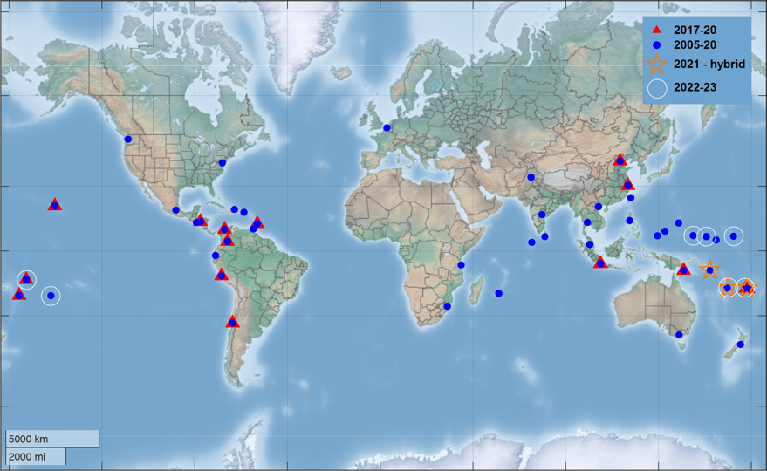
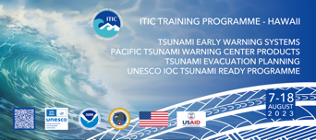
ITIC - IOC TSUNAMI CAPACITY BUILDING (2005-2021, >130 trainings)
  2019
    Caribbean, Colombia, Papua New Guinea, SOP
    Hawaii (global, 2-week), End-to-end, SOPs
    PICT, TEMP 1 - Inundation Model / Map
    Tonga (2-week), NTWC Competency pilot
  2021 - 2022:
    IOC Ocean Teacher Global Academy (OTGA) online/hybrid
    November, Hybrid – live remote
      Review / Update SOPs
      4 days each: Solomon Islands, Fiji, Vanuatu
  2023:
  Tsunami Ready Implementation, Fiji, Micronesia (Chuuk, Pohnpei, Yap), Marshall Islands (Majuro), Palau - 2022-23
  Cook Islands Review and Update of TWC and TER SOPs - Jan 2023
  PICT Regional on Tsunami Ready I - Jan 2023
  ITP-Hawaii, Tsunami Early Warning Systems, Aug 2023 – video
Courses
Awareness (1 day)
TEWS (1 wk)
TWC & TER SOPs (1wk)
TEMPP (5 1-wk)

Slide 8
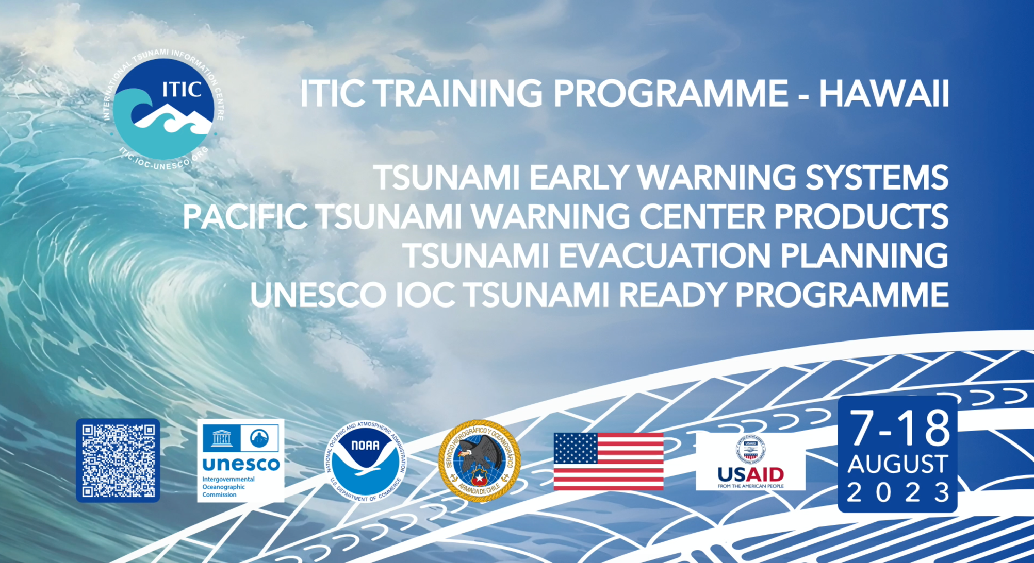

Slide 9
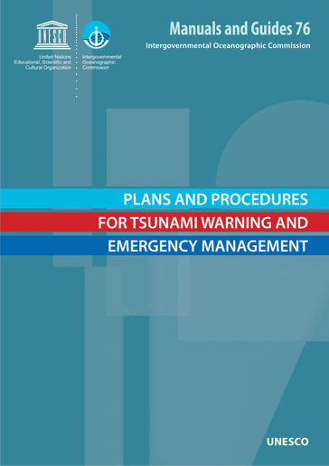
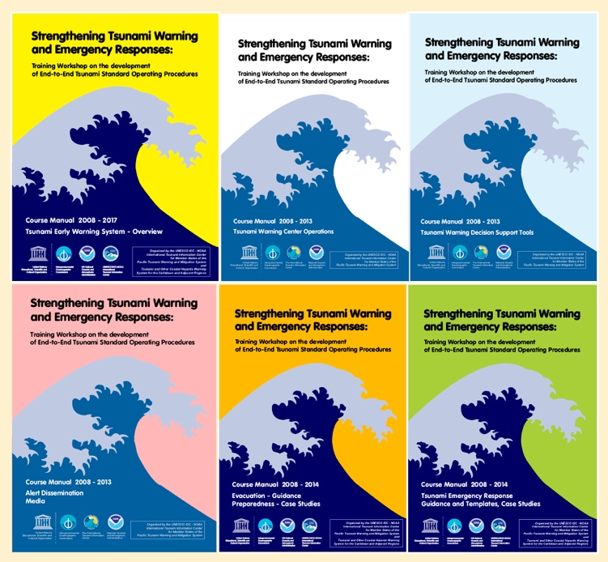
ITIC Training – SOPs
Tsunami Warning Center and Tsunami Emergency Response Standard Operating Procedures (TWC TER SOPs) – IOC MG 76 Plans and Procedures for Tsunami Warning and Emergency Management, Guidance for countries in strengthening tsunami warning and emergency response through the development of Plans and Standard Operating Procedures for their warning and emergency management authorities (2017)
Manual (English)
  http://itic.ioc-unesco.org/index.php?option=com_content&view=category&layout=blog&id=2166&Itemid=2640

Slide 10
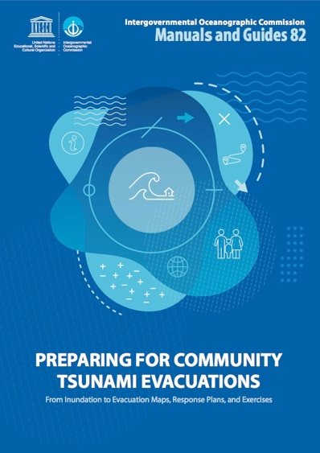
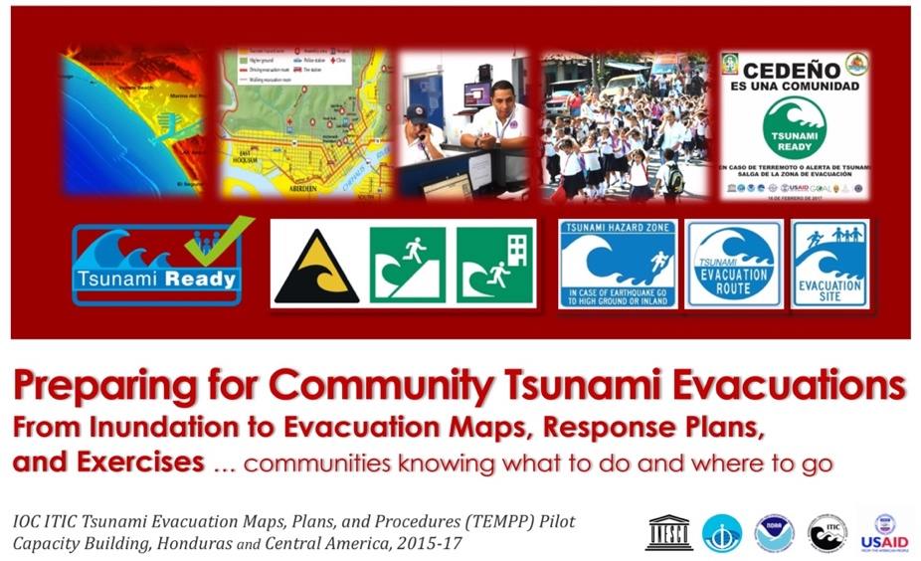
ITIC Training – TEMPP
Tsunami Evacuation Maps, Plans, and Procedures (TEMPP) – IOC MG 82 Preparing for Community Tsunami Evacuations: from inundation to evacuation maps, response plans and exercises (2020)
Manual (English, Spanish)
Supplement 1 (Detail Module Explanations, Guidance) (English)
Supplement 2 (Creating Maps with QGIS, draft Feb 23 update)
Specialized Documents
  http://itic.ioc-unesco.org/index.php?option=com_content&view=category&layout=blog&id=2166&Itemid=2640

Slide 11
    OTGA work plan (2021-2025): ITIC and IOC, work with other TICs
- pending funding
Course | Length (hrs) | Date | Audience - TWM tsunami warning and mitigation | Language | Comments * Interest by other RTCs to teach
ITIC: Tsunami Awareness - overview covering hazard assessment, warning, preparedness, mitigation, response | 4-8 hrs | 2023 | All levels, no background necessary. | Eng, Span | Standard content with options for regional customization. (*)
IOTIC/ITIC: Tsunami Ready (IOC MG 74) - Overview of guidelines, process for establishing TR Programmes and recognizing TR communities | 4-8 hrs | 2023 - 2024 | Govt and NGOs responsible or interested in preparedness, in TR | Eng, Span | Standard content with options for regional customization.
ITIC: Tsunami Early Warning Systems (TEWS) - components of, requirements for robust, reliable, effective TWS | 40 hrs | 2024 | Agencies responsible for TWM in country | Eng, Span | Standard content with options for regional customization. (*)
ITIC/IOTIC TEMPP (Tsunami Evacuation Maps, Plans, and Procedures, IOC MG 82) 1. Identifying Inundation Areas, 2. Developing Evacuation Maps, 3. Developing Response Plans and Standard Operating Procedures, 4. Exercising | 4 40-hr module, Tot 160 hrs | 2023 - 2024 | Scientists, govt, and NGOs involved in preparedness | Eng | (*) Sequential training and product development with outcome community recognized UNESCO IOC Tsunami Ready.
ITIC: Tsunami Warning and Emergency Response Standard Operating Procedures (SOPs) (IOC MG 76) - procedures and protocols used successful tsunami warning |  | 2024 | Agencies involved in TW and TER | Eng | Standard content. (*)
ITIC: TWC Staff Basic Competencies - Information and skill requirements for TWC staff. Topics: science of earthquakes and tsunamis, analysis methods, tools and techniques for monitoring, assessing tsunami threat, issuing alerts, cancelling tsunami warnings | 120 hrs | 2024 - 2026 | TWC staff | Eng, Span | Standard content with options for regional customization. (*)

Slide 12
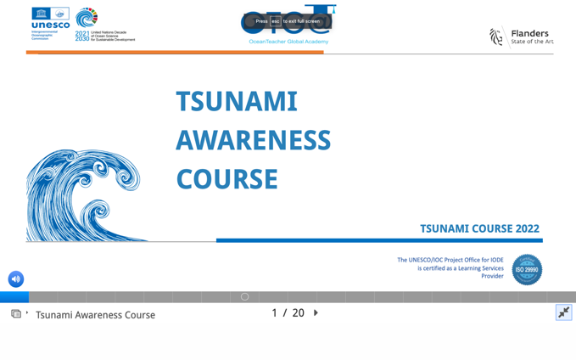
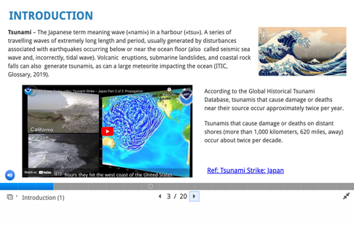
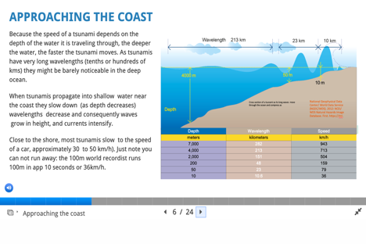
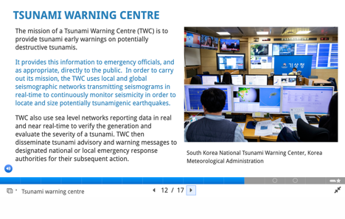
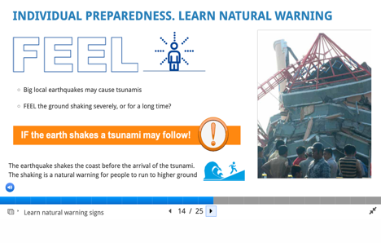
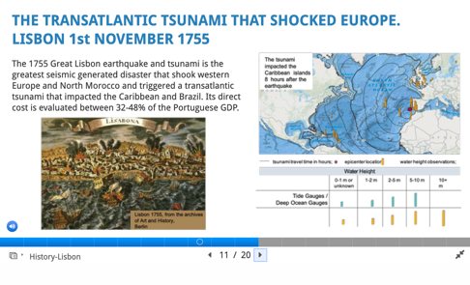
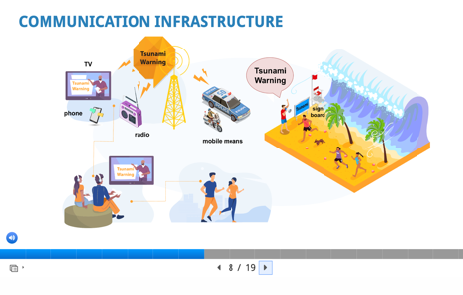
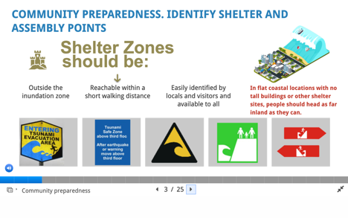
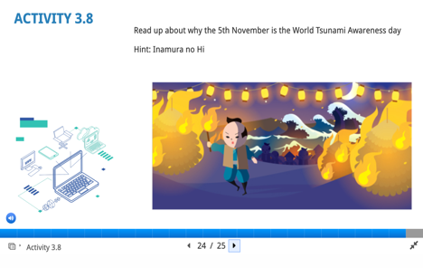
OTGA Tsunami Awareness – 3 Modules
Tsunami Basics – 1, 2
Tsunami Warning Systems – 1, 2
Tsunami Preparedness – 1, 2

Slide 13
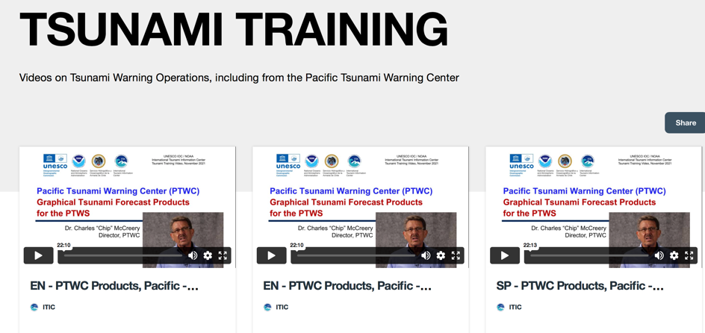
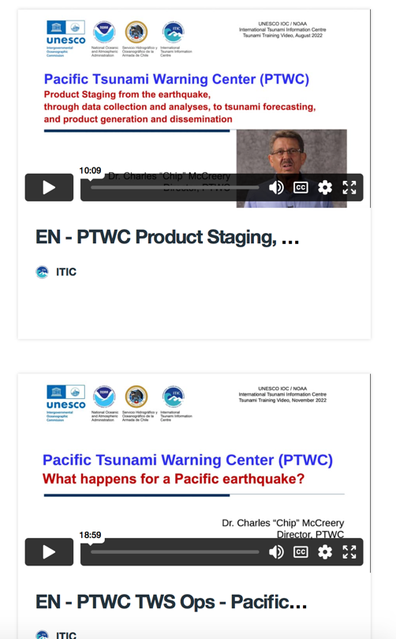
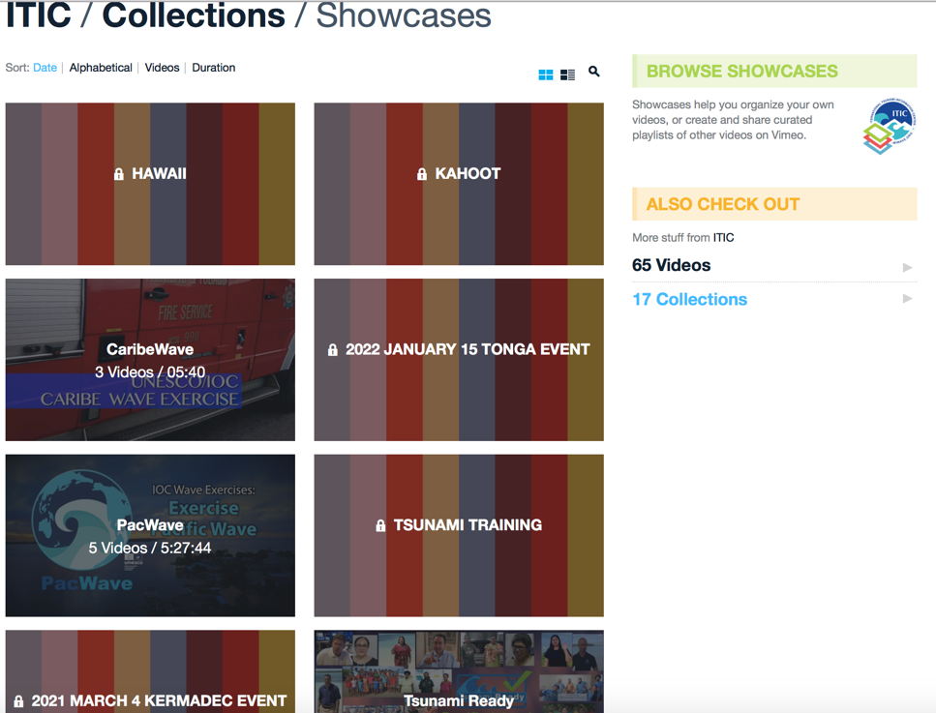
ITIC training videos – PTWC SOPs (support OTGA)
  2021-22: PTWC Enhanced Products and Staging (Pacific, Caribbean) (EN-SP-FR) 10-22 min
  2022: TWC Operations – What happens at PTWC during Pacific earthquake? (EN) 18 min
  Planned: Tsunami Forecasting (EN) (req fr PTWS 4 Mar 2021 debrief) – 20 min
https://vimeo.com/showcase/8956022
Password: training

Slide 14

ITIC support to PacWave22
Member TT
Create PacWave video for outreach
Host PW22 web site pacwave.info, incl PW22-PICT web page
Host Post-Exercise Eval tool (Survey Monkey)
For PW22-PICT, host 1 Communication method (Email listserv), serve as Observer
Support TT and Chair for compilation of Summary Report

Slide 15
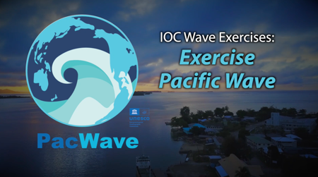

PacWave information video – Dec 2021
ITIC, IOC, USA, Chile
TOPICS
  What is PacWave ?
  Why is PacWave important ?
  What does PacWave do ?
CONTENT
  ‘Interview’ narratives – IOC, ITIC, PTWC, NWPTAC, Chile, Philippines, El Salvador
  Visuals of previous PacWave and other exercises (upstream, downstream)
  https://vimeo.com/654705877
Notes:
Test communications between countries and PTWC.
Strengthen (and synchronize) regional response to tsunami treats.
Identify gaps for improvement: Allow duty officers to improve threat assessment: intl data integrated into country assessment

Slide 16

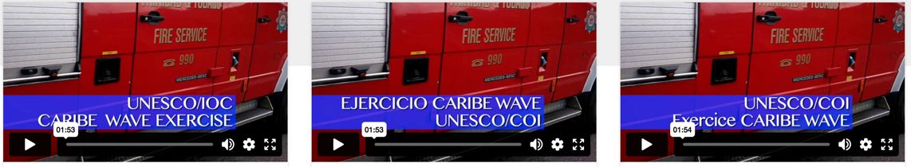
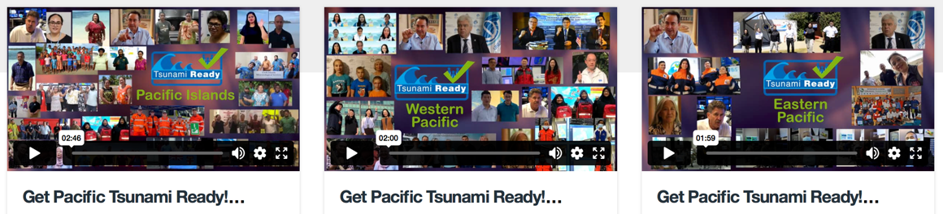
Short videos – IOC Wave, Tsunami Ready
  Exercise Pacific Wave – Eng, Feb 2022
  CARIBE Wave Exercise – 1-min PSA. Mar 2022
  Get Pacific Tsunami Ready Shout-outs (WTAD 2021)
    Update to PICT, Sep 2023: add Micronesia, Palau, USA (NWS Director)
  https://vimeo.com/654705877
English Spanish French
https://vimeo.com/showcase/9334456
  Western Pacific, Pacific Island Countries and Territories Eastern Pacific
  https://vimeo.com/showcase/8288490
https://vimeo.com/641742226

Slide 17
UN Decade Support - Pacific, Caribbean, 2021-2023
Reduce time and increase certainty of forecasts for Local Tsunami Warning Advancing Tsunami Detection and support cable initiatives and SMART pilots - Vanuatu/NC (ITIC lead for training), Indonesia CBT, NZ-Antarctica, Portugal CAM2, Mediterranean MEDUSA, Caribbean
100% at risk communities are prepared and resilient (Pacific, Caribbean) – Facilitate, participate Tsunami Ready Board, Training, Awareness materials, etc) and execute TR Pilots – 2021-2024 funding to ITIC (USAID). Partner with SPC
  Pacific: Fiji, Marshall Islands (Majuro), Micronesia (Pohnpei, Chuuk, Yap), Palau
    2024+: 4 addtl PICT (Kiribati, Samoa, Solomon Islands, Vanuatu)
  Caribbean: Dominica, St Lucia, Barbados
    2024+: 3 addtl (Antigua and Barbuda, Anguilla (renew), Honduras (3 renew 3 - 1 Pac, 2 Car)
Capacity Building: Create online / hybrid training through OTGA Courses: Tsunami Awareness, Tsunami Ready (IOTIC), TEMPP, TEWS, TWC/TER SOPs, NTWC Competencies
Collaborations and partnerships with other stakeholders to advance Multi-hazard Early Warning Systems – most active in Caribbean

Slide 18
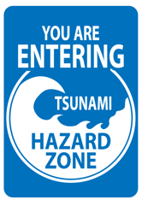
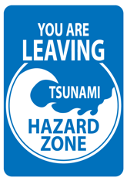
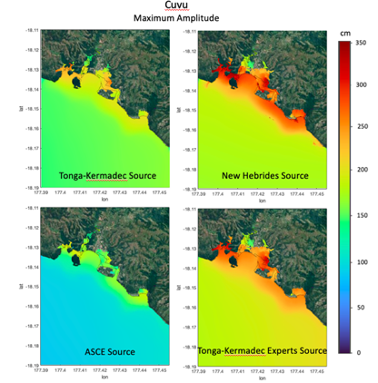
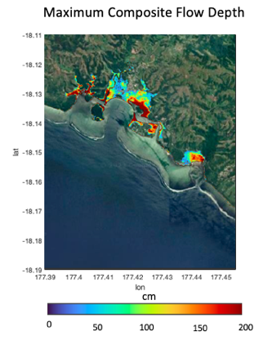
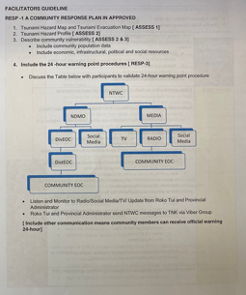
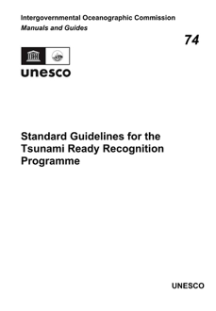
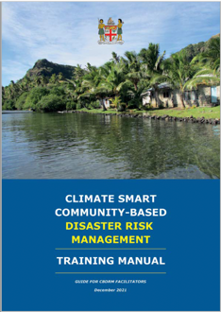
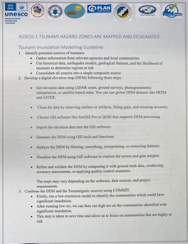
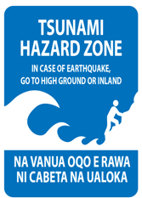
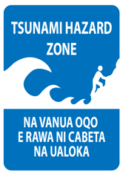
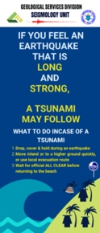
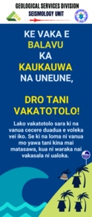
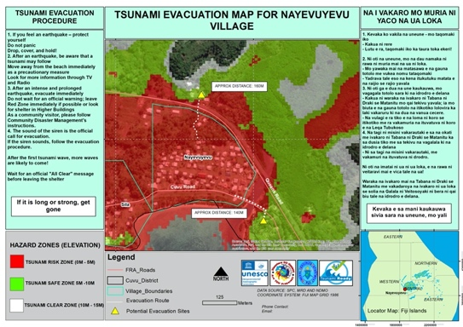
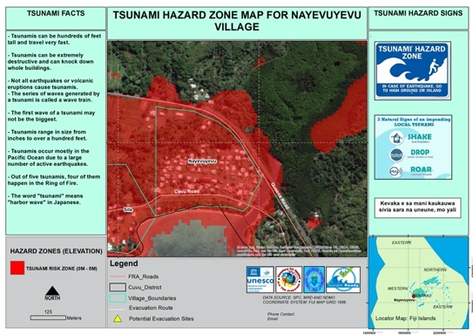
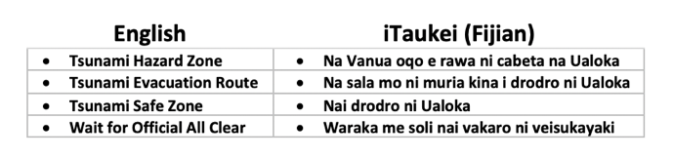

Fiji, Coral Coast - Cuvu District
Nayevuyevu Village (in process)
Implementation Approach - Stakeholders
Mineral Resources Department, National Disaster Management Office, Ministry of Lands, Provincial Administrator, iTaukei Affairs, Plan International, Partners in Community Development (Fiji), People Living with Disability Organization
Hazard Assessment: Tsunami Sources Study and Inundation Map
Signage:
+
➥
Draft 2023
(Living Documents)
Preparedness:
Hazard and Evacuation Maps (Participatory Mapping Meeting - Sept 2023)
Awareness and Education Materials: Use of local language
DRAFT
DRAFT

Slide 19
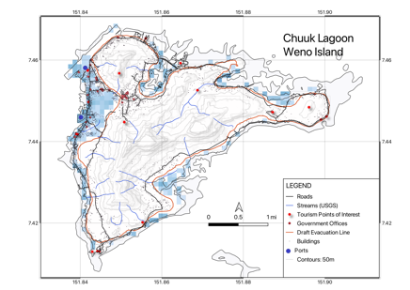
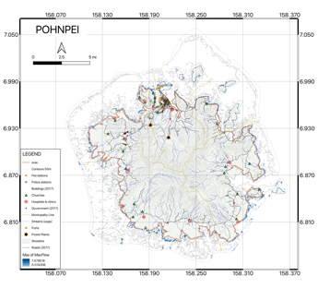


Federated States of Micronesia (Chuuk, Pohnpei, Yap)
Status - Target Completion Nov 5, 2023
Assessment Indicators
Hazard Assessment
Est at-risk populations, resources
Preparedness Indicators
Draft evacuation maps
Signs decided, Awareness materials
Signage plan
Community outreach; Exercise (Chuuk & Pohnpei)
Exercise (Yap Tabletop);
Response
Response plan
Receive Alert / Warning
Disseminate Warning / Warning
Key Stakeholders
National – DECEM
State - Weather Service Offices, Disaster Coordination Offices
Done
In-progress
Remaining

Slide 20




Republic of Marshall Islands (Majuro atoll)
Status - Target Completion Nov 5, 2023
Assessment Indicators
Hazard Assessment
Est at-risk populations, resources
Preparedness Indicators
Draft evacuation maps
Signs ordered
Awareness materials selected;
Signage plan
Community outreach
Exercise
Response
Response plan
Receive Alert / Warning
Disseminate Warning / Warning
Key Stakeholders
NDMO, Weather Service Offices
Done
In-progress
Remaining

Slide 21



Republic of Palau
Status - Target Completion October 5, 2023
Assessment Indicators
All Indicators being verified as done
Preparedness Indicators
All Indicators being verified as done
Additional Evacuation and Assembly Area signs ordered
Response
All Indicators being verified as done
Key Stakeholders
NDMO, Weather Service Office
Done
In-progress
Remaining

Slide 22






UNESCO IOC Tsunami Ready Recognition
www.tsunamiready.org
Facilitated by TICs
Web (ITIC): PTWS, CARIBE-EWS, IOTWMS, NEAMTWS recognized communities
Global Tsunami Ready Interactive Map Viewer

Slide 23
ITIC Mandate (1977) – Intersessional Activities
www.tsunamiwave.org
http://itic.ioc-unesco.org/index.php
Monitor, recommend improvements
  Events – improving warning and response
  Tsunami Warning Decision Support Tools
Assist in establish/strengthen national, regional systems
  Capacity Building, Training
  IOC Wave Exercises
  UN Decade for Ocean Science for Sustainable Development
Information resource - preparedness / education (create, compile, share)
  Guides, Manuals, Best Practices, Awareness materials
Information resource - historical tsunamis (collect, compile, share)
  Database, global and regional hazard, post-event surveys

Slide 24


ITIC Services – Community Guide
IOC Manual and Guides 86
  Multi-Annual Community Tsunami Exercise Programme Guidelines for the Tsunami and other Coastal Hazards Warning System for the Caribbean and Adjacent Regions
With Collaboration of EMIZA (French Emergency Management Agency-original manual) and National University of Costa Rica (Formatting)
English, French, Spanish
https://unesdoc.unesco.org/ark:/48223/pf0000380540.locale=en

Slide 25









ITIC Awareness materials – update, printed, EN, SP http://itic.ioc-unesco.org/index.php?option=com_content&view=category&layout=blog&id=1075&Itemid=1075
Tsunami Glossary 2019 (printed En, Sp) => updated 2023 (TOWS-WG-XVI)
Tsunami Warning! Comic Amer Samoa (en) (IOC/INF1223) and English (update 2020)
Tsunami Great Waves, Surviving Tsunamis Lessons Learned (1960, 2010 Chile) Where the First Wave Arrives in Minutes (2004, 2006 Indonesia) Tsunamis on the Move, Sensing a Tsunami

Slide 26
ITIC Mandate (1977) – Intersessional Activities
www.tsunamiwave.org
http://itic.ioc-unesco.org/index.php
Monitor, recommend improvements
  Events – improving warning and response
  Tsunami Warning Decision Support Tools
Assist in establish/strengthen national, regional systems
  Capacity Building, Training
  IOC Wave Exercises
  UN Decade for Ocean Science for Sustainable Development
Information resource - preparedness / education (create, compile, share)
  Guides, Manuals, Best Practices, Awareness materials
Information resource - historical tsunamis (collect, compile, share)
  Database, global and regional hazard, post-event surveys

Slide 27




ITIC Awareness materials – update, printed http://itic.ioc-unesco.org/index.php?option=com_content&view=category&layout=blog&id=1075&Itemid=1075
ITIC-NCEI Hazard Posters – updated to 2022 (will update 2023 / print 2024)
Global Tsunami Sources 1610 B.C. to A.D. 2022 – poster, icosahedron (2020)
Significant Earthquakes 2150 B.C. to A.D. 2022
Significant Volcanic Eruptions 4360 B.C. to A.D. 2022 (1000 printed)

Slide 28




ITIC Awareness materials – update, some printed http://itic.ioc-unesco.org/index.php?option=com_content&view=category&layout=blog&id=1075&Itemid=1075
ITIC – NCEI posters Regional Historical Tsunami Effects
  Caribbean, Central America, Mexico (update 2022, EN SP)
  Historical Tsunamis Effects near the Tonga Trench (1837-2015), update with HTHH Oct 2022 (2023) - printed
  Papua New Guinea/Solomons (2019) - printed
  Vanuatu / New Caledonia, New Hebrides (2021)
  South America (draft 2023-24)

Slide 29




Post-Tsunami Assessments
IOC Post-Event Assessments – triggered by 15 Jan 2022 IOC CL 2877 (31 Jan 2022)
Post-Tsunami Field Survey (normally, International Tsunami Survey Teams, ITST), 15 Jan 2022 – remote technical support to Tonga Geological Service
At request of country, assist in coordinated international surveys, Tonga Post-Tsunami Survey
  IOC/ITIC, SPC (NZ, US equipment donate)
  Due to COVID, virtual technical assistance to Tongan agencies
Pure Appl Geophys, Dec 2022
http://itic.ioc-unesco.org/index.php?option=com_content&view=article&id=2226:international-tsunami-survey-team-tonga&catid=2709&Itemid=3327

Slide 30
2024+ - Next ‘new’ efforts
Tsunami Ready
  Chair Tsunami Ready Coalition. TR Implementation – Agenda 4.2
  TIC ”mandate” to facilitate all PTWS. Build resilience capacity.
  Host TR web site (communities recognized)
  Have USAID funding to implement in few PIC
Training (Member States include training funding in their budget)
  ITP-Hawaii (2-week) – 2024, asking Chile if interested (last in 2018)
  Other, as requested
SMART cable – advocate, JTF SMART Science & Society co-chair (Jerome Aucan, SPC). NC-VN SMART, ITIC lead TWC SOP capacity bldg
NTWC Competency (Agenda 4.3) – Framework approved ICG/PTWS-XXX. ITIC propose conduct Pilot (e.g., develop training course, test with 1 cohort, with PTWC ’attachment’, USAID pending). Work with PIC to devise national ‘assessment’ and ‘certification’ process.

Slide 31
Thank You
Muchas Gracias
Dr. Laura Kong
Director, ITIC, USA NOAA
Cdr. Carlos Zuniga Christa von Hillebrandt
Associate Director, ITIC, Chile SHOA Deputy Director, ITIC, USA NOAA
Manager, ITIC Caribbean Office

