Slide 1
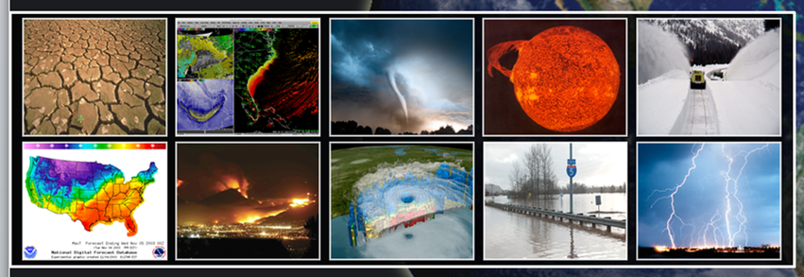
US National Report Summary
Sept 12, 2023
30th Pacific Tsunami Warning System (PTWS) ICG-PTWS
Mike Angove, NOAA Tsunami Program Manager/US Tsunami National Contact; Paul Earle, USNEIC Dir; Dan McNamara; Earthscope Consortium
National Weather Service

Slide 2
US Delegation (Tonga)
NOAA HQ: Mike Angove (Head of Del); Susan West (virtual)
PTWC: Chip Mccreery
ITIC: Laura Kong
NCTR: Vasily Titov; Chris Moore (virtual)
NCEI: Nic Arcos (virtual)
NEIC (USGS): Paul Earle (virtual); Jana Pursley (virtual)
NASA: Tim Melbourne
SMART: Bruce Howe; Ceci Rodriguez Cruz; Matt Fouch (virtual)
Earthscope: Dan McNamara (virtual); Glen Mattioli (virtual)
DOS: Stephanie Clark (virtual)

Slide 3
Focus Areas
Tsunami detection and measurement.
DART 4G
GNSS/GFAST; GNSS/GUARDIAN
SMART Repeater
Advanced seismic techniques (regional wphase, seismogeodetic, etc)
Non-seismic tsunamis: Volcano, landslide and meteotsunami—source agnostic procedures
U.S. Tsunami Warning Center (TWC) Alignment.
TWC Alignment: Full service Back-up
Common analytic baseline for events
Common systems and architectures
US TsunamiReady® Program
There are currently 31 TsunamiReady communities in the Pacific: Hawaii (22), Guam (6), and American Samoa (3). The renewal cycle is 4 years. https://www.weather.gov/TsunamiReady/communities
NOAA, through the National Tsunami Hazard Mitigation Program (NTHMP), provides funding to Guam, CNMI and American Samoa that support Tsunami Ready.

Slide 4
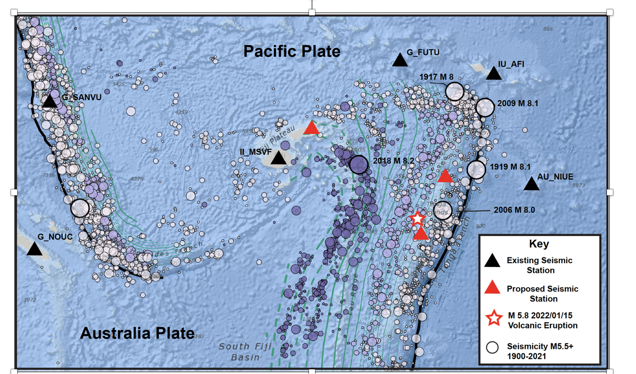
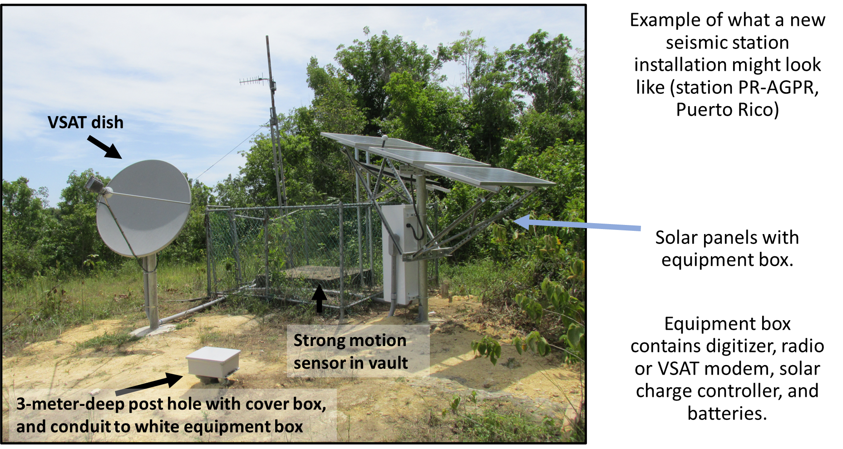
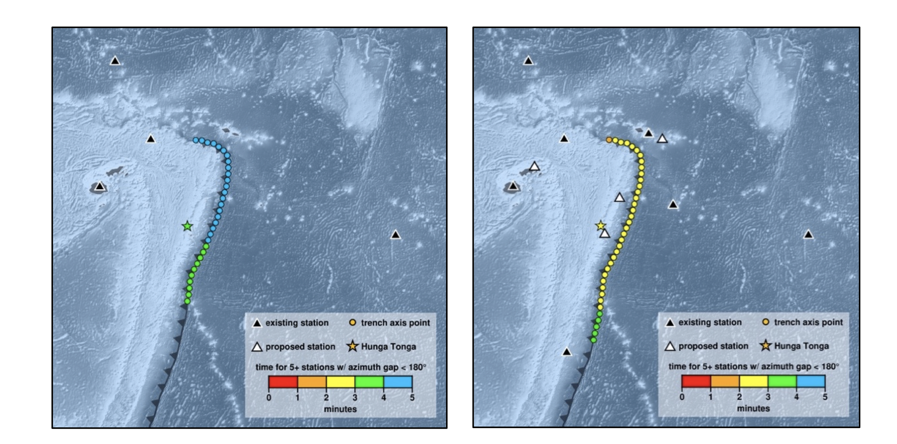
USGS NEIC activities in Tonga – Fiji Region
The Bureau of Humanitarian Aid funded an up to 3-year project for capacity building and three seismic stations in planned collaboration with Fiji Mineral Resource Department and both Tonga Geological and Meteorological Services
The first training with Tonga and Fiji seismologists took place in June 2023
One station has been sited and should be completed in the fall. Internal conversations about the 2024 strategy are ongoing, considering other regional projects.
Discussions within USGS on establishing a similar hardened station in American Samoa
Nov 2023, Labasa Fiji
Time of detection modeling with 4 additional stations, provided by NOAA

Slide 5
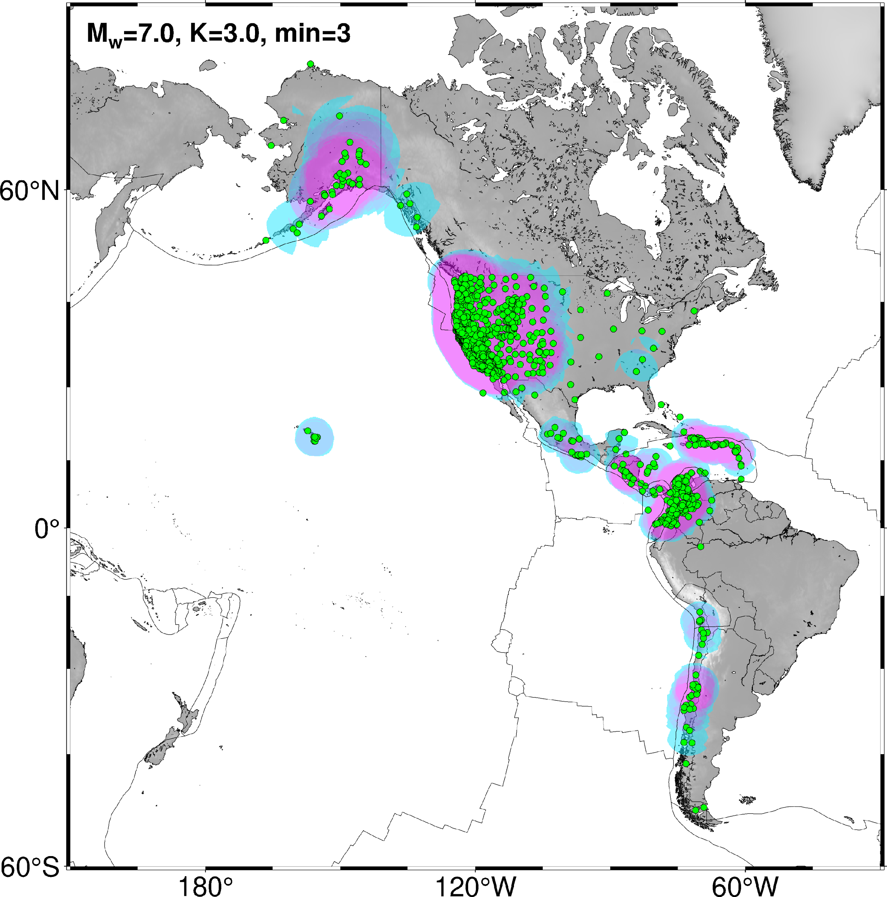


Real-time GNSS Data
GNSS stations available to TWCs and regional network operators for earthquake and tsunami monitoring.
Eastern Pacific earthquake source zones are well covered for rapid detection
Pursuing MOUs to fill gaps (red boxes)
ES is interested in developing partnerships with western Pacific GNSS operators to expand GFAST coverage for PTWS TSPs
Cyan regions are where at least 3 stations are available to detect Mw7
Red boxes show coverage gaps

Slide 6
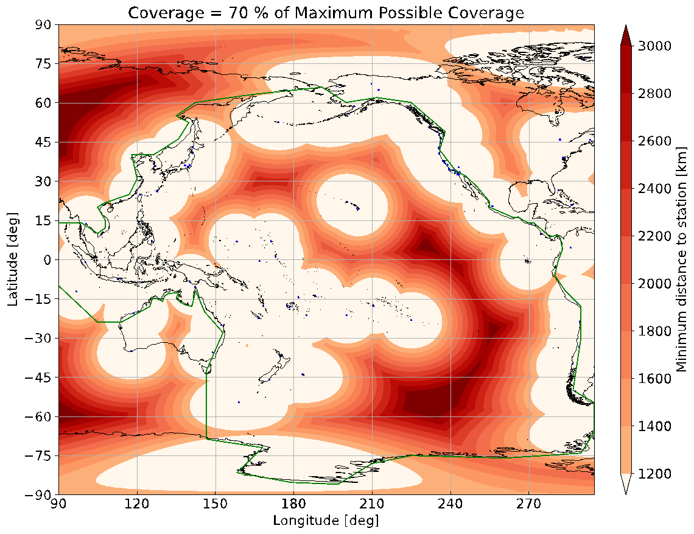
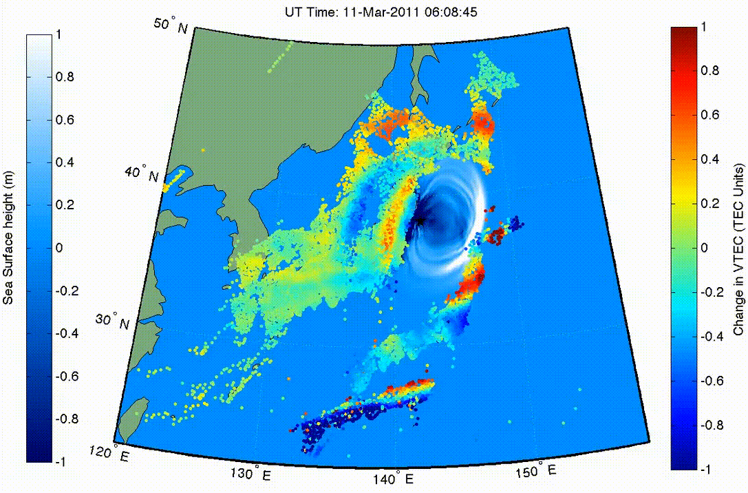
The GUARDIAN Near-Real-Time Ionospheric Monitor (Martire¹, Krishnamoorthy¹, et al., 2023) - DOI: 10.1007/s10291-022-01365-6 ¹ NASA’s Jet Propulsion Laboratory, California Institute of Technology
Tsunamis (and other natural hazards) cause ionospheric perturbations.
GUARDIAN monitors the ionospheric Total Electron Content (TEC), up to 1200 km horizontally around each ground station, in near-real-time (3-min latency).
Accurate TEC data and various analyses available publicly in near-real-time: https://guardian.jpl.nasa.gov/.
Automated detections are validated on the 2023 Turkish Kahramanmaraş quakes (Luhrmann et al., under review).
GUARDIAN currently covers ~70% of the Pacific Ocean.
GNSS satellite
disaster-induced
acoustic/gravity waves
ionosphere
line of sight
GNSS receiver
quake
volcano
tsunami
=
1
50°N
1
GUAM
40°N
sea surface height [m]
change in VTEC [TECU]
0
0
30°N
-1
120°E
130°E
140°E
150°E
-1
Figure: Ionospheric TEC and sea surface height map for the 2011 Tōhoku-Oki event (Galvan et al., 2012).

Slide 7
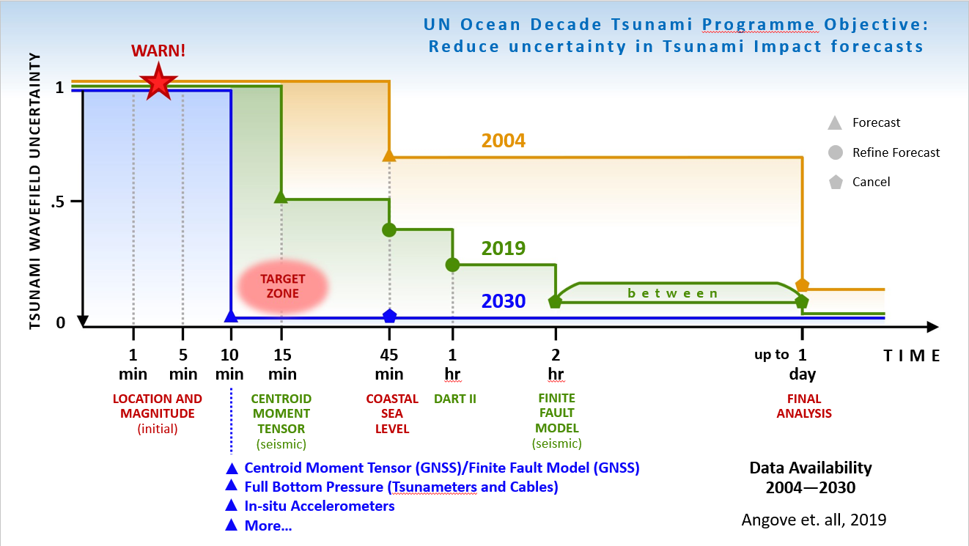
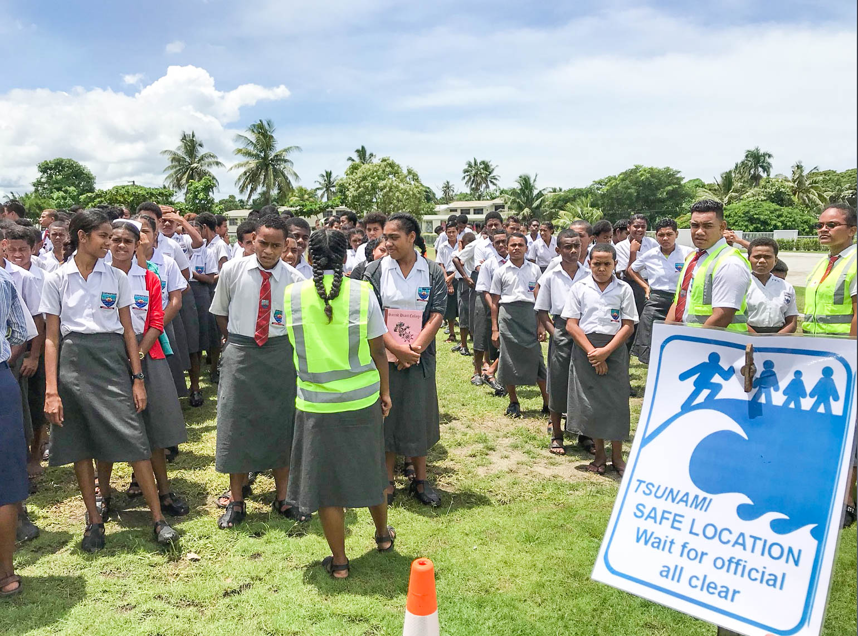
UN Decade of Ocean Science
NOAA actively engaged in the UN Decade of Ocean Science for Sustainable Development under IOC’s Ocean Decade Tsunami Programme (ODTP)--Two Contributions on (1) Increase forecast accuracy: Direct Detection and Measurement; (2) Global Preparedness: Tsunami Ready
NOAA advocates for the development and implementation of SMART Cables, GNSS (GFAST and TEC), as well as expansion of advanced tsunameter networks.
NOAA will continue to advocate and support (as funding permits) the implementation and maintenance of UNESCO/IOC Tsunami Ready Recognition Programme, including the Chairing of UNESCO/IOC Tsunami Ready Coalition by Dr. Laura Kong, Director of ITIC.
NOAA looks to advance both primary UNODTP objectives through ICG engagement

Slide 8
Tsunami Mitigation and Best Practices
ITIC has resumed in-person outreach activities in which tsunami guidance is provided.
NCEI and ITIC updated the Global Historical Tsunami, Significant Earthquake, and Significant Volcanic Eruption posters in 2023.
NCEI and ITIC are updating the American Samoa / Samoa / Tonga posters, Historical Tsunami Effects: Caribbean, Central America, Mexico and Adjacent Regions (1530–2020) Poster in 2023, and finalizing its New Hebrides poster in 2023. Additional regional maps are available for regions near the New Guinea and Bismarck Trenches
PMEL, ITIC, and PTWC continued the development of new features in the TsuCAT software and made it available to training participants.
PMEL is developing tsunami hazard risk assessment products for several coastal locations around the Pacific as part of the DOS natural hazard assessment project.

Slide 9
Tsunami Mitigation and Best Practices (cont)
PMEL continued to maintain and update ComMIT modeling tools for tsunami inundation simulations.
ITIC is developing online and blended training as an IOC Ocean Teacher Global Academy Specialized Training Center for Tsunamis, with courses available in 2023.
ITIC created informational video for Exercise Pacific Wave, and PSA for Exercise Caribbean Wave 2023 English, French, Spanish.
ITIC has created informational training videos on the PTWC Products and Operations for the Pacific and Caribbean (English, French, Spanish), Videos are available for viewing and download from the ITIC Vimeo site (Password: training).
In 2023, ITIC set up a YouTube Channel for sharing videos, including a Tsunami Ready video by NWS Director, Ken Graham.

Slide 10
Additional Questions

