Slide 1
AtlantOS
Jessica Snowden, AtlantOS Chair | Deputy Director, NOAA, USA
Isabel Sousa Pinto, Maria Paz Chidichimo, Renellys Perez, Lucie Cocquempot, Brad deYoung, Francis Asuquo, Patrick Gorringe, Gleyci Moser, Virginia Povedano, Isabelle Ansorge, Martin Visbeck, Ann-Christine Zinkann
GOOS 12th Steering Committee meeting, 25 - 27 April 2023

Slide 2
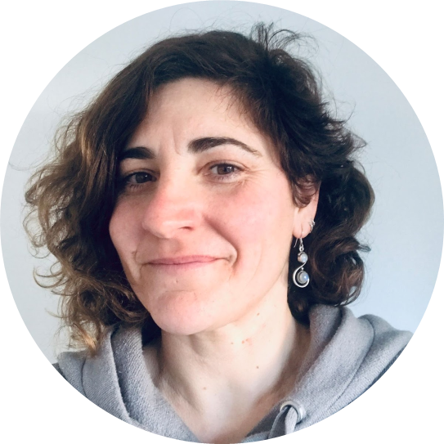
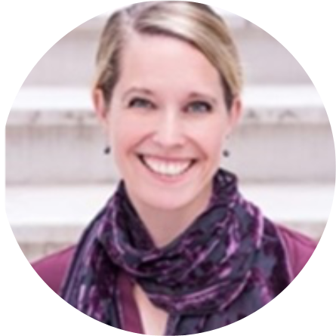
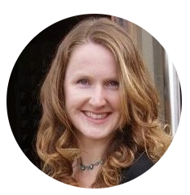
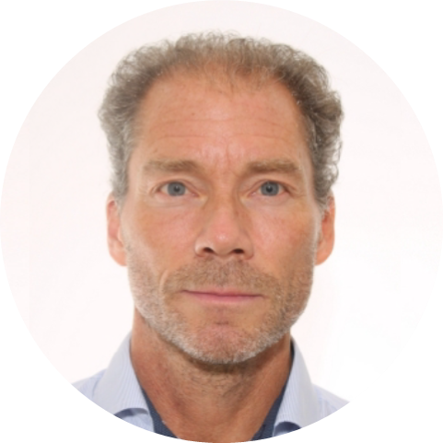
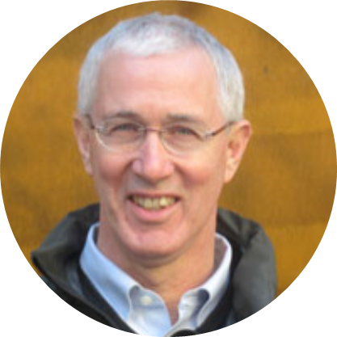
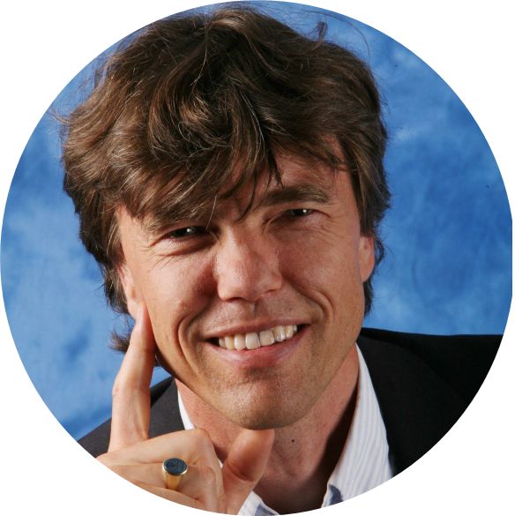
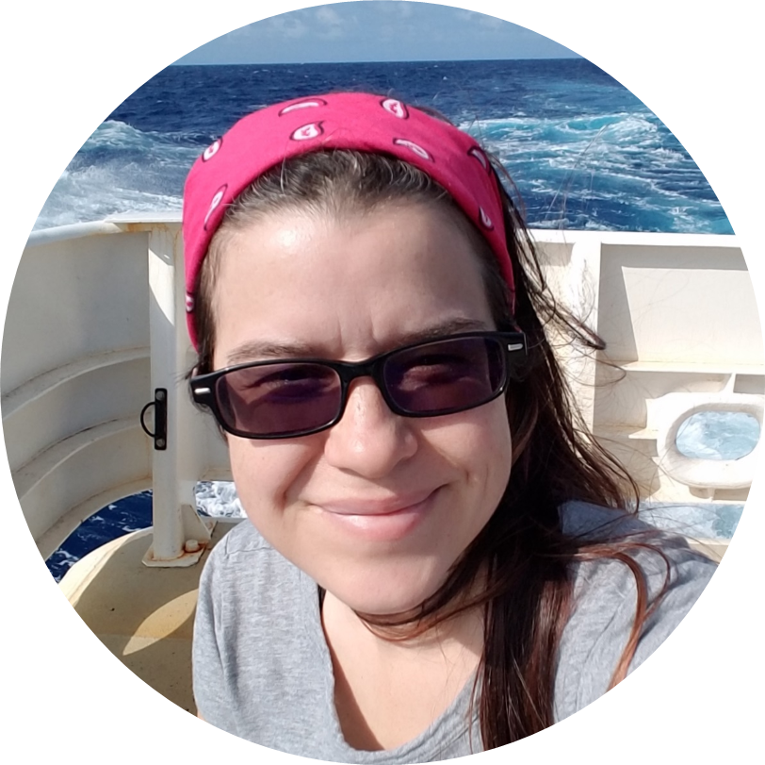
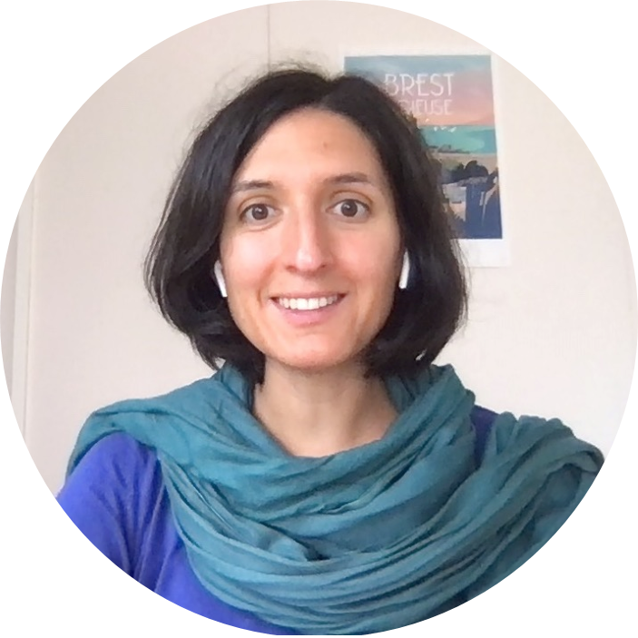
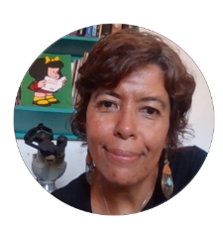
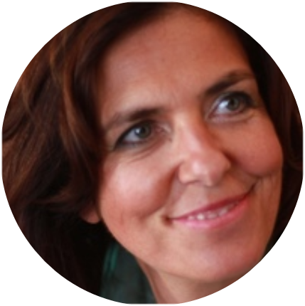
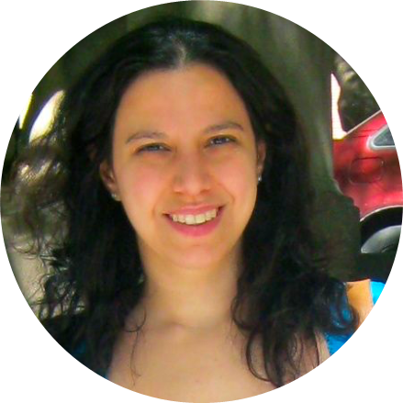
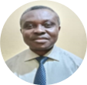
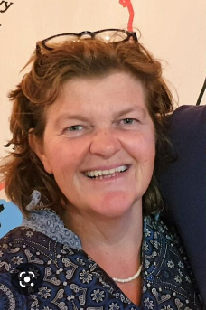
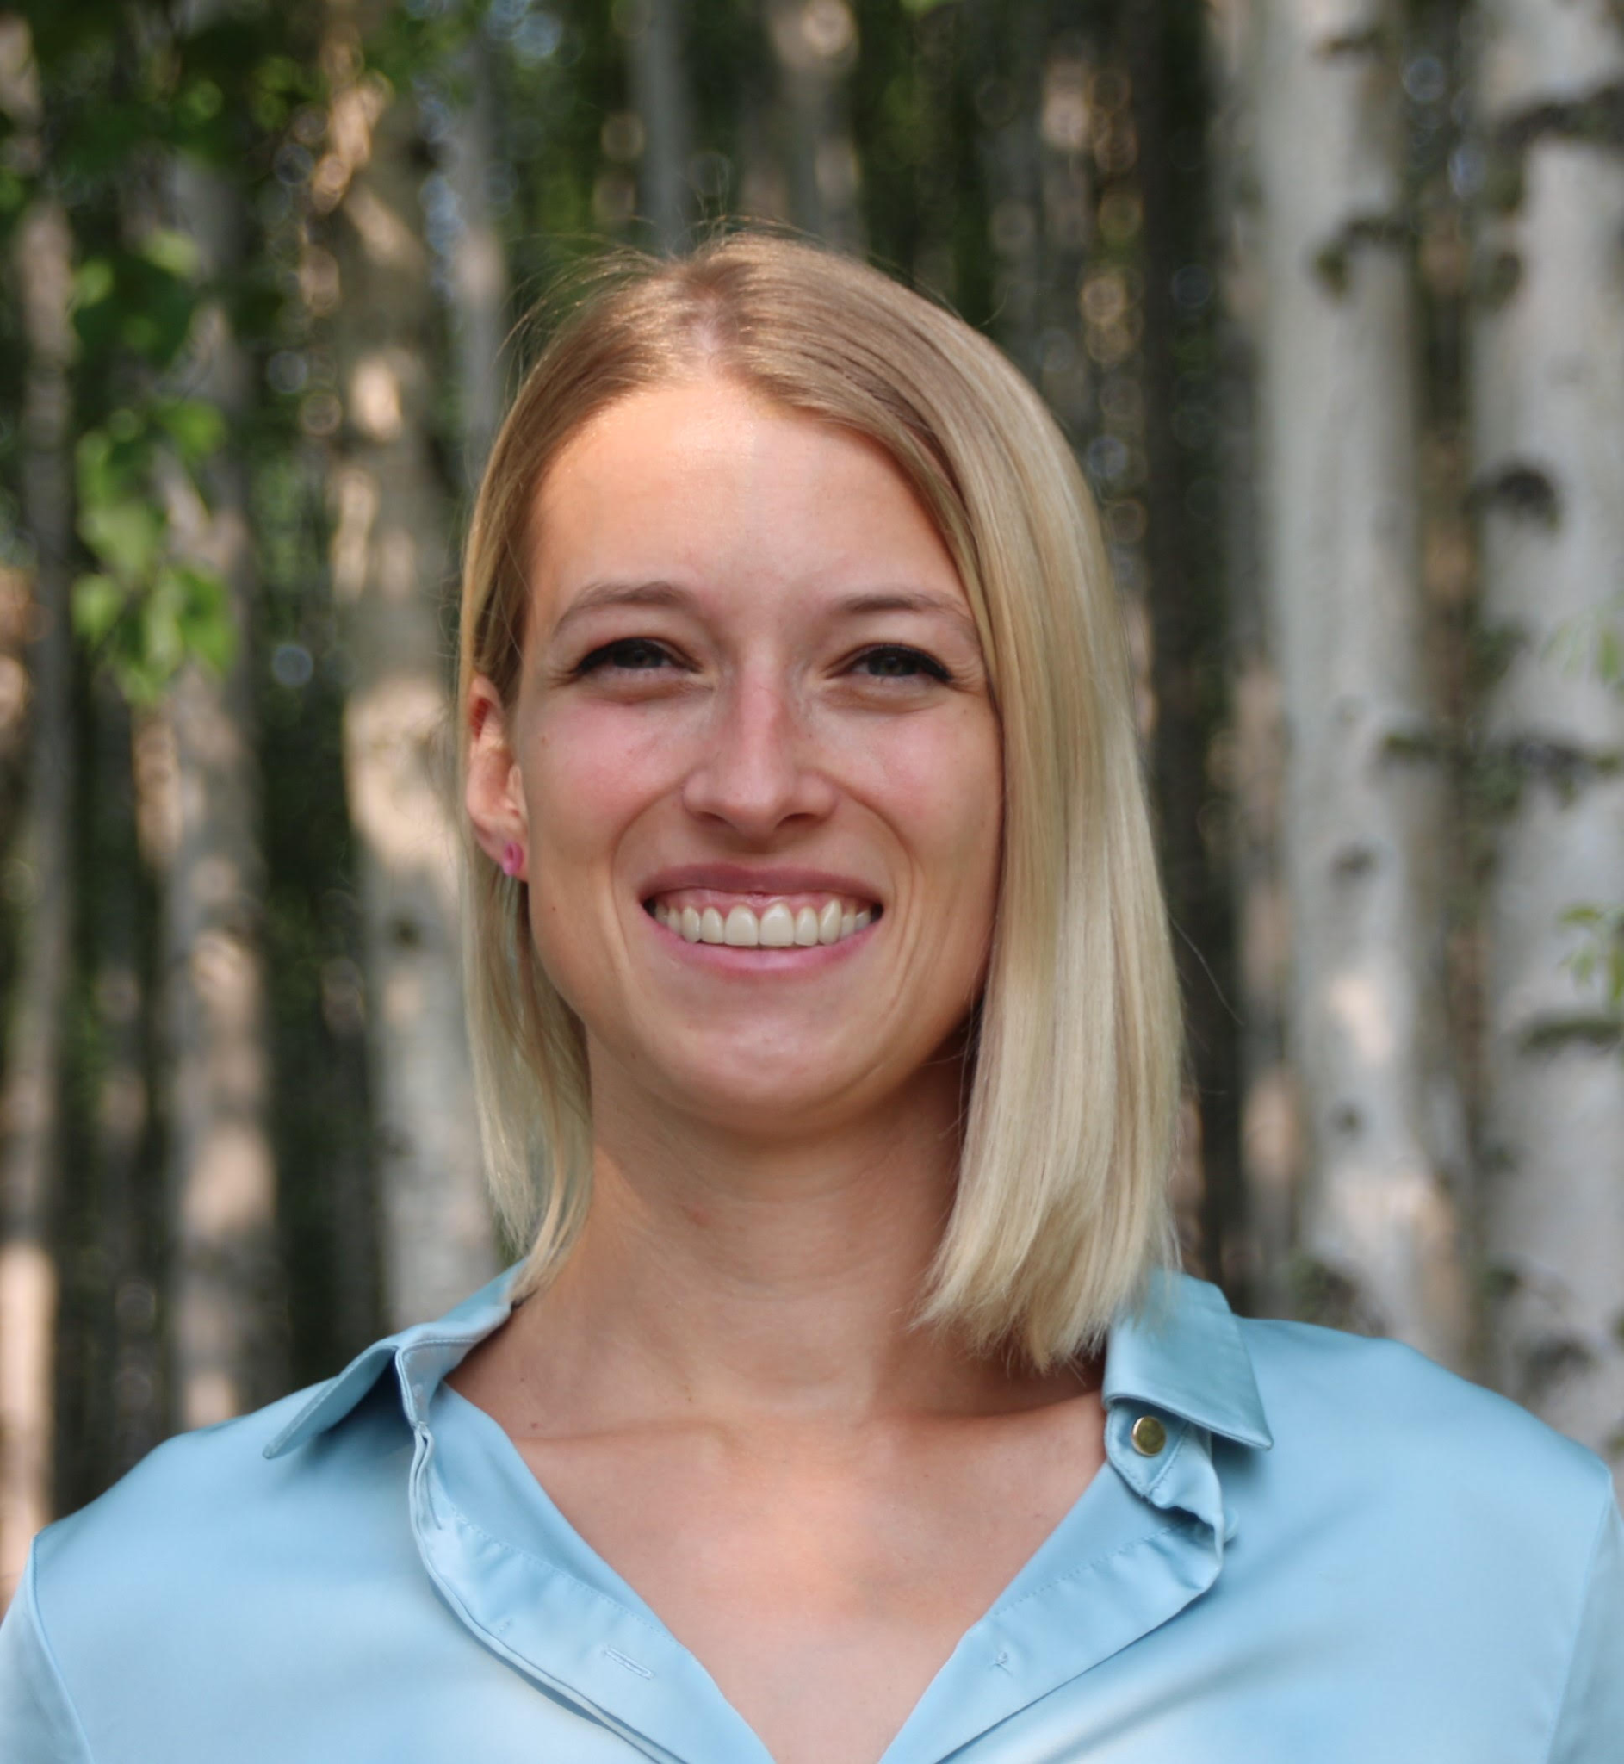
Virginia Polonio Povedano (UK)
Jessica Snowden (USA) (Chair)
Christine Sams (UK)
Brad deYoung (Canada)
Patrick Gorringe (Sweden)
Martin Visbeck (Germany)
Renellys Perez (USA)
Lucie Cocquempot (France)
Gleyci Moiser (Brazil)
Isabel Sousa Pinto (Portugal)
Maria Paz Chidichimo (Argentina)
Isabelle Ansorge (South Africa)
Francis Emile Asuquo (Nigeria)
Ann-Christine Zinkann (USA)

Slide 3
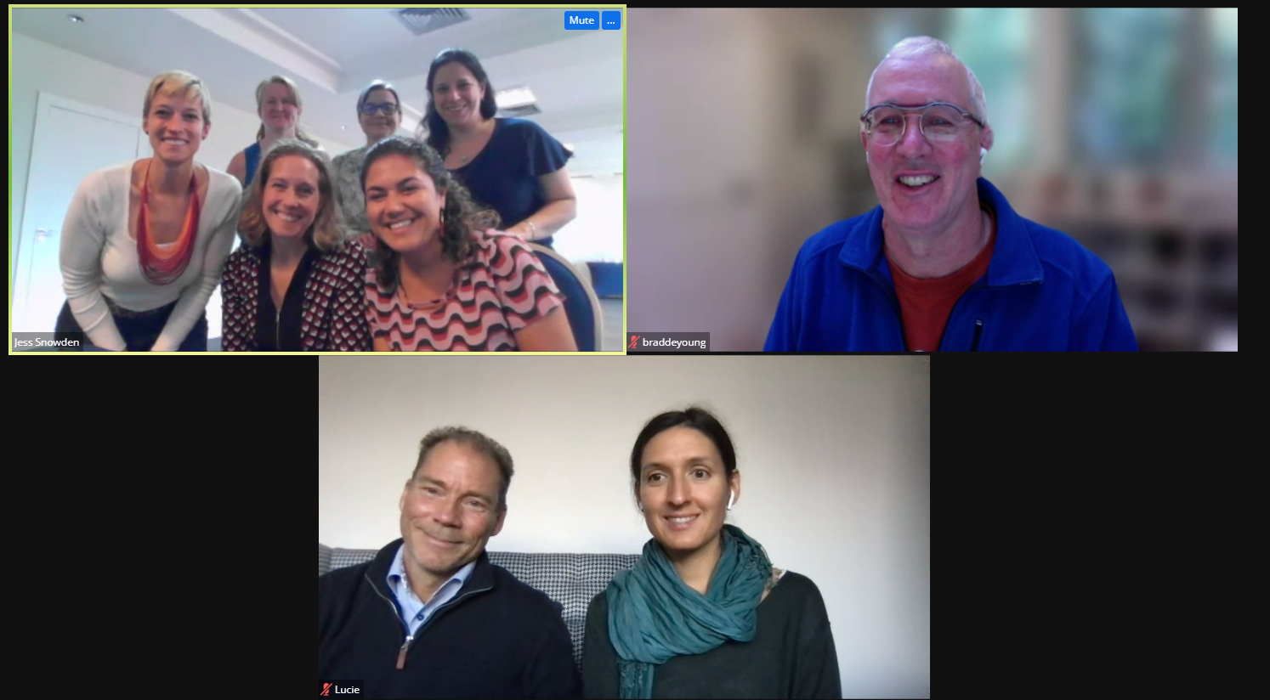
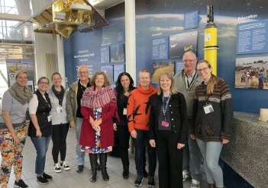
Highlights & Accomplishments
Welcomed a new AtlantOS Chair!
In-Person meetings:
Steering Committee meeting, October 2022
AMOC writing session, March 2023
Alignment with GOOS Ocean Decade programs
Co-Design framework and principles
“AtlantOS Connect” endorsed under Observing Together:
New Activity Areas: OASIS, Sargassum, Low cost sensor platforms, AMOC
Established updated Governance and work plan - soon to be released!
AtlantOS Ocean Hours [many on low sensor technologies]
Seeked funding to support the program and an international workshop

Slide 4
Next steps | Opportunities
Engagement and Visibility
Rebranding of the Program to AtlantOS Connect OR AtlantOS Network
Reworking of the AtlantOS website
Ocean Hour on OASIS process studies in the Atlantic
Release of work plan
Continued alignment with GOOS Co-Design program, learn and implement processes
Continue International engagement
Notes:
think it would be good to emphasize tomorrow at the AtlantOS presentation that we are implementing co-design and that we are doing the low tech workshop and are part of the BC workshop and the proposal that we are tyring to get funded with David

Slide 5
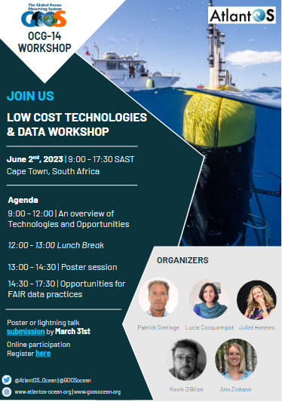
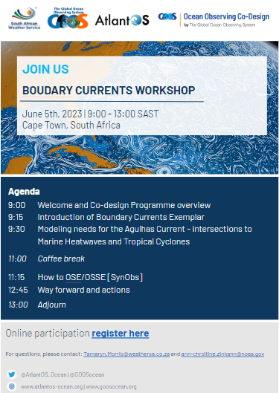
Next steps | Opportunities
Workshops
Low cost technology and data on hands workshop, June 2nd
Boundary current workshop, June 5th - OSE/OSSE development
Workshop preparations for integrated EOV based ocean obs system
Funding
POGO proposal: Outreach material development
Proposal to develop an “Integrated EOV based observing system”

Slide 6
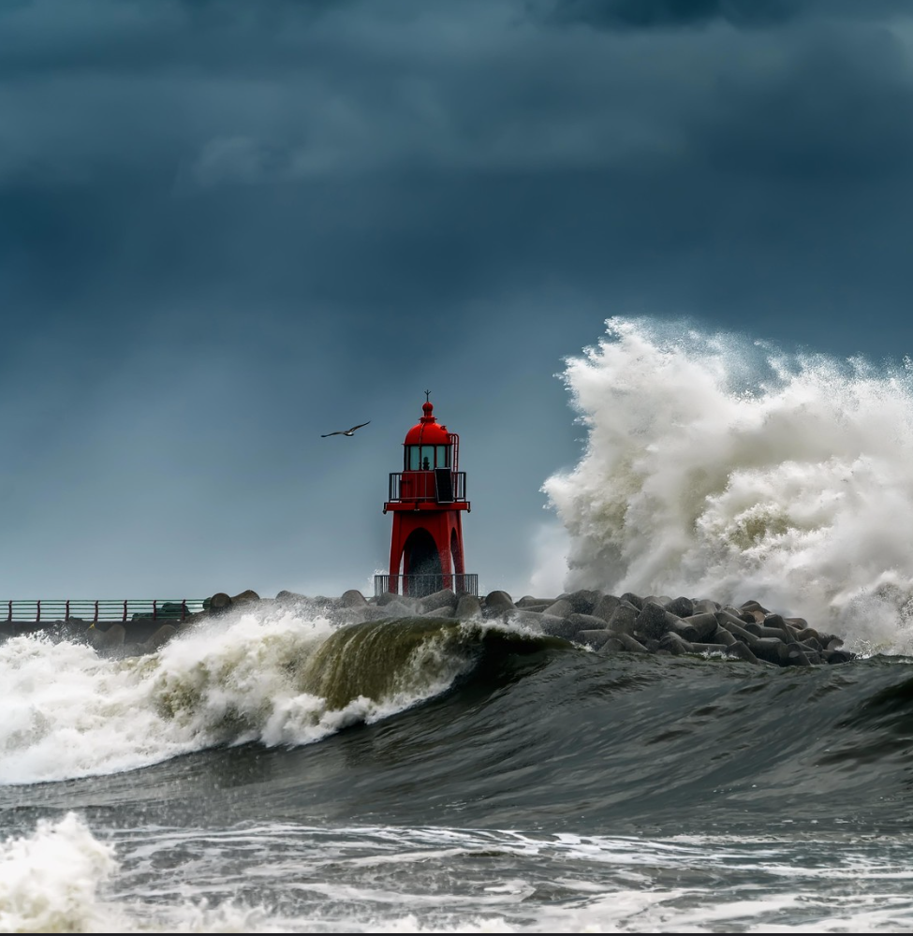
Thank you
goosocean.org
Contact:
Ann-Christine Zinkann - ann-christine.zinkann@noaa.gov

Slide 7
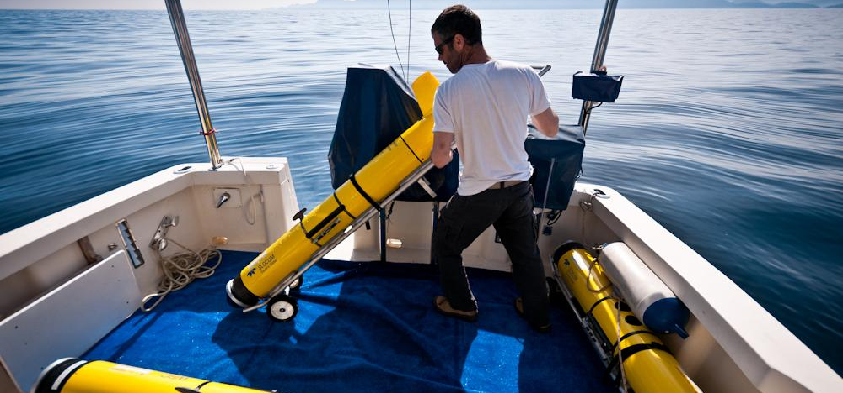
Plans & Opportunities
Activities
Low cost technology workshop
Boundary current workshop
Ocean Hour on OASIS process studies in the Atlantic
Workshop preparations for integrated ocean obs system
Engagement
Rebranding of the Program
International engagement at various meetings
Website updates
Alignment with co-design program and implementation of processes within AtlantOS
Funding
POGO proposal
Proposal to develop an “Integrated EOV based observing system”
In-kind support
In
Notes:
think it would be good to emphasize tomorrow at the AtlantOS presentation that we are implementing co-design and that we are doing the low tech workshop and are part of the BC workshop and the proposal that we are tyring to get funded with David

