Slide 1
Reports from GOOS components:
Biology and Ecosystem Panel
Gabrielle Canonico (U.S. IOOS, Co-Chair)
Karen Evans (CSIRO, Co-Chair)
Ana Lara Lopez (International Project Officer)
GOOS 12th Steering Committee meeting 25 - 27 April 2023

Slide 2
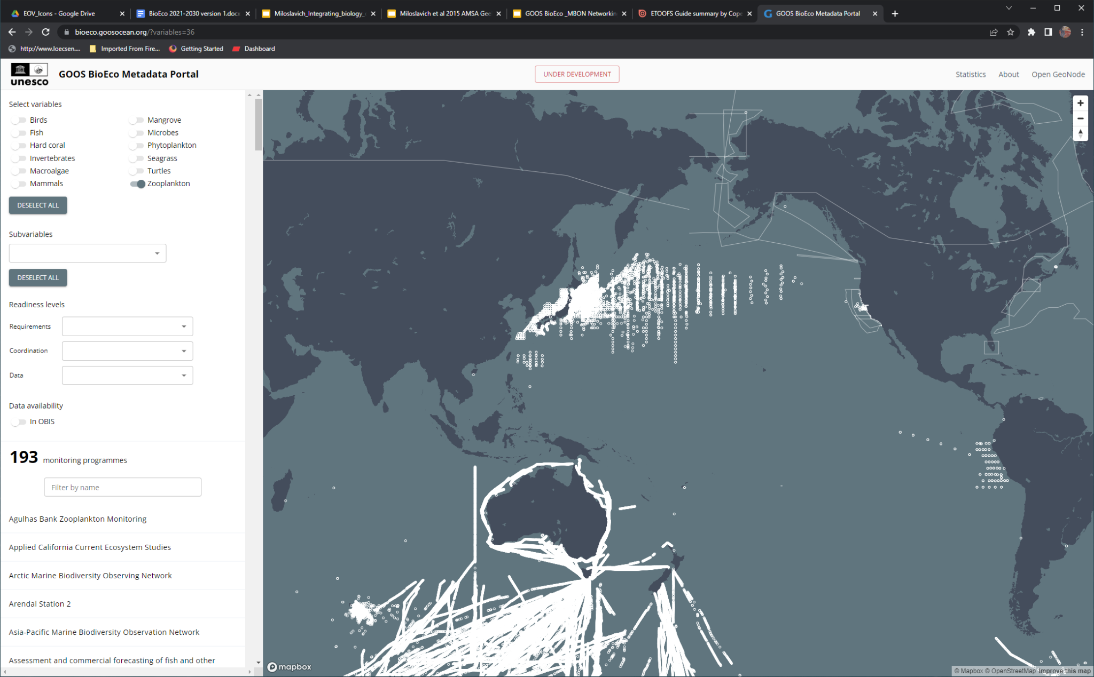
Some achievements and highlights
GOOS BioEco Portal 1.0 launched
Phytoplankton in 2022 GOOS Report Card
GOOS at CBD COP-15
IPO support for EuroSea ‘Strengthen and extend BioEco monitoring networks throughout the European Seas’
Ocean Sound EOV spec sheet and implementation plan
Spanning coastal to deep ocean (invertebrates, corals, sound)
New EOV leads: Coral (ECOP deep sea co-lead), Seabird, Seagrass, Turtle, Zooplankton; identification of co-leads for Microbes, Mangroves underway
Decade, G7 engagement
https://bioeco.goosocean.org/
Notes:
The BioEco Portal, completed in July 2022, is an online platform that provides essential metadata for the extent of BioEco observing networks in the global ocean to identify who is measuring what, where, how, and why for marine life
This is a key starting point for coordinating and improving access to marine life observations, thereby bridging the gaps in data collection.
This directly delivers on Strategic Objective 3, Task 3.5 in the GOOS Implementation Plan: Develop an interactive map of networks and metadata for biological monitoring.
The ocean observing community can use the BioEco Portal to access information on BioEco observations and the sustained programs that collect them.
A key objective is to establish an automated data and metadata flow from ocean observing programs to the portal and other data management systems like OBIS, and to build linkages to OceanOps to improve GOOS accounting of BioEco networks and progress.
This latter point is one that we would welcome discussion about with the Steering Committee. What is the suitability of the Bioeco Portal from an Ocean Ops perspective? Is there a pilot effort we can undertake to engage with Ocean Ops to improve pathways for BioEco networks and variables to be more visible.
Background:
The Portal was developed using information from the global survey undertaken by the PEGASuS/Future Earth project and enhanced through the addition of European networks identified during surveys and workshops conducted by the
EuroSea project. The portal currently contains information from 634 programmes and programme contacts are further updating the information through the GeoNode edit interface of the GOOS BioEco Portal.

Slide 3
Future plans
Hybrid meeting Sept 2023 - aligned with EuroSea, Horizon Europe/MARCO-BOLO
2023 GOOS Report Card
Emerging networks discussion with GRAs
Re-establishing MOU with GEO BON/MBON
G7 Future of Seas and Oceans Initiative ‘Marine Life’ priority
Pursuing additional Horizon Europe funding
Decade engagement
Other strategic partnerships

Slide 4
Discussion topics
Strategy for long-term support for the Panel
Funding for the IPO position is currently not available to provide full-time support for the work requirements of the Panel and has not been for the last three years.
Funding to develop and socialize EOV specification sheets (eg community workshops)
Strategy for long-term support for BioEco data coordination
Support to ensure OceanOps engagement with BioEco community, data flow mapping
BioEco Portal funding ended March 2023; 2.0 launch for July 2023 delayed
What are mechanisms to best engage BioEco with other components as well as OCG, OceanOps on data mapping and reporting?
Important to ensure uptake of BioEco EOVs and visibility, longevity of BioEco EOV collection and programmes
Notes:
BioEco has been without a full-time IPO since late 2019, with the position working with the Panel only 60% from mid-2020 until October 2022, and 50% from Jan until October 2023.
Example from ECCWO - people are broadly using the BioEco Portal – eg “The Integrated Ecosystem Programme: Southern Benguela, a South African multidisciplinary flagship on ocean observations for assessing the marine environment” directly referenced the BioEco Portal in one talk. This programme is actively incorporating the GOOS EOVs into their program and then developing specific EOVs for their own purposes (so innovating on the basis of the GOOS BioEco EOVs). This highlights the utility of the portal and the need to support the portal.
If our EOV communities/ocean observing communities are taking the time to collect observations and then organising their observations, how can we continue to facilitate the sharing and in association longevity of their observations?

Slide 5
Thank you
goosocean.org

