Slide 1


Reports from GOOS components
OOPC
Sabrina Speich, Weidong Yu, Belén Martín Míguez and OOPC experts
GOOS 12th Steering Committee meeting 27 April 2023

Slide 2
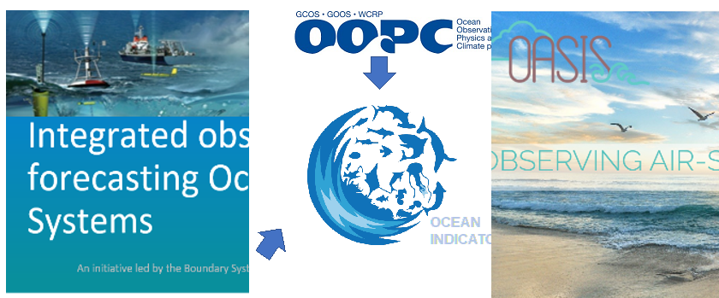
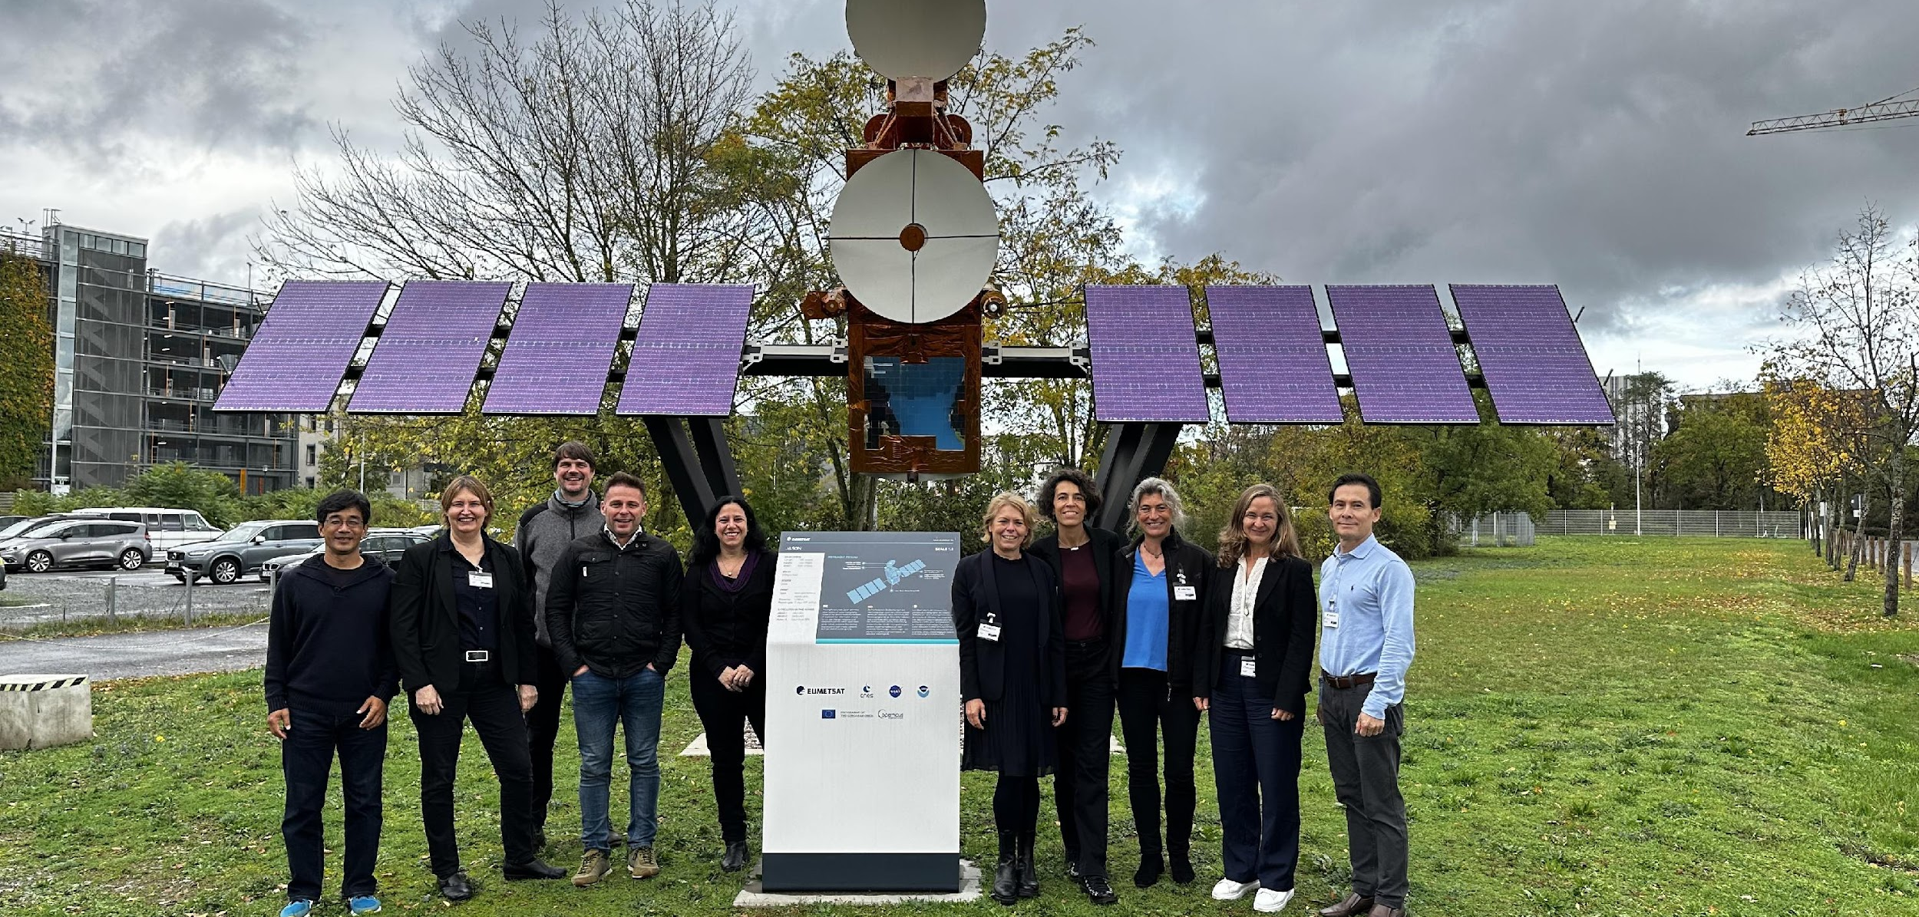


Achievements and Highlights
OOPC activities move forward
OASIS
Indicators
Boundary Systems
ECVs requirements updated
OOPC in person meeting (Darmstadt Oct 2022)
Bottom Pressure and Turbulent Mixing
Re-start activity on Heat and Freshwater….
Call for new OOPC Members
Climate Observation Conference and COP27
Strong participation and visibility of the ocean community

Slide 3
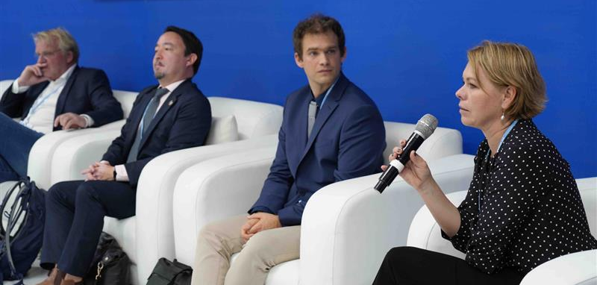
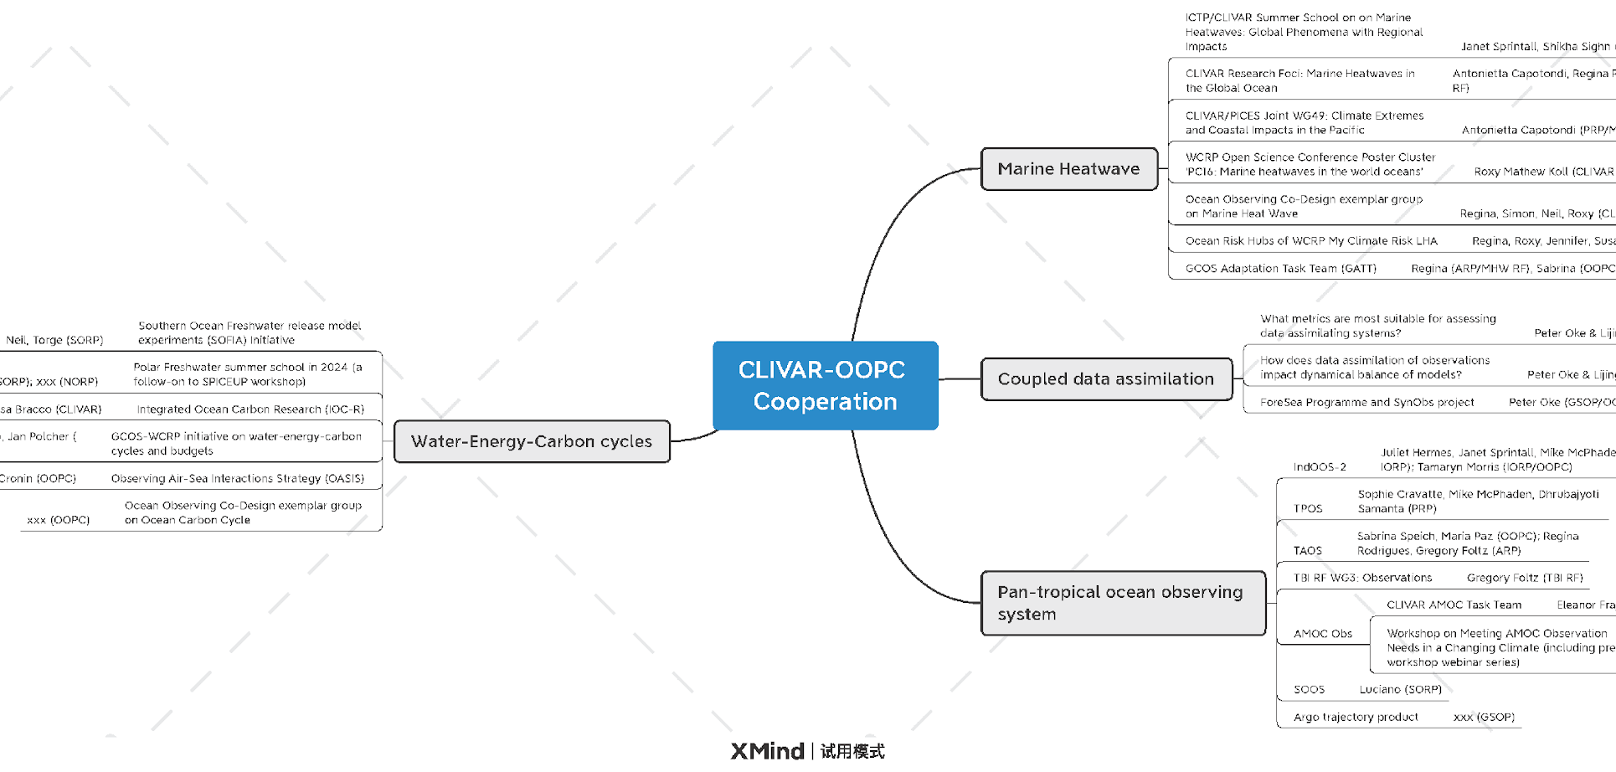
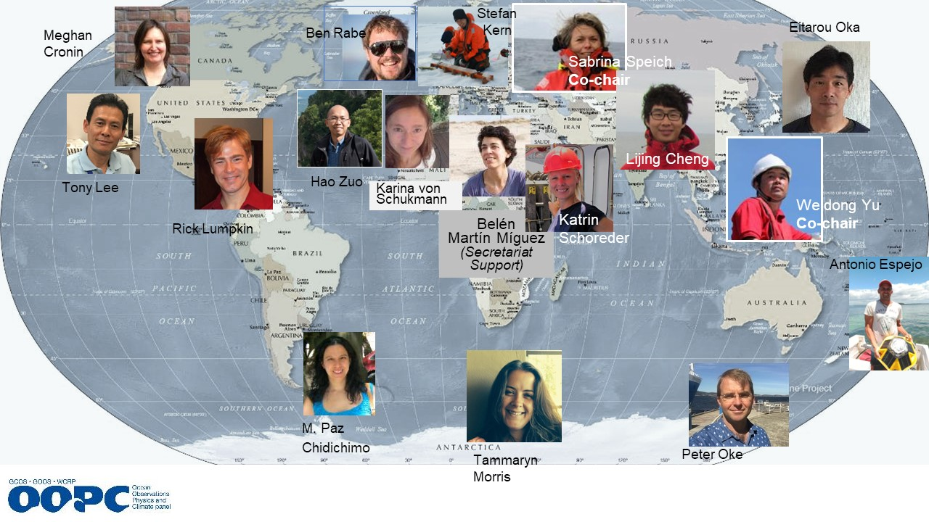

Opportunities and Issues
What’s the role of OOPC nowadays???
Ocean more visible in climate conversations
GCOS offers an opportunity but engagement from the other GOOS panels and OCG is needed to ensure good input into the 2026 Status Report and the 2027 Implementation Plan.
Synergies with Observing Co-Design and CLIVAR
Many potential synergies, but difficult to keep up with so many initiatives and meetings without support for coordination activities
New Members/New activities
More modelers
More connection with ocean networks
More connection with island states

Slide 4


Future Plans
Developing OOPC Workplan 2024-2028
At the next OOPC meeting in June 2023 (Bonn, Germany)
Consolidating interactions around concrete outputs
GOOS and GCOS panels
Observing Co-Design
CLIVAR
Modeling community
Important meetings
OCG
GCOS Joint Panel Meeting
CLIVAR Summer School
EuroSEA
WCRP Open Conference

Slide 5
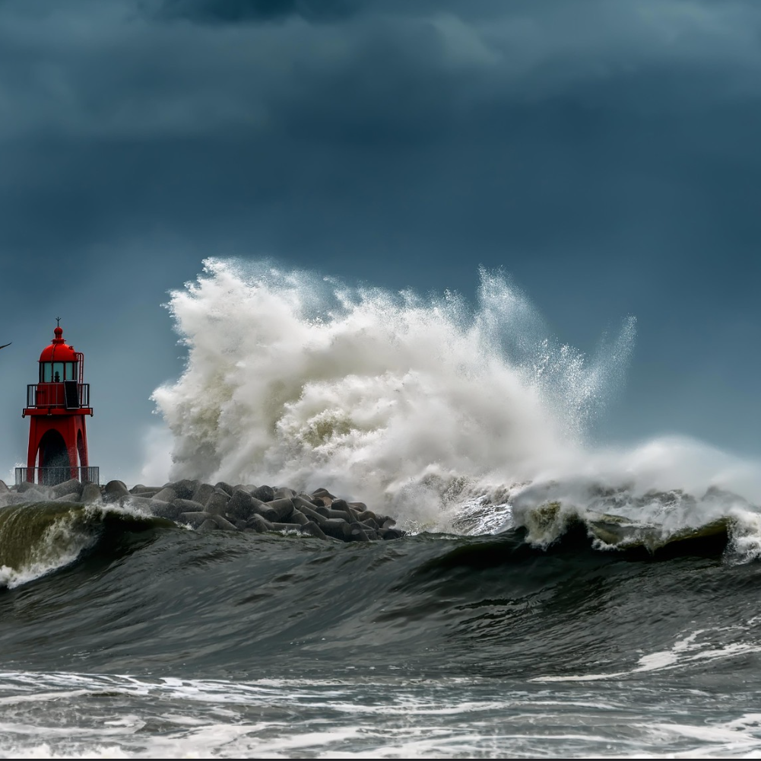
Thank you
goosocean.org

