Slide 1

Integrated Marine Debris Observing System (IMDOS)
GOOS Project Request
GOOS 12th Steering Committee meeting, 25 - 26 April 2023

Slide 2




Benefits of IMDOS as a GOOS Project
Joint project of:
      Regular and direct interfacing with, and potential integration into, relevant GOOS Structures including: Panels of Experts, OCG, OceanOPS, GRAs, OBPS and other GOOS Projects;
      Receiving guidance and support in the implementation of IMDOS as a truly integrated observing system (--> IMDOS as a collective impact organization)
      Identifying and attracting additional stakeholders and funders by promoting IMDOS mission and enhancing IMDOS visibility through the communication channels of GOOS
      Continued development of IMDOS enhances the capacity of GOOS to fulfil its Strategic Objective #10
      IMDOS as a transformative project under one of the UN Decade Programmes of GOOS?

Slide 3


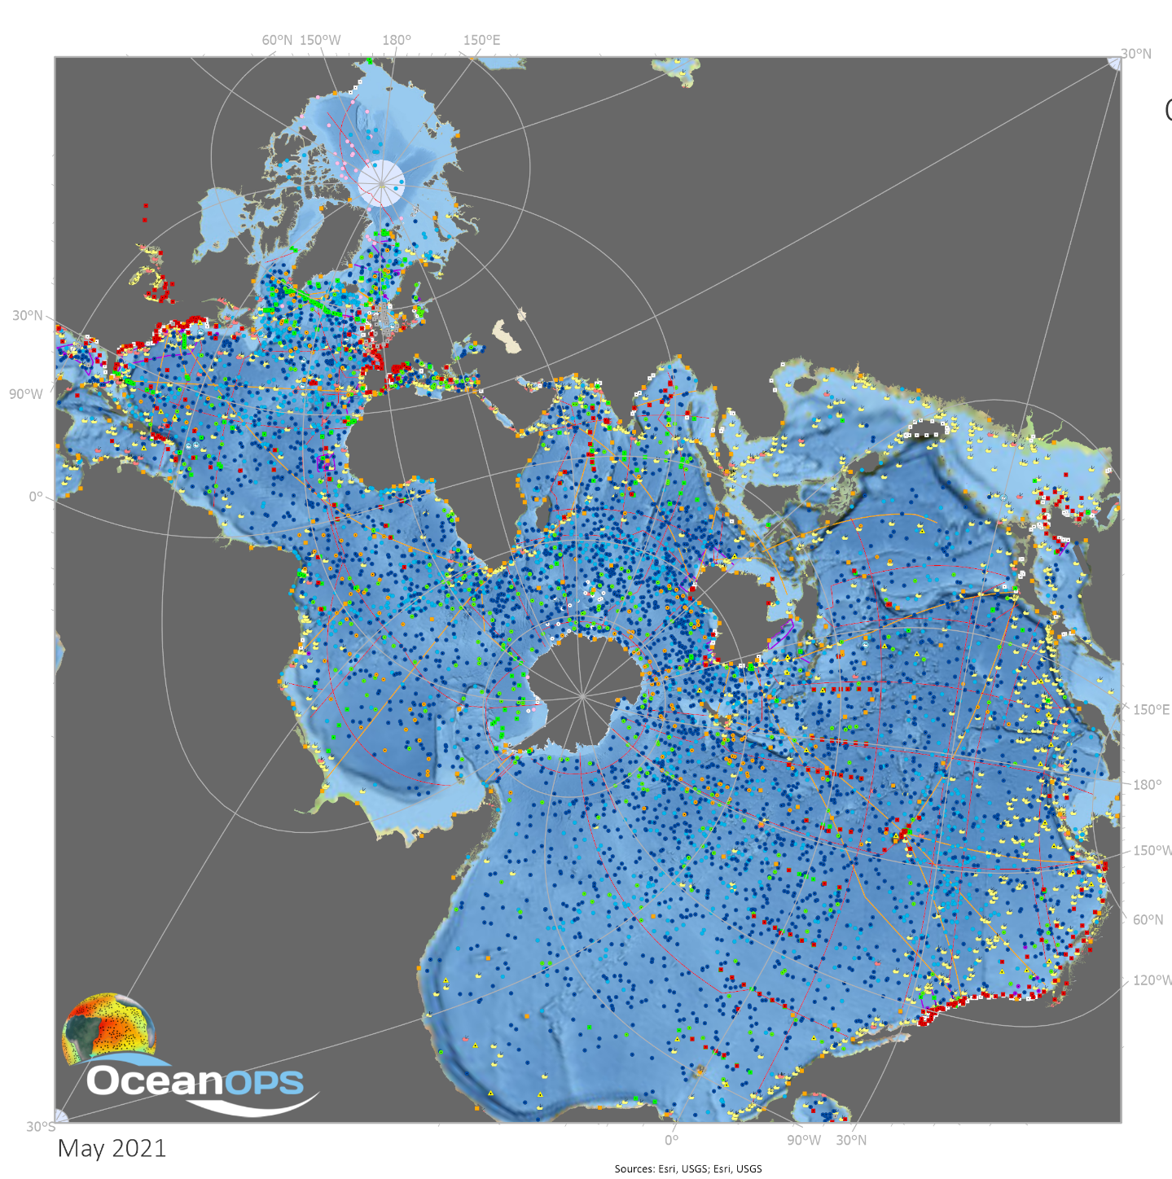

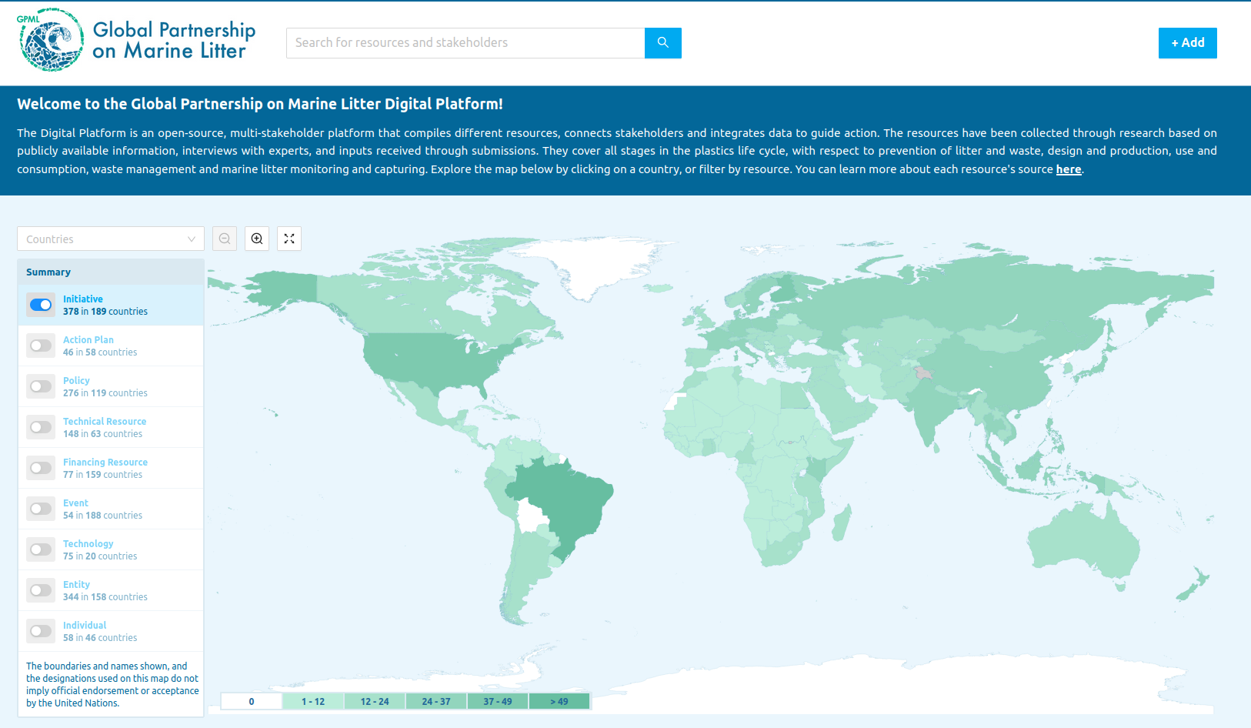

IMDOS supports GOOS Principles*:
“meets defined objectives on the basis of user needs”
* “GOOS Projects: principles for affiliation, Document version 4 (25 May 2015).”
e.g.
Clean Ocean Network Brazil
(Global South)
https://digital.gpmarinelitter.org
Backbone observing structure providing guidance and coordination for a global sustained observing system to strengthen the scientific knowledge on marine debris/litter pollution.
‹#›

Slide 4
“Defined objectives” = IMDOS ToRs (1)
promote the development of a global network of marine debris observations according to Regional Seas Programme Action Plans and integrated within GOOS in cooperation with existing ocean observing infrastructures, networks and communities of practice;
define strategies and priorities for coordinated and harmonised marine debris observations based on most relevant monitoring methods, standards and practices;
develop standard sampling protocols and best practices in marine litter data collection and support training activities for their implementation;
promote integration of data management activities to provide free and open access to marine debris data and information products for stakeholders (e.g., via the GPML Digital Platform);

Slide 5
“Defined objectives” = IMDOS ToRs (2)
support the development of remote sensing methods to detect marine debris by enhancing availability of required ground-truthing data;
strengthen the interface between marine debris monitoring and modelling communities to support the development of a Digital Twin of the Ocean for Marine Litter Pollution;
evaluate the readiness level and promote technological innovation to advance global observing approaches;
create communication services for the marine debris monitoring community

Slide 6
“Is independently managed”
Initial coordination support by:
Audrey Hasson (GEO BP/MOi, France)
Artur Palacz (IOCCP/IOPAN, Poland)
Mine Tekman (GEO BP Consultant, Turkiye)
With guidance from an international
interim Steering Committee:
Francois Galgani (Ifremer, France)
Georg Hanke (JRC, Italy)
Nikolai Maximenko (Uni Hawaii, USA)
Stefano Aliani (CNR ISMAR, Italy)
Kara Lavender Law (SEA, USA)
Paolo Corradi (ESA, Netherlands)
Alexander Turra (Uni São Paolo, Brazil)
Toste Tanhua (GEOMAR, Germany)
Permanent Ex Officio Position for a GOOS rep
‹#›
Notes:
IMDOS is being developed as a joint project by the Global Ocean Observing System (GOOS) and the Group on Earth Observations (GEO) Blue Planet Initiative, in collaboration with the United Nations Environment Programme (UNEP) Global Partnership on Marine Litter (GPML), the Scientific Committee on Oceanic Research (SCOR) Working Group #153, GESAMP Working Group #40, the International Ocean Colour Coordinating Group Task Force on Remote Sensing of Marine Litter and Debris, Ministry of Environment Japan (MOEJ), among others.

Slide 7



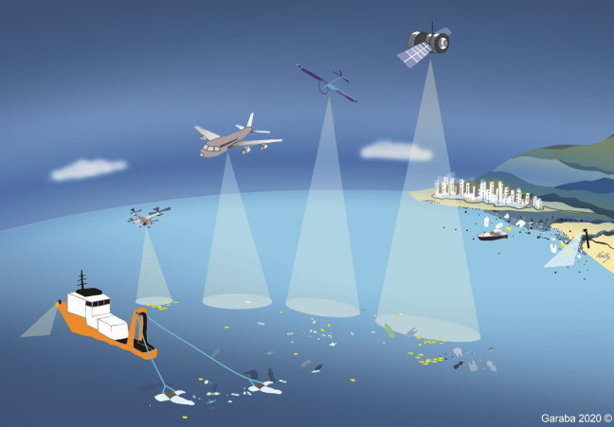






“Identifies and manages interfaces with existing structures, projects, networks, systems and organizations”
WG #153
FLOTSAM
Brings together experts and leading authorities focused on marine debris policy and research requirements, monitoring capacity, data management, technology development, and assessments.
‹#›
Notes:
IMDOS is being developed as a joint project by the Global Ocean Observing System (GOOS) and the Group on Earth Observations (GEO) Blue Planet Initiative, in collaboration with the United Nations Environment Programme (UNEP) Global Partnership on Marine Litter (GPML), the Scientific Committee on Oceanic Research (SCOR) Working Group #153, GESAMP Working Group #40, the International Ocean Colour Coordinating Group Task Force on Remote Sensing of Marine Litter and Debris, Ministry of Environment Japan (MOEJ), among others.

Slide 8




“Uses the Framework for Ocean Observing and associated tools…”
Name of EOV |  | Marine Plastics Debris
EOV sub-variables |  | beach litter: abundance per type and size category floating* microplastics: abundance, weight floating macroplastics: abundance seafloor litter: abundance per type and size class (macro, micro) Additional sub-variables under consideration: Macroplastics in biota (ingestion by seabirds, fish, sea turtles) Microplastics in biota (ingestion by seabirds, bivalves)
 |  | *Floating refers to both surface and water column
Essential Ocean Variable Specification Sheet
Marine Plastics Debris
 | EOV Specification Sheet curated by:
Global Ocean Observing System (2022). Essential Ocean Variable Specification Sheet: Marine Plastics Debris. GOOS Reference No XX; DOI: [to be assigned]
Based strongly on the GESAMP WG40
recommendations for global scale monitoring
Version: 1.0 - April 2022
Notes:
In the current version of the new Marine Plastics Debris EOV Specification Sheet, you will find a list of proposed parameters which have the highest impact and feasibility to be observed on a global scale, based mainly on GESAMP WG40 expert recommendations and other community consultations.
The current draft Marine PLastics Debis EOV Spec Sheet was published as part of a EuroSea report, and it contains plenty of information about requirements and current obserivng and data management capacity. Later this year there will be further broad community consultations on this document prior to presenting the EOV for formal approval by the GOOS Steering Committee.
[next slide please]

Slide 9
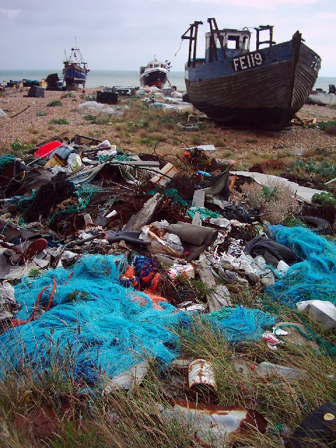
Thank you
goosocean.org

