Slide 1


Realizing the Benefits of Ocean Knowledge through Ocean Observing Co-Design
Presenter: Ann-Christine Zinkann | NOAA / UCAR, ECOP for Ocean Observing Co-Design Program
David Legler | Director, Global Ocean Monitoring & Observing, National Oceanic & Atmospheric Administration
Sabrina Speich | Professor, Physical Oceanography & Climate Sciences, Institut Pierre-Simon Laplace
Emma Heslop | Acting Director, Global Ocean Observing System,IOC-UNESCO
Andrea McCurdy | COL / NASA
Mairéad O’Donovan | Former GOOS, IOC-UNESCO
Notes:
Acknowledgement of co-chairs etc.
1 of three endorsed GOOS UN Decade programs

Slide 2
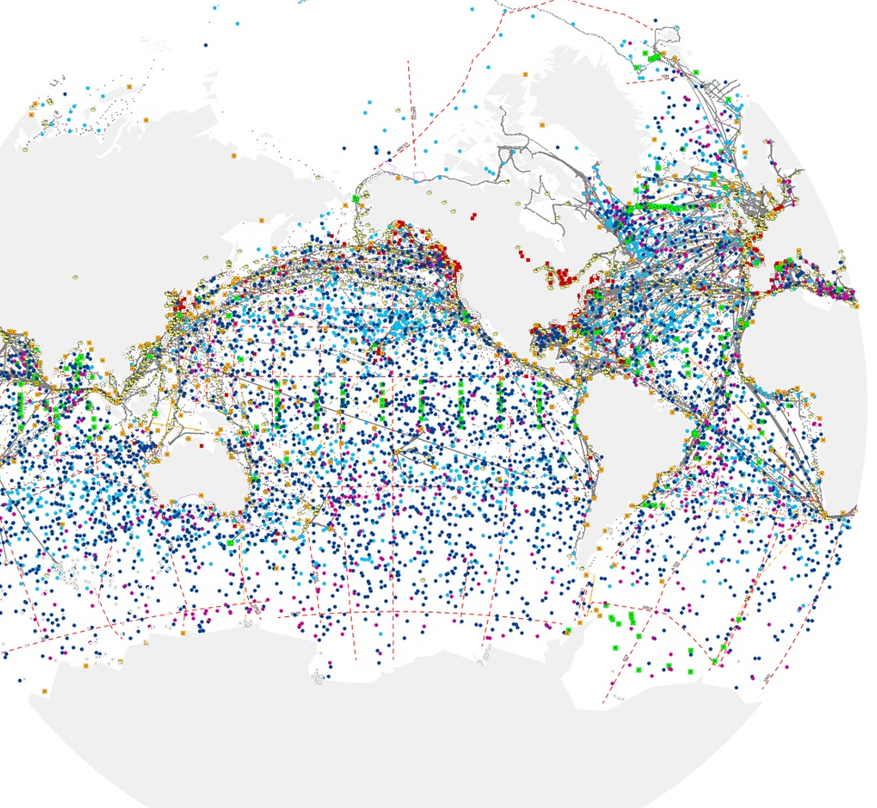

The Programme will evolve the ocean observing system so that it is co-designed with end-users and responds to their needs
Notes:
David-------------------------------------
Our vision is to evolve and transform the Global Ocean Observing System to better address the Decade Challenges through observing Co-Design processes (Here co-design is understood as a continuous process, a collaborative and iterative effort among all stakeholders). By actively engaging user perspectives and knowledge, we will transform and augment the current ocean observing system to be more RESPONSIVE TO USER NEEDS, AND provide COMMUNITIES with INFORMATION they can act on. Such a system will more naturally attract resources, better address needs, allow us to increase capacity, and become more unified through regular best practices and processes to set priorities,,,,,, and ultimately better observe the global oceans…enabling a wide range of activities throughout the UN Decade.
Next Slide
===================
Make clear that user-focused obs is not how we have been operating but science driven
An ocean observing co-design process provides a fit-for-purpose and responsive observing system that interconnects experts and stakeholders to ensure sharing of knowledge across disciplines, integration along the value chain, co-construction of solutions and innovative concepts, and the targeted production of products and services useful to stakeholders. Here co-design is understood as a continuous process, a collaborative and iterative effort among all stakeholders.

Slide 3





OUTCOMES
Link along value chain and users
Design for observing and forecasting
Economic value assessment
Blueprint for services if they don’t exist
Ongoing tracking of implementation
Notes:
We need more information on the ocean to meet challenges such as climate change mitigation and adaptation, improving ocean, coastal and weather prediction, food security, and human health and safety.
This demands a step change in how we design our global ocean observing system: firstly bridging and integrating across the value chain of observing, modeling, and ---most importantly ---- user engagement.
From this, we will develop better capabiliities to establish clear priorities for how we invest in ocean observing for the future and better integrate and co-design/co-develop observations, models, and other tools to produce useful and actionable ocean knowledge
These co-design capabilities will then allow for robust exploration of observing possibilities, including innovative observing technologies, new satellites, as well as new modeling and data delivery systems such as digital oceans/digitial twins
Finally, we must strengthen our underlying capacity worldwide to routinely co-deisng and co-develop useful and impactful ocean information
Next slide
The change we are envisioning is transformative in how Our vision to address this information gap is to fundamentally change the observing system design process - to CHANGE BUSINESS AS USUAL, be RESPONSIVE TO USER NEEDS AND connect COMMUNITIES with INFORMATION they can act on
Urgency in expanding, consolidating & sustaining the ocean observing system to respond to the climate challenges
There is a choice to thrive not just survive: Necessity by nations to take action now!
Society’s needs are expanding and changing. Existing system is not enough to address needs e.g. related to COP 15, COP 27, climate change, extreme weather, low-lying states, species shifts
Answer society’s questions, not just science questions
Focus on end-user needs - society, policy, UN & national decision makers
GLOBAL system not just pockets of national funding / coverage
Enable participation & value for disadvantaged / vulnerable communities
Unbiased access to data and actionable information
Advance to a level of operation similar to weather forecasting (WMO)

Slide 4
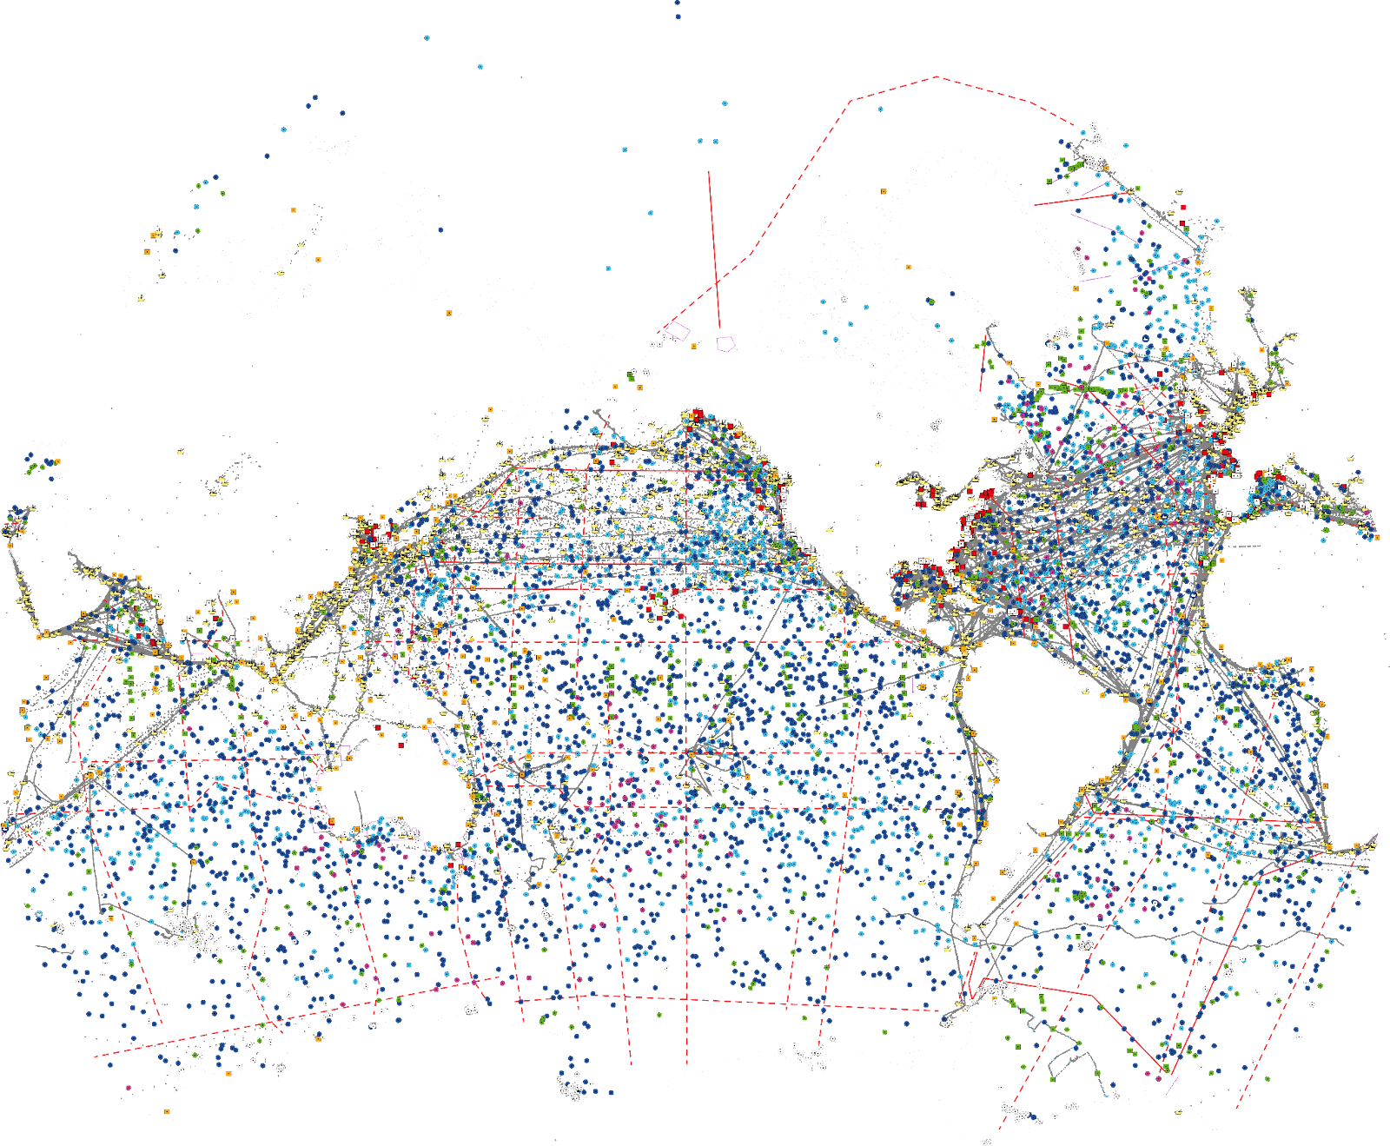






HOW DO WE BEGIN?
Ocean Carbon Cycle
Tropical Cyclones
Marine LIfe
Marine Heatwaves
Boundary Current
Storm Surge
Notes:
David
<<<<<<<<<<<<<SHOW EXCITEMENT>>>>>>>>>>>>>>
We’ve articulated the transformative changes we need. This is an enormous task - how do we begin?
We are starting by gathering global communities around key high impact societal need areas .
We’ve identified 6 to start with through which we will develop the co-design practices and processes taht we envision will lead to long term systemic change to our observing systems, and build capacity. We call these Exemplar projects.
The 6 chosen Exemplars are noted here:
Ocean Carbon Cycle, Tropical Cyclones, Marine Life, Marine Heat Waves, Boundary Currents, and Storm Surge
The Ocean Carbon Cycle will transform our ocean carbon observing strategy to address key policy and carbon market questions and needs.
IN 2022, Hurricane Ian caused $165 billion in damages and killed at least 145 people. The Cyclone Exemplar will develop and demonstrate the impact of ocean information for hurricane predictions and enabling communities to better respond to cyclones.
The Marine Life exemplar will use co-design in regional pilot studies to improve predictive capabilities and knowledge for ocean resource management and stewardship
Marine Heat Waves are increasingly recognized extremes in the ocean, impacting marine ecosystems, ocean health, and other components of the earth system. This Exemplar will use co-design in regional pilot studies to better monitor, detect, and inform end-users about these impactful events.
The Boundary Currents Exemplar will better assess variability in boundary current regions that are so vital to short-term and seasonal weather forecasts, regional fisheries, food security and blue economy activities.
Lastly, the Storm Surge Exemplar will develop improved observing and forecasting capabilities to better serve vulnerable communities.
These Exemplar projects have been chosen from among many because:
1. We know that these are areas where improved ocean observations will have a massive impact
2. The policy / end-users can be defined and we believe there is advanced readiness and willingness on their parts to actively participate in a co-design project targeting high impact needs
3. Finally, each of the chosen exemplars will have an impact in and of itself, but crucially there is a broader longer-term legacy because these projects are well positioned to provide a blueprint of co-design processes that can expand into the global ocean observing system.
I would love to have the time to talk about all 6 of the Exemplars; however, there isn’t sufficient time. I will describe in more detail for just 2 of them.
These are truly exciting opportunities to develop our co-design capabilities across a number of highly desirable and challenging application areas.
INCLUDE OR NOT???? Each exemplar will
Address key gaps in an integrated value chain across observing – modelling - services – users
Engage key user stakeholders to understand their needs
Integrate along the chain from observers to users to assure deliver
Assess value of investment on ocean observation
Support the development of co-design best practice
These are our best opportunities to will fundamentally move away from business-as-usual and evolve and grow a user-driven co-designed observing system.
NEXT SLIDE
==================
====================================
Exemplar projects do 3 things: help lift the system, embed new co-design practices, the programme then develop process and infrastructure for wide spread co-design

Slide 5






CO-DESIGN to bring about a STEP CHANGE
Year 1-2
Year 2-3
Year 3-4
ENGAGEMENT & DESIGN
Engaging with user communities to inform pilot activity
PILOT ACTIVITY
Fill observing system gaps and evaluate solutions
Refine delivery of ocean information
IMPLEMENTATION
Maximize Return On Investment
Embed across global observing systems
Tools for tracking and reporting of success
Continuous engagement and feedback from user communities
Develop standards and processes
Notes:
In general each exemplar will follow a similar development path. From the basics of initiating communications and a co-design process (engaging users, describing the value chain, etc) to full-scale globalizaiton of their intended activities.
Different exemplar areas are at different readiness levels - some will mature to implementation within a year, others will need longer to determine the design and the value - often down to the maturity of the sector and the service - e.g. tropical cyclone forecasts are well connected to users - we are increasing the accuracy, but for carbon, and marine resource management the services do not yet exist.
They all share in common the common purpose of developing tools/diagnostics, and best practices and demonstrating their effectiveness through pilot projects that, if successful, could then be scaled to a more permanent and global scale system.
NEXT SLIDE
======================================
- requiring alignment and investment - to deliver design for obs & recommendations for models and services (connected chain)
Work out scaling too…..
GOOS synthesises recommendations
Linked to observing projects - programme/GOOS
At same time programme is developing over the next 1-4 years
tracking and reporting capability
Developing infrastructure - DCCs, DCOs, GOOS, WMO connecting to other processes (RRR), and UN Policy, GCOS
Develop knowledge for best practice - deliver this for more exemplars - global and regional scale
Work on cultural change…
Where will we be at 5 years?
X exemplars?
System lifted in key areas
Ability to now test the system for needs - WNO others,
New exemplars - perhaps even regional/ local to lift the system
Expanded testing facility with ability to access for GOOS Projects,
Links between prediction and observing firmly established, assessment of value routinely undertaken
AT 5 years - ASSESS - what need to do to move from exemplars to systemic - size of any core facility/management… is it even needed

Slide 6
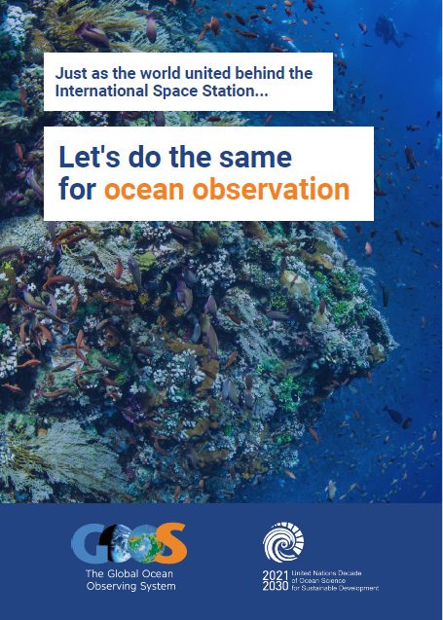
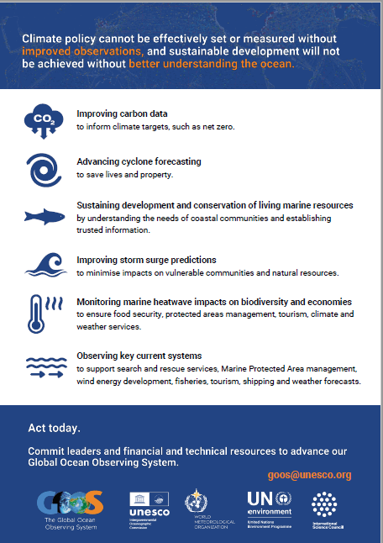
CURRENT STATUS & NEXT STEPS
Co-Design Workshop, June 2022
Lessons learnt from co-design across GOOS and other sectors and shaping the outline of co-design 'exemplar' projects
Co-Design Workshop Report
To be released end of April
Supporters Forums
Interactive session with co-design partners, observing networks, prediction groups, GOOS, UN Decade, national funders
Co-Design Legacy Workshop
Funding acquired for a co-design workshop during the EuroSea High level conference in September
Focus to advance exemplar projects

Slide 7
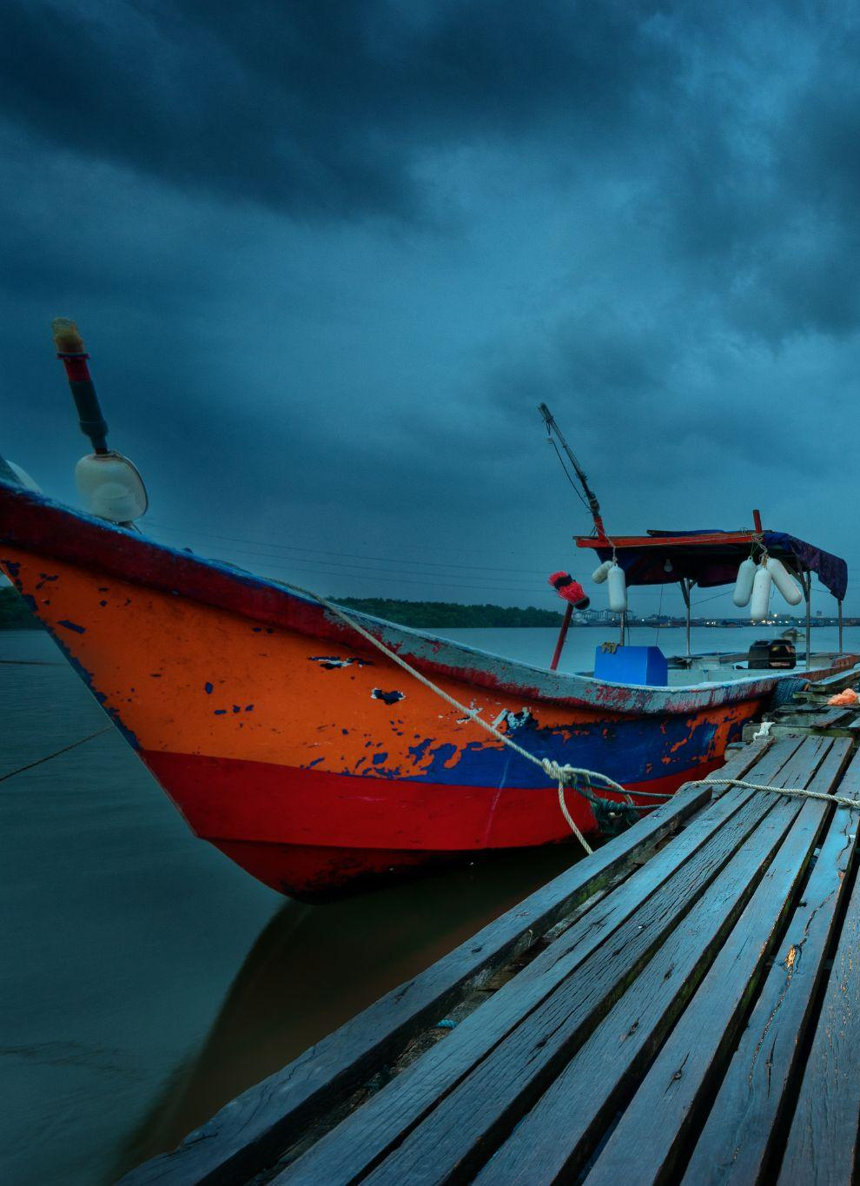
OPPORTUNITIES | QUESTIONS
Forward movement in the exemplar project areas and increased collaboration with the SynObs community that is gaining a lot of momentum.
Co-Design Legacy workshop planned for Fall 2023.
How does the programme relate and engage with the other components of GOOS to evolve the ocean observing infrastructure together?
How do we build processes [Observation, Requirement setting, assessment tools, stakeholder engagement best practices] and ensure the implementation of these in the GOOS components?
Notes:
BC takes off and created a plan and new requirements and observing activities. How will those be captured in the existing components in GOOS?
ECMWF
Made progress in the exemplar areas - Synobs a lot of momentum, encourage others to get engaged

Slide 8

THANK YOU
Contact:
Ann-Christine Zinkann - ann-christine.zinkann@noaa.gov
Notes:
David
We’ve done a lot of work in planning our actions going forward. Let us know if there is a particular exemplar project that interests you. We would love to participate in focussed one-one calls about Exemplar projects that interest you.
We have exemplar leads
Thank you for participating in today’s call. I look forward to the discussion. S
Turn back it over to Emma to moderate the discussion.

Slide 9
ADDITIONAL
EXEMPLAR INFORMATION
Notes:
<<<<<<<<<<<<<SHOW EXCITEMENT>>>>>>>>>>>>>>
Delighted today to give a preview of the progress in developing the co-design programme and the first key projects that will launch the process and the change.
These exemplars are at the intersection of critical needs, engaged user communities, opportunities to innovate our observing approaches, and engaging new communities and voices.
Because of their importance, because of the opportunities, there is a lot of energy and enthusiasm behind each of the exemplars which you’ll hear about next.
It’s my pleasure to introduce Tammy Morris, Senior Scientist/Marine Coordinator from the S African Weather Service who will begin our roundtable of Exemplar summaries
NEXT SLIDE
====================================
Exemplar projects do 3 things: help lift the system, embed new co-design practices, the programme then develop process and infrastructure for wide spread co-design
Each exemplar will
Address key gaps in an integrated value chain across observing – modelling - services – users
Engage key user stakeholders to understand their needs
Integrate along the chain from observers to users to assure deliver
Assess value of investment on ocean observation
Support the development of co-design best practice

Slide 10
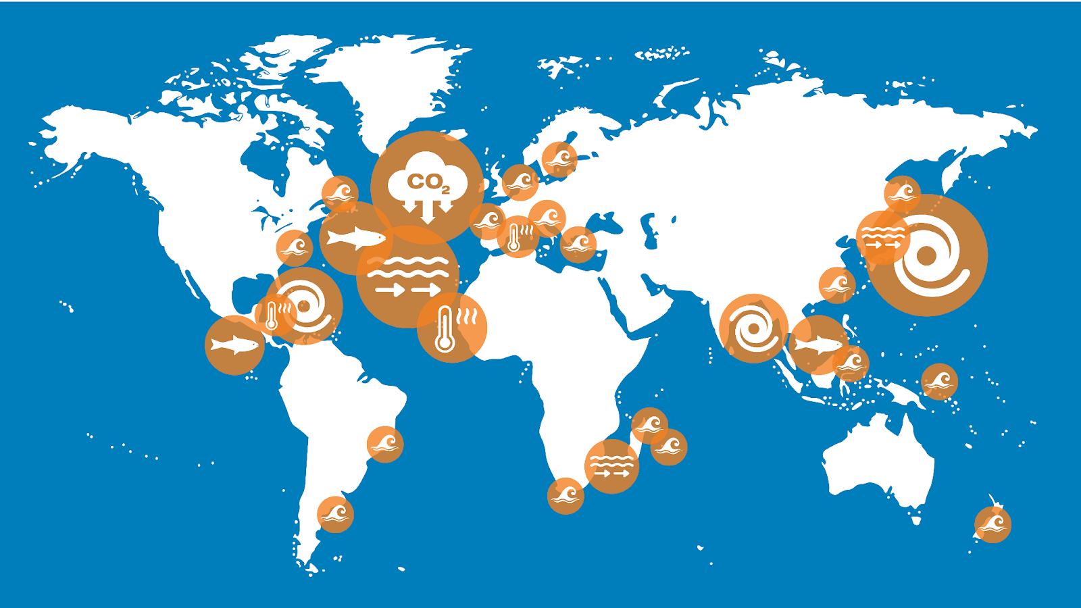
EXEMPLAR PROJECT PILOT AREAS
Notes:
THe 6 initial exemplars are envisioning pilot activities that will engage a wide range of users from around the world to target some really important issues where ocean knowledge will be very important for a range of uses…policy, decision-making, safety, food security, saving lives and property.
These are our starting points.
It is the intention of every exemplar to pilot their work in identified areas, and build on early successes to scale to a more global capacity and capabilities
NEXT SLIDE

Slide 11
We cannot know what ‘net zero’ is without ocean carbon. Leverage leading edge projects towards defining what societal users need.
How will Carbon Dioxide Removal (CDR) activities collectively affect the Ocean Carbon Cycle and net ocean carbon?
‘If we do this amount of CDR and this amount of fishing in this area’ then what will happen to the Ocean Carbon Cycle?
A cohesive global system:
Support climate targets, adaptation and management strategies
Inform Carbon Dioxide Removal targets and policy
Predict coastal and ecosystem impacts
OCEAN CARBON
Users:
Government policy, Carbon Dioxide Removal industry and regulators, UNFCCC, Nature-based solutions, Fisheries
Pilot Region: North Atlantic
Notes:
We are at a pivotal moment in our planet’s history. We have run out of time to further reduce emissions and keep our planet from warming more than 2-degrees C. Removal of carbon dioxide (CDR) from the atmosphere and/or ocean is increasingly likely in our future. USERS (noted here) have urgent need for better knowledge about carbon in the oceans. UNFCCC and governments are demanding more specific knowledge about carbon in the ocean and the ocean’s capacity to store it and continue absorbing carbon.
Markets are driving us towards such engineering efforts to remove carbon dioxide but we lack the ability to monitor if and where CDR will actually deliver, and if so, what impacts will they have on the carbon cycle, marine ecosystems, and other related activities.
There are many efforts and initiatives examining ocean carbon through observations and the methodologies for doing this are robust and well established. But a lot of the science is happening in pockets of research and the data are very sparse. We are NOT at present capable of globally observing key elements of ocean carbon that are critical to monitoring the ocean’s ability to sequester anthropogenic carbon. We are also in very early stages of developing predictive capability and plug into digital twins of the future. Lastly, At present we have no means of understanding if CDR will actually work and what potential impacts it may have on other ocean processes and ocean-dependent communities.
The Ocean Carbon exemplar will help lead global efforts to engage these users, bring ocean observing technologies technologies on board, work with the modelers and others to provide needed products and information, and answer key questions about the oceans continued ability to store carbon, questions about the effectiveness of marine CDR.
What an exciting and important mission for GOOS and the ocean observing community!
NEXT SLIDE

Slide 12
Impacts of ocean current structures on climate phenomena
Boundary current variability and prediction is critical to short-term and seasonal weather forecasts, climate adaptation, regional fisheries, food security and blue economies.
Co-design to enhance regional operational ocean modelling using a multi-platform approach:
Product and services for ocean industries (i.e., shipping)
Integrated boundary current observing system strategy
Report on economic value of a boundary current monitoring system
BOUNDARY CURRENTS
Users:
Weather services; Regional fisheries; Ocean Industries, e.g. shipping; Marine resource management, Other Exemplar Projects [Carbon, Cyclones, Heatwaves]
Pilot Region: Agulhas Current, Gulf Stream and Kuroshio

Slide 13
Sustainably manage ocean resources
This exemplar will identify needs for scientific information about marine life at local, regional and global scales in an integrated way, to sustainably manage ocean resources and improve the livelihood of coastal communities.
Co-design to improve predictive capabilities for ocean resource management:
A framework for observations at different scales and the intersection of development, conservation, science, and policy
Global ecosystem assessments with national participation
Stakeholder driven planning for 30x30 and sustainable development
MARINE LIFE
Users:
Small scale fishers;
National and regional governments; industry; International conventions and treaties, Intergovernmental Science-Policy Platform on Biodiversity and Ecosystem Services (IPBES)
Pilot Region: Costa Rica; Malaysia, N. Atlantic, global (for 30x30 MPAs designation needs)

Slide 14
Improving forecasting lead-time and accuracy to save livelihoods
This exemplar will develop observing and forecasting capabilities to better serve vulnerable communities.
Co-design regionally distributed ocean observing and forecasting systems at local pilot sites in the global coastal ocean.
Relocatable integrated observing and prediction for storm surge
Development of impact forecasting systems
Storm surge hazard and warning systems, end-to-end demonstration
STORM SURGE
Users:
National weather & ocean forecast centres; First & second responders;
Resiliency planners; Aquaculture, ports, tourism, insurance industries
Pilot Region: Shelf and slope regions in global coastal ocean

Slide 15
Co-design a sustainable monitoring system of marine heatwaves
This exemplar will develop a sustainable monitoring system to better advice management to ensure food security through transformative science.
Co-design of operational forecast models for marine heatwaves:
Real-time in-situ information for validation and corrections of operational forecast models
Early warning systems for end-users
Sustainable monitoring systems of marine heatwaves and their impacts on marine ecosystems co-designed with stakeholders
MARINE HEATWAVES
Users:
Climate change adaptation; Aquaculture; Commercial, artisanal & Industrial fisheries; Operational forecast centers; MPA & coral reef management
Pilot Region: Mediterranean Sea, Caribbean Sea, West Africa

Slide 16
Disproportionate impacts in Less Developed Countries and Small Island Developing States
Impacts are being amplified by warming ocean, rising sea levels, growing coastal populations - how do we improve forecasts to save lives and property in the future?
What is the best system design to support equity and resilience for all coastal regions?
Co-designed regional systems will:
Test new responsive observing technologies
Improve early-warning systems
Enhance forecasting capacity in critical regions (e.g. LDCs, SIDS)
TROPICAL CYCLONES
Users:
Cyclone Forecasting Centres,
Emergency Response, Blue economy
Pilot Region: Tropical Atlantic/Caribbean Sea, North Pacific and Marginal Seas, Indian Ocean/Bay of Bengal
Notes:
The Tropical Cyclones Exemplar Project we present as this is quite an advanced exemplar because observing capabilities are already being evaluated and used in a few regions. Together these disparate efforts will make more progress. MOreover, there is vast inequality in the tropical cyclone forecasting depending on world regions. Not all Tropical Cyclone forecasting centres have a connected ocean-atmospheric prediction model to base forecasts on. And globally there has been little improvement in forecasting cyclone intensity.
This Exemplar will involve testing of new technology and leveraging knowledge and experiences from regions to support improvements in other regions, particularly those regions where communities are most vulnerable.
There is a very active community in the US evaluating new ocean observing technologies and what impact they will have on hurricane forecasts AND on providing much needed informaitno to coastal communities as they prepare for storms and monitor storm conditions as they happen.
We aren’t yet realizing the value of ocean knowledge for cyclone prediction, but already we can envision the use of scalable technologies.
NEXT SLIDE

Slide 17
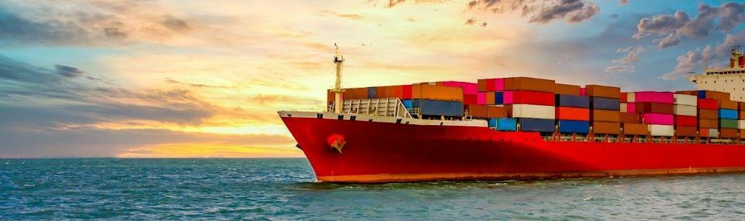
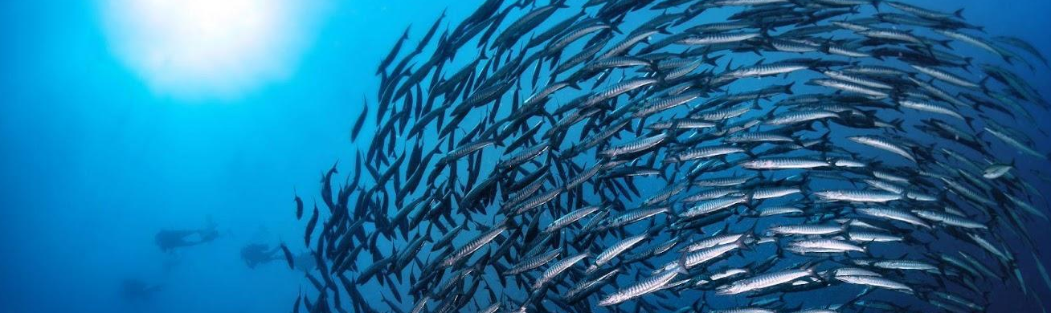

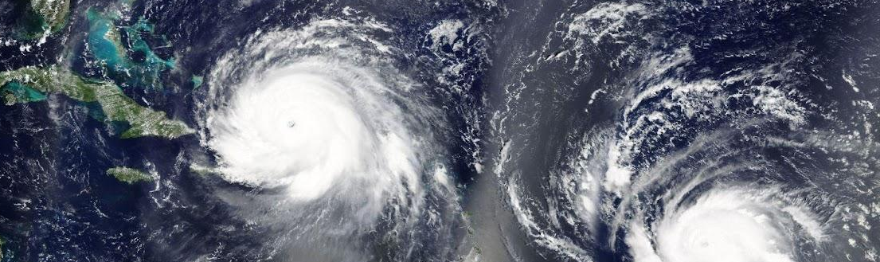
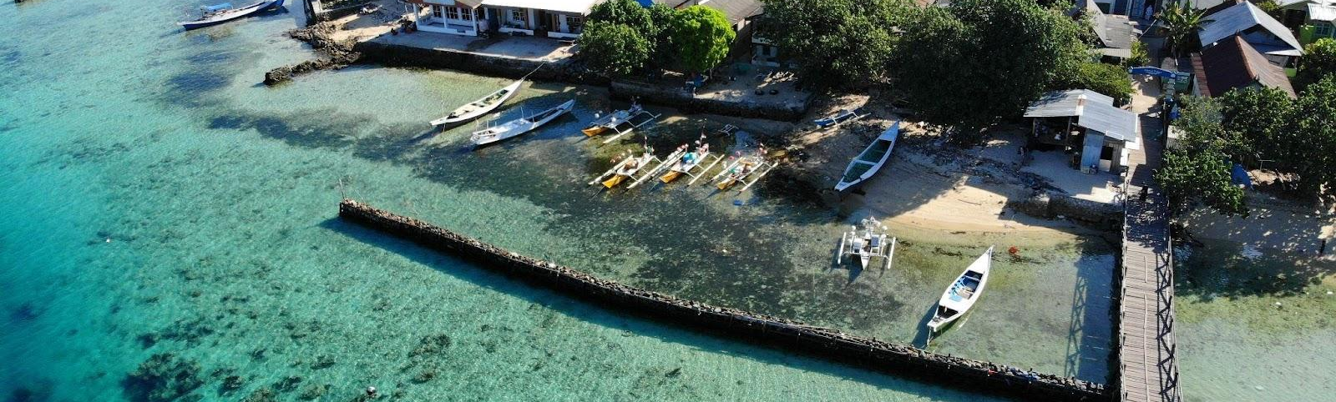
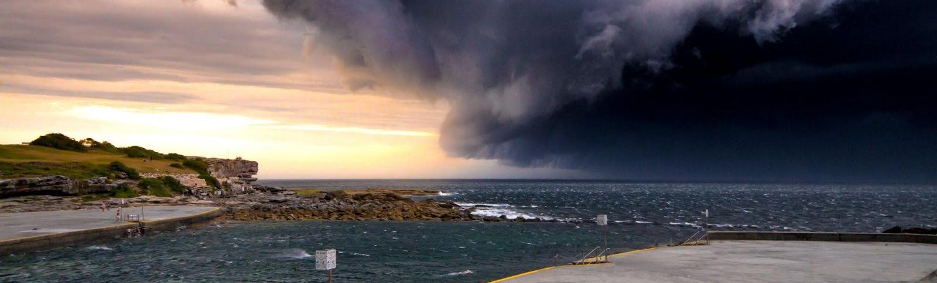
EXPERT TEAM LEADS [some groups have already formed international steering teams]
BOUNDARY CURRENTS
Tamaryn Morris, South African Weather Service , SAF
Ann-Christine Zinkann, NOAA, USA
MARINE LIFE
Frank Muller-Karger, U. South Florida, USA
Jake Kritzer, G. Canonico, IOOS, USA
OCEAN CARBON
Richard Sanders, NORCE / ICOS, NOR
Anya Waite, Ocean Frontier Institute, CAN
TROPICAL CYCLONES
Scott Glenn, Rutgers University, USA
Cheyenne Stienbarger, NOAA, USA
MARINE HEATWAVES
Alban Lazar, SU-LOCEAN , FR
Diana Ruiz Pino, SU-LOCEAN, FR
Juan Carlos Herguera,
CIGOM-CICESE, MEX
STORM SURGE
Giovanni Coppini, CMCC, IT

