Slide 1

OceanSITES
OCG-14 Hybrid Meeting
6-8 June 2023
Cape Town, South Africa
Raquel Somavilla Cabrillo, Co-Chair
Johannes Karstensen, Co-Chair
Long Jiang, Technical Coordinator
Virtual presentation

Slide 2
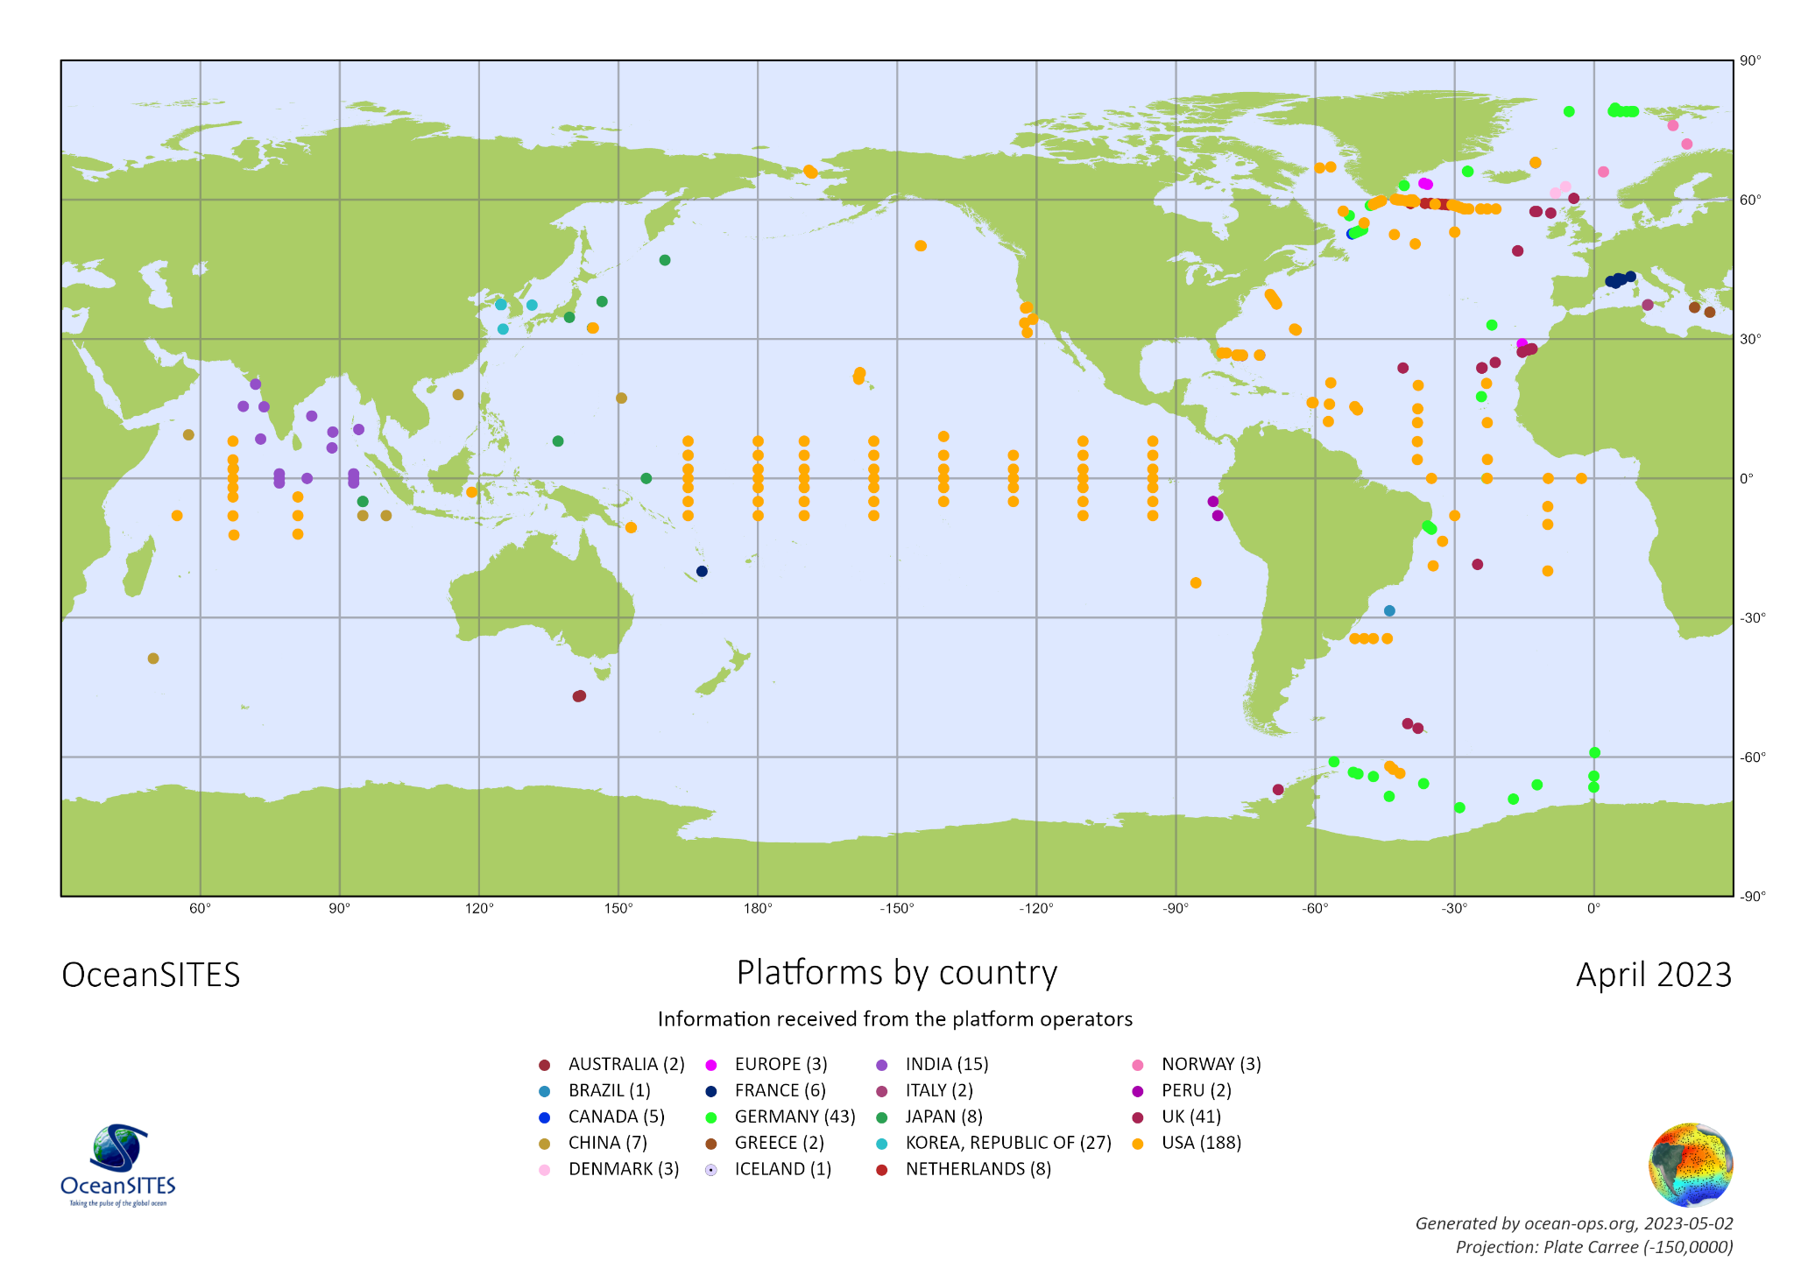
Network Overview
Through OceanSITES, national activities to obtain high-quality time series for the ocean, seafloor, and air-sea interface at fixed locations are coordinated on a global scale
367 sites registered
from 18 countries (plus EU)
OceanSITES time series data is key for understanding and responding/mitigating the effects of climate change on the ocean
Network h-index >200

Slide 3
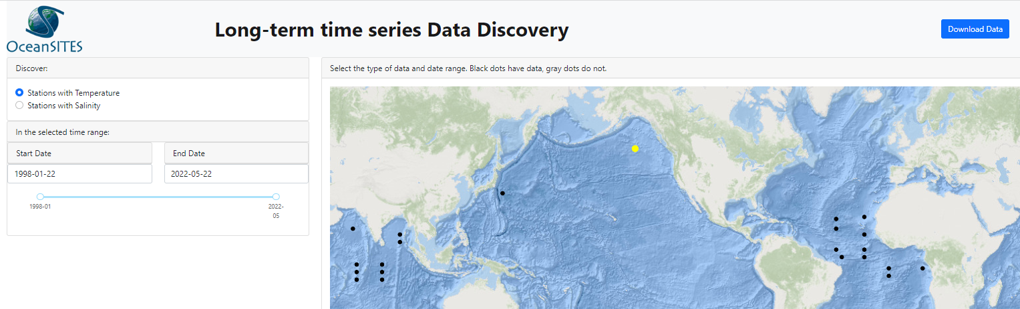
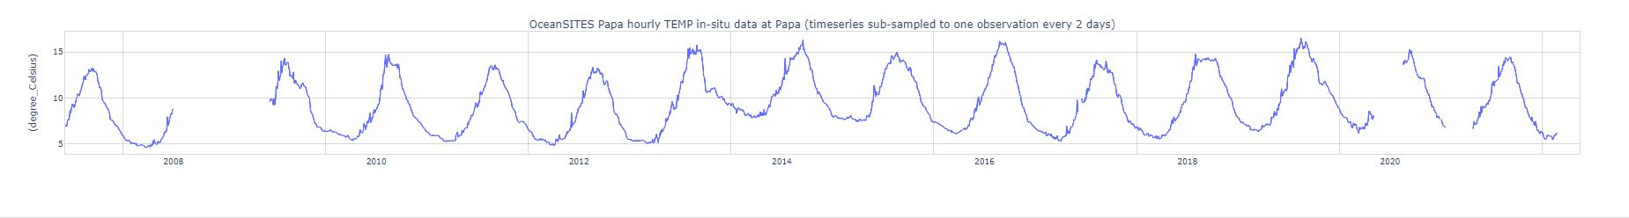
Developments and Achievements
New OceanSITES members:
  Italy: SiCO1 & SiCO2 in Sicily channel (30 yrs time series data)
  Spain (Espartel, Strait of Gibraltar)
  China (CKEO, China Kuroshio Extension Observatory)
Visualization of time series
  OceanSITES Flux data is available at https://data.pmel.noaa.gov/oceansites/airseafluxes/
  Next step: implementing “distributed data” (e.g., IMOS or Pangaea.de data servers)

Slide 4
Developments and Achievements
Applying Artificial Intelligence (AI) to gap filling & extrapolation
  IMOS EAC moorings, https://doi.org/10.1175/JTECH-D-21-0183.1
Capacity development
  Italy/SiCO sites presented at DBCP Mediterranean training workshop, May, Tunisia
Synergies & Stragegies
  Relationship with SMART cables (e.g., OceanSITES Data Group and SMART cable discussions)
Selected meeting presence & publications
  AGU Fall meeting Dec. 2022 (special session)
  GCOS observational meeting Oct 2022 (Offenbach, Germany) (incl. OASIS & Air/flux reference sites)
  EuroGOOS Fixed Platform TT meeting April 2023
  BAMS paper on air/sea flux reference sites

Slide 5
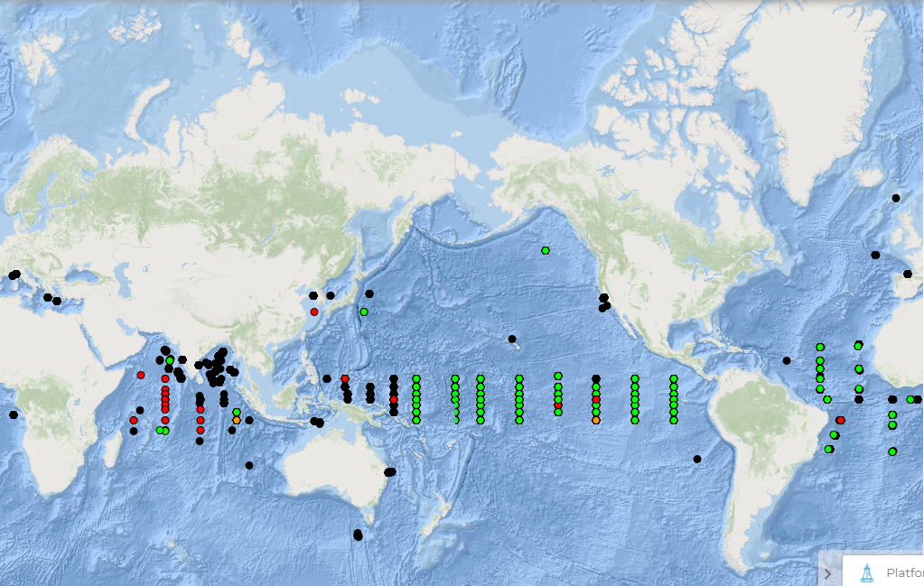
Developments and Achievements
OceanSITES = Global network of Reference Sites
5
OceanSITES acts as a Global Surface Reference Network at many levels and fills expected criteria to be considered as a reference network for ocean measurements (similarly to GRUAN for GCOS): to assess uncertainties in remotely sensed flux EOVs and wind stress products, cal/val for surface currents, assimilation/validation of reanalysis and/or modelling products.
This work providing Fiducial Reference Measurements extends to other variables (ocean carbon reference sites, chla, ..).

Slide 6
Attribute Report out
Global in scale: sites in all ocean basins; design is NOT a homogeneous distribution but aligned with phenomena to observe (e.g. boundary current, abyssal plains, air/sea interface, straits) and national interest
EOV: all physics EOV/ECV, all biogeochemistry EOV/ECV,
Biology:passive acoustics, backscatter target strength, camera systems, plankton sampler
Observations sustained: It is a qualification criteria for registering sites in OceanSITES
Community of Practice: Governance, Vision/Mission, Data policy & Management Team
Mission/Target: Long time series products to support climate indicator framework (e.g., GCOS; G7 FSOI; UN Decade); number of “EOV-Years”; shortness of gaps; representativeness for areas (e.g., AMOC - local observation but global indicator)
FAIR Data (incl. metadata): OceanSITES DMT & data format
Standards/Best Practices: Data reference manual endorsed by GOOS, recommendation for plankton measurements, among others.
CD & technology transfer: A lot on nations level but less on network level
Environmental Stewardship: moored observations are autonomous and thus without much impact to the environment except batteries, antifouling. Some waste is from the ground weight (but recoveries are needed in some EEZ areas)

Slide 7
Future Plans and Opportunities
Future plans and developments
  “Biennial” OceanSITES meeting;
  Plan: OSM2024 town-hall + virtual meeting series (AGU2022 town hall proposal failed)
  Further progress with global Best Practices
  Visualisation of data from various data centres (currently only NOAA)
  Renew & expanding of OceanSITES exec team
  Attract nations to register sites
  Intensify dialogue with
    SMART Cable
    Biological Timeseries (METS) - OceanSITES is ex-officio in METS
  Set up modern and tailored OceanSITES website (www.oceansites.org)

Slide 8
Challenges and Concerns
GOOS umbrella:
difficulties in motivating nations (PIs) to update metadata - OceanOPS process seems too cumbersome and always the question: “What is the benefit for the extra money spend on that”?
Data access:
Transform from a GDAC-centric to a truly “distributed data archive”
(may also help with the Metadata problem outline before)

Slide 9
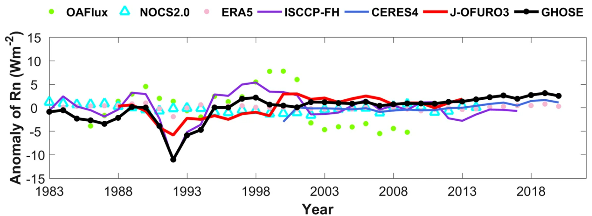
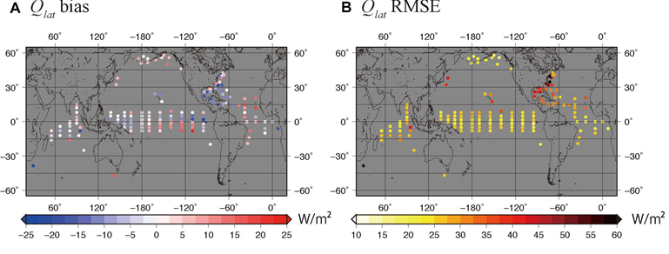
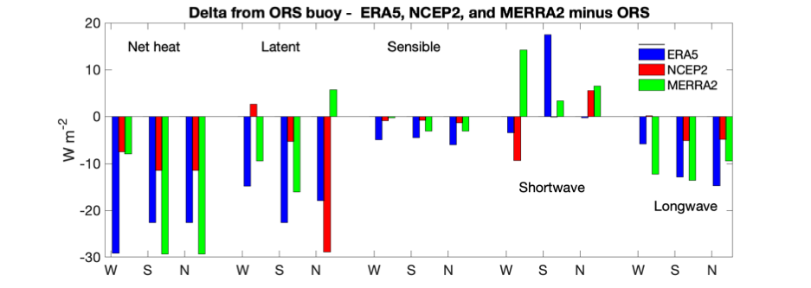
Asks from OCG
“Better have two networks than one?’’
Example SMART cables & OceanSITES: Would OCG support/encourage synergy between networks? Or will OCG not take any position? Is there a vision from OCG for synergies between networks (e.g. better merging as subnetworks or new networks)?
What is OCGs vision to support a truly Multi-platform observing system? OCG is structured in a single-platform network universe - and always is asking for single-platform Metrics…
Does OCG want to include “wild card” platforms/sites, not linked to OCG networks (e.g. some EMSO sites in Europe) ? Isn’t it more sustained if such sites would be linked to existing networks (e.g., DBCP or OceanSITES) and likewise, encourage also the OCG networks to modify ToRs to allow providing a “home” to them?
Dialogue with modeling/reanalysis centers about
utilizing in-situ platforms to assess and improve
model/reanalysis performance and to understand
the sensitivity of the models to in-situ platform
distributions as well as to remote sensing that is ingested
Has OCG/GOOS a certification program for reference stations/networks?
W (WHOTS), S (Stratus), N (NTAS)
Weller et al. 2022
Cronin et al. 2019
Liang et al. 2022

Slide 10
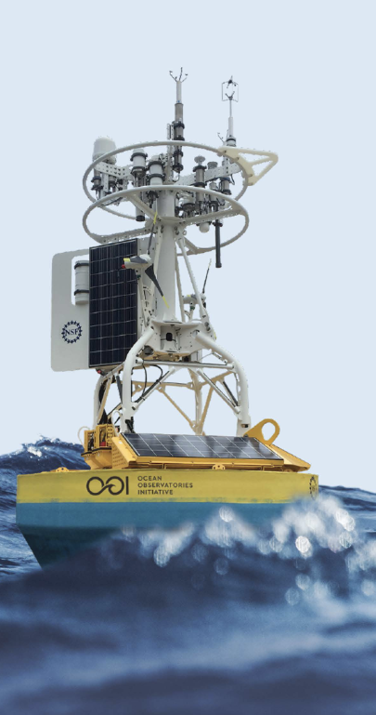
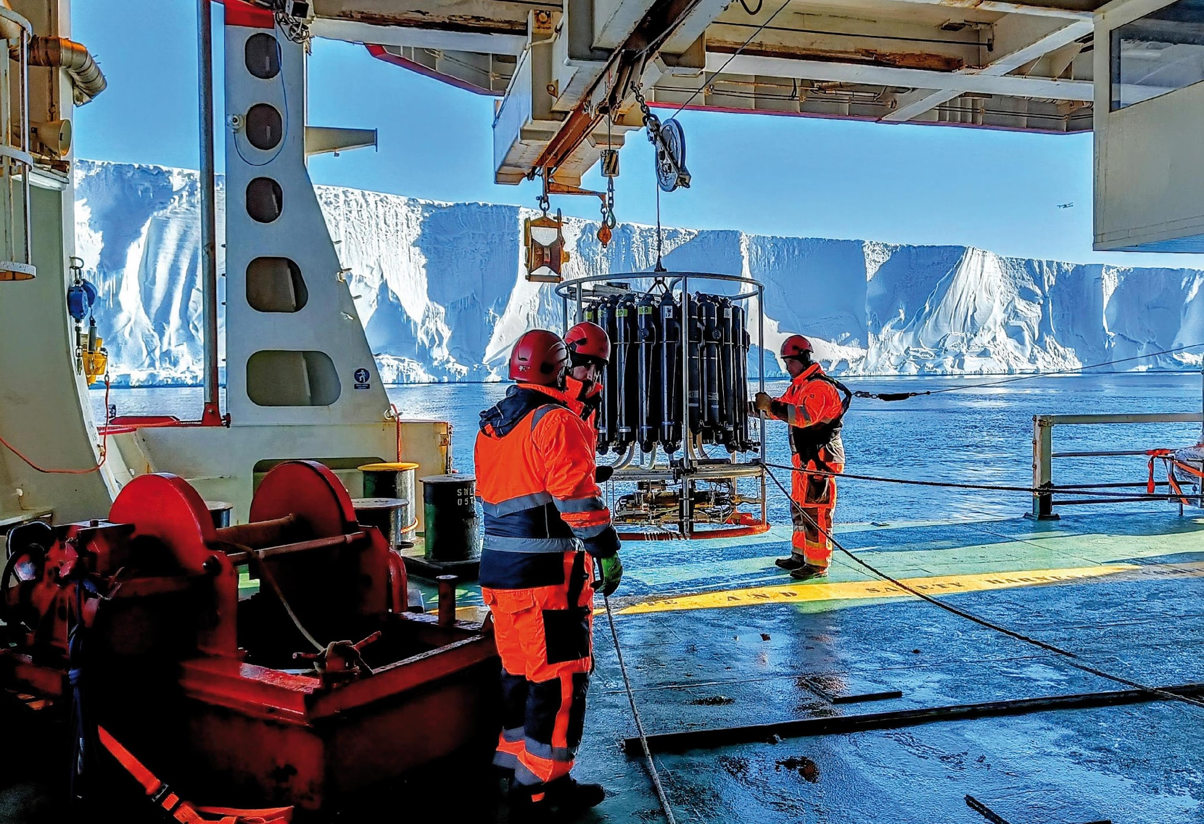
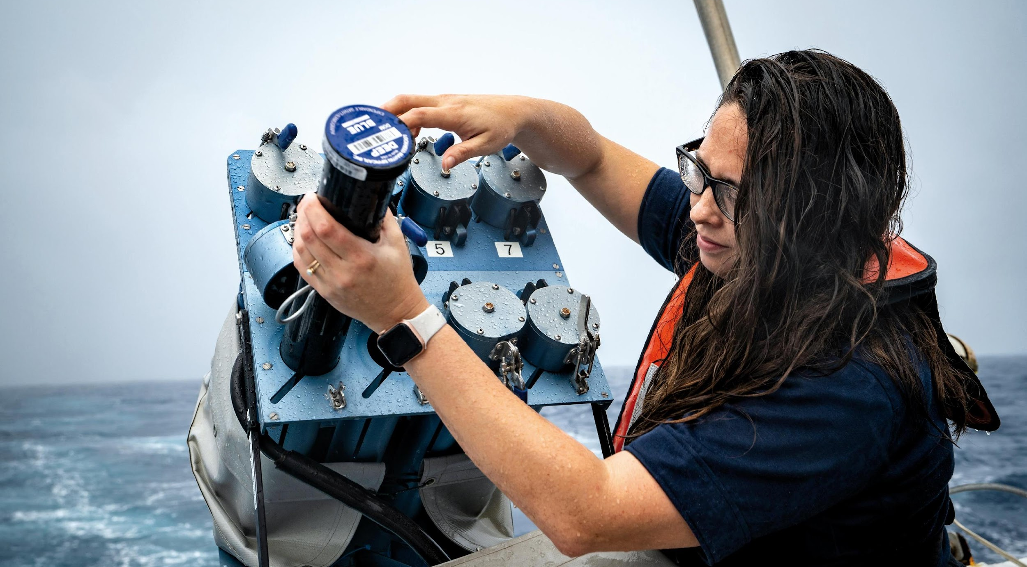
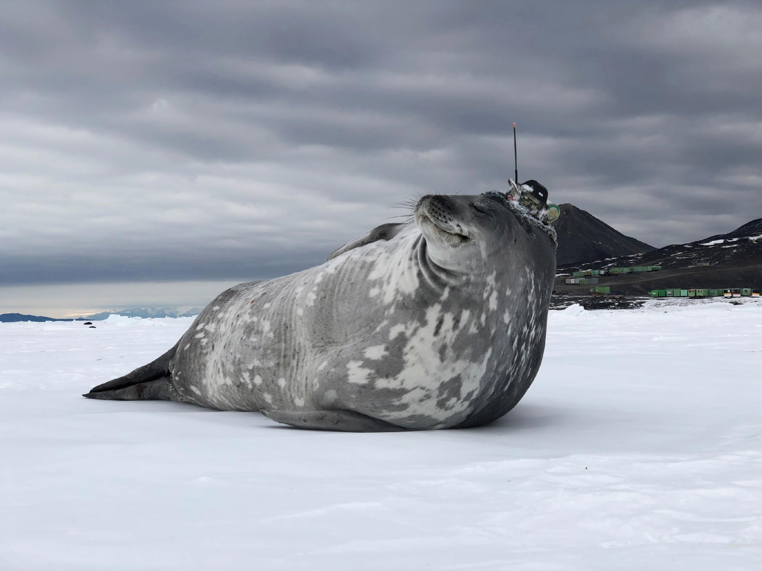
Thank you
goosocean.org

