Slide 1


OceanObs ‘24 Midway Conference
Tamaryn Morris, Juliet Hermes & Weidong Yu
OCG-14 Meeting, June 5-8, 2023
Breakwater Lodge, Cape Town, South Africa
Notes:
Ann

Slide 2
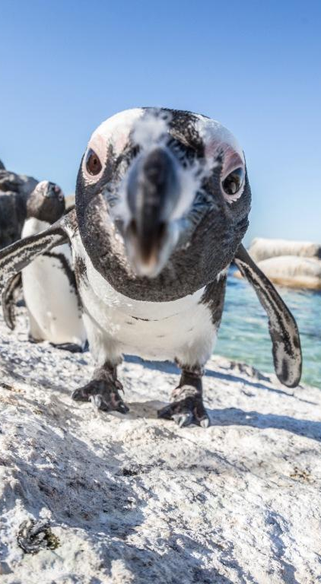
WHY A MID-WAY CONFERENCE?
THE PROBLEM
How do we engage better the LDCs, SIDS and other ocean observing communities to achieve a truly global ocean observing system?
THE GOAL
Help to strengthen and coordinate activities and recommendations from OceanObs’19
Drive open and honest dialogue
Engage with underrepresented countries in the ocean observing networks
Build onto existing ocean observing systems,
Support emerging and low-cost technologies
Promote open access to FAIR and CARE data principles
Notes:
Congratulations on making it through this year. Largely recovered, except ship-based activities where we WILL see a COVID gap in our records.
Despite the limitations from COVID, the community has responded and demonstrated dedication to ocean observing
OCG too
UN Decade (Wed)
Work and collaboration with UN Decade Programmes as they initiate
Time consuming endeavour. UN Decade activities are a pathway to change. Opportunity for more engagement (eventually resourcing???)
Things are becoming more clear, still need to be vigilant for duplication, efficiency, opportunity and developing and implementing the system.
How best for OCG to support networks with this?
EH Notes
What do we need this to do at the start of the meeting
Lay out some excitement about the agenda and aims
Show progress and good work across the year, responding to circumstances, focus on foci and actions from last year, acknowledge people's work, commitment, progress, ideas of exec (Vice Chairs) and networks - real successes we ahev had - we should be very clear on this - OCG, the networks gains recognition for efforts - in turn support our work to develop observing system
Other work to make OCG meaningful for OO - WMO IP etc
Challenges ahead
How our discussions this week will help guide OCG

Slide 3
DELIVERABLES (broad categories)
Deepening engagement and impact
Stakeholder connections
Observing system co-design
Messaging and communications
Indigenous knowledge and representation
System integration and delivery
Connecting open ocean to coastal observations
Data management and accessibility
Best Practices
Embracing scientific and technological innovations
New social/human impact Essential Ocean Variables
The role of the Ocean Decade
Notes:
Congratulations on making it through this year. Largely recovered, except ship-based activities where we WILL see a COVID gap in our records.
Despite the limitations from COVID, the community has responded and demonstrated dedication to ocean observing
OCG too
UN Decade (Wed)
Work and collaboration with UN Decade Programmes as they initiate
Time consuming endeavour. UN Decade activities are a pathway to change. Opportunity for more engagement (eventually resourcing???)
Things are becoming more clear, still need to be vigilant for duplication, efficiency, opportunity and developing and implementing the system.
How best for OCG to support networks with this?
EH Notes
What do we need this to do at the start of the meeting
Lay out some excitement about the agenda and aims
Show progress and good work across the year, responding to circumstances, focus on foci and actions from last year, acknowledge people's work, commitment, progress, ideas of exec (Vice Chairs) and networks - real successes we ahev had - we should be very clear on this - OCG, the networks gains recognition for efforts - in turn support our work to develop observing system
Other work to make OCG meaningful for OO - WMO IP etc
Challenges ahead
How our discussions this week will help guide OCG

