Slide 1
OCG - Capacity Development
Champika Gallage, Zulfikar Begg, Juliet Hermes, Ann Zinkann, Tamaryn Morris
OCG-14 Meeting, June 5-8, 2023
Breakwater Lodge, Cape Town, South Africa
Notes:
Ann

Slide 2
Goals for 2023
Enhance engagement with the Networks and coordinate across the networks
Seek funding opportunities to enable in-person training sessions and capacity building opportunities
Notes:
3 Emerging networks transitioning to mature status [AniBOS, OceanGliders, HF Radar]
Potential new networks interacting with OCG [Smart Cables, Ship based ocean time series, USV OASIS, Marine Debris]

Slide 3
CD Activities / Highlights
Webinar Series:
WMO Information System 2.0 (WIS 2.0)
Argo Data - how to access and use this freely available dataset
IOC/UNESCO information and data related resources and the Ocean InfoHub Project
ASAP - Upper air profiles at sea
Future planned webinars:
ERDDAP Hands on Series
Creation of Best Practises
Environmental Stewardship
ETOOFS
Notes:
Ann

Slide 4
Meetings and Workshops
Ocean Observations side event at the 18th WMO Regional Association I Conference-to improve coordination and collaboration between RA's and GRAs
https://www.euro-argo.eu/News-Meetings/Meetings/Others/7th-Argo-Science-Workshop-October-2022
Outreach Event - June 9th
Ocean Observation impacts on society platform showcasing
Argo float signing
Research Vessel Agulhas II Tour
Instrument donations
2 drifters donated by DBCP (to Solomon Islands )
3 VOS observation instruments donated by SOT (to Argentina, Chile, and Russia)
Notes:
Ann

Slide 5
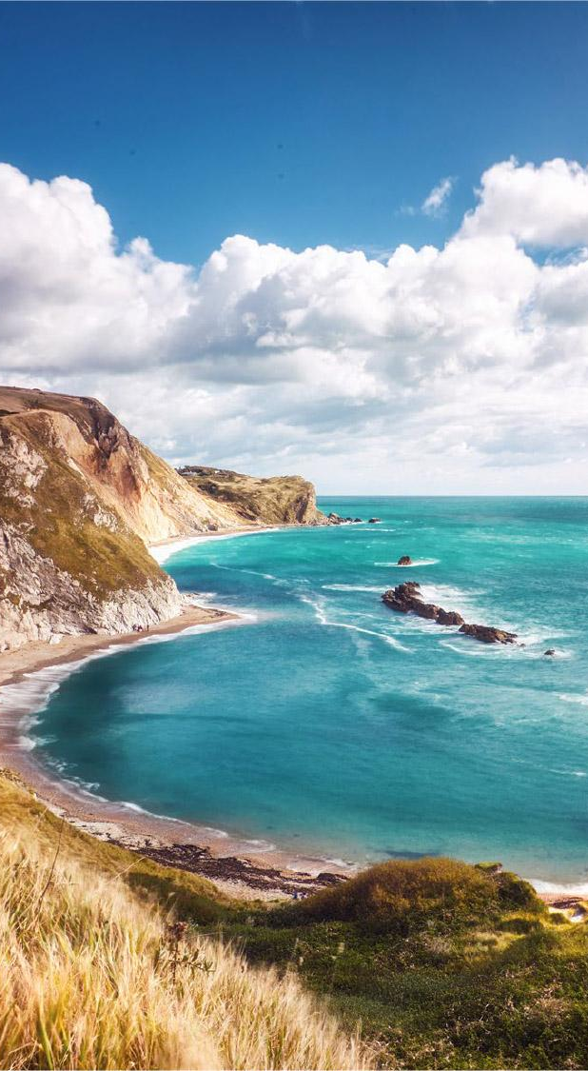
Next Steps
Next Steps
Identifying needs
Focussed training sessions
Adopt an instrument
Cross network training opportunities
Introduction to tools and datasets
Ask from Networks and OCG
Share upcoming CD activities or CD calendar
Reach out to OCG CD team for focused training opportunities
Notes:
EH: GOOD CHALLENGES
Emerging networks…. Which(from BGC and BIOECO and GRAs) are ready to join OCG… (resource limitations within OCG and OceanOPS)...?

Slide 6
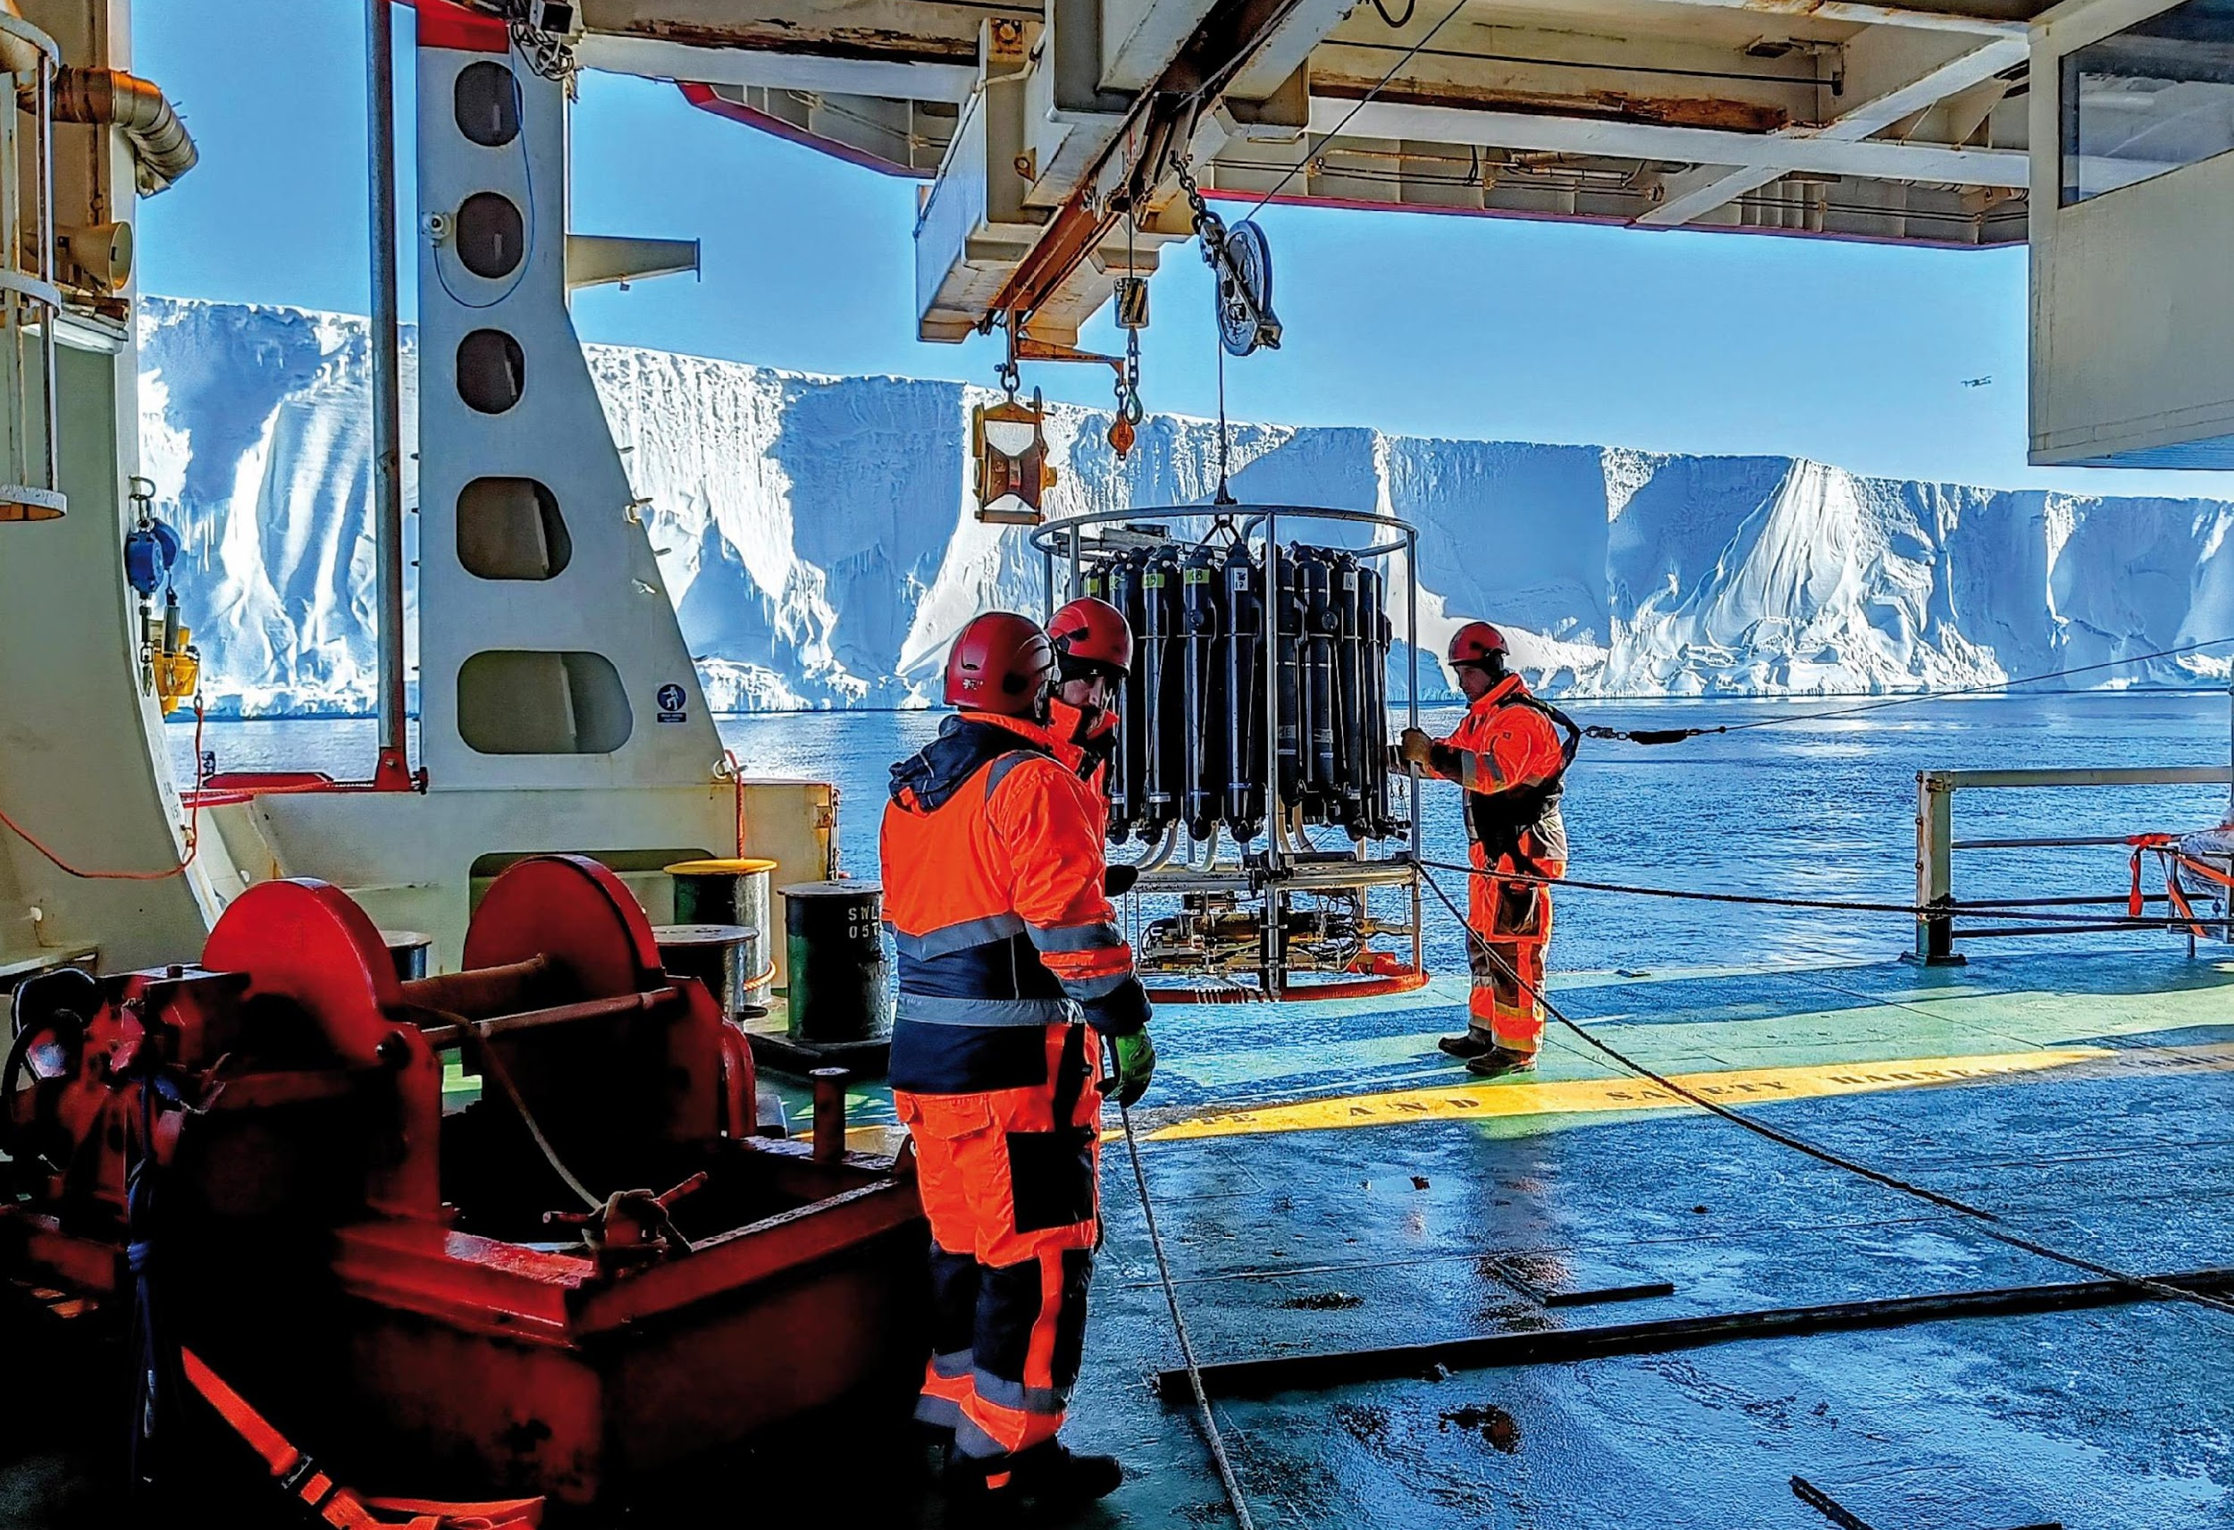
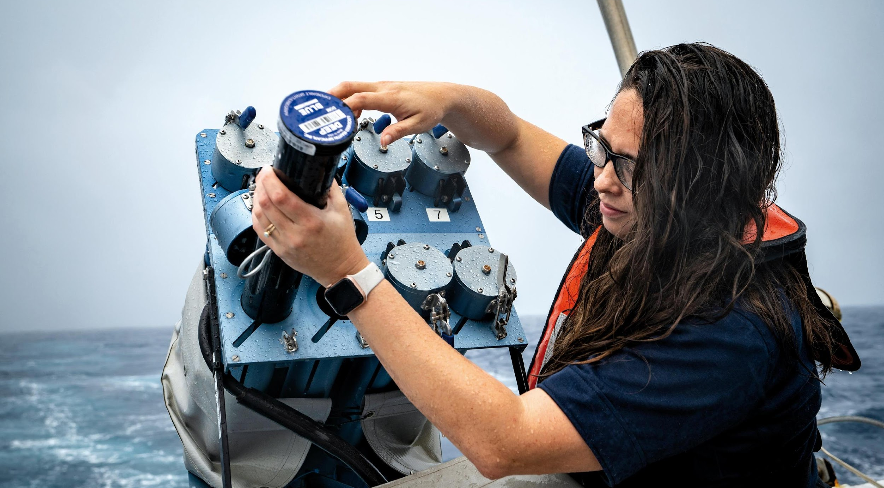
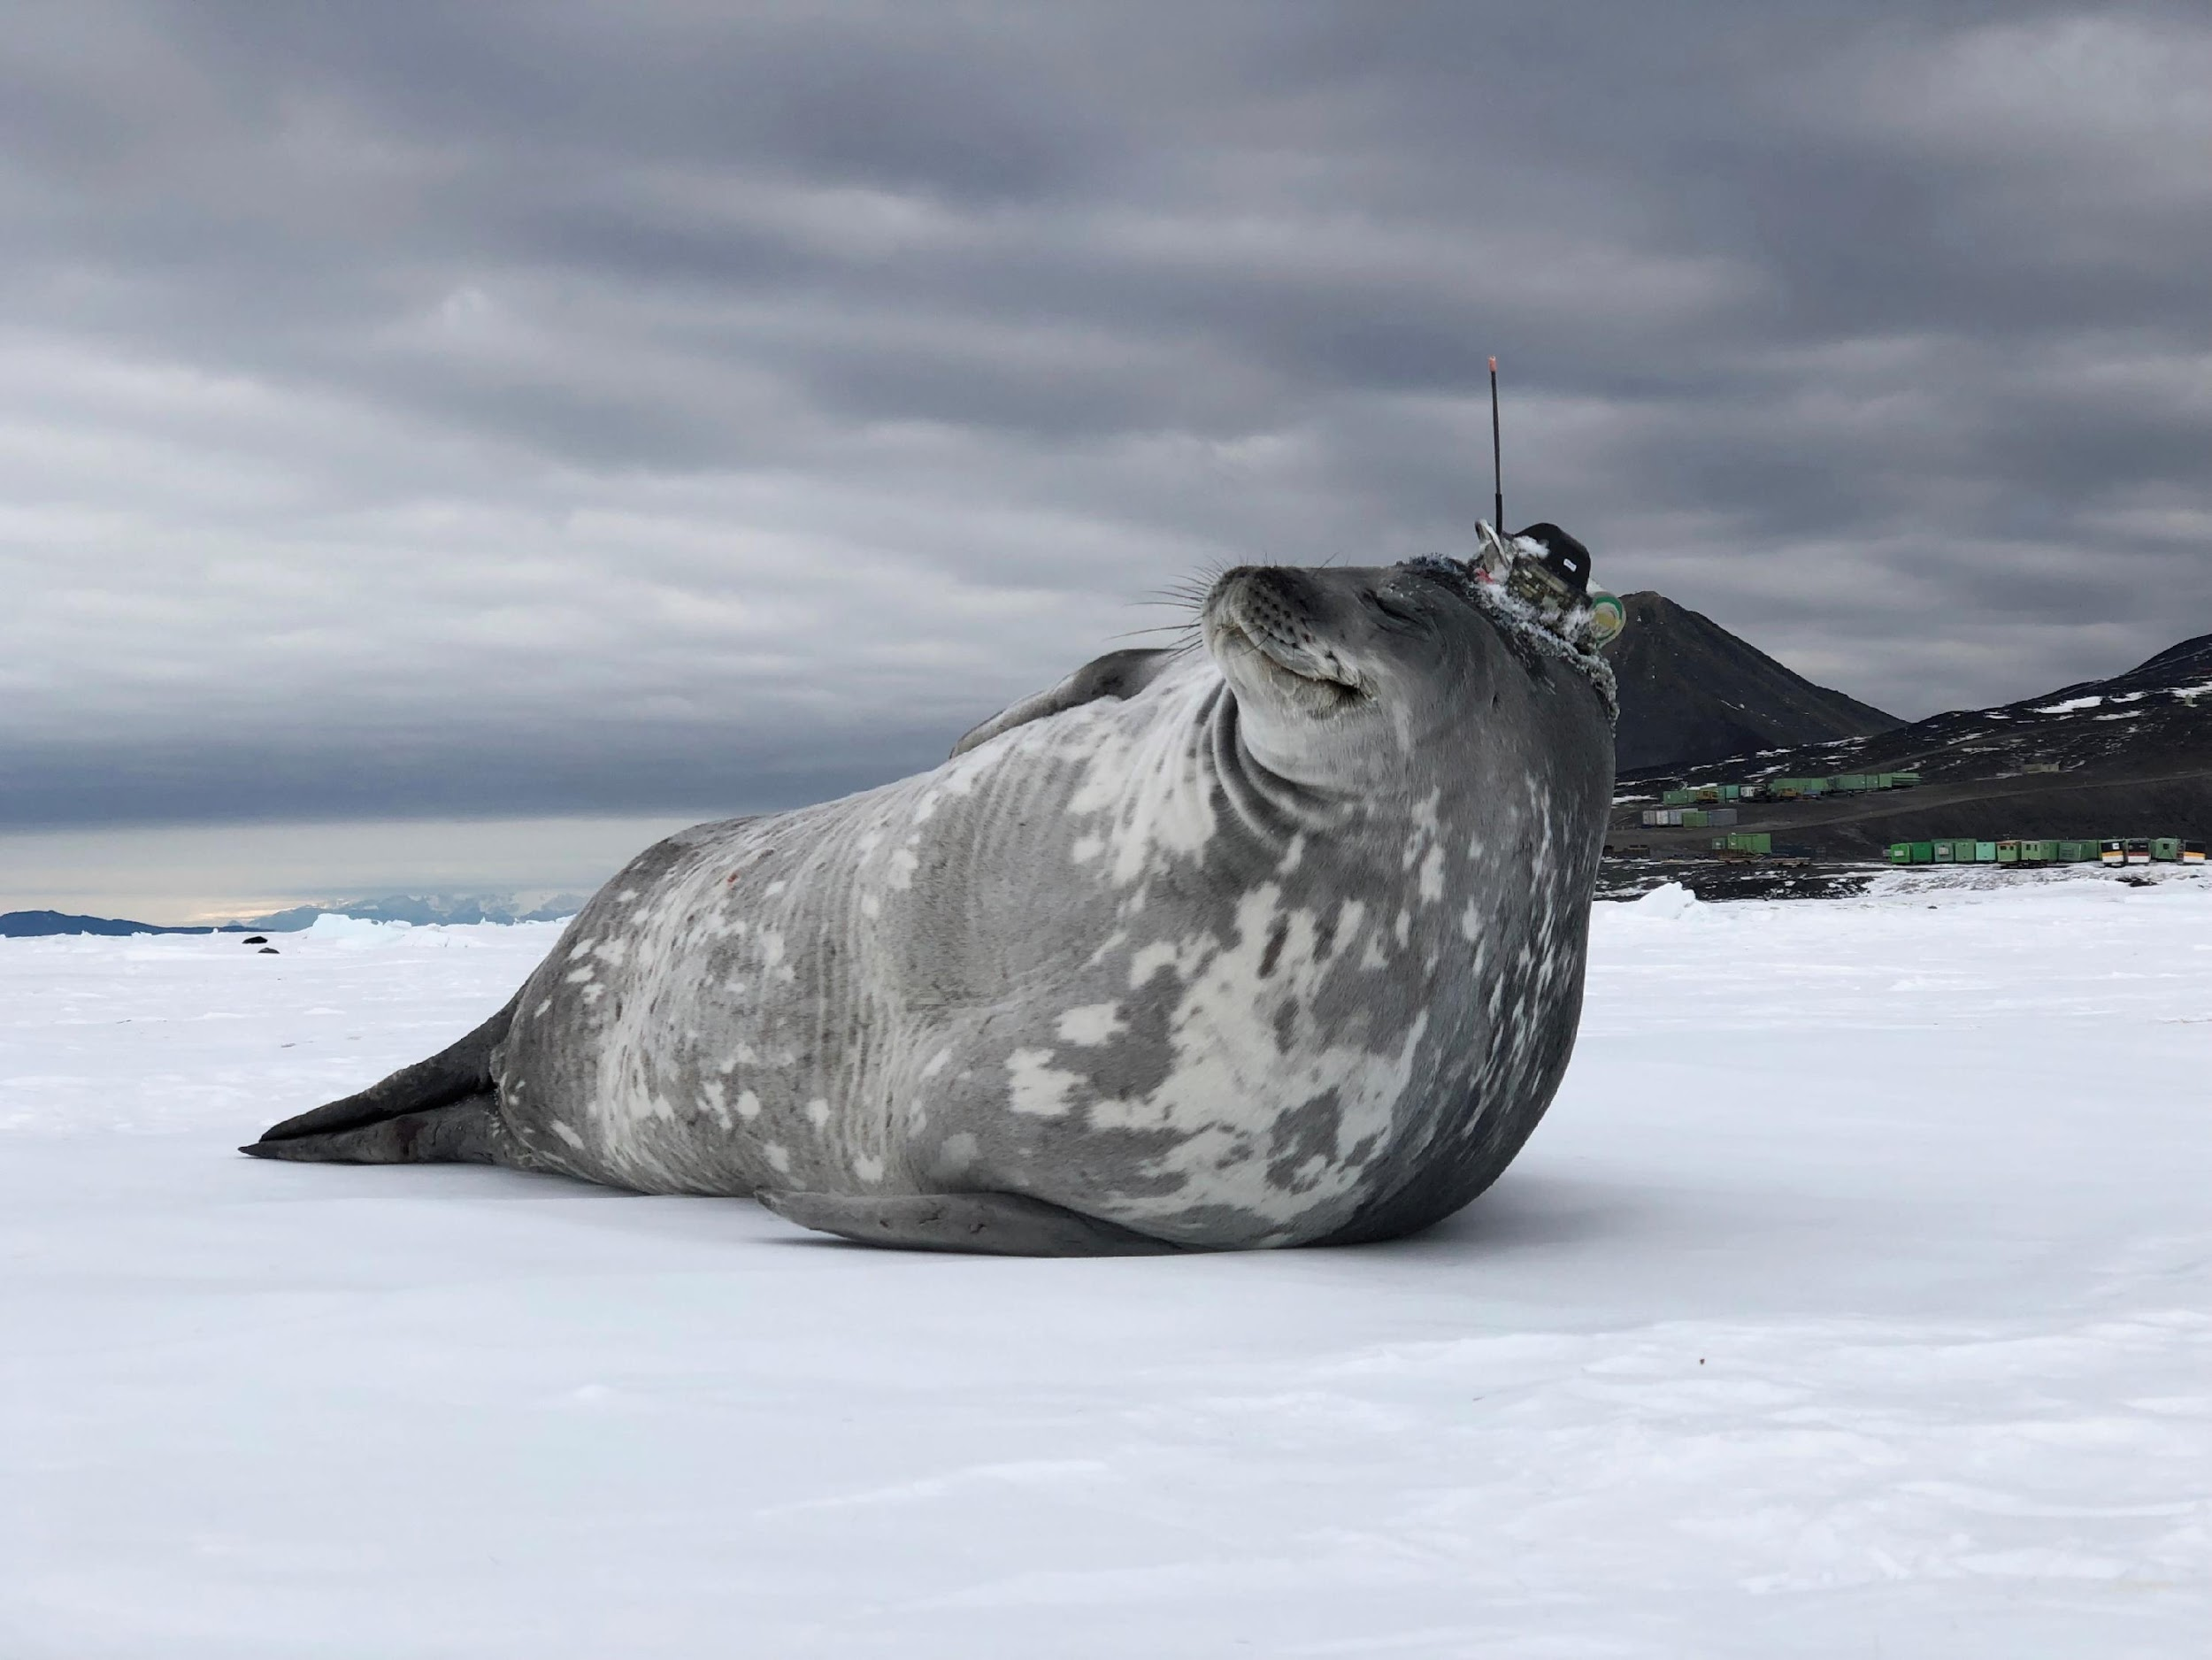
Thank you!
Stay connected:
Contact:
Zulfikar Begg - ZulfikarB@spc.int
Notes:
David
We’ve done a lot of work in planning our actions going forward. Let us know if there is a particular exemplar project that interests you. We would love to participate in focussed one-one calls about Exemplar projects that interest you.
We have exemplar leads
Thank you for participating in today’s call. I look forward to the discussion. S
Turn back it over to Emma to moderate the discussion.

Slide 7
Capacity Building of the Data Buoy Cooperation Panel (DBCP)
OCG-14 Hybrid Meeting
6-8 June 2023
Cape Town, South Africa
JIANG Qiu-Rachel, Chair of DBCP Task Team on Capacity Building

Slide 8
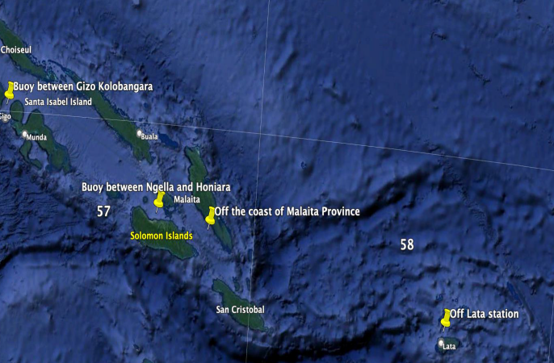
Developments and Achievements
2 decades of dedicated in-region capacity building activities from 2003
5 Western Indian Ocean, 5 Pacific Islands, 5 NPOMS, 1 Mediterranean, 500+ trainees, great appreciation from Members/Member States
Tangible results: for example, wave drifter pilot deployment for Solomon Islands

Slide 9
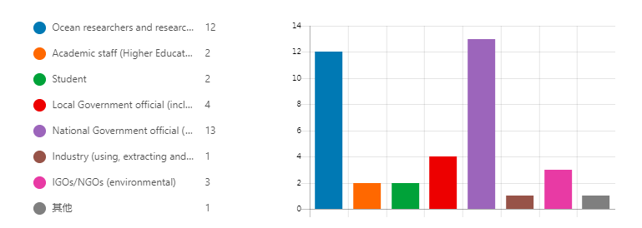
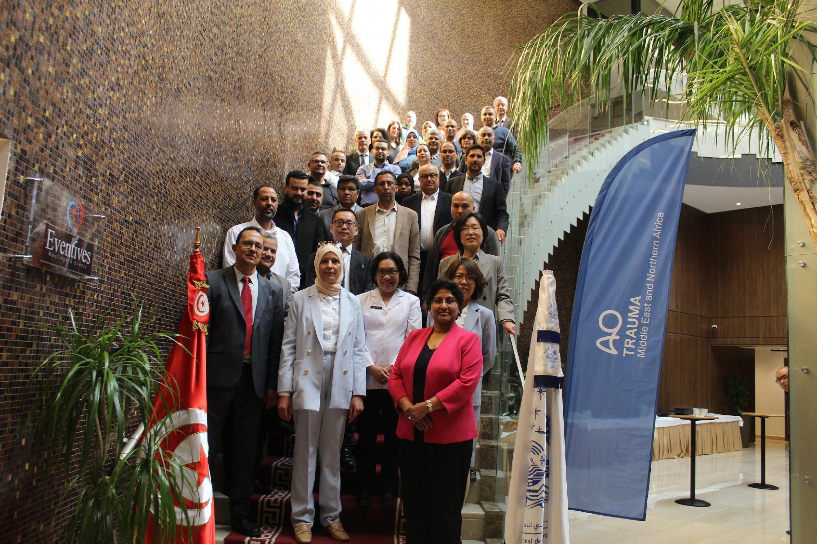
First DBCP Mediterranean Workshop
Part I, virtual, Nov 2022
34 Countries , 125 Participants, 17 presentations.
Part II, hybrid, May 2023, Tunis, Tunisia
24 countries, ~80 participants, 27 presentations.
14 trainees funded by DBCP Trust Fund (IOC&WMO),
14 recommendations and 4 actions.
Good Diversity and Inclusivity of trainees in the region, representations of most GOOS networks relevant to the basin, and GOOS value chain.

Slide 10
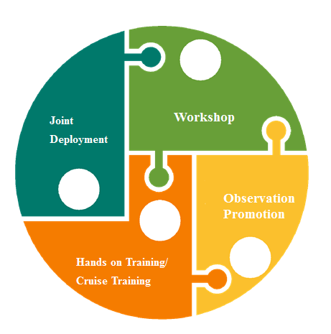
Future Plans and Opportunities
Cyprus, Egypt, Morocco showed interest in Mediterranean workshop ;
BMKG of Indonesia intent to host for Asia ;
Other regions/basins such as Southern Atlantic .
Liaise with GOOS GRAs and networks of GOOS, WMO RTC,
RMICs and RICs.
Wave drifter pilot deployment (Continue..);
Gliders/Sail Drones jointly deployment (Mediterranean , South Pacific islands…);
Tide Gauge jointly establish.
Potential linkage with Ocean Gliders, GLOSS …
DBCP’s Barometer upgrade program
Calibration and Inter-comparison services
Best Practices.
Liaise with GO-SHIP, OBP ,WMO ET-QTC and …
Hands on Training and Cruise training
Explore the possibilities ,cooperate with SOT…

Slide 11
Challenges and Concerns
Wide and diversified expectations, limited resources, difficult to sustain
Technical challenges in different regions (administrative and internal approval processes, VISA, language barriers, connectivity, electricity, …)
Follow up and monitoring mechanism
Asks from OCG
Strategic guidance on CD?
Funding and resources support?

Slide 12
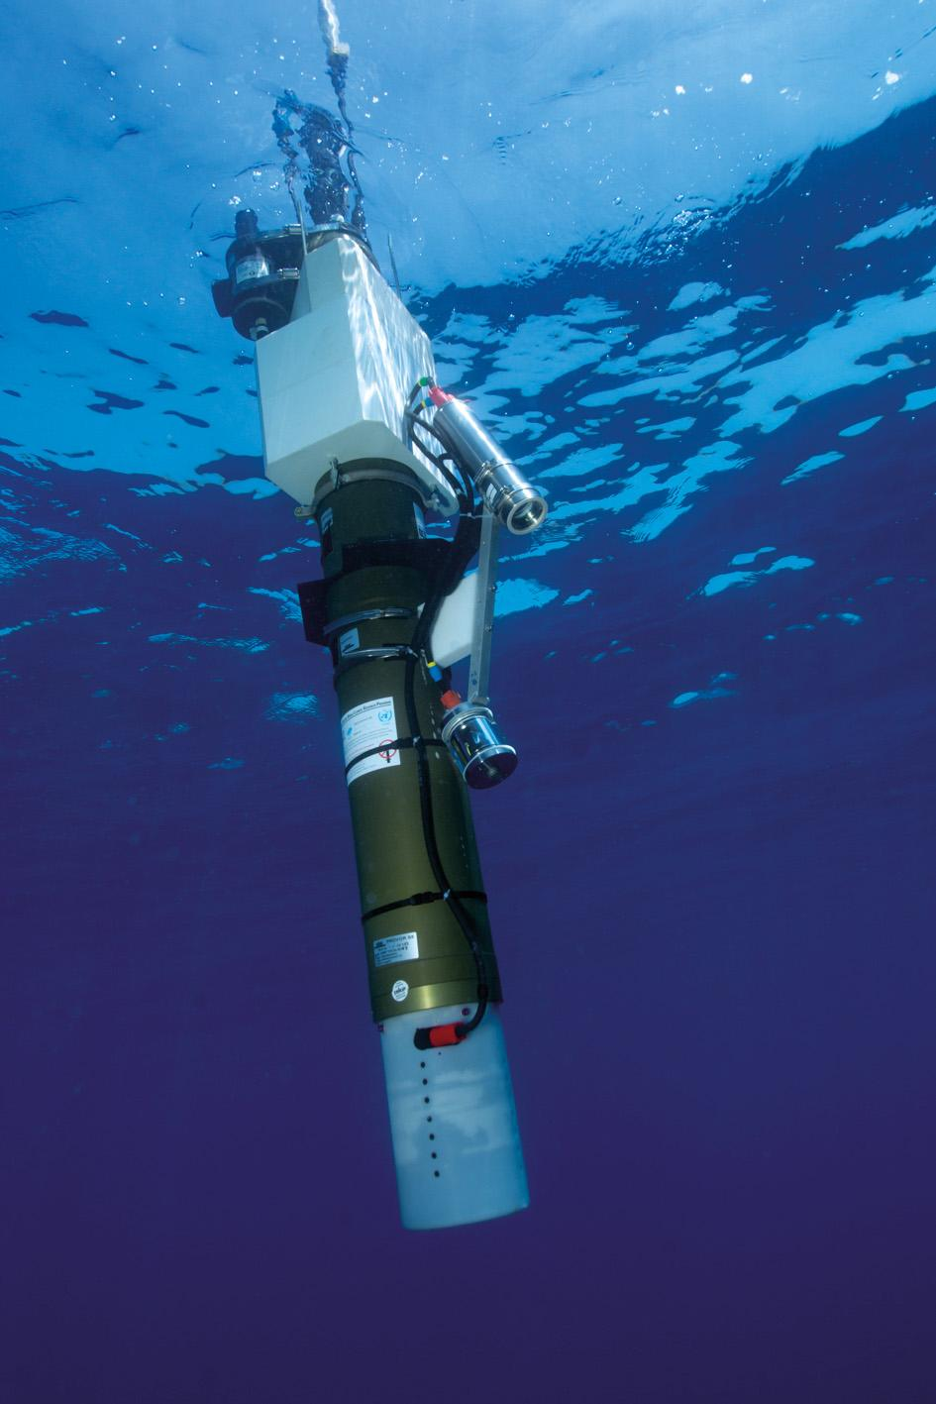
Thank you
goosocean.org

Slide 13
Low Cost Technology Workshop
Patrick Gorringe, Lucie Cocquempot, Callum Rollo, Antonio Novellino, Kevin O'Brien,
Juliet Hermes, Tamaryn Morris, Ann Zinkann
OCG-14 Meeting, June 5-8, 2023
Pieter Stoker Centre, Department of Forestry, Fisheries and the Environment (DFFE), Cape Town, South Africa
Notes:
Ann

Slide 14
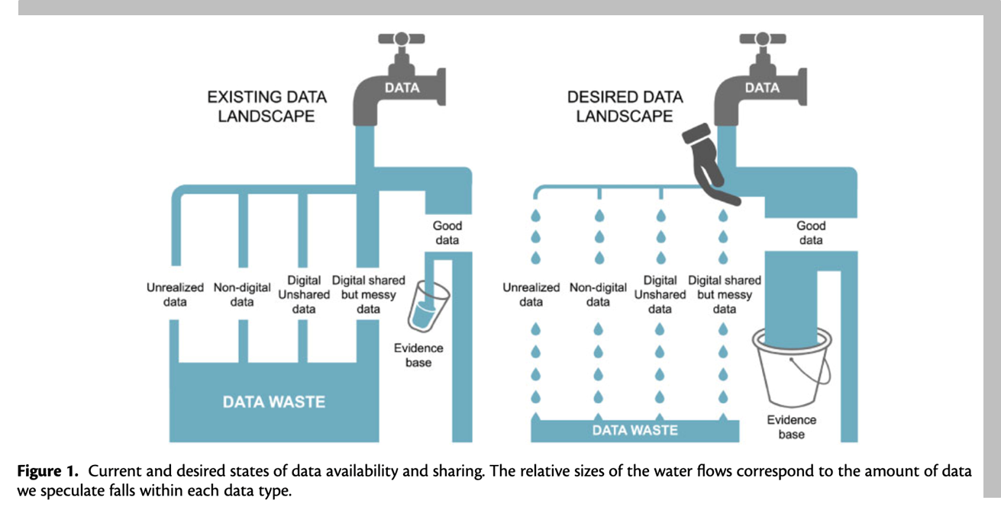
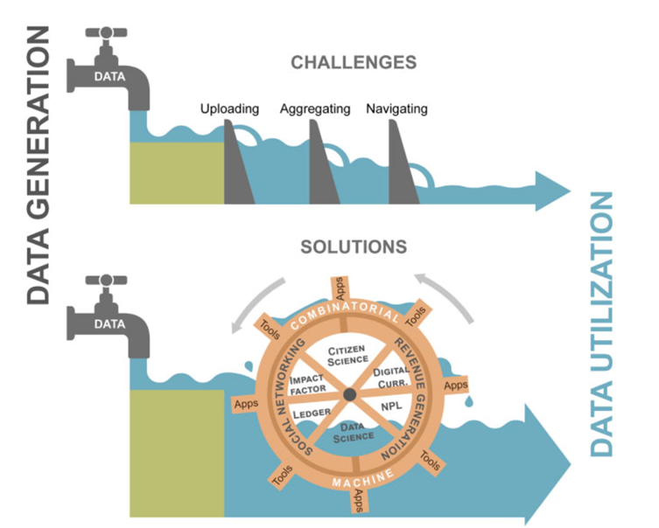
Why Low Cost Technologies?
THE PROBLEM: Many countries face major challenges in observing & monitoring the ocean and accessing equipment and information, lack of standard operating procedures, best practices and belief that high-end equipment and facilities are necessary
In more developed countries, it is necessary that our scientific communities, especially those specializing in instrumental research, question their resource consumption and environmental impacts associated with new technological developments. In addition, data collected by less ‘advanced’ technologies are often not able to be submitted to data centers resulting in a lack of data availability in certain areas, loss of data and reduced data availability.
This workshop is geared towards showcasing low-cost technologies that are available to observe coastal waters. The first half of the day will focus on short presentations of these technologies and their users, while the second half will focus on-hands training sessions on ERDDAP services to enhance data accessibility and opportunities to ensure the data collected is publicly available.
To foster interactions and expertise sharing information about the technologies will be circulated after the workshop.
Notes:
Congratulations on making it through this year. Largely recovered, except ship-based activities where we WILL see a COVID gap in our records.
Despite the limitations from COVID, the community has responded and demonstrated dedication to ocean observing
OCG too
UN Decade (Wed)
Work and collaboration with UN Decade Programmes as they initiate
Time consuming endeavour. UN Decade activities are a pathway to change. Opportunity for more engagement (eventually resourcing???)
Things are becoming more clear, still need to be vigilant for duplication, efficiency, opportunity and developing and implementing the system.
How best for OCG to support networks with this?
EH Notes
What do we need this to do at the start of the meeting
Lay out some excitement about the agenda and aims
Show progress and good work across the year, responding to circumstances, focus on foci and actions from last year, acknowledge people's work, commitment, progress, ideas of exec (Vice Chairs) and networks - real successes we ahev had - we should be very clear on this - OCG, the networks gains recognition for efforts - in turn support our work to develop observing system
Other work to make OCG meaningful for OO - WMO IP etc
Challenges ahead
How our discussions this week will help guide OCG

Slide 15
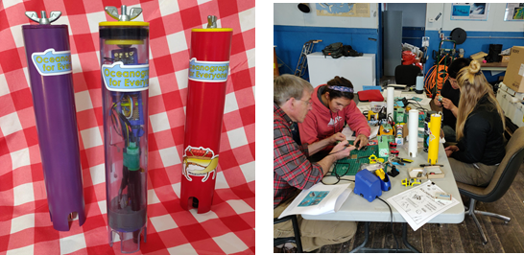
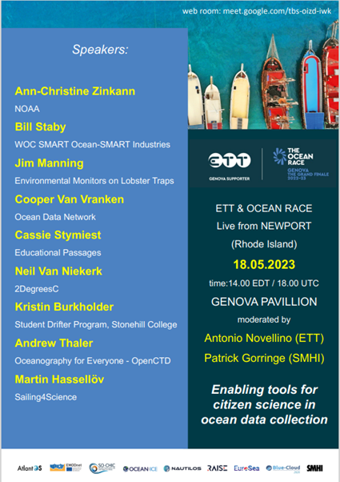
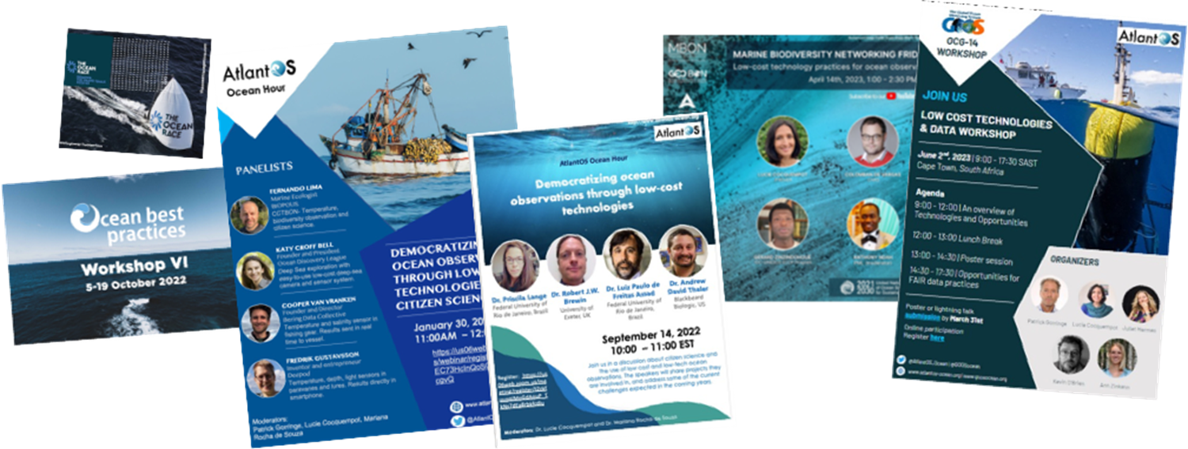
THE MOMENTUM
Notes:
Congratulations on making it through this year. Largely recovered, except ship-based activities where we WILL see a COVID gap in our records.
Despite the limitations from COVID, the community has responded and demonstrated dedication to ocean observing
OCG too
UN Decade (Wed)
Work and collaboration with UN Decade Programmes as they initiate
Time consuming endeavour. UN Decade activities are a pathway to change. Opportunity for more engagement (eventually resourcing???)
Things are becoming more clear, still need to be vigilant for duplication, efficiency, opportunity and developing and implementing the system.
How best for OCG to support networks with this?
EH Notes
What do we need this to do at the start of the meeting
Lay out some excitement about the agenda and aims
Show progress and good work across the year, responding to circumstances, focus on foci and actions from last year, acknowledge people's work, commitment, progress, ideas of exec (Vice Chairs) and networks - real successes we ahev had - we should be very clear on this - OCG, the networks gains recognition for efforts - in turn support our work to develop observing system
Other work to make OCG meaningful for OO - WMO IP etc
Challenges ahead
How our discussions this week will help guide OCG

Slide 16
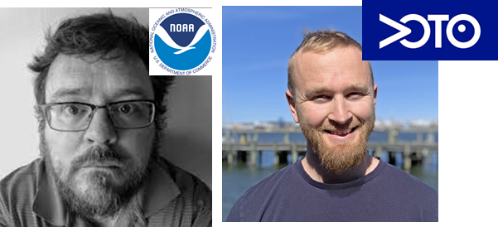
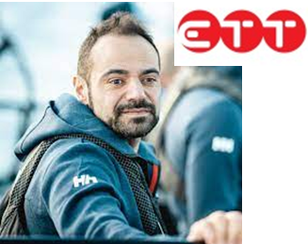
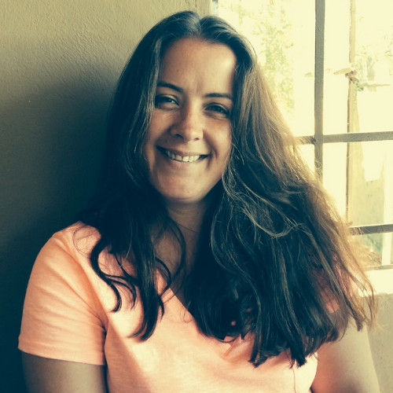
THE WORKSHOP
THE TEAM: OCG, South African Weather Service, Ifremer, SAEON, and AtlantOS
FOCUS:
Showcasing the technologies available and their application
ERDDAP as an opportunities for accessible ocean data
Notes:
3 Emerging networks transitioning to mature status [AniBOS, OceanGliders, HF Radar]
Potential new networks interacting with OCG [Smart Cables, Ship based ocean time series, USV OASIS, Marine Debris]

Slide 17
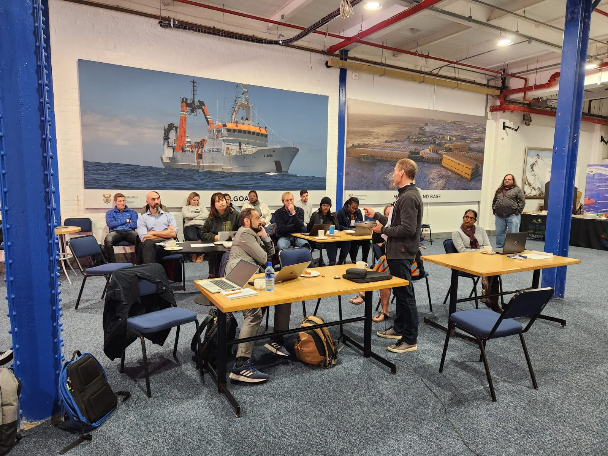
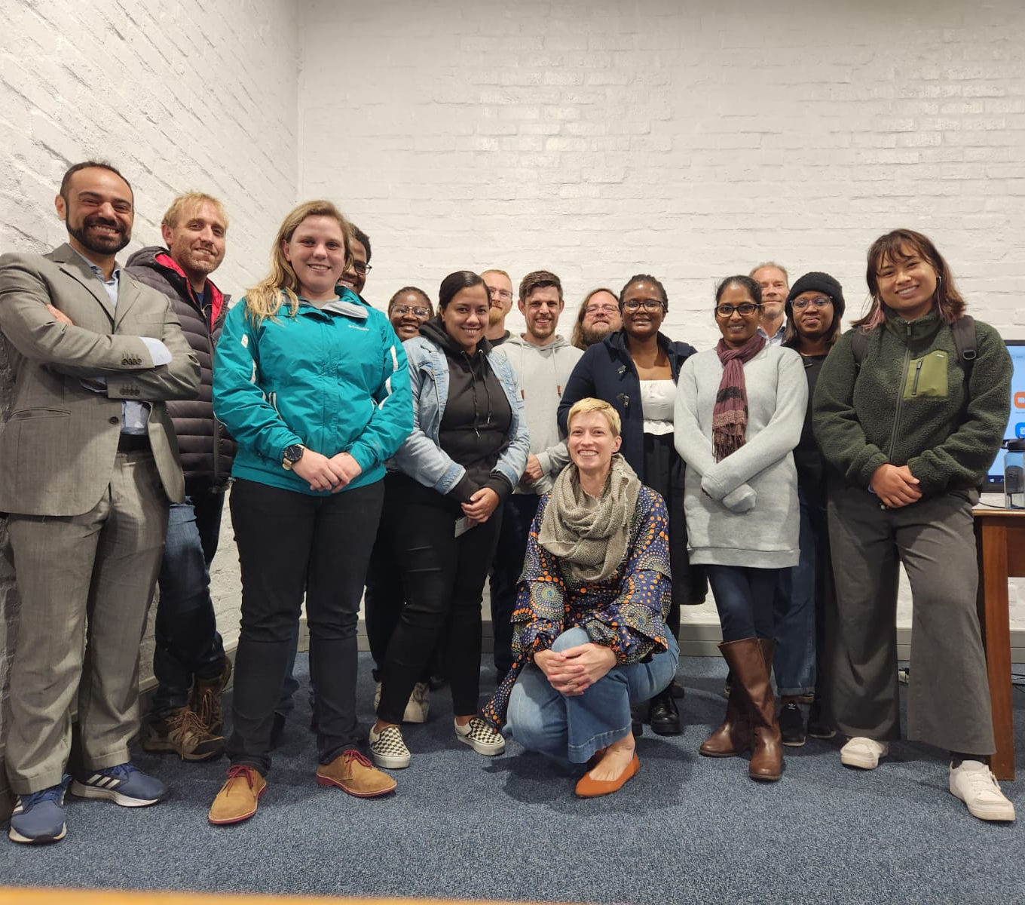
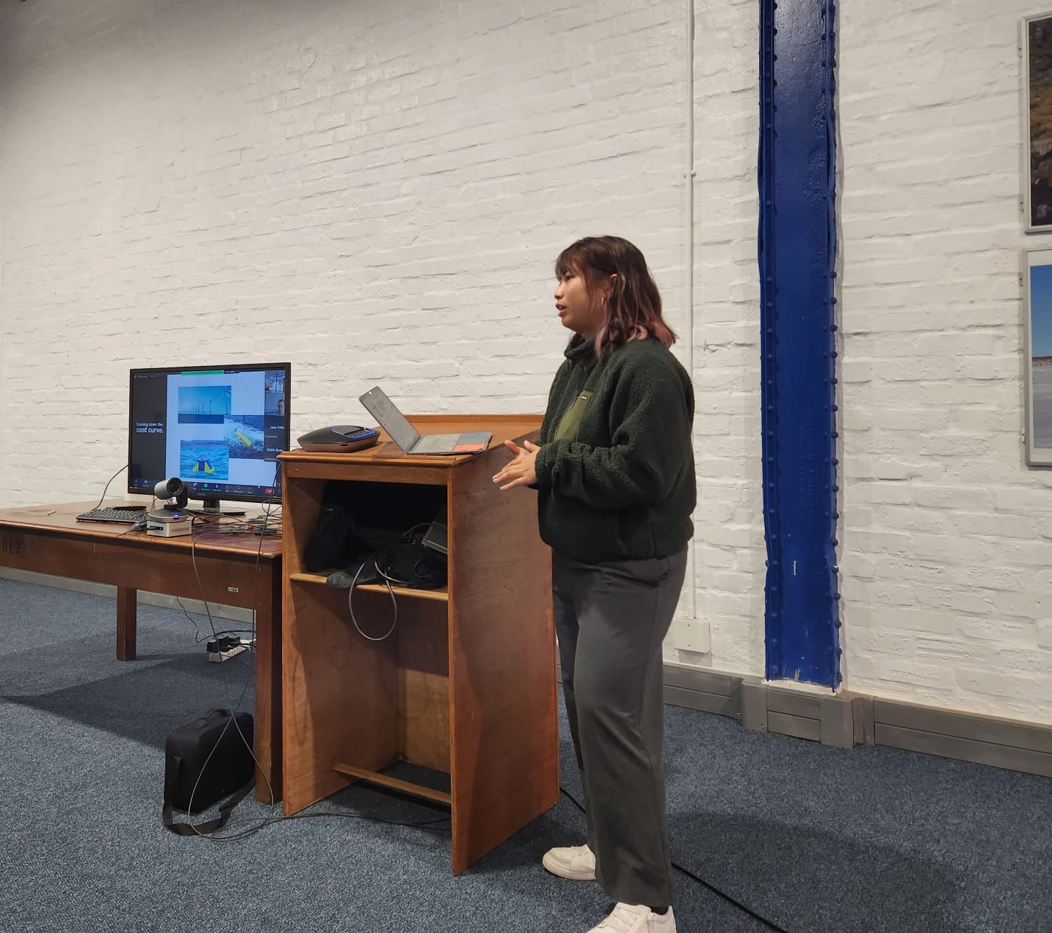
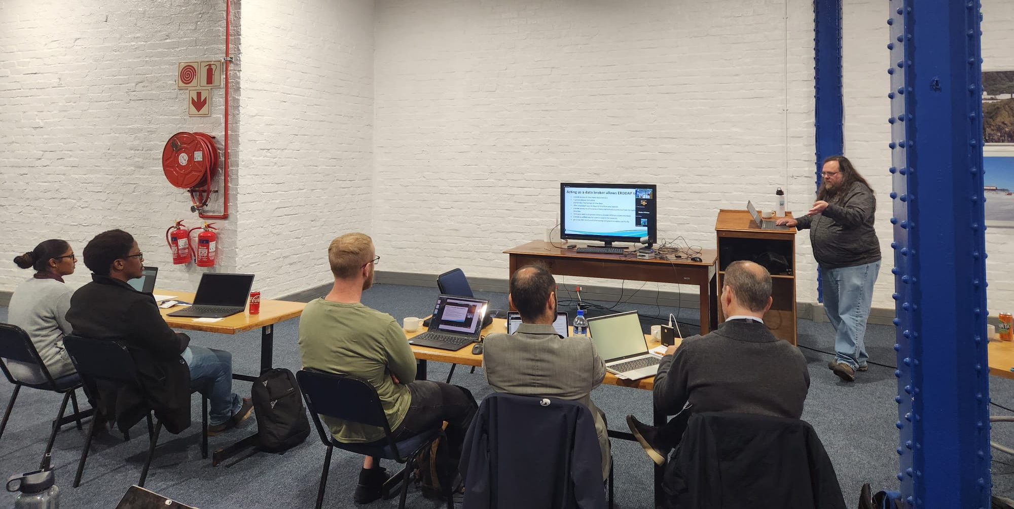
18 In-person | up to 56 Online
12 Presentation on low cost technologies
Notes:
3 Emerging networks transitioning to mature status [AniBOS, OceanGliders, HF Radar]
Potential new networks interacting with OCG [Smart Cables, Ship based ocean time series, USV OASIS, Marine Debris]

Slide 18
Potential actions
…………..
Notes:
MOU between GOOS and MBON and OBIS need to be renewed, Panel would like to propose the MOU that GOOS Exec can implement
The BioEco Panel co-chairs are currently discussing potential attendance at the GRA Forum (date still being decided but likley to be early 2024) to discuss emerging BioEco networks and to further facilitate uptake of BioEco EOVs into the GRAs.
https://obis.org/2016/12/15/goosgeobonobis/

Slide 19
Thank you!
Contact:
Patrick Gorringe
Lucie Cocquempot
Antonio Novellino
Ann-Christine Zinkann
Notes:
David
We’ve done a lot of work in planning our actions going forward. Let us know if there is a particular exemplar project that interests you. We would love to participate in focussed one-one calls about Exemplar projects that interest you.
We have exemplar leads
Thank you for participating in today’s call. I look forward to the discussion. S
Turn back it over to Emma to moderate the discussion.

Slide 20
Boundary Currents Workshop
Tamaryn Morris & Ann-Christine Zinkann
OCG-14 Meeting, June 5-8, 2023
Pieter Stoker Centre, Department of Forestry, Fisheries and the Environment (DFFE), Cape Town, South Africa
Notes:
Ann

Slide 21
Transforming Ocean Observing through Co-Design
David Legler | Director, Global Ocean Monitoring & Observing, National Oceanic & Atmospheric Administration
Sabrina Speich | Professor, Physical Oceanography & Climate Sciences, Institut Pierre-Simon Laplace
Emma Heslop | Acting Director, Global Ocean Observing System,IOC-UNESCO
Ann-Christine Zinkann | Program Manager & ECOP, NOAA / UCAR
Andrea McCurdy | COL / NASA

Slide 22
WHY BOUNDARY CURRENTS?
THE PROBLEM
Boundary current variability and prediction is critical to short-term and seasonal weather forecasts, climate adaptation, regional fisheries, food security and blue economies.
THE GOAL
Product and services for ocean industries (i.e., shipping)
Integrated boundary current observing system strategy
Report on economic value of a boundary current monitoring system
THE PILOT REGION
Agulhas Current
Notes:
Congratulations on making it through this year. Largely recovered, except ship-based activities where we WILL see a COVID gap in our records.
Despite the limitations from COVID, the community has responded and demonstrated dedication to ocean observing
OCG too
UN Decade (Wed)
Work and collaboration with UN Decade Programmes as they initiate
Time consuming endeavour. UN Decade activities are a pathway to change. Opportunity for more engagement (eventually resourcing???)
Things are becoming more clear, still need to be vigilant for duplication, efficiency, opportunity and developing and implementing the system.
How best for OCG to support networks with this?
EH Notes
What do we need this to do at the start of the meeting
Lay out some excitement about the agenda and aims
Show progress and good work across the year, responding to circumstances, focus on foci and actions from last year, acknowledge people's work, commitment, progress, ideas of exec (Vice Chairs) and networks - real successes we ahev had - we should be very clear on this - OCG, the networks gains recognition for efforts - in turn support our work to develop observing system
Other work to make OCG meaningful for OO - WMO IP etc
Challenges ahead
How our discussions this week will help guide OCG

Slide 23
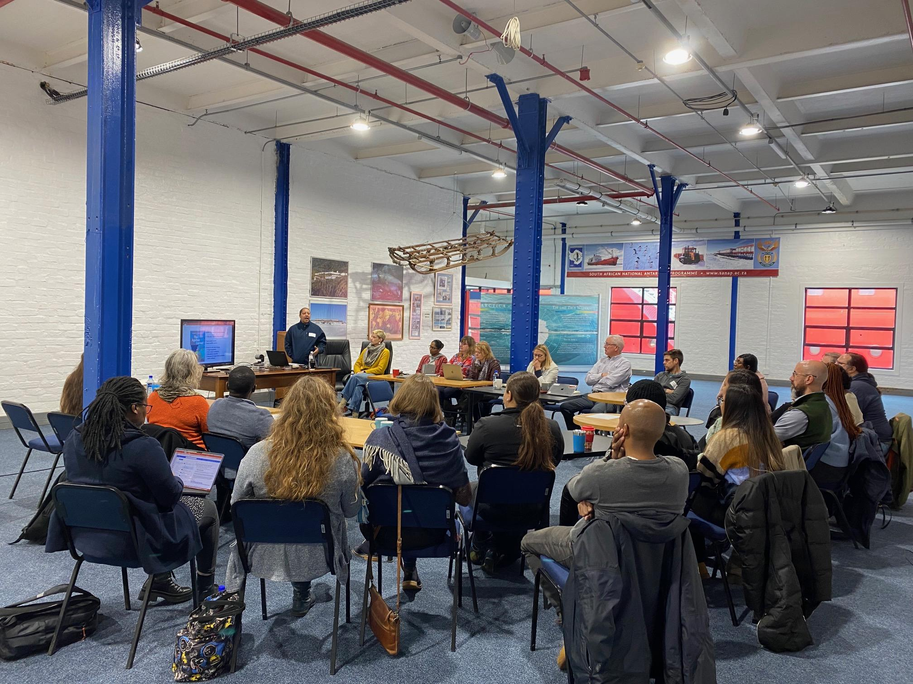
THE WORKSHOP
THE TEAM
South African Weather Service, NOAA, SAEON, and AtlantOS, GOOS Co-Design co-chairs
FOCUS
Begin the discussions in-country of using the Agulhas Current as a pilot for the GOOS Co-Design Boundary Current Exemplar Project
What do we know and what observations have been made / are being made of the Agulhas?
What are the needs of operational modelers?
Who are the stakeholders?
How can the SynObs OSSE project assist?
Notes:
Congratulations on making it through this year. Largely recovered, except ship-based activities where we WILL see a COVID gap in our records.
Despite the limitations from COVID, the community has responded and demonstrated dedication to ocean observing
OCG too
UN Decade (Wed)
Work and collaboration with UN Decade Programmes as they initiate
Time consuming endeavour. UN Decade activities are a pathway to change. Opportunity for more engagement (eventually resourcing???)
Things are becoming more clear, still need to be vigilant for duplication, efficiency, opportunity and developing and implementing the system.
How best for OCG to support networks with this?
EH Notes
What do we need this to do at the start of the meeting
Lay out some excitement about the agenda and aims
Show progress and good work across the year, responding to circumstances, focus on foci and actions from last year, acknowledge people's work, commitment, progress, ideas of exec (Vice Chairs) and networks - real successes we ahev had - we should be very clear on this - OCG, the networks gains recognition for efforts - in turn support our work to develop observing system
Other work to make OCG meaningful for OO - WMO IP etc
Challenges ahead
How our discussions this week will help guide OCG

Slide 24
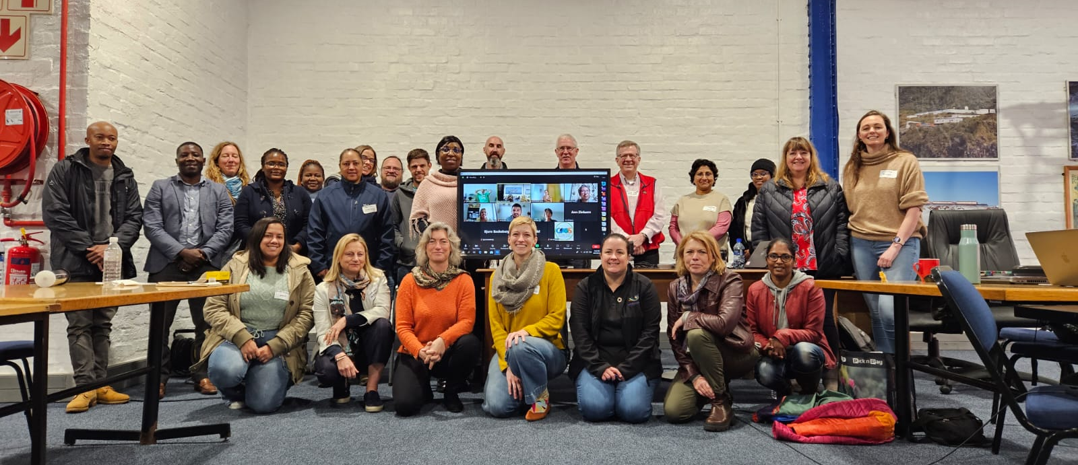
24 In-person | 10 Online
Representatives: OCG, GOOS, Observers, Modelers, Tropical cyclone and Marine Life researchers
Notes:
3 Emerging networks transitioning to mature status [AniBOS, OceanGliders, HF Radar]
Potential new networks interacting with OCG [Smart Cables, Ship based ocean time series, USV OASIS, Marine Debris]

Slide 25
KEY QUESTIONS
Requirements and key questions raised by modelers and researchers
Validate LACCE along the altimetry areas through in-situ
Where is the cooling inshore originating from?
What is driving seasonal differences ?
What is driving the latitudinal variability in Temp., Salinity, Chl, and Oxygenation?
Tracking of mesoscale eddies
Understanding the intrusions: warming and cooling
Notes:
MOU between GOOS and MBON and OBIS need to be renewed, Panel would like to propose the MOU that GOOS Exec can implement
The BioEco Panel co-chairs are currently discussing potential attendance at the GRA Forum (date still being decided but likley to be early 2024) to discuss emerging BioEco networks and to further facilitate uptake of BioEco EOVs into the GRAs.
https://obis.org/2016/12/15/goosgeobonobis/

Slide 26
POTENTIAL ACTIONS
Review Paper focussed on the societal and weather impacts of the Agulhas Current, observational capabilities and key questions
Call for Steering Committee for Boundary Currents to assist with:
Prioritization of action
Identification of Stakeholders
Resource mobilization
Stakeholder identification and engagement to set priorities
Create best practices so other observing systems can follow this
Explore top down approach to get more government buy in and create stronger workforce
Post Doc solicitation to archive historical data
Notes:
MOU between GOOS and MBON and OBIS need to be renewed, Panel would like to propose the MOU that GOOS Exec can implement
The BioEco Panel co-chairs are currently discussing potential attendance at the GRA Forum (date still being decided but likley to be early 2024) to discuss emerging BioEco networks and to further facilitate uptake of BioEco EOVs into the GRAs.
https://obis.org/2016/12/15/goosgeobonobis/

Slide 27
Thank you!
Contact:
Tamaryn Morris - Tamaryn.Morris@weathersa.co.za
Ann-Christine Zinkann - ann-christine.zinkann@noaa.gov
Notes:
David
We’ve done a lot of work in planning our actions going forward. Let us know if there is a particular exemplar project that interests you. We would love to participate in focussed one-one calls about Exemplar projects that interest you.
We have exemplar leads
Thank you for participating in today’s call. I look forward to the discussion. S
Turn back it over to Emma to moderate the discussion.

Slide 28
OceanObs ‘24 Midway Conference
Tamaryn Morris, Juliet Hermes & Weidong Yu
OCG-14 Meeting, June 5-8, 2023
Breakwater Lodge, Cape Town, South Africa
Notes:
Ann

Slide 29
WHY A MID-WAY CONFERENCE?
THE PROBLEM
How do we engage better the LDCs, SIDS and other ocean observing communities to achieve a truly global ocean observing system?
THE GOAL
Help to strengthen and coordinate activities and recommendations from OceanObs’19
Drive open and honest dialogue
Engage with underrepresented countries in the ocean observing networks
Build onto existing ocean observing systems,
Support emerging and low-cost technologies
Promote open access to FAIR and CARE data principles
Notes:
Congratulations on making it through this year. Largely recovered, except ship-based activities where we WILL see a COVID gap in our records.
Despite the limitations from COVID, the community has responded and demonstrated dedication to ocean observing
OCG too
UN Decade (Wed)
Work and collaboration with UN Decade Programmes as they initiate
Time consuming endeavour. UN Decade activities are a pathway to change. Opportunity for more engagement (eventually resourcing???)
Things are becoming more clear, still need to be vigilant for duplication, efficiency, opportunity and developing and implementing the system.
How best for OCG to support networks with this?
EH Notes
What do we need this to do at the start of the meeting
Lay out some excitement about the agenda and aims
Show progress and good work across the year, responding to circumstances, focus on foci and actions from last year, acknowledge people's work, commitment, progress, ideas of exec (Vice Chairs) and networks - real successes we ahev had - we should be very clear on this - OCG, the networks gains recognition for efforts - in turn support our work to develop observing system
Other work to make OCG meaningful for OO - WMO IP etc
Challenges ahead
How our discussions this week will help guide OCG

Slide 30
DELIVERABLES (broad categories)
Deepening engagement and impact
Stakeholder connections
Observing system co-design
Messaging and communications
Indigenous knowledge and representation
System integration and delivery
Connecting open ocean to coastal observations
Data management and accessibility
Best Practices
Embracing scientific and technological innovations
New social/human impact Essential Ocean Variables
The role of the Ocean Decade
Notes:
Congratulations on making it through this year. Largely recovered, except ship-based activities where we WILL see a COVID gap in our records.
Despite the limitations from COVID, the community has responded and demonstrated dedication to ocean observing
OCG too
UN Decade (Wed)
Work and collaboration with UN Decade Programmes as they initiate
Time consuming endeavour. UN Decade activities are a pathway to change. Opportunity for more engagement (eventually resourcing???)
Things are becoming more clear, still need to be vigilant for duplication, efficiency, opportunity and developing and implementing the system.
How best for OCG to support networks with this?
EH Notes
What do we need this to do at the start of the meeting
Lay out some excitement about the agenda and aims
Show progress and good work across the year, responding to circumstances, focus on foci and actions from last year, acknowledge people's work, commitment, progress, ideas of exec (Vice Chairs) and networks - real successes we ahev had - we should be very clear on this - OCG, the networks gains recognition for efforts - in turn support our work to develop observing system
Other work to make OCG meaningful for OO - WMO IP etc
Challenges ahead
How our discussions this week will help guide OCG

