Slide 1
Dialogues with Industry
Shaping the future ocean observing and services market
Emma Heslop
Act. Director Global Ocean Observing System (GOOS)
Donna Kocak (MTS/L3Harris), Zdenka Willis (MTS), Peer Fietzek (Kongsberg Discovery), Michelle Heupel (Integrated Marine Observing System), Ralph Rayner (NOAA, IOOS Office), R Venkatesen (MTS India), Monica Ostrander (MTS), Liz Tirpak (NOAA), Matthew Hodanbosi (NOAA)

Slide 2
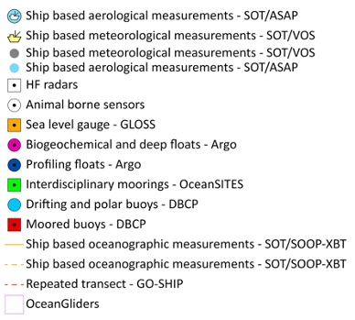
GOOS Today
84 countries, 8,700+ observing platforms, 13 global networks
More than 100,000 observations per day - delivering an accessible, safe and productive ocean
Global observing networks, e.g. Argo, GO-SHIP, Drifting Buoys, plus emerging networks, e.g., OceanGliders, HF Radar.
“The weather forecasting systems will run off the rails if they don’t have the surface pressure information over the ocean to constrain them” - Lars Peter Riishojgaard, Director of the Earth System Branch WMO
www.ocean-ops.org/reportcard2022
Notes:
In the last 30 years, GOOS developed -
Mature networks drifting buoys, voluntary observing ships, tide gauges, Argo floats, and emerging networks; HF Radar, ocean gliders
Ocean Observing is big science

Slide 3
We face key challenges in expanding observations and enhancing fit for purpose of our observing system What is the role of the private sector?
Notes:
Ocean Observing has made great progress… BUT not sufficient for societies current and future needs but
Right now, we are driving into our future in darkness. And GOOS aims to turn on the headlights.

Slide 4
Why
Societal need for expanded ocean observations and services is increasing exponentially – driven by key factors:
Climate Change – forecasts, adaptation, investment in carbon storage
Ocean management – ecosystem services and sustainable blue growth
Dialogues with Industry is a significant opportunity to connect the public and private sector stakeholders in the Global Ocean Observing System
Identify opportunities
Lower barriers
Market immaturity inhibits the speed and efficiency of system development
New technology needed, but no established fast-track for technology
Notes:
A quick re-cap of why we embarked on this effort
We wanted to really develop a systematic, and that's key, systematic mechanism for information sharing across the public, private, and academia, and highlight opportunities where we could act together for mutual benefit
We learned through this effort that terminology continues to be confusing.
But I wanted to make sure we understand the term Ocean Enterprise.
The Ocean Enterprise includes all entities in the public, private, nonprofit/NGO, research and academic sectors that provide infrastructure and capacity for ocean observation, measurement, and forecasting, or who deliver operational ocean information services
This is the premise of the effort to identify those opportunities, identify and then lower the barriers, and to be able to meet the new demands that are going to be required of the ocean observing system. How do we mature this enterprise? What are the market inhibitions? How do we speed up technology to market, and how do we do that in a coherent and cohesive way?

Slide 5
Market Components & Challenges
No consistent view of technology needs
Lack of visibility of market potential; fragmented market with small unit numbers
Lack of visibility of R&D efforts in academia; limited partnering with industry; duplication of development work
Interaction of new commercial services with established operations
High unit costs and no universal standards; variable manufacturing/calibration quality
System resilience with limited suppliers serving other markets
Dialogues with Industry, Background Paper

Slide 6
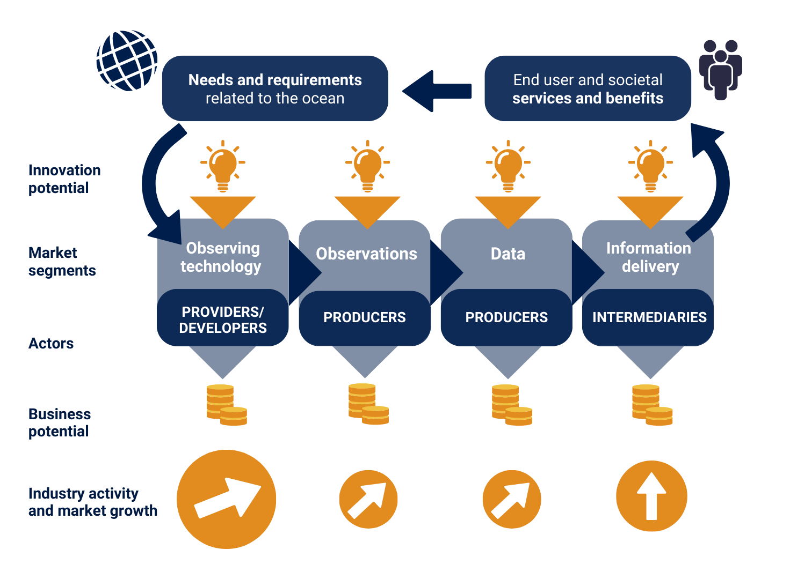
Dialogues with Industry
Facilitate dialogue between government, science and industry across the value chain
Lower barriers and increase opportunity for private sector engagement and partnership
Recommendations for GOOS, government, science, and industry to act on
4 Sessions: Sep 2022 – Feb 2023 – value chain
Opportunity to expand observing capacity, increase efficiency, and support blue economy

Slide 7
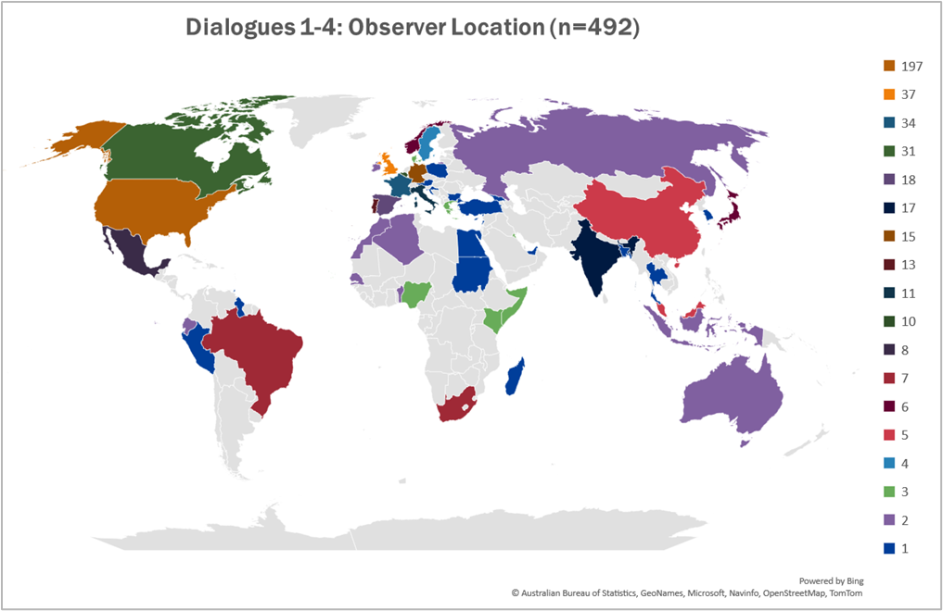
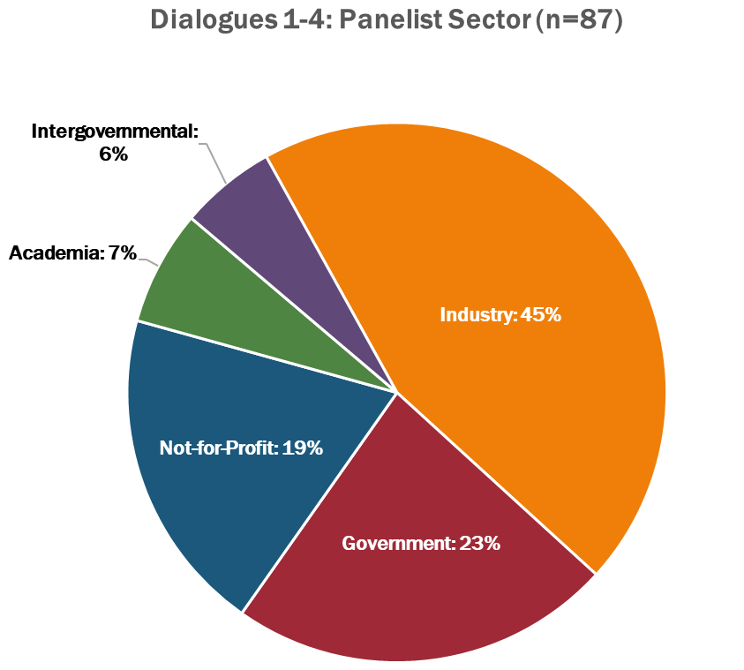
Participant Demographics
Notes:
The panelists were invited to participate. The focus of the panelists was on representatives from the industry and not-for-profit sector. Across the four Dialogues with Industry sessions, 69% of the participants were from that sector. While a global distribution of panelists is the goal, the heavy participation by North America, Europe, and Australia follows the current market trend of companies within the marine sector.
But when you look at it across the world, it is somewhat reflective of where we know the ocean businesses exist currently. It is certainly somewhat reflective of the planning team and who we knew, but it definitely shows that we are not reaching the entire globe. And as we look at going forward in discussing these results, we need to make sure that we are conscious that we are getting into parts of the world that are not represented here.

Slide 8
Initial Synthesis: Focus areas
❶
❷
❸
❹
Improving the market
Societal/ Governmental change
Collaboration to grow
Market elements shaping the future
Notes:
First and foremost Ocean Observing and Services must be viewed as essential to lives and livelihoods of everyone, on par with the Weather Enterprise. This does not exist now. Too often ocean observing is considered ancillary.
While the dialogues followed the value chain, common themes emerged. These are represented by the 4 focus areas that reflect essential actions needed across the Ocean Enterprise market. Under each of the focus areas, twelve categories were identified to expose unseen dynamics of the ocean observing and services market to help structure the intended future conversations with stakeholders.
. That we coalesced recommendations into four focus areas, and that we had four dialogues, is purely coincidental – the four focus areas we used to bring together the 12 categories of recommendations do not map to each dialogue. Instead, input from each of the four dialogues is spread across all areas of the report synthesis.

Slide 9
❶
Ocean Observing and Services not seen as an independent market activity
Understanding/articulating the market size drives investment
Fragmented market hinders investment
Aggregation of Demand is missing
Lack of sustained funding in the public sector stymies growth
Ocean observing can de-risk Blue Investment but Investors do not understand the capability the Ocean Enterprise
New markets will be driven by applications rather than general concepts
Low cost/easy to use NOT low cost/low risk to develop
Industry needs assurance of market after development
New Actors
Improving the market
Notes:
Understanding and articulating market size helps facilitate and drive investment. It is the perception that today's market is fragmented, it's a niche, it's specialized, one-off sensors and can be a static market.
Ocean Observing and Services not established as an industry. While we are seeing an significant increase in companies making sensors/platforms/offering these as services – hard to capture impact. The OE study by US, Canada and UK have captured this – not systematically captured in industry codes/studies
You told us that there is uncertainty by Blue market investors because Blue investing is risky. They believe more Ocean information could help them de-risk investments but they are unaware of the Ocean Enterprise Capacity.
Is ocean observing and services actually an ocean activity that can be systematically measured? So that's one thing that we needed to look at, and that fed into market aggregation, understanding that market impact, and having the need to have more market reports and market understanding.
We heard that specific applications will drive the observing market and regulations and international conventions can help spur this
Risk took on a number of forms, but by and large, it is how do we create an enabling environment to move towards economies of scale and away from the high cost, high risk, customized, one-off, short-term projects? We need a market that has the ability to quickly scale to manufacturing. We need to be able to create a market that has volume purchases, does not over-design, and that clearly the user's needs are understood so that we can make that fit for purpose.
Bringing in new actors - The introduction of new technologies is hard, particularly if you're an operational agency and you have a mission to provide, how do you insert the new technology while still delivering on that operational capability? Further, industry has sometimes found that agencies and observing systems networks are a closed club and hard to break into, which can be a distinct disadvantage to small and medium businesses that are often agile and have the potential to provide disruptive technologies.

Slide 10
❷
Perception change needed from ocean data from being peripheral to essential
Critical infrastructure
Data and Missions as a service – a paradigm shift
Multi-sectoral ocean observing architectures require a better understanding between sectors & are not risk-free
The private sector - Data is an asset
Adopt licensing schema that supports public sector missions and private sector profitability; academic sector access
Societal/ Governmental change
Notes:
Understanding the differences between the motivations, timelines and expectations across the Ocean Enterprise sectors is fundamental to realizing a high functioning multi-sectoral ocean observing system. That's not unknown, but we need to continue to reinforce that.
Data as a mission and service – represents a new way of doing business that presents both opportunities and risks. This will involve a cultural shift on how the public sector does business. It does not come without risk, particularly when regard to looking at that data sharing, and how do you put together end user license agreements that allow for that market productivity but still is reasonable for the mission of an agency, and yet does not leave our academic partners and international agreements behind? We can look to the space enterprise and the weather enterprise from that perspective.
Ocean data perception
Goes back to my opening statement – Ocean data can not be ancillary. This extends to branding, clear communication, and imparting ocean literacy at all levels of education with reach out to different departments at the graduate and undergraduate level – Use real-world problems of societal/national/international concern that are grounded in ocean science as a means to expose individuals outside of the ocean community to the importance of the ocean.
Ocean information and services must be considered critical infrastructure

Slide 11
❸
Standards – a significant barrier to accelerating the Ocean Enterprise
Largest component today producers, largest component on the future Intermediaries?
The blurred lines between the roles of public and private components can create an impedance for the private sector.
Public and Private sector data complementary
Public data is still confusing
Private sector data being made interoperable to be ready to plug into future market areas
Some classes of data may never be profitably generated
Collaboration to grow
Notes:
So looking at areas to grow, our whole core team was, surprised that was brought up in all 4 of the dialogues. And what you told us about standards is that, that's both for hardware and software, those protocols not being there is a significant barrier to growth and that we need to be able to be transparent. It levels the playing field. But the key here is, what standards are most impactful and how do we go about really working towards a few standards that will really make a big impact?
When we talk about intermediaries, those that are taking the ocean information and providing value. We see great aspects for the growth in this area, but where is that cultural shift from the public sector that starts to rely on an intermediary providing that service? One could say the same thing for the providers of ocean platforms providing missions or data as a service. As both of these areas grow how will the public agencies’ perceptions shift to be able to accommodate the private sector. That's going to take a lot of discussion as to where that lines should be between public and private roles. We suggest that line will always be a blur but one that will require persistent conversations.
Data access continues to be an area we need to focus on. Two areas. One, can we get to that data easily? We have major programs out there, GOOS, IOOS, IMOS, EMODnet, all providing these portals, but yet we still have this concern that it's not easy to get to that data. So what are those issues that remain, that we need to continue? Where are those siloed datas? How do we work across corporate to be able to release that data as well?
Blue tech, clusters a and accelerators. They are beneficial but can be overwhelming as this space as grown rapidly in the recent past. Making sense of these efforts through pilot projects that would highlight new technologies represent a multi-sectoral ocean observing architecture to solve a problem/ocean observing gap. The project could serve as a blueprint for achieving a multi-sectoral observing architecture and mixed public, private and academic investment, development and testing.

Slide 12
❹
Significant obstacle to market growth is the hiring a skilled workforce
How do we attract talent from other sectors?
Careers in Industry should be on par with careers in academia
Tech Transfer - Early engagement with commercial partners is critical for transitioning innovation from the public and academic sectors
Funding for anticipation of market technology future needs
Future lies in finding the right combination of devices and the platforms on which they are deployed to address specific use cases
Biggest transformation - new generation of sensors, which will provide insights into biochemistry, ocean health, and marine life
AI/Machine learning can be used for the characterization of big data
Market elements shaping the future
Notes:
Work Forces came up in every dialogue. A universal issue that will require a coordinated Ocean Enterprise wide campaign to solve. There is no simple answer to this. This is a collective initiative that we can all work together on communicating the value and the passion and the enthusiasm we have for careers in the ocean-related fields, and how do we communicate that?
Technology Transfer – These are not new issues but the reinforcement of working with industry early to ensure successful transfer and the need remains for public programs that can truly help with the transfer of new technologies to a scalable and sustained commercial markets
Emerging Technology – many examples of exciting work that ranges from AI, to Communications to new sensors, from Molecular technology, autonomy to muli-purpose to crowdsourcing. To reiterate reaching across to different industry sectors to advance these technologies and creating hubs that provide a credible source of reliable information can help create the aggregate market demand that you told us was going to be crucial to grow this Ocean Enterprise.

Slide 13
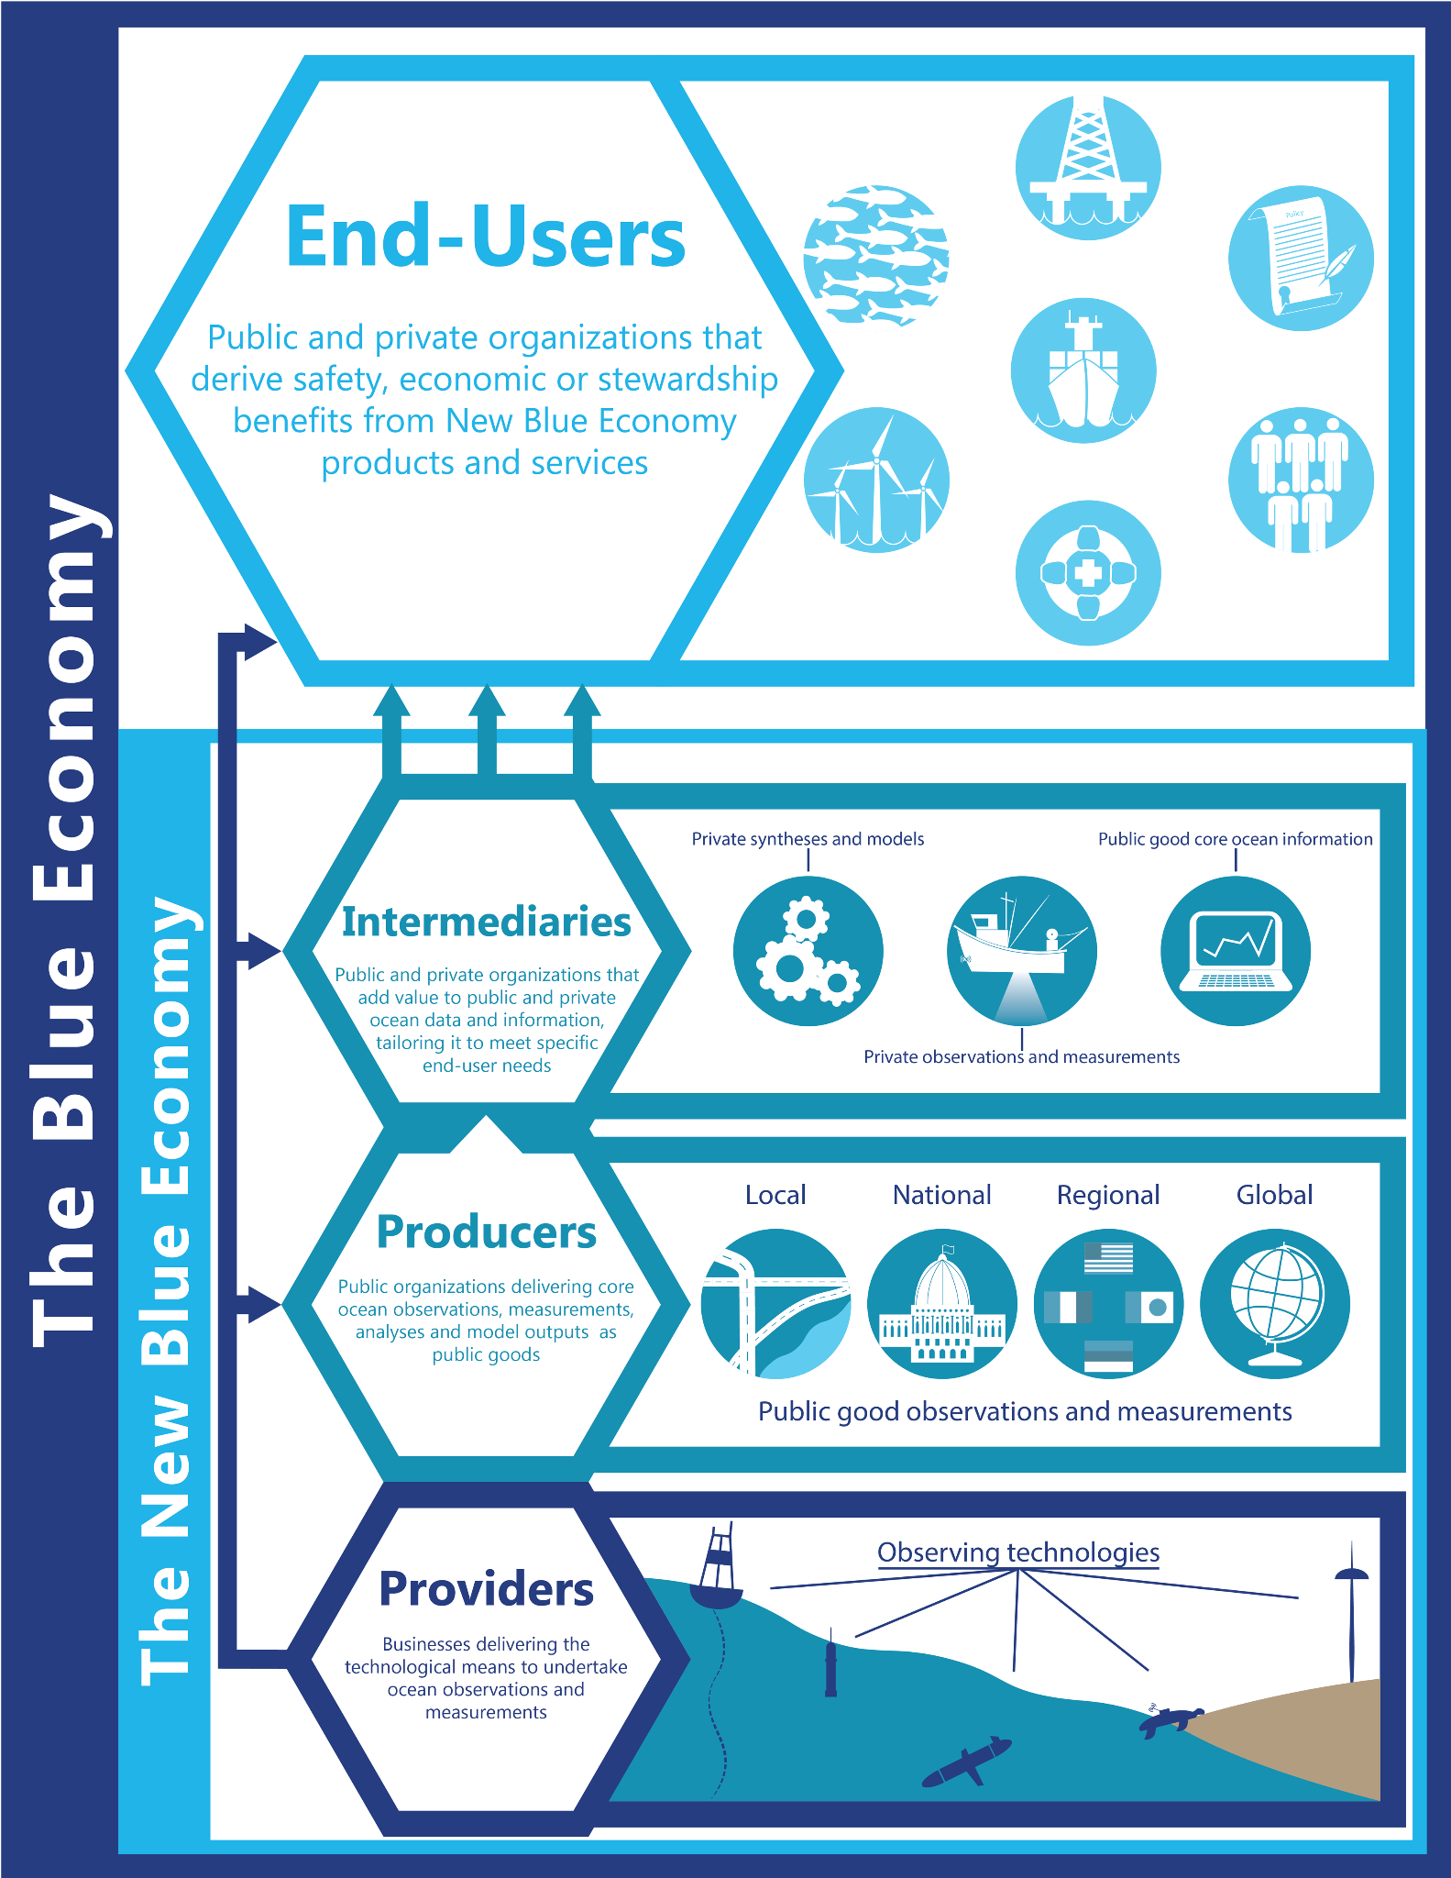
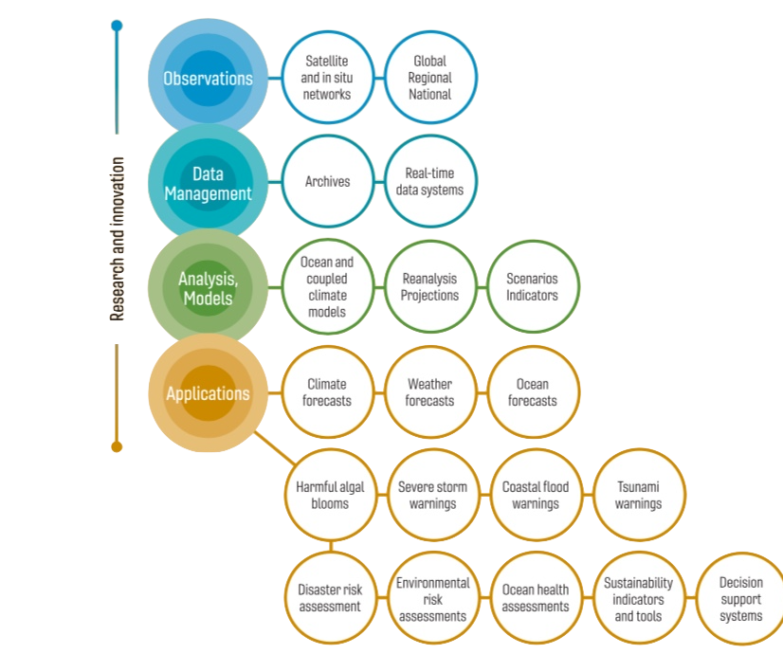
Underpinning a wide range of applications
Vision: A truly global ocean observing system that delivers the essential information needed for our sustainable development, safety, wellbeing and prosperity
Notes:
2019 IOC Assembly adopted a Global Ocean Observing System 2030 Strategy which now informs our work
Ambitious – need a step change to deliver a fit-for-purpose system
Eleven Strategic Objectives guide our planning
System integration and delivery are the ‘core’ of GOOS ‘business’ today
Deepening engagement and impact are key priority - only achievable through partnership with key stakeholders
Going to look at 3 important axis of this partnership with stakeholders – co-design of fit for purpose system, increasing partnership with private sector and across the UN

Slide 14
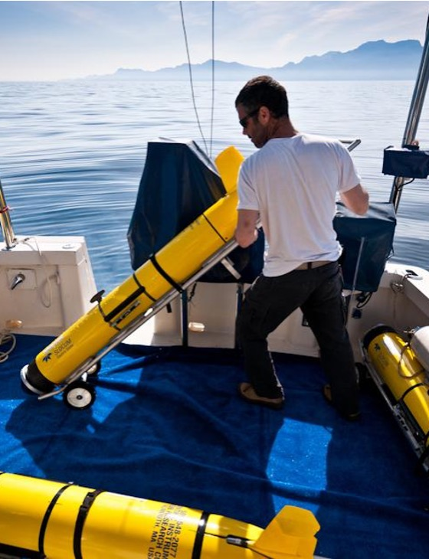
OCG - interaction
Standards
Aggregation of demand
Funding for anticipation of market technology future needs - c-funding to de-risk
Government sustained funding

Slide 15
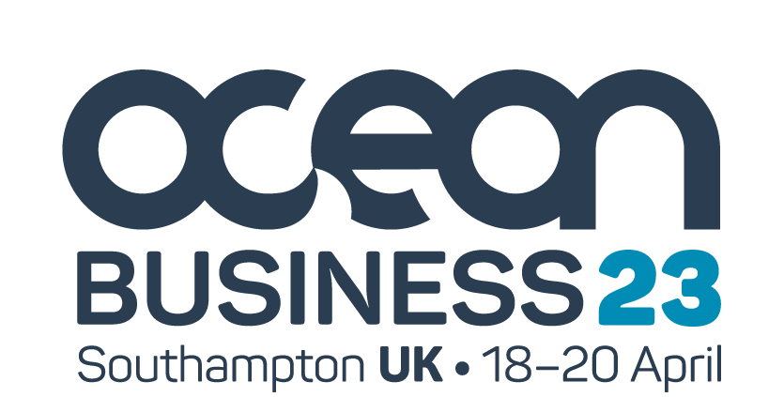
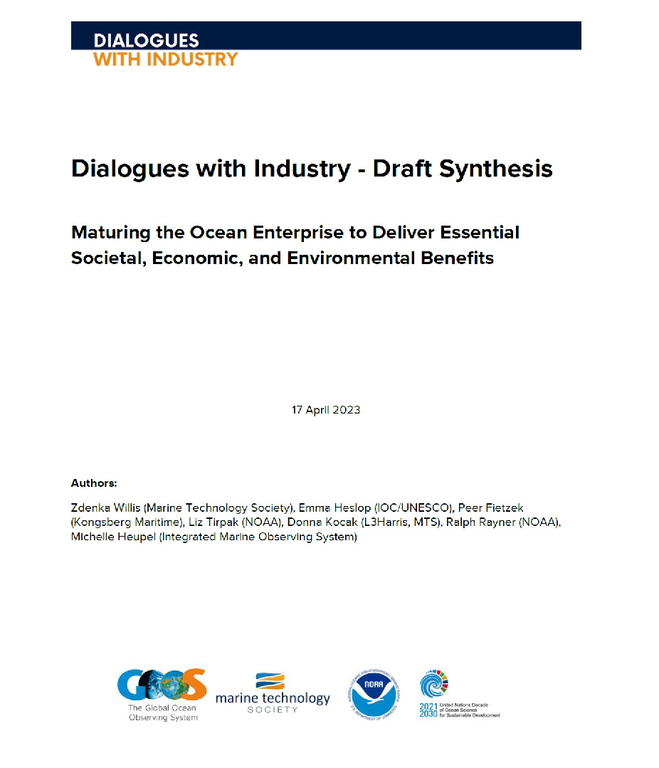
Next Steps
18-20 April 2023
Summer 2023
Fall 2023
Community engagement
Final Synthesis Report
Build a Vibrant Ocean Enterprise
May-Aug to prioritize recommendations and near, mid-term activities
Focus Sessions: Help us Realize a Robust Ocean Enterprise
Notes:
Sense of commitment to talking further and exploring actions through projects
Aim is to do something
Many next steps in the report released today
Can’t all be done
Can’t be done without the private sector engagement - to explore and what resonates and what doesn’t Tiek down key action.

Slide 16
Collaboration between science, the private sector and governments is key to propel development of the technologies we need.
Discover the Dialogues with Industry Background Paper, 4 Dialogue reports and draft Synthesis Report here

Slide 17
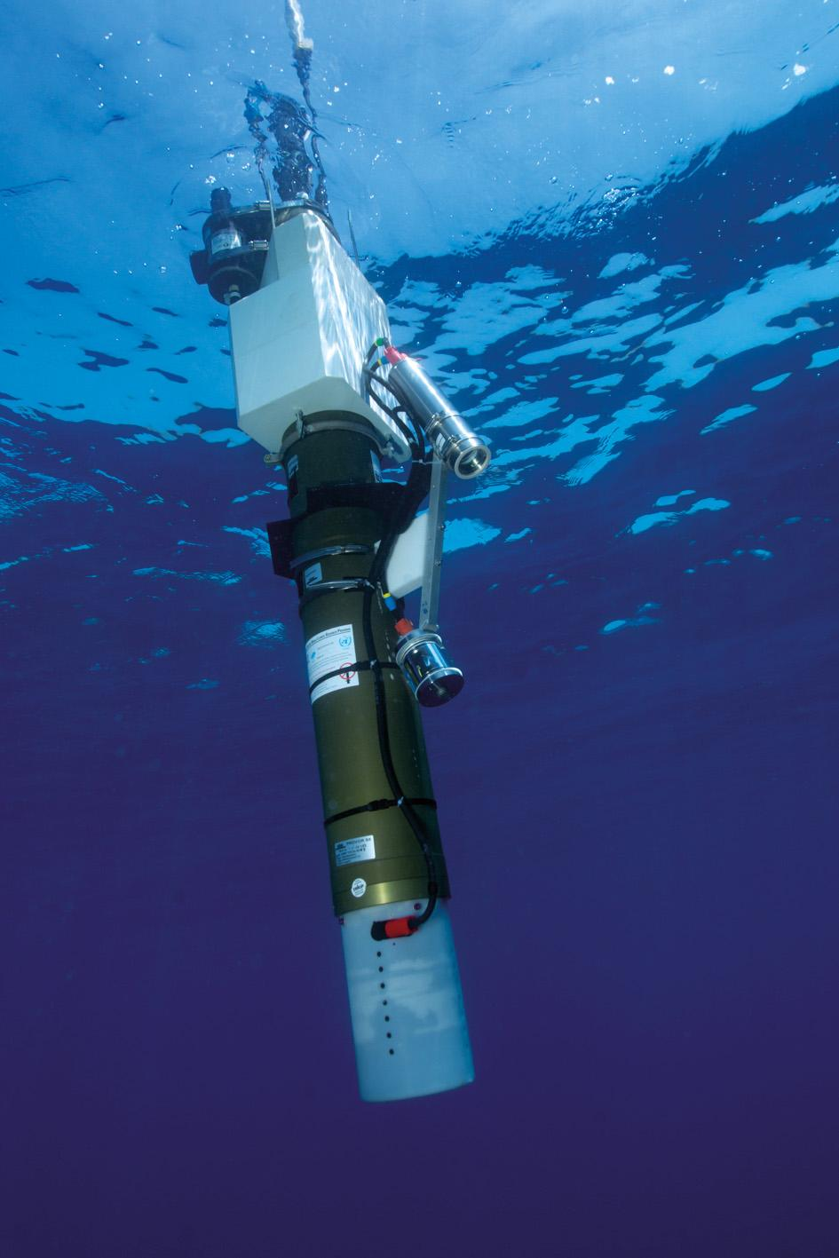
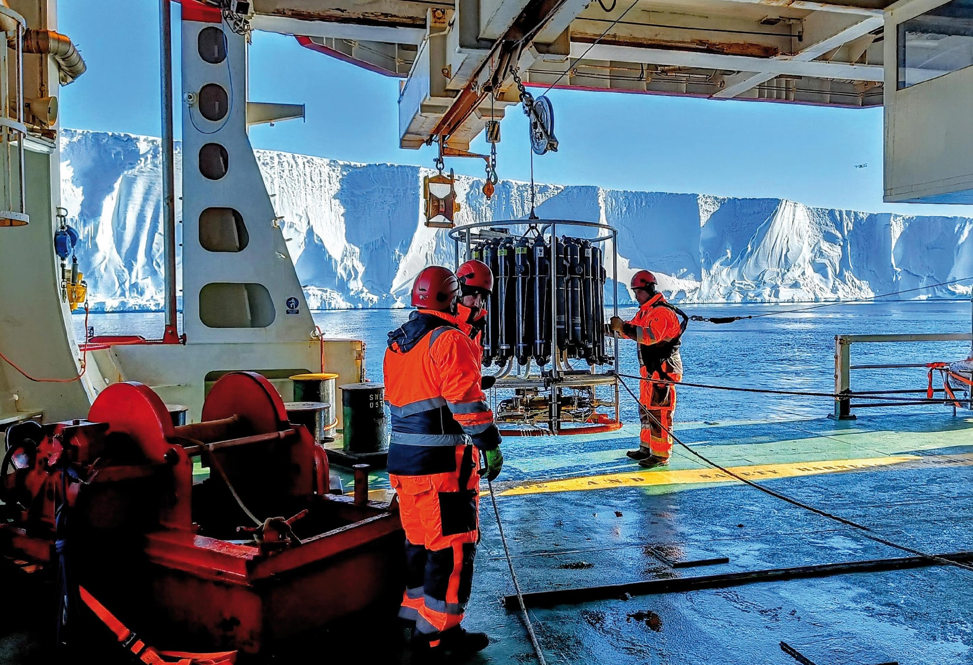
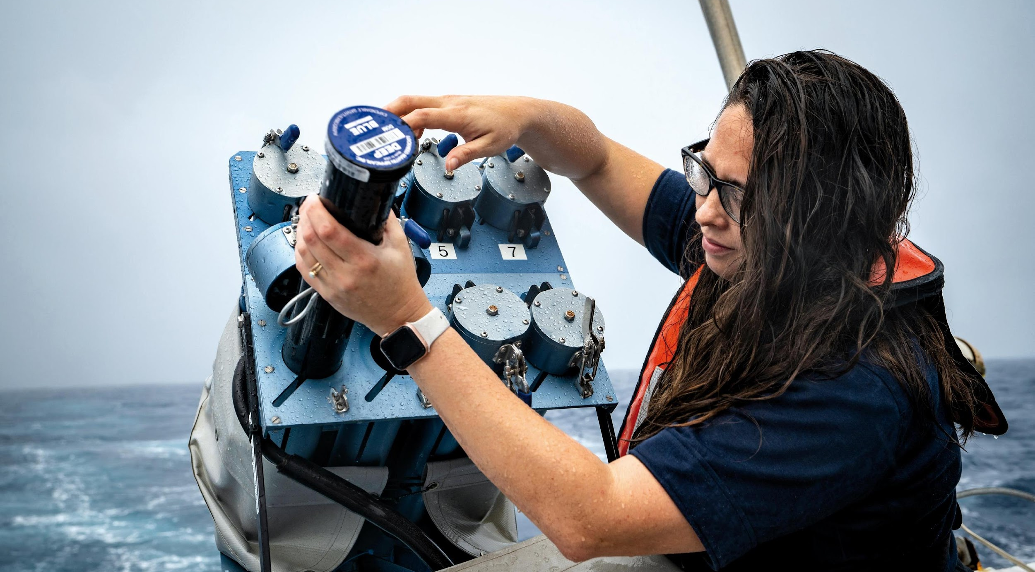
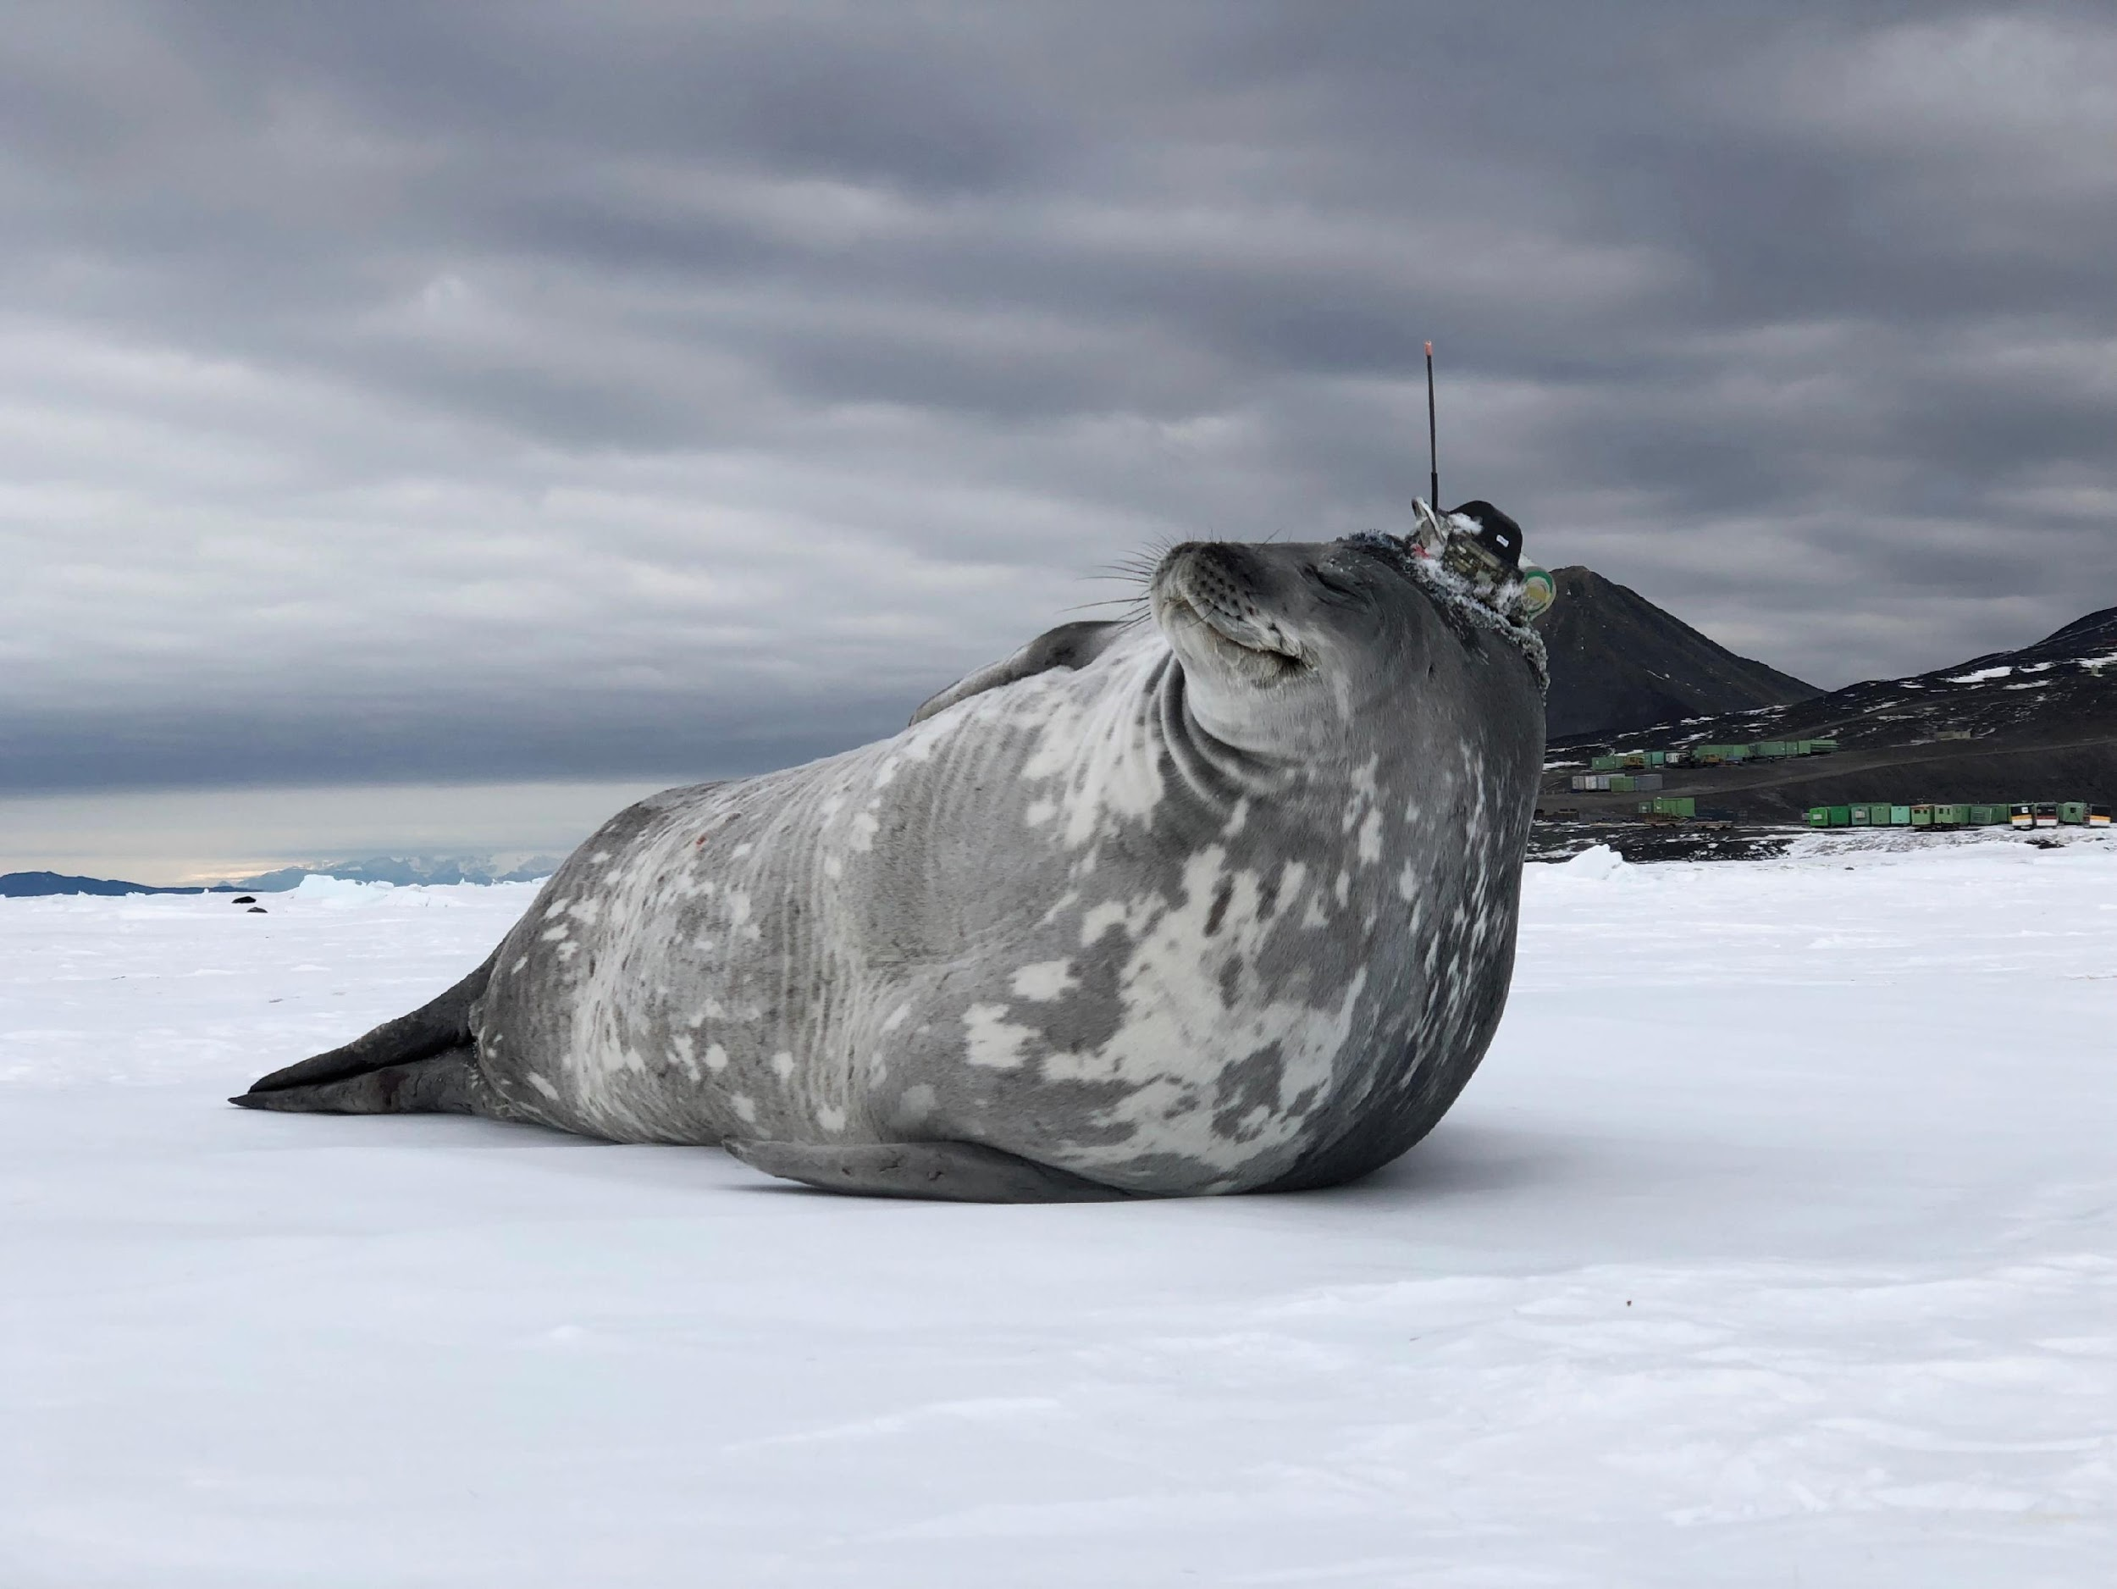
Thank you
goosocean.org

Slide 18
Market Components & Benefits
A mature market across the value chain would:
Have more clarity and planning capacity; growth and more industrial engagement
Show enhanced manufacturing efficiency
Foster demand for technological/service and spur faster innovation
Lead to a drop in cost for data and more targeted products
Enhance the data flow and enable information products
Increase in sustained ocean observing system capacity globally
Dialogues with Industry, Background Paper

Slide 19
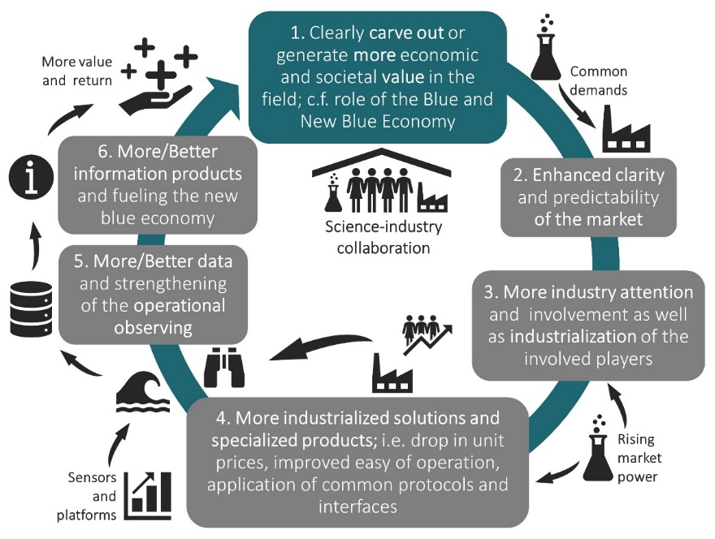
A more industrialized and mature Ocean Observing Environment
through enhanced collaboration and common goals
No competition between academia (societal impact, knowledge generation) and industry (economic success, sustainability aspects);
Distinct sectoral strengths 🡺 Various options for win-win initiatives!
Source: Fietzek 2021

