Slide 1
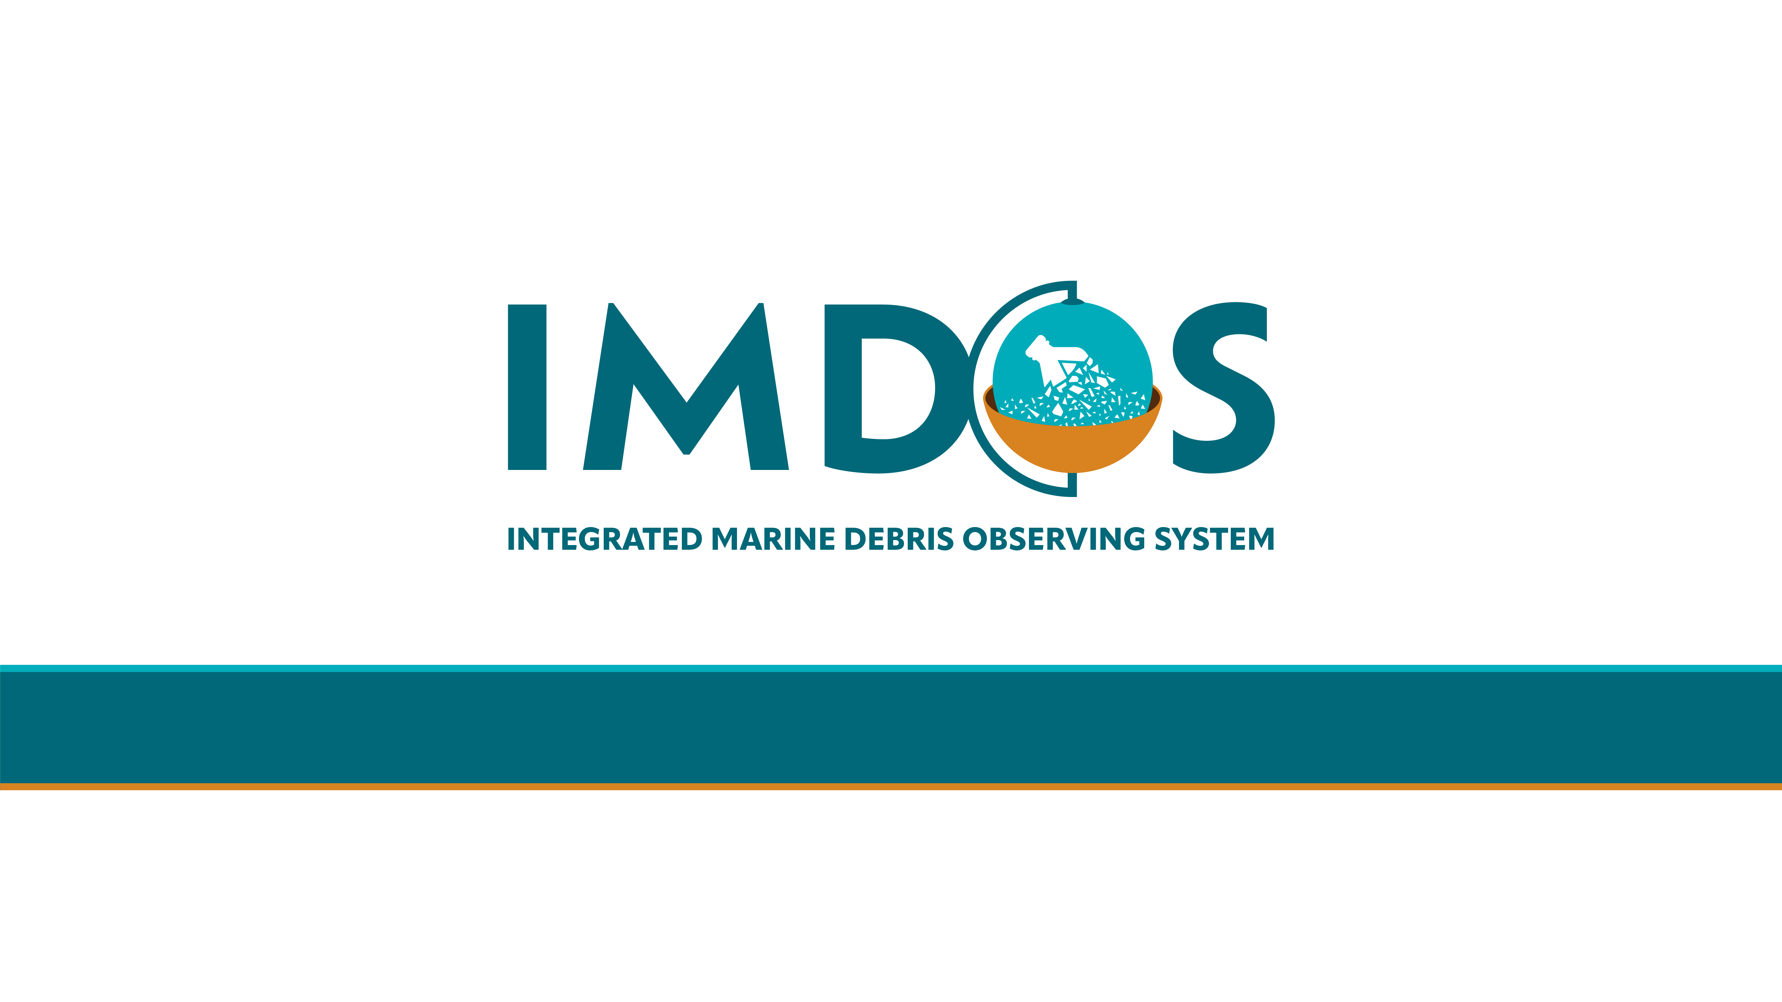
Coordinated observations of floating plastics
a key component of a future
Integrated Marine Debris Observing System
Mine Tekman – Mercator Ocean International/GEO Blue Planet Consultant, Türkiye
Artur Palacz - IOCCP Project Officer / IOPAN, Poland
Audrey Hasson – Mercator Ocean International/GEO Blue Planet, France
OCG-14, 7 June 2023
Notes:
Following up on previous discussions at OCG meetings, I would like to give a brief update of latest IMDOS developments around the potential of setting up coordinated observations of floating plastics as a key component of IMDOS, in line with the attributes of OCG networks.

Slide 2

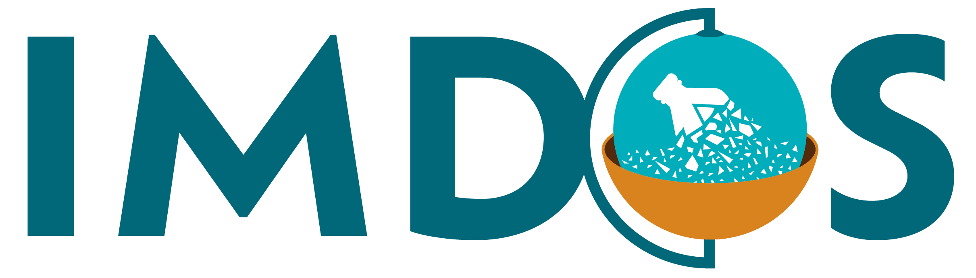
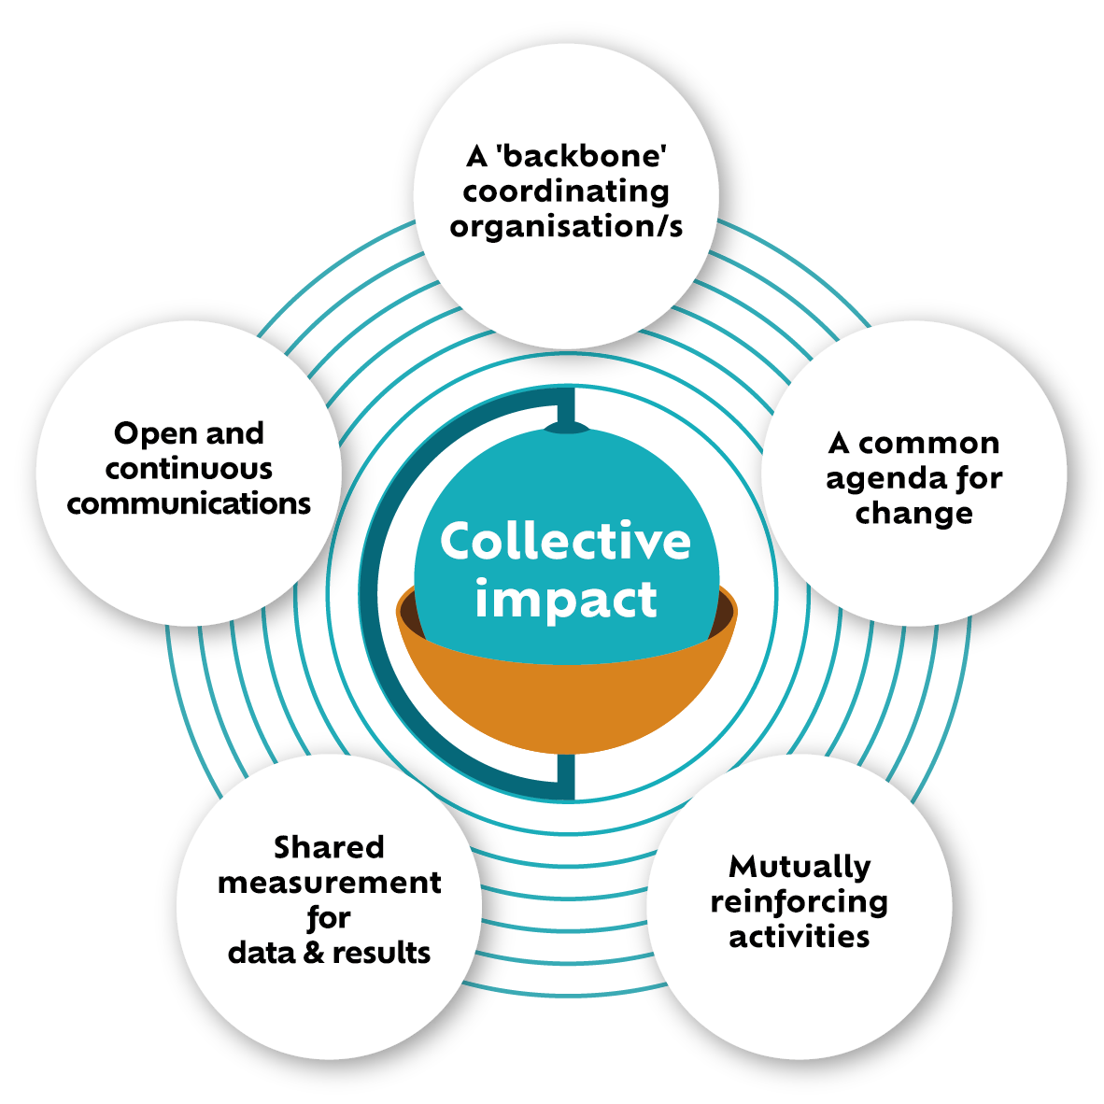
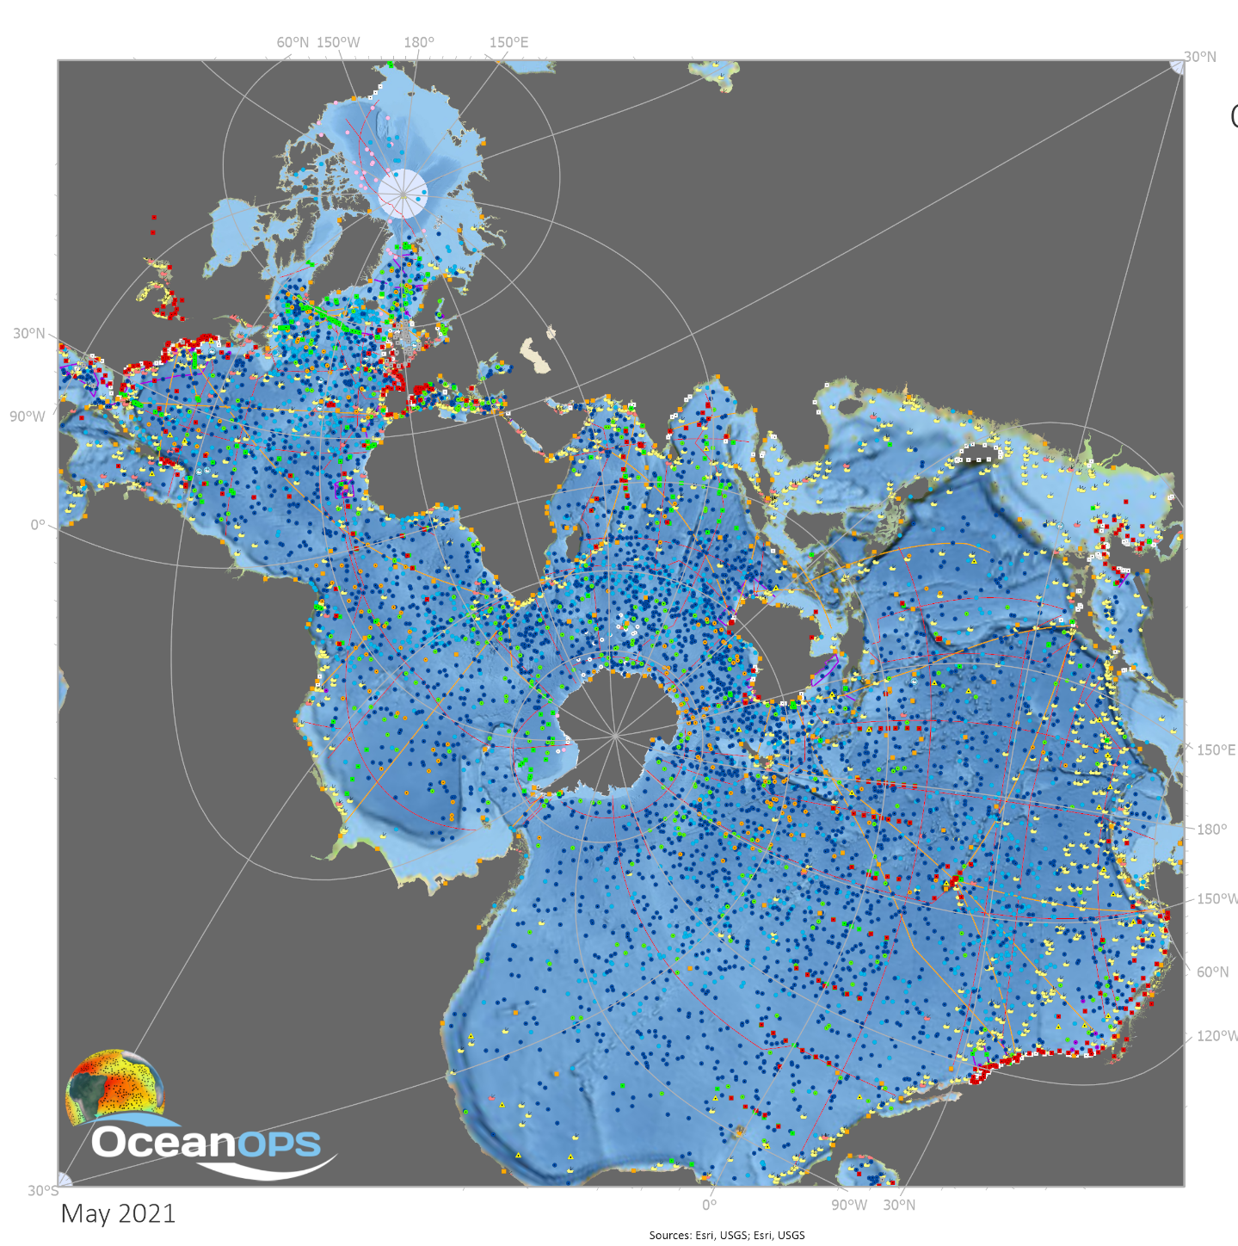





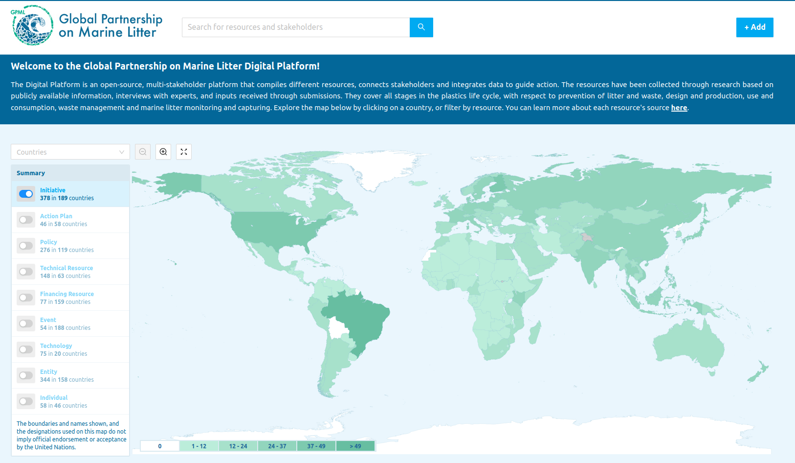
Integrated Marine Debris Observing System
https://digital.gpmarinelitter.org
Providing guidance and coordination for a global sustained observing system to strengthen the scientific knowledge on marine debris/litter pollution.
Notes:
Just a quick recap of what the mission of IMDOS is. IMDOS aims to provide guidance and coordination for a global sustained observing system to strengthen the scientific knowledge on marine debris and litter pollution. IMDOS thus responds to the growing demand from environmental managers, states, institutions and initiatives, many of which are brought together under the umbrella of the Global Partnership on Marine Litter, to form a coordination group and a technical platform dedicated to harmonized marine litter monitoring.
Recognizing the complex landscape of organizations and initiatives addressing the challenge of marine litter pollution, we want to build IMDOS according to the principles of collective impact organizations which are summarized on the diagram on the right.

Slide 3

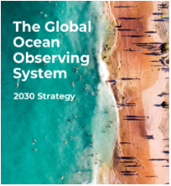
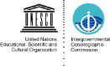

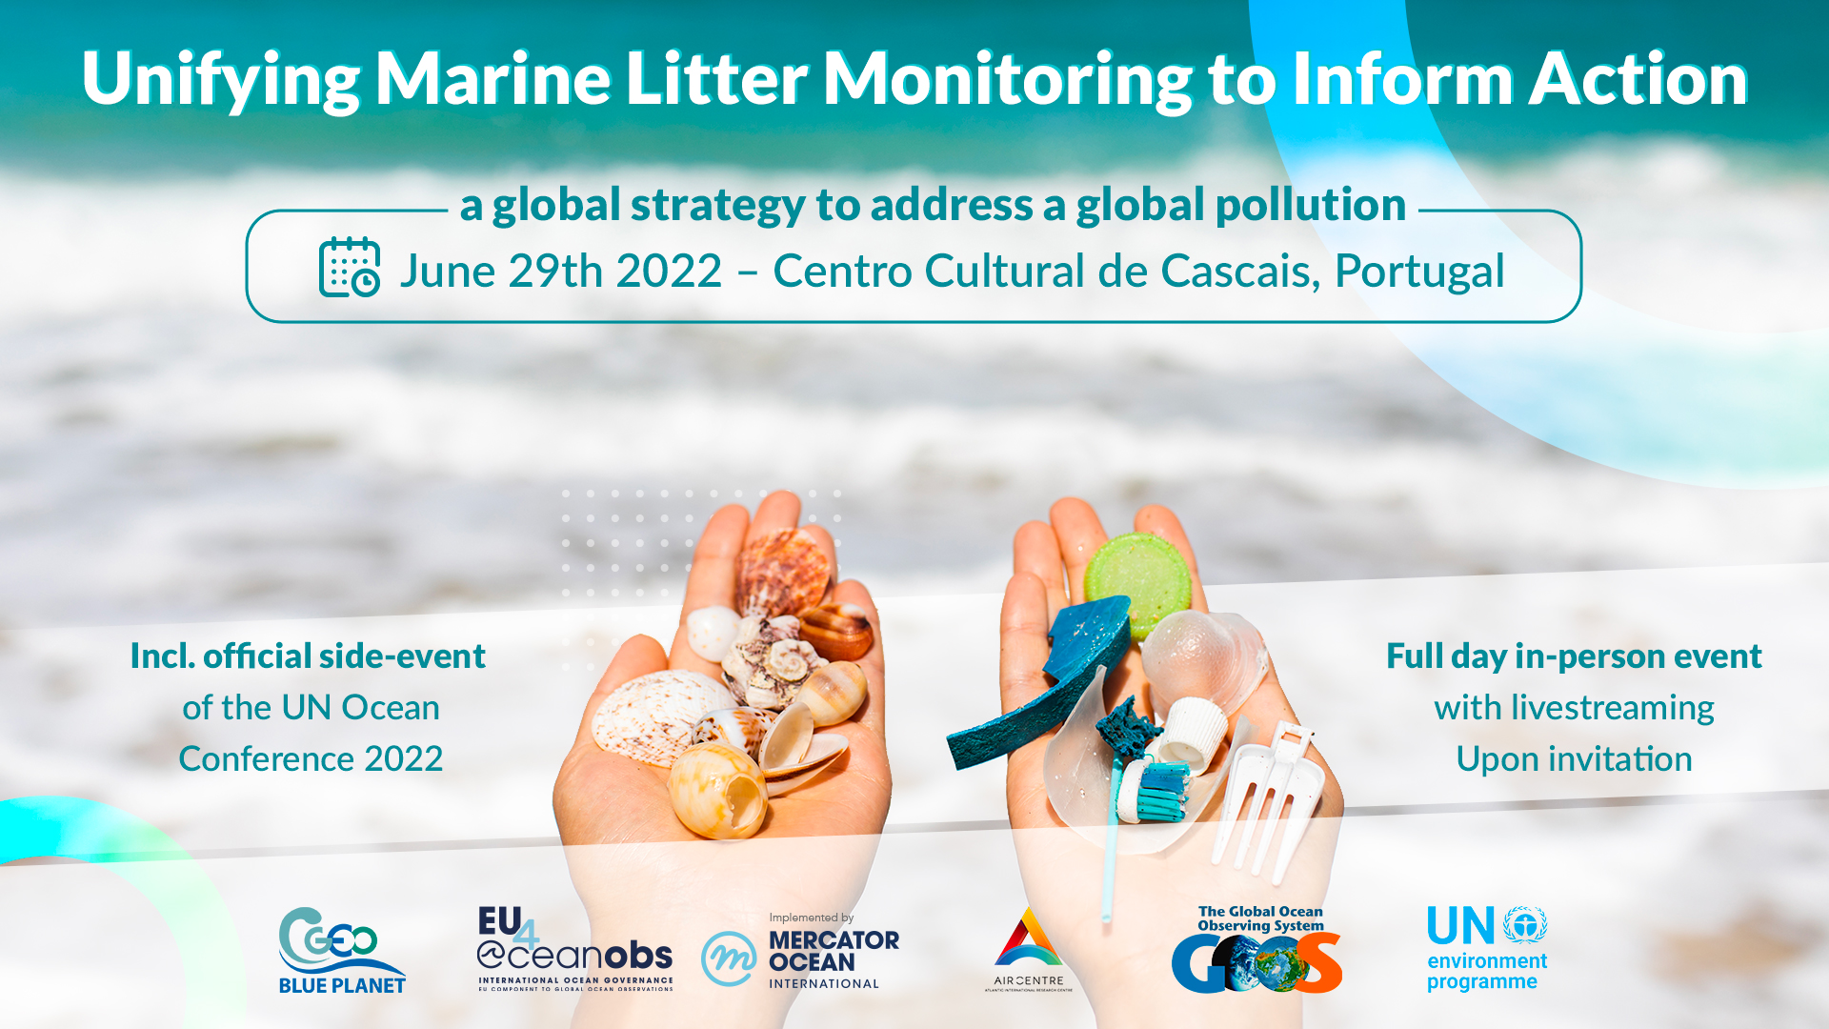
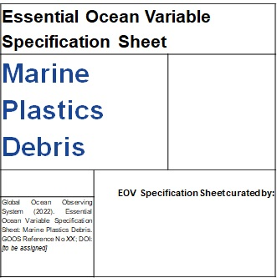
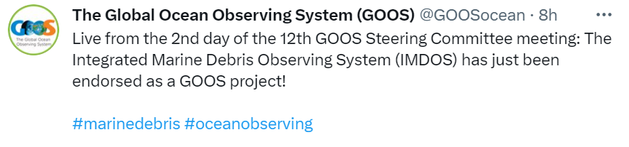
IMDOS: from vision to implementation
IMDOS is a joint initiative of GOOS, GEO Blue Planet and UNEP GPML - launched during the UN Oceans Conference in 2022
International Interim Steering Committee, Terms of Reference and an interim distributed Coordination & Communication Office
IMDOS Strategy and Implementation Plan under development
Marine Plastics Debris EOV under final community review
Endorsed as a GOOS Project during GOOS-SC-12 in April 2023
Version: 1.0 - April 2022
Notes:
Since 2019, we have been gradually moving IMDOS from an ambitious community vision to implementation. Formally launched during a dedicated side event during the UN Ocean Conference in Lisbon in June 2022, IMDOS is a joint initiative of GOOS, GEO Blue Planet and UNEP GPML. Through this unique strategic partnership, IMDOS is well placed to fill to the void for a technical coordination body to support global marine litter monitoring.
By now, IMDOS has an international Interim Steering Committee, its provisional Terms of Reference and a distributed Coordination and Communication Office with up to 5 staff members working partially.
During the 12th Session of the GOOS Steering Committee, IMDOS was officially endorsed as a GOOS Project. It was recommended that more details of implementation be presented. As the IMDOS Strategy and Implementation Plan are currently under development, we hope to meet those expectations by the end of this year.
Very important, withing the EU H20202 EuroSea Project, a Specification Sheet for new EOV for Marine Plastics Debris has been developed in response to a direct request from GOOS SC to develop this as a new type of Human Pressure EOV. Pending final community review this year, it will be presented to GOOS Steering Committee for acceptance.

Slide 4
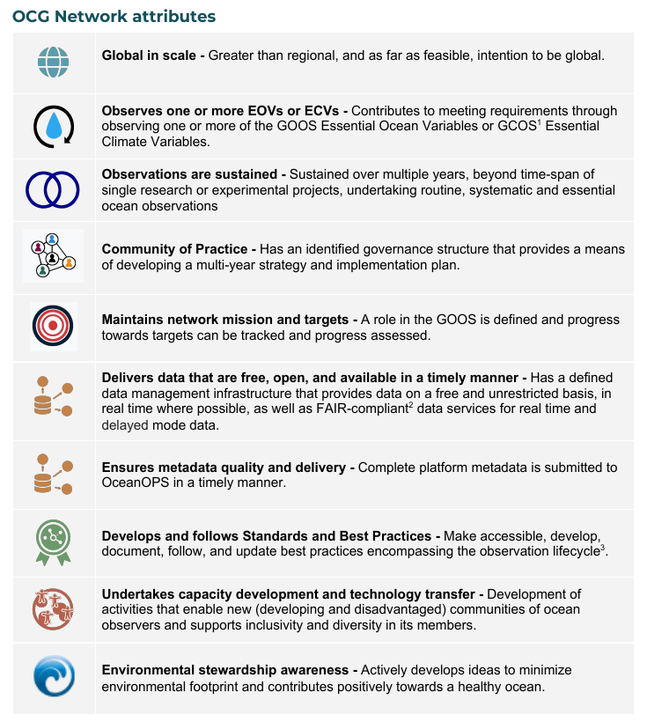
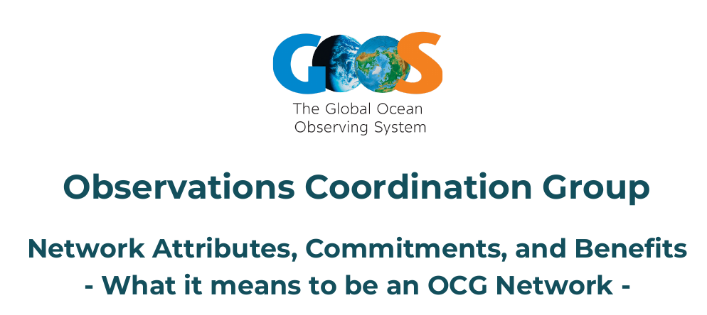
Towards a coordinated observing network for surface floating plastics
From IMDOS ToRs:
"Promote the development of a global network of marine debris observations according to Regional Seas Programme Action Plans and integrated within GOOS in cooperation with existing ocean observing infrastructures, networks and communities of practice"
Notes:
While the Terms of Reference of IMDOS are broad, a key objective is to promote the development of a global network of marine debris observations according to Regional Seas Programme Action Plans an integrated within GOOS in coopreation with existing ocean observing infrastructures, networks and communities of practice.
From the beginning we aim for these developments to be in line with the OCG network attributes, where possible. Based on existing work on methods and data harmonization, global data synthesis product development and deriving common sense data and metadata requirements, we see large potential in developing a coordinated observing network for surface floating microplastics as one of the global scale indicators of marine plastics debris.

Slide 5



International Marine Debris Data Harmonization Workshop
29-31 August 2023, Tokyo, Japan
✅
✅
❓
❓
Key Anticipated Outcomes
A coordinated network of ocean surface microplastic data providers initiated under the auspices of IMDOS
Guidelines for common sampling protocols, metadata and data requirements (with consideration of OceanOPS)
Consensus among MOEJ, EMODnet and NOAA NCEI and any other potential large data integrators for a roadmap towards a federated data management system
✅
?
✅
✅
Notes:
By cross-checking the list of OCG network attributes with what the community has already accomplished, you will see that quite a solid foundation has been laid for initiating such a coordinated observing network.
Towards the end of August this year, the Ministry of Environment of Japan, H2020 EuroSea and EU4OceanObs project are jointly convening a large international workshop of marine debris data harmonization. The key anticipated outcomes of this workshop would further bring the community closer to being able to meet the OCG network attributes when it comes to surface floating microplastics, but potentially also other parameters which could be measured on the same platforms.
The anticipated outcomes of thsi workshop include:
[list from the slide]
Although we are atthe early stages of development of such a network, we are convinced that a close dialogue with GOOS OCG already now will help ensure we are on the right track towards eventual integration within the existing GOOS Structures, either inetgrated into exisitng ship-based or other types of observing networks, or formed as a separate one dedicated to marine debris. We hope that the fact that IMDOS is an endorsed project of GOOS will faciliate regular interactions with OCG as well as other structures of GOOS.

Slide 6






This project has received funding from the European Union’s Horizon 2020 research and innovation programme under grant agreement No 862626.
imdos.org & @IMDOS_org
to be launched soon!
Notes:
I want to acknowledge that establishing global coordination and communication of IMDOS has been supported financially jointly by the EU H2020 EuroSea project and the EU4OceanObs project. The current interim Coordination and Communication Office of IMDOS is created under the existing structures of IOCCP - GOOS Biogeochemistry Panel and GEO Blue Planet European Office. We are searching for dedicated sponsorship to ensure long-term institutional support for the IMDOS Office.
Very soon we will be launching the IMDOS website and social media communication channels. You will be able to follow the project developments through this link and twitter handle.

Slide 7
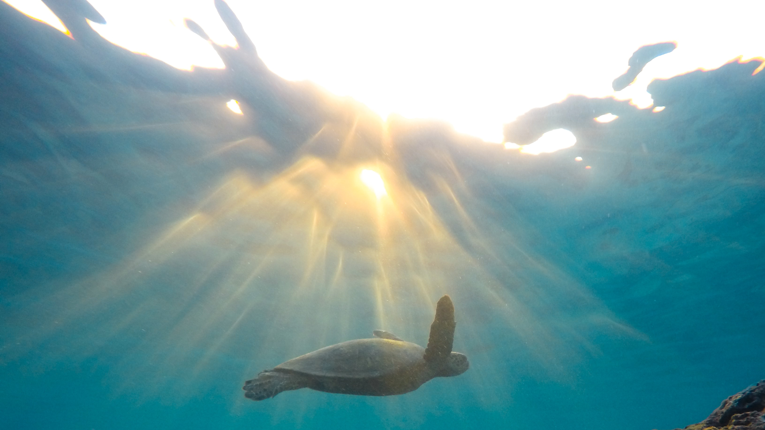
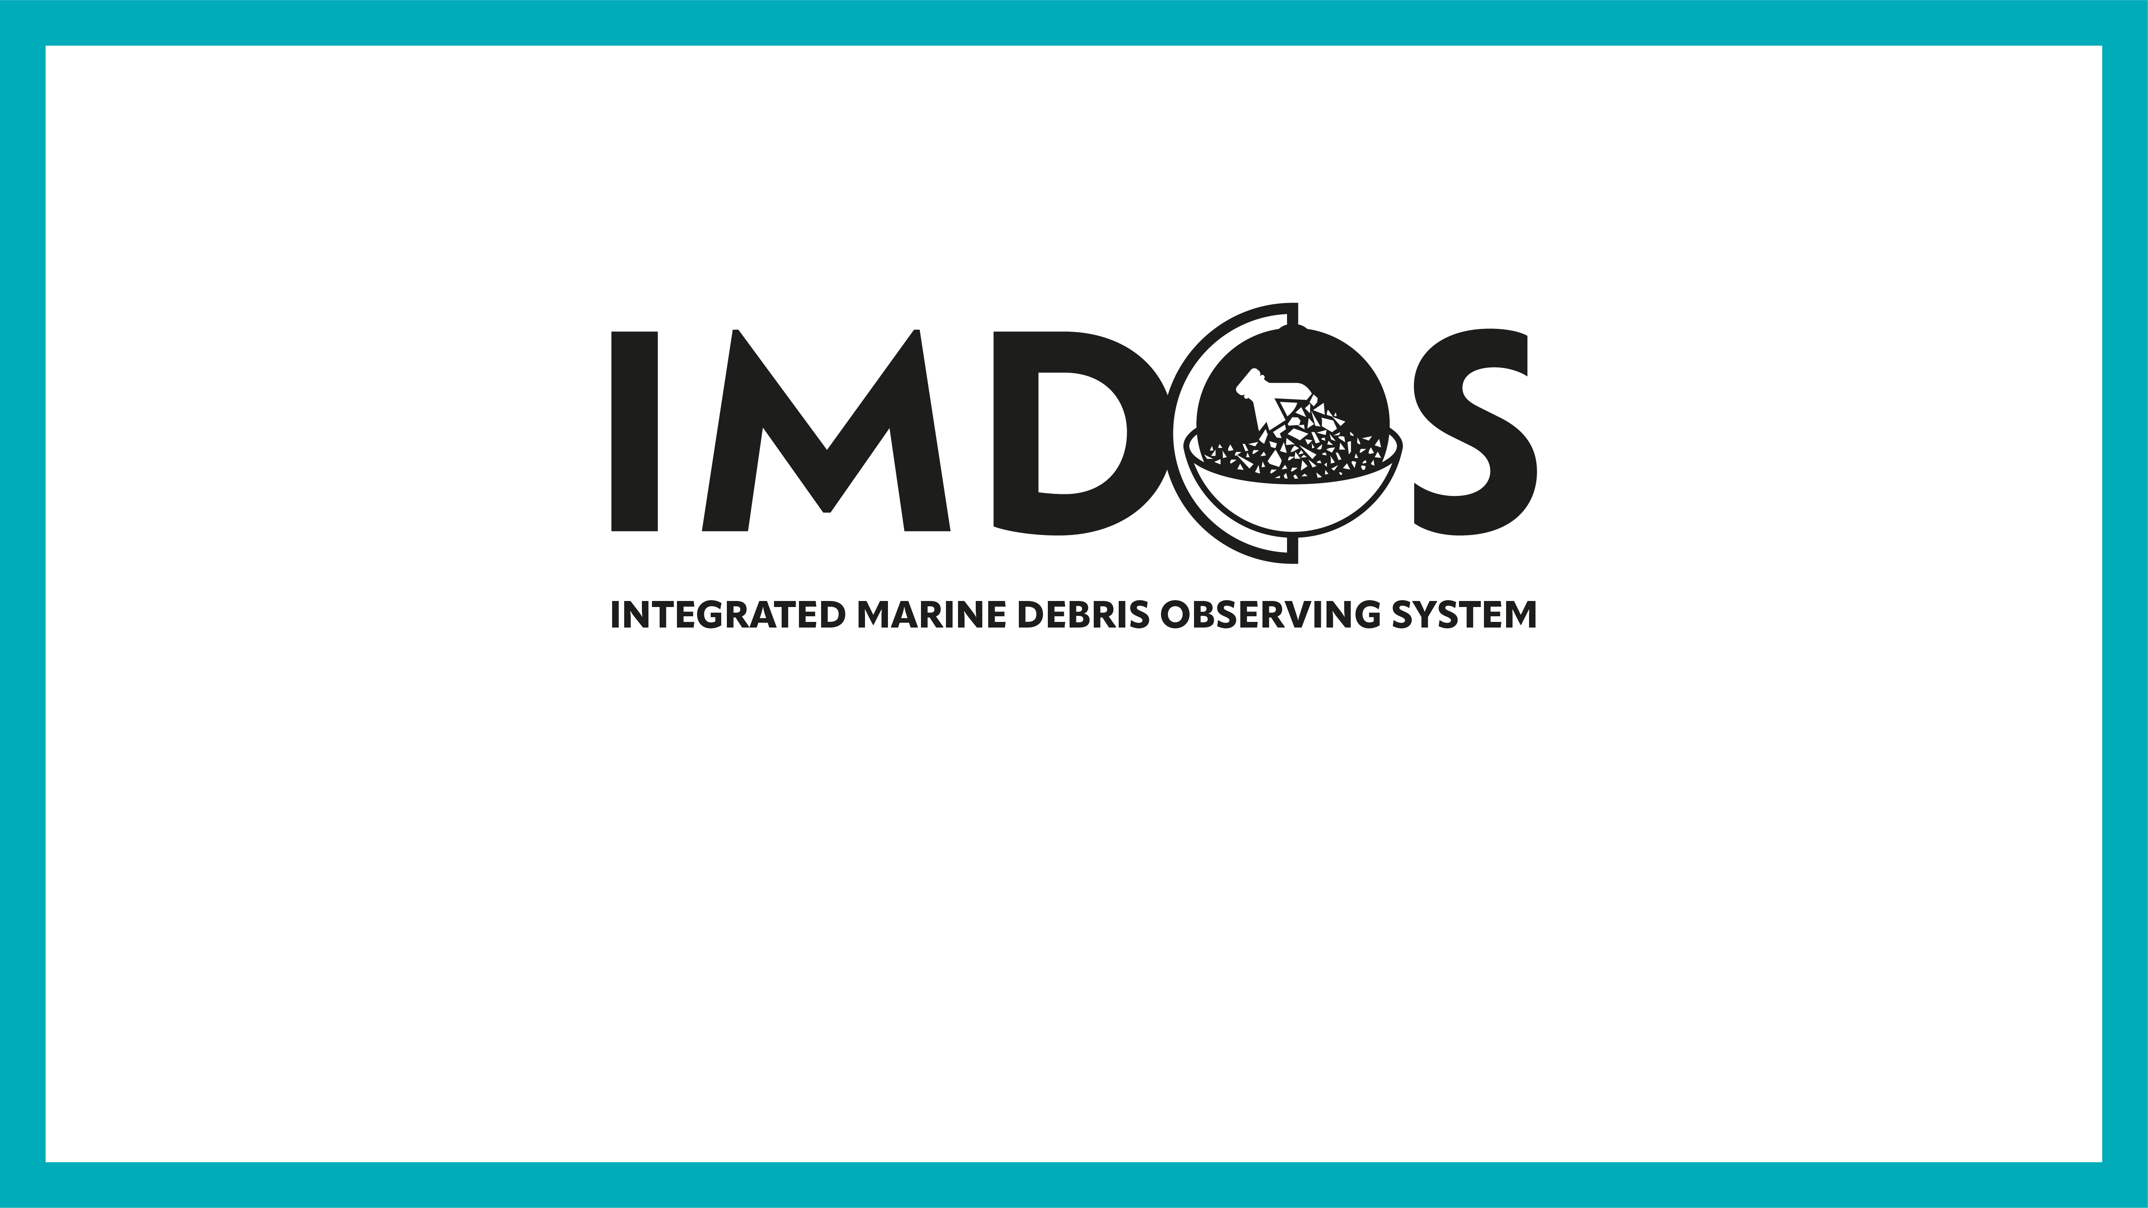
THANK YOU!
Notes:
I want to acknowledge EuroSea and IOCCP which make the involvement of GOOS with the marine debris community possible.
But with many partners actively building IMDOS up, we hope that this work will be supported in a much greater capacity in the near future.

