Slide 1
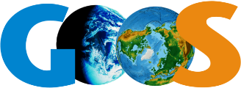
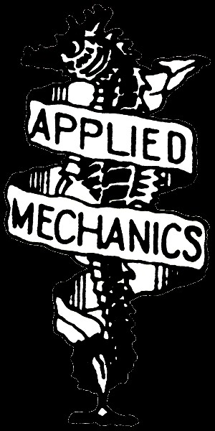
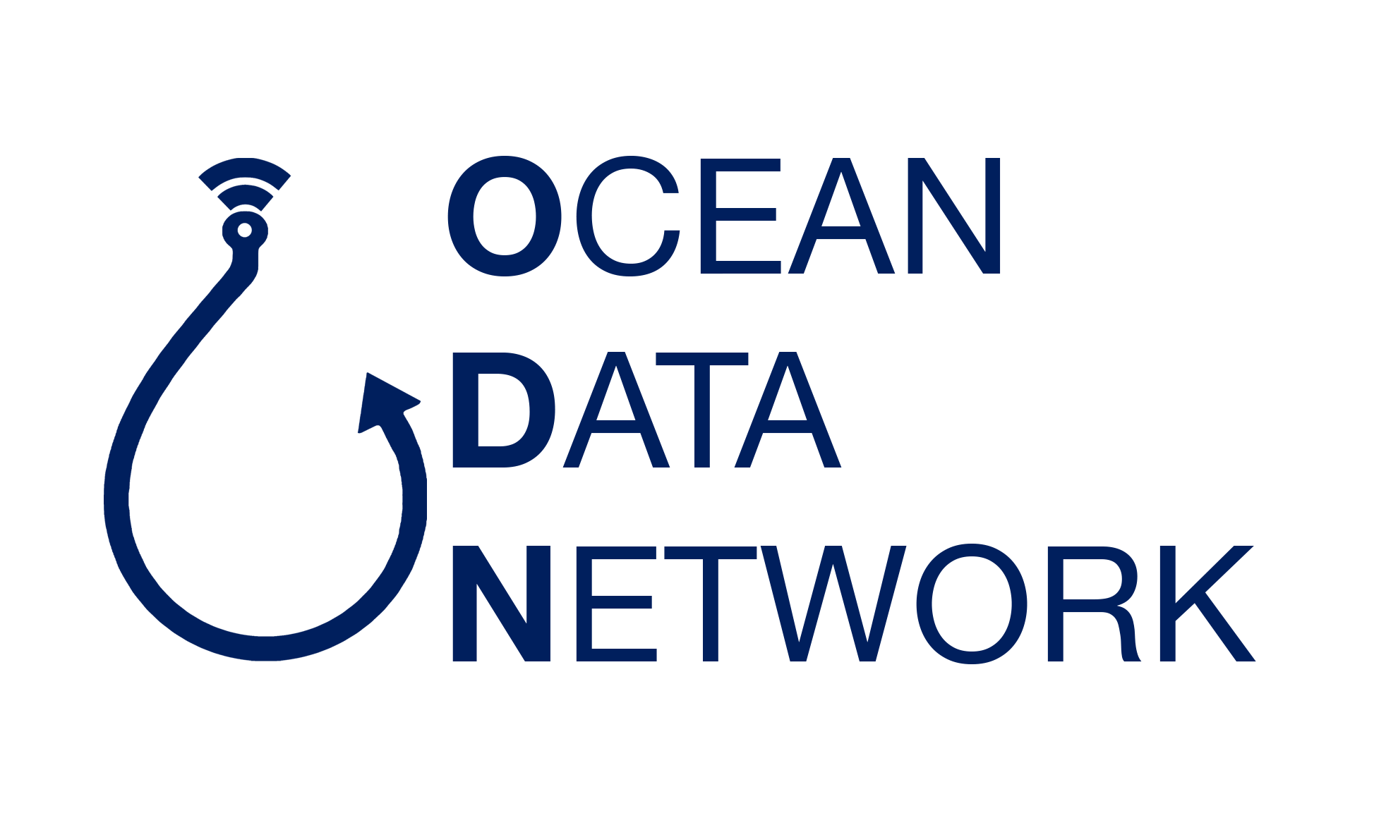
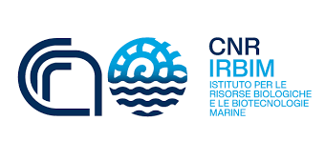
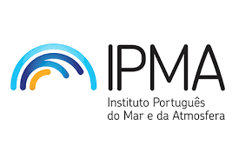
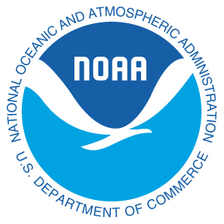
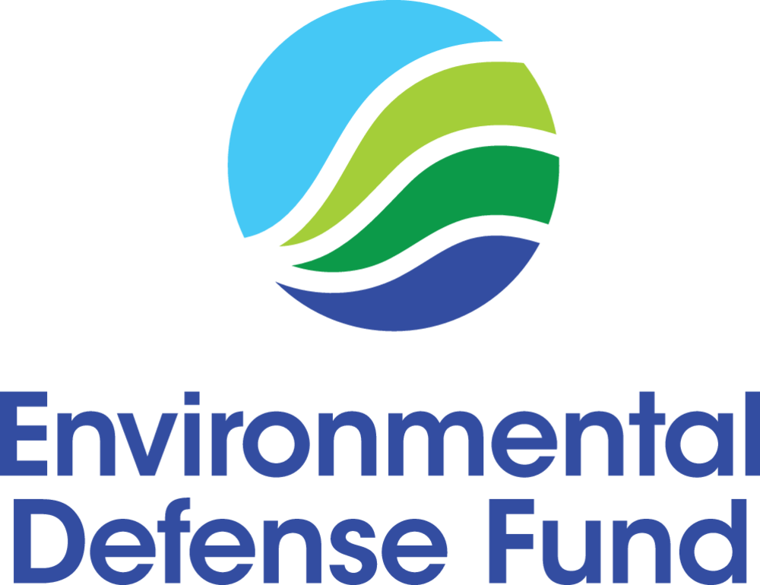
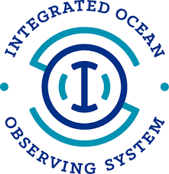
FVON The Fishing Vessel Ocean Observing Network
Emerging network presentation, 14th Observations Coordination Group (OCG) Meeting
Cooper Van Vranken, Julie Jakoboski, Christopher Cusack, Patrick Gorringe, Naoki Hirose, James Manning, Michela Martinelli, A. Miguel Piecho-Santos, Moninya Roughan, João de Souza, Peter McComb, George Maynard, Carles Castro Muniain, Hassan Moustahfid

Slide 2
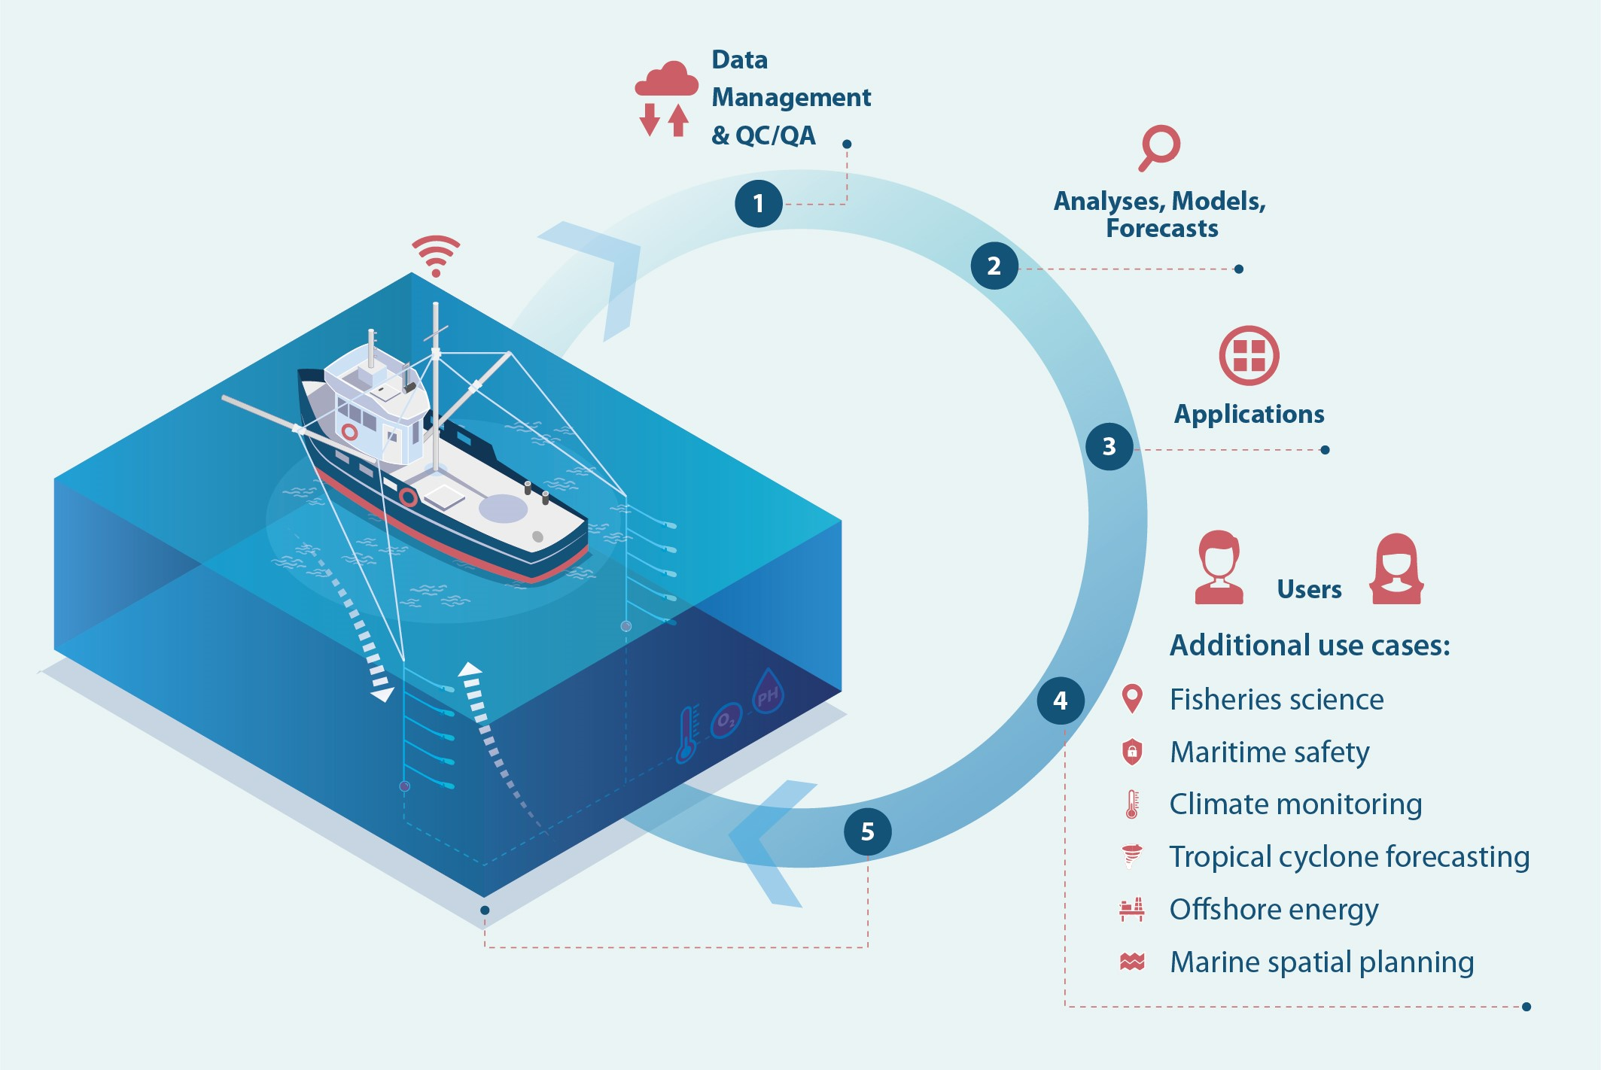
Fishing for data
Sensors go along for the ride
Catching water column profiles
Temperature, salinity, and more
Fully automatic: as soon as the gear & sensor surface data is transmitted automatically into our cloud database.

Slide 3
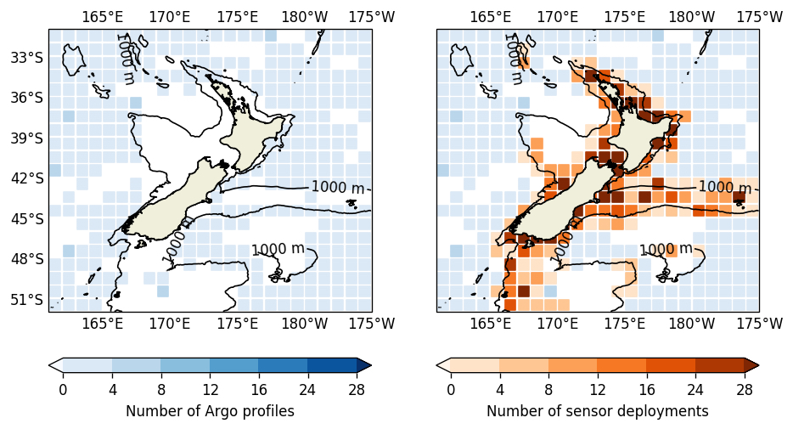
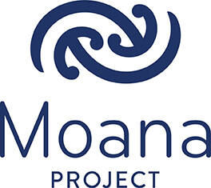
Will be developed
COMPLEMENTARY
Shelf complement to Argo
Gravitates towards dynamic features
Frontal regions, ice edges, Boundary Currents
Contribute to filling key Gaps in regions of high societal, economic, & ecological importance
Van Vranken, C., Vastenhoud, B. M. J., Manning, J. P., Plet-Hansen, K. S., Jakoboski, J., Gorringe, P., & Martinelli, M. (2020). Fishing Gear as a Data Collection Platform: Opportunities to Fill Spatial and Temporal Gaps in Operational Sub-Surface Observation Networks. Frontiers in Marine Science https://doi.org/10.3389/fmars.2020.485512

Slide 4
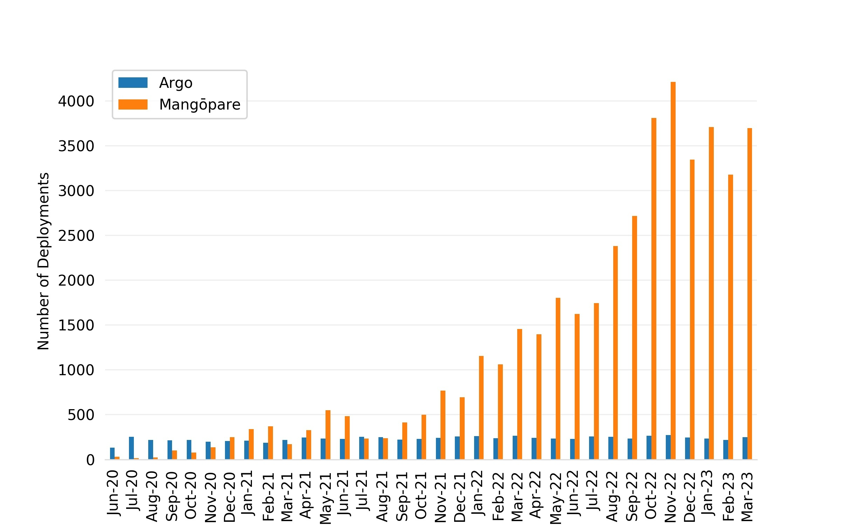
Will be developed

Slide 5
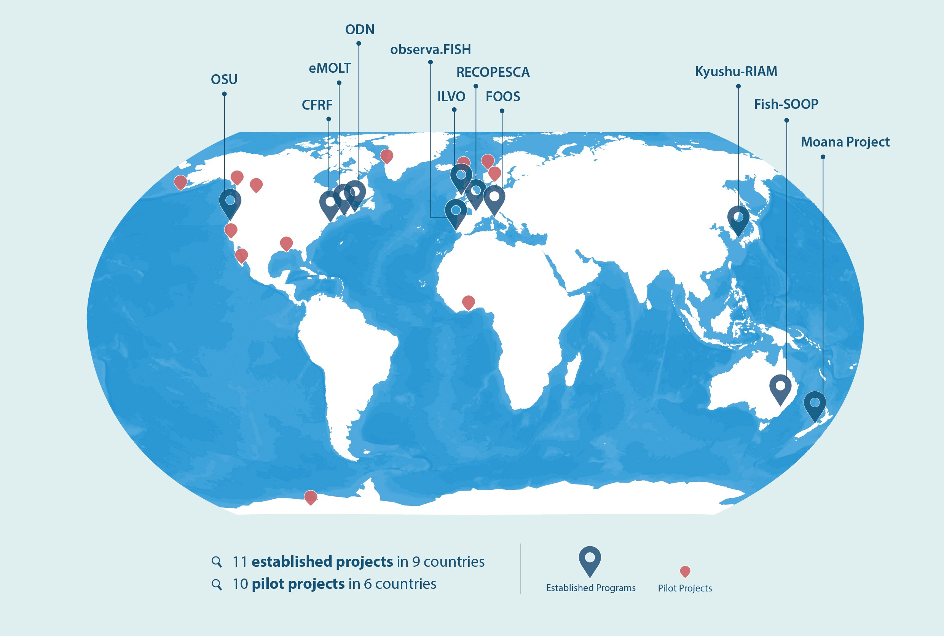
Proven in a diversity of fisheries, cultures, & regions
https://www.saildrone.com/news/arctic-sea-ice-edge-mission
Van Vranken, C., Jakoboski, J., Carroll, J., Cusack, C., Gorringe, P., Hirose, N., Manning, J., Martinelli, M., Penna, P., Pickering, M., Piecho-Santos, A. M., Roughan, M., de Souza, J., Moustahfid, H. (In Review). Towards a global Fishing Vessel Ocean Observing Network (FVON): State of the art and future direction. Frontiers in Marine Science
https://data.saildrone.com/

Slide 6
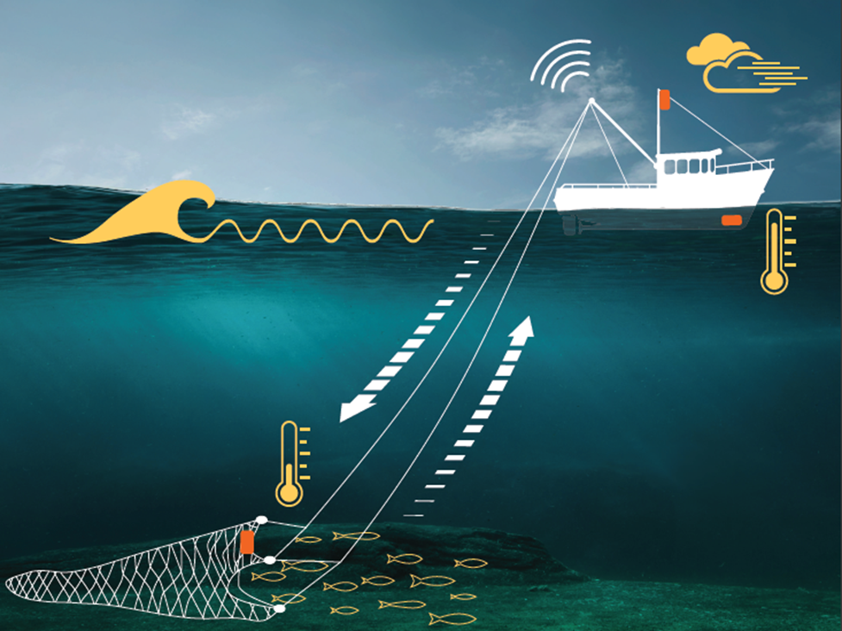
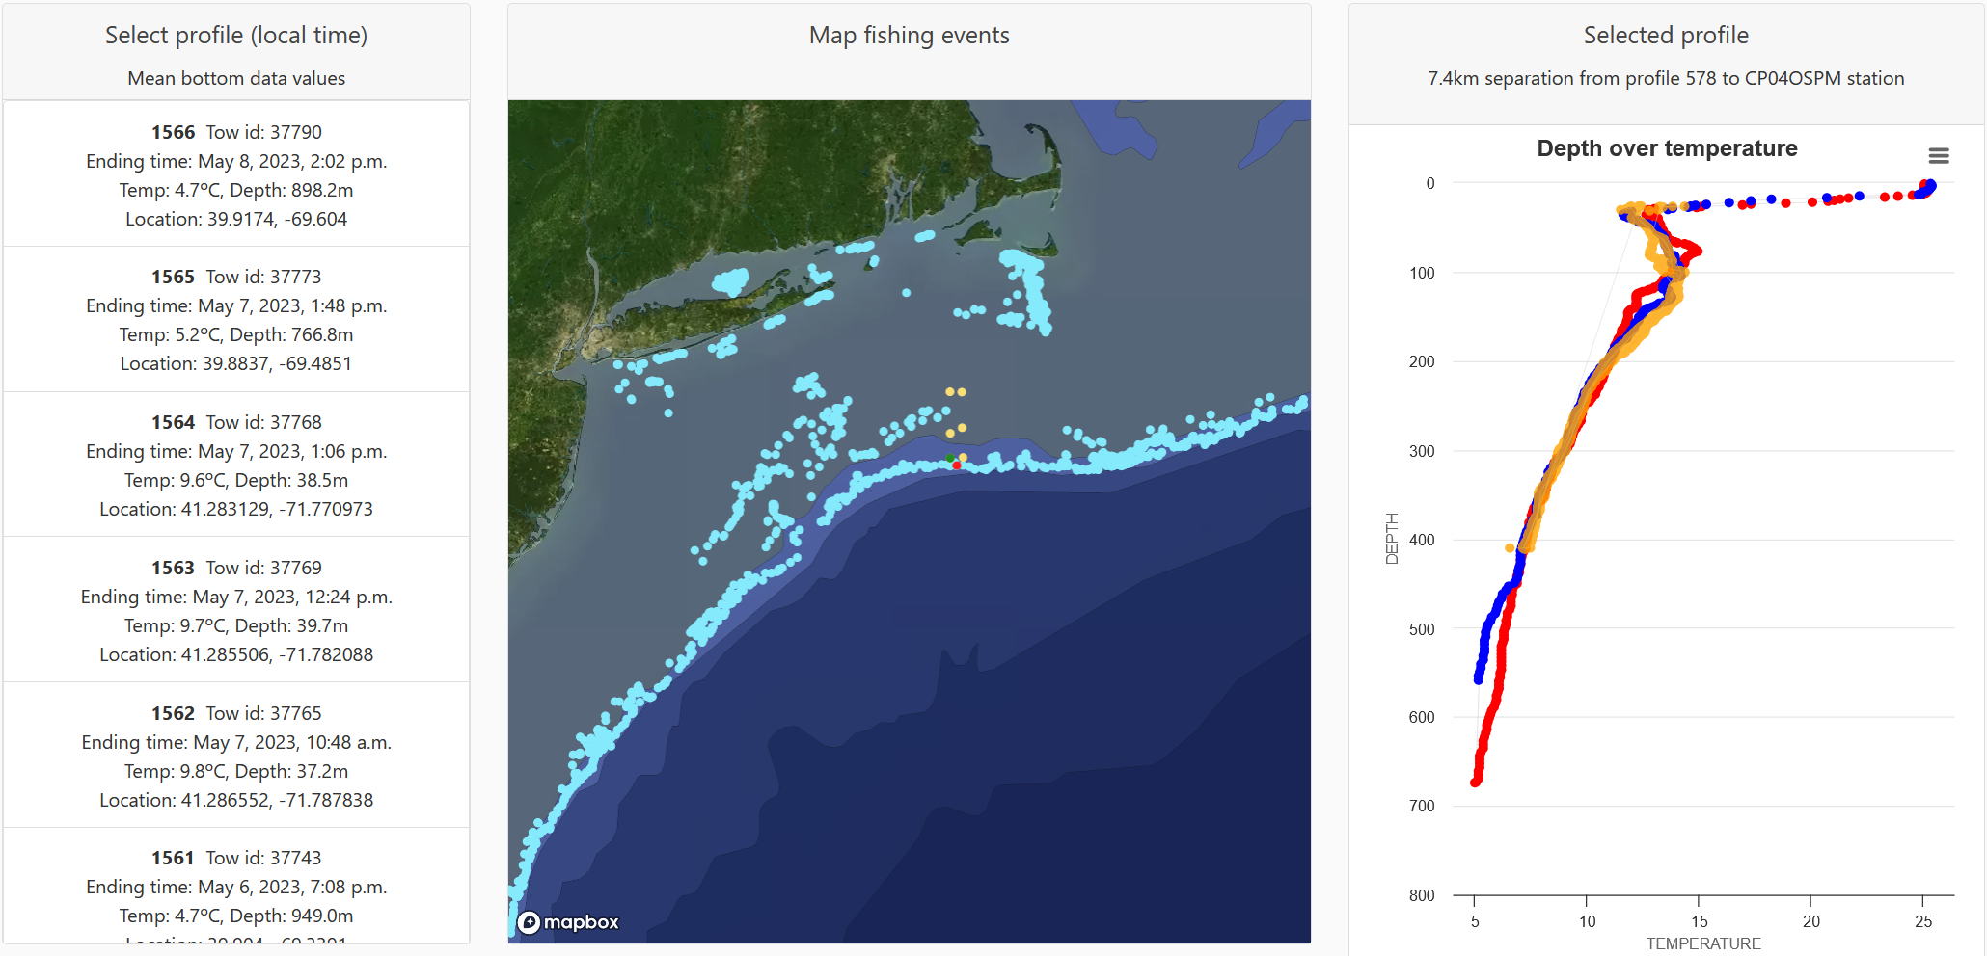
Multidisciplinary co-located capabilities:
SubS – Surface – Air
OOI wire profiling CTD
Crab trap Moana sensor:
Downcast
Upcast
This material is based upon work supported by the U.S. Office of Naval Research under Contract No. N00014-22-P-2003.

Slide 7
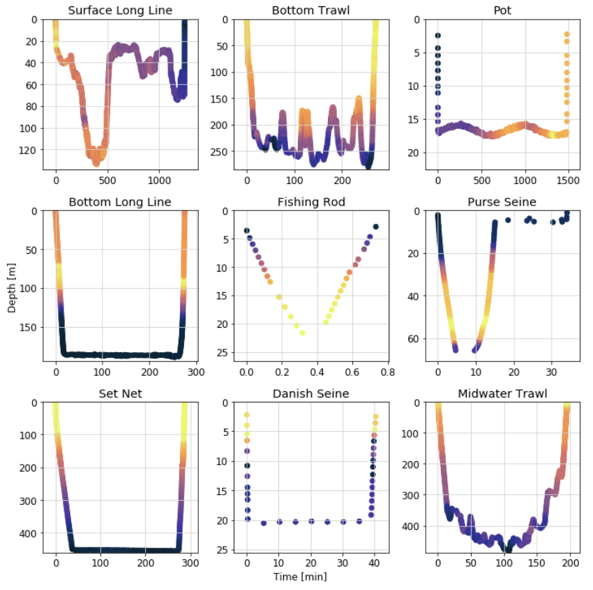
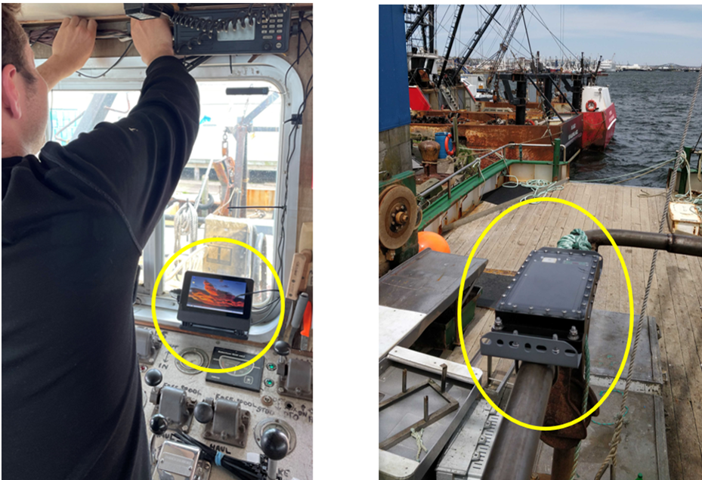
Best practices are being developed to ensure interoperability
R/P FLIP at 9 m height
Challenging to integrate with, and standardize data from, the diversity of fishing vessels & practices.
Wave Glider at 1 m height

Slide 8
Established procedure for WMO-ID minting with OceanOPS
Data privacy concerns are less than most imagine
Traceability &
Increased Exposure
DOIs
Scientific Programs
(eMOLT, ILVO and more)
Data aggregators
EMODnet, CMEMS, GTS(soon) Findable
Database
QC (Argo, QARTOD + fishing specific)
Metadata Standards
Inter-operable
ERDDAP
Accessible
Data users
(Oceanographers, Met Offices, etc.)
Fishing Industry data sources & individual vessels
Confidentiality, customized access
Translating the diversity of fishing activities into standardized and interoperable data streams.
FVON aims to also include CARE standards for Indigenous data standards.
Currently standardizing QC between programs

Slide 9
Mostly pilots or short-term funding
Sustained funding is lacking, but…
FV collaboration is extremely cost-effective!
Fastest growing data segment is industry funded; often needs unlocking
Many potential alternative sources of funding:
-Oceanographic products, tax credit schemes
Feedback from Kyushu SFiN captains:
“Through the CTD castings, I found the range of bottom temperature for good catches.”
“Prediction of high-frequency changes of ocean current is quite accurate on this app. I can choose the moderate condition for the best behavior of my fishing gear.”
“I do not have to look around the fishing grounds anymore and thus 15% cut of fuel oils. It makes me so relaxed that I can take a nap on site.”

Slide 10
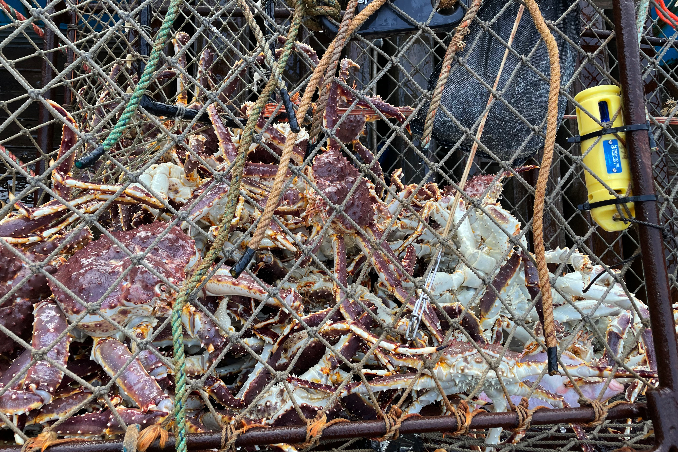
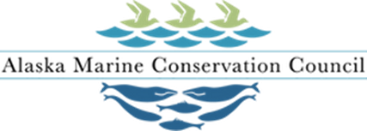
Intrinsically environmental: Going along for the ride & path towards improving sustainability of fisheries
No additional vessel trips to deploy or service equipment
The platforms already exist
Lack of data in shelf regions holds back ecosystem-based fisheries management and climate resilience

Slide 11
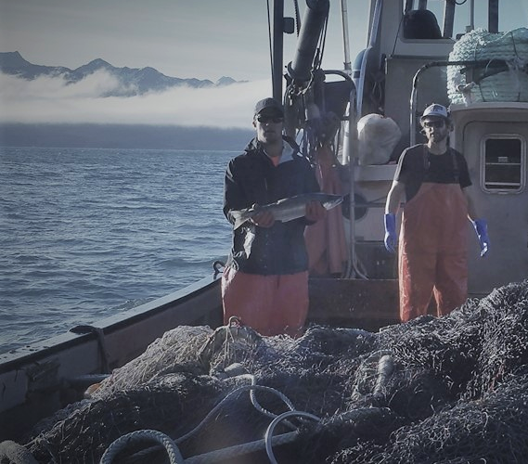
Built on collaboration, and intrinsically inclusive
Includes and empowers fishers to be part of the solution
-Compounding benefits for both science and fisheries
Accessible & affordable method of ocean observing for resource constrained coastal nations
Olsen, N. A., Bahr, F., Bethoney, N. D., Mercer, A. M., Gawarkiewicz, G. (2023). Integrating fishers’ knowledge with oceanographic observations to understand changing ocean conditions in the Northeast United States. Frontiers in Marine Science https://doi.org/10.3389/fmars.2023.1144178

Slide 12
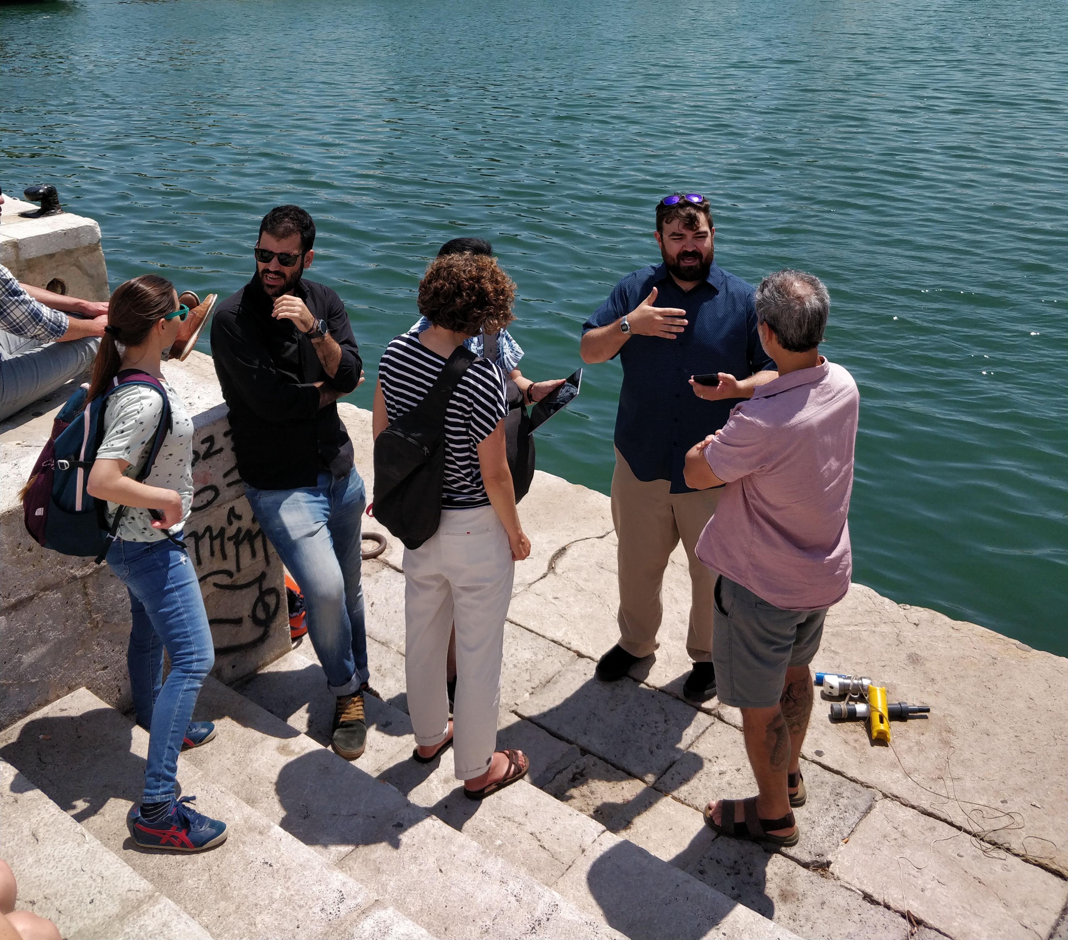
Preliminary structures defined at first in-person meeting
FV based obs can unlock a wealth of coastal data, complementing existing observation networks
Working towards UN Decade project, likely under CoastPredict
Next FVON meeting at Ocean Sciences Meeting in New Orleans Feb 2024

Slide 13
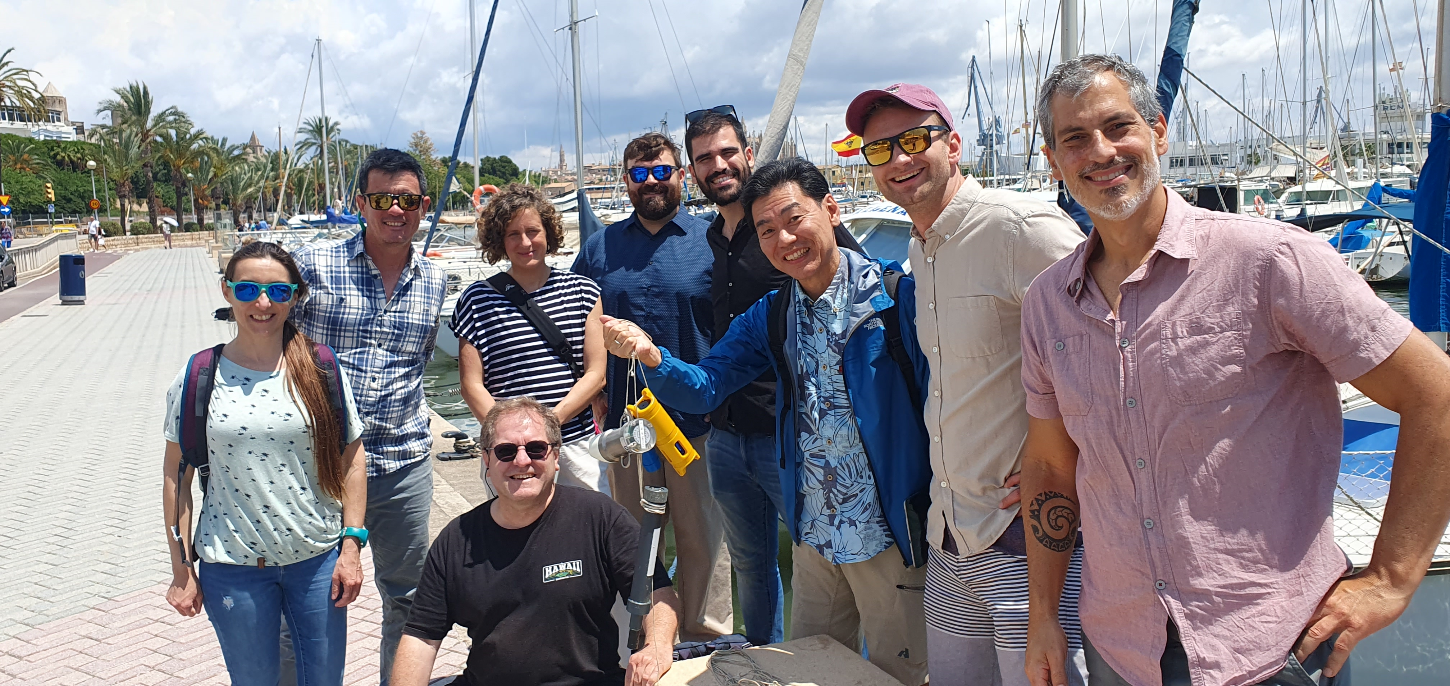
Thank you!
amsantos@ipma.pt
ccusack@edf.org
hassan.moustahfid@noaa.gov
J.DeSouza@metocean.co.nz
Julie.Jakoboski@metocean.co.nz
michela.martinelli@cnr.it
hirose@riam.kyushu-u.ac.jp
george.maynard@noaa.gov
p.mccomb@oceanum.science
mroughan@unsw.edu.au
james.patrick.manning@gmail.com
patrick.gorringe@smhi.se
cooper@oceandata.net
https://fvon.org/

