Slide 1
High Frequency Radar
OCG-14 Hybrid Meeting
6-8 June 2023
Cape Town, South Africa
Dr. Hugh Roarty, Rutgers University, MARACOOS
Chair of the Global High Frequency Radar Network

Slide 3
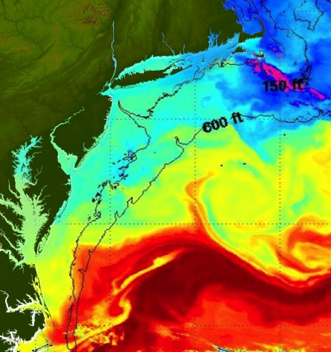
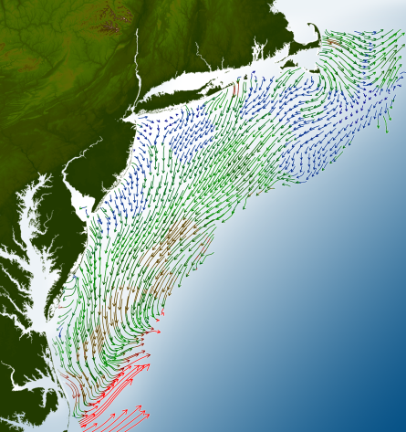
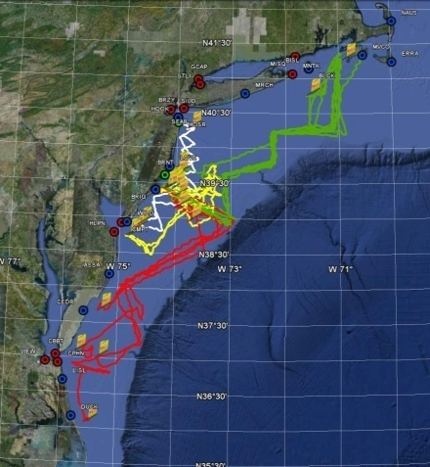
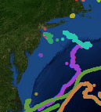
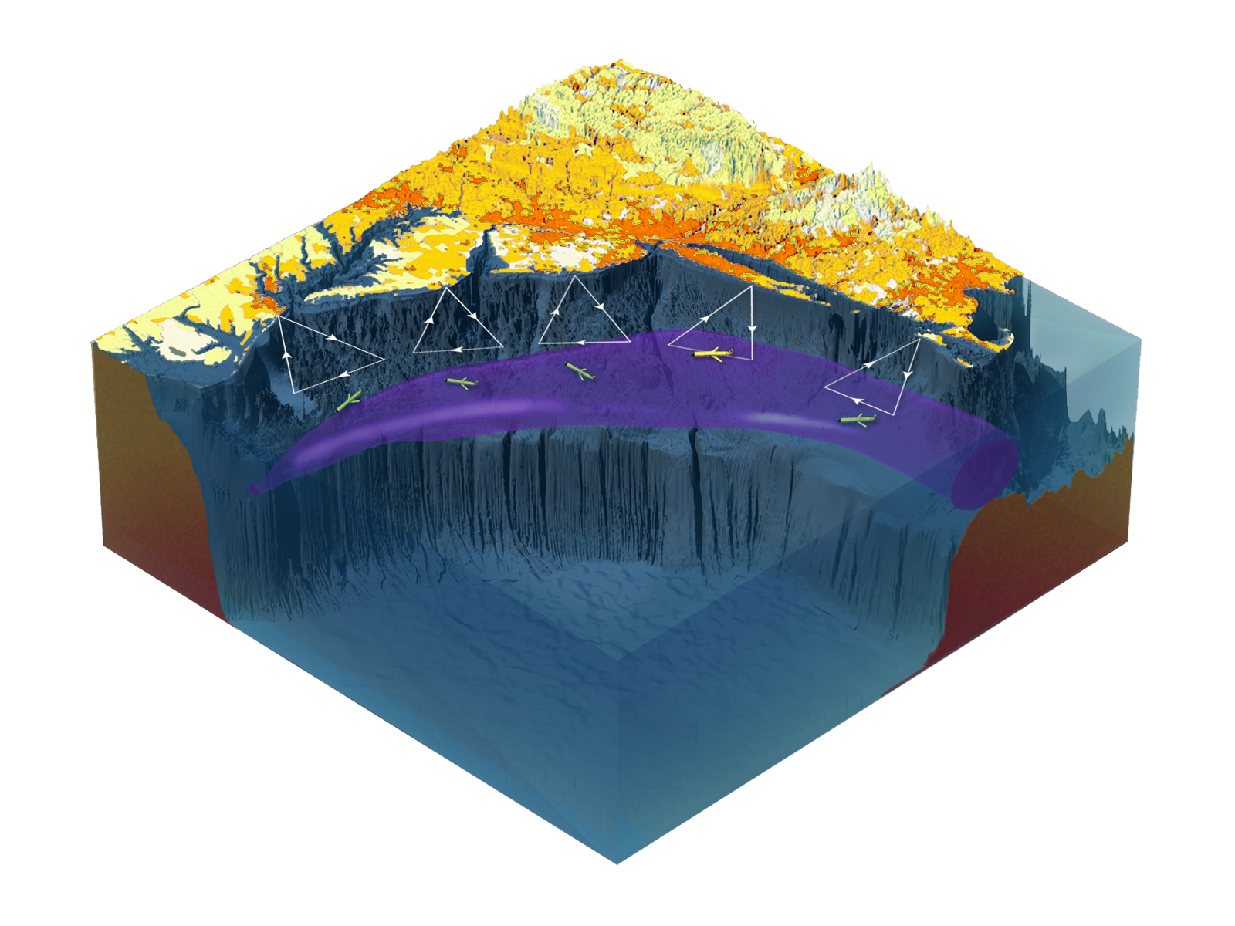
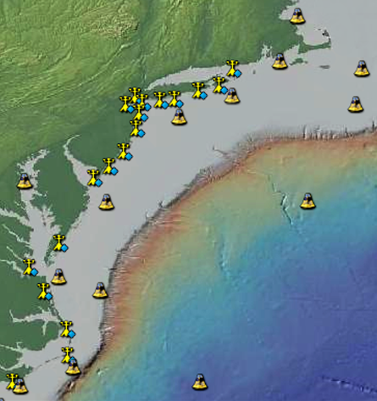
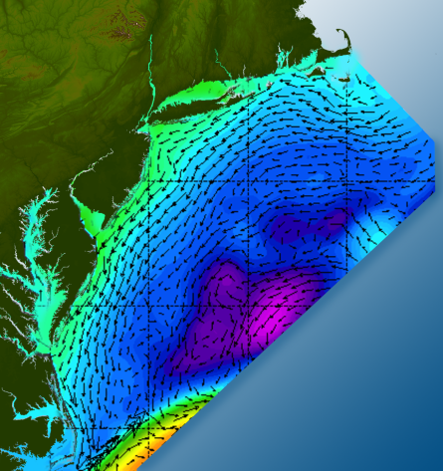
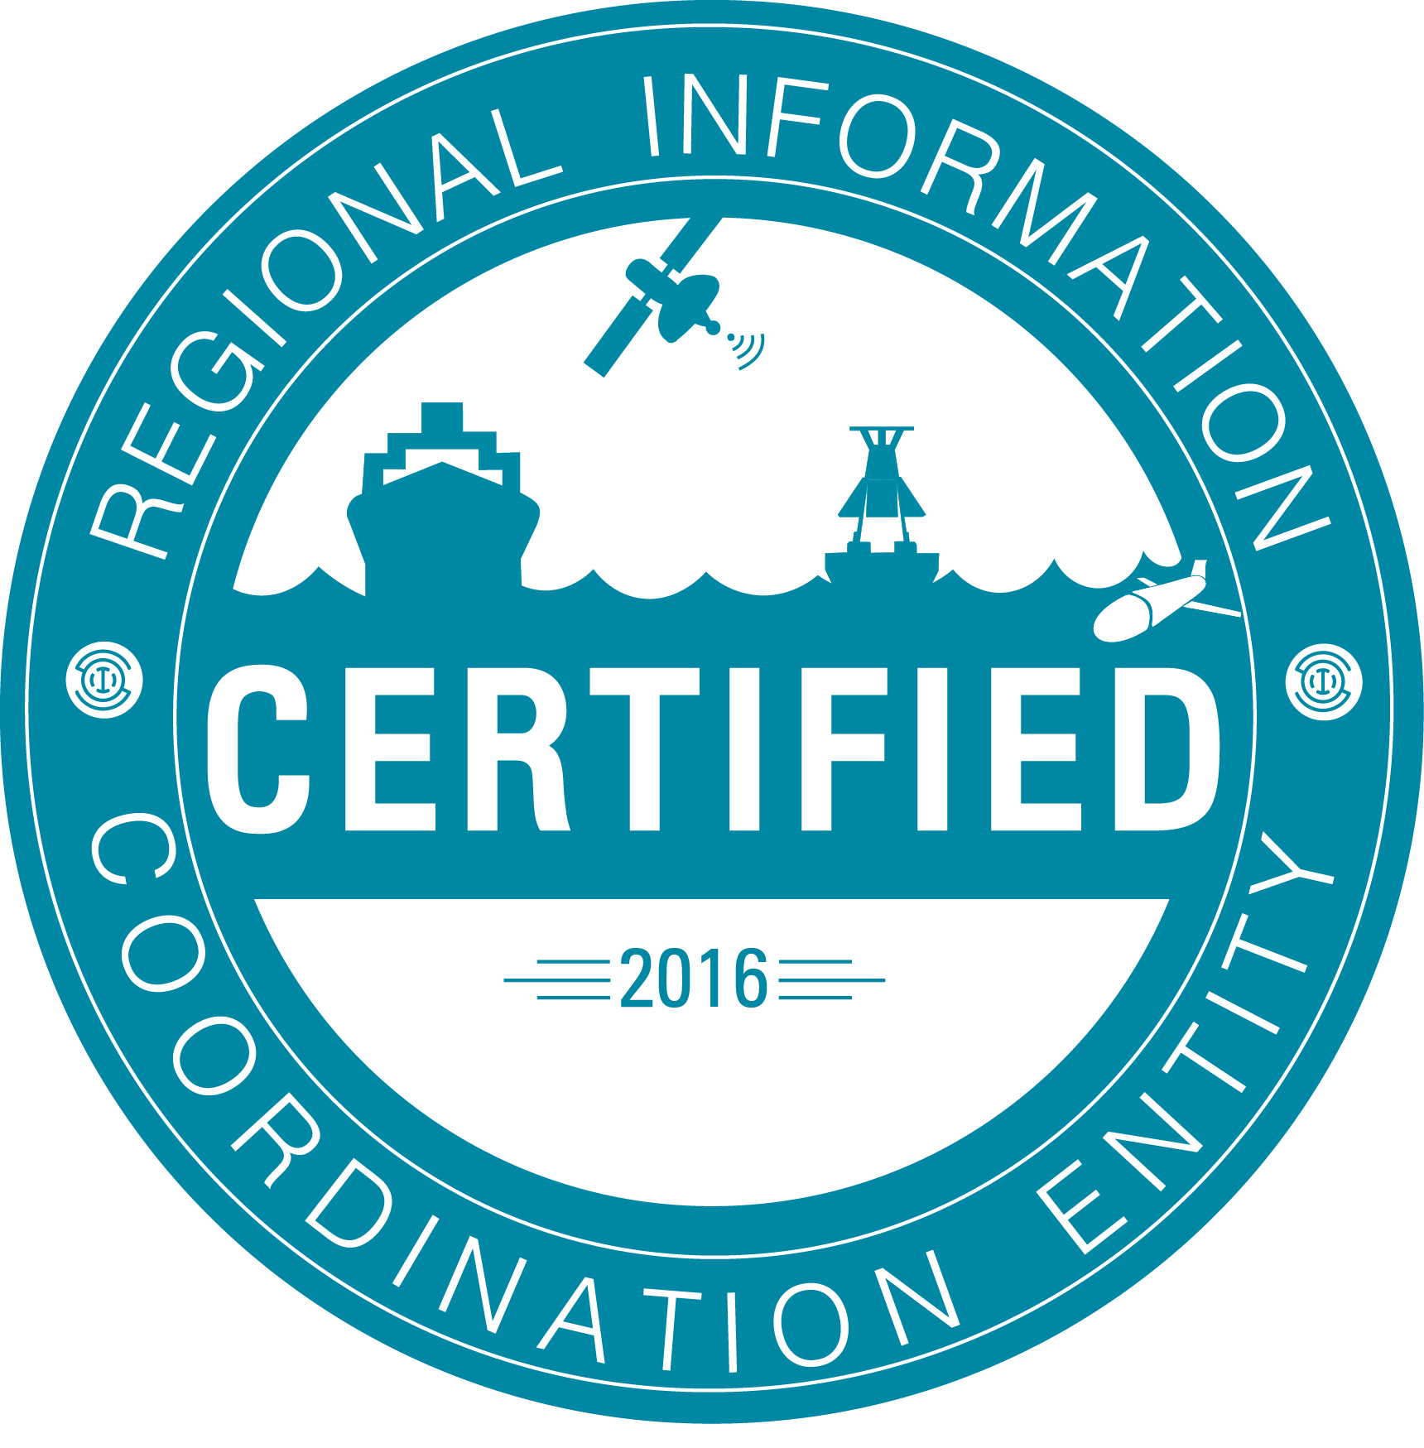
Satellites
HF-Radar
Gliders
Drifters
Population Density
To power understanding and prediction of the Mid Atlantic ocean, coast and estuaries
Weather Stations
Atmosphere & Ocean Forecast Ensembles

Slide 4
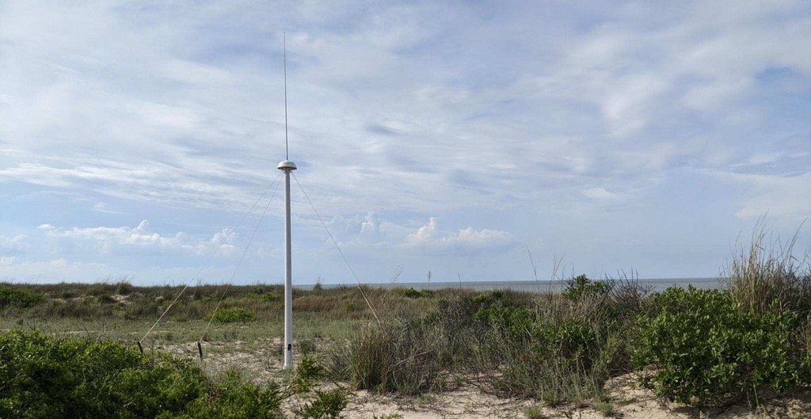
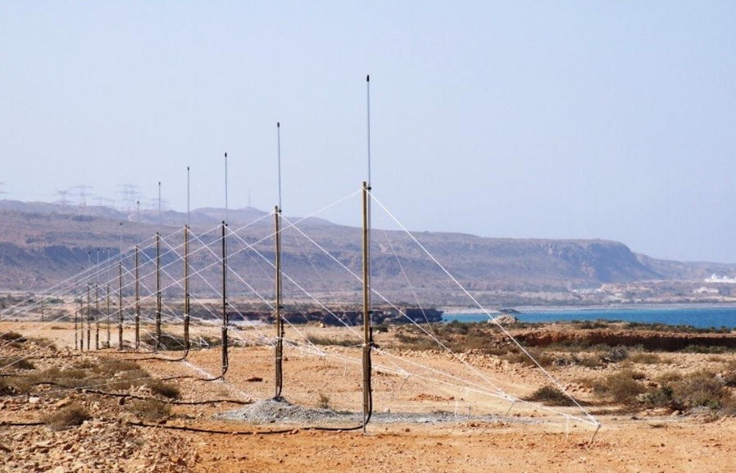
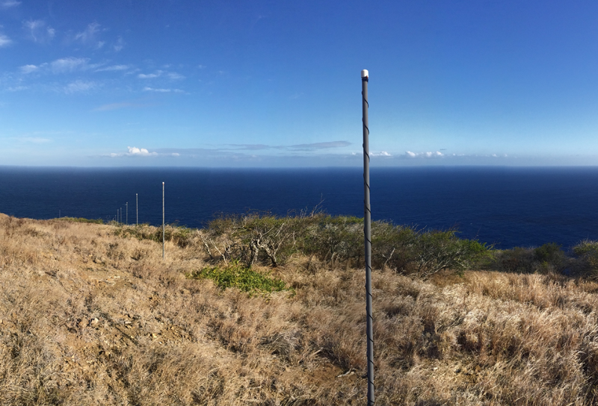
High Frequency Radar
WERA phased-array radar Dibab, Oman
CODAR Tx/Rx Antenna
Lewes Beach, DE USA
Dzvonkovskaya, Anna, Leif Petersen, Thomas Helzel, and Matthias Kniephoff. "High-frequency ocean radar support for Tsunami Early Warning Systems." Geoscience Letters 5, no. 1 (2018): 29.
LERA radar
Hawaii, USA

Slide 5
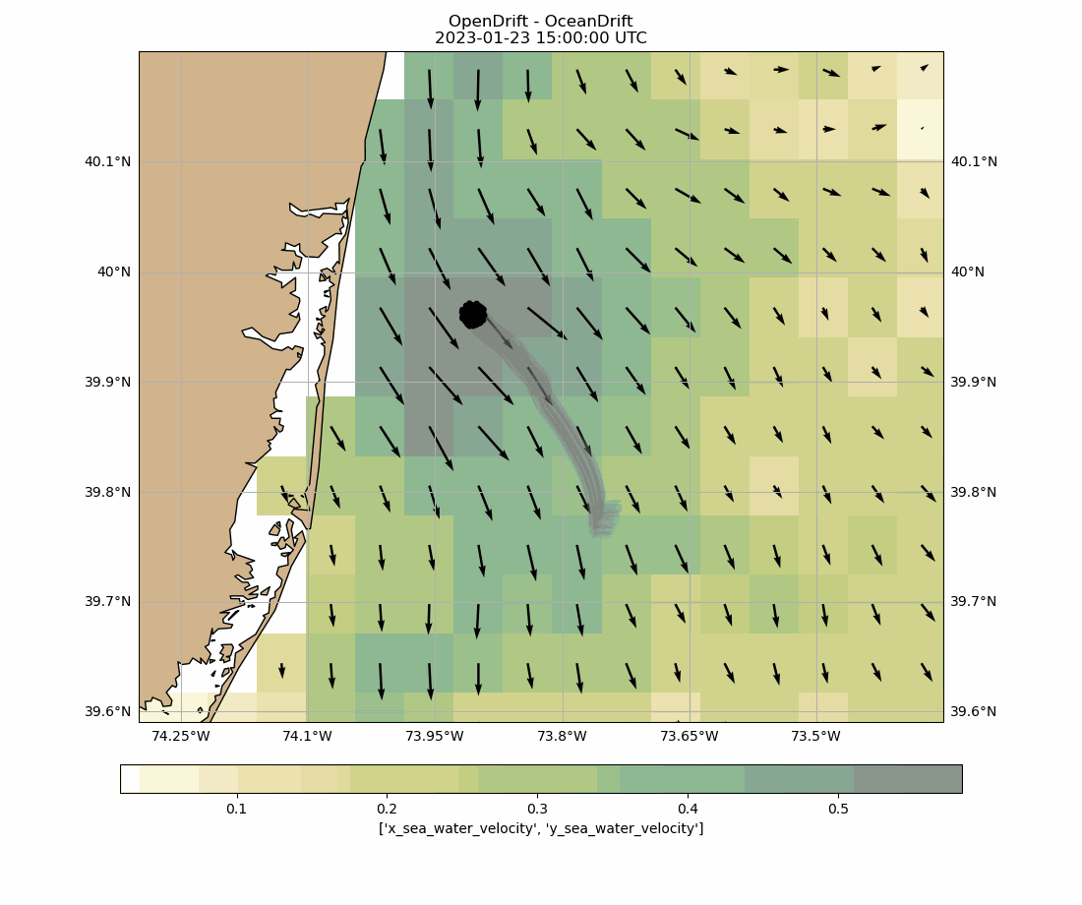

Slide 6
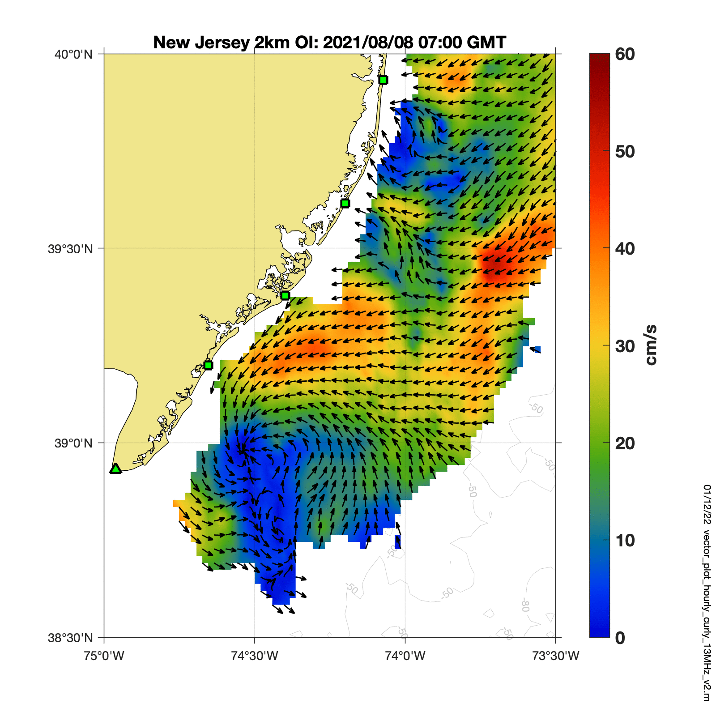
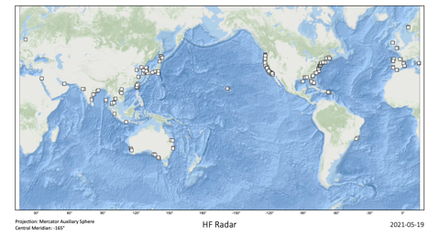
Network Overview
Region | Geographic Coverage | Number of Stations
1 | Europe, Africa, Middle East | 72
2 | North and South America | 195
3 | Asia and Oceania | 140
~ 407 Total

Slide 7
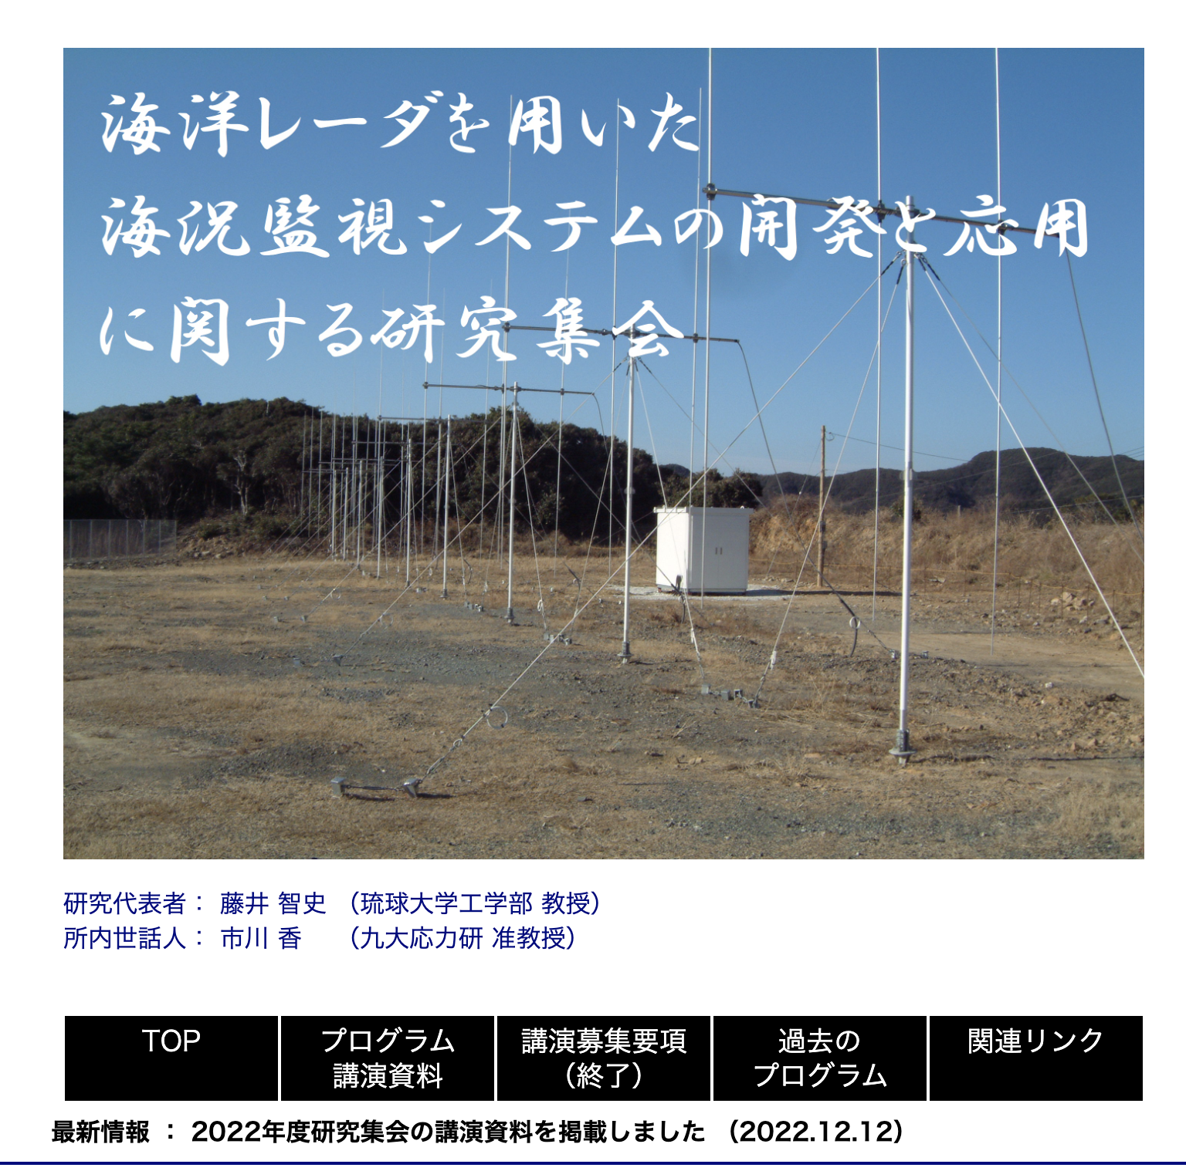
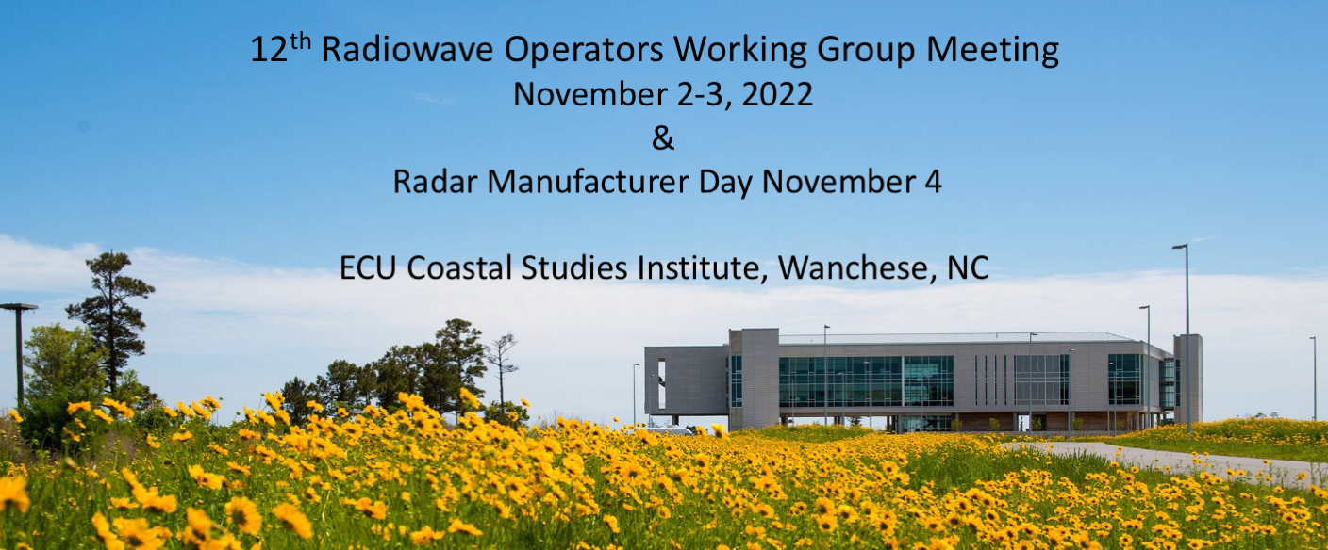
Developments and Achievements
Ongoing development of the web portal for the European HFR Node (hfrnode.eu to be launched before end of 2023)
New significant systems planed for installation (Ireland, Spain, Italy)
Implementation of the HFR Online Outage Reporting Tool (HOORT) of the European network developed in collaboration with MARACOOS colleagues: it is a web-based application to aid High-Frequency Radar (HFR) operations and maintenance and keep operators more aware of common problems, helping them to report them.
18th HFR User Community of Japan
“Development and Application of Sea State Monitoring System using Ocean Radars”.

Slide 8
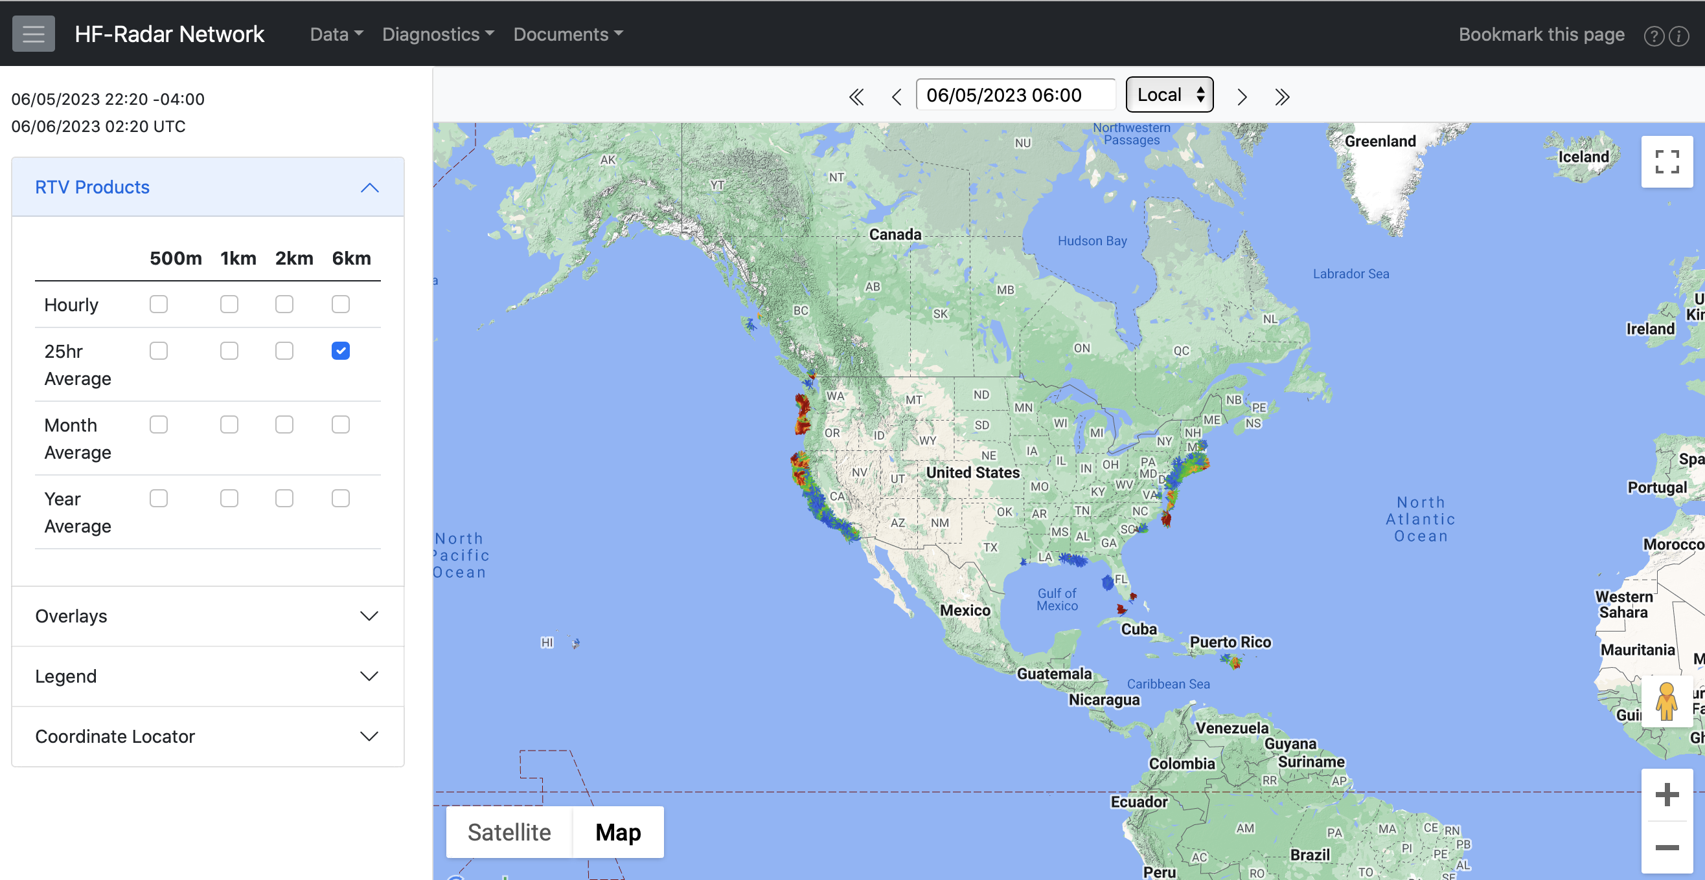
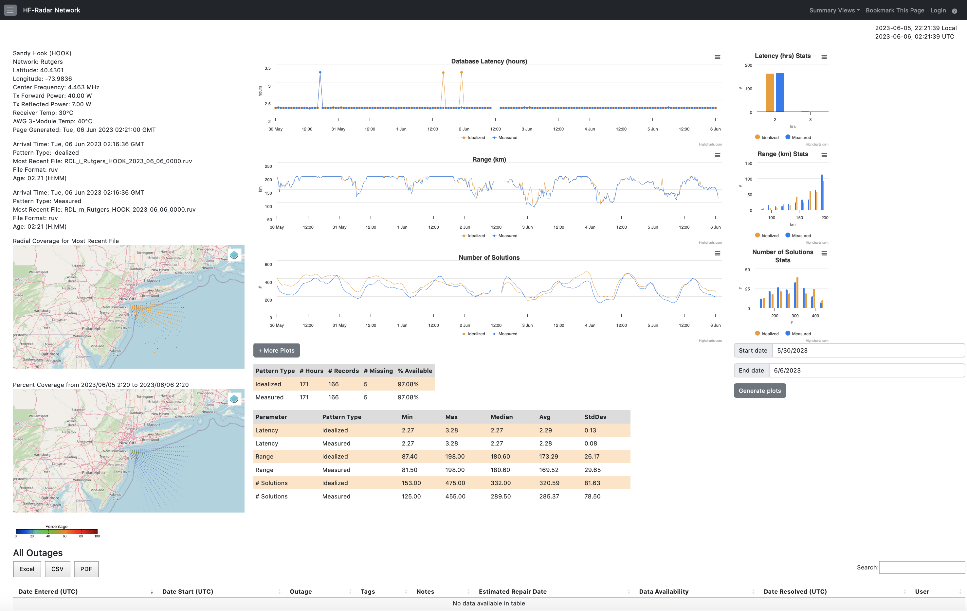

Slide 10
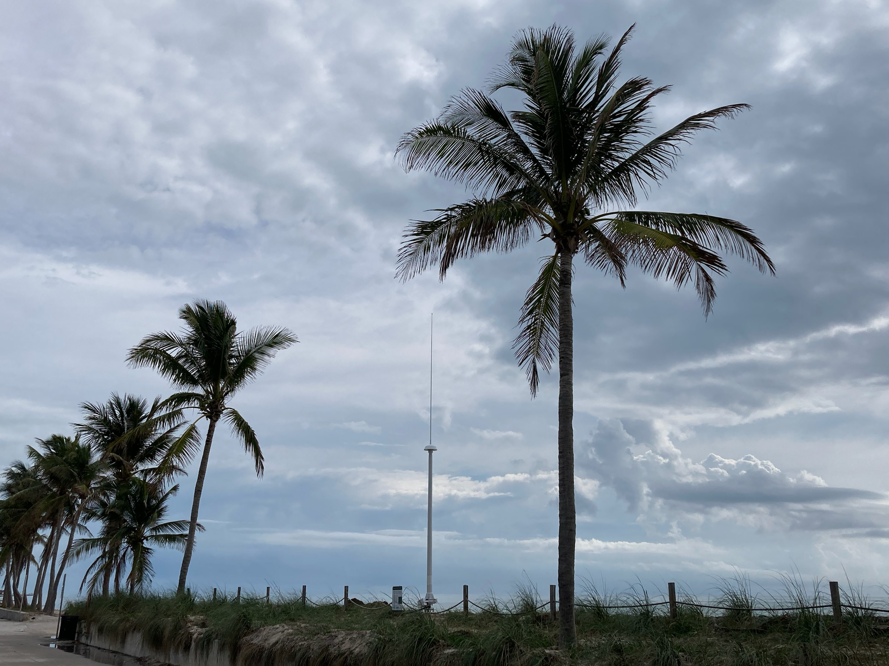
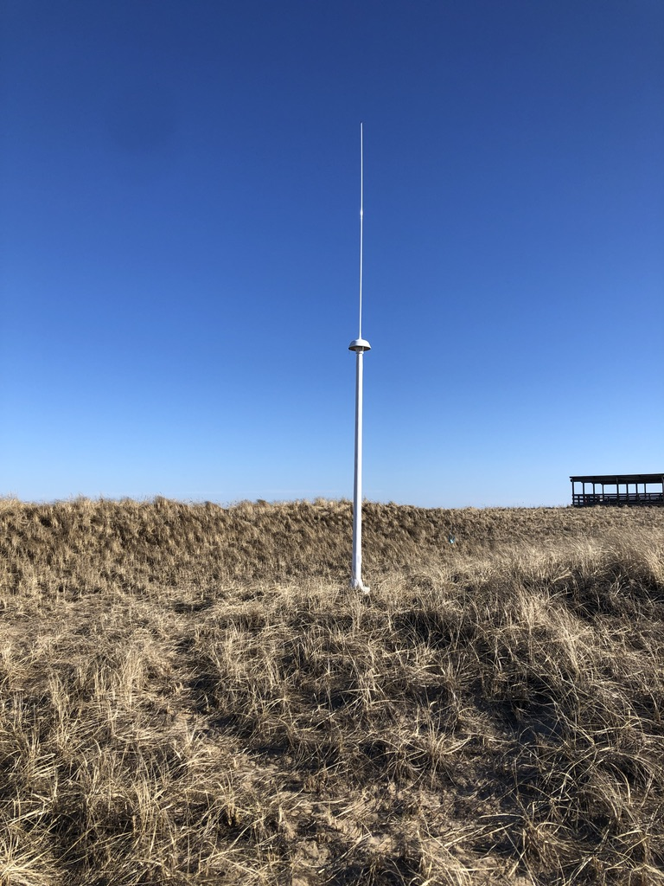
5 MHz Tx/Rx Antenna
Key West, FL USA
5 MHz Tx/Rx Antenna
Gulf of Maine, USA

Slide 11
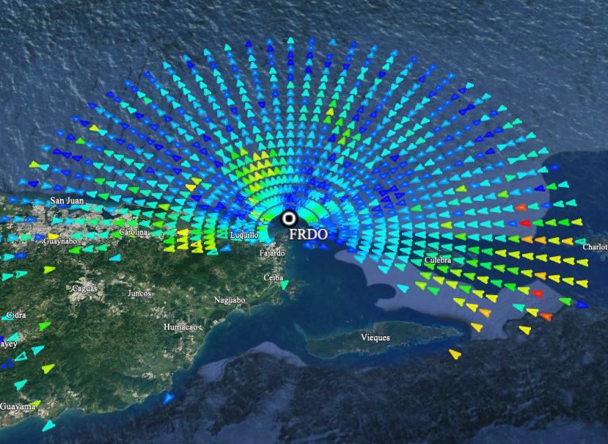
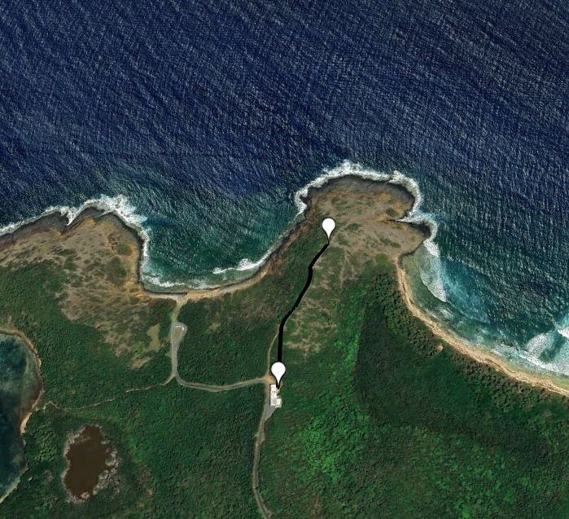
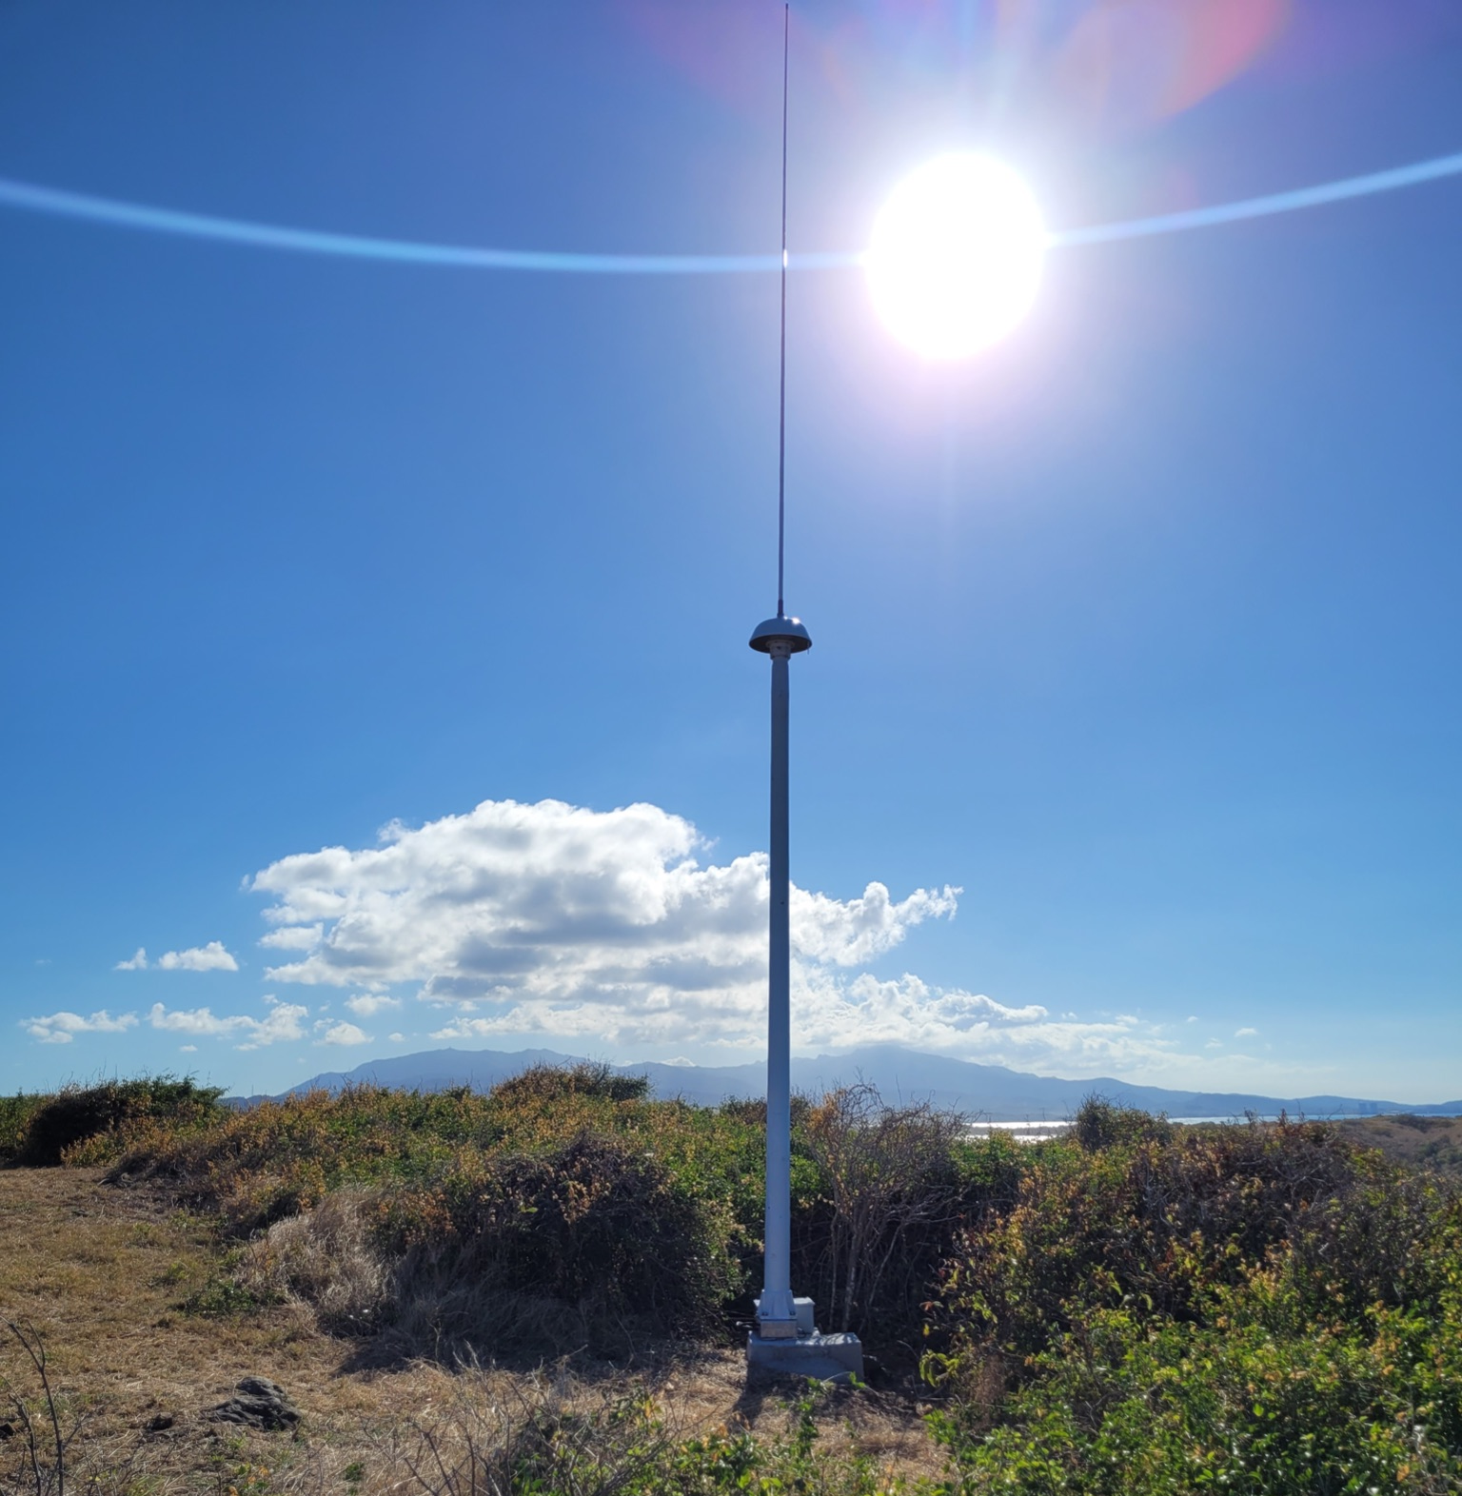
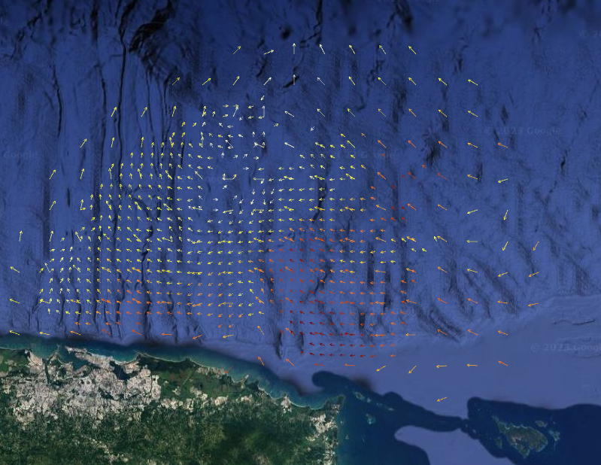
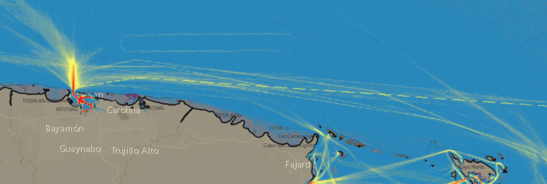
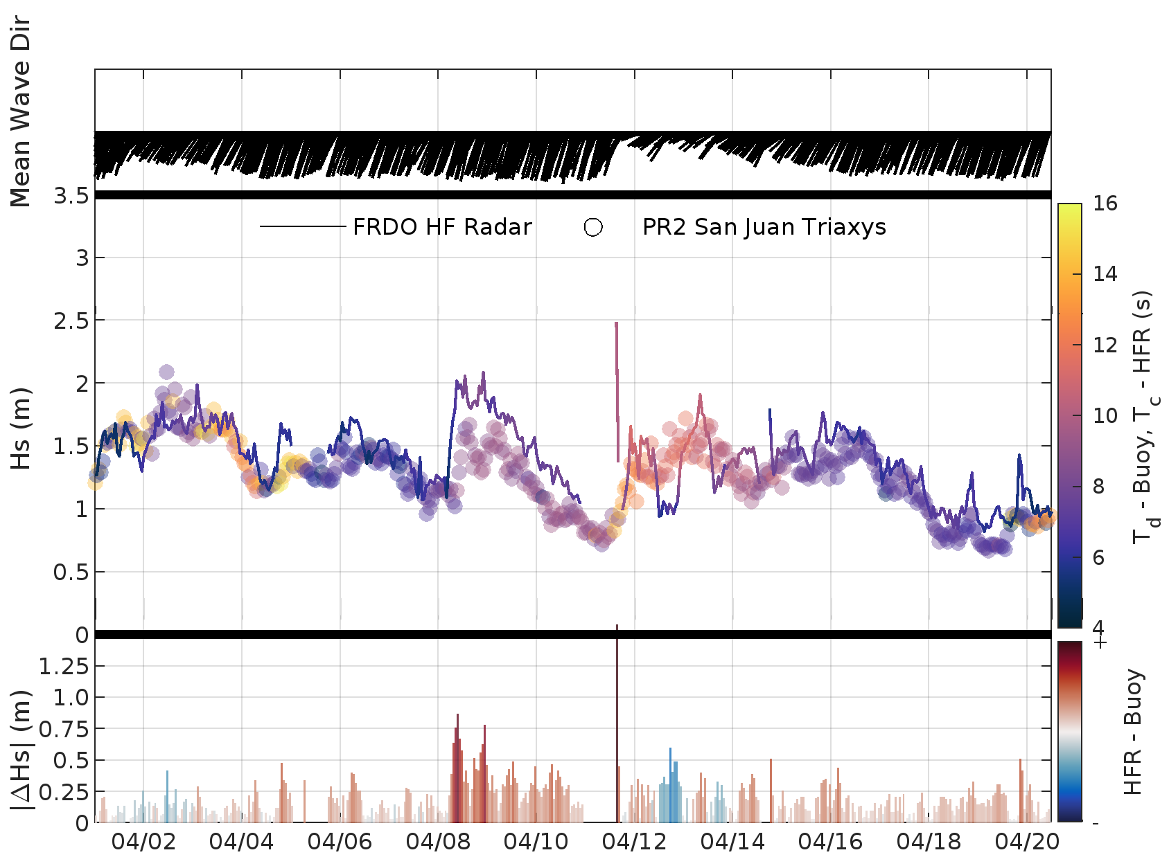
CARICOOS FRDO 13.5 MHz Low Power System
Las Cabezas de San Juan, Fajardo PR
Tx/Rx Antenna
Radial Output
New FRDO site paired with SBAY (Isla de Cabras, PR) covers most of the sea lanes, an area of concern for the Coast Guard Sector San Juan
Cable Junction Box
450 ft cable run
275 ft cable run
Secondary Wave Comparisons
Electronics Enclosure & Low Power SeaSonde
SBAY
FRDO

Slide 12
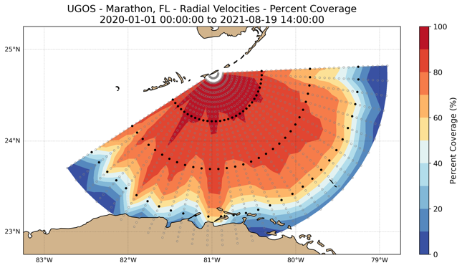
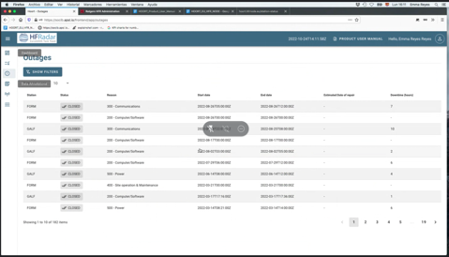
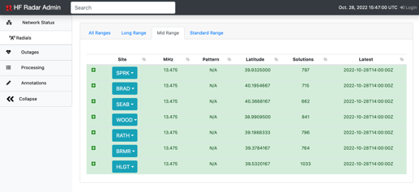
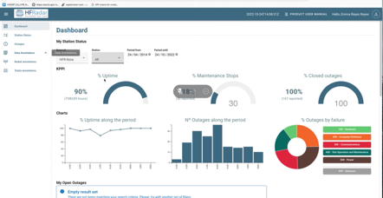
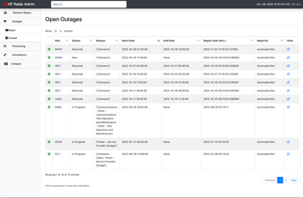
Development of Quality Control Tools
Gulf of Mexico Loop Current and Eddy Observations from HF Radar Systems
2018-2022
MARACOOS (Mid-Atlantic IOOS):
Powering Understanding and Prediction of the Mid-Atlantic Ocean, Coast, and Estuaries
2021-2026
Improving and Integrating the European Ocean Observing and Forecasting System
2019-2024

Slide 13
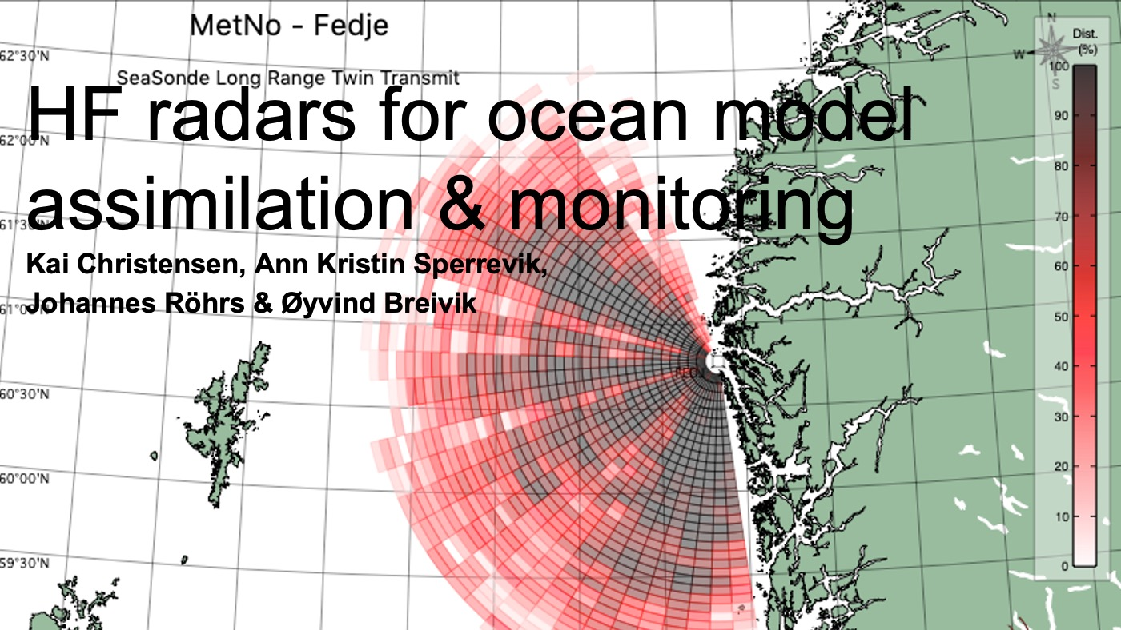
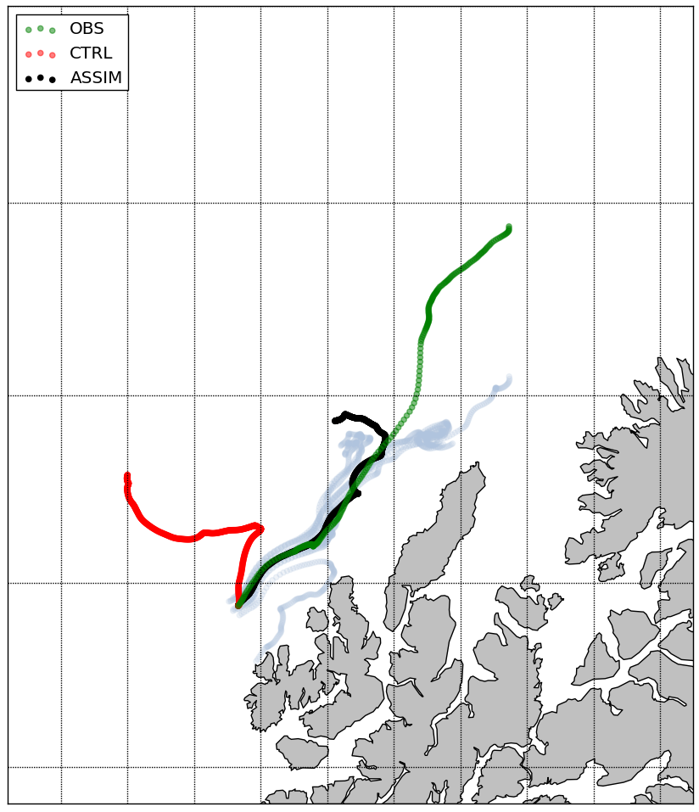
Observation (drifter)
Model with data
assimilation
Model with no
data assimilation
Approximate HF radar coverage
When used in data assimilation, HF radars have impact also outside their coverage area (e.g. Christensen et al., 2015).
HF radars play a central role in MET Norway’s strategy for ocean observations.
Notes:
MET Norway now runs assimilative high resolution ocean models operationally
HF radars play a central role in MET Norway’s strategy for ocean observations

Slide 14
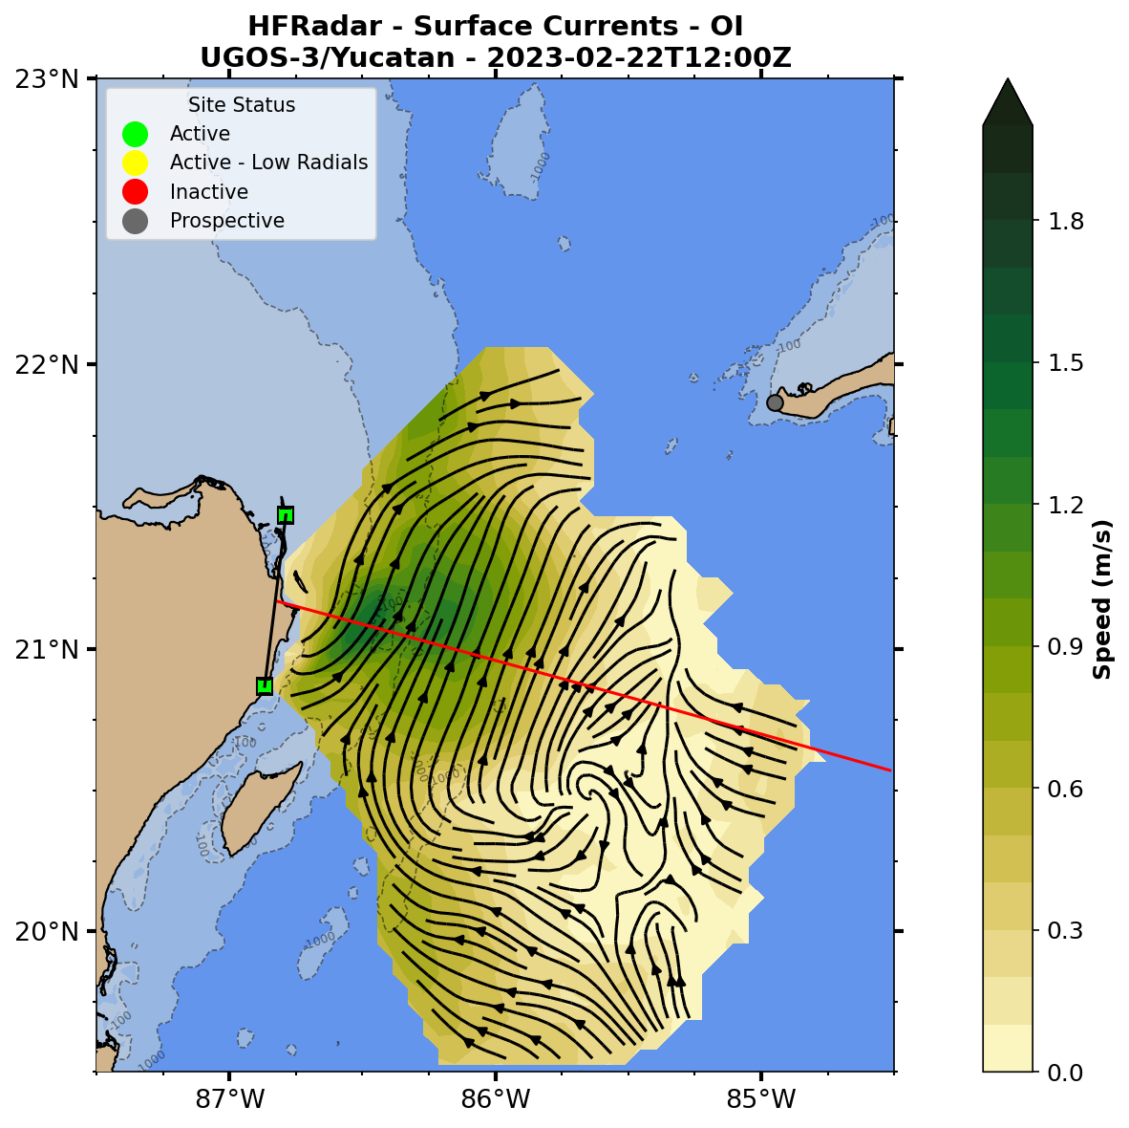
https://rucool.marine.rutgers.edu/ugos-hfr/
14

Slide 15
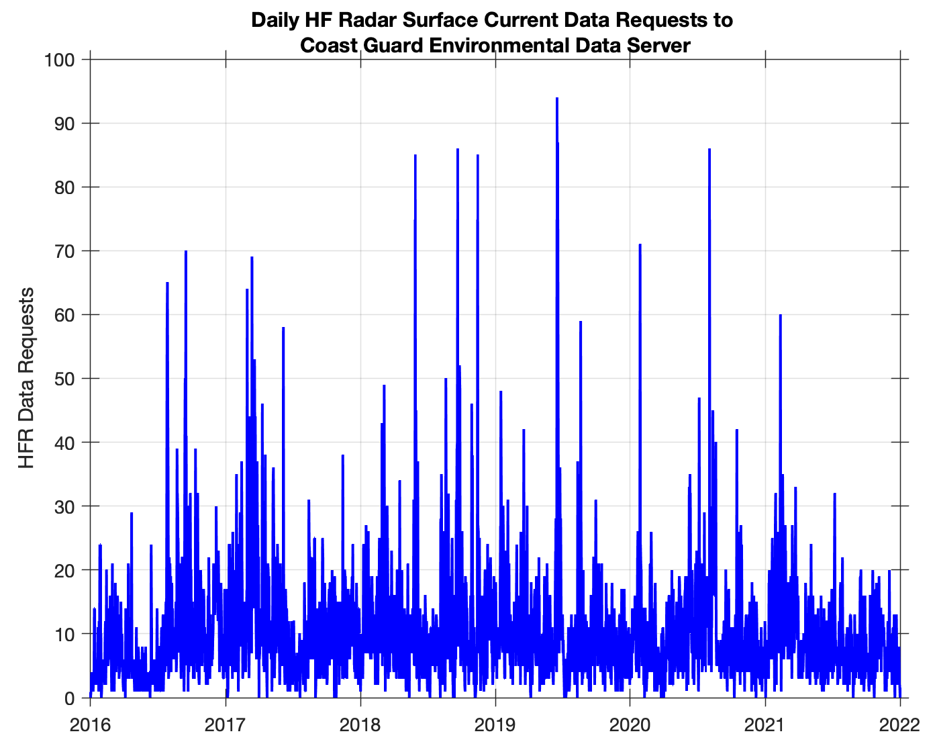

Slide 16
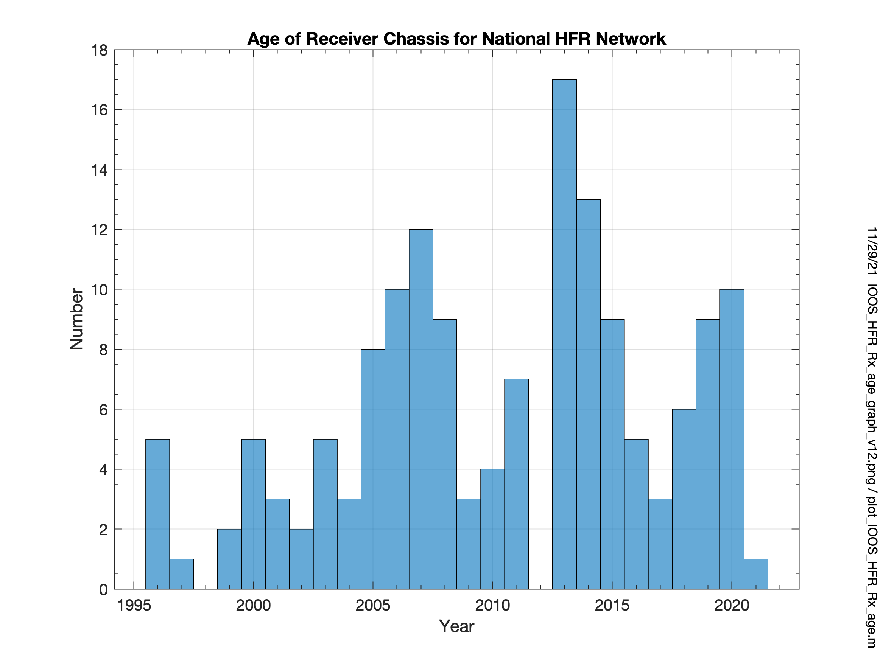
Challenges and Concerns

Slide 17
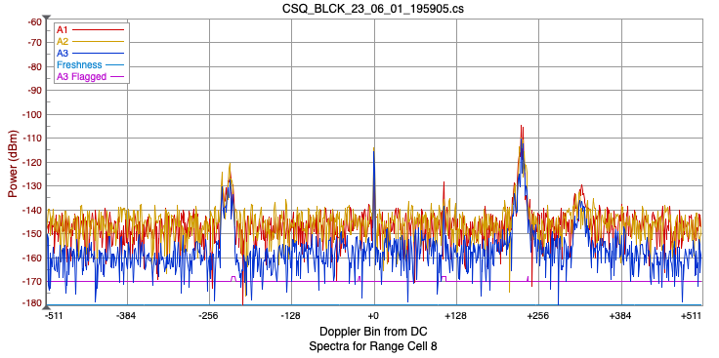
Challenges and Concerns

Slide 18
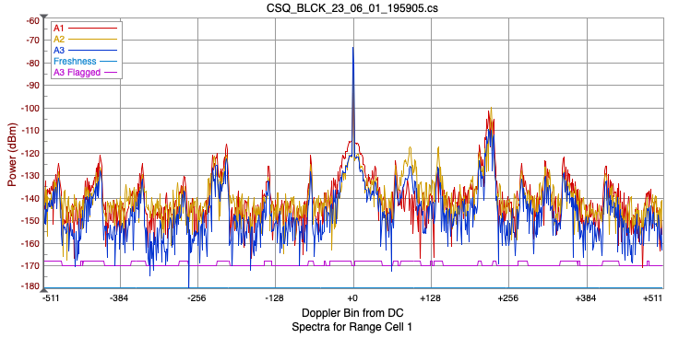
Challenges and Concerns

Slide 19
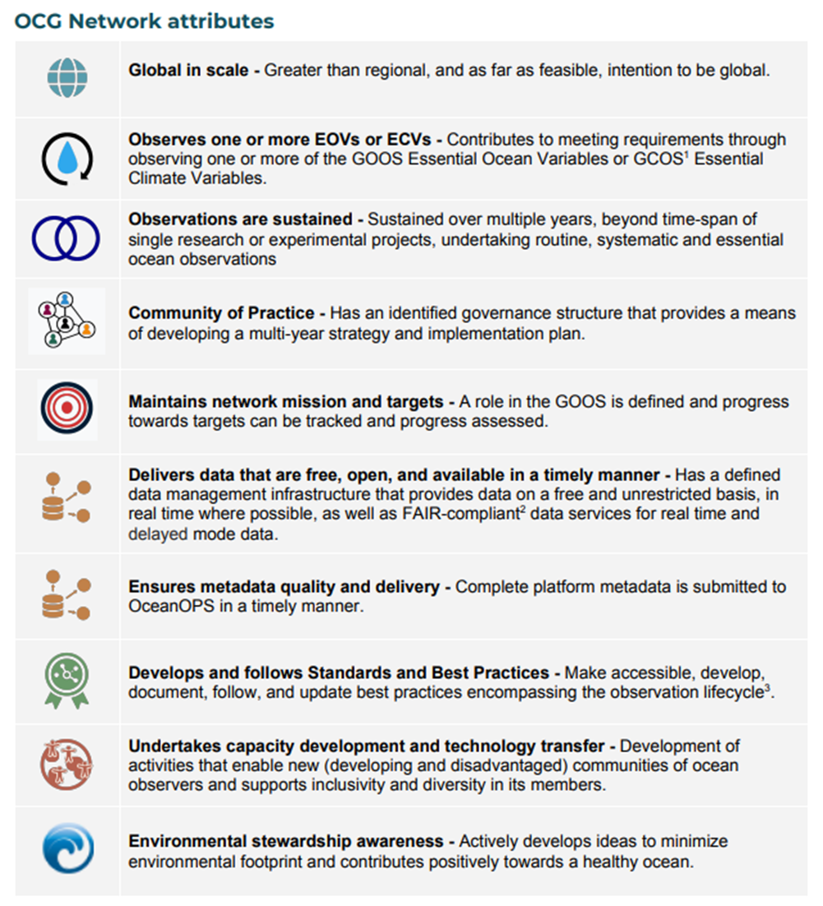
Attribute Report out

Slide 20
Future Plans and Opportunities
Future plans and developments, for example
Contributions to UN Decade of Ocean Science, SDGs, GOOS strategy, WMO Strategy ……
Opportunities to collaborate with other networks
Third party/private sector engagement

Slide 21
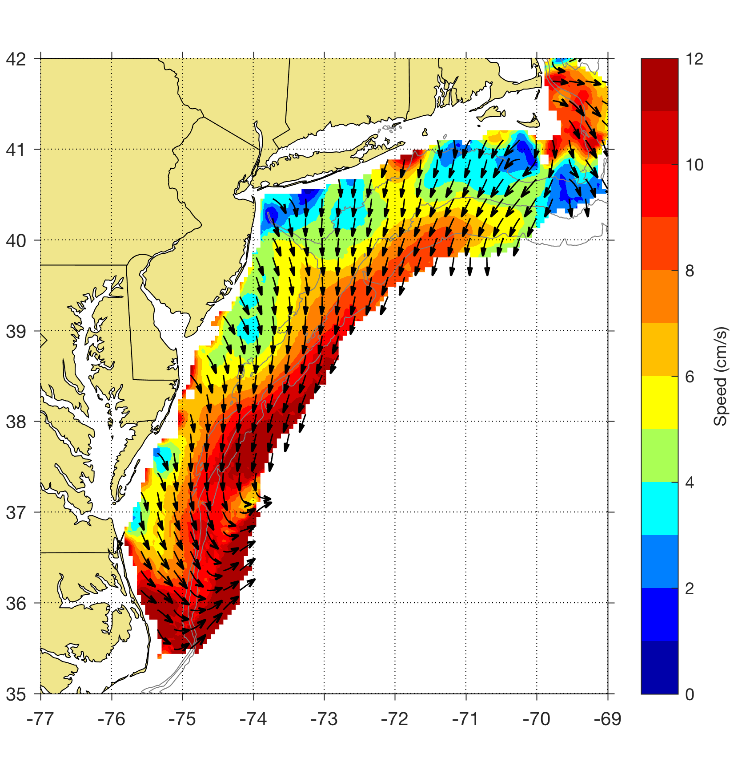
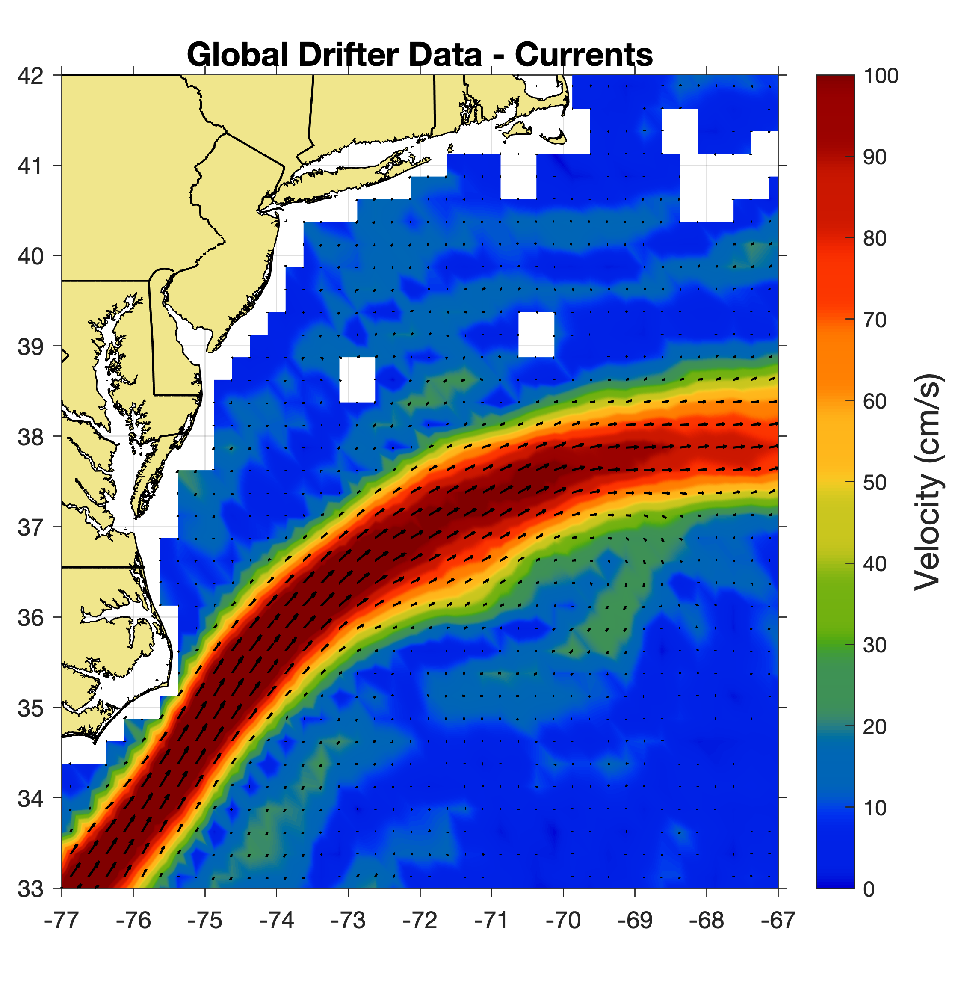
MARACOOS HFR Surface Current
2007-2016
Northwest Atlantic Surface Currents
1979-2015
Roarty, H.et al. "Annual and seasonal surface circulation over the Mid‐Atlantic Bight Continental Shelf derived from a decade of High Frequency Radar observations." Journal of Geophysical Research: Oceans 125, no. 11 (2020): e2020JC016368.
Laurindo, L., A. Mariano, and R. Lumpkin, 2017: An improved near-surface velocity climatology for the global ocean from drifter observations Deep-Sea Res. I,124, pp.73-92, doi:10.1016/j.dsr.2017.04.009 .
Notes:
https://www.aoml.noaa.gov/phod/gdp/mean_velocity.php

Slide 22
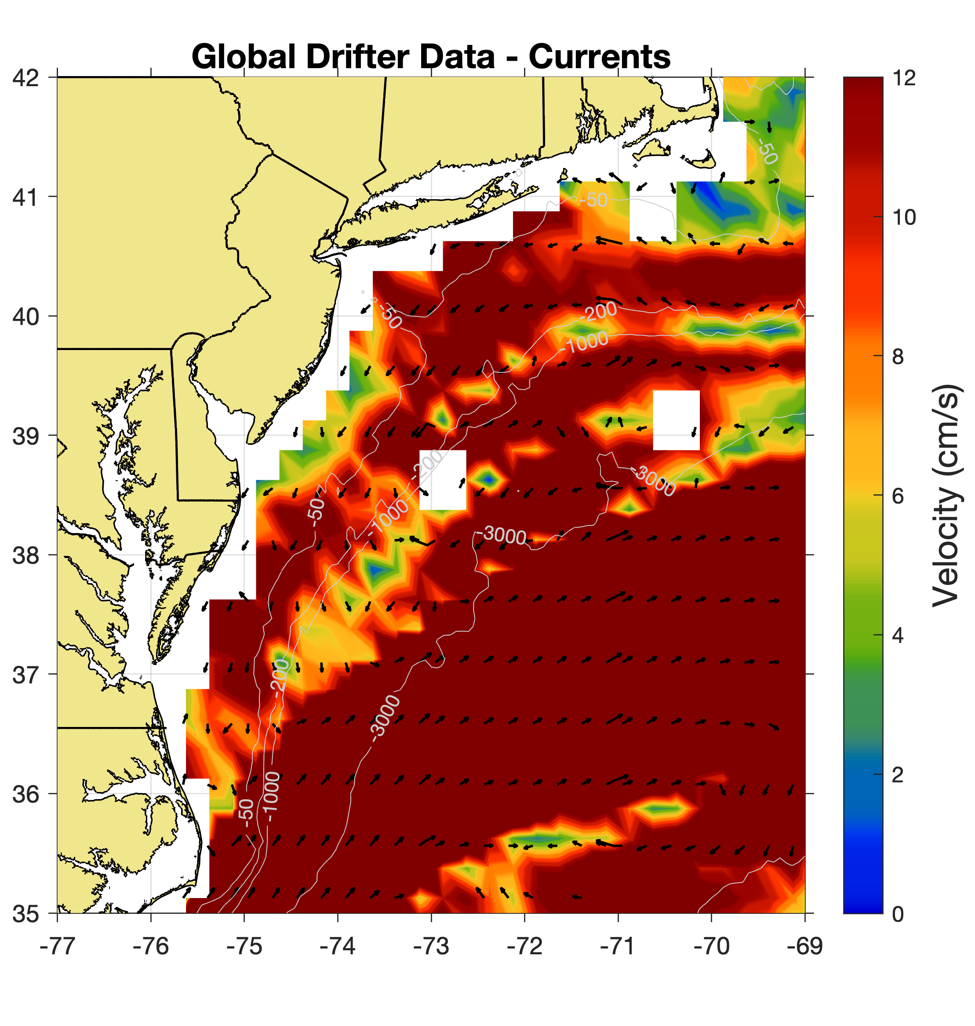
MARACOOS HFR Surface Current
2007-2016
MARACOOS HFR Surface Current
1979-2015
Roarty, H.et al. "Annual and seasonal surface circulation over the Mid‐Atlantic Bight Continental Shelf derived from a decade of High Frequency Radar observations." Journal of Geophysical Research: Oceans 125, no. 11 (2020): e2020JC016368.
Laurindo, L., A. Mariano, and R. Lumpkin, 2017: An improved near-surface velocity climatology for the global ocean from drifter observations Deep-Sea Res. I,124, pp.73-92, doi:10.1016/j.dsr.2017.04.009 .

Slide 23
Asks from OCG
Increased spectral bandwidth. Can OCG endorse a request for more spectral bandwidth at an upcoming World Radiocommunication Conference.
As HFR operators move onto dedicated bands for oceanographic radars, can OCG play a role in helping synchronize systems across countries to avoid radio interference.
Facilitate discussions with the ocean modelling community on the value of HFR surface current and wave data for assimilation into and validation of operational forecast models.
When radial measurements cross country borders, can OCG help foster the generation of total vector products.

Slide 24
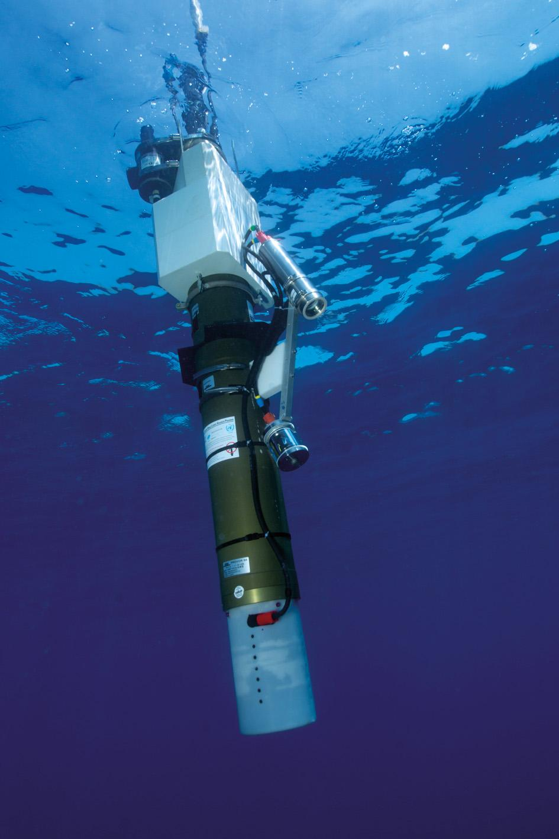
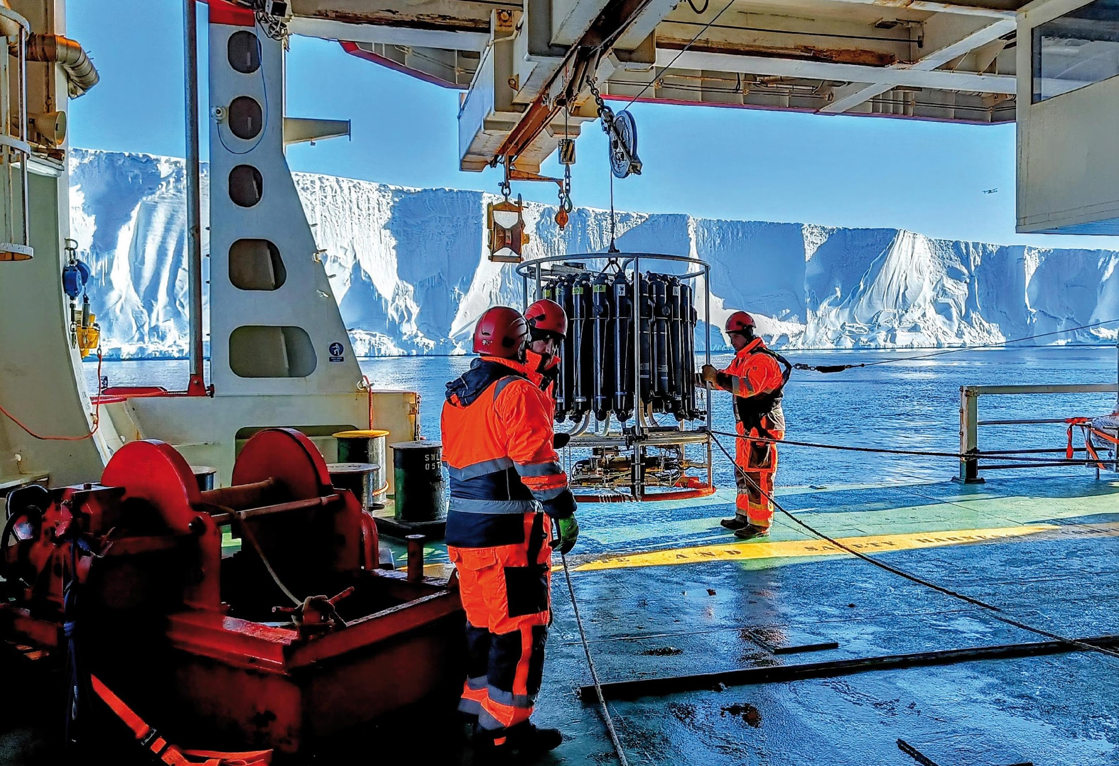
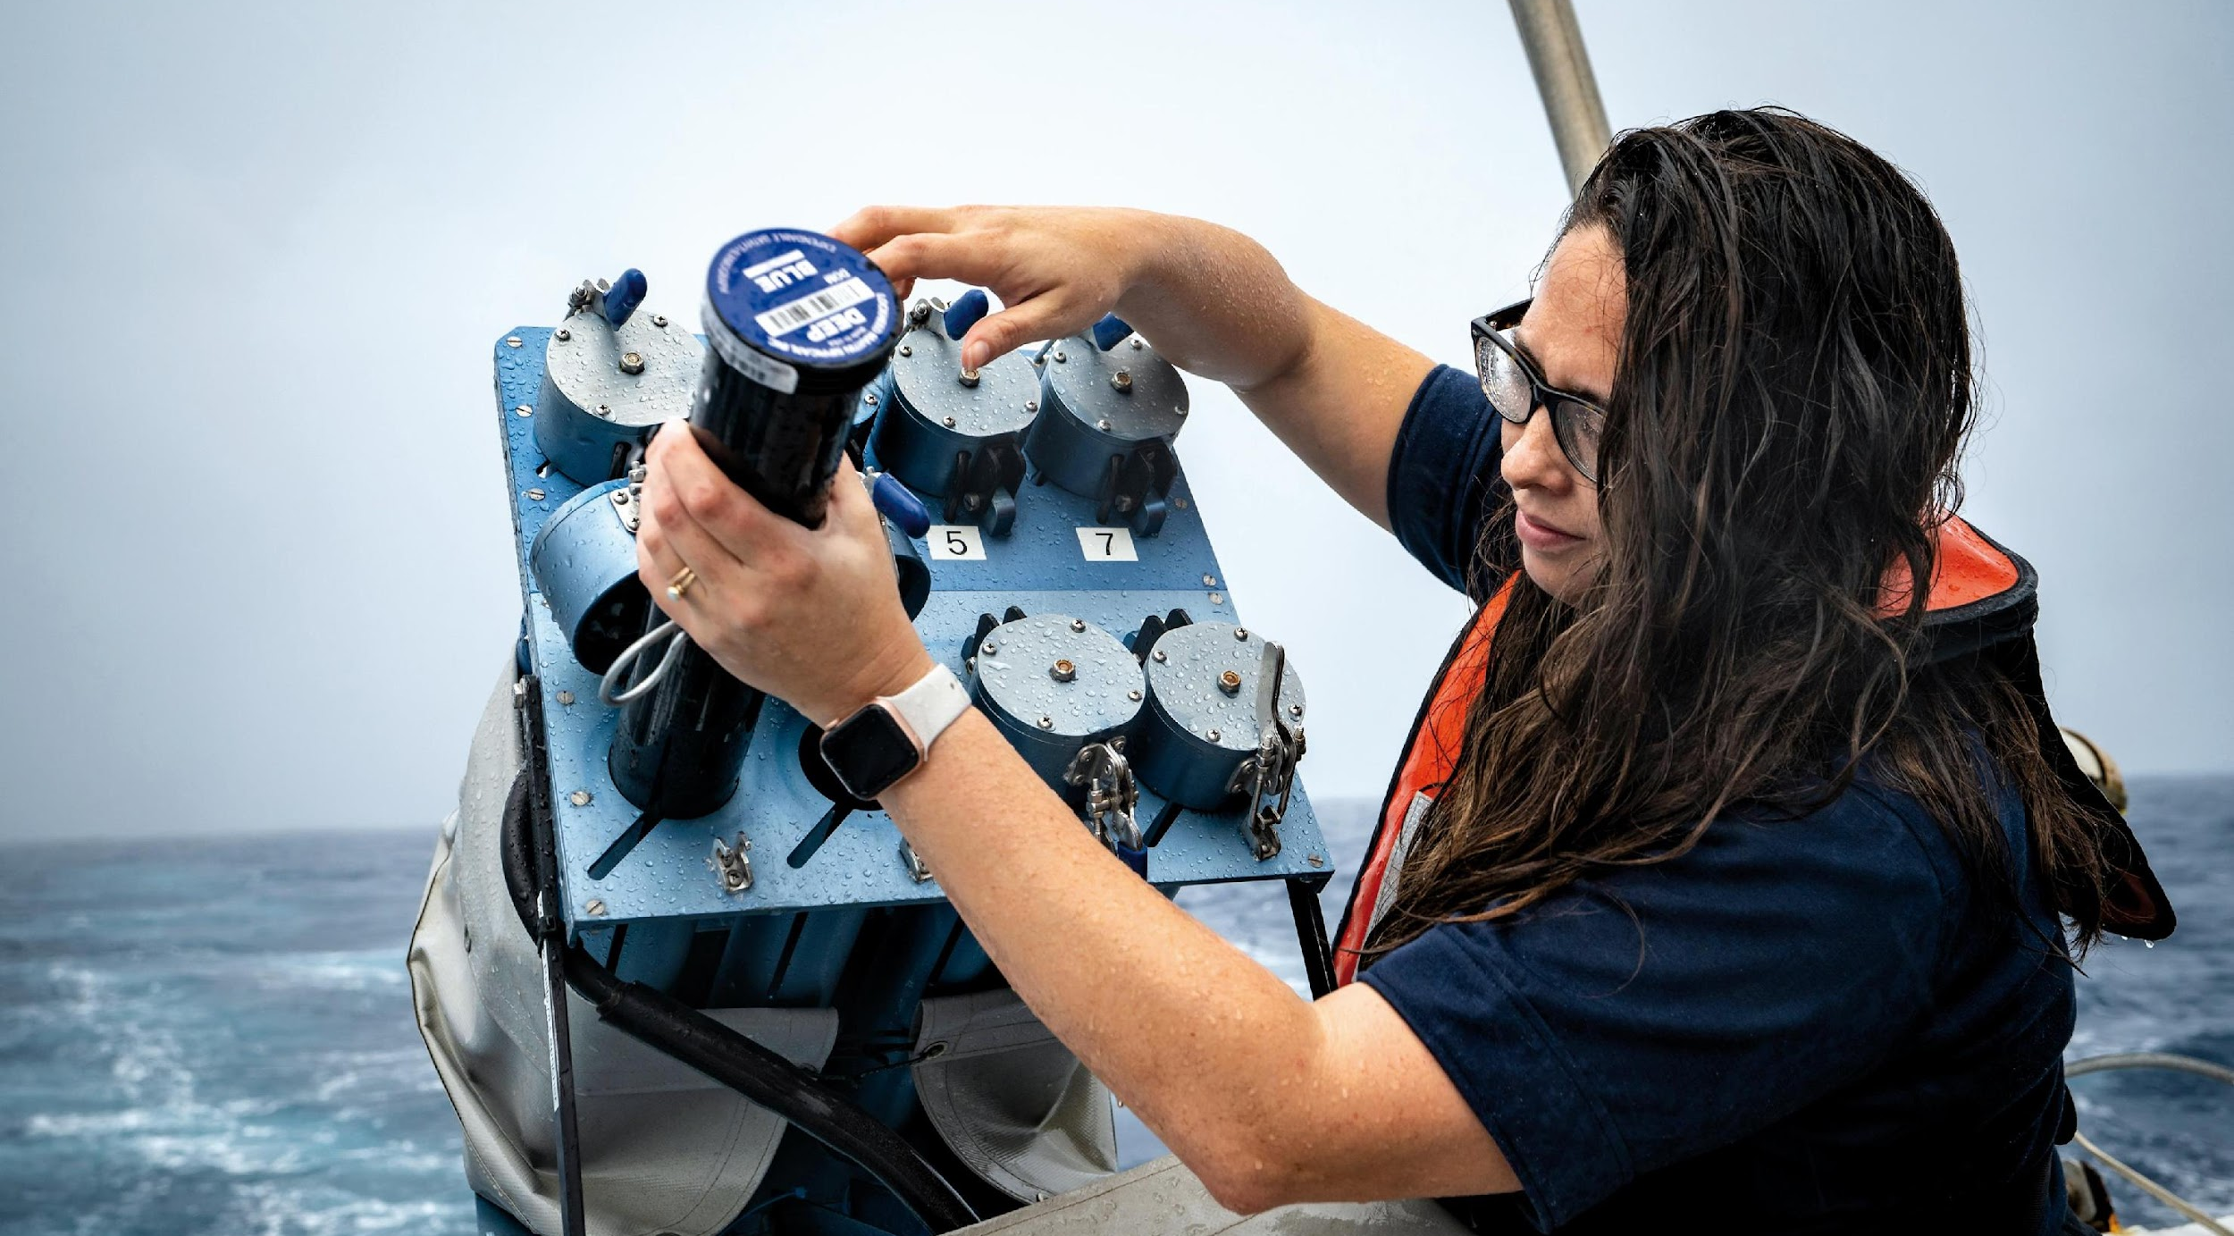
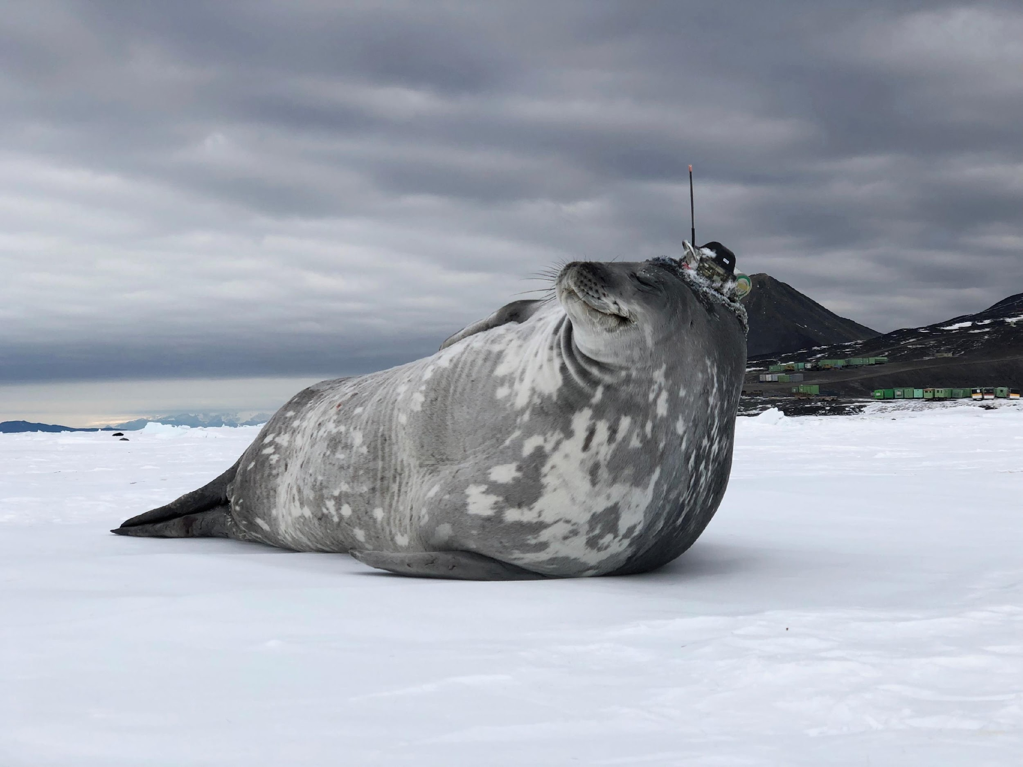
Thank you
goosocean.org

