Slide 1
GLOSS
OCG-14 Hybrid Meeting
6-8 June 2023
Cape Town, South Africa
Gary Mitchum, Chair of the GLOSS Group of Experts

Slide 2
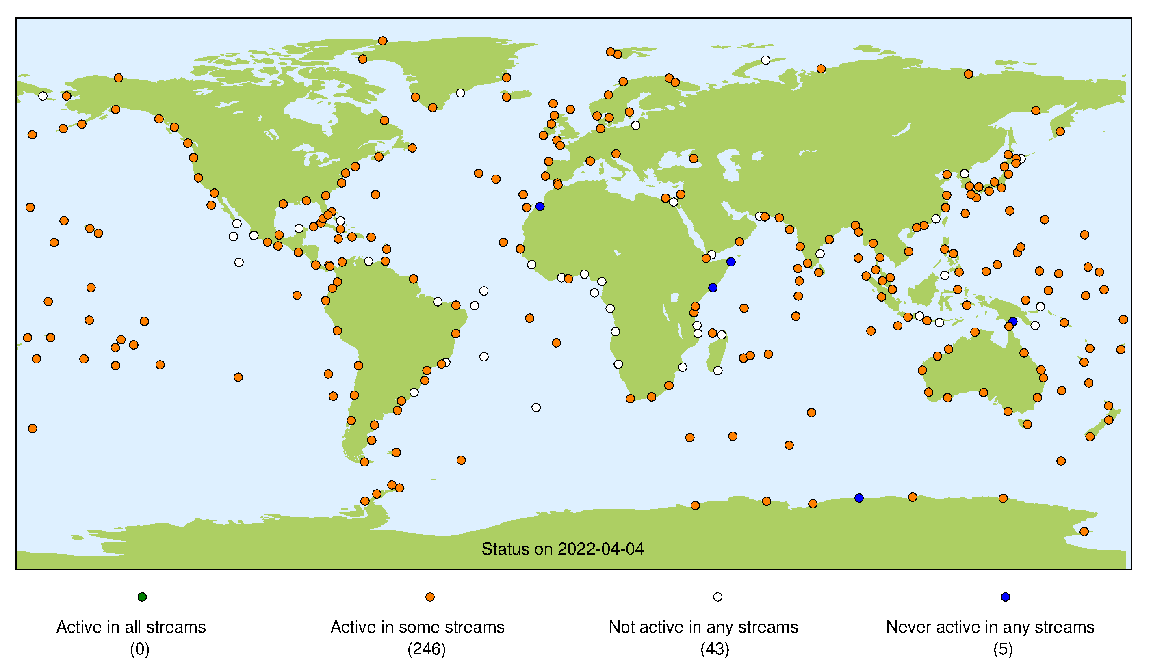
Network Overview

Slide 3
Developments and Achievements
In person meeting of data center representatives in July 2022
In person Group of Experts (GE) meeting in November 2022 (only 1 year late)
Created plans to improve GLOSS data access and meta data
GE approved a suggestion to modernize our governance structure
Collaborated on a successful proposal to IAPSO to hold a workshop on tidal analysis best practices to be held in Liverpool in a few months

Slide 4
Challenges and Concerns
Lack of centralized resources has always been and continues to be the largest problem
A related issue is uneven support for our data centers

Slide 5
Attribute Report out
What is the status on OCG attributes? I am still not sure what is needed here.
Global in scale :
Observes one or more EOVs or ECVs :
Observations are sustained :
Community of Practice :
Maintains network mission and targets :
Delivers data that are free, open, and available in a timely manner :
Ensures metadata quality and delivery :
Develops and follows Standards and Best Practices :
Undertakes capacity development and technology transfer :
Environmental stewardship awareness :

Slide 6
Future Plans and Opportunities
Implement the new governance structure
Implement the plan to improve access to GLOSS data
Implement the plan to improved GLOSS meta data
Carry out the tidal analysis workshop and publish a best practices article

Slide 7
Asks from OCG
Advice on how we might address the uneven funding of our data centers?

Slide 8
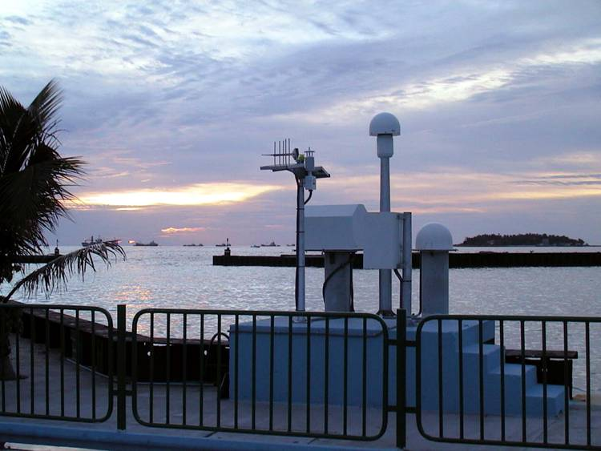
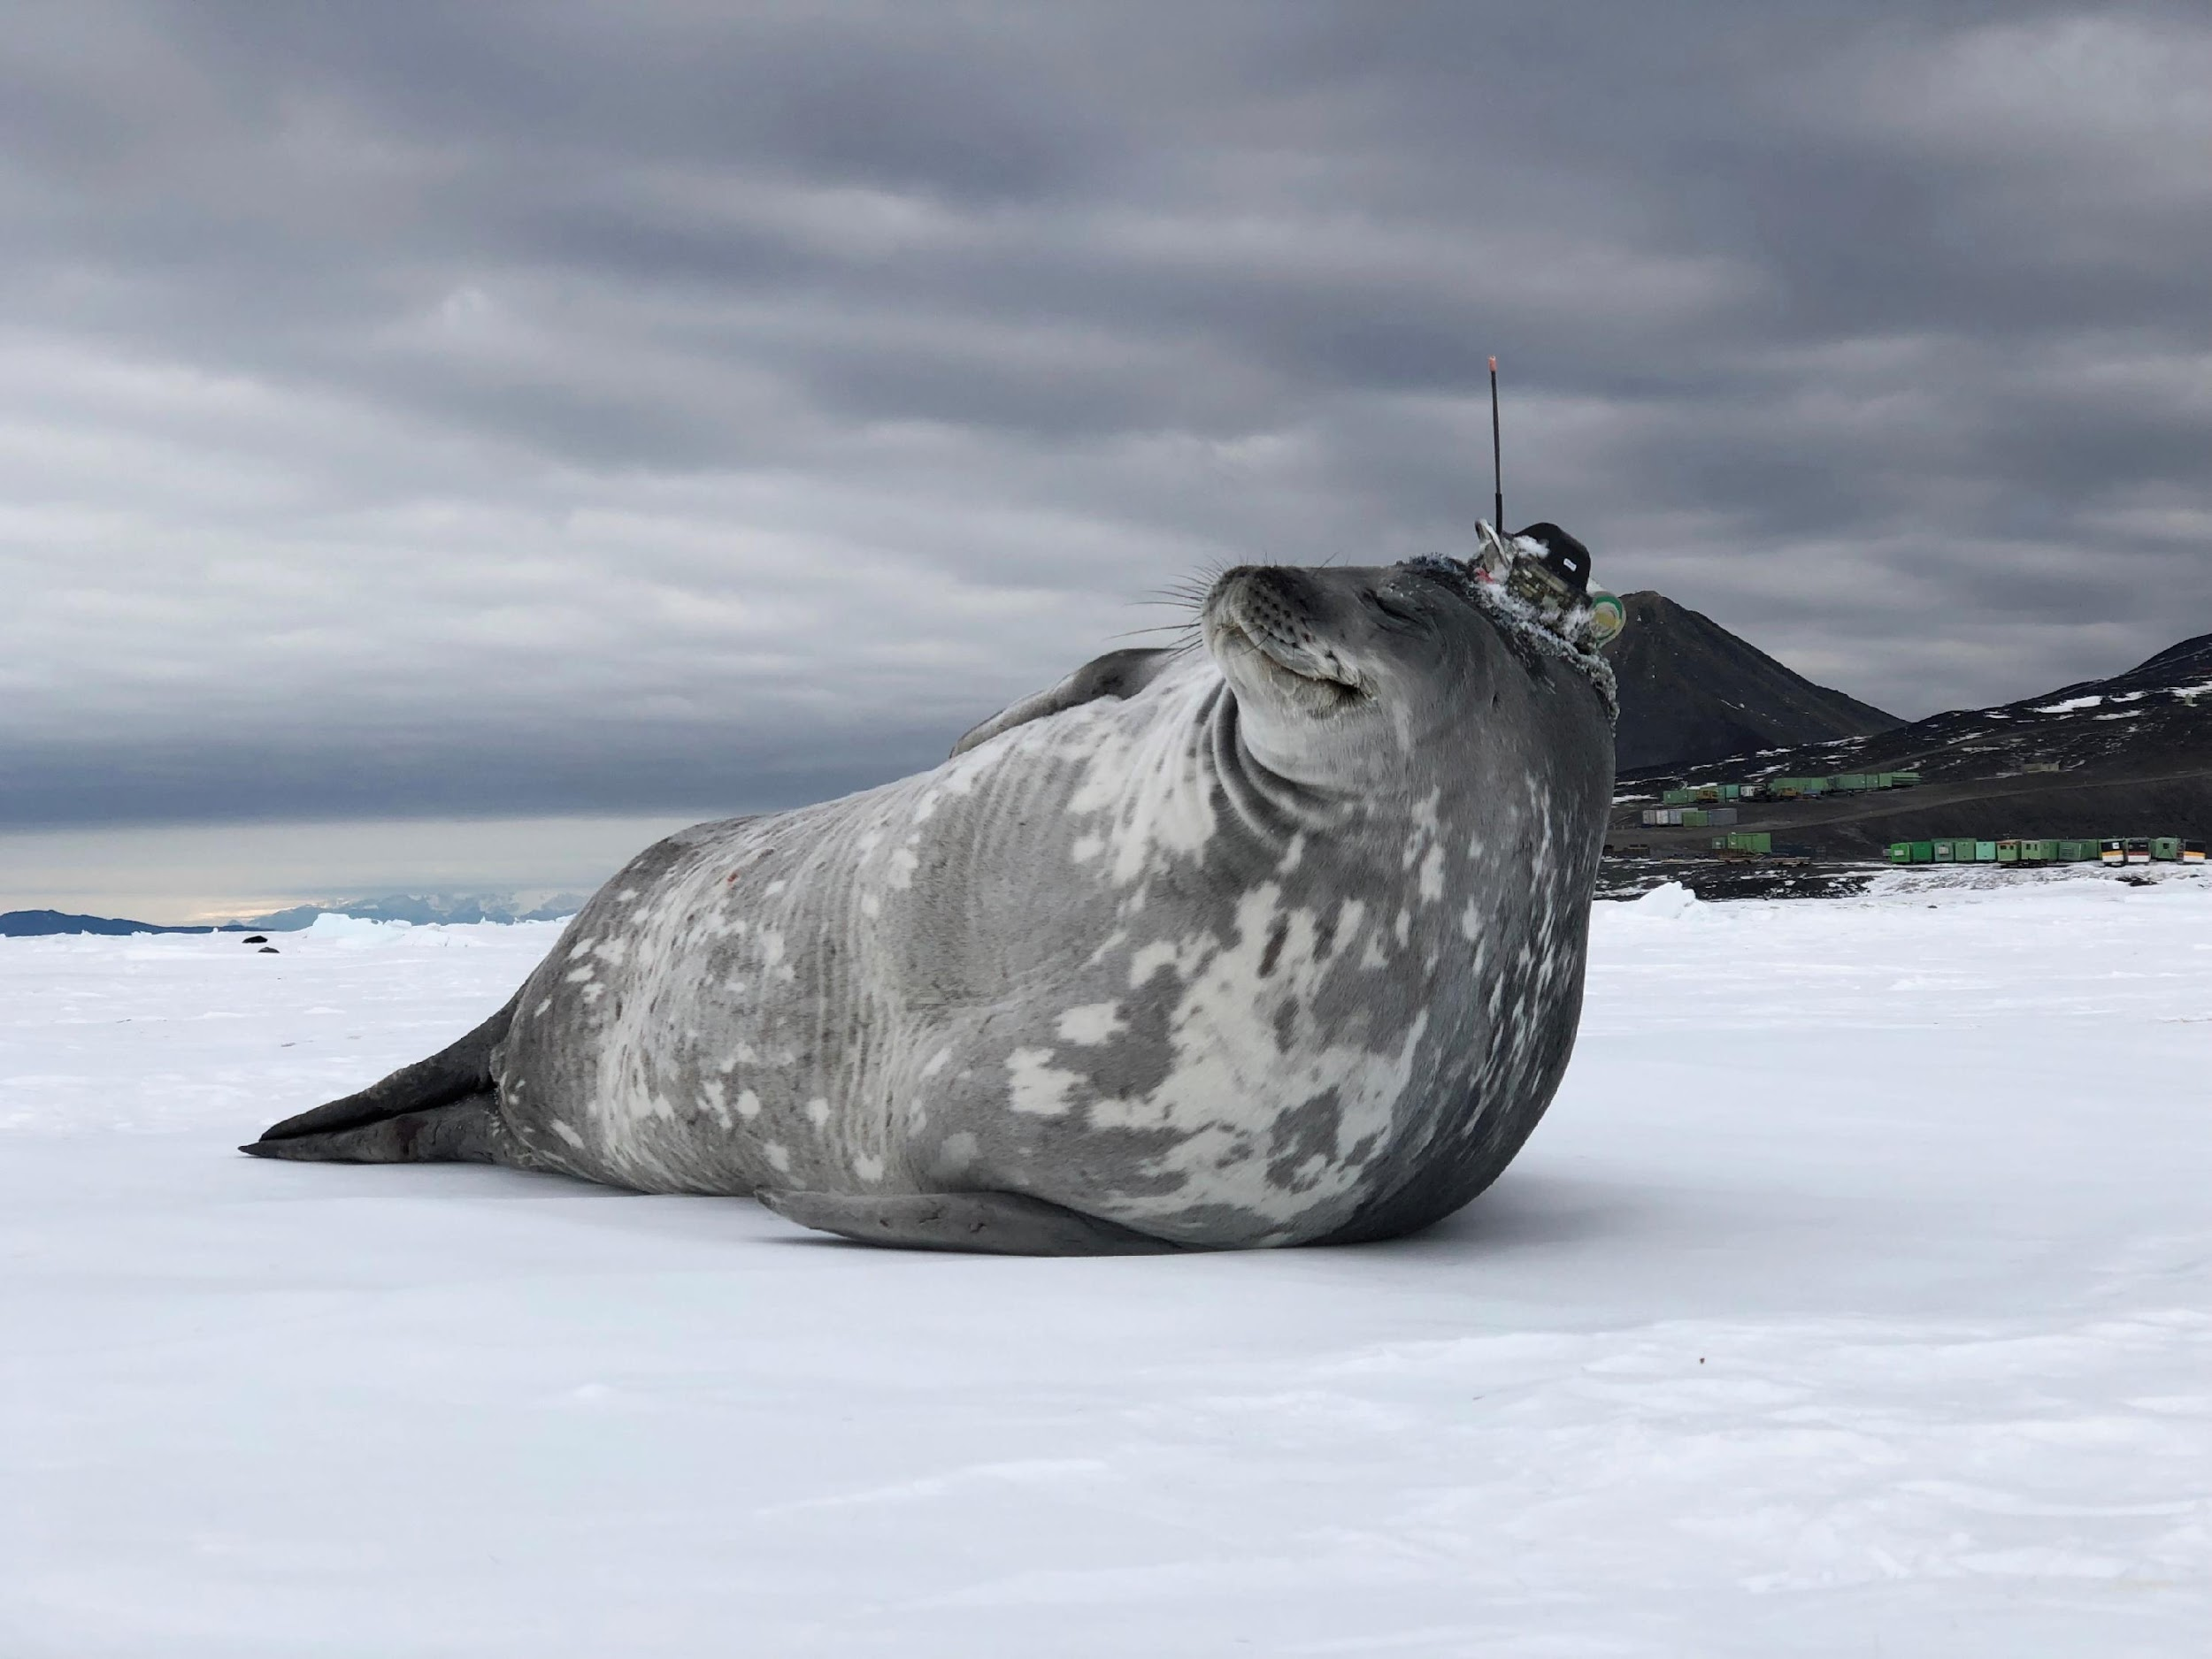
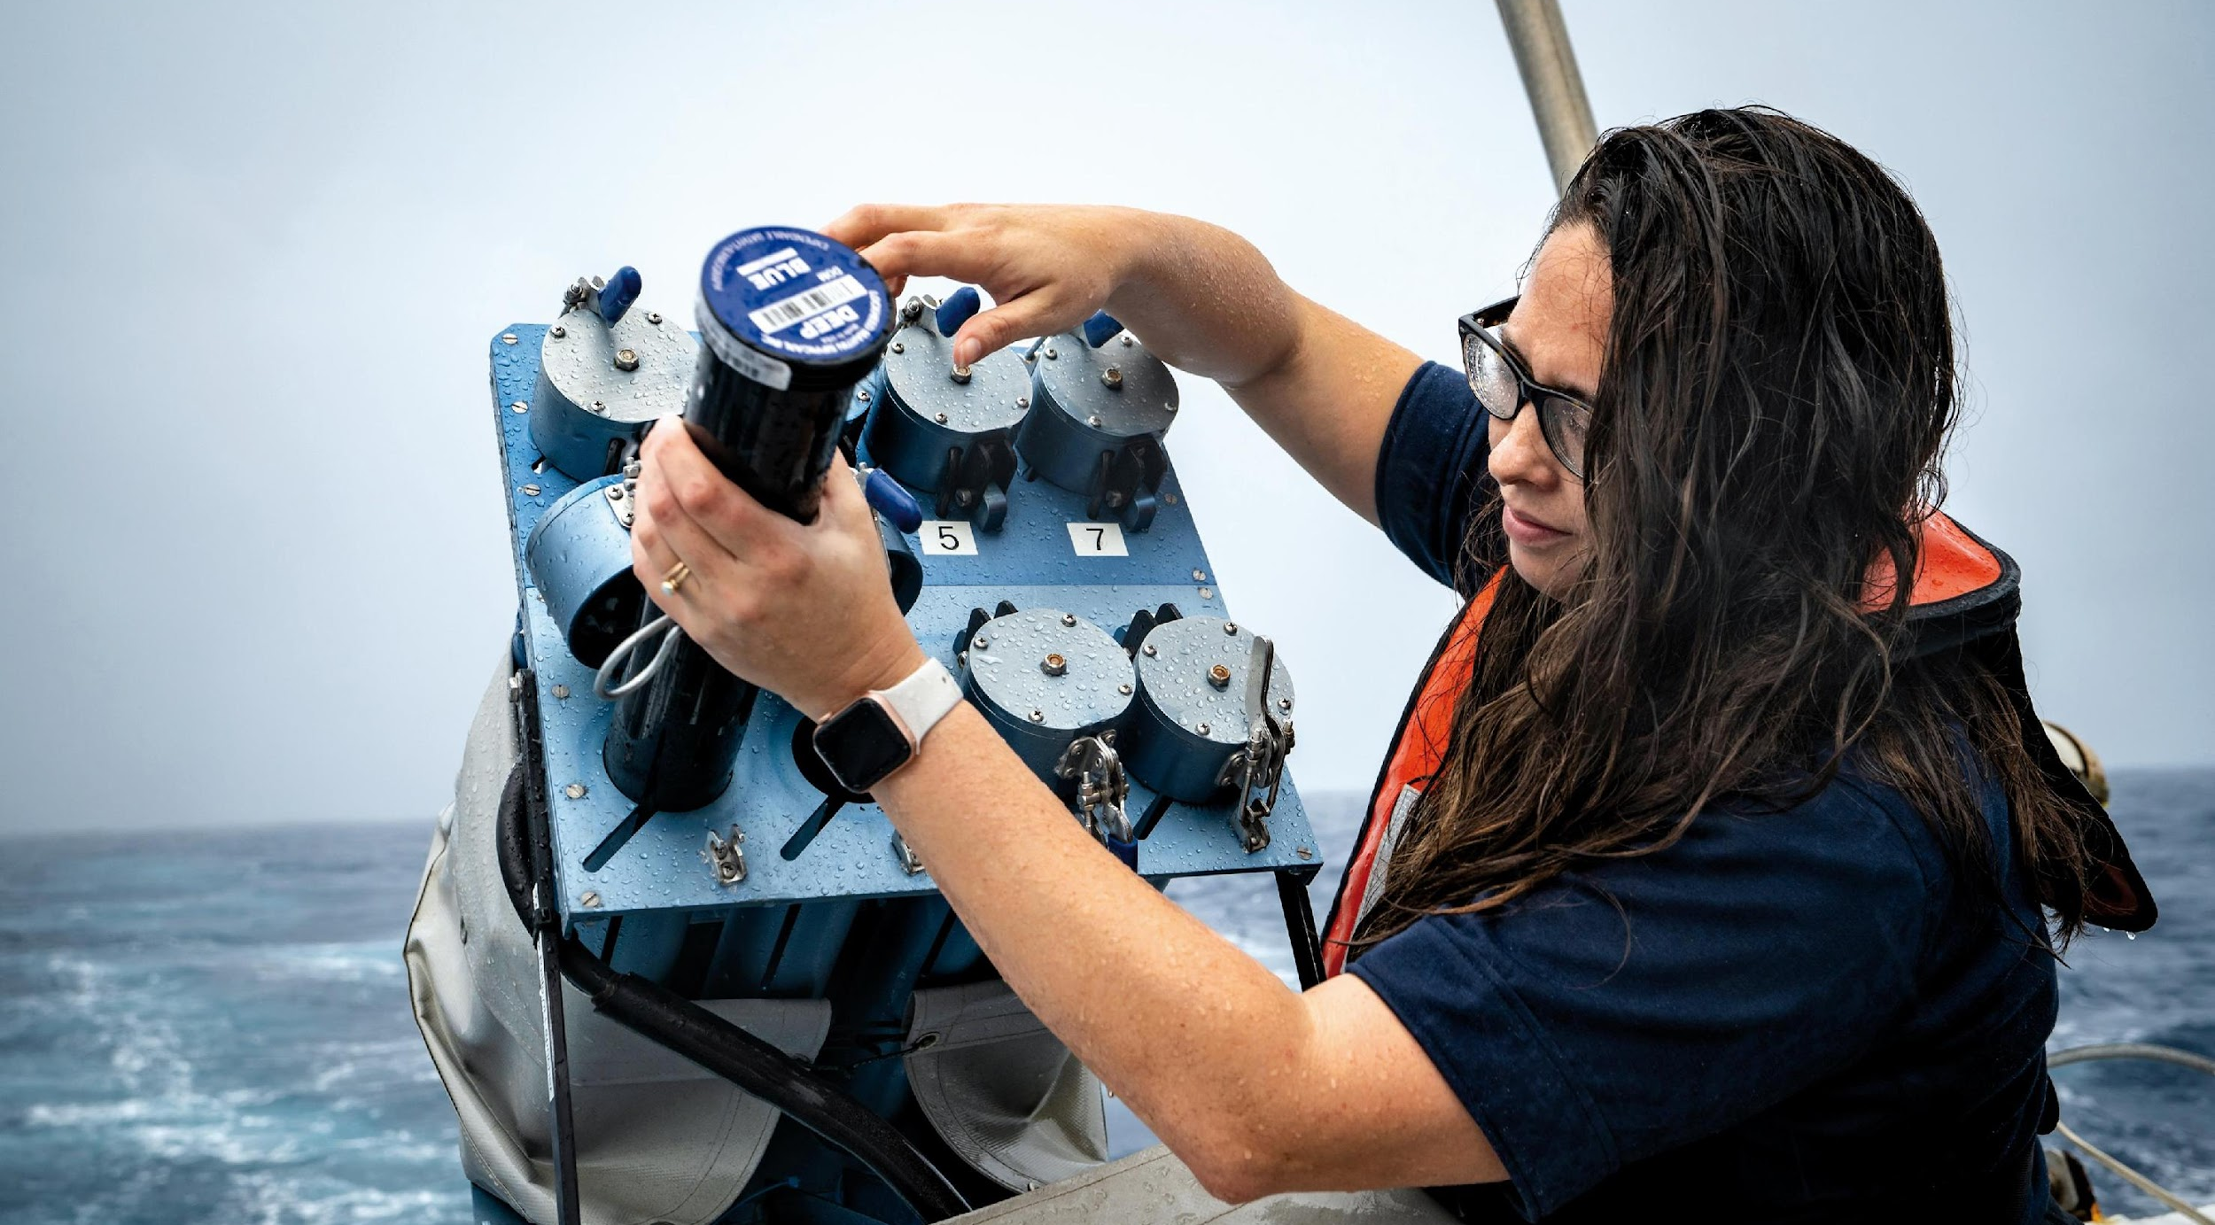
Thank you
goosocean.org

