Slide 1
Capacity Building of the Data Buoy Cooperation Panel (DBCP)
OCG-14 Hybrid Meeting
6-8 June 2023
Cape Town, South Africa
JIANG Qiu-Rachel, Chair of DBCP Task Team on Capacity Building

Slide 2
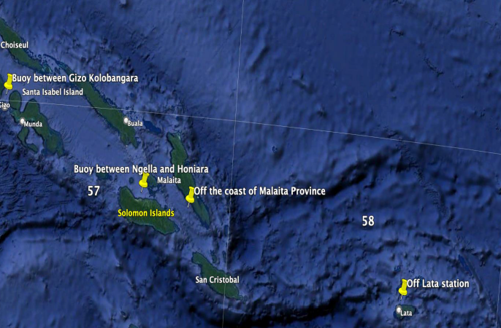
Developments and Achievements
2 decades of dedicated in-region capacity building activities from 2003
5 Western Indian Ocean, 5 Pacific Islands, 5 NPOMS, 1 Mediterranean, 500+ trainees, great appreciation from Members/Member States
Tangible results: for example, wave drifter pilot deployment for Solomon Islands

Slide 3
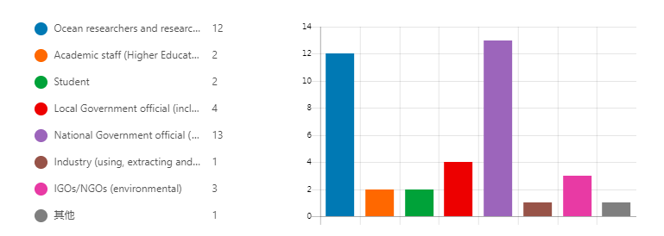
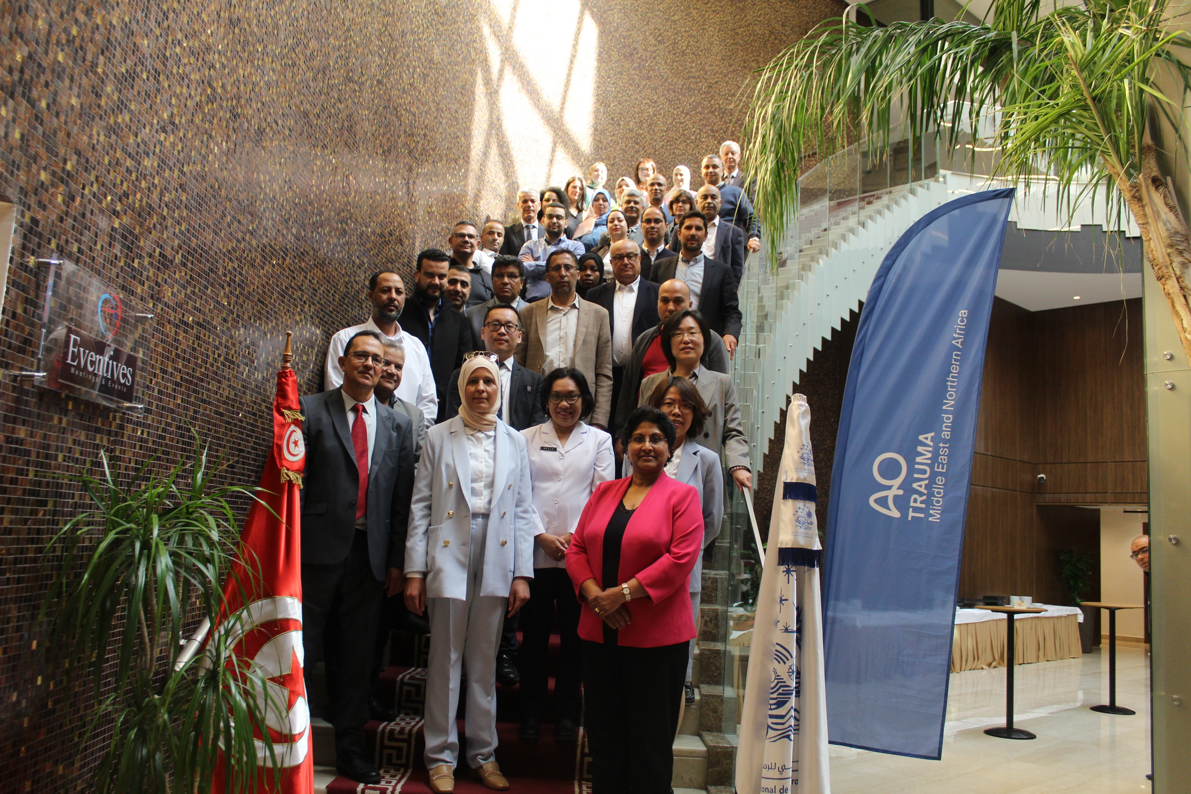
First DBCP Mediterranean Workshop
Part I, virtual, Nov 2022
34 Countries , 125 Participants, 17 presentations.
Part II, hybrid, May 2023, Tunis, Tunisia
24 countries, ~80 participants, 27 presentations.
14 trainees funded by DBCP Trust Fund (IOC&WMO),
14 recommendations and 4 actions.
Good Diversity and Inclusivity of trainees in the region, representations of most GOOS networks relevant to the basin, and GOOS value chain.

Slide 4
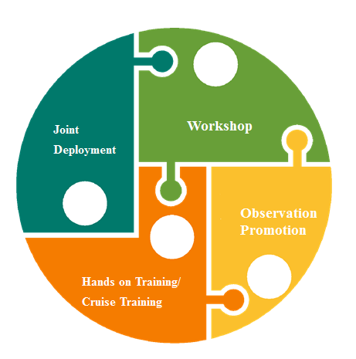
Future Plans and Opportunities
Cyprus, Egypt, Morocco showed interest in Mediterranean workshop ;
BMKG of Indonesia intent to host for Asia ;
Other regions/basins such as Southern Atlantic .
Liaise with GOOS GRAs and networks of GOOS, WMO RTC,
RMICs and RICs.
Wave drifter pilot deployment (Continue..);
Gliders/Sail Drones jointly deployment (Mediterranean , South Pacific islands…);
Tide Gauge jointly establish.
Potential linkage with Ocean Gliders, GLOSS …
DBCP’s Barometer upgrade program
Calibration and Inter-comparison services
Best Practices.
Liaise with GO-SHIP, OBP ,WMO ET-QTC and …
Hands on Training and Cruise training
Explore the possibilities ,cooperate with SOT…

Slide 5
Challenges and Concerns
Wide and diversified expectations, limited resources, difficult to sustain
Technical challenges in different regions (administrative and internal approval processes, VISA, language barriers, connectivity, electricity, …)
Follow up and monitoring mechanism
Asks from OCG
Strategic guidance on CD?
Funding and resources support?

Slide 6
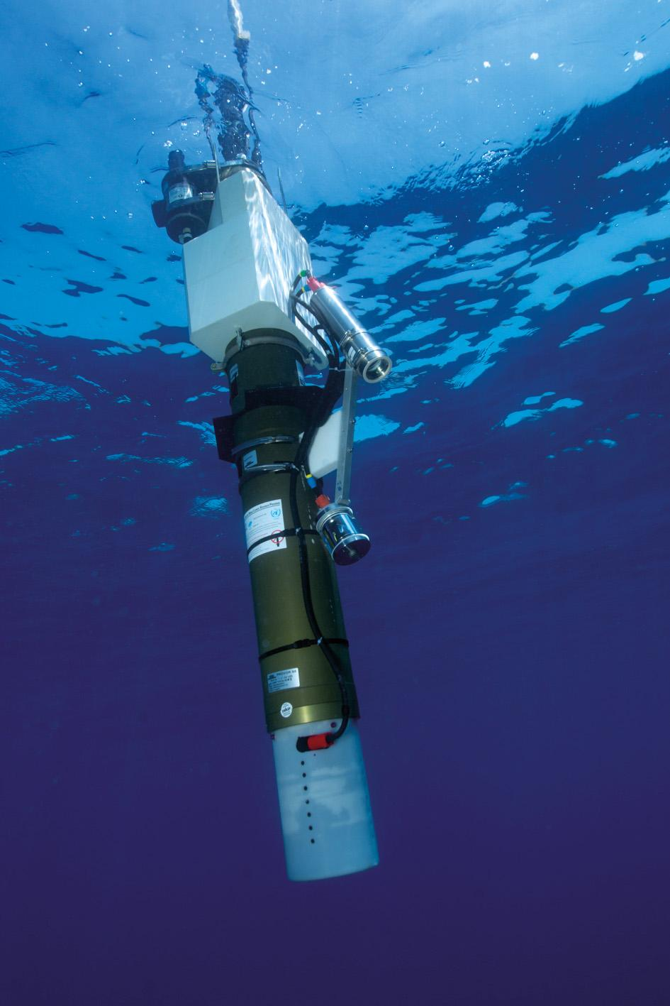
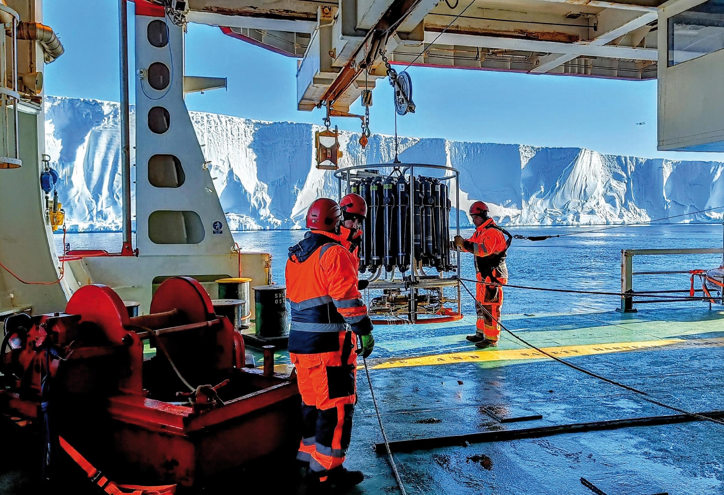
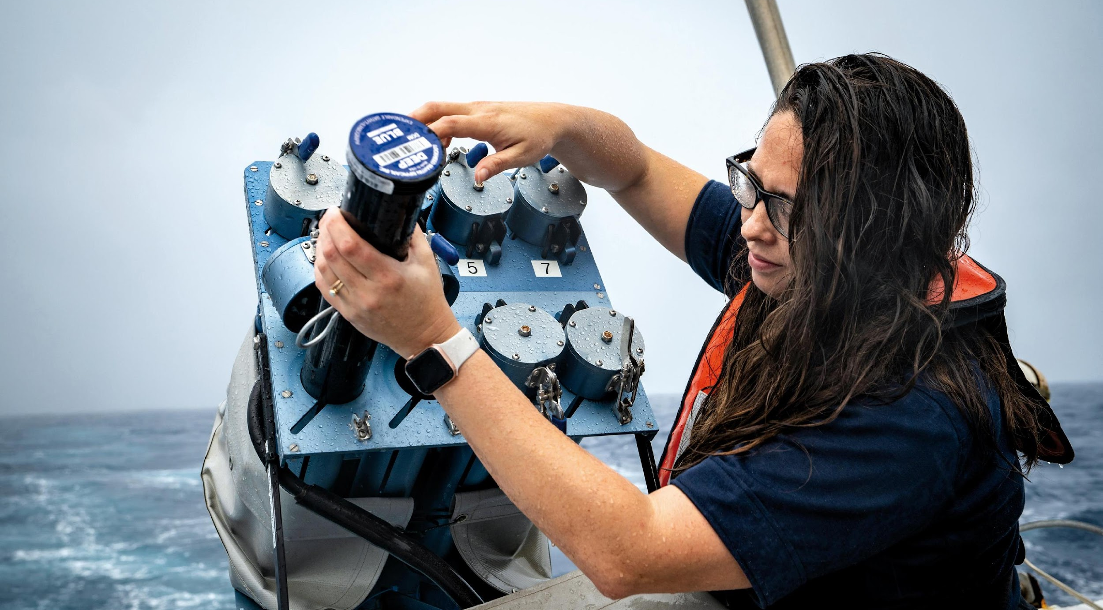
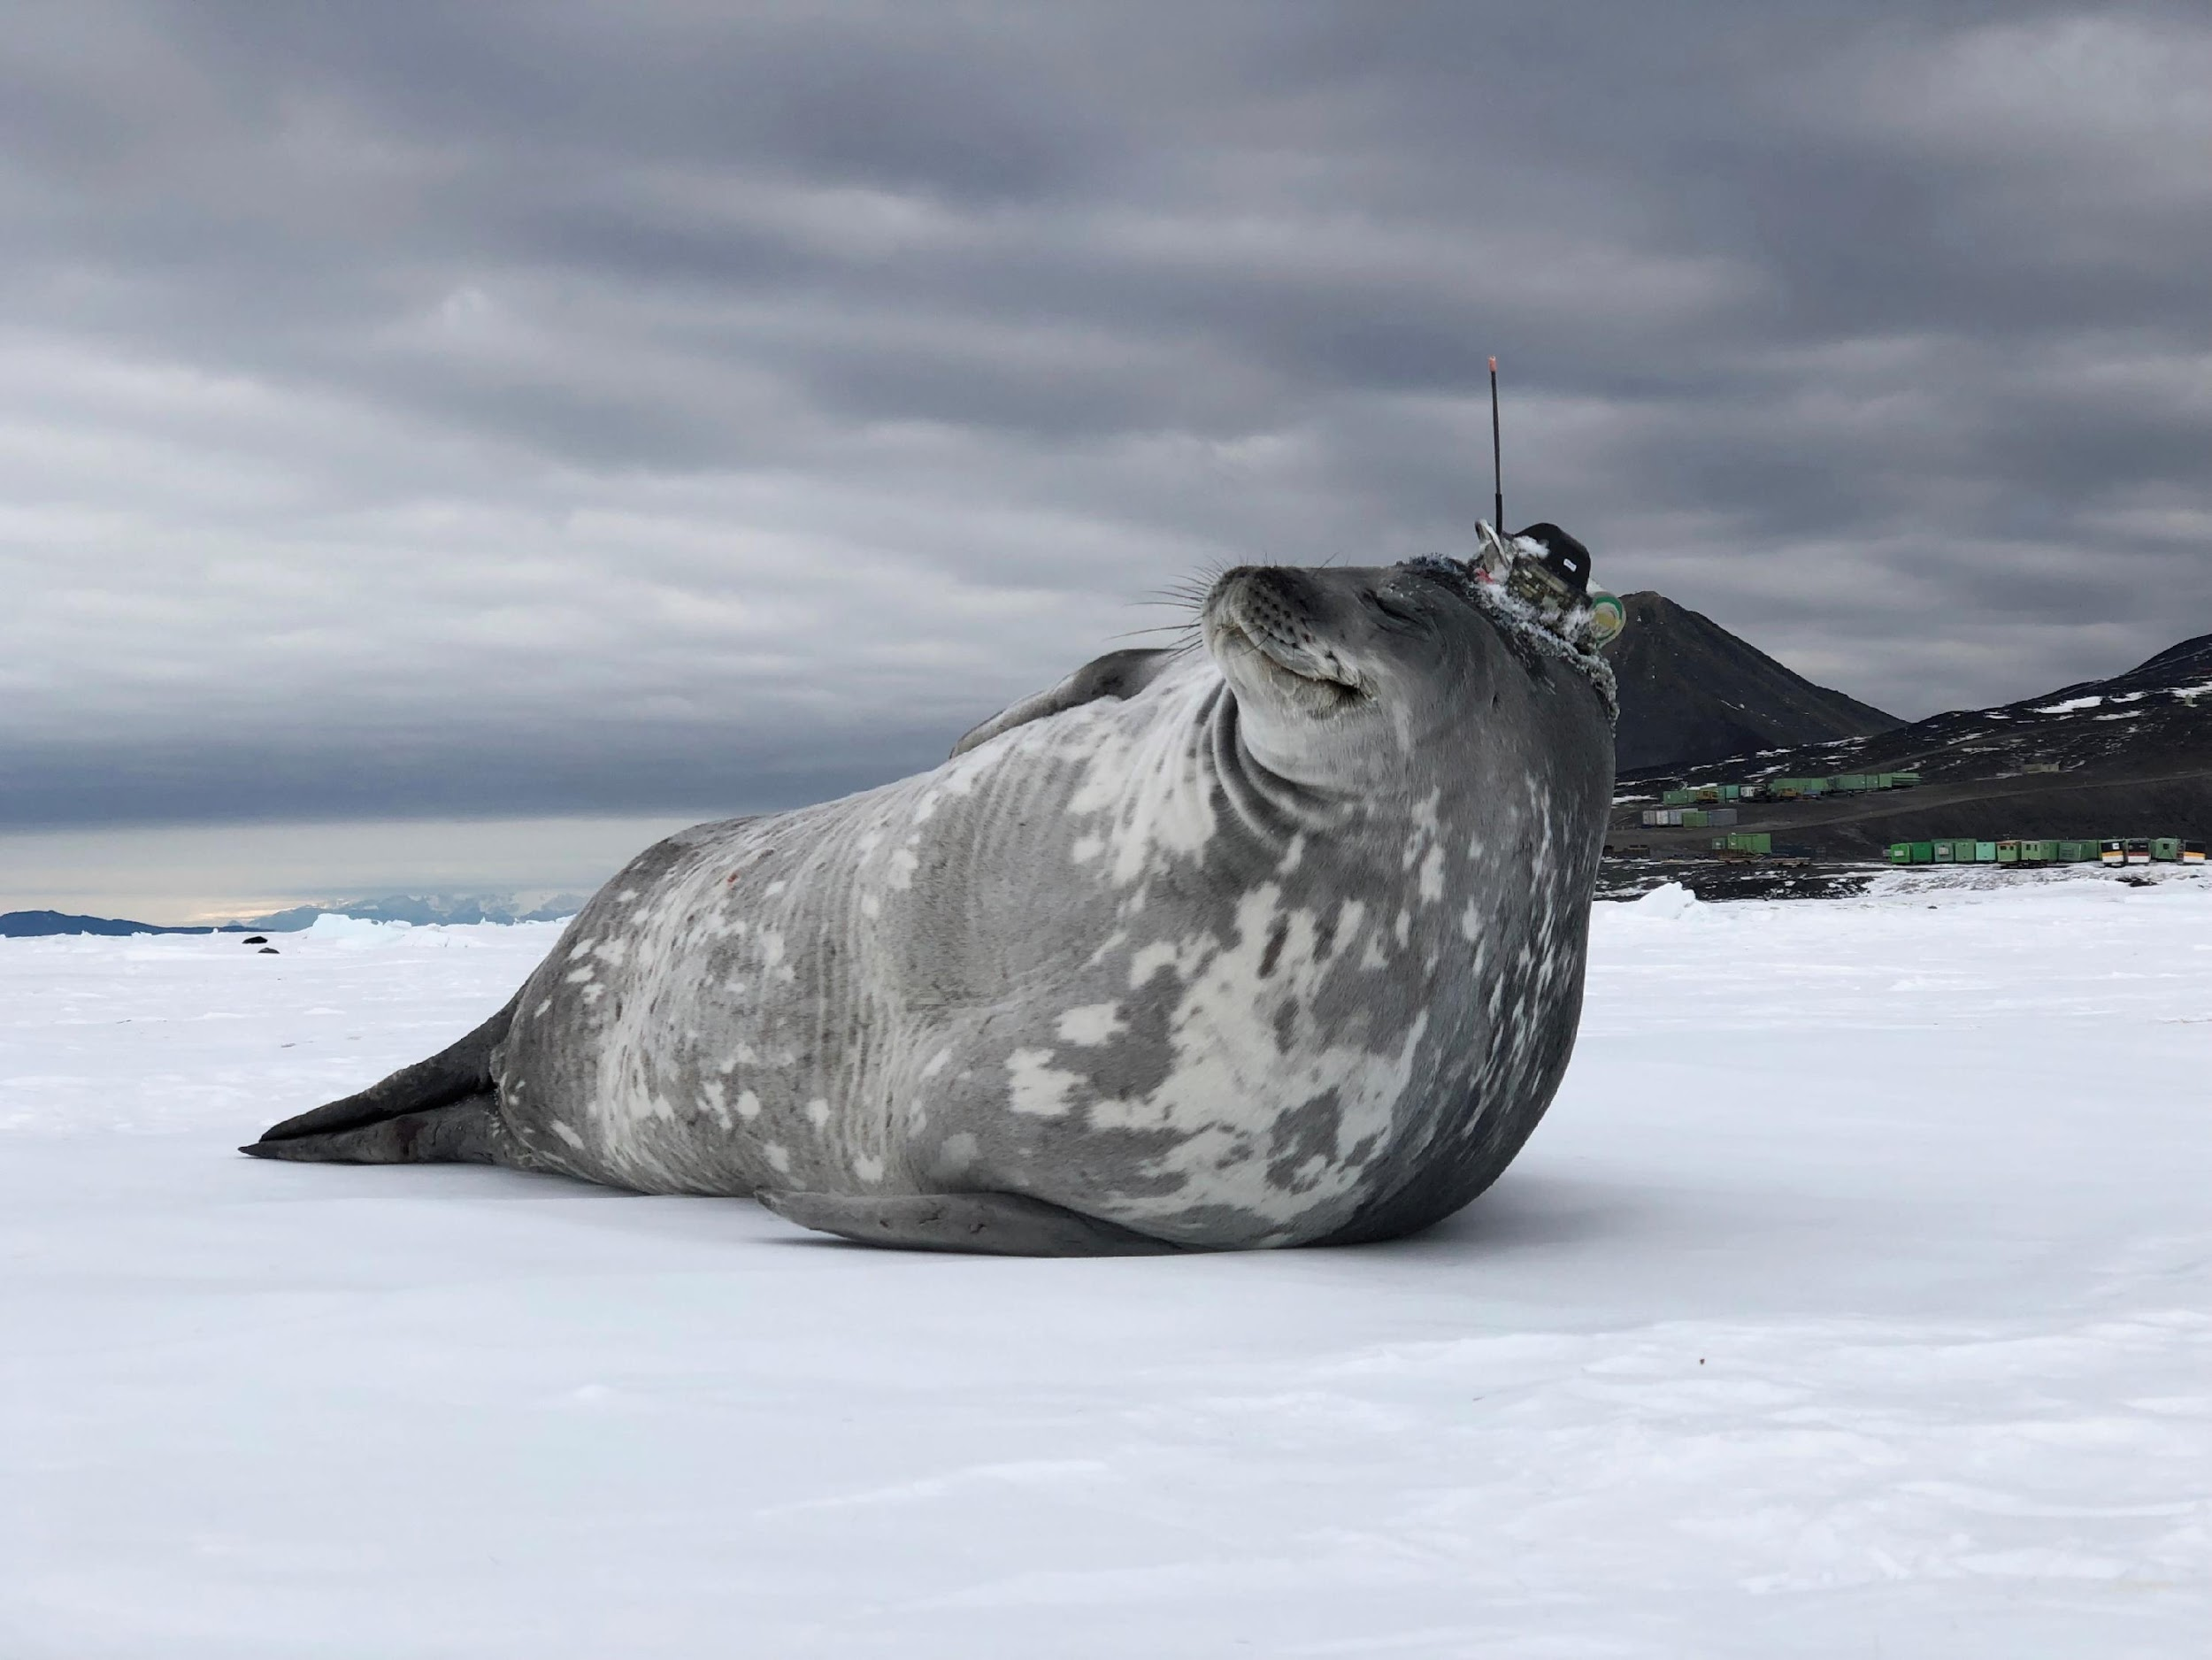
Thank you
goosocean.org

