Slide 1
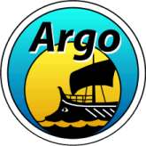
The Argo Program
OCG-14 Hybrid Meeting
6-8 June 2023
Cape Town, South Africa
Breck Owens
Argo Director, WHOI
Susan Wijffles
Co-Chair, WHOI
Brian King
Co-Chair, NOC

Slide 2
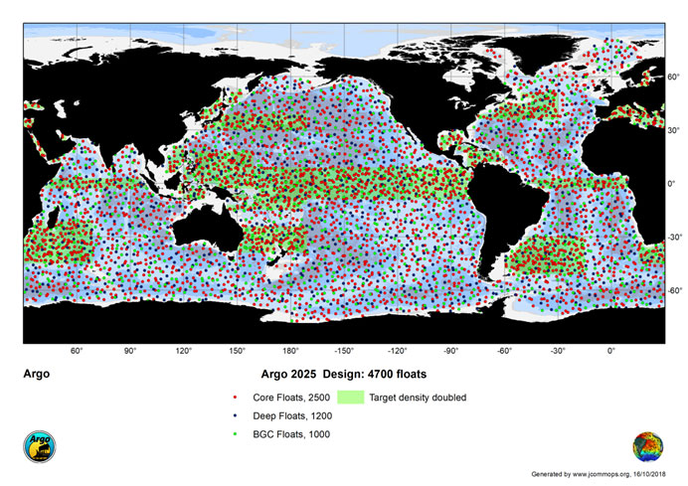
OneArgo
Global array of 4700 profiling floats
BGC Argo to address ocean carbon sink, ocean acidification, and ocean deoxygenation,
Deep Argo to sample to full depth
Core continues global coverage for real-time forecasting, climate analyses and use by broader oceanographic community, with increased coverage for
- high latitude oceans with seasonal ice
- marginal seas
- enhanced sampling for:
Tropical Pacific Ocean
Western Boundary regions,

Slide 3
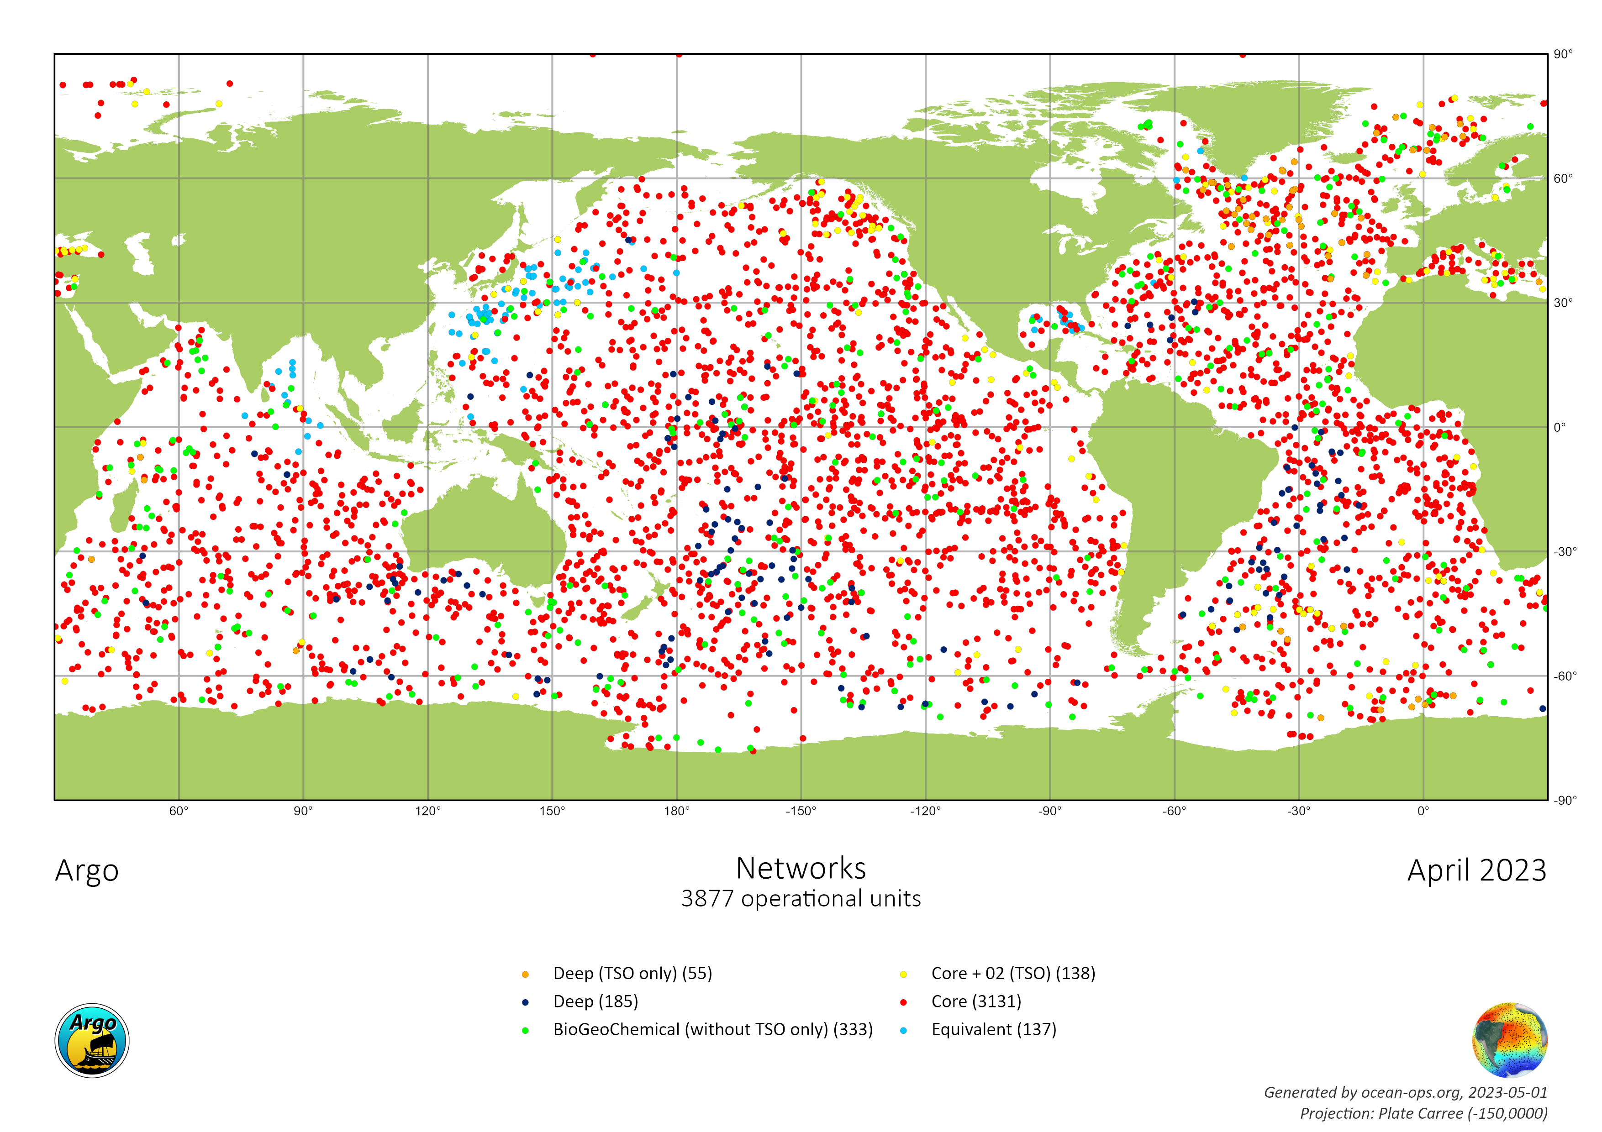
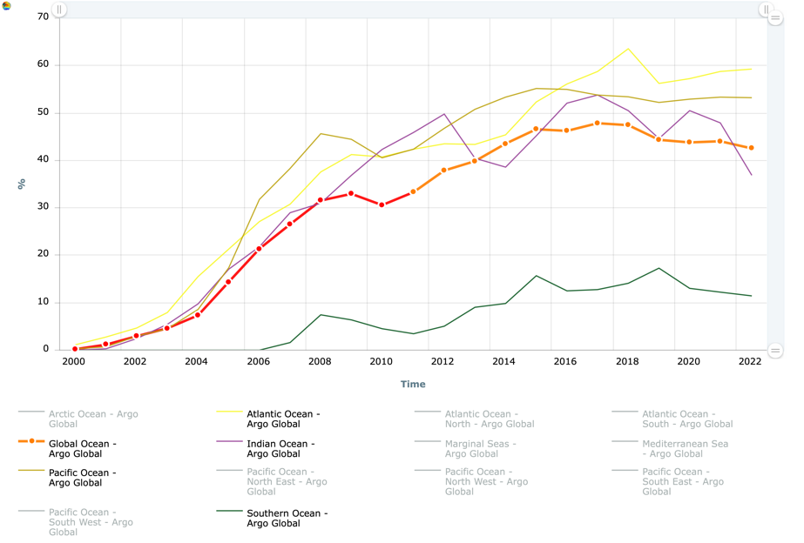
Status of the Argo Array
Size of the Array
%
year
Slow decrease from maximum in 2018
Significant holes in the Indian and Southern Oceans
TPOS2020 enhanced coverage no longer exists
Western boundary current enhancements never realized

Slide 4
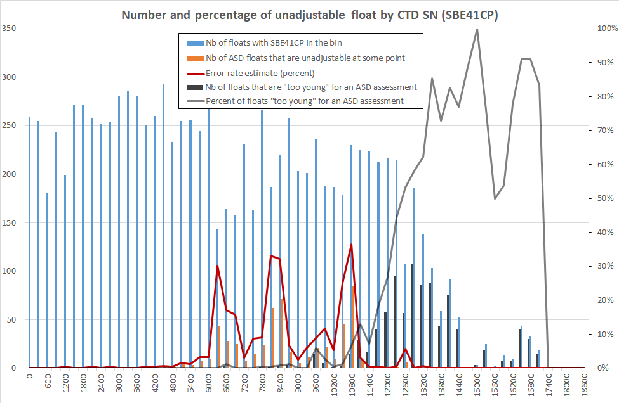
Status of the Argo Array
Unadjustable Conductivity Sensors
3877 floats listed at Ocean-Ops
682 grey-listed floats with bad Abrupt Salinity Drift
140 floats profile < 1200 dbar
Effective array of ~3000 “healthy” floats
comparable to original Core Argo Design
64% of OneArgo Core target
240 Deep floats (4000 -6000 dbar), effectively limited to initial regional deployments
25% of OneArgo Deep target
333 BGC floats (with more than O₂ sensor)
Large contribution from one-time grant from US NSF for SOCCOM and GOBGC programs. A proposal to continue SOCOM is being prepared. GOBC will not be sustained.
29% of OneArgo BGC target
Number
%
Serial Number
Performance of SBE41 CTDs by serial number
Abrupt Salinity Drift is due to change in manufacturing of conductivity cells
Recent batches of sensor do not show a significant fraction of failures.

Slide 5
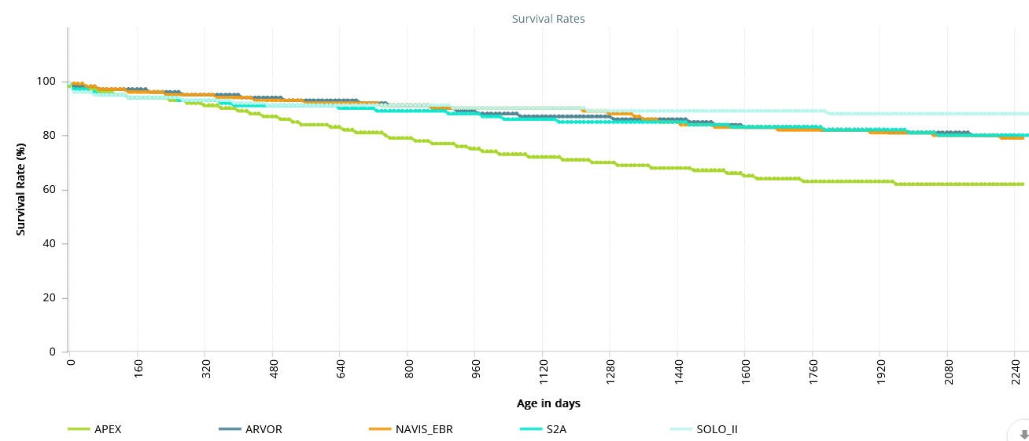
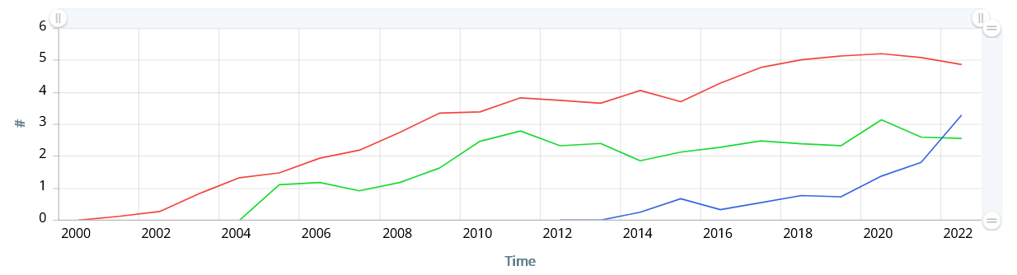
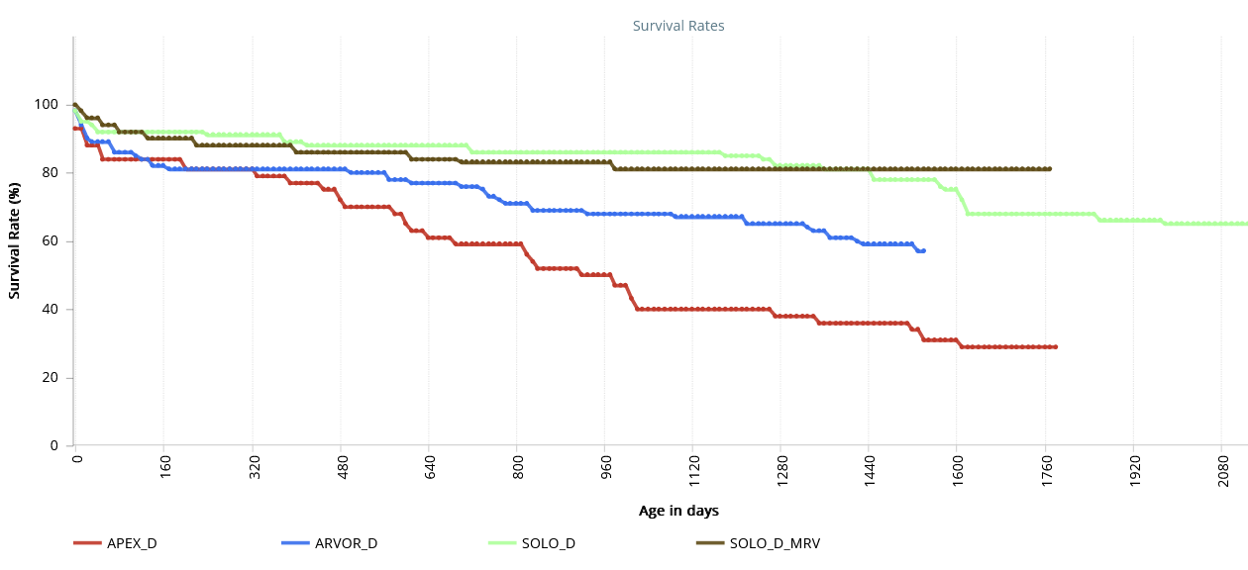
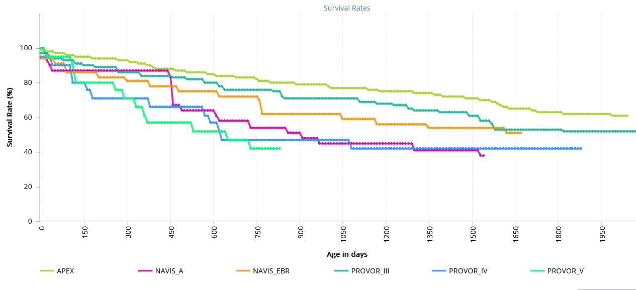
Float Development
Improvements in batteries and manufacturing and check-out procedures have led to increased lifetimes
Survival Rates
Average age of failure
Core
Age [years]
6 yrs
Deep
For planning OneArgo lifetimes:
Observed Designed
Core 6 years 8-9 years
Deep 4 years 6 years
BGC 3 years 5 years
Survival rate varies significantly by manufacturer and deployer
5 yrs
BGC
5 yrs

Slide 6
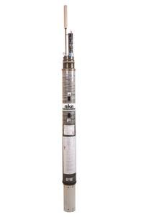
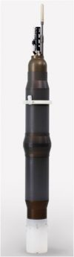
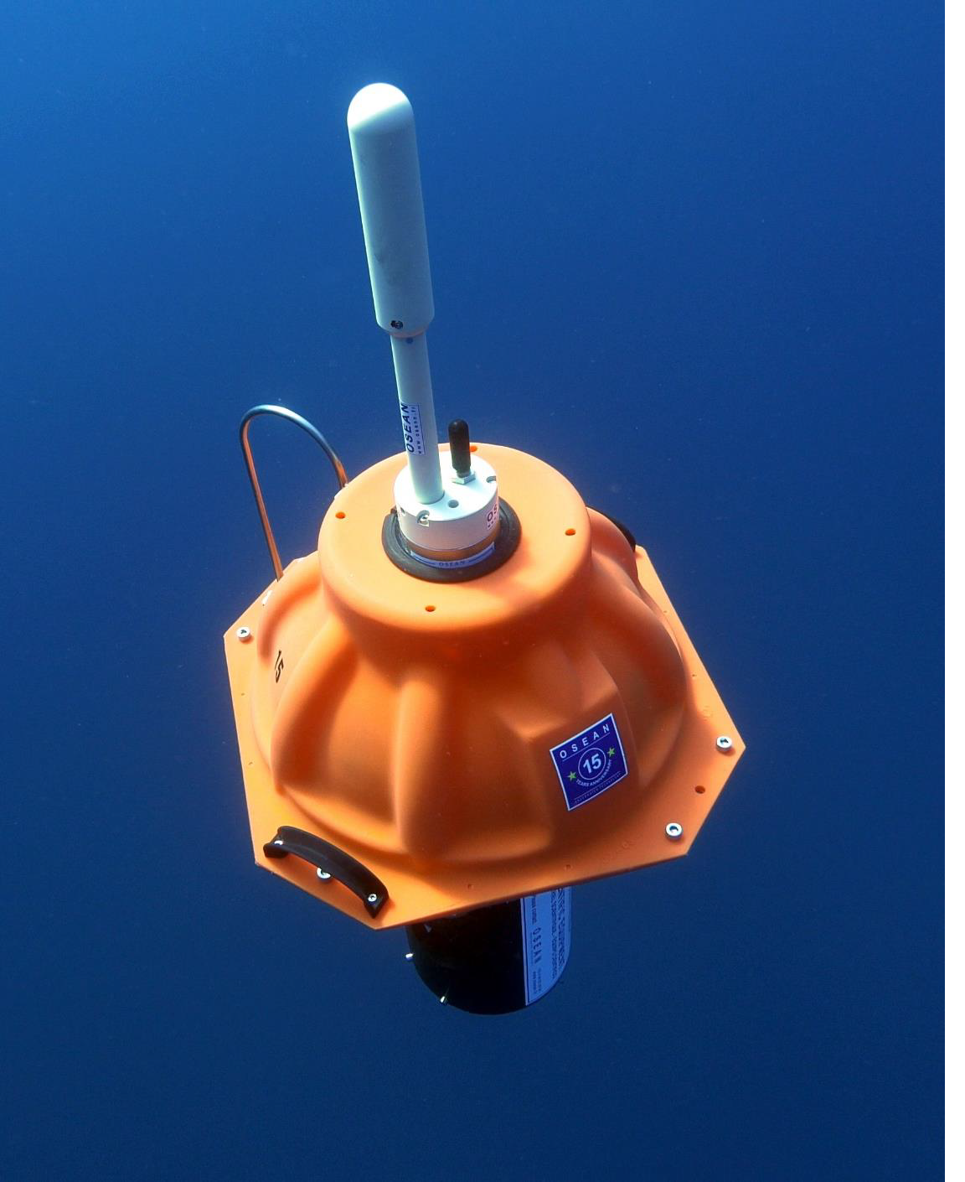
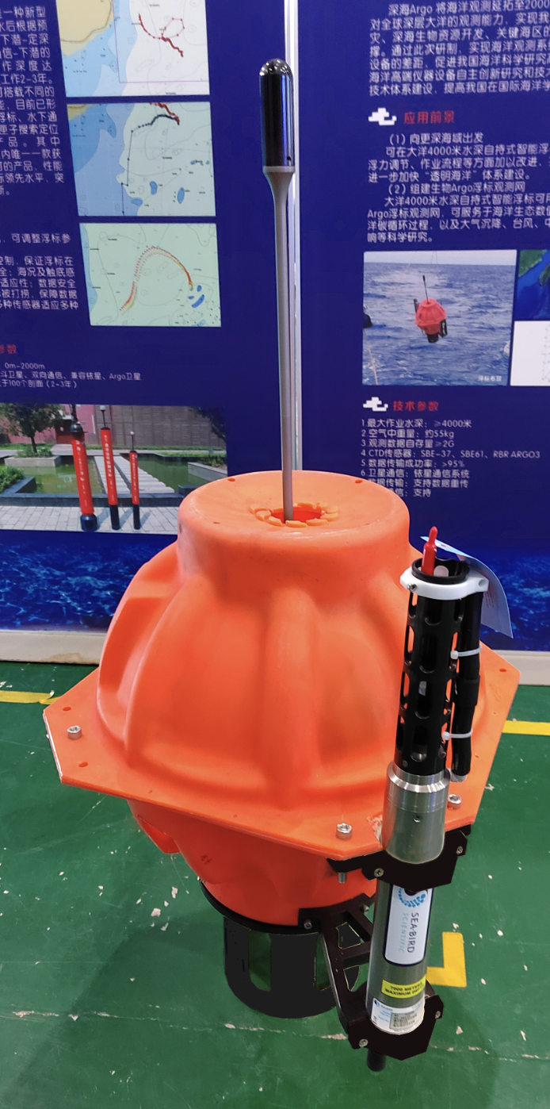
Deep Float Development
Due to lack of orders, Teledyne Webb no longer offers a 6000 m float.
One commercial vendor, MRV, for 6000 m float.
Osean has expanded its Moby float to include a SBE61 CTD. Prototype hydraulic system to increase operate to 6000 m available in 2025
Development of a Deep Arvor capable to 6000 m will produce prototypes by 2025.
4000-m Deep Argo floats
6000-m Deep Argo floats
Deep Arvor
Deep NINJA
MOBY
Deep SOLO
Xuanwu

Slide 7
Sensor Development
CTDs
2000 dbar SBE 41 reliability improved with revamped manufacturing procedures, but data team remains vigilant for failures.
2000 dbar RBRargo³ development of calibration and dynamic response modeling approaching Argo accuracy, increased deployments to further evaluate performance.
6000 dbar SBE61 has new more accurate pressure sensor and improved pressure calibration procedures to approach Deep Argo accuracy requirements
pH Sensors
US Agencies intervened to continue making ISFET chips used in Seabird Sensor, alternate ISFET manufacture identified.
Early failures of Seabird Sensor has led to mechanical redesign
Alternative optical sensors development underway
Dissolved Oxygen
Most mature BGC sensor and is relatively inexpensive and low-power.
A small Argo Task Team will examine cost/benefits to expand dissolved oxygen to Core and Deep floats.

Slide 8
Sensor Development
Radiometer Sensors
Number of frequencies and their values under review
Hyperspectral sensors available
Adequacy for use in estimating short-wave radiation penetration for Mixed Layer physical modeling being investigated.
Prototype BGC Navis and BGC Solo include Radiometer sensors
For NAVIS requires upgrade in platform payload size.
The BGC NKE float includes a radiometer and can also make hyperspectral upward and downward shortwave radiation

Slide 9
Achievements
Driven down the latency of real-time data delivery to enable coupled NWP.
93% of data are delivered within 12 hours, 82% in 6 hours and 50% in 3 hours.
A best practices document for participating in the Argo Program completed and will be submitted
for publication shortly.
Formed a Community of Practice of Argo Engineers and technicians with organized zoom discussions on float testing, deployment and performance issues.
A short document describing the requirements necessary to be an Argo float is now available to help scientific float users outside of Argo to properly follow IOC directions and respect Coastal States jurisdiction rights.
Argo regional basin deployment planning meetings continue to be very successful and helpful. Should these planning activities be broadened to involve a subset of the other OCG networks?
Capacity building within national Argo teams to carry out the expanded OneArgo missions has been very successful.

Slide 10
Challenges and Concerns
Recent erroneous estimates by climate analysis centers of an increase in global averaged salinity derived from Argo data demonstrated that quality-control flags and delayed-mode profile data were not being used for these analyses. A paper and various presentations at international meetings have shown how to properly use Argo data for climate studies. Continued outreach meetings with analysis centers are being organized.
There continues to be strong community support for the expanded OneArgo program, and indeed an expectation that this expansion is ‘in the pipeline’. Progress towards securing the required larger, sustained funding for expanded Core, Deep and BGC missions has stalled. A narrow window exists to secure funding to maintain momentum and keep our suppliers interested. Without this support, we will be forced to fall back to a Core only design.
Losing momentum for expanded coverage in the polar, equatorial and western boundary regions.
BGC deployments likely to fall off when GOBCG ends in 2025.

Slide 11

Argo Float Program Attributes

Slide 12
Future Plans and Opportunities
  Developing DMQC for Deep profiles, methodology and reference data sets
  Oxygen design studies
  - oxygen impact on physical and BGC state estimates
  - unknown accuracy estimates for Deep oxygen
  Dynamic error estimates for BGC sensors evolving
  Continue to improve metadata to make Argo data FAIR. This activity should be in collaboration with other networks, particularly GOSHIP and Gliders
  Manufacturing Workshop in 2024
  Engaging analysis and aggregating centers to improve use of Argo data
  Involved in G7 technical workshop
  Engage with WMO May 2024 workshop planning

Slide 13
Asks from OCG
Replace binary result for OCG Network Attributes to move towards a WMO RRR requirements form for global EOVs. For example, for estimates of the global change in heat and freshwater, we need to resolve the temperature throughout the ocean on nominal 1000 km scale on a time scale of 3 months. Then a index can indicate what fraction of the global ocean is resolved by the network measurements. Similar indices can be formulated for other EOVs and the relevant scientific questions such as the carbon cycle, acidification and deoxygenation...
Help with engaging the UN Decade activities to develop these indices
Need summary of the UN Decade reporting.
Continue to look for OCG network collaboration on sensor development and sensor static and dynamic corrections.
Continue to look for cross network deployment planning.

