Slide 1
OCG Network AniBOS
OCG-14 Hybrid Meeting
6-8 June 2023
Cape Town, South Africa
Mia Wege, University of Pretoria
Clive McMahon, University of Tasmania
Fabien Roquet, University of Gothenburg

Slide 2
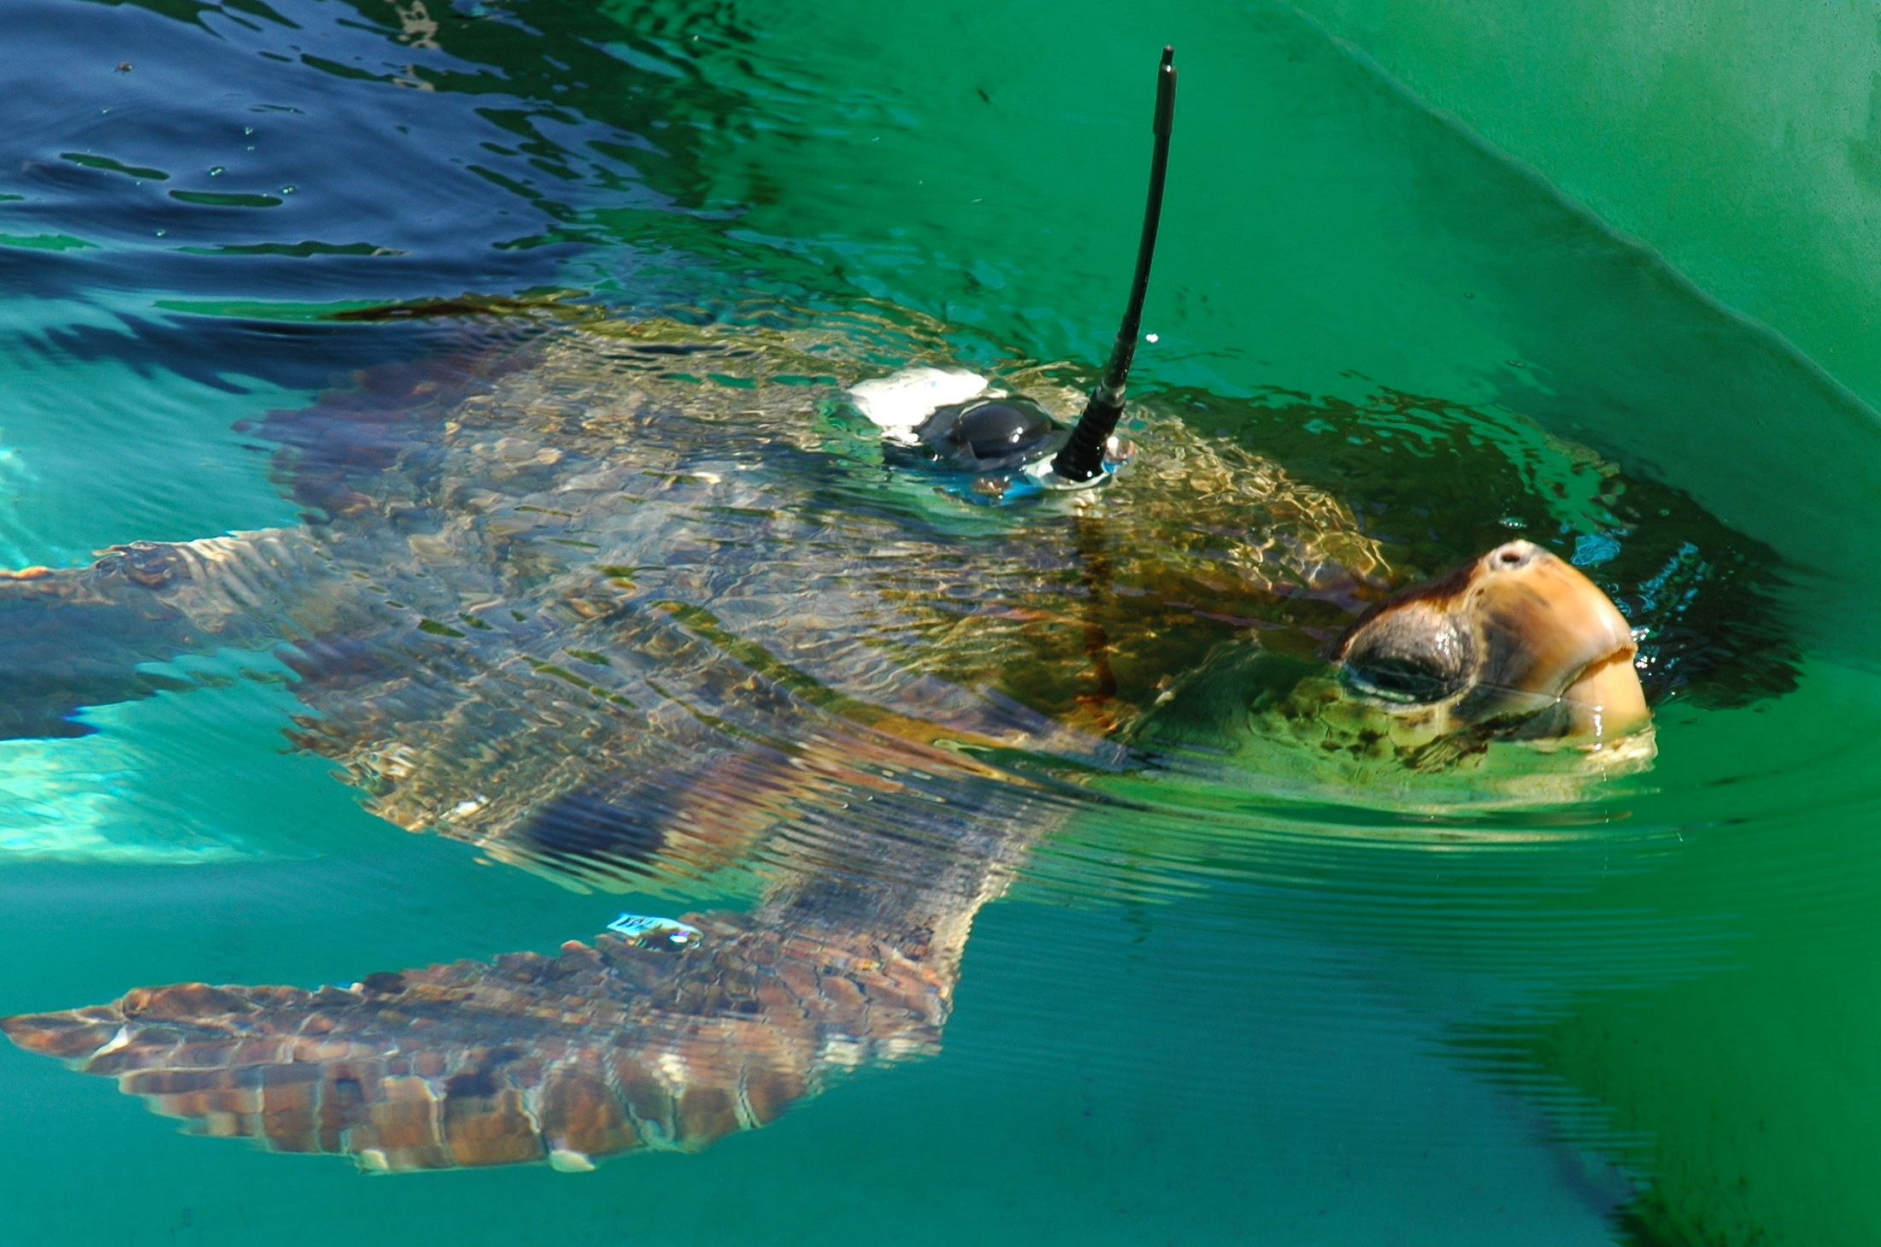
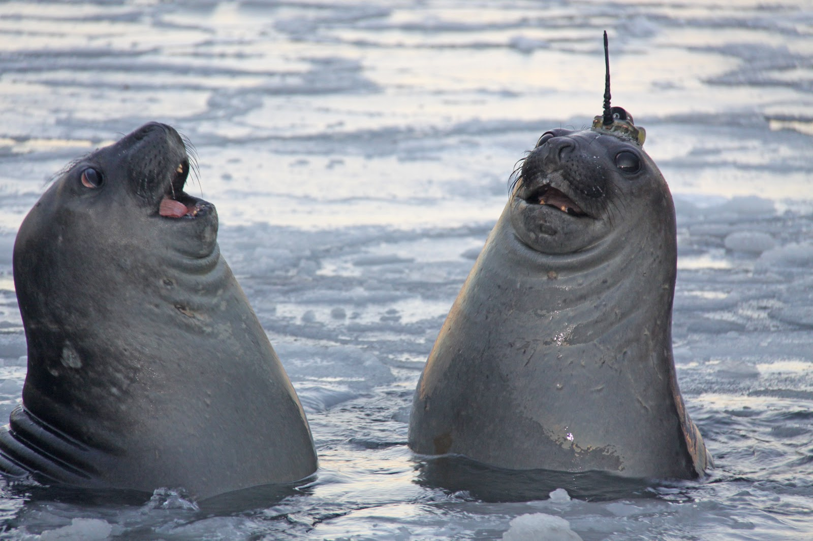
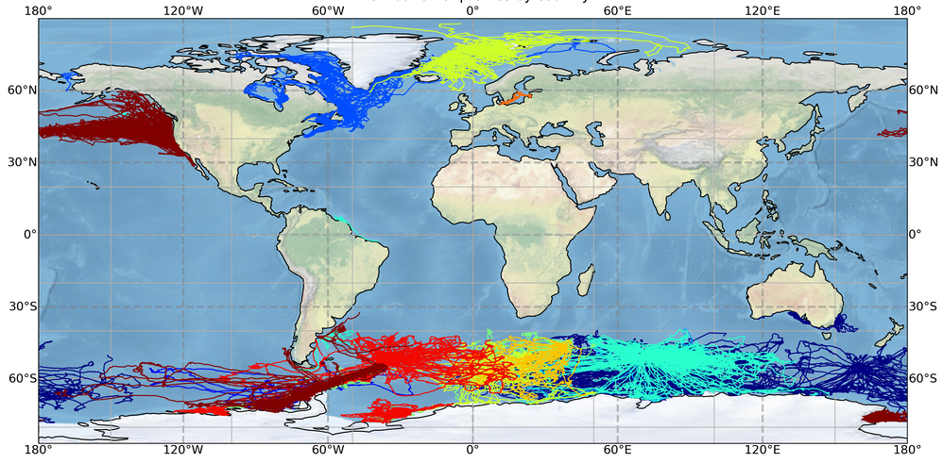
Network Overview
AniBOS collects and makes freely available oceanographic measurements from the most inaccessible regions of the global seas to understand our Changing Oceans.
Emerging OCG GOOS network since 2020
Publication: McMahon, Roquet et al. (2021). Animal Borne Ocean Sensors – AniBOS – an essential component of the Global Ocean Observing System (GOOS). Frontiers.
Website: anibos.com, Twitter: @ani_bos
AniBOS Endorsed as a Project of the UN Decade
World map showing the distribution of CTD profiles (i.e. vertical profiles of temperature and salinity) currently available in the MEOP-CTD database (last release in Nov 2021): > 650 000 T-S profiles

Slide 3
Developments and Achievements
Updated MEOP-CTD database published in Nov 2021
Metadata integrated in OceanOPS – metadata & data visibility
Standardized data framework published to facilitate collection of Essential Ocean Variables (EOVs) in support of the Global Ocean Observing System (GOOS)
Best practice on animal handling and metadata naming convention developed
Data available through ERDDAP
> 100 loggers deployed in the last year (Indian Ocean and Southern Ocean)
Oxygen sensor tested successfully in the Southern Ocean (PI: C. Guinet, CNRS)

Slide 4
Challenges and Concerns
Spatial coverage has decreased globally since 2021 – COVID19
Sustained observations rely on research funding - longevity
Improved procedures for oxygen and chlorophyll data needed
Lack manpower to start integration of biological data

Slide 5
Attribute Report out
No major updates since 2022.

Slide 6
Future Plans and Opportunities
Sustain core deployments & prepare for the future
Continue development of automated CTD quality control routines & publish QC routines
Develop work with OceanOPS – metadata & data visibility
Contribute to Decade of the Ocean as a project and engage with complimentary projects as appropriate
Work with BCG community to incorporate F-CTDs
Publish two Best Practice documents on Data Quality Control & Animal welfare and ethics

Slide 7
Asks from OCG
No specific request.
What was the point of Decade of the Ocean again?

Slide 8
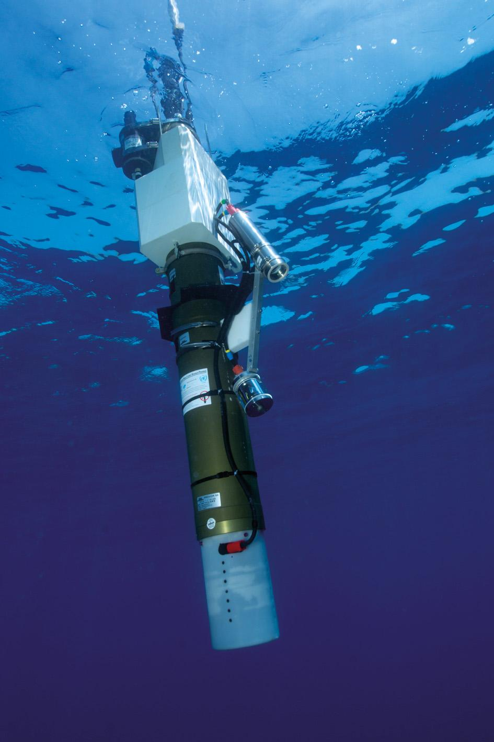
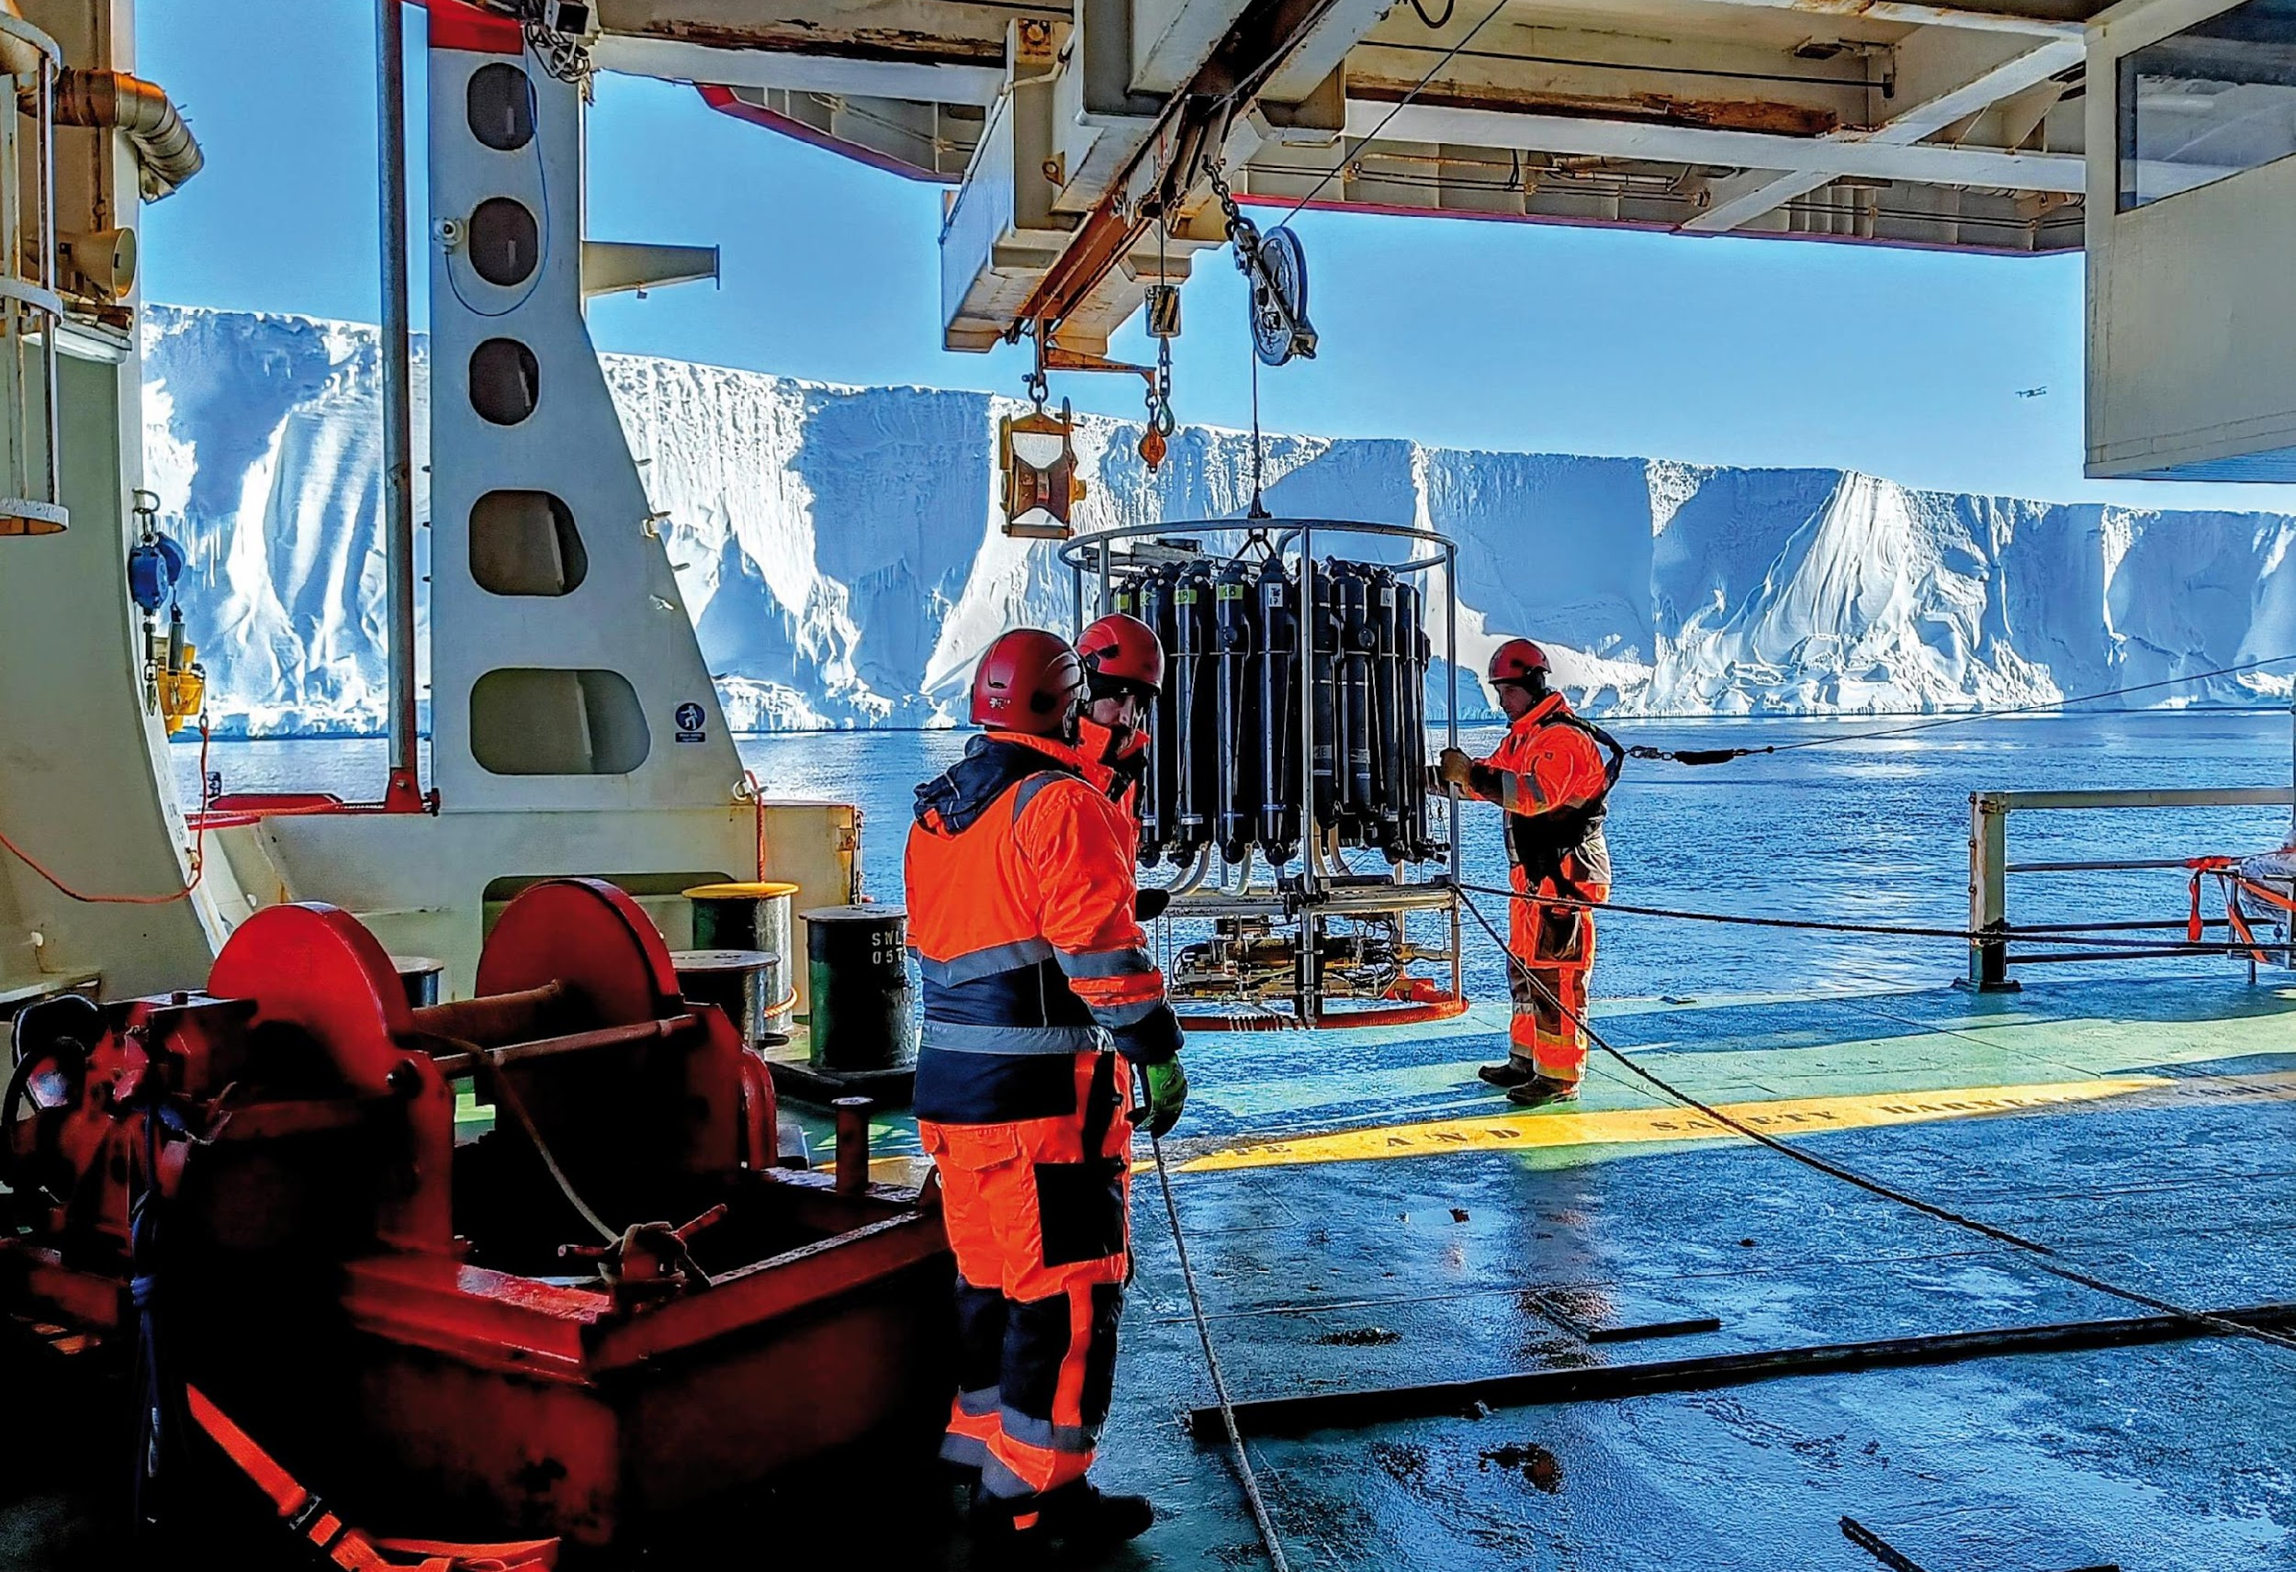
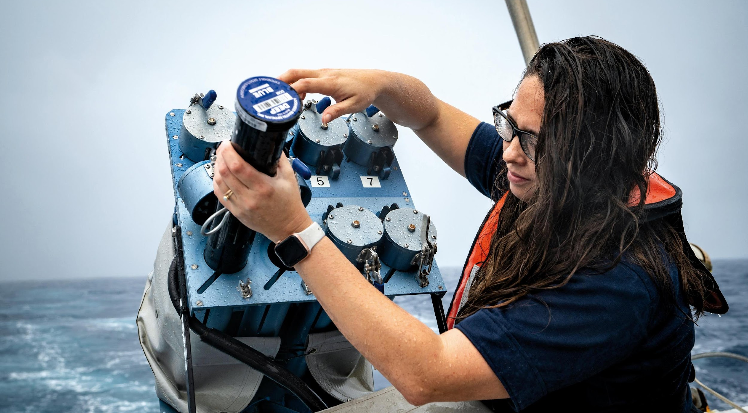
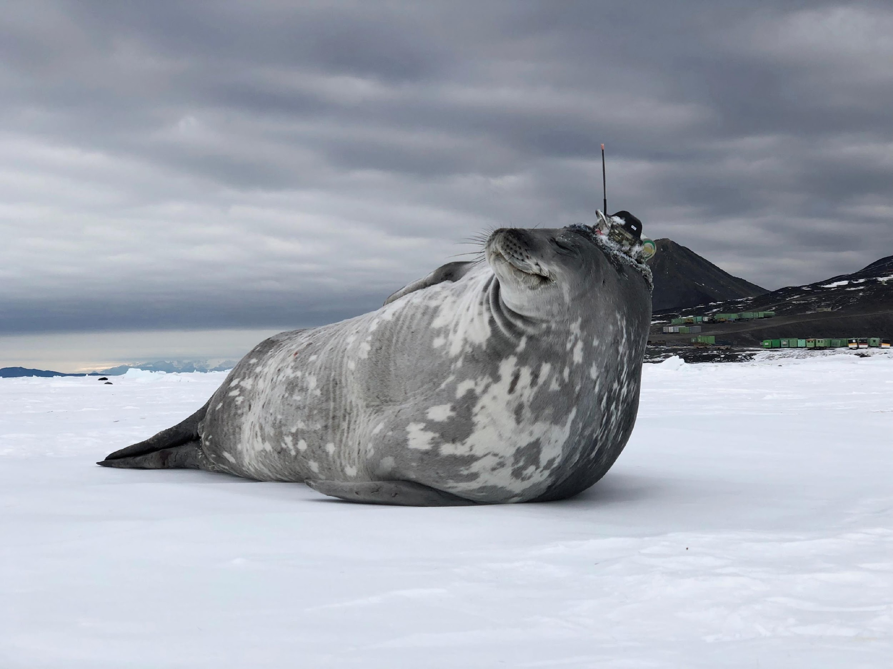
Thank you
goosocean.org

