Slide 1
Data Buoy Cooperation Panel (DBCP)
OCG-14 Hybrid Meeting
6-8 June 2023
Cape Town, South Africa
Nelly Florida, Chair
Lance Braasch, Vice-chair
Long Jiang, Technical coordinator

Slide 2
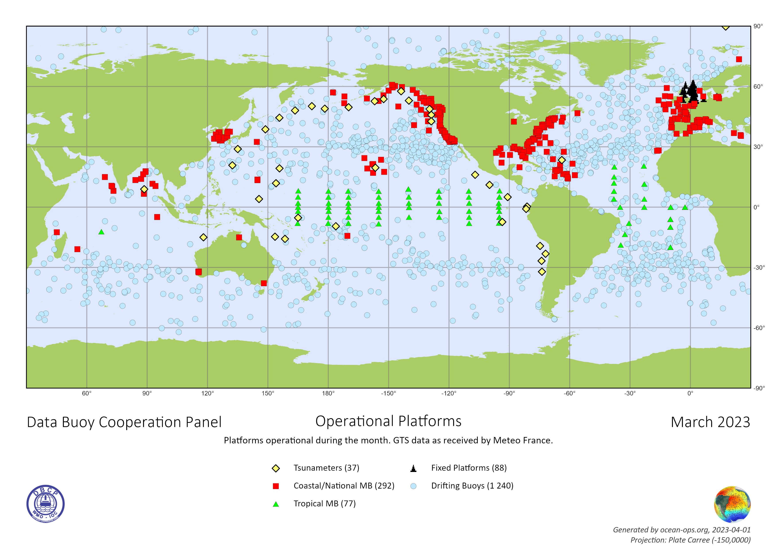
Network Overview
Obvious drop of operational drifters in 2021-2022 period, due to Iridium. esp. persistent gaps in Indian Ocean and Southern Ocean, slight pickup in deployment opportunities from March 2023
Slump of tropical moorings array, esp. RAMA-OMNI redeployment disrupted. Slight pickup thanks to PIRATA and TAO redeployments in March 2023
Bilateral agreements between NOAA with INCOIS and BMKG, increase of RAMA-OMNI moorings expected by end of 2023, May & July cruises anticipated
Notes:
For example DISA in the USA

Slide 3
Developments and Achievements
New Executive Board: Chair (Nelly Florida), Vice-chair (Lance Braasch), Data Impact and Value (Marc Lucas) [Thanks to Boris Kelly-Gerreyn, Sidney Thurston, Laura Medeiros]
New data quality control tool developed at MeteoFrance: http://esurfmar.meteo.fr/qctools/statistics/statistics.php
Lagrangian Drifter Laboratory, Scripps Institution of Oceanography, University of California, San Diego (LDL/SIO/UCSD) designated as Data Acquisition Centre of WMO marine climate data system
Coriolis/France willingness to host GDAC for moored buoys
Region-free WMO ID allocation made available through OceanOPS
WIS 2.0 pilot: SIO/LDL for drifting buoys
Notes:
DAC/SIO/LDL, officially designated at EC-76
used by Canada, France, India, Indonesia, Russian Federation, USA, etc.
CB: Benin, Comoros, Solomon Islands;
, ruling out region-specification for drifting buoys

Slide 4
Developments and Achievements
Capacity Building, diversity and inclusivity:
Funded 3 participants to DBCP annual session (Benin, Comoros, Solomon Islands);
First time to fund 2 wave drifter pilot deployment to be implemented by LDL and Solomon Islands;
Successful First Mediterranean training workshop, Part I virtually Nov 2022 and Part II hybrid in National Institute of Meteorology, Tunis, Tunisia, May 2023

Slide 5
Challenges and Concerns
Decrease of operational units of drifters (Indian Ocean, Southern Ocean) and drop deployments tropical moored buoys (Indian Ocean)
Metadata accuracy need to be addressed between operators and OceanOPS; Expand OceanOPS collected metadata in support of both operators and user requirements
Not all data in agreed binary universal form (BUFR) and shared to GTS; some shared and discoverable online in other formats (Copernicus, EMODnet, etc.)
Cost increase/delay of instruments and equipment, shipping costs, ship-time costs, telemetry, etc. due to inflation (20-50%), adversely impacting maintenance, (re)deployments, and leading to decommissions. Costs are affecting Moorings and Drifters alike
Vandalism persistent concern
Multiple websites even some links broken
Notes:
Limited R/V space available for drifters and other instruments

Slide 6
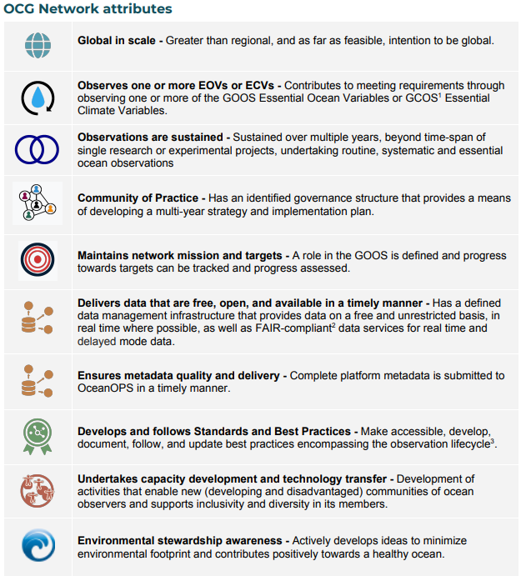
Attribute Report out
✓
✓
11 out of 31
✓
4 decades
✓
TTs: Data Management, Moored Buoys, Wave Measurements, Capacity Building, DBPD (below)+ new (Environmental Stewardship, User Engagement)
✓
GTS BUFR: Drifter 100%, MB 60%
Drifter DACs: AOML delayed mode, LDL/SIO real time;
Drifter GDACs: Coriolis/France, MEDS/Canada
Mooring GDAC: commitment from Coriolis/France
CMOC/China
✓
✓
✓
Task Team on Data Buoy Best Practices and Technology Development
✓
✓
Notes:
CMOC: Centre for Marine Meteorological and Oceanographic Climate data

Slide 7
Future Plans and Opportunities
Future plans and developments
Review metadata at OceanOPS for accurate attribution of contributors and attributes of observed data with support and inputs from DBCP recommendations
Develop global basic observing network (GBON) specifications on buoys
TT-Data Impact and Value will consult and contribute to WMO rolling review of requirements (RRR) and Ocean Decade Co-design
Closer cooperation with Ship Observing Team on deployment opportunities in gap regions, explore possibility of joint capacity building activities
Environmental Stewardship survey circulated, a virtual workshop in preparation

Slide 8
Asks from OCG
OCG to clarify audience of OceanOPS metadata
Roles and responsibilities of OCG networks with regard to OceanOPS metadata management; clarify OceanOPS method of prioritization for network support
Advocate and facilitate the coupling of metadata and data sharing in agreed formats
Clarify required websites for DBCP network to reduce overlap of information and address inconsistencies.

Slide 9
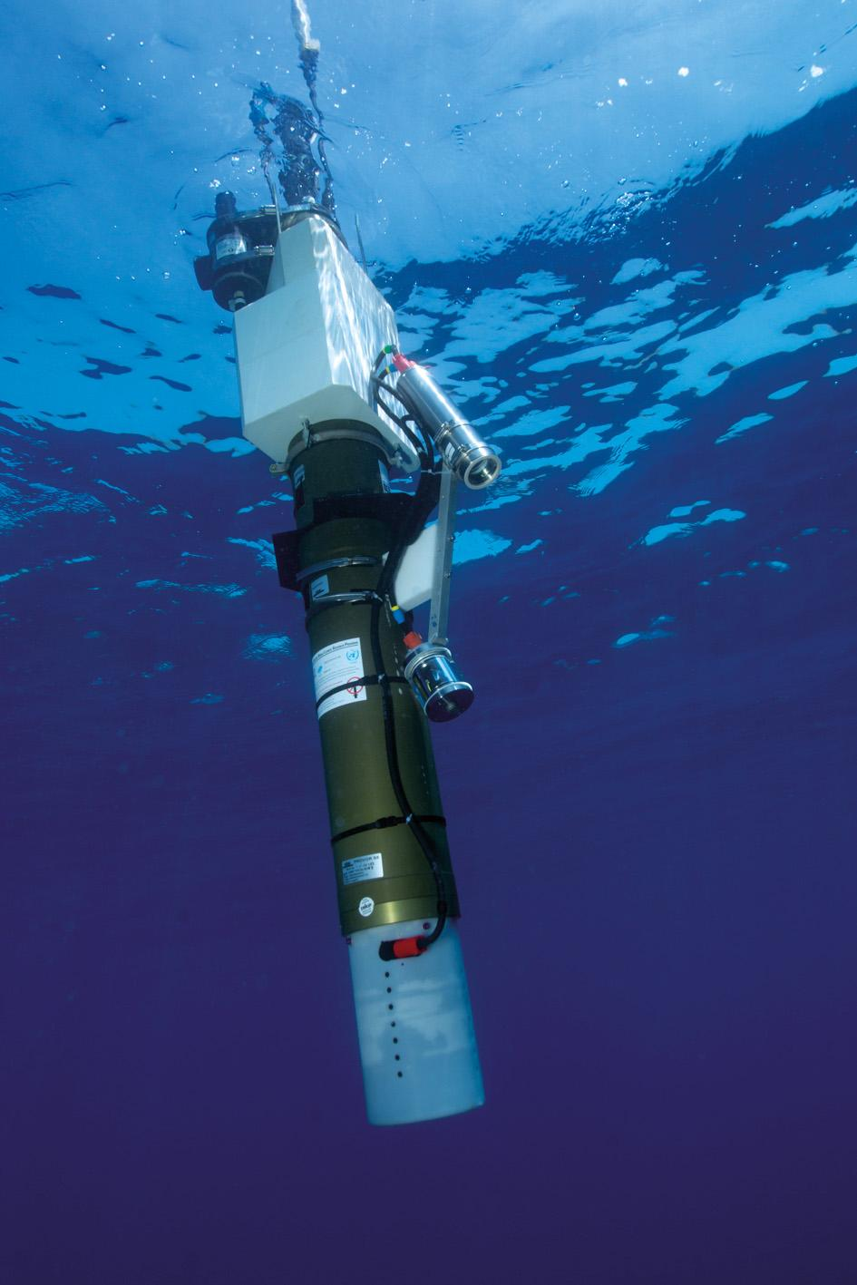
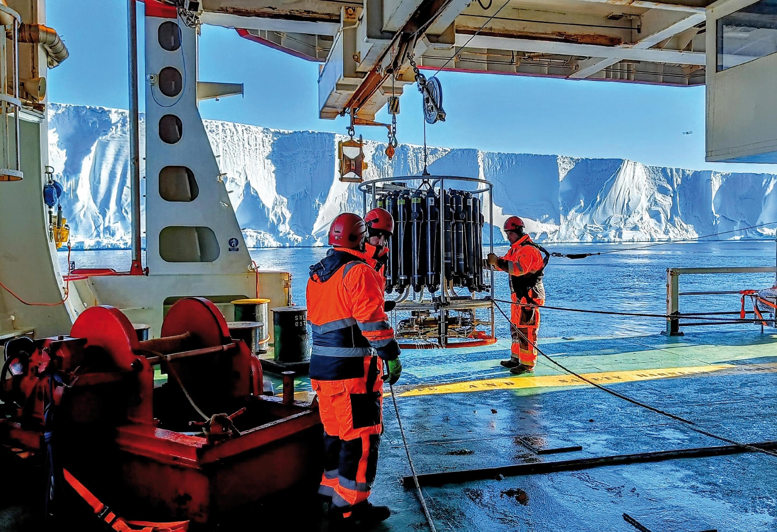
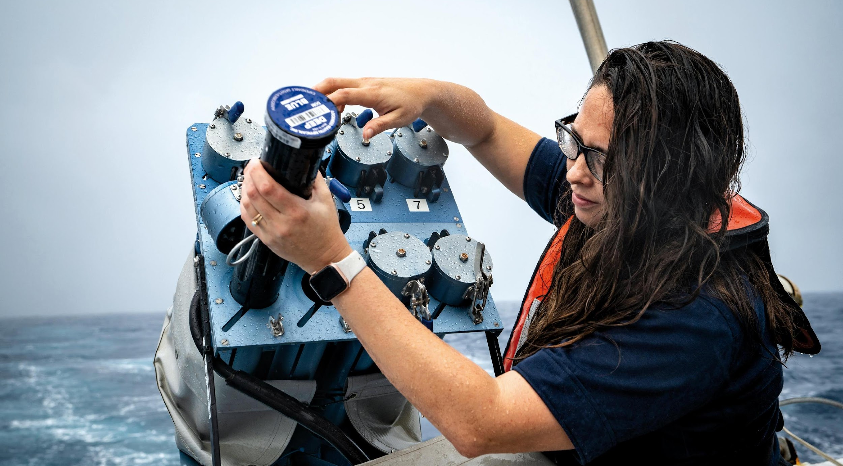
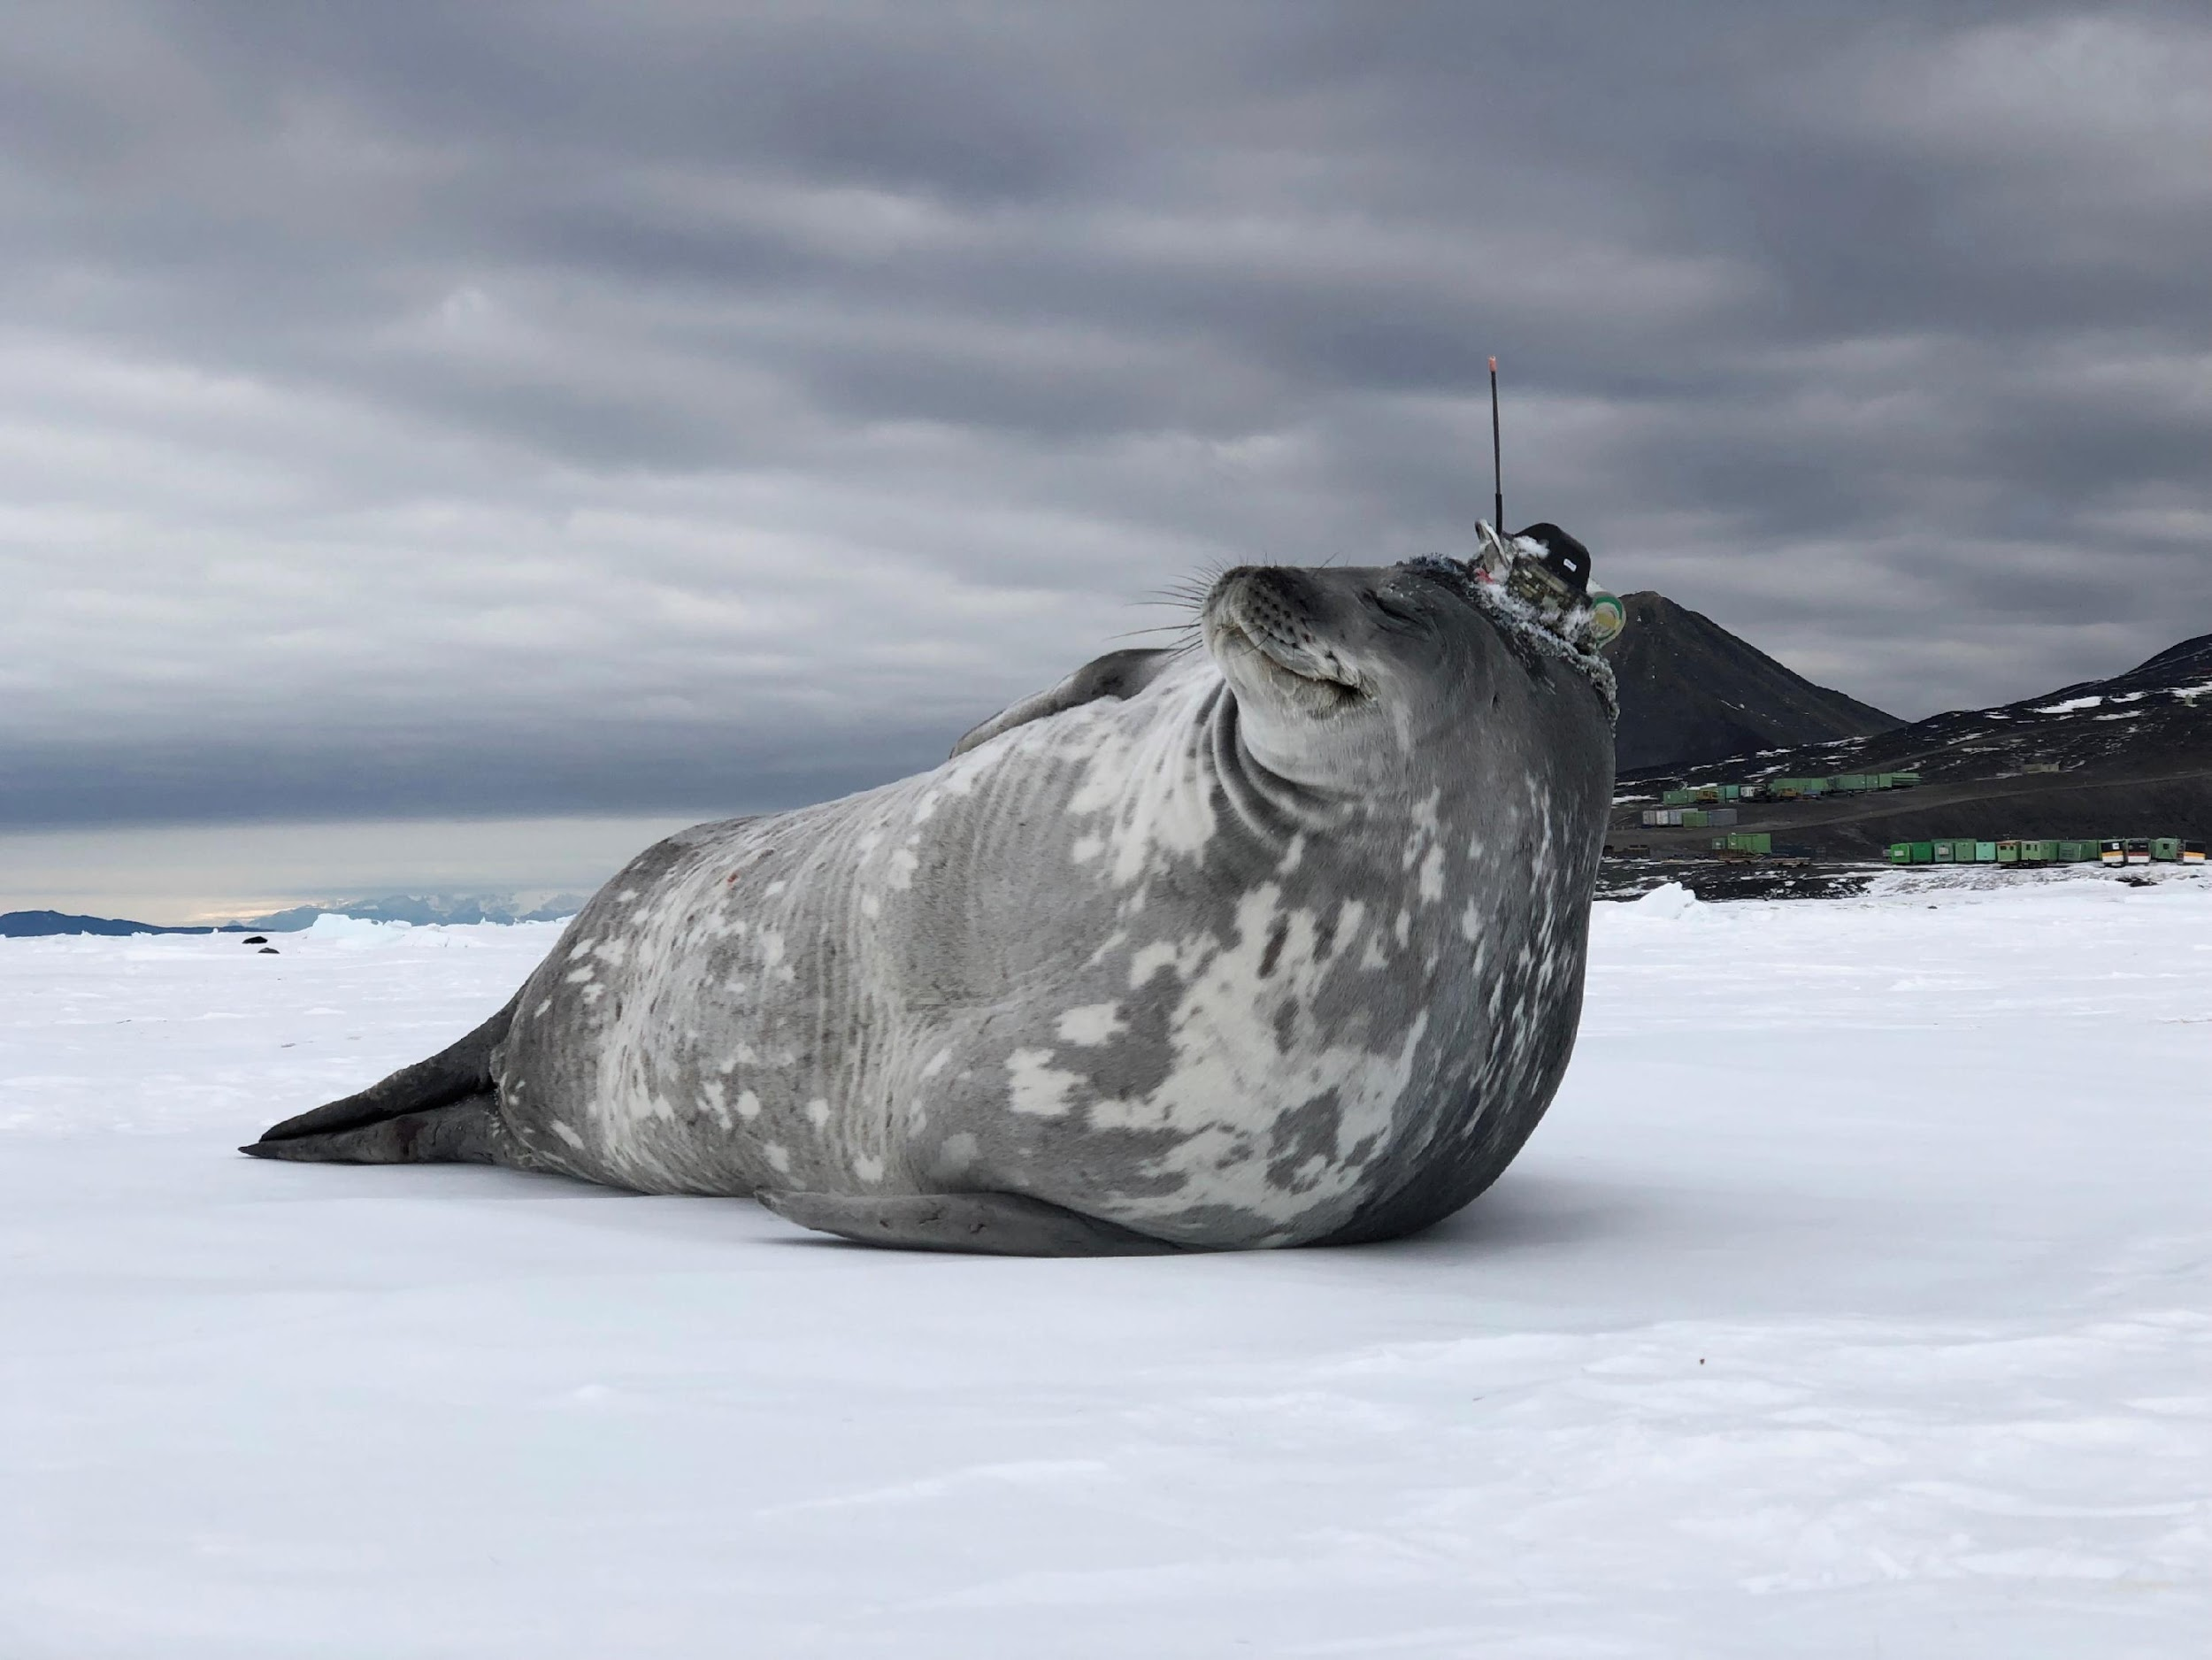
Thank you
goosocean.org

