Slide 1
GO-SHIP
OCG-14 Hybrid Meeting
6-8 June 2023
Cape Town, South Africa
Elaine McDonagh, co-chair

Slide 2
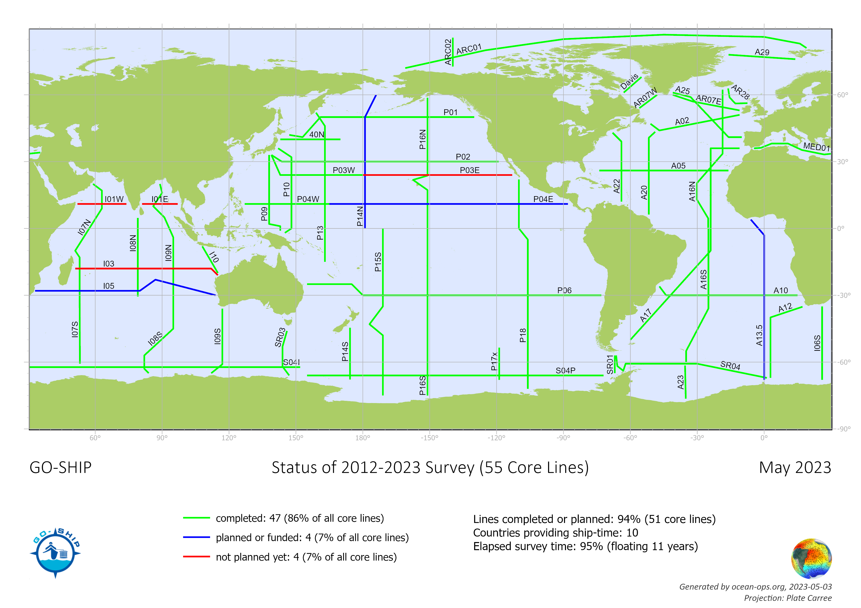
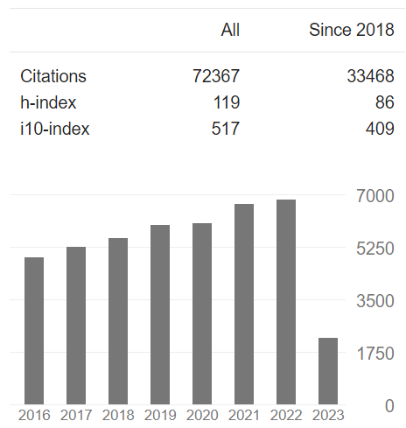
Network Overview
93% of all core reference lines in present decadal survey
already completed or funded
600+ publications in GO-SHIP bibliography
33K+ citations for GO-SHIP based papers since 2018.

Slide 3
Developments and Achievements
Data Management Team established
terms of reference
Cruise id established
Guidance On Data Licence Policy
Mapping Data Flows
Updating List Of Go-ship Data Archives
Bio-GO-SHIP
2 cruises in US pilot project P02 (2022), A16N (May 2023)
Australian and Japanese projects
EuroGO-SHIP project funded and begun
Shared facilities and access opportunities (CRMs, training, best practices,
Data management (data pathways, ADCP, real-time)
secondary quality control
Application for renewed CCHDO funding submitted

Slide 4
Challenges and Concerns
Capability for transient tracer measurements – level 1 parameter
Carbon certified reference materials
Expansion to BIO GO-SHIP
Data: working groups on License, Metadata, Data flow and Implementation, and Archiving.
CCHDO funding renewal

Slide 5
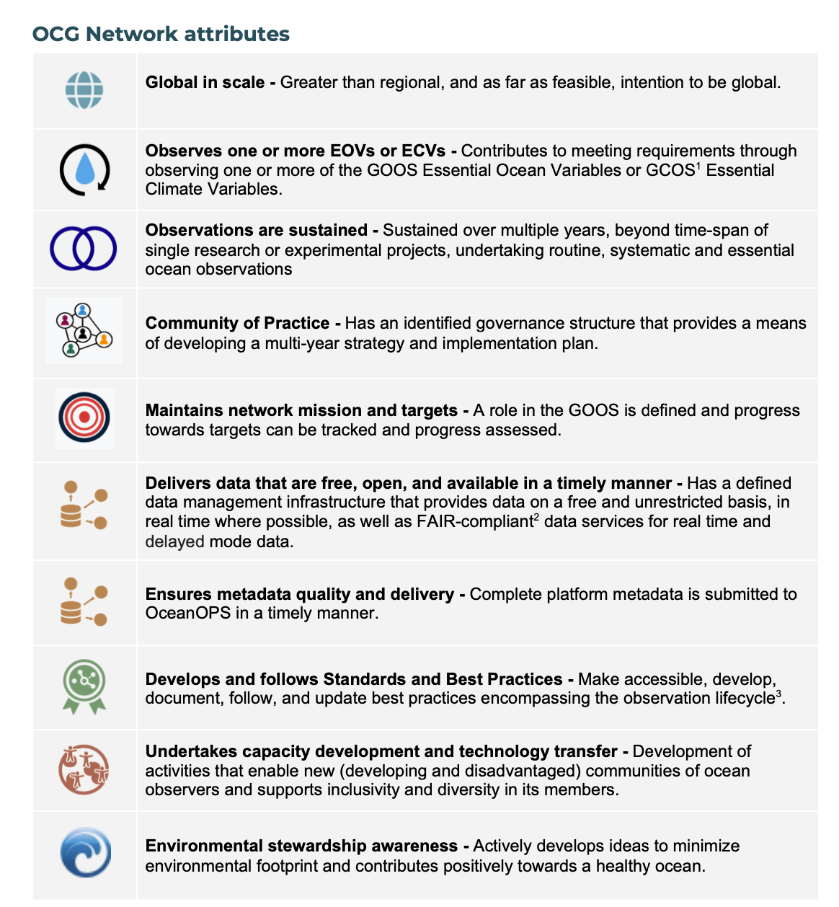
Attribute Report out
✓ global network
✓ broad range of EOVs
✓ about to begin fourth decade of observations
✓ co-chairs, TC, executive, science committee, DMT
✓ reference sections
✓ data policy, mapping data flows, real-time data
✓ implementing cruise id
✓ best practices
✓ national representation, associated sections, training
✓ looking for funding/capacity to do this

Slide 6
Future Plans and Opportunities
Associated sections
Review approach
increase reach
Global network of regional observations
Advocacy and success stories
Environmental stewardship

Slide 7
Asks from OCG
Advocacy for key measurements transient tracers and CRMs for carbon
Advocacy for key data centres
Oversight from OCG on emerging biological observations – cross network cooperation
Data
continued assistance from OCG to assist with integration with ERDDAP services
assistance in improving machine-2-machine metadata flows with OceanOPS

Slide 8
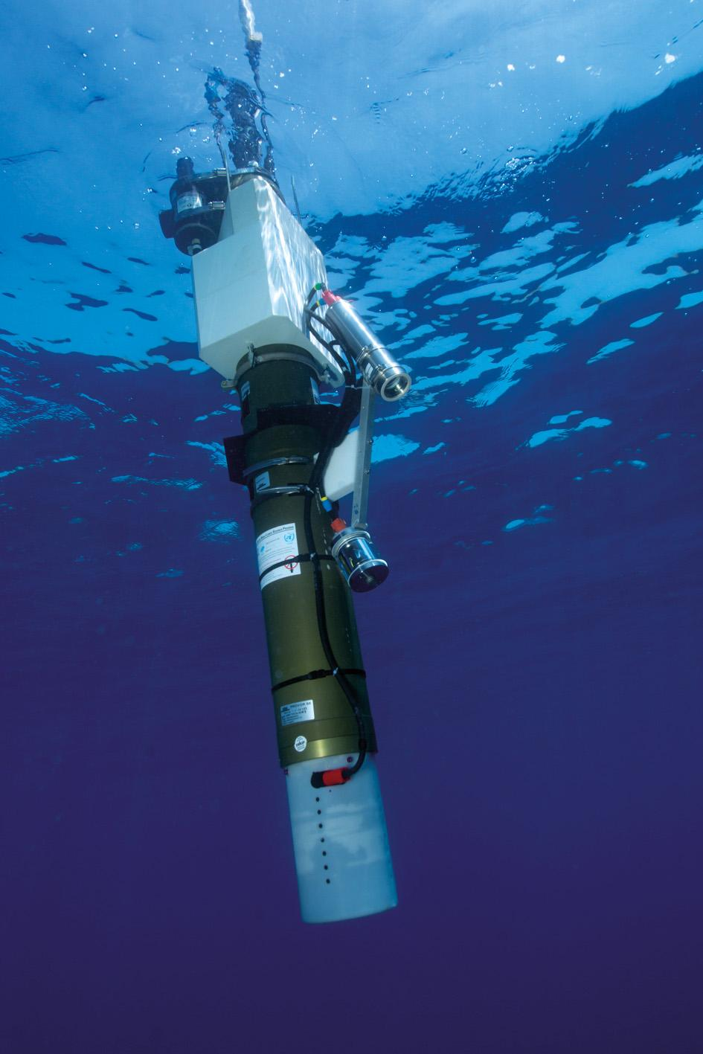
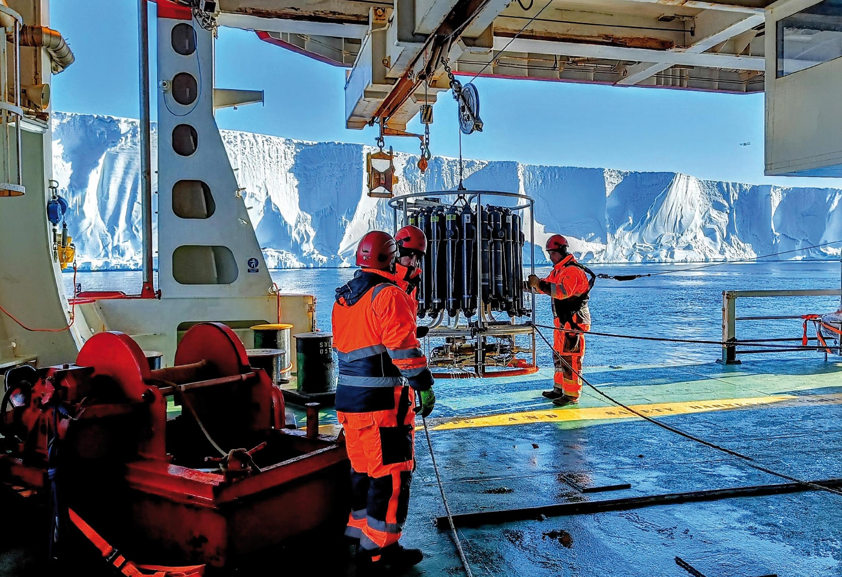
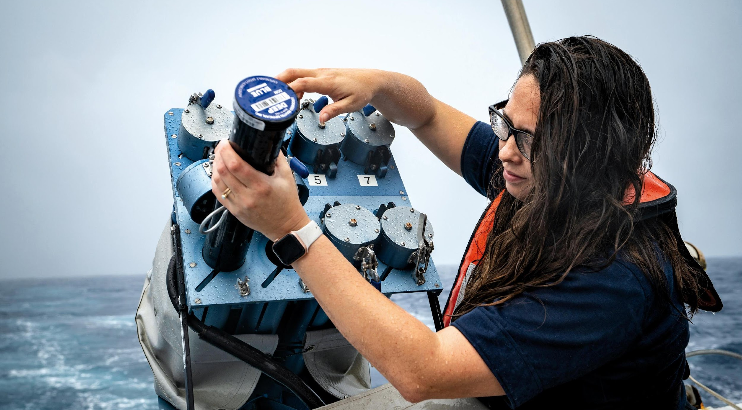
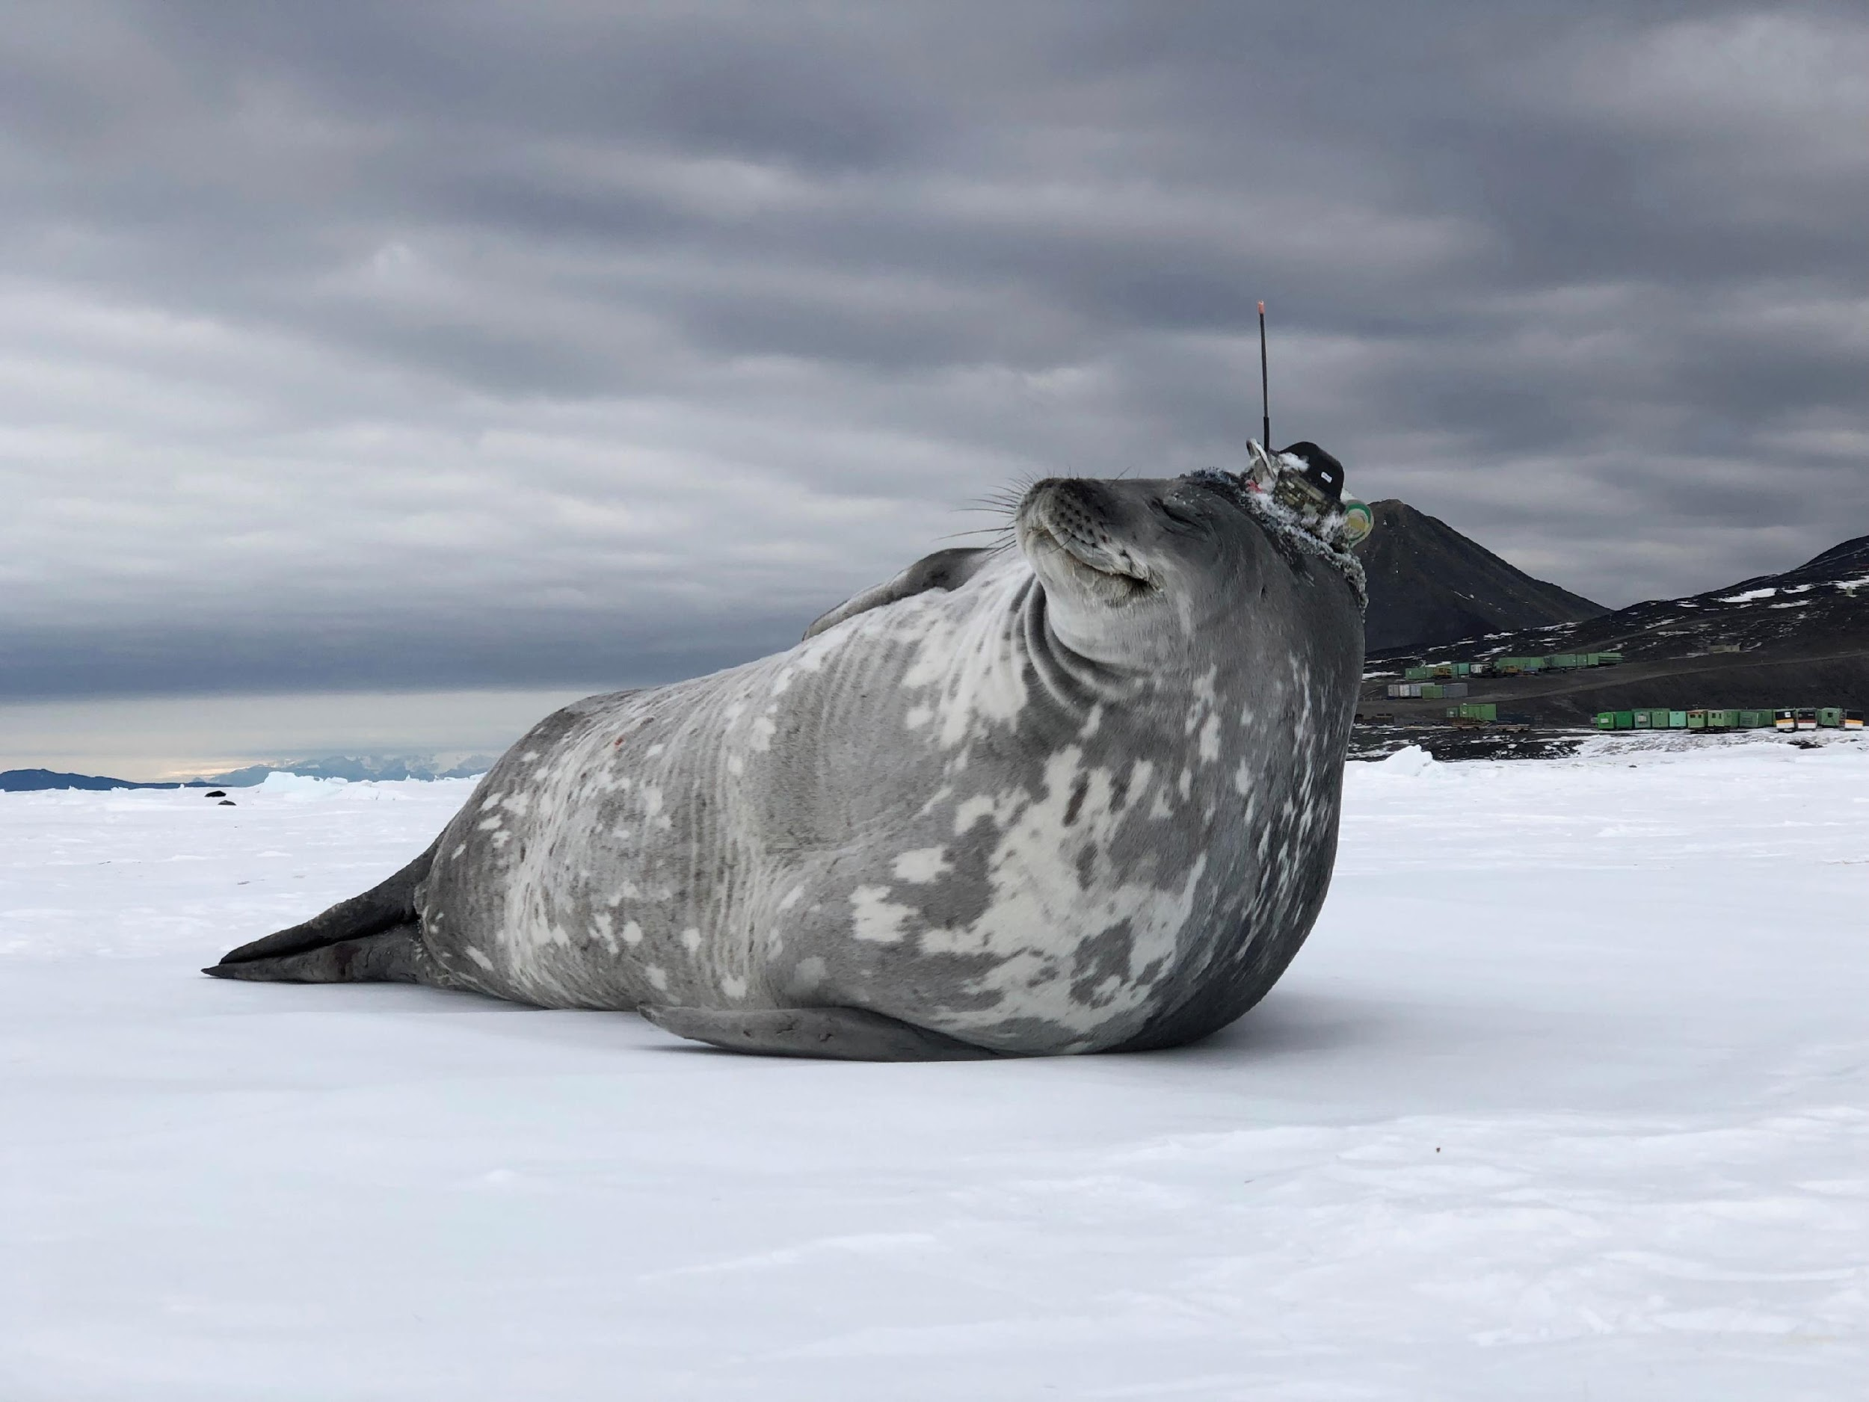
Thank you
goosocean.org

