Slide 1
National Progress Report of Guatemala

Slide 2
Tsunami Standard Operating Procedures
Local Event
INSIVUMEH has a wide seismic network array to detect important earthquakes capable of generating a tsunamigenic event. Over the last two years we have added new stations most coming from international agreements.
When the 24/7 monitoring people detect an important event, a bulletin is created to advice to CONRED, the national institution in charge of prevent disasters or reduce the impact in society, and post it in social network for the propagation of the message.

Slide 3
Regional Event
With aid of our neighbour countries that share some of their seismic data, we can also receive some information about an event that comes with tsunamic hazard.
Mainly we take this information coming from PTWC and CATAC, the procedure after getting this information is the same as for local events.

Slide 4
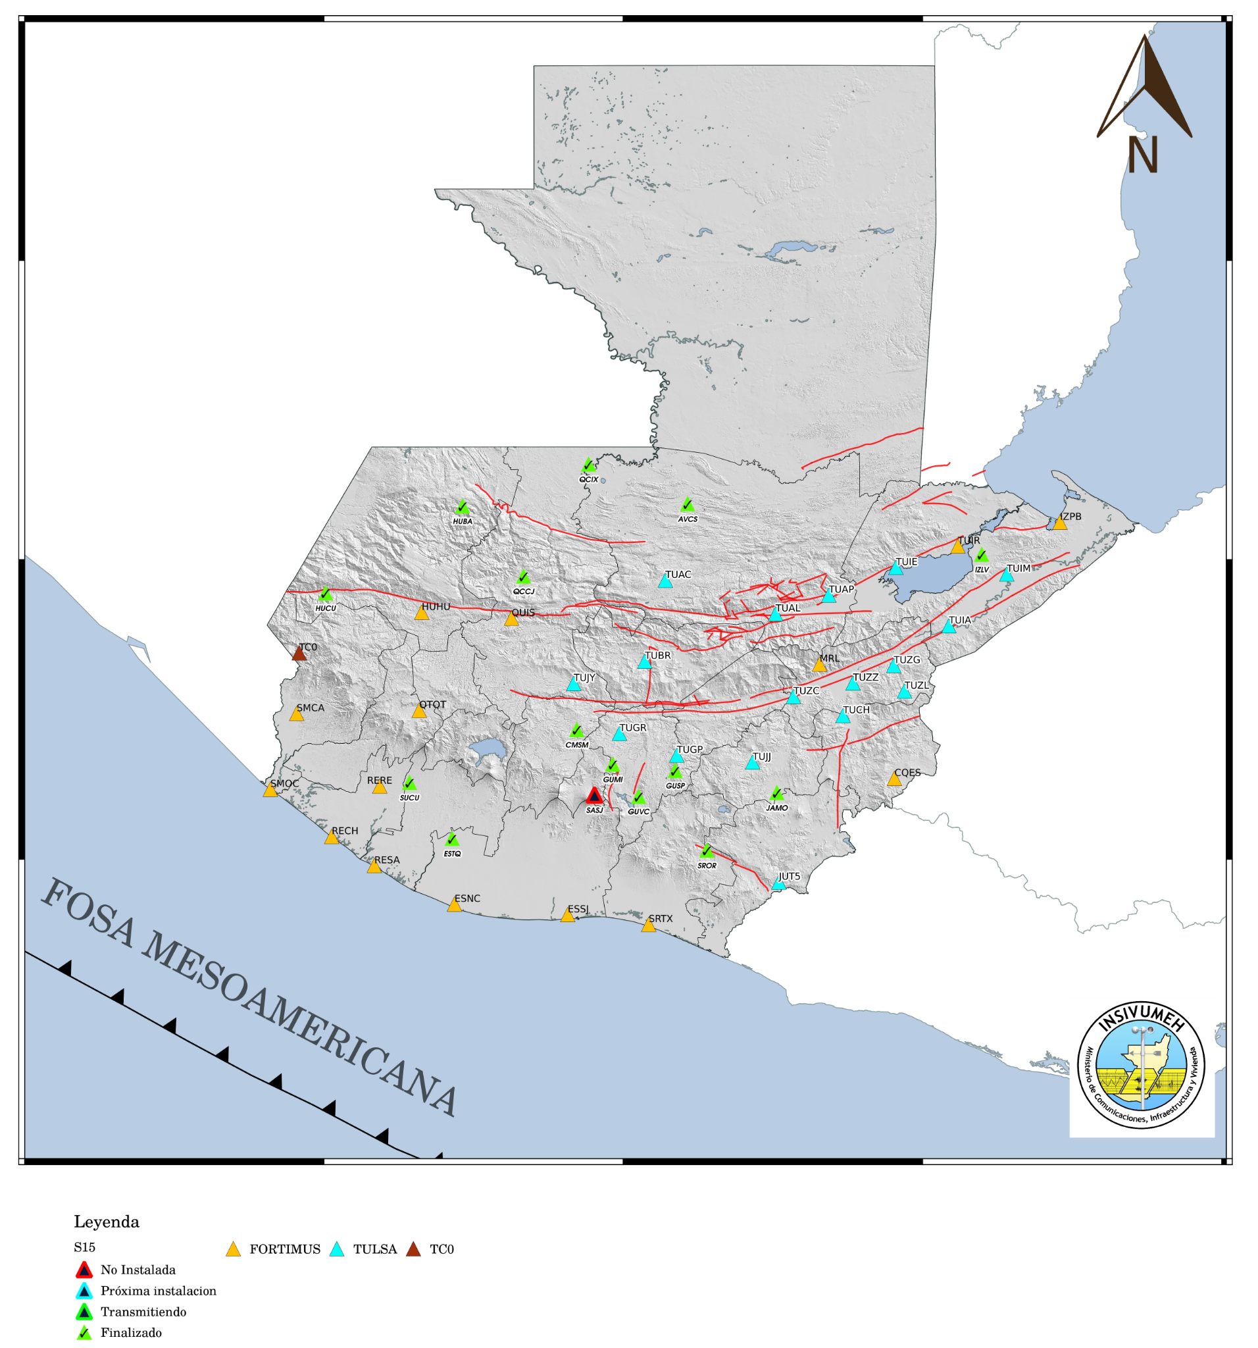
Current seismic network
For local and regional events we can use our seismic network that has grown.

Slide 5
Distant events
For distant events like earthquakes or volcanic events we take the advice information from PTWC.

Slide 6
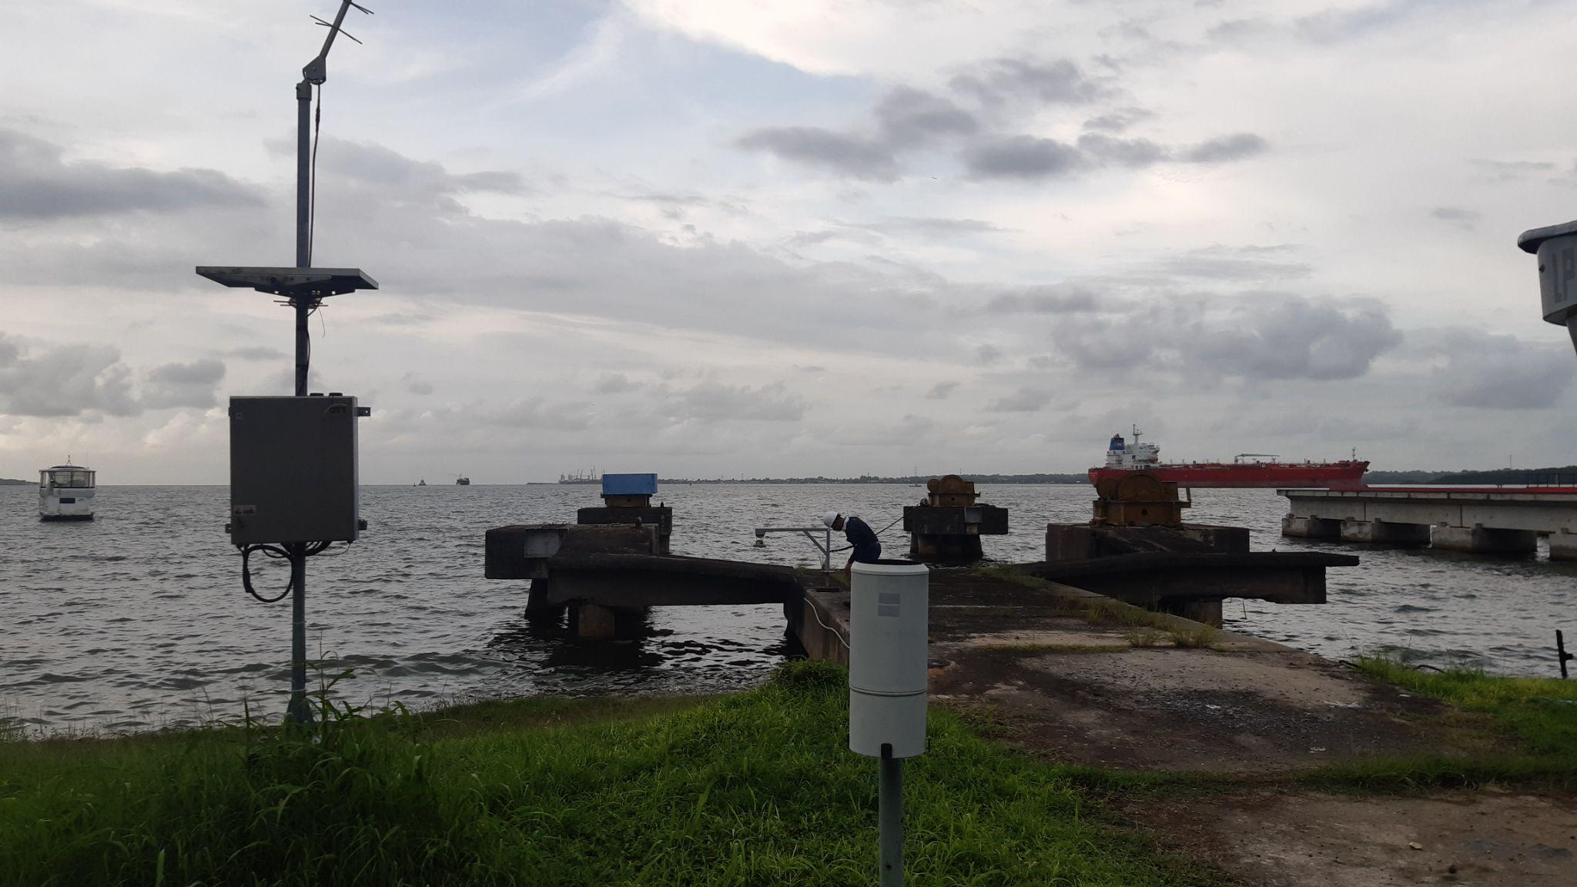
National Sea Level Network
We have a mareographic station in Puerto Barrios. This station although was out of service during a long time, now is online, transmitting data since September 2021.

Slide 7
Tsunami ocurrences/Tsunami Exercises
During CaribeWave23, the seismology and hydrology staff participated processing and give the main bulletin to CONRED. We have now a system that reads emails automatically, so when potencial tsunami event is sent by PTWC/CATAC, the processing of the email informacion is as fast as possible.
The propagation of the information also is automatized by emails and Telegram.
We have updated our internal manual of standard procedures in case of a tsunami occurs.

Slide 8
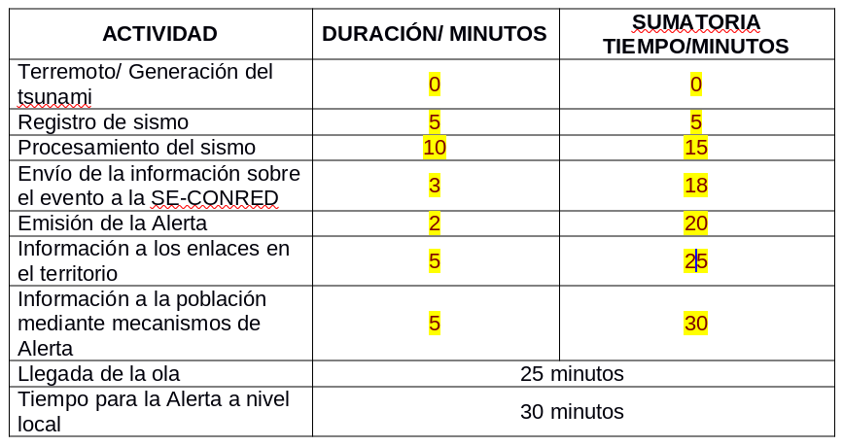
The general process in case of a tsunamigenic event

Slide 9
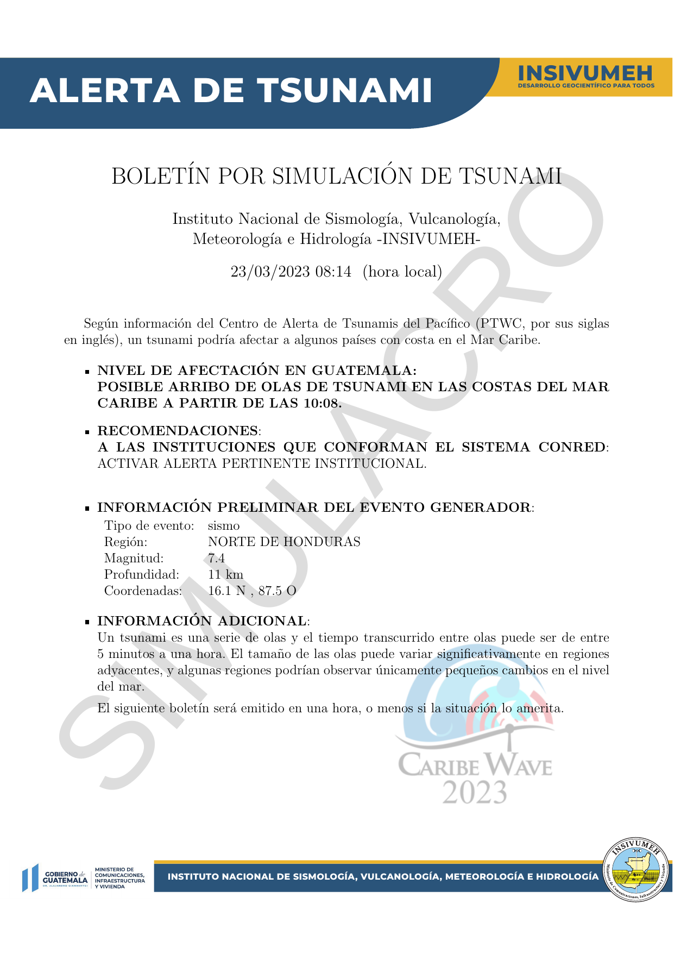
Example of the initial bulletin

Slide 10
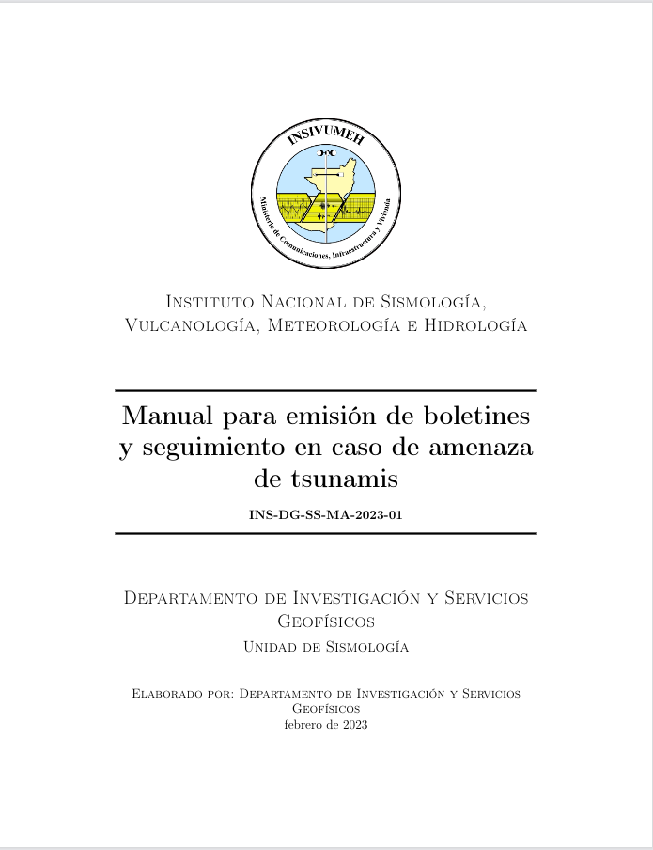
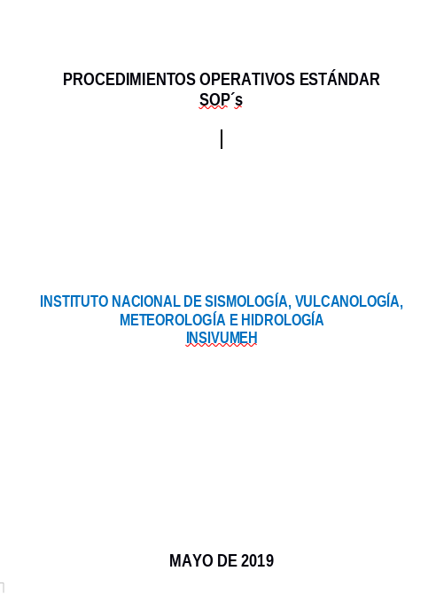
Our manuals

Slide 11
Challenges and future plans
Inundation-evacuation maps:
Until now, we have just two inundation-evacuation maps for the Pacific coast and nothing for the Caribe.
We can download data from GEBCO from 2022 where there is a higher resolution: 15 arc sec. This is an opportunity to take this bathymetry data and try to continue elaborating this maps.
From there we can plan different routing evacuation for simulations of tsunami events.

