Slide 1

REPORT OF THE TASK TEAM ON TSUNAMI PROCEDURES FOR VOLCANIC CRISES
ICG CARIBE EWS XVI Session
April 25-28, 2023
Costa Rica
Valerie Clouard, Christa von Hillebrandt-Andrade, Bernardo Aliaga, Michael Angrove, Nicholas Arcos, Silvia Chacon-Barrantes, Dondin Frederic, Erouscilla Joseph, Laura Kong, Charles McCreery, Daniel McNamara, Raphael Paris, Lizzette Rodriguez, Graham Ryan, Jelis Sostre, Emilio Talavera, Virginia Tenorio

Slide 2
Agenda
Introduction
Narrative Summary
Formatted Threat Messages
Memorandum of Understanding
CARIBE WAVE 23
Recommendations

Slide 3
Introduction

Slide 4
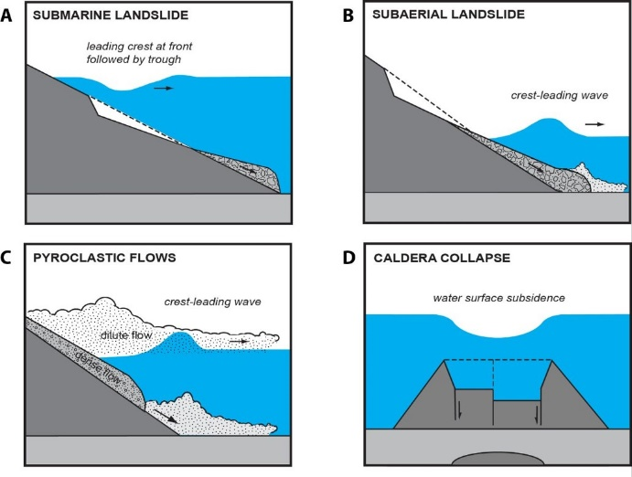
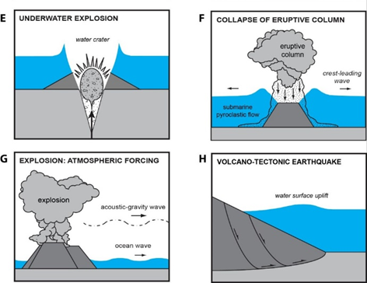
Tsunami Generating Mechanisms from Volcanoes (from Raphael Paris)

Slide 5
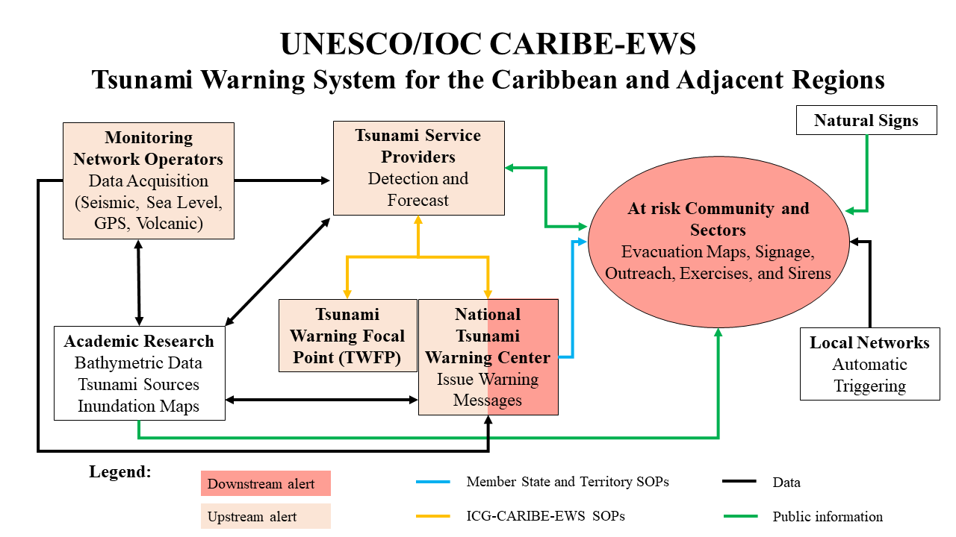

Slide 6
Background
Volcanic unrest of Kick’em-Jenny during the week of 13th July 2015, prompted a discussion at the 11th session of the ICG/CARIBE EWS about the potential for tsunami waves created by volcanic crises
ICG/CARIBE-EWS-XI.3 recommended to establish an ICG/CARIBE-EWS Task Team to identify the procedures to follow for volcanic crises.
Recommendation ICG/CARIBE-EWS-XI.2 suggested that the ICG identify volcano observatories as the primary entities responsible for determining the potential of a volcano-induced tsunami threat.

Slide 7
Background
Recommendation ICG/CARIBE-EWS-XIII.6 decided that Caribe Wave 19 will propose a scenario with a local event associated with an underwater volcanic eruption at the Kick’em Jenny submarine volcano northwest Grenada in southern Lesser Antilles
Recommendation ICG/CARIBE-EWS-XIV.6 noted that for the first time a volcano source was tested and feedback was gathered on the experimental volcano products to be issued by PTWC
Recommendation ICG/CARIBE-EWS-XV.5 suggests that the CARIBE WAVE 23 exercise consist of 3 scenarios including a volcanic eruption of one of the volcanoes of the Lesser Antilles.

Slide 8
Narrative Summary

Slide 9
During the inter-sessional period, the volcano TT has:
Worked on standard and formatted messages that could be issued by volcano observatories and/or institutes responsible for monitoring volcanoes in case of a potentially tsunamigenic event
Worked on the draft of a Memorandum of Understanding (MoU) that could be signed between the TSP and volcano observatories and/or institutes responsible for monitoring volcanoes
Collaborated with the CARIBEWAVE23 TT to prepare Mount Pelée scenario

Slide 10
During the inter-sessional period, the volcano TT has:
Elaborated the specific messages issued towards the TSP by the Seismological and Volcanological Observatory of Martinique (OVSM/IPGP) regarding the Mount Pelée scenario as reported in the Caribe Wave handbook.
Presented the recent advance in the implementation of tsunami procedures in case of volcano crises to the LACSC meeting (Quito, Sept. 22), to the Cuban Geological Convention (La Havane, April 23) and to the SSA meeting (Puerto. Rico, April 23)

Slide 11
Formatted Threat Messages

Slide 12
Standard and formatted text messages
Recent volcanic crisis in the Caribbean show that there are two different cases where the TSP needs to issue messages towards the NTWC:
    In the case of a volcanic activity showing phenomena potentially tsunamigenic for if a tsunami is observed
    In the case of an escalation of volcanic activity to be able to advise MS
In both cases, this information originates from the volcano observatory in charge of the monitoring of an unrest volcano.
Constraints on these bulletins are standard formatted information, basic information on the volcano and information on the potential or occurring tsunami.

Slide 13
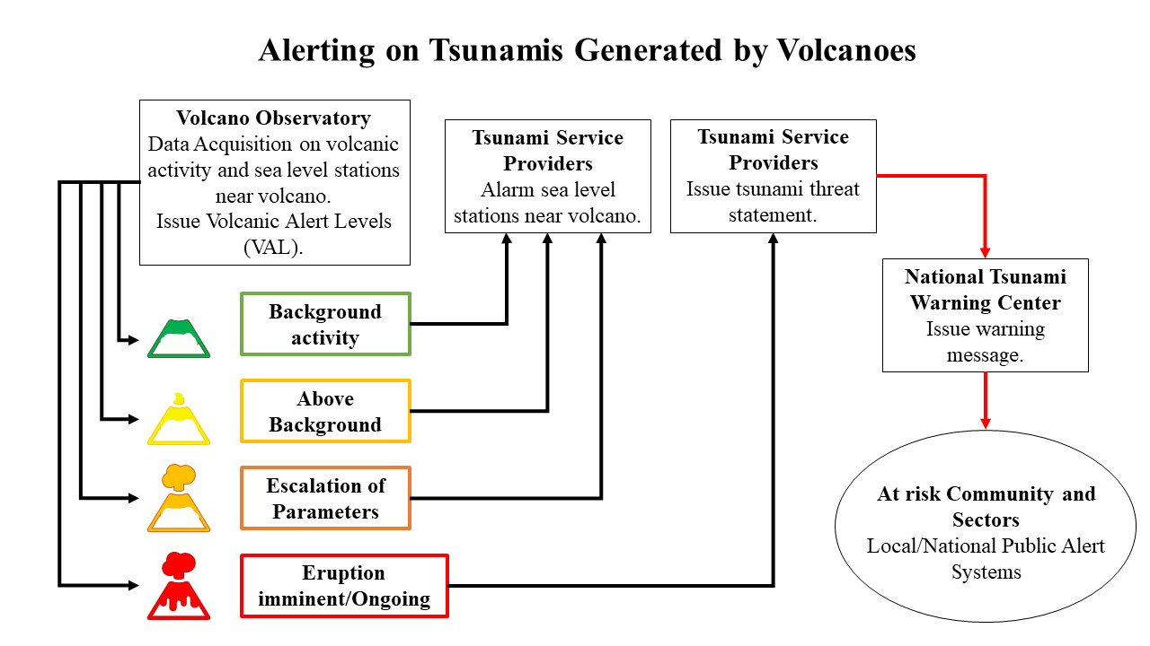
VONUT to TSPs

Slide 14
Volcano Observatory Notice for Tsunami Thread (VONUT)
(1) VOLCANO OBSERVATORY NOTICE FOR TSUNAMI THREAT-VONUT
(2) Issue: Universal (Z) date and time (YYYYMMDD/HHMMZ):
(3) Volcano: Name and number (per Smithsonian database at http://volcano.si.edu/): | Pre-filled
(4) Current Aviation Colour Code: GREEN, YELLOW, ORANGE, OR RED in upper case bold font
(5) Previous Aviation Colour Code: Lower case font, not bold
(6) Source: Name of Volcano Observatory (volcanological agency)
(7) Notice Number: year-VONUT number (e.g. 2010-1)
(8) Volcano Location: Latitude, longitude in NOTAM format (deg min N or S deg min W or E, e.g. 4701N 0513W) | Pre-filled

Slide 15
Volcano Observatory Notice for Tsunami Thread (VONUT)
(9) Area: Regional descriptor | Pre-filled
(10) Summit Elevation: nnnnn FT (nnnn M) | Pre-filled
(11) Volcanic Activity Summary: Concise statement that describes activity at the volcano. If known, time of onset and duration of eruptive activity are specified (local and UTC).
(12) Sea sector of the impact (North/South, East, West) “UNKNOWN” if no data available
(13) Name of the sea (Caribbean, Atlantic, Dominique Channel, etc) “UNKNOWN” if no data available
(14) Closest tide gauge stations Indicate name and url (from IOC web site: https://www.iocsealevelmonitoring.org/station.php?code=) of tide gauges at less than 100 km. A map of tide gauge locations and name is Annex 4. | Pre-filled

Slide 16
Volcano Observatory Notice for Tsunami Thread (VONUT)
(15) Remarks: Optional; brief comments on related topics such as monitoring data, observatory actions, volcano’s previous activity, sea level disturbance observed, etc.
(16) Contacts: Names, phone numbers (voice and fax), email addresses. | Pre-filled
(17) Next Notice: “A new VONUT will be issued if conditions change significantly or the colour code changes.” “Final notice” if final notice for an event. URLs of Websites where the latest volcanic information is posted are included.

Slide 17
Memorandum of Understanding (MoU)

Slide 18
Memorandum of Understanding (MoU)
Based on the MoU signed by volcano observatories with the Civil Aviation for issuing VONA
Might be used by volcano observatories as guiding procedures
Contains an introduction to be signed by volcano observatories, the list and the coordinates to which volcano observatories have to send their VONUT, the VONUT itself and 3 annexes:
    Table with Volcano level of alert color codes
    Schematic representation of volcanic sources of tsunamis
    Local map with tide gauges within 100 km.

Slide 19
CARIBE WAVE 23

Slide 20
Mount Pelée Scenario
Based on a moderate flank collapse on the southwestern flank at the beginning of an explosive eruption.
Based on previous studies on Mount Pelée flank collapses and laboratory experiments compared to numerical modeling.
Two VONUT messages were issued by the OVSM/IPGP:
    30 minutes before the beginning of the exercise – simulate change in volcanic activity level from orange to red
    5 minutes before the beginning of the exercise – inform the TSP that a large dome collapse has reached the Caribbean Sea

Slide 21
Mount Pelée Scenario (cont)
After discussion with EMIZA, the French regional Disaster Manager Organization, we would like to add two remarks to the CCW23 survey:
    In the messages from the TSP, a link to a direct source of information, i.e., to the volcano observatory web page is missing. As it is provided in the VONUT by the volcano observatory, we suggest to the TSP to include it in its text messages in the case of a volcanic event.
    EMIZA expressed its interest, as a table exercise, to simulate at the same time the beginning of a volcanio eruption and a tsunami. They hope that other CW exercises based on volcanic eruption will be planned

Slide 22
Recommendations for ICG/CARIBE EWS XVI

Slide 23
Recommendations for ICG/CARIBE EWS XVI
Considering the report of TT for tsunami procedures for volcanic crises,
Noting the list of potentially threatening volcanoes and the list volcano observatories and institutes responsible for monitoring volcanoes for the Caribbean identified by the TT,
Noting the draft of a Memorandum of Understanding (MoU) established by the TT to be used between the TSP and the volcano observatories and/or institutes responsible for monitoring volcanoes,

Slide 24
Recommendations for ICG/CARIBE EWS XVI (cont)
Recognizing the use of Volcano Notice for Tsunami Threat (VONUT) during CARIBEWAVE23 between the volcano observatory of Martinique and the TSP,
Suggests that the TSP includes the VONUT messages in its procedures to activate its alert system,
Recommends that ICG/CARIBE-EWS (WG 2, 3?) initiate contacts with the identified volcano observatories and/or institutes responsible for monitoring volcanoes threatening the Caribbean basin, to implement the MoU of the VONUT

Slide 25
Recommendations for ICG/CARIBE EWS XVI (cont)
Noting the 2020-2021 eruption of the La Soufrière volcano in Saint Vincent and the Grenadines, La Palma eruption in 2021, the increasing level of volcanic activity at Soufrière of Guadeloupe, and the Hunga Tonga Hunga Ha’apai eruption and tsunami in 2022,
Recommends that WG1 maintain a specific watch on sea level networks around active volcanoes, continues the activities of its group to advise on the installation of temporary sea level sensor networks around volcanoes when volcanic activity increases, continues its evaluation and actions towards the use of GNSS-R in real time, to increase the sea level station network.

Slide 26
Recommendations for ICG/CARIBE EWS XVI (cont)
Further recommends that WG2 continue to investigate volcanic sources in the Caribbean and impulse numerical modelling based on volcanic sources.
Further recommends that WG3 develop contacts with Caribbean and Atlantic volcano observatories and/or institutes responsible for monitoring volcanoes, with the objective to establish communication procedures between them and the TSP, possibly using our drafted MoU.
Further recommends that WG4 help improve public awareness on tsunamis generated by volcanic activity.

Slide 27
Recommendations for ICG/CARIBE EWS XVI (cont)
Noting the interest expressed by MS for CARIBEWAVE exercises based on volcano eruption,
Considering the on-going implementation of communication procedures between the TSP and volcano observatories and/or institutes responsible for monitoring volcanoes,
Acknowledging the on-going changes made by the TSP to modify its procedures to activate its alert system in case of non-seismic event and its experimental text products,
Recommends that volcanic eruptions and/or landslides as a source of tsunamis in the Caribbean basin continue to be considered for future CARIBEWAVE exercises,

Slide 28
Recommendations for ICG/CARIBE EWS XVI (cont)
Considering the report of the Ad Hoc Team on Tsunami Generated by Volcanoes (TGV) presented at TOWS 2023,
Recommends that volcano list and volcano observatory list for the Caribbean established by the TT and the Volcano Notice for Tsunami Threat (VONUT) used during CARIBWAVE23 exercise be shared with the Ad Hoc Team on Tsunamis Generated by Volcanoes (TGV Team) of TOWS-WG Task Team on Tsunami Watch Operations (TT-TWO)

Slide 29

Gracias – Thank you – Merci – Danke - Obrigado

