Slide 1


REPORT OF THE INTRASESSIONAL WORKING GROUP ON REALIGNMENT WITH UNODTP OBJECTIVES
Mike Angove (Chair)
Silva Chacon
Dan McNamara
Wilfried Strauch
Annie Zaino
Regina Browne
Anthony Murillo
Bernardo Aliaga
CARIBE EWS ICG, 27 April, San Jose, Costa Rica

Slide 2
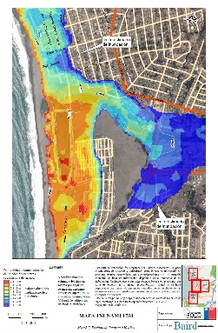
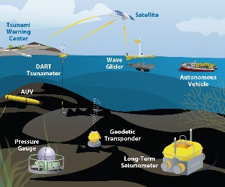
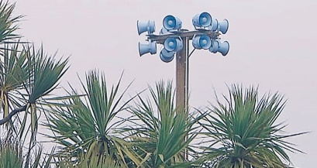


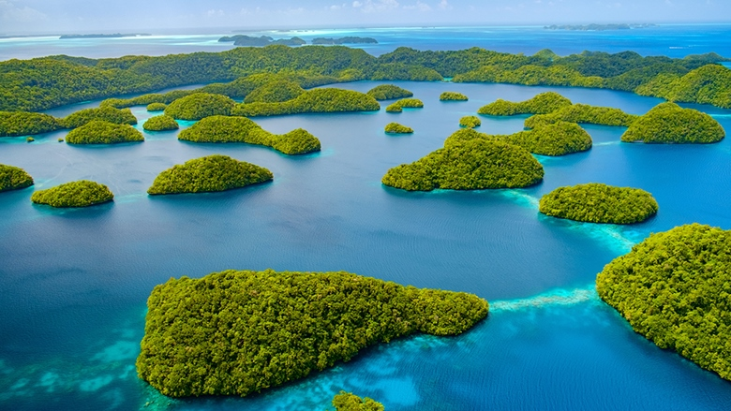
Key Elements of the UNODTP Research, Development & Implementation Plan
1. Tsunami Risk Knowledge: Identify and prioritise at-risk communities
2. Tsunami Detection, Analysis and Forecasting: Expand existing, and deploy new observing technologies and warning systems
3. Warning, Dissemination and Communication: Access to data, tools, communication platforms, protocols and training to effectively warn coastal and maritime communities
4. Preparedness and Response Capabilities: To build tsunami-resilient communities
5. Capacity Development, SIDS and LDCs, Multi-hazard Framework: Underpinning elements
6. Governance and Pathways to Implementation
Notes:
Enhance tsunami risk assessments and the research on technologies for it, so the countries know their expected threat and vulnerability, and are able to identify and prioritise the at-risk communities.
Expand and improve existing detection and monitoring systems, including seismographs, coastal tide gauges, and deep ocean tsunameters, to fill identified gaps, and deploy new technologies to address observational gaps that cannot be covered by existing networks.
Ensure all National Tsunami Warning Centres (NTWCs) have access to data, tools and communication platforms, protocols and training to timely and effectively warn coastal and maritime communities threatened by tsunamis and other coastal hazards that are integrated into a multi-hazard framework
Emphasise the importance of building tsunami resilient communities through the IOC-UNESCO Tsunami Ready Recognition Programme, which is achieved through involvement of stakeholders at all levels.

Slide 3
Existing WGs
WG3: Tsunami Related Services
Purpose: To examine current and developing capacities in each country of the region and advise the ICG about the definition and composition of early warnings and tsunami products and the methods and best practices for effective procedures for end to end communication and dissemination of early warnings and tsunami products.
WG4: Preparedness, Readiness and Resilience
Purpose: To advise and recommend to the ICG strategies to enhance public awareness, education and resilience capacities and to develop the necessary recommendations, tools and procedures.
WG1: Monitoring and Detection Systems.
Purpose: To review and recommend to the ICG priorities and actions required towards the full establishment of a coordinated regional tsunami warning system.
WG2: Hazard Assessment
Purpose: To advise the ICG on the identification and characterization of coastal hazards, their assessment and the required modeling.

Slide 4
Regional WG Alignment Proposal
WG1 | Tsunami Risk Knowledge (former WG2) | Chair ViceChair
WG2 | Tsunami Detection, Analysis and Forecasting | Chair ViceChair Tsunami Source Characterization ViceChair Tsunami Detection (SL) ViceChair Tsunami Forecasting
WG3 | Warning, Dissemination and Communication | Chair ViceChair
WG4 | Preparedness and Response Capabilities (former WG4) | Chair ViceChair Preparedness and Response ViceChair Tsunami Ready

Slide 5
Primary Tasks: WG1
Chair / Vice Chair
Review and evaluate required methods and data sets, including bathymetry and coastal topography for determining coastal hazards.
Advise the member states on the requirements for operating the appropriate models for risk assessment.
Advise and build capacity for risk assessments and their interpretation.
Present a progress report based on the Key Performance Indicators related to the UN/IOC ODTP
Advise and seek advice from member states about other coastal hazards that can be included into the warning system.

Slide 6
Primary Tasks: WG2
Chair / 3 Vice Chair
General:
Support the operations of a fully interoperable regional tsunami warning system.
Support and integrate the work of the subgroups
Present a progress report based on the Key Performance Indicators related to the UN/IOC ODTP
Establish strategies to enhance the warning system by including other coastal hazards.

Slide 7
Primary Tasks: WG2
Chair / 3 Vice Chair
2.1 Tsunami Source Identification and Characterization
Ensure the effectiveness of the observational system by promoting the open exchange of seismic and other relevant data in real time.
Advise member states on the monitoring and detection capabilities of tsunamigenic sources needed for operating national tsunami warning centers.
Assure the compliance with the agreed standards for the detection systems.
Promote the sharing of experience and expertise, and capacity building essential to effective monitoring.
2.2 Tsunami Detection
Ensure the effectiveness of the observational system by promoting the open exchange of sea level data in real time.
Advise member states on the tsunami monitoring and detection capabilities needed for operating national tsunami warning centers.
Assure the compliance with the agreed standards for the detection systems.
2.3 Tsunami Forecasting
Define the operational requirements for the monitoring and forecasting systems.
Promote the sharing of experience and expertise, and capacity building essential to the development of impact forecasts.

Slide 8
Primary Tasks: WG3
Chair/Vice Chair
Explore and document the dissemination capabilities and existing alert guidance in the countries of the region.
Identify the difficulties and challenges existing in the region that hinder the impact of “end to end” communication and dissemination of early warnings.
Establish strategies for the development and implementation of methods and technologies to strengthen the interaction with the media and dissemination of early warnings within the countries of the region.
Evaluate communication tests and tsunami exercises, in order to identify weaknesses and make recommendations to help strengthen these delivery systems.
Create communication protocol and standardized information identifying the minimum acceptable levels for communication and dissemination of tsunami early warning in all countries for approval by the IGC.
Provide feedback to the Tsunami Service Providers on its products and communication procedures.
Serve as a reviewing and approving body for proposed changes to TSP products for the CARIBE-EWS, or determine if proposed changes warrant going to the ICG for review and approval.
Present a progress report based on the Key Performance Indicators related to the UN/IOC ODTP

Slide 9
Primary Tasks: WG4
Chair / 2Vice Chair
General
Consider UN Ocean Decade Tsunami Programme and other relevant decade actions, the Regional Action Plan for the Implementation of the Sendai Framework for Disaster Risk Reduction 2015-2030 in the Americas and the Caribbean and the UN Early Warnings for All Initiative (EW4ALL)
Present a progress report based on the Key Performance Indicators related to the UN/IOC ODTP
4.1 Preparedness and Response capabilities
Identify the public awareness and education strategies and tools that the Member States can integrate into their risk reduction and emergency management programs.
To closely cooperate with the Caribbean Tsunami Information Centre (CTIC) in carrying out its mandate and in the implementation of its program.
4.2 Tsunami Ready
Identify and employ strategies to ensure 100% of at-risk communities achieve UNESCO/IOC Tsunami Ready Designation
Support the development of guidelines and capacity development on preparedness, response and recovery planning for Member States, communities and organizations, which should include sharing of training and evacuation best practices.

Slide 10
Existing and Proposed TTs
Tsunami Ready (move to WG4)
CARIBE WAVE (retain)
Volcanic Sources (considered in WG2)
Evacuation Mapping (considered in WG1 and 4)
Future Goals and Performance Indicators (Considered in all WGs)
UN Decade of Ocean Science for Sustainable Development (sunset)

Slide 11
ICG/PTWS WG - Central America
ICG/PTWS has sub regional working groups
Considering most Central America countries are ICG/CARIBE-EWS
Propose that ICG/PTWS-WG-CA to report at next ICG/CARIBE-EWS sessions

Slide 12
Recommendations
Realign CARIBE EWS Working Groups And Task Teams to directly support CARIBE EWS Performance Goals as represented in UNODTP Objectives
Task Teams on Tsunami Ready, Volcanic Sources, Evacuation Mapping, Future Goals and Performance Indicators, and UN Decade of Ocean Science for Sustainable Development be stood down all having achieved their objectives
Task Team on CARIBE WAVE be retained indefinitely
ICG/PTWS-WG-CA to report at next ICG/CARIBE-EWS sessions

