Slide 1

Strategic Objective 11
GOAL 3
GOOS 12th Steering Committee meeting, 25 - 26 April 2023

Slide 2
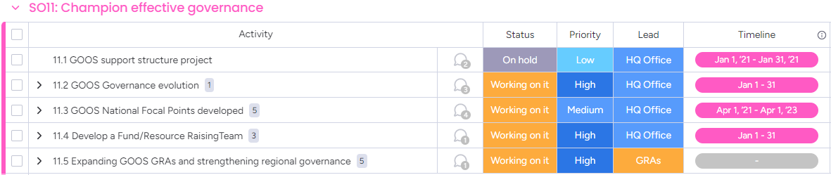
Actions
Play a leading role in establishing effective governance for global in situ and satellite observing, together with partners and stakeholders

Slide 3
Progress/Achievements
Evolving GOOS Governance
TORs for Evolve GOOS Governance TT agreed in 2022
Call for members via IOC Circular Letter May 2023
GOOS Office to seek governance expert support for the TT
Regional
Regional Policy TT - delayed due reduction in resource.
Workshop Report complete as a base for the TT
Currently supporting activity in Pacific Islands, Caribbean, Africa, and Arctic to reinvigorate regional coordination (GRA report out Session 9)

Slide 4
ToR Update Process
2017
2019
2021
Jan
2023
Mar
2023
Apr
2023
CL 2666
Task Team
Recruitment
CL 2931
SC-12
2030 Global Ocean Observing System Strategy
Request for designation or update of NFP
Task Team formed as a response to SC-9
NFP ToR updated
GOOS NFP Consultant newly joined
Circulation of ToR draft
Feedback on ToR and update of NFP nomination
Submission for approval of GOOS SC
Prompted GOOS SC to consider the role of NFPs
32 responses (few more in pipeline)
6 new NFP contacts proposed
Now 65 NFPs & more expected
84 countries contribute to OceanOPS

Slide 5

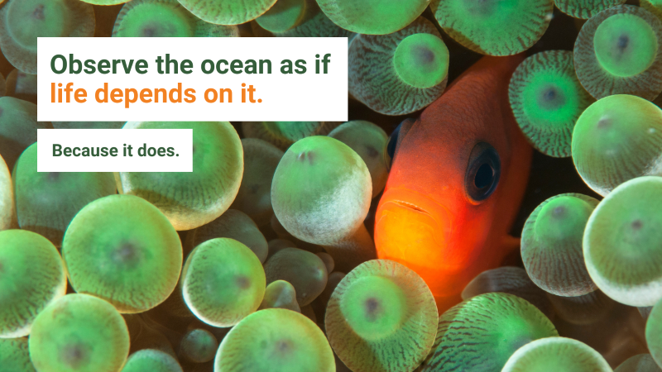

Progress/Achievements
Fundraising
Some success
New in-kind support: loan under development, Co-Design and CoastPredict have attracted new in-kind support & implementation interest
3 new EU Projects submitted in April around EOVs – GOOS Panels
Dialogues with Industry work attracting funding interest through MTS to continue work
DCO supported by Decade Coordination Unit (100K)
IOC funded NFP
Next steps
New contract scoped to advance work GG+A to SC and Exec develop cross-GOOS methods for philanthropy fundraising (would help all)
Funding Plan (Session 8) progress slowed by GOOS Office resource squeeze

Slide 6
Outcomes & Assessment
No. | SO11 Outcomes | Assessments
1 | A governance architecture for the global ocean observing system, that integrates GOOS and partners in a framework, with clarity in roles, processes and evaluation | Progress slow (30%) Work done in defining the process and ToRs for TT & work with partners
2 | A clearly articulated voice for ocean observations and services, with multiple stakeholders contributing to define the message | On track (40%) Clearer message, more partners and sponsors noting the need for ocean observations, no yet advocating for GOOS
3 | Improved global observing system delivery, responsiveness and sustainability (not sure all of this is relevant – more success of the strategy overall other SOs) | Progress slow (20%) Advances through OCG, partnership, Decade work…) but still some way to go
4 | Greater support for national systems and their needs for ocean information | On track (30%) Specific comms planned for NFP support

Slide 7


Gaps & action
Sustainability of the system
Develop comms stories related to sustainability issues? E.g. findings from Dialogues with Industry
UN Policy is where the need for ocean observations can be coded in, working through IOC and our world leading experts is important
Partners that are vocal for the need for observations & GOOS. UNDRR used co-communications, we could look at this idea further
Funding Plan
View of GOOS structure and support, including in-kind, against the workplan
Notes:
Governance and funding are complex, the problems go back a long way and it will take time – GOOS has made major major advances that help with the funding and governance BUT this are now needs focus in 2023-2024

Slide 8
Next/Future Steps
Fundraising
Develop Plan and initiate – needs resource - priority action
GG+A contract to aid GOOS to work together in 2024
GOOS Office to develop a resources assessment end 2023 - core structure support (Panels, OceanOPS, OBIS BioEco work, and GOOS Projects, Partners, Fundraising, NFP) and in-kind resources (% peoples time, and affiliations, components NFP time….) that support GOOS work plan
DCO recruit should be a support for Decade Programmes
NFP
NFP brochure/comms: July-Sept 2023
GOOS NFP European Regional Meeting – EuroSea Assembly: Sept 2023
GOOS NFP Forum (Virtual): Oct 2023
Evolve GOOS Governance
CL after SC to initiate call for TT members – balance `membership - priority action
Engage with GOOS Sponsors

Slide 9
Resource required - new
GOOS needs to carefully consider its priorities (this SC) and structure/resource to deliver.
Fundraising GG+A contract to help GOOS focus and work together 40K$
Longer term need specific resource for fundraising support
Governance expert/consultant to support TT 30-40K$
NFP need to consider how this will be supported beyond 2023
Notes:
identify how it is going support and needs for core and project related funding e.g., support initiatives such as NFP beyond 2023

