Slide 1

Strategic Objective 10
Observe human impacts on the ocean
Presenter: Artur Palacz, GOOS Biogeochemistry Panel Project Officer
GOOS 12th Steering Committee meeting, 25 - 26 April 2023

Slide 2
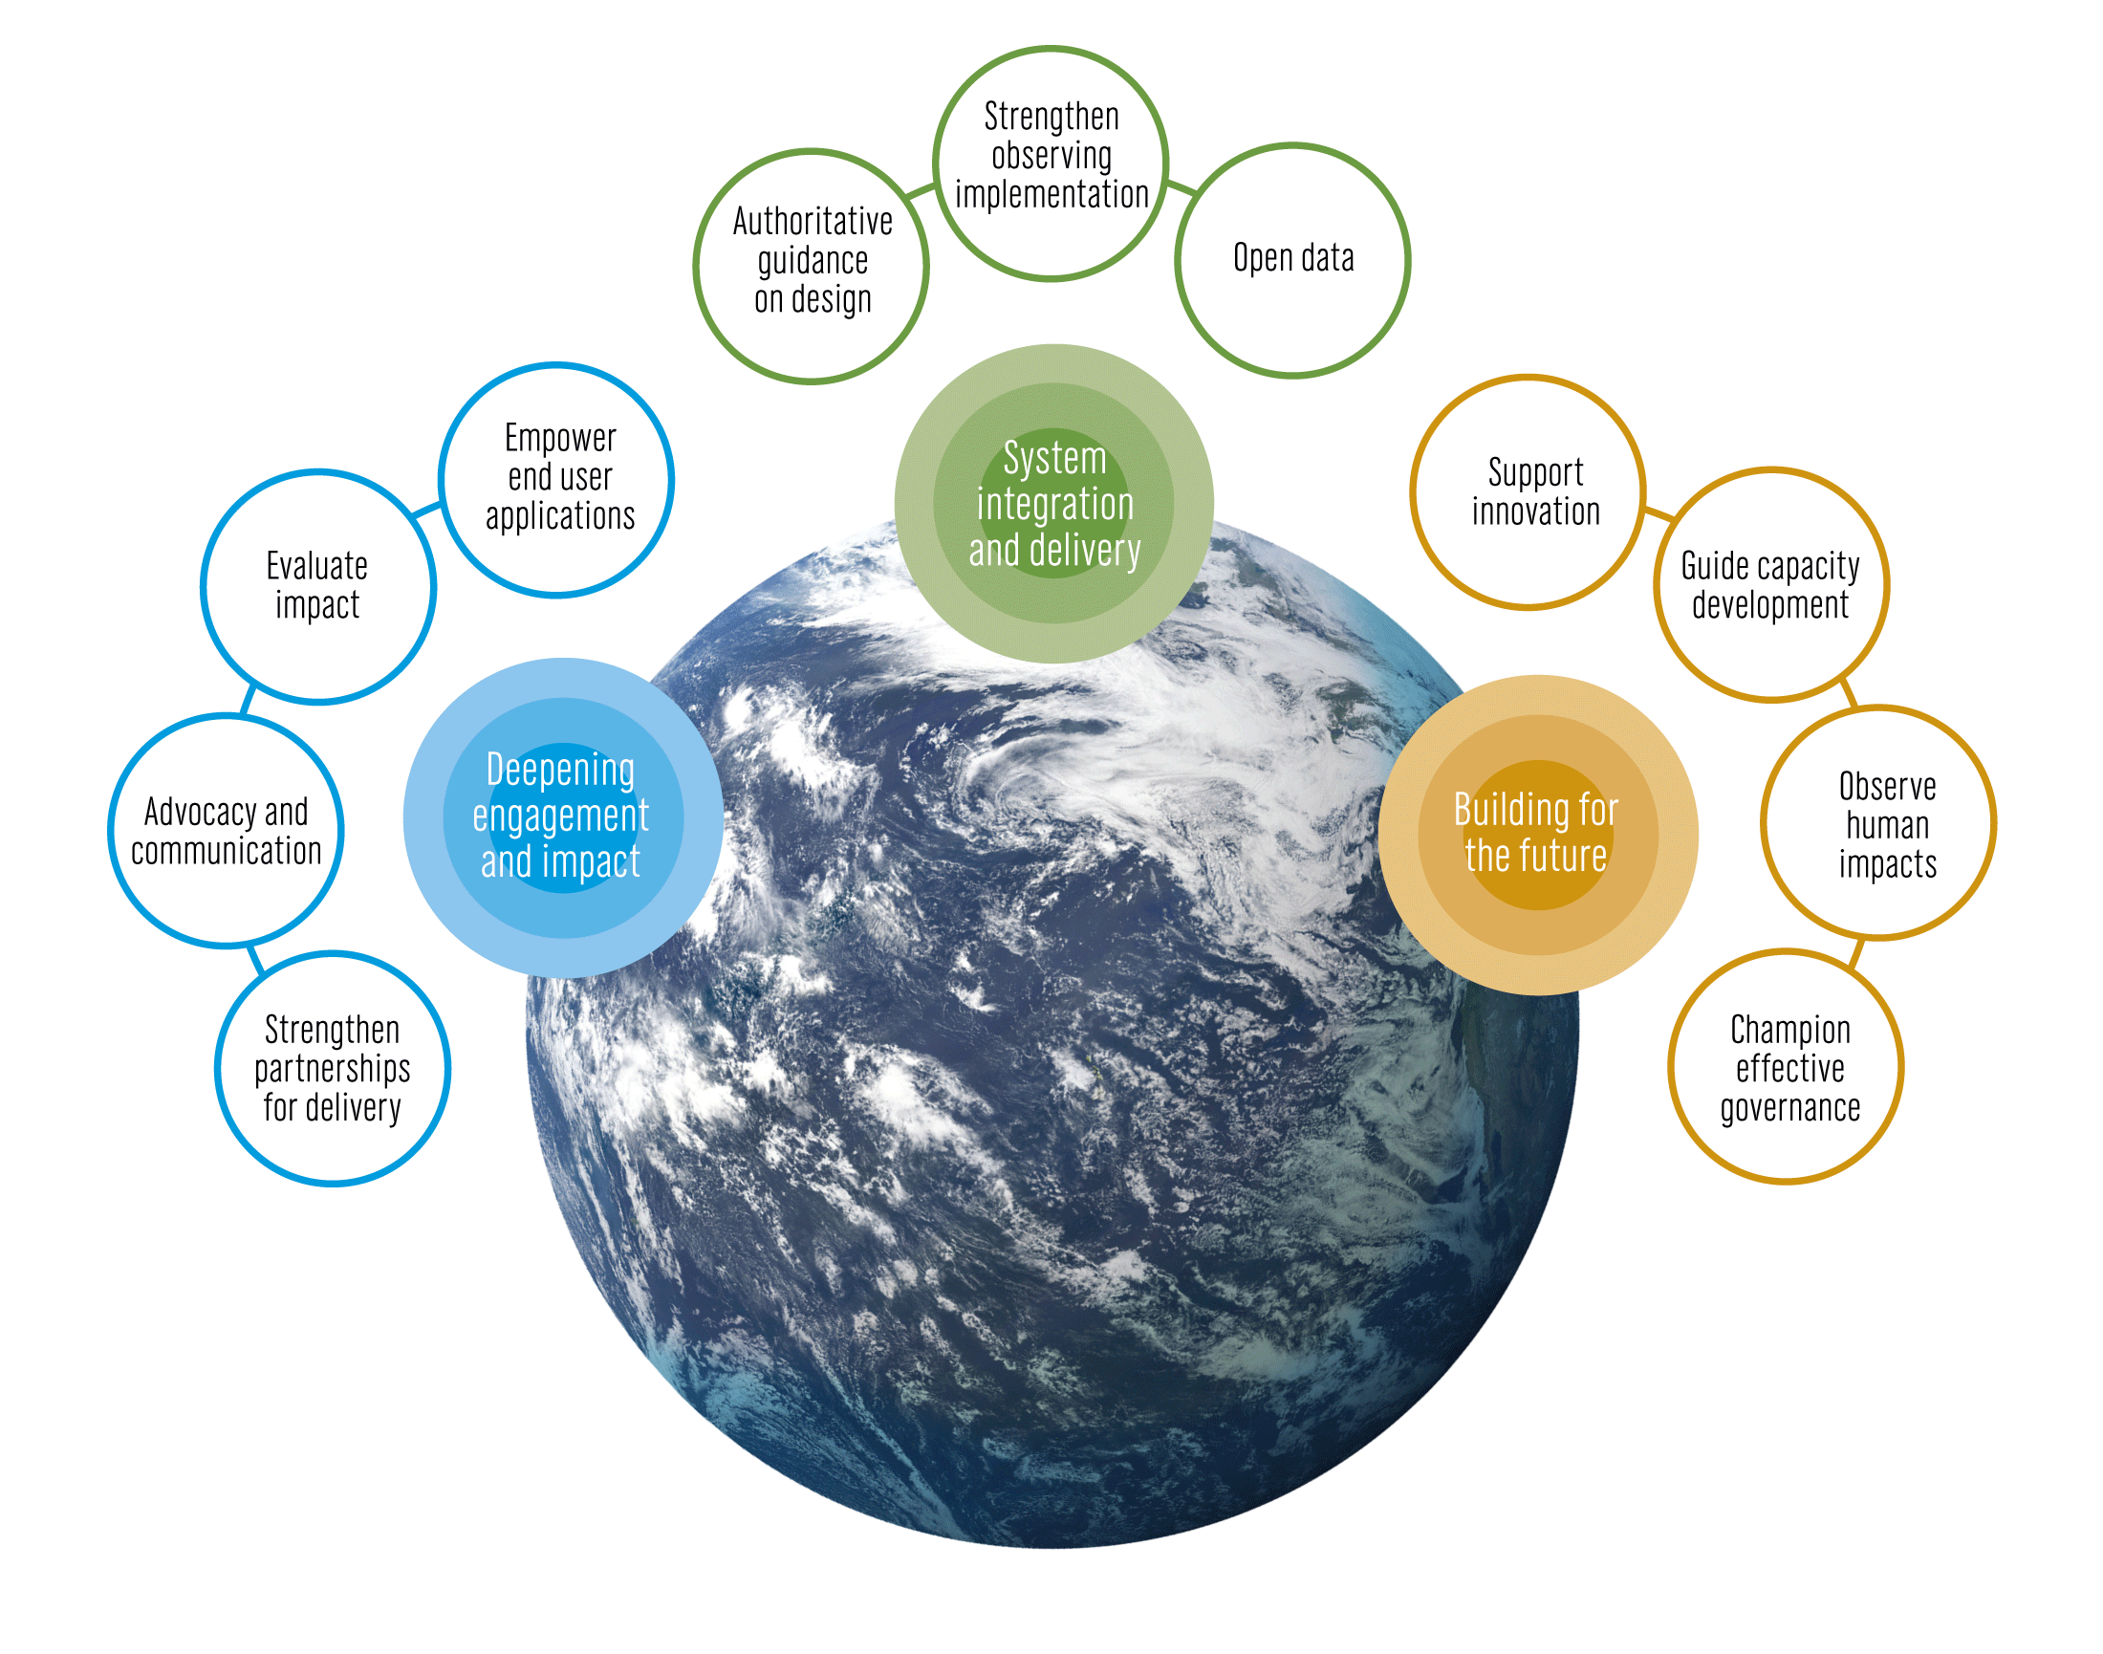
The GOOS 2030 Strategy
Notes:
The Global Ocean Observing System or GOOS is led by the Intergovernmental Oceanographic Commission of UNESCO and is co-sponsored by the World Meteorological Organization (WMO), United Nations Environment Programme UNEP and the international science council
The IOC Assembly in 2019 adopted a Global Ocean Observing System 2030 Strategy which now informs our work.
[vision] [mission]
Suite of Strategic Objectives which have become important to our planning:
System integration and delivery are the ‘core’ of GOOS ‘business’ today
Deepening engagement and impact are key priority areas for work – including developing partnerships for delivery, advocacy and communications
Building for the future are about building the additional pieces we need for a fully integrated system, including capacity development and innovation, and leading the development of a governance system for the future system that includes say partners and other stakeholders

Slide 3
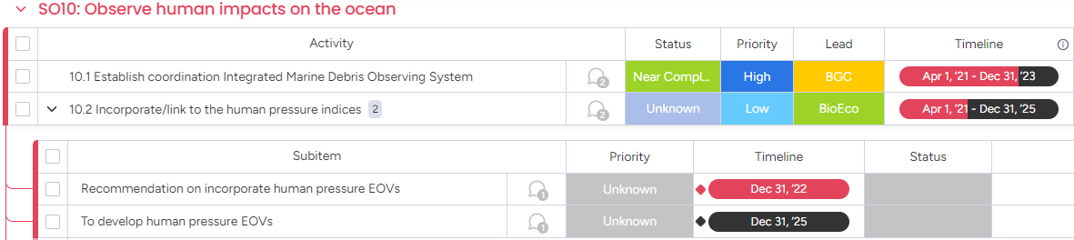
Actions
Extend systematic observations to understand human impact on the ocean

Slide 4
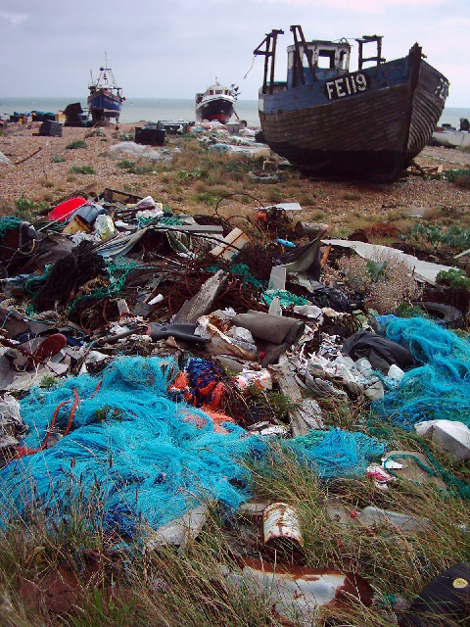
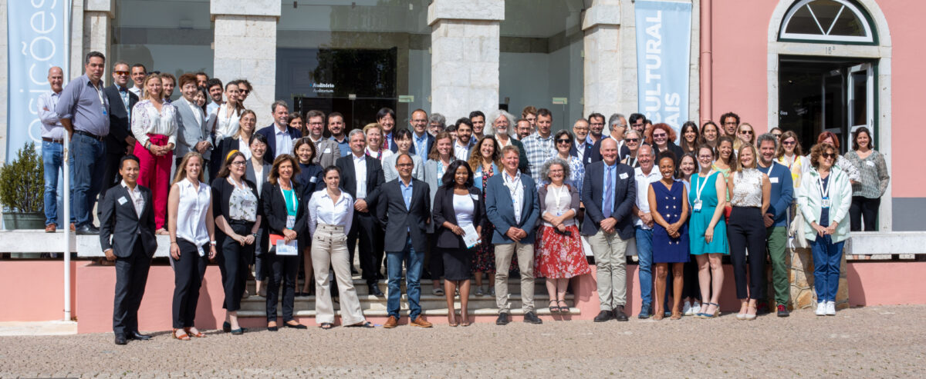


Progress/Achievements
10.1 Establish coordination of Integrated Marine Debris Observing System (IMDOS)
Significant support via EU H2020 EuroSea and EU4OceanObs projects
Strategic 3-way partnership of GOOS, GEO Blue Planet & UNEP Global Partnership on Marine Litter (GPML) to establish IMDOS as a joint project;
Interim IMDOS Steering Committee and Project Office established
IMDOS Terms of Reference established
IMDOS publicly launched (UN Ocean Conference, June 2022)
Recommendations for sampling co-design and common protocols
First report on the observing status of marine debris observations published
Initial efforts to advance global harmonization of data and metadata requirements across main data infrastructures
Successful advocacy for a global federated data management model
Group photo at the UN Ocean Conference side event
Centro Cultural de Cascais, 29 June 2022

Slide 5
Progress/Achievements
10.2 Incorporate/link to the human pressure indices
First Human Pressure EOVs developed in strong partnership with international expert working groups and projects
Reconciliation of SDG 14.1 indicators with the EOV framework for observations and data reporting (ongoing with UNEP GPML); including common ontology development (Ocean Best Practices WG)
Ocean Sound EOV developed in partnership with the International Quiet Ocean Experiment, EOV Specification Sheet published.
Marine Plastics Debris EOV developed in partnership with IMDOS and associated organizations such as GESAMP WG 40, SCOR WG FLOTSAM, MSFD Tech Group on Marine Litter, IOCCG Task Force on Remote Sensing of Marine Litter and Debris.
Other indicator development work led by GOOS BioEco Panel

Slide 6
Outcomes & Assessment
No. | SO10 Outcomes | Assessments
1 | A pilot project, in partnership with other organizations in this area, around variables related to human activities, potential initial targets are: (1) ocean noise, (2) marine plastics, and (3) harmful algal blooms | Pilot project on ocean noise - On track Fostered use of acoustics monitoring for biodiversity and ecosystem health assessments Successful partnership with the International Quiet Ocean Experiment (IQOE); model of “outsourcing” the EOV development, following that of the Ocean Colour EOV Need for continuous development of acoustics-based data products for various applications
 |  | (2) Pilot project on marine plastics - On track Joint initiative by GOOS, GEO BP & UNEP GPML; strategic 3-way partnership established (although formal Letters of Exchange to be finalized) Involving many other international organizations, expert WGs, NGOs, etc. as well as GOOS structures (GOOS Panels, OCG, OceanOPS, OCG, OBPS, GRAs) Interim International Steering Committee, Project Office and Terms of Reference established; no sustained funding secured beyond 2023 No de facto coordination of on the ground observing and monitoring activities
 |  | (3) Pilot project on harmful algal blooms wwwwwwwwwwwwwwww No dedicated effort initiated? Basic HAB requirements considered under Phytoplankton EOV
2 | Recommendations for the implementation selected human activity variables within an integrated global ocean observing system, and their implementation in the EOV framework | Ocean Sound EOV - Completed Accepted into the EOV framework, with Spec Sheet published Curated jointly by GOOS BioEco and OOPC
 |  | (2) Marine Plastics Debris EOV - On track Emerging EOV, First EOV Specification Sheet developed; and to be presented for approval at the next GOOS SC session. Foreseen joint curation by IOCCP and BioEco.

Slide 7
CHALLENGES (IMDOS)
Need to establish a broad and active IMDOS community which will undertake projects or activities through coordination of IMDOS Task Teams (guided by the Strategy and IP documents); should we risk this without sufficient resources secured by GOOS and others?
Relatively weak link to the Global South when it comes to coordination of activities; how to best capitalize on existing regional structures (IOC, GOOS, GOA-ON)?
General lack of observing networks/communities of practices to build on for “on the ground” coordination; need for efficient co-design and augmenting existing observing efforts.
Elevate existing guidelines and best practices to status of standard sampling protocols; how to reconcile this need with the rapid tech and research development?

Slide 8
Next Steps (IMDOS)
IMDOS request to be recognized as a GOOS Project
Strong lobbying for IMDOS to assume technical coordination of marine plastics monitoring in direct support of the newly negotiated international “Plastics Treaty” (2023-2024)
IMDOS website and branding developed (July 2023)
IMDOS Strategy and Implementation Plan drafted (Septemeber 2023)
International Data Harmonization Workshop (August 2023)
IMDOS Task Teams established and operating
Integrate elements of IMDOS into OCG networks starting with surface floating microplastics (2023-2025), incl. Pilot demonstration in the OceanOPS Dashboard
IMDOS potentially highlighted in the 2024 OceanOPS Report Card

Slide 9
Resources required (IMDOS)
Existing Resources:
IOCCP Project Officer supporting IMDOS Project Office at 0.2 FTE until end of 2023; IOPAN communication officer supporting IMDOS at 0.5 FTE until 05.2024
GEO Blue Planet support for IMDOS Project Office: 0.2 FTE until end of 2023 + 0.5 FTE Consultant until 09.2023
Funds for large community workshop (08.2023 in Japan)
Feasible outcomes: IMDOS Strategy published, IMDOS website and branding developed, IMDOS IP drafted, Int. Workshop on Data Harmonization held.
Resource needs:
Min. 3 FTE Project Office to be ensured for IMDOS activities
0.5 FTE starting in 01.2024 as minimal requirement for keeping IMDOS alive
Potential funding sources:
SCOR → IMDOS as a SCOR project, not just a WG
Ministry of Environment Japan
IOC and UNEP secondments

Slide 10
Thank you
goosocean.org

Slide 11
Notes to the template Using image placeholders
The picture slides are predefined with picture placeholders that help you to manage the image you add into the field.
Click the button in the middle of the field to select and import the picture you want to use. The picture field will automatically fill the field with the image.
You can edit the position of the image using the crop tool, which is in the ‘Picture Tools > Format menu. This menu appears when you click on an image.
The crop tool allows you to enlarge, adjust position or crop the image to fit.

