Slide 1
Strategic Objective 9: Develop Capacity
GOAL 3
GOOS 12th Steering Committee meeting, 25 - 26 April 2023
Presenter: Gabrielle Canonico, NOAA, US IOOS, BioEco Panel Co-chair

Slide 2
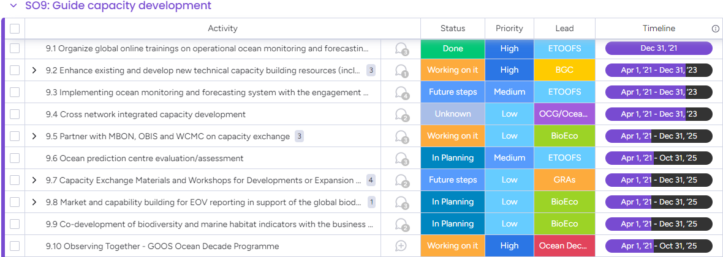
Actions
Develop capacity to ensure a broader range of beneficial stakeholder participation

Slide 3
Progress/Achievements 1
9.1 Organize global online trainings on operational ocean monitoring and forecasting system - ETOOFS
2 online workshops (> 272 participants from 65 countries)
Understanding the Benefits of Operational Ocean and Forecasting Systems ('Awareness Workshop’)
Implementing an Operational Ocean Monitoring and Forecasting Systems ('Hands-on Workshop')
9.2 Enhance existing and develop new technical capacity building resources (including online) - BGC
2 training courses ready to go
IOCCP/ICOS-OTC Biogeochemical Sensors Summer Course 3-18 June 23 (4 EOVs, 15 sensors, 50 people, 19 countries)
GOOD-OARS-CLAP-COPAS summer school 6-12 Nov 2023 (ocean deoxygenation and acidification; 40 students, 20 countries)
Ocean Acidification Data QC Online Tool
Draft decision tree for data QC’ers developed
Surveyed marine carbon data QC practitioners to establish inventory of existing tools.

Slide 4
Progress/Achievements 2
9.3 Implementing ocean monitoring and forecasting system with the engagement of GRAs - ETOOFS
ETOOFS developed a guide for supporting implementation of the ocean monitoring and forecasting system and reported about this tool to the GRAs
9.4 Cross network integrated capacity development - OCG
Participation in capacity building initiatives ( Wave drifter pilot deployment to Solomon Islands, DBCP/SOT CB workshops, bilateral pilots on instrument donations)
Participation with WMO/SOFF to develop specifications for surface drifters and weather stations in EEZs.
9.5 Partner with MBON, OBIS, WCMC on capacity exchange - BioEco
BioEco Panel includes OBIS Project Manager, MBON leads, ensuring links. Existing partnership agreement to be refreshed as a GOOS-OBIS-MBON MOU
Early career scientist from diverse backgrounds identified or included as EOV co-leads (TBM, Corals) and Panel members

Slide 5
Progress/Achievements 3
9.6 Ocean prediction centre evaluation/assessment - ETOOFS
ETOOFS initiated cooperation with the OceanPredict scientific group (oceanpredict.org) in the frame of the UN Decade to import and document evaluation/assessment metrics and best practices.
9.7 Capacity Exchange Materials and Workshops for Developments or Expansion of GRAs - GRAs
A special GRA meeting was organised in late 2022 to showcase the ObservingTogther project, with a second presentation of the program during the first GRA Council meeting in Feb 2023
9.8 Market and capability building for EOV reporting in support of the global biodiversity framework indicators and assessment - BioEco
BioEco Panel co-chairs looking at potential attendance at the GRA Forum to discuss emerging BioEco networks and further facilitate uptake of BioEco EOVs into GRAs.
Notes:
9.10 - no info
9.9 - raising awareness on observations and indicators at COP15, CBD engagement to provide input to their indicators task team.

Slide 6
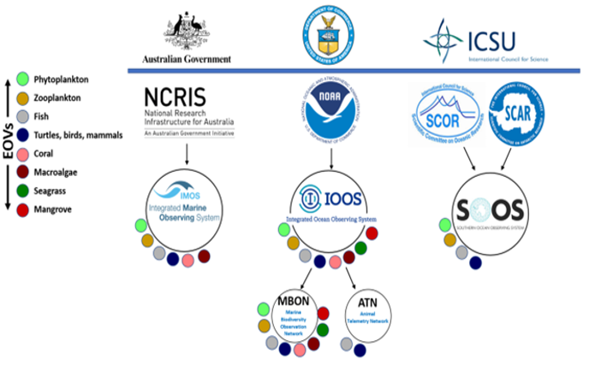
Progress/Achievements 4
9.9 Codevelopment of biodiversity indicators - BioEco
Engagement in Convention on Biological Diversity (CBD) COP-15 - development of the Kunming-Montreal global Biodiversity Agreement
Nomination of GOOS representatives to indicator development working group?
9.10 Observing Together - Decade Programme
Nothing reported
Notes:
9.10 - no info
9.9 - raising awareness on observations and indicators at COP15, CBD engagement to provide input to their indicators task team.

Slide 7
Outcomes & Assessment
No. | SO9 Outcomes | Assessments
1 | A greater number of countries actively participating in the global ocean observing system | Progressing (on-track) good developments with Indonesia, and Central and South America. Post COVID improvement from Asian contributors
2 | A greater number of countries with capabilities in ocean forecasting | Progressing (on-track) ETOOFS and OceanPrediction Decade Collaborative Centre started an inventory of ocean forecasting centres worldwide
3 | New best practices and data products addressing the needs and capacities of increasingly diverse participating countries | Progressing (on-track) increase in number of BP documents submitted in OBPS with 7 GOOS Endorsed BP
Notes:
Indonesia is definitely the new interesting contributor with a truly GOOS integrated perspective (floats, drifters, weather stations, HF radars, gliders), funded by the French Development Agency and implemented by CLS for BMKG. Central/South America is another interesting development supported by the GRASP and WMO/IOC regional offices. Data distribution according to international standards is the main barrier to overcome. To be noted that the COVID impacted the Asian contributors to the GOOS and there is now an improvement.
3) A total of 1815 documents submitted in OBPS repository, with 7 GOOS endorsed best practices

Slide 8
Gaps
What is the GOOS niche?? Define GOOS role in capacity development (CD) and how it relates to other programs and organisations
What activities should GOOS actively lead - when should GOOS partner with organisations dedicated to CD?
A clear program level strategy for broad engagement with IOC and external efforts, including for CD
IOC Capacity Development Working Group
IOC Ocean Teacher Global Academy
POGO
UNEP -WCMC
GEOBON/MBON
Notes:
Can we ID capacity development needs to discuss with potential partners, e.g. eDNA, cross network instrument related collaborations, best practices, data management, other?
What other areas can GOOS ID CD needs?

Slide 9
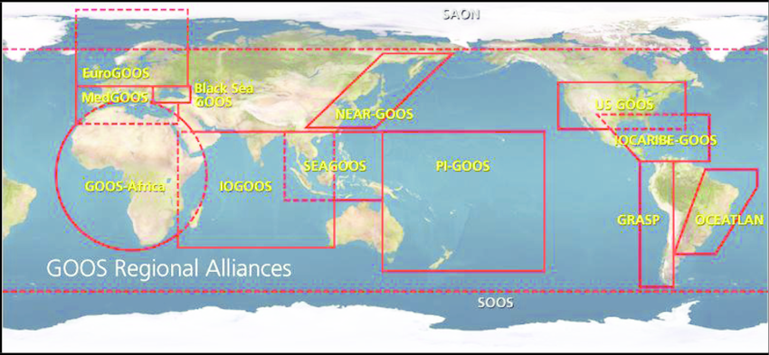
Gaps
Clear plan for GRAs to engage across GOOS components to improve monitoring and implement capacity development at national and regional level
A mechanism to strengthen links across Panels and GOOS programs, projects and networks, including GRAs
Support for activities and communication
‘Onboarding’ materials for new Panel members, participants in other GOOS components
Map out EOV connections/links to strengthen cross-panel exchange
Link GOOS Strategy implementation, GRAs, and GOOS components to identify activities where we can work together

Slide 10
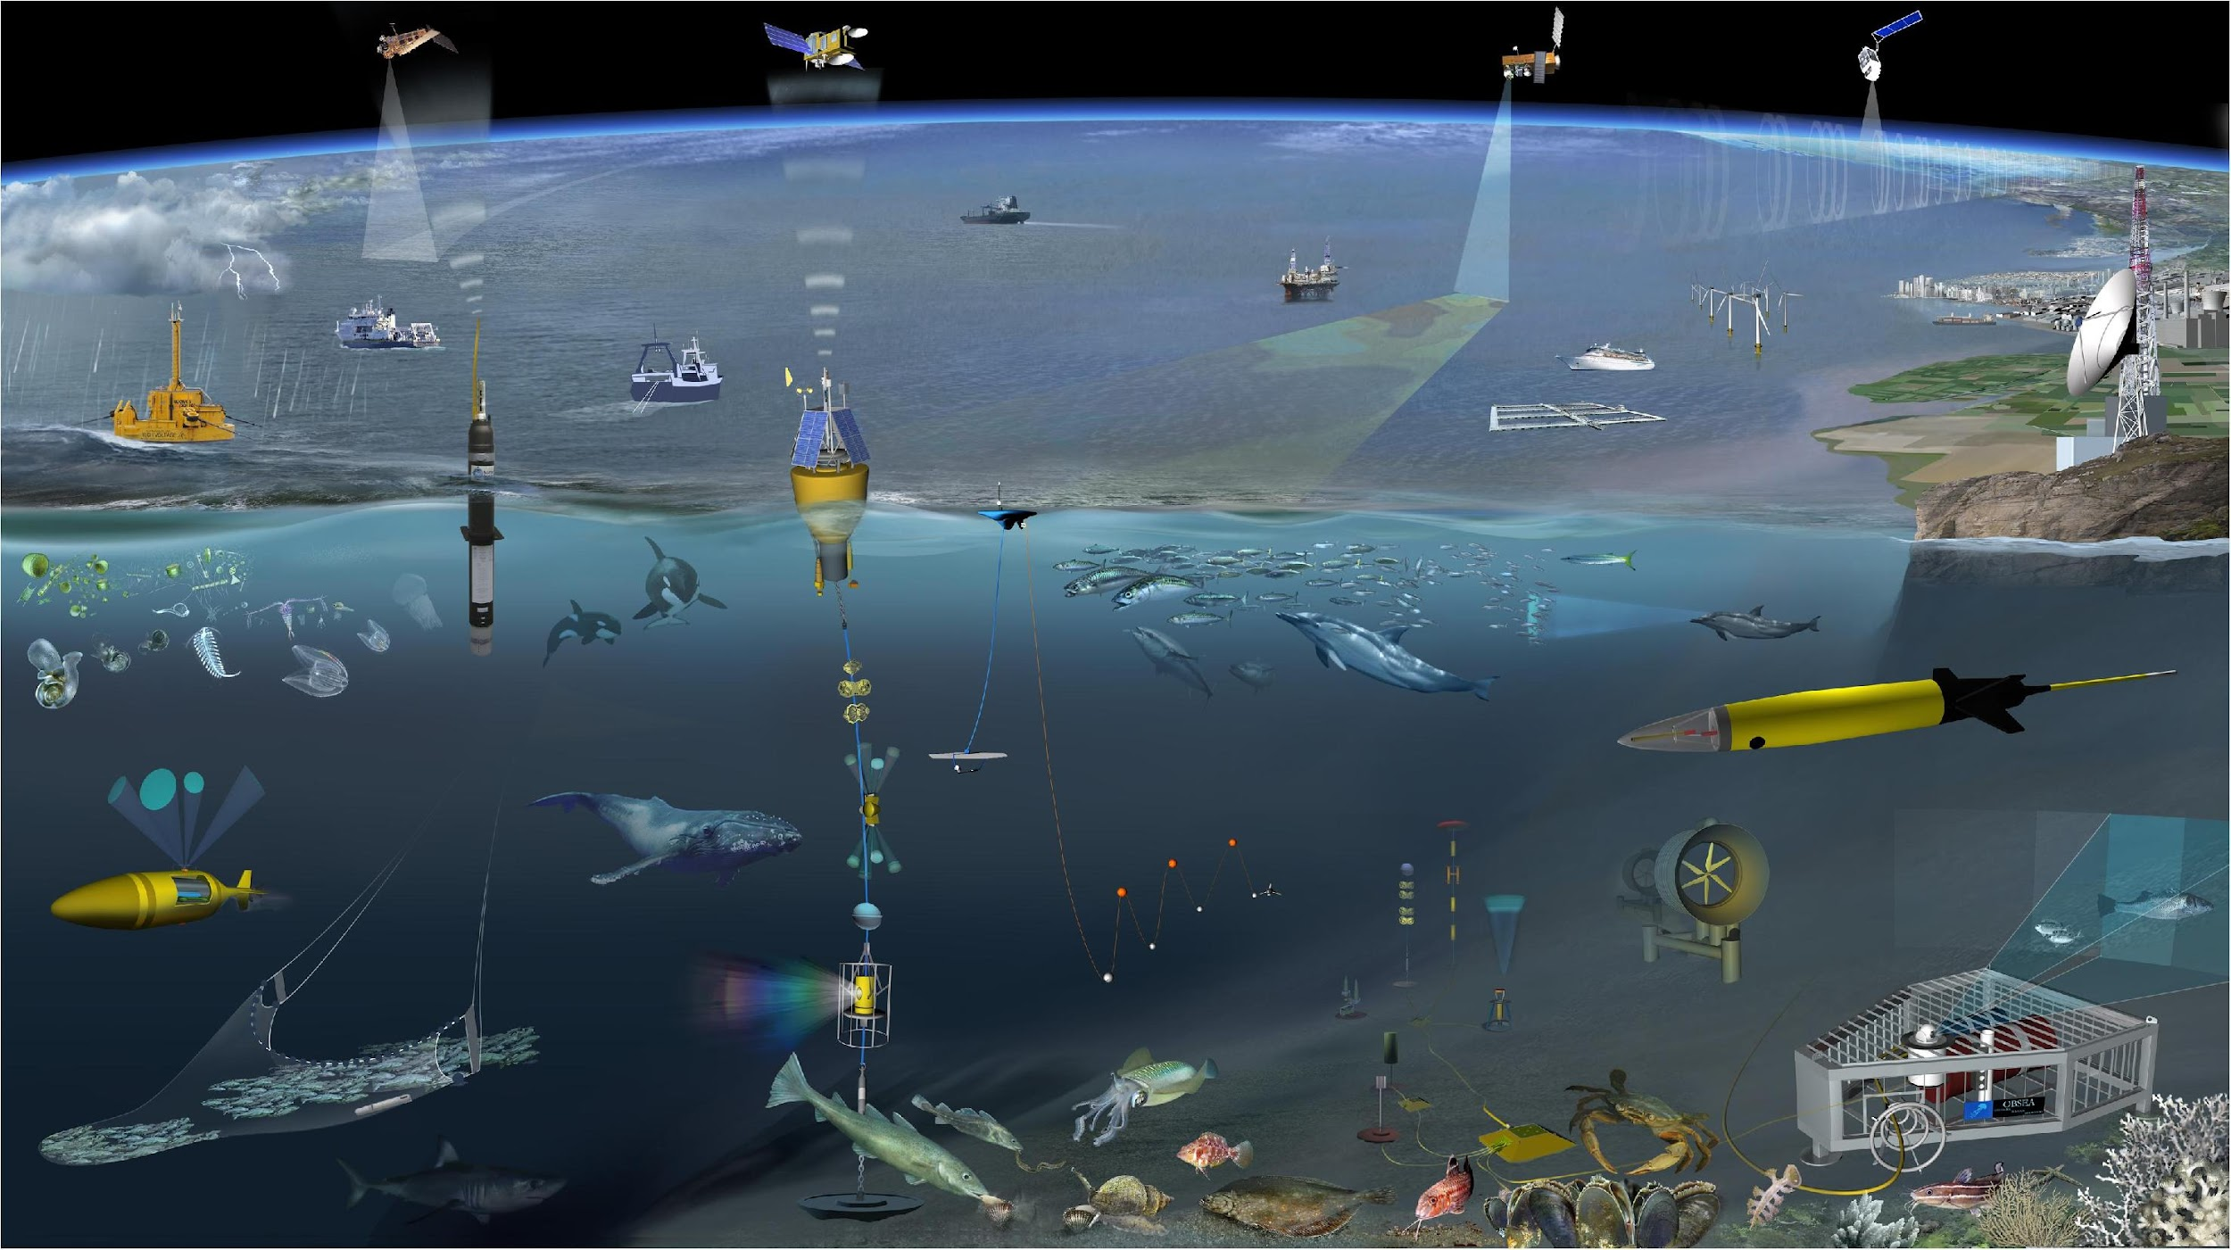
Next/Future Steps
Develop and coordinate GRA activities to facilitate uptake of EOVs, implement ETOOFS guide
Identify partnerships to build capacity
Develop a GOOS engagement strategy with external programs/organisations, including for CD (eg IOC, WMO/SOFF, UNEP/GEMS, POGO, GEO, others)
Establish/improve mechanisms to strengthen links between GOOS panels, components, projects and GRAs
Engage Decade programs to advance GOOS CD objectives

Slide 11
Resources required
Funding to:
Participate in capacity development activities: e.g. funding for instruments, testing of technologies,training workshops
Support Panel expert contributions to CD, including EOV workshops, meetings and IPO support
Potential sources:
Through projects e.g. Horizon Europe
IOC mechanisms (Regional Network of Training and Research Centers on Marine Science, Ocean Teacher Global Academy, others?)
Notes:
OceanOPS participates in the capacity building initiatives (DBCP/SOT CB workshops, bilateral pilots on instrument donations).
It participates as well in the WMO/SOFF specifications where surface drifters and wether stations will be considered (in EEZs only).
The main blocking points in that space is to get instruments funded to start tangible co-operations.
The SOFF mecanism could enable some side opportunities on the short run (as the inclusion of ocean onto GBON will take time).
Odyssey project is also the context to identifiy champions to fund instruments ( MAERSK, MSC, etc).

Slide 12
Thank you
goosocean.org

