Slide 1

GOOS Office
Emma Heslop
Act. Director GOOS Office, IOC/UNESCO
GOOS 12th Steering Committee meeting 25 - 27 April 2023

Slide 2
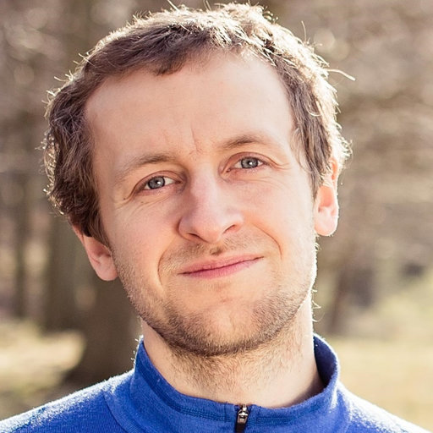
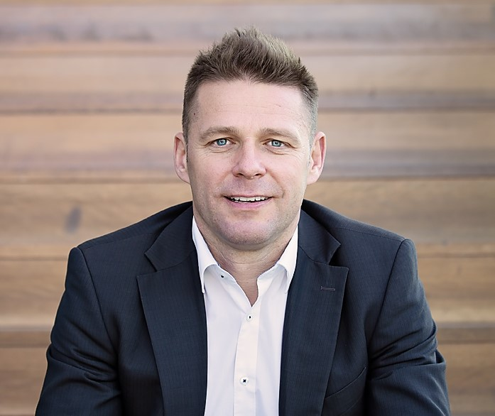
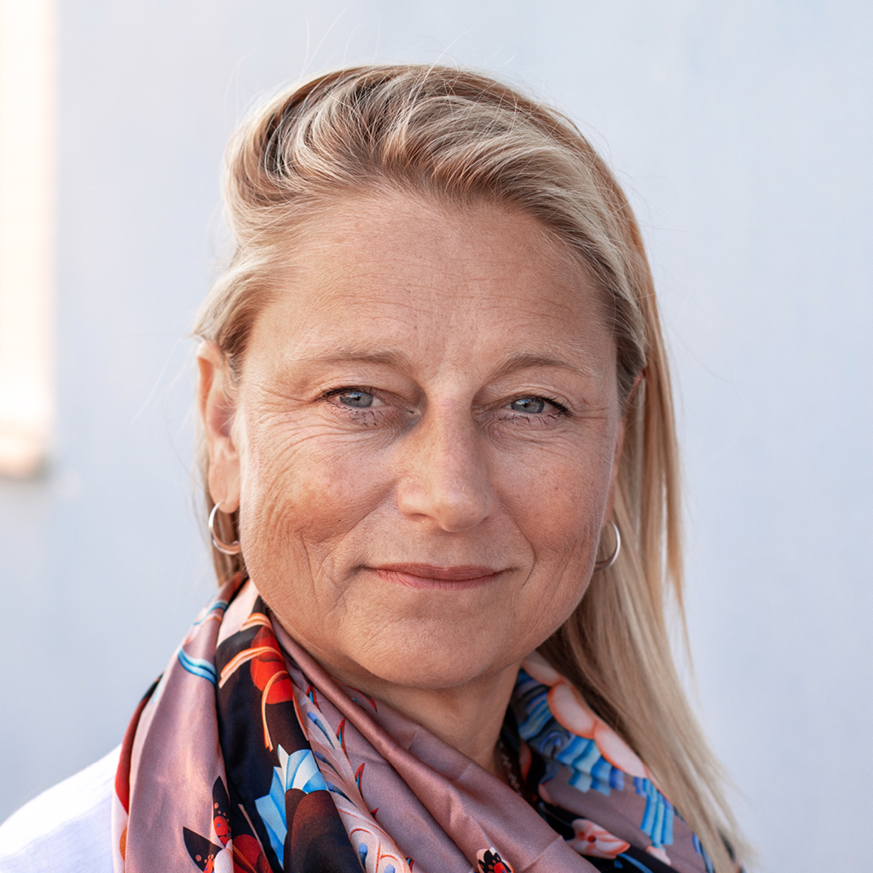
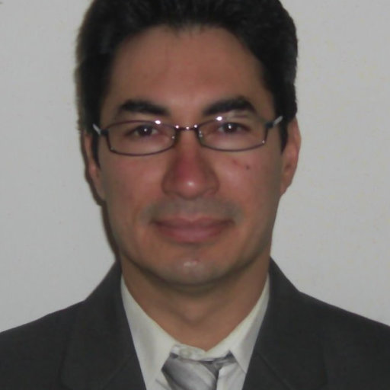
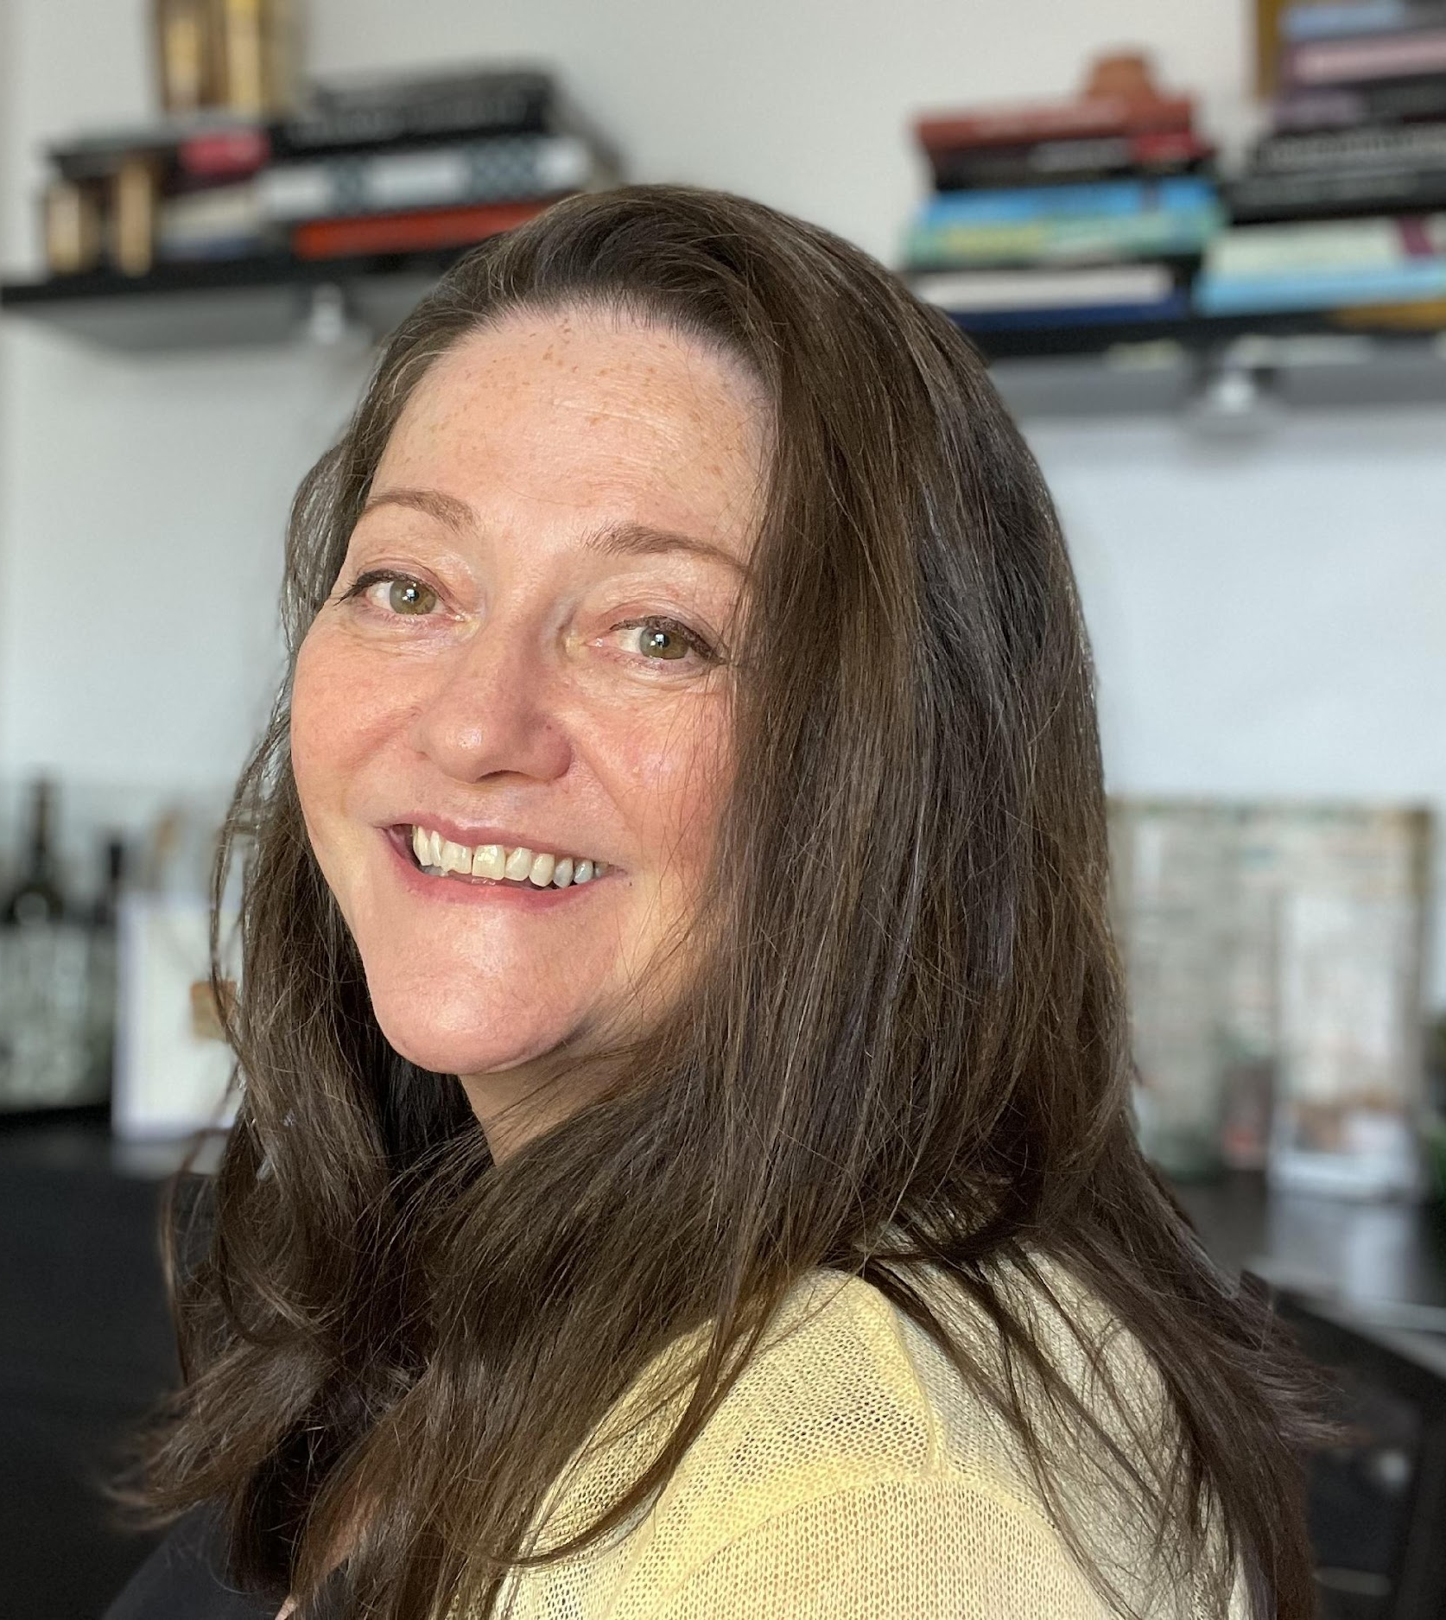
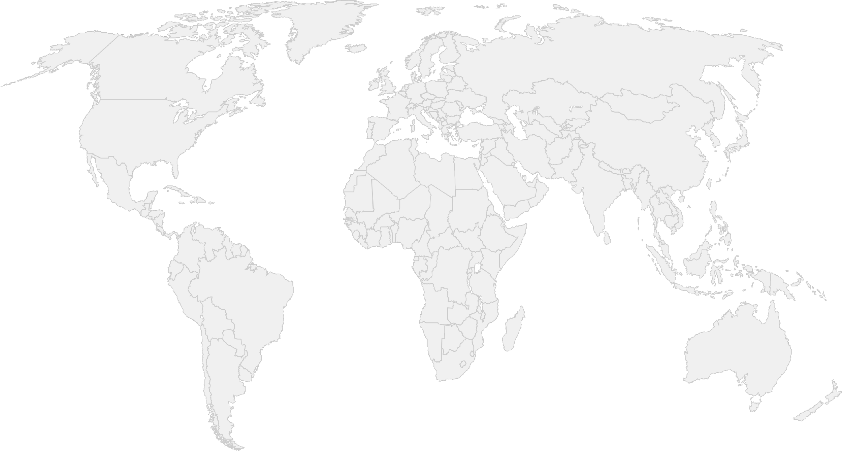
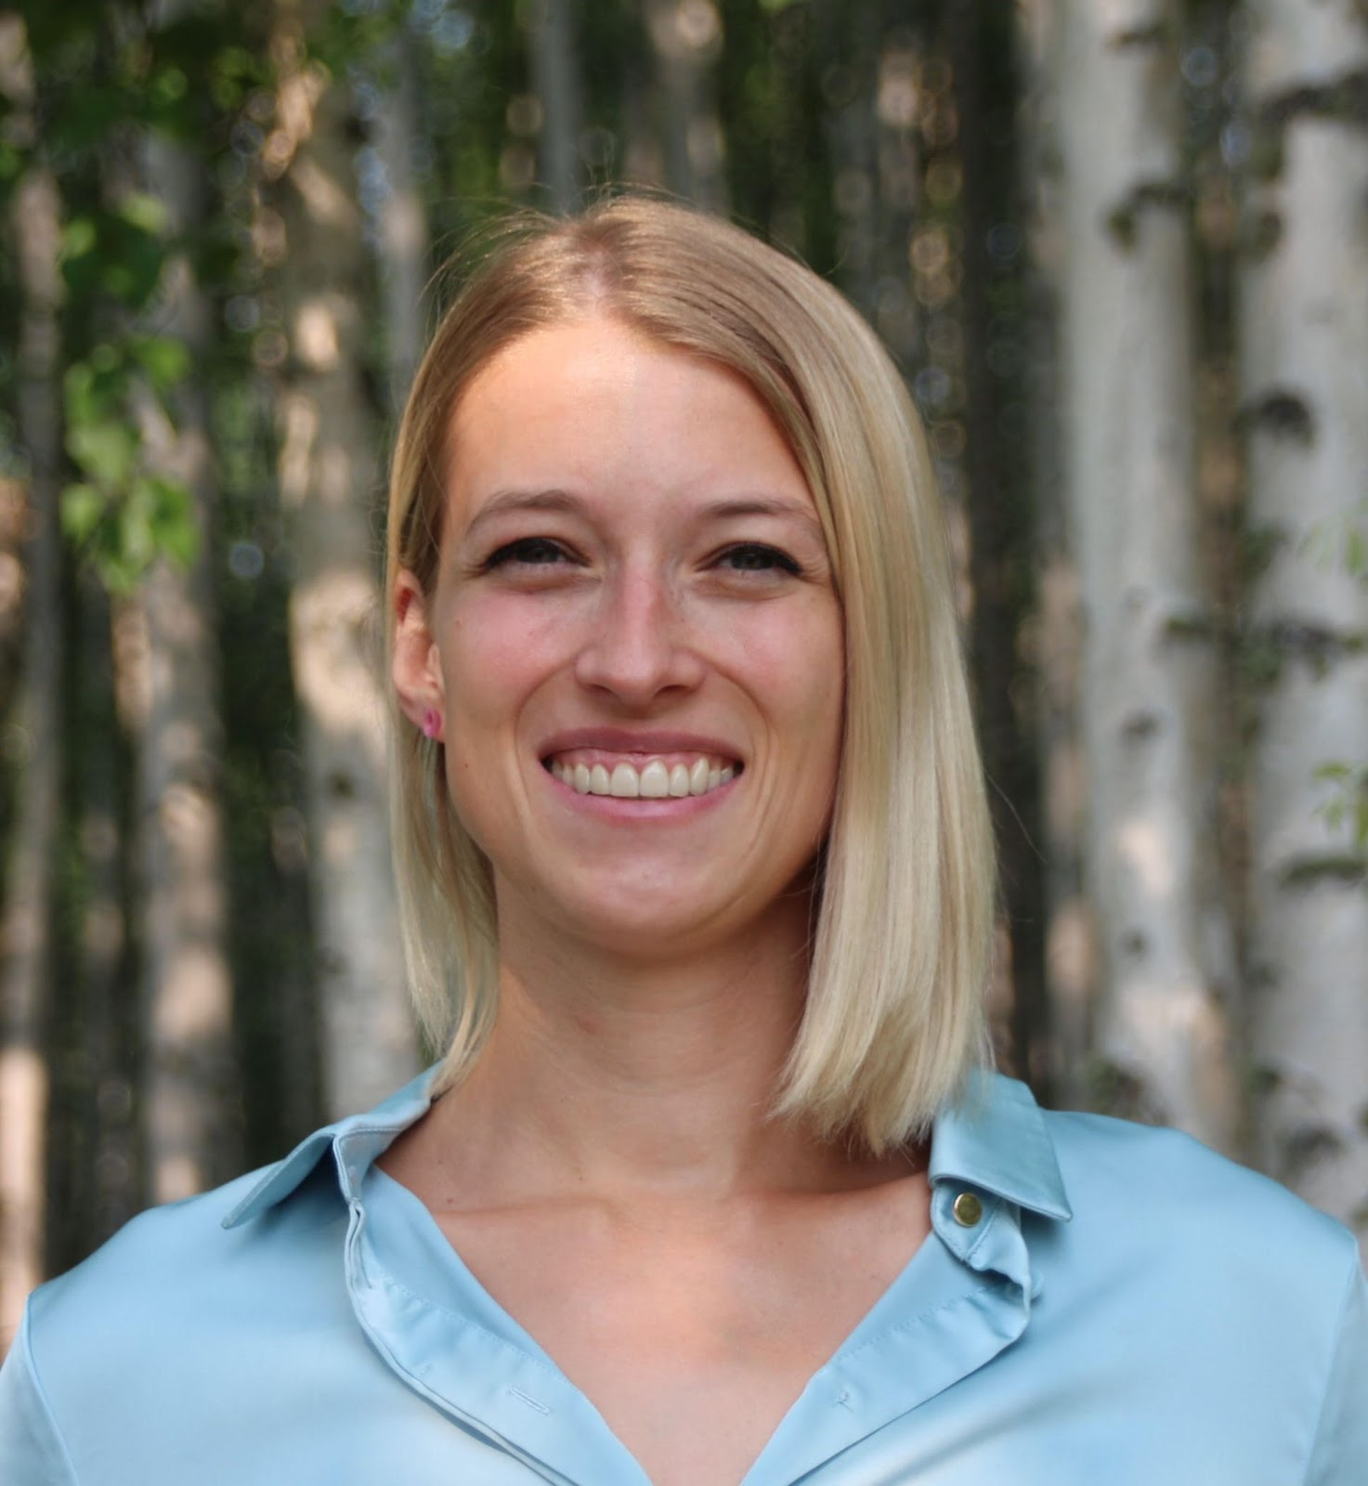
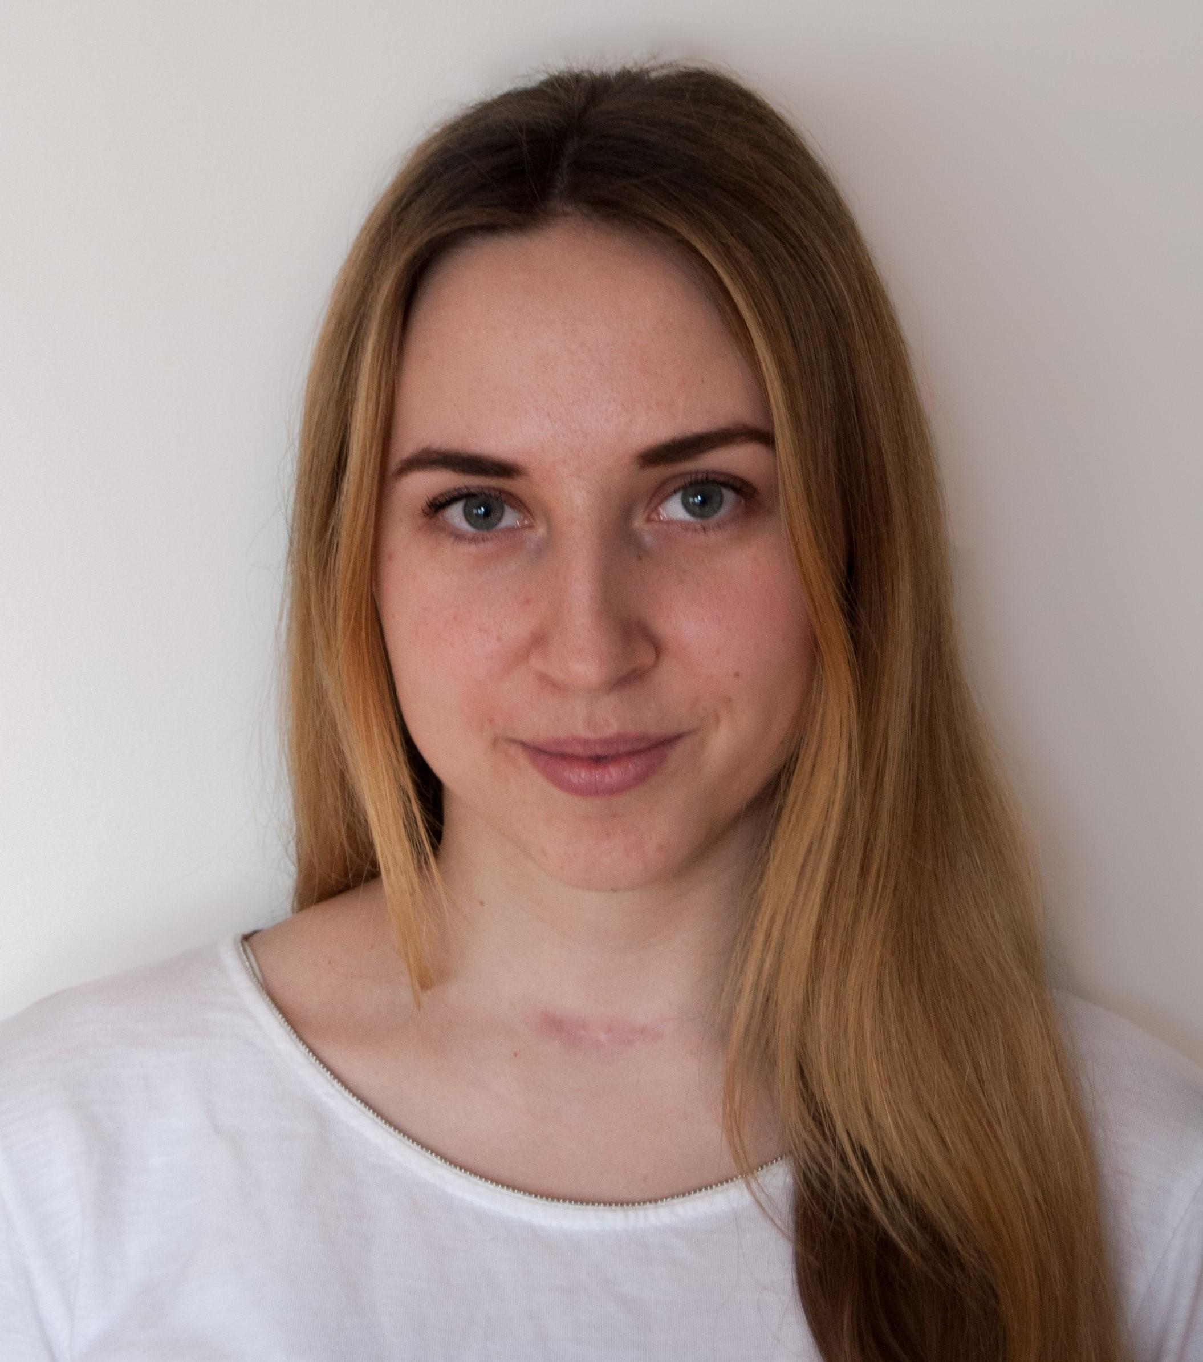
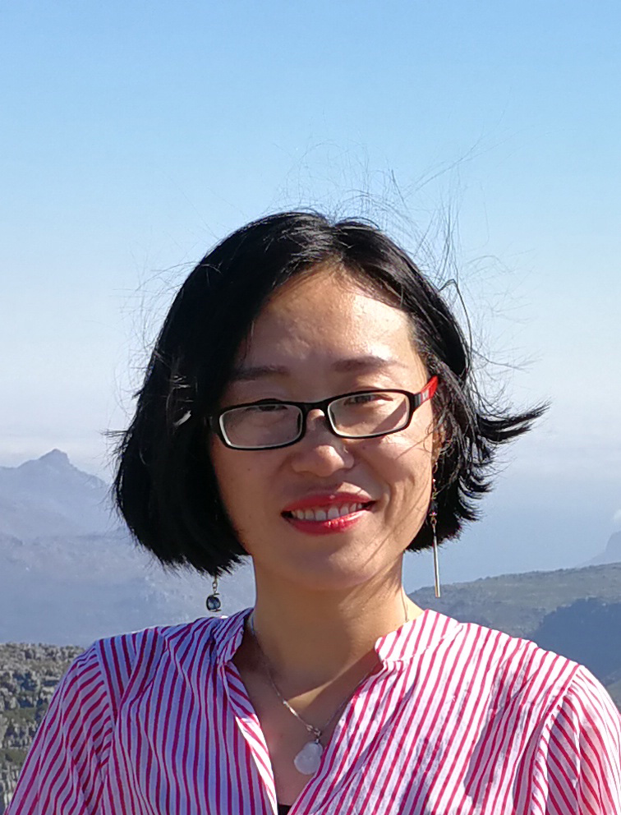
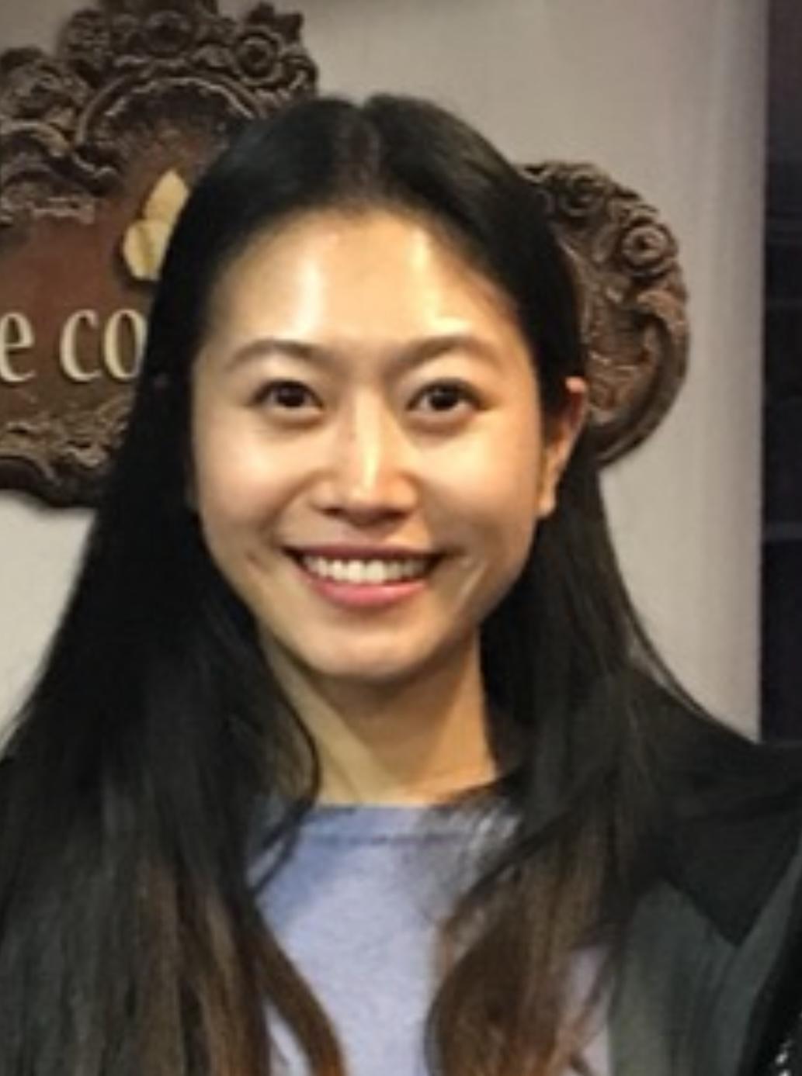
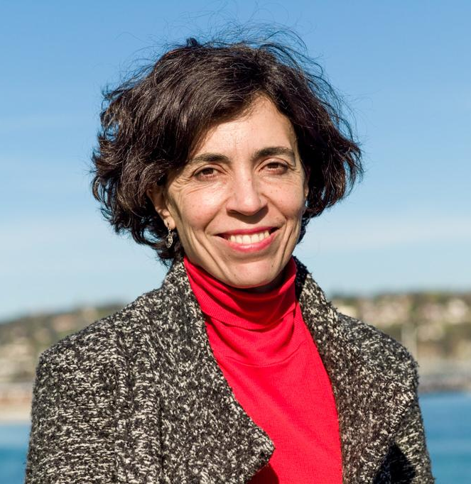
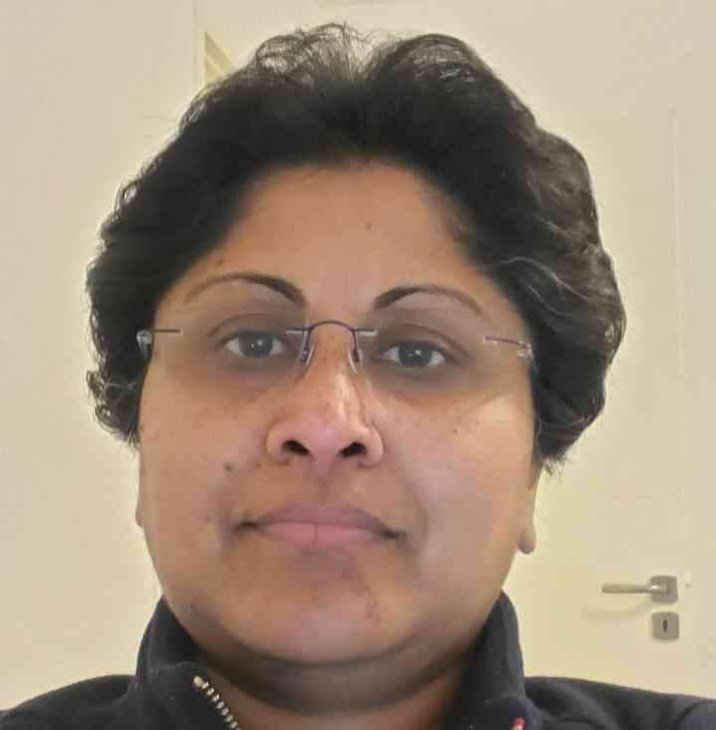
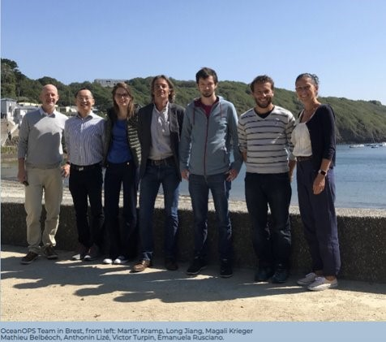
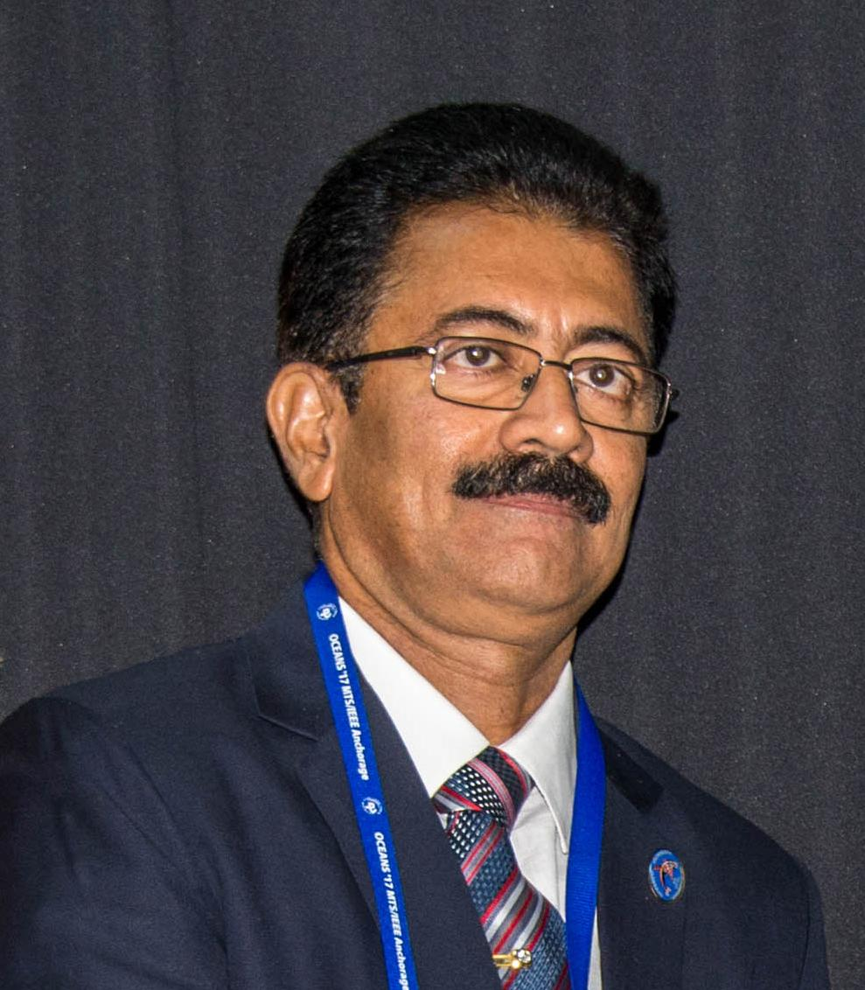
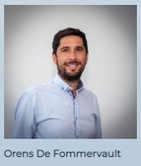
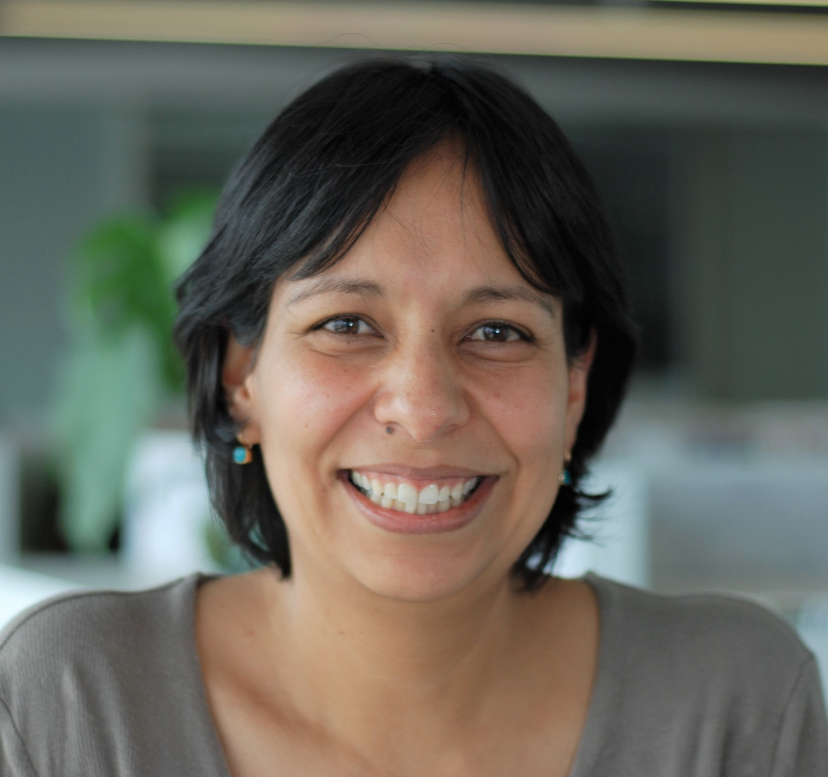
GOOS Office Team
Artur Palacz and Maciej Telszewski
IOCCP, Sopot, Poland
BGC Panel
Ann-Christine Zinkann,
NOAA, US
OCG, Co-Design, GOOS Projects
Laura Stukonyte,
Barcelona, Spain
GOOS Communication,
Emma Heslop, Denis Chang Seng, Forest Collins
Yu Ting, and Yaeji Baek
GOOS HQ in Paris, France
GOOS, ETOOFS, GRAs, OCG, DCO
Belen Martin Miguez, and Champika Gallage
WMO headquarter in Geneva, Switzerland
OOPC and OCG
R Venkatesan, GOOS consultant, India. NFP
OceanOPS team in Brest, France
From left: Martin Kramp, Long Jiang, Magali Krieger, Mathieu Belbeoch, Anthonin Lize, Victor Turpin, Emanuela Rusciano
Ana Lara-Lopez
BioEco, Hobart, Australia
BioEco Paneel
Notes:
21 people - supporting the work of GOOS

Slide 3
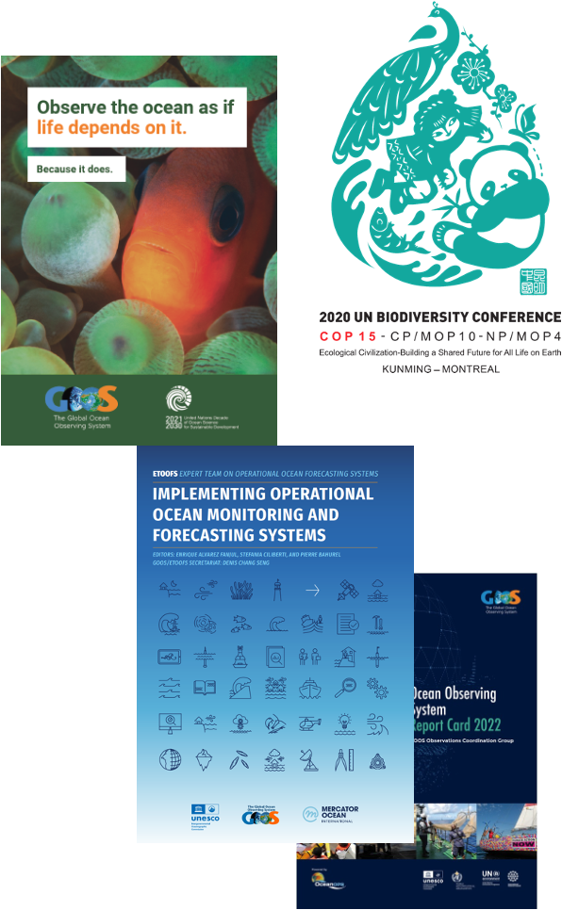

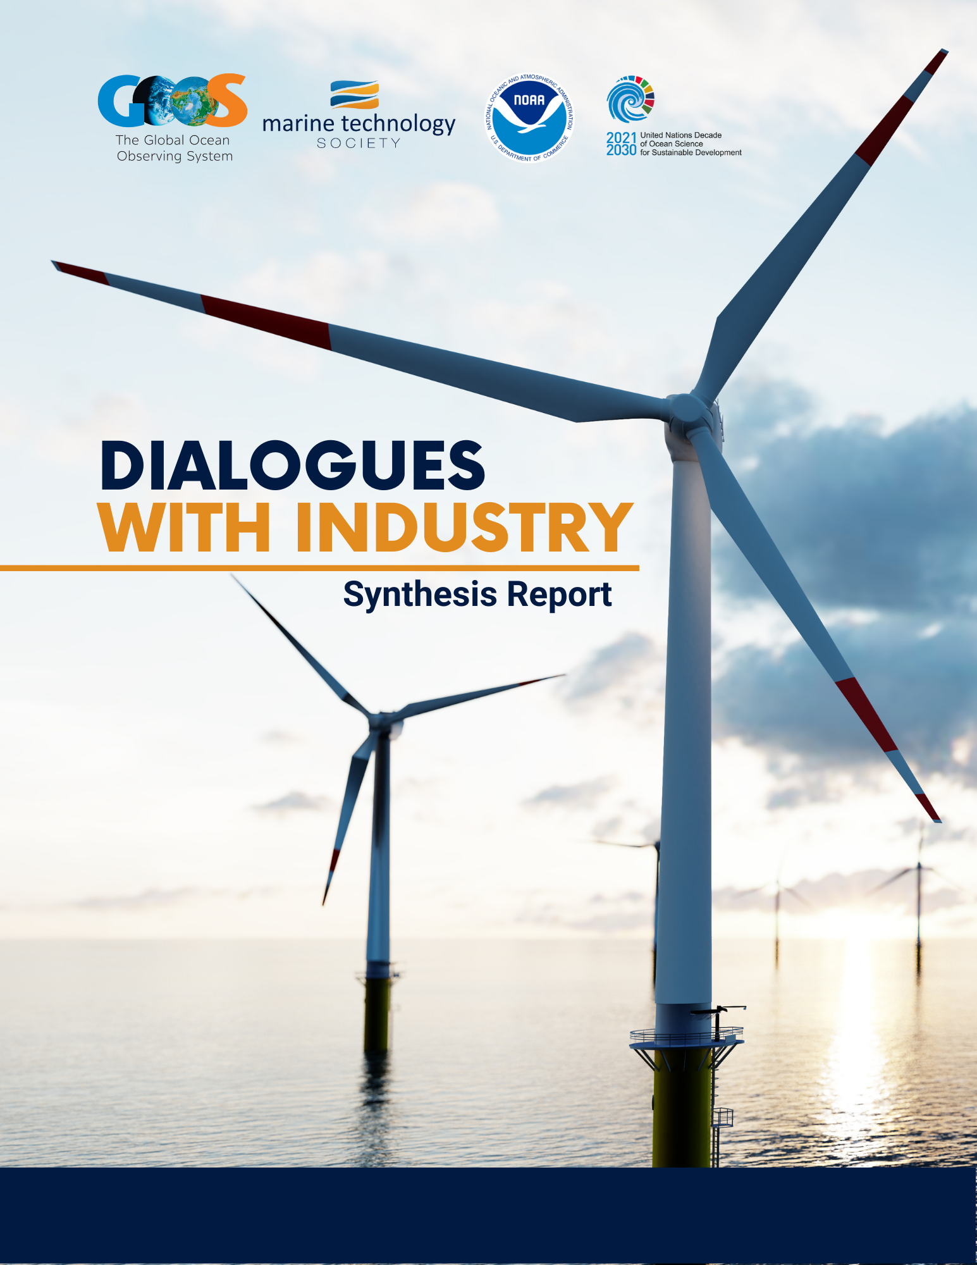

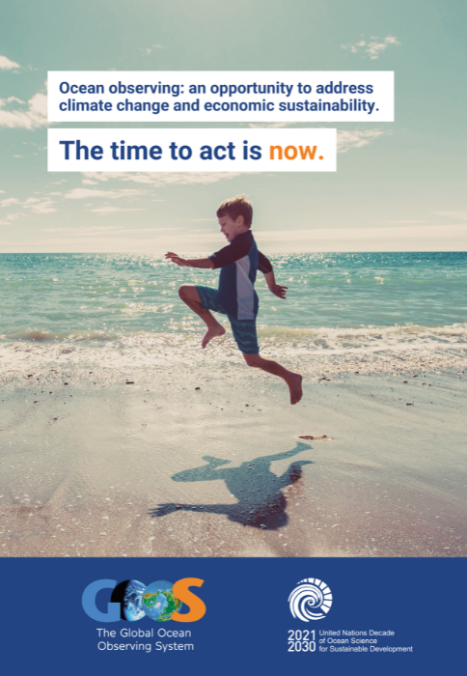
Focus and successes
Comms & Advocacy across the UN
EOV Paper - nearing completion
Regional - Pacific Islands, Caribbean, Africa, Arctic
GOOS & MTS & NOAA Dialogues with Industry
OECD & GOOS Value of Ocean Observations Paper
NFP - re-activated and moving forward
WMO - RRR and other interactions
IOC - IODE, MSP, OSS, Member States and UN
UNESCO Hosting Agreement Sorbonne - OceanOPS
GOOS IP / Actions in Monday - for the first time reporting out to the GOOS SC Objectives
EuroSea important steps integrated with GOOS
Ocean Decade Programmes & DCO
Notes:
Change
Comms
Advocacy
NFP
Relationships
Thought Leadership

Slide 4






Co-Design Exemplars
*Each exemplar is at different levels of maturity
The Ocean Carbon Cycle
Improving carbon data to inform climate targets, such as net zero
Tropical Cyclones
Advancing tropical cyclone forecasting to save lives & property
Storm Surge Improving predictions to minimise impacts on vulnerable communities & natural resources
Marine Life
Conserving marine biodiversity and supporting sustainable use of resources
Boundary Currents
Understanding key current systems that significantly influence productivity, weather and climate
Marine Heatwaves Monitoring marine heatwave impacts on biodiversity and economies
Notes:
In general each exemplar will follow a similar development path. From the basics of initiating communications and a co-design process (engaging users, describing the value chain, etc) to full-scale globalizaiton of their intended activities.
Different exemplar areas are at different readiness levels - some will mature to implementation within a year, others will need longer to determine the design and the value - often down to the maturity of the sector and the service - e.g. tropical cyclone forecasts are well connected to users - we are increasing the accuracy, but for carbon, and marine resource management the services do not yet exist.
They all share in common the common purpose of developing tools/diagnostics, and best practices and demonstrating their effectiveness through pilot projects that, if successful, could then be scaled to a more permanent and global scale system.
NEXT SLIDE
======================================
- requiring alignment and investment - to deliver design for obs & recommendations for models and services (connected chain)
Work out scaling too…..
GOOS synthesises recommendations
Linked to observing projects - programme/GOOS
At same time programme is developing over the next 1-4 years
tracking and reporting capability
Developing infrastructure - DCCs, DCOs, GOOS, WMO connecting to other processes (RRR), and UN Policy, GCOS
Develop knowledge for best practice - deliver this for more exemplars - global and regional scale
Work on cultural change…
Where will we be at 5 years?
X exemplars?
System lifted in key areas
Ability to now test the system for needs - WNO others,
New exemplars - perhaps even regional/ local to lift the system
Expanded testing facility with ability to access for GOOS Projects,
Links between prediction and observing firmly established, assessment of value routinely undertaken
AT 5 years - ASSESS - what need to do to move from exemplars to systemic - size of any core facility/management… is it even needed

Slide 5
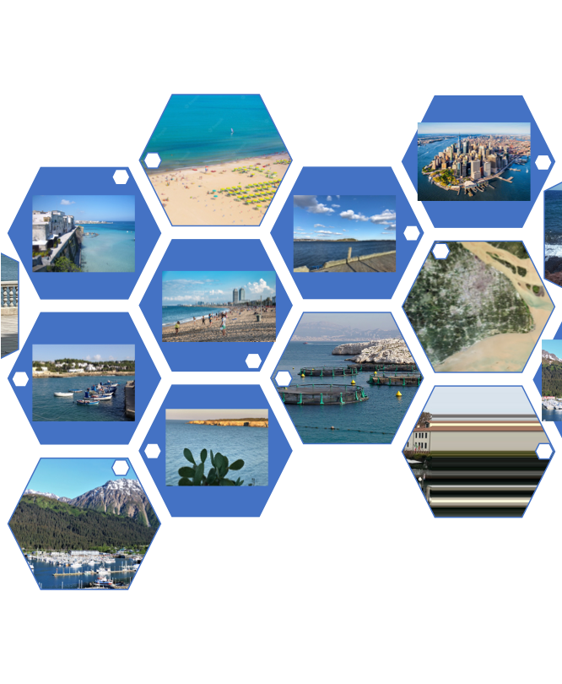
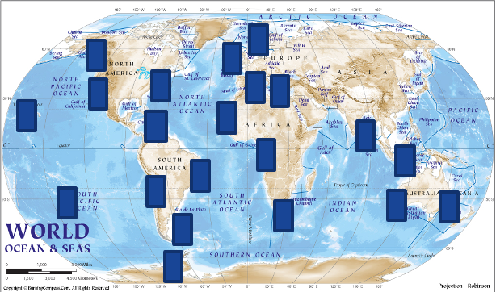
Global Coast
Area with different coastal features, societal needs, and level of development - same backbone
Global Coast - 4-6 sites, variety of coastal features, societal needs, existing infrastructure
Developing services, advancing science/capability, testing new tech
Common data and best practice backbone
Notes:
Revolutionising Global Coastal Ocean observation and forecasting and offering open and free access to coastal information

Slide 6
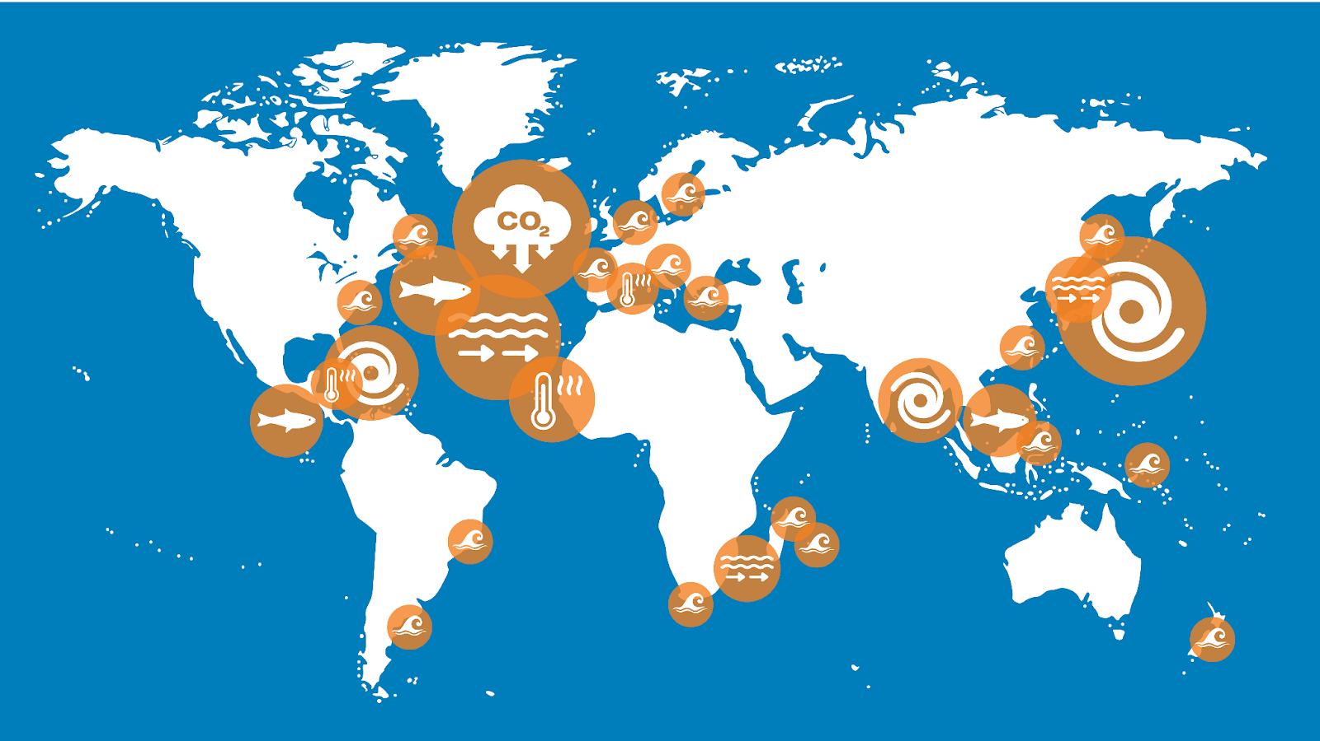
Pilot Areas
Tropical Cyclones - 3 Boundary Currents - 2
Ocean Carbon - 1 Storm Surge - 10
Marine Heatwaves - 6 Marine Life - 2

Slide 7
IOC Assembly
Notes:
Ocean Observing has made great progress… BUT not sufficient for societies current and future needs but
Right now, we are driving into our future in darkness. And GOOS aims to turn on the headlights.

Slide 8
IOC Assembly June 2023
GOOS Work Plan: IP Summary based on SO reports and SC priorities
  Decision: Adopts the GOOS GOOS Implementation Plan Summary 2024-2025 as the GOOS work plan for 2024–2025;
EEZ: Report on GOOS Network Survey and member states feedback
  Decision: Decides to establish an ad-hoc working group to consider the outcomes of the Summary Report and make recommendations for action to IOC EC-57 in 2024
GCOS IP and Joint WMO-IOC-UNEP-ISC Review for GCOS: Summary GCOS IP and Review
  Resolution: Endorses the conclusions of the 2022 GCOS Implementation Plan (GCOS-244, GOOS-272) and the 2022 GCOS ECVs Requirements (GCOS-245);
  Decision: Requests the Executive Secretary 1) To prepare a revised GCOS Memorandum of Understanding (MoU) with the co-sponsors for approval by the Executive Council, based upon the draft MoU contained in the Joint Study Group Report,
JCB: Summary progress
  Decision: Asks the Executive Secretary to oversee the WMO-IOC JCB self-evaluation review of performance, and report back with the findings to IOC EC-57 in 2024

Slide 9
Team and Budget
Notes:
Really great progress all SOs

Slide 10
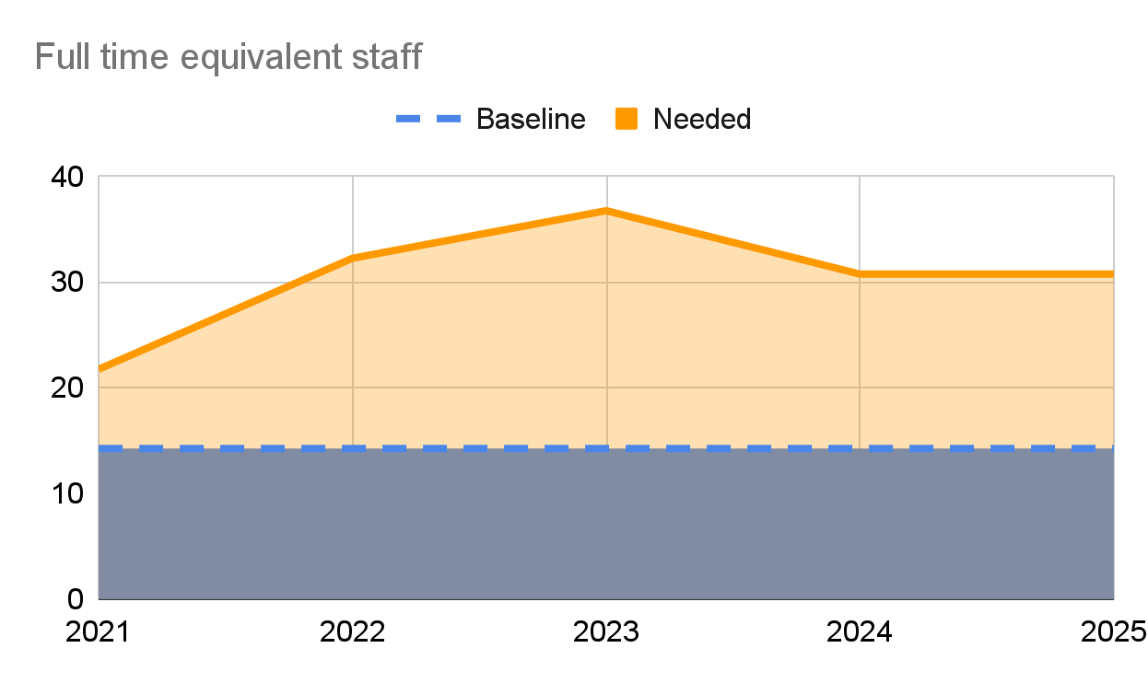
Resource as reported out to IOC 31 (2020) - GOOS first IP Report
Support structure today
distributed GOOS Office
supported by IOC, WMO (+1 in 2021),
USA (NOAA, NSF via SCOR),
Australia (CSIRO, AIMS),
EC projects, Monaco, EUMETNET, France,
Canada, China, Germany, Japan,
Italy, India, New Zealand, South Africa, and UK
Support needed
in full to advance with all Core Team Actions
14.25 full time equivalent staff
+280% in 2 years
Ostend
Brest
Sopot
Paris
Washington DC
Geneva
Hobart

Slide 11
GOOS Element | FTEs | Funding source | In-Kind | Location
HQ Office | 2.7 | IOC |  | Paris, France
HQ Office | 1.5 | Korea, Canada, China |  | Paris, France
HQ Office | 2 | IOC, EuroSea |  | Remote
OOPC | 1 | US 100% | Hosted WMO | Geneva, Switzerland
BGC Panel | 2 | NSF, SCOR, EuroSea, IOC | Hosted Poland | Sopot, Poland
BioEco Panel | 0.5 | EuroSea |  | Hobart, Australia
 | 0.05 | GOOS RP, CEAS Pegasus project, OBIS | Hosted Belgium | Oostende, Belgium
OCG | 1.1 | IOC, WMO, NOAA |  | Paris, Geneva, Washington DC
Networks | 0.6 | IOC, WMO, NOAA |  | Paris, Geneva
OceanOPS | 8 | National contributions from USA (68%), Monaco, France, Australia, Canada, China, Germany, Japan, Italy, India, and South Africa. Plus EU, IOC/GOOS, WMO and EuroSea. |  | Brest, France
ETOOFS | 0.25 | IOC |  | Paris, France
GRAs | 0.25 | IOC |  | Paris, France
Total | 20
Notes:
Squeeze on resources (missing 1 FTE for 6 months in 2022, 4 months 2023) - ambition of GOOS will require more staff at HQ or supporting HQ work
Few more in Ocean Decade programmes
Working on more

Slide 12
Budget information - IOC
Proposal for a Draft Programme and Budget for 2024-2025 (42 C/5) was submitted by the Director-General to the 216th session of the UNESCO Executive Board (10-24 May 2023)
Two scenarios are presented with respect to the regular budget::
Base Case scenario – + $30M for total UNESCO programme budget; +$2.2 million for IOC, which translates into + $1.6M for non-staff part of the budget. this in turn allows to significantly increase the non-staff budget for GOOS (ballpark figure 50%).
Zero Nominal Growth (ZNG) scenario = almost the same budget as currently
Review UNESCO Executive Board 217th session fall 2023, and final budget will be approved by the UNESCO General Conference in November 2023
The IOC Secretariat is currently finalizing its proposal for consideration by the IOC Assembly at its 32rd session, 21-30 June 2023. The document will be published shortly.
Given where we are in the budgeting process and the level of uncertainty as to the final scenario, the Assembly will be expected to review the proposal and provide guidance to the Secretariat on priorities and as to what programmatic areas to reinforce with extra funding available. The GC should do the same.

Slide 13
Looking ahead
Notes:
Really great progress all SOs

Slide 14
Looking ahead
  Lessons learned - balance effort and outcomes, some examples
EEZ issues
TT and Projects developed to address needs - actions grow with no additional support
WMO - SG OOIS, RRR entail additional work
  Increased focus
Evolve GOOS Governance
Resourcing/Fundraising
Strengthening and integration
Priorities to lift the observing system
Notes:
Strengthen mechanisms to bring recommendations to SC from TT and Projects - set priorities and seek support (new work needs to be supported)
Strengthen IP implementation Monday - GOOS Exec update and assess every quarter year
Ask GOOS Office to develop a structure assessment & human resources needs end 2023 (IOC funding clear) – assess core structure support (Panels, OceanOPS, OBIS BioEco work, and GOOS Projects, Partners, Fundraising, NFP) related to the objectives, and including visibility of the real in-kind resources (panels in kind support % people's time, NFP time….) current and future needs to support GOOS workplan ahead

Slide 15

Resource and fundraising
What
Big integrated asks - priorities - major GOOS projects that have more impact (many small asks difficult to handle) and bring funds that will support coordination and change
Concrete outcomes and transformation
Who
Support for core through sponsors and main observing system funders for now - evolve GOOS Governance TT longer term change, and GOOS NFP committees may also increase national commitment
Use loans and secondments to support areas of work at HQ
Approach philanthropic sector for core projects for change - e.g. GOOS Africa, Co-Design, work to identify projects and funders (started)
Engage green Funds/World Bank/Blue Funds - ensure understand the importance of ocean and ocean observing & to understand how nations could use these towards aligned infrastructure asks
Notes:
One person to fundraise?
Make the case for changes in funding to sustained and for ‘infrastructure’, should go alongside this, also make the case for culture change around recognition for collaboration and BP, make the case for vital public infrastructure

Slide 16
Strengthening and integration
  GOOS
Core Team - strengthen and integrate
Transparency in processes
Identify GOOS unique core value/work
IP implementation / Monday
  System - Goal 2 (SO5, 6, 7, 3)
EOVs
Data/metadata flow
Best Practices
Regional and national (GRAs / NFPs)
Integration - obs-modelling-services
Fit for purpose - connection users
Notes:
Squeeze on resources (missing 1 FTE for 6 months in 2022, 4 months 2023) - ambition of GOOS will require more staff at HQ or supporting HQ work
Strengthen mechanisms to bring recommendations to SC from TT and Projects - set priorities and seek support (new work needs to be supported)
Strengthen IP implementation Monday - GOOS Exec update and assess every quarter year
Ask GOOS Office to develop a structure assessment & human resources needs end 2023 (IOC funding clear) – assess core structure support (Panels, OceanOPS, OBIS BioEco work, and GOOS Projects, Partners, Fundraising, NFP) related to the objectives, and including visibility of the real in-kind resources (panels in kind support % people's time, NFP time….) current and future needs to support GOOS workplan ahead

Slide 17
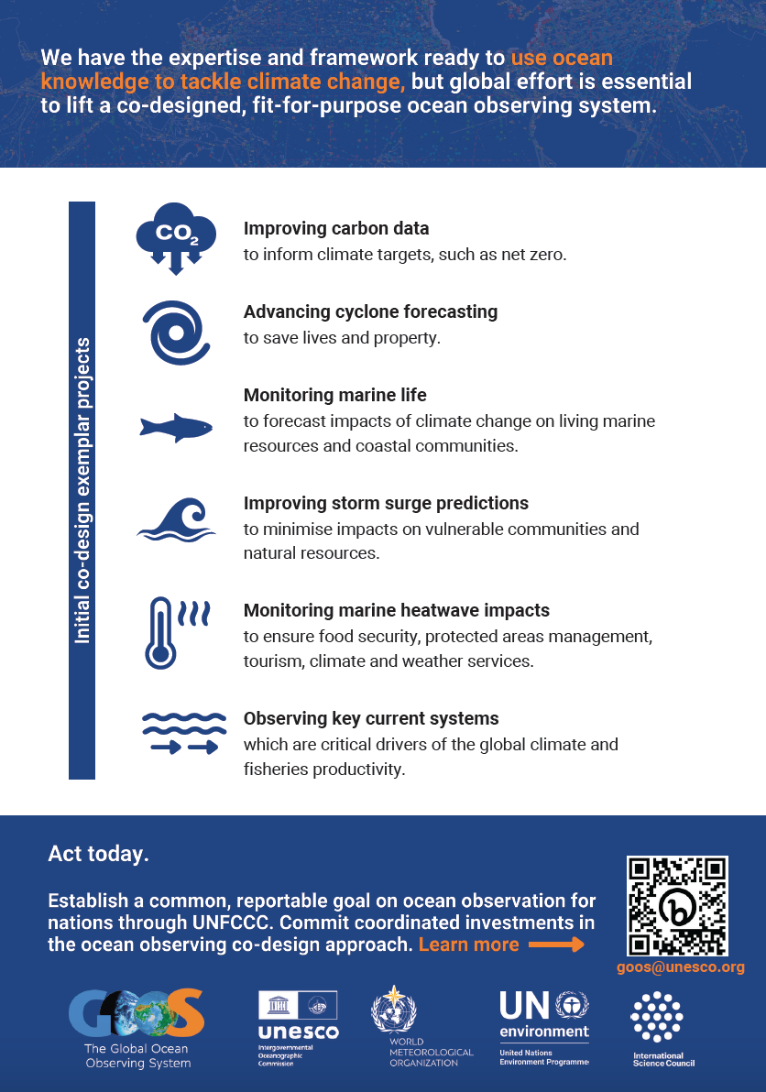
GOOS priorities for lifting the observing system?
Why?
Impact - inspiring ambition that can be measured
  Implementation Roadmap articulates areas in IMPACT Section
  Co-Design & CoastPredict focus on many of them
GG+A work and other interaction with funders shows that we need powerful messaging about impact/benefit for society
  Co-Design set 6 areas - we are using these by default in messaging for COP etc. give tangible impact
We are asked by G7, EC, others priority areas for investment/action
Galvanise collaboration between nations - NFP, GRAs
Alignment in funding for impact
Foci for big ask projects, brings coordination funding at the same time
Focuses GOOS work with tangible impact
Integrate needs GCOS climate / RRR / GHG etc
Notes:
Priority areas to focus effort to lift ocean observing system capacity - creating & measuring impact
Limited in number 5 or 6?
Set for limited duration 3-4 years duration
Strongly linked to societal need
Could GOOS SC agree such areas and set with input Panels, GCOS etc.
Take from the Implementation Roadmap and review/synthesise

Slide 18
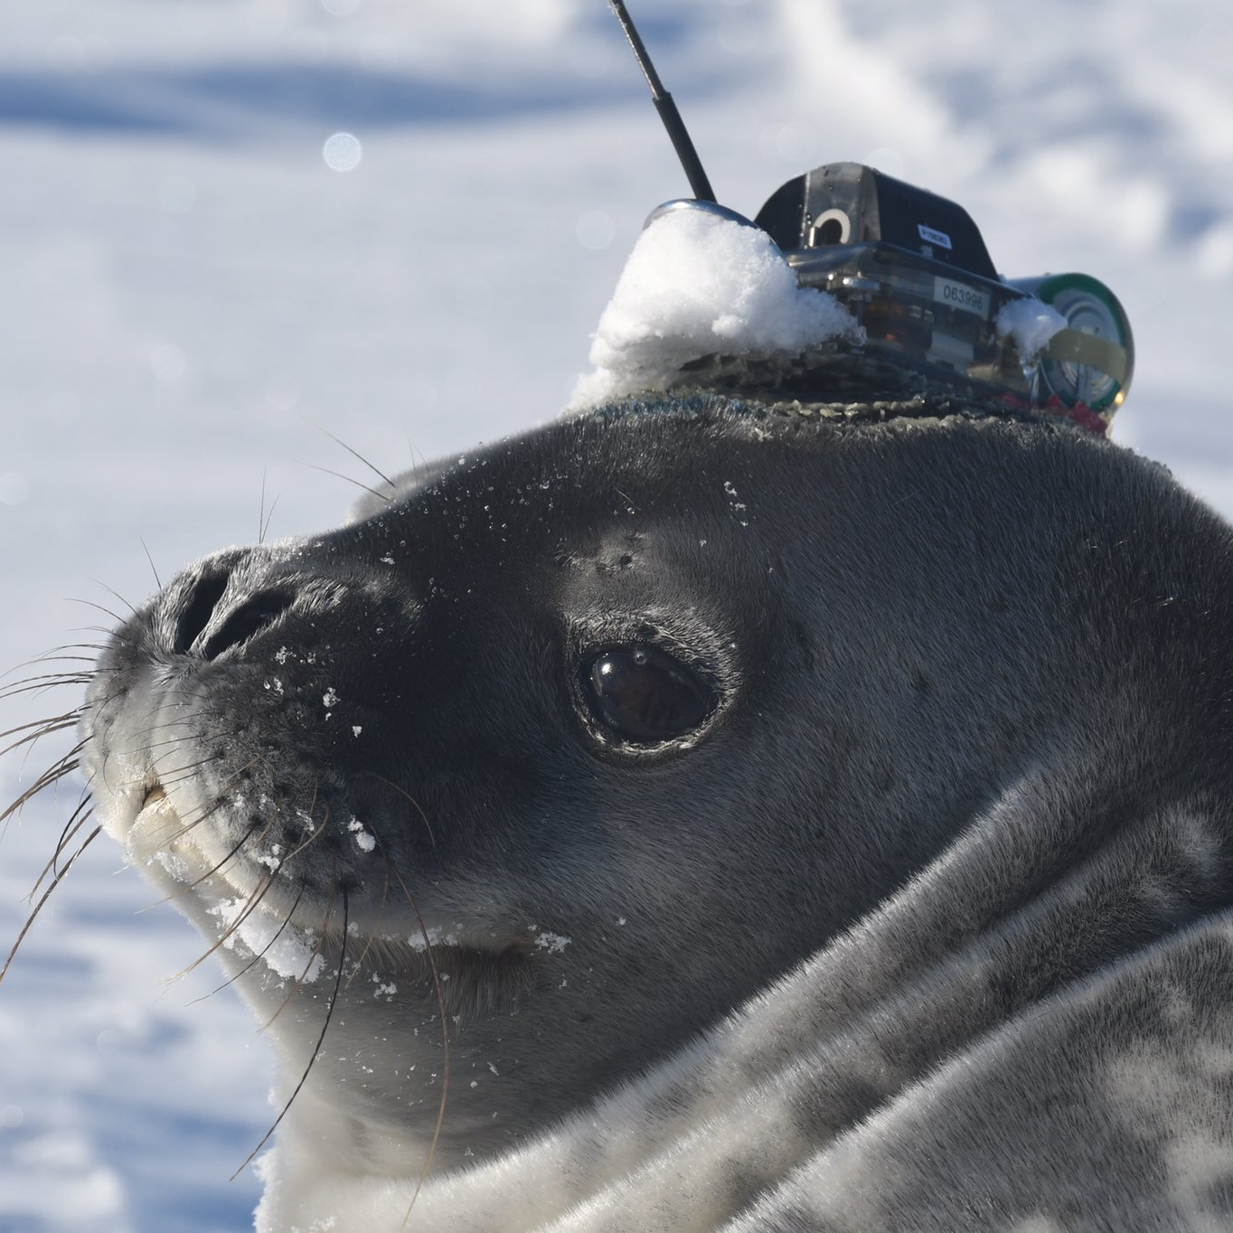
Thank you
goosocean.org

