Slide 1
GOOS NFP Updated ToRs
Ramasamy Venkatesan (Venkat)

Slide 2
ToR Update Process
2017
2019
2021
Jan
2023
Mar
2023
Apr
2023
CL 2666
Task Team
Recruitment
CL 2931
SC-12
2030 Global Ocean Observing System Strategy
Request for designation or update of NFP
Task Team formed as a response to SC-9
NFP ToR updated
GOOS NFP Consultant newly joined
Circulation of ToR draft
Feedback on ToR and update of NFP nomination
Submission for approval of GOOS SC
Prompted GOOS SC to consider the role of NFPs

Slide 3
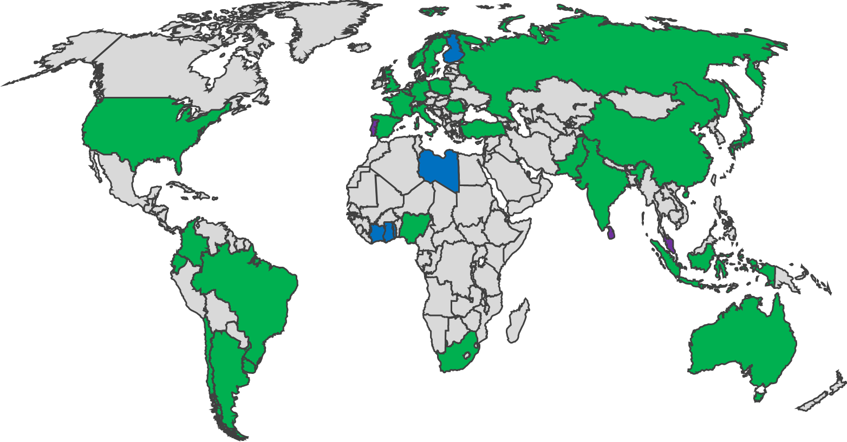
GOOS National Focal Points – responses to CL
35 Responses
Argentina
Australia
Belgium
Brazil
Bulgaria
Colombia
Chile
China
Ecuador
Finland
France
Gambia
Germany
Ghana
India
Indonesia
Italy
Ivory Coast
Japan
Kuwait
Libya
Nigeria
Norway
Pakistan
Poland
Russia
Togo
Turkiye
Spain
Sweden
South Africa
Srilanka
Uruguay
United Kingdom of Great Britain & Northern Ireland
United States of America
35 5esponses, most accepted, 3 comments
6 New NFPs: Finland, Togo, Ivory Coast, Libya, Ghana
65 NFP with more expected - agreed to nominate: Singapore, Portugal, Mexico
84 countries contribute to OceanOPS – the work will continue

Slide 4
Response on ToR Draft
Nomination from 35 Member States
Agreement received: three of them with comments
Comments
UK: “…whilst we are content with the new terms we would like to express a note of caution. We recognise the value of what the ToRs are trying to achieve but we can foresee issues relating to NFPs capacities in undertaking what are now growing demands/expectations of them. To this end there should be a level of expectation management on what each MS NFP can contribute and as such what the GOOS itself should strive to achieve.”
Turkiye: to add the expressions about the meanings of the abbreviations
India: “Draft looks fine. However, consider including operational services, forecasting systems and capacity building in the ToR at point 2 2. National Ocean data, modelling, operational services, forecast systems, capacity building and ocean assessment activities, including national representatives of the International Oceanographic Data Exchange. The same may be included in the para 2 of Description in Section 1 accordingly.”

Slide 5
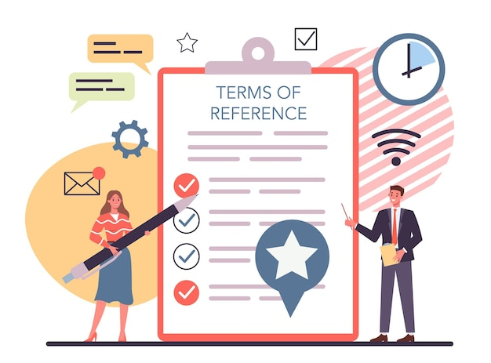
NFP ToR Document includes
Description
ToRs (Specific responsibilities of the GOOS NFPs)
GOOS support to the National Focal Points
Benefits of GOOS National Focal Point Role
To MS
To GOOS
Annex 1: Guidance for National Hub / Committee
Annex 2: National Focal Point list of potential connections
Document is on this link

Slide 6
ToRs
The specific responsibilities of the GOOS National Focal Points are to:
Work at national levels towards implementation of the GOOS strategic goals, and support the alignment of national activities in broader international and regional ocean observing activities, assuring synergy and increasing efficiency
Develop a national hub for the coordination of integrated ocean observing across disciplines and sectors, possibly through establishing a GOOS national committee (see Annex 1). Connection with the following would be appropriate:
Representatives of national ocean observing programmes or systems, across open ocean, coastal, physical, biogeochemical, and biological realms
National representatives of GOOS ocean observing networks
National representatives of GOOS Regional Alliances (GRAs), where relevant
National representatives of GOOS sponsors: the IOC, the WMO, UNEP and the ISC, if designated at a national level
National ocean data, modelling, and ocean assessment activities, including national representatives of the International Oceanographic Data Exchange (IODE)
Government departments with an interest in ocean issues
Representatives from national marine industry/blue economy, with an interest in services derived from ocean observing and forecasting
Advocate for national investment in sustained ocean observing systems
Promote nationally and/or regionally coordinated strategies and implementation for a sustained ocean observing system delivering the needed information to users.
Promote the work of GOOS at the national level:
Strengthen and develop communications with national and regional stakeholders,
Promote GOOS plans and documents where relevant,
Publicise opportunities for engagement with the GOOS Core Team and actions
Promote national FAIR ocean data practices, in collaboration with IODE national representatives and national data structures
Encourage timely delivery of quality metadata, adhering to international best practices or standards, and in support of global ocean observing system implementation and tracking
Support capacity building for ocean observing
Maintain contact with relevant national committees such as for Global Climate Observing System (GCOS) and the United Nations Decade of Ocean Science for Sustainable Development (Ocean Decade), if designated at a national level

Slide 7
ToRs
The specific responsibilities of the GOOS National Focal Points are to:
6. Ensure that national needs, capability, and gaps related to sustained ocean observing systems are brought to the attention of GOOS, and work with GOOS towards developing a regular reporting to the IOC on the status and future plans of national ocean observing system activities that contribute to GOOS, leveraging any existing reporting.
7. Participate in GOOS organised meetings for the National Focal Points.
Request GOOS SC approve the GOOS National Focal Point ToRs in document here (GOOS_NFP_TOR_draft_CL_2931_1_)

