Slide 1


6.6 REPORT OF THE TASK TEAM ON UN DECADE OF OCEAN SCIENCE FOR SUSTAINABLE DEVELOPMENT
UNODTP Status and Overview
UNODTP Research, Development and Implementation Plan
Regional Implementation Strategy
Recommendations
Mike Angove
on behalf of the
Ocean Decade Tsunami Programme Scientific Committee (ODTP-SC)
CARIBE EWS ICG, 27 April, San Jose, Costa Rica

Slide 2
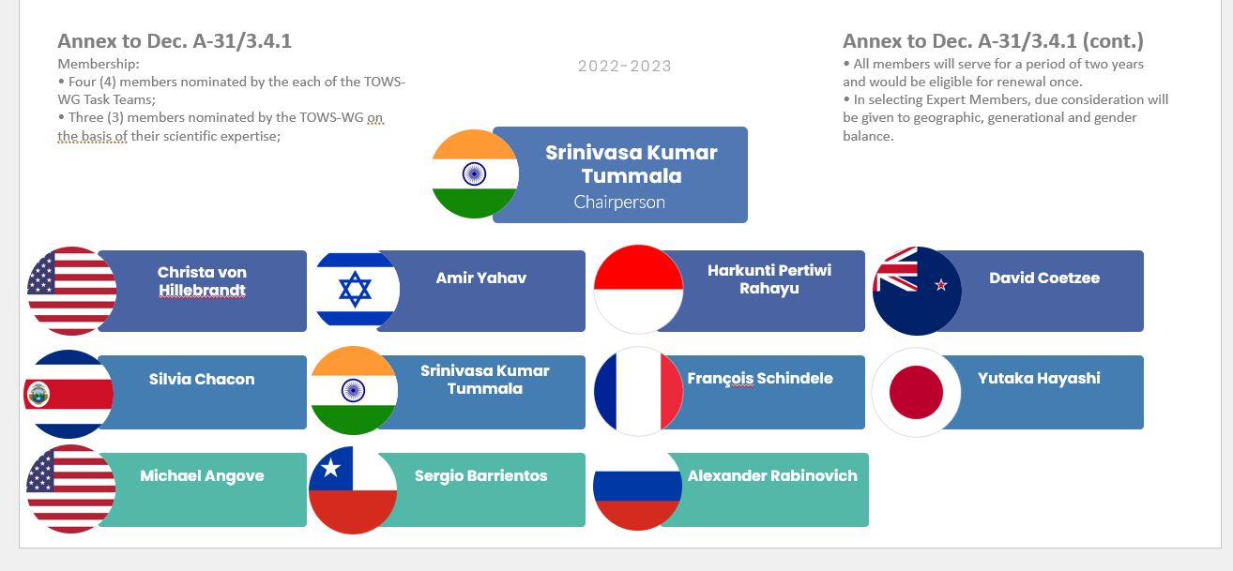
UN Ocean Decade Tsunami Programme Scientific Committee

Slide 3
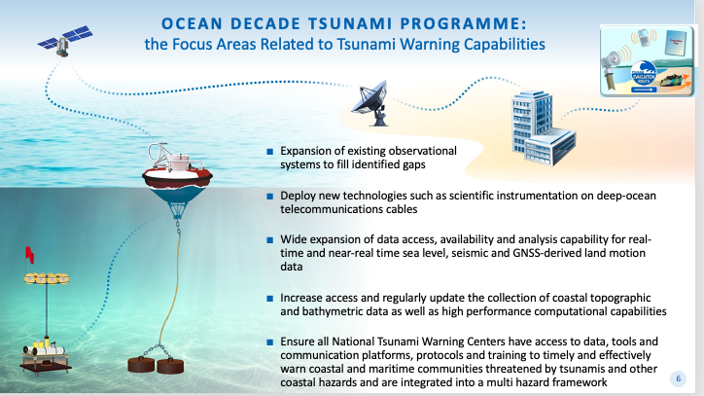
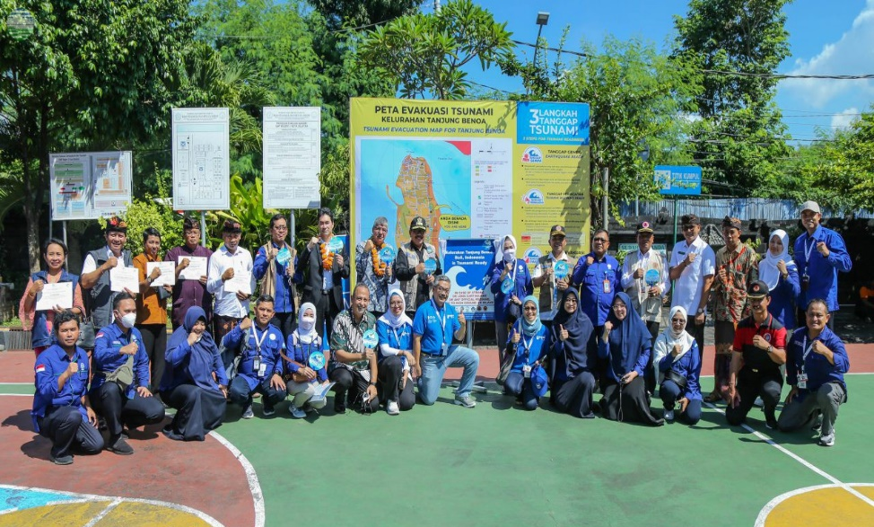
ODTP- Objectives
To develop the warning systems’ capability to issue actionable and timely tsunami warnings for tsunamis from all identified sources to 100% of coasts at risk
100% of communities at risk be prepared and resilient to tsunamis by 2030 through programmes like the IOC-UNESCO Tsunami Ready Recognition Programme (TRRP)

Slide 4
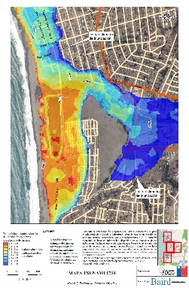
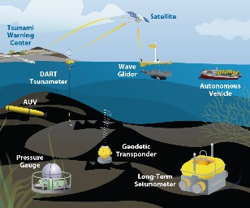
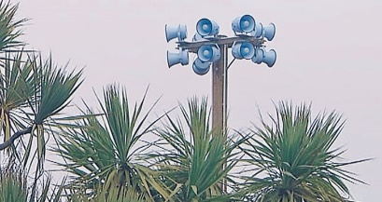


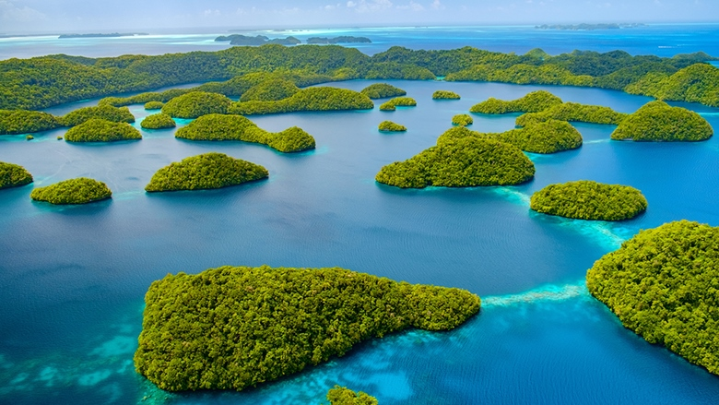
Key Elements of the Research, Development & Implementation Plan
1. Tsunami Risk Knowledge: Identify and prioritise at-risk communities
2. Tsunami Detection, Analysis and Forecasting: Expand existing, and deploy new observing technologies and warning systems
3. Warning, Dissemination and Communication: Access to data, tools, communication platforms, protocols and training to effectively warn coastal and maritime communities
4. Preparedness and Response Capabilities: To build tsunami-resilient communities
5. Capacity Development, SIDS and LDCs, Multi-hazard Framework: Underpinning elements
6. Governance and Pathways to Implementation
Notes:
Enhance tsunami risk assessments and the research on technologies for it, so the countries know their expected threat and vulnerability, and are able to identify and prioritise the at-risk communities.
Expand and improve existing detection and monitoring systems, including seismographs, coastal tide gauges, and deep ocean tsunameters, to fill identified gaps, and deploy new technologies to address observational gaps that cannot be covered by existing networks.
Ensure all National Tsunami Warning Centres (NTWCs) have access to data, tools and communication platforms, protocols and training to timely and effectively warn coastal and maritime communities threatened by tsunamis and other coastal hazards that are integrated into a multi-hazard framework
Emphasise the importance of building tsunami resilient communities through the IOC-UNESCO Tsunami Ready Recognition Programme, which is achieved through involvement of stakeholders at all levels.

Slide 5
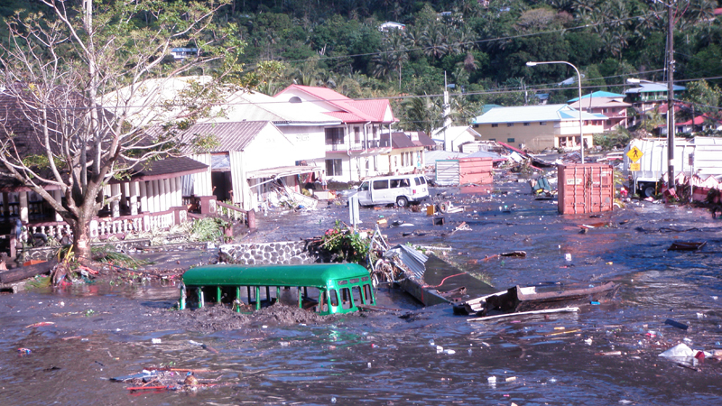
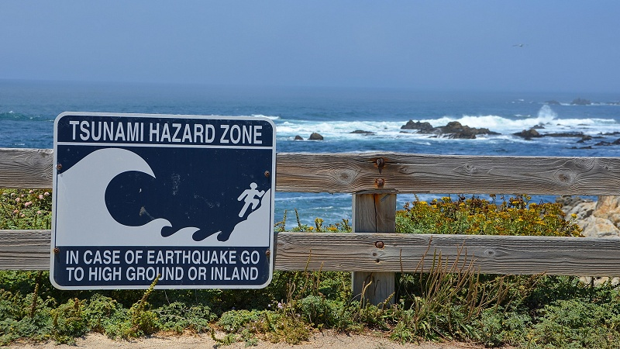
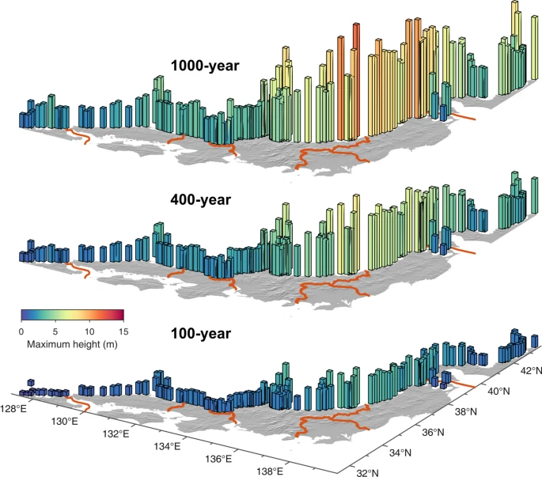
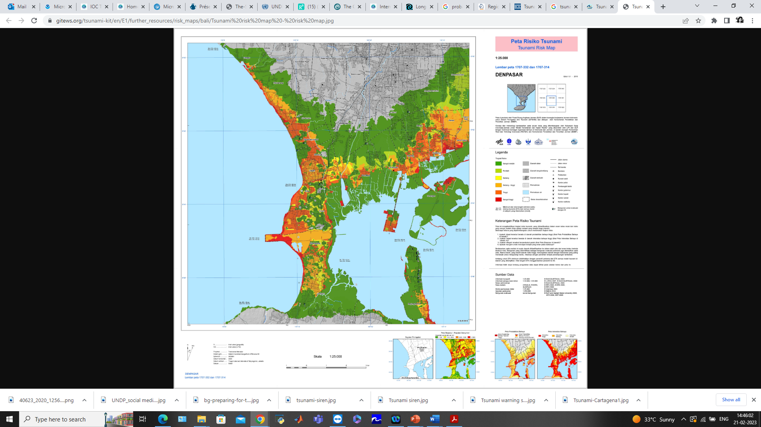
Tsunami Risk Knowledge - Goals
    Tsunami hazard zones should be mapped for all at-risk locations, specific “hot spots” of the strongest expected tsunamis have to be identified including maximum values of runup, inundation area and flow depth, and minimum values of arrival times should be known by emergency planners, responders and communities exposed to tsunami hazard by 2030
    Each ICG to have a database of tsunami source scenarios, including non-seismic by 2030
    Each country to identify vulnerable groups and identify total and disaggregated numbers for population at risk within tsunami inundation areas by 2026 and identify and prioritize critical infrastructure by 2030
    Develop methodologies for tsunami risk assessments including multi-scenario, location-based risk assessment of tsunami hazard characteristics, vulnerability, exposure, likelihood and consequences by 2026

Slide 6
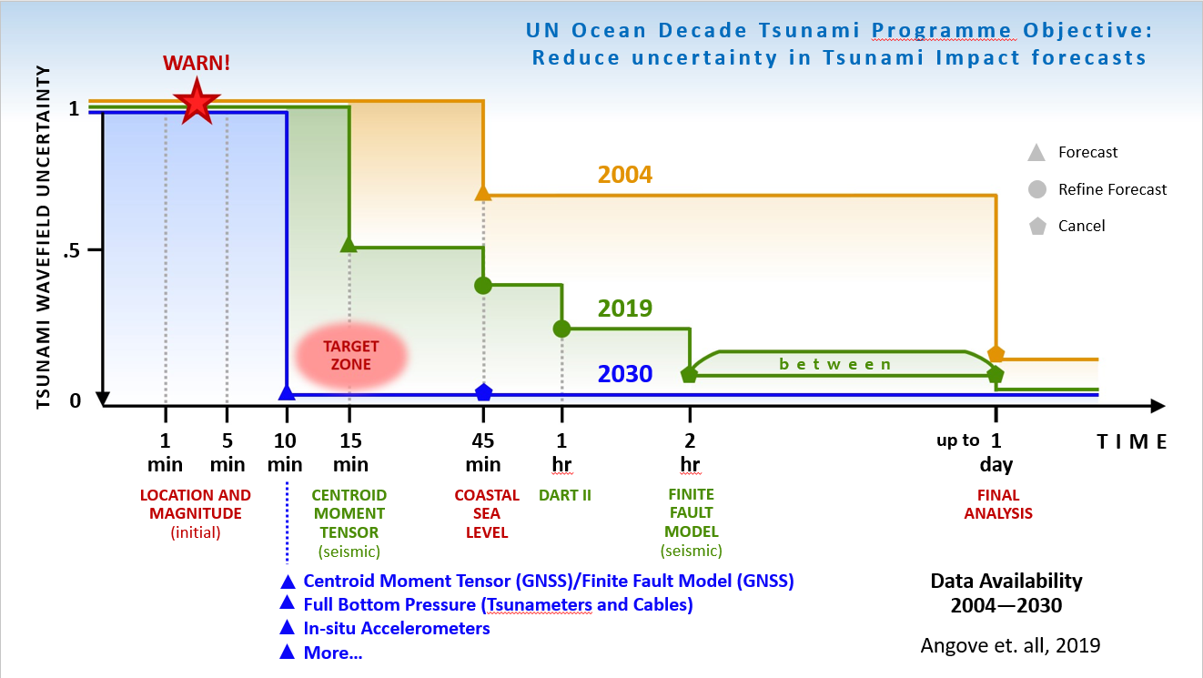
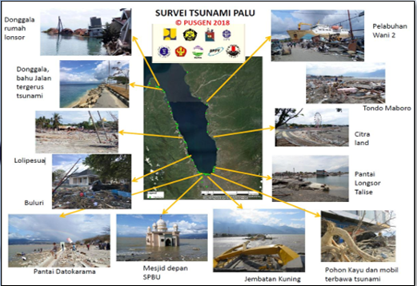
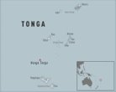

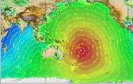
Tsunami Detection, Analysis And Forecasting - Goals
  Tsunami Threat Life Cycle : Initial indicators, confirmation, forecasting, validation and cancellation
  Throughout the threat life cycle it is possible to provide information on the potential threat
  Initial indicators based on seismic proxy provide necessary timelines but can be inaccurate
  Additional challenges with non-seismic and near-source tsunamis
  Greatly expand international cooperation in tsunami warning and mitigation, to improve capability to directly detect and measure tsunamis and reduce reliance on seismic proxy relationships in terms of projecting impacts
  To develop the warning systems’ capability to issue actionable and timely tsunami warnings for tsunamis from all identified sources to 100% of coasts at risk
  Most urgently, the ODTP will aim to provide tsunami confirmation within 10 minutes or less of origin for the most at-risk coastlines

Slide 7
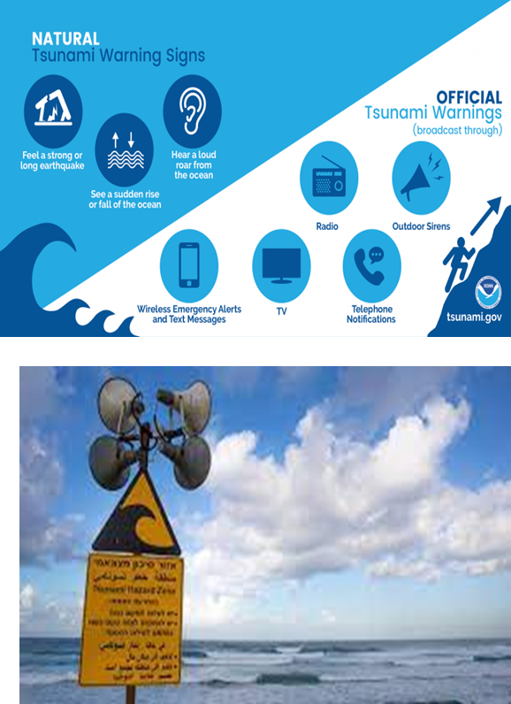
Tsunami Warning, Dissemination and Communication – Goals
    The ODTP goal is that by 2030 there will be significant improvements in the national decision making to warn, and mechanisms in place for the effective and inclusive construction, dissemination and communication of warnings.
    Most importantly, 100% of the national authorities will be able to effectively warn the communities and population at risk.
    The communities at risk will be able to use these advances to improve local tsunami preparedness and response capabilities and become Tsunami Ready
    Key elements that need to be addressed
    Effective decision making to warn - National/local tsunami warning chains and procedures; Decision support tools; Capacity building
    Effective construction of warnings – Time constraints, Inclusive, Actionable content
    Effective dissemination and communication of warnings – Institutional capacity, Communication mechanisms, Multi-Hazard Warning Systems, Multiple sources of information

Slide 8
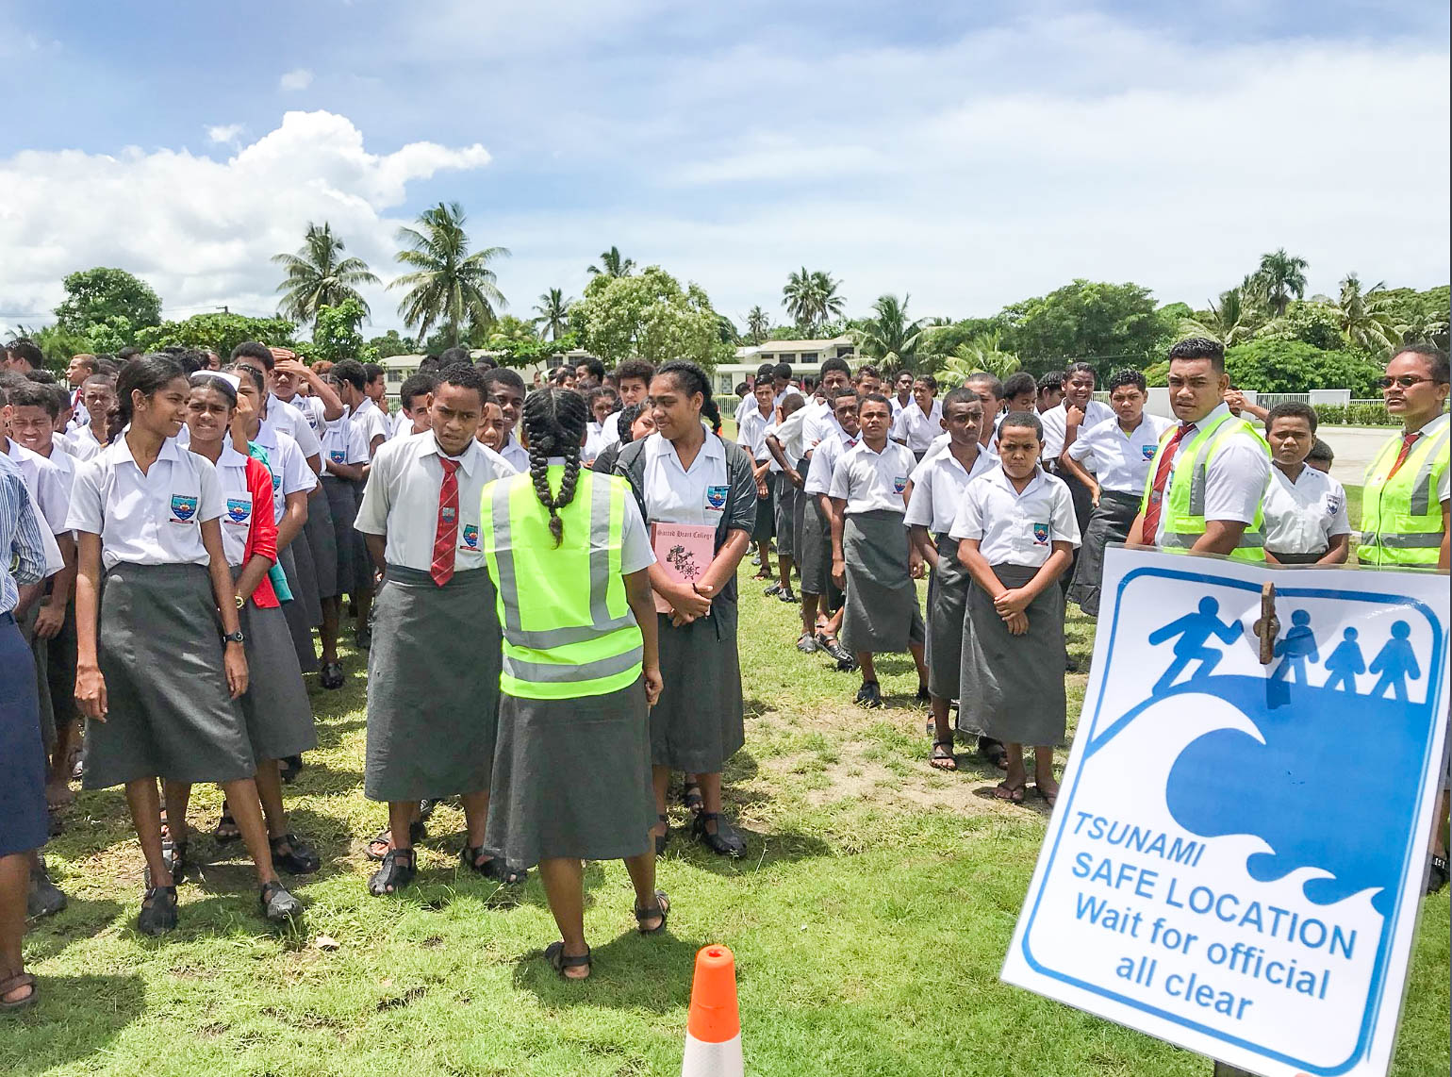
Preparedness and Response Capabilities - Goals
  Aspirational social outcome of the Ocean Decade Tsunami Programme is that 100% of communities at risk from tsunamis are prepared for and resilient to tsunamis by 2030 through efforts like the IOC-UNESCO Tsunami Ready Recognition Programme
  Key elements to be addressed
    Risk Perception and Awareness – Risk perception studies need to be encouraged across all regions and targeted for the ODTP
    Preparedness
      All at-risk communities have tsunami evacuation maps
      Public display of tsunami information
      Locally relevant education and awareness resources
      promote communities to actively participate in the World Tsunami Awareness Day (5 November)
      100% of communities at risk conduct a local tsunami exercise every two years
  Response Capability
  All countries with tsunami risk should have agreed parameters at the national and local level for warning and have approved response plans. Inclusiveness should be addressed in these plans
  100% of at-risk communities have multiple effective and sustainable communication methods in place
    Mitigation
      Communities have access to an inventory of best practices of plans and structural and nature-based solutions and that more communities have implemented plans and measures to minimize impacts to critical infrastructure and marine assets from tsunamis and other coastal hazards, and importantly mainstreaming disaster risk reduction into urban planning

Slide 9
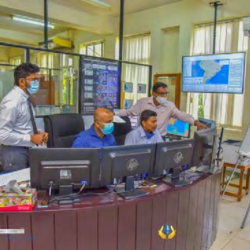
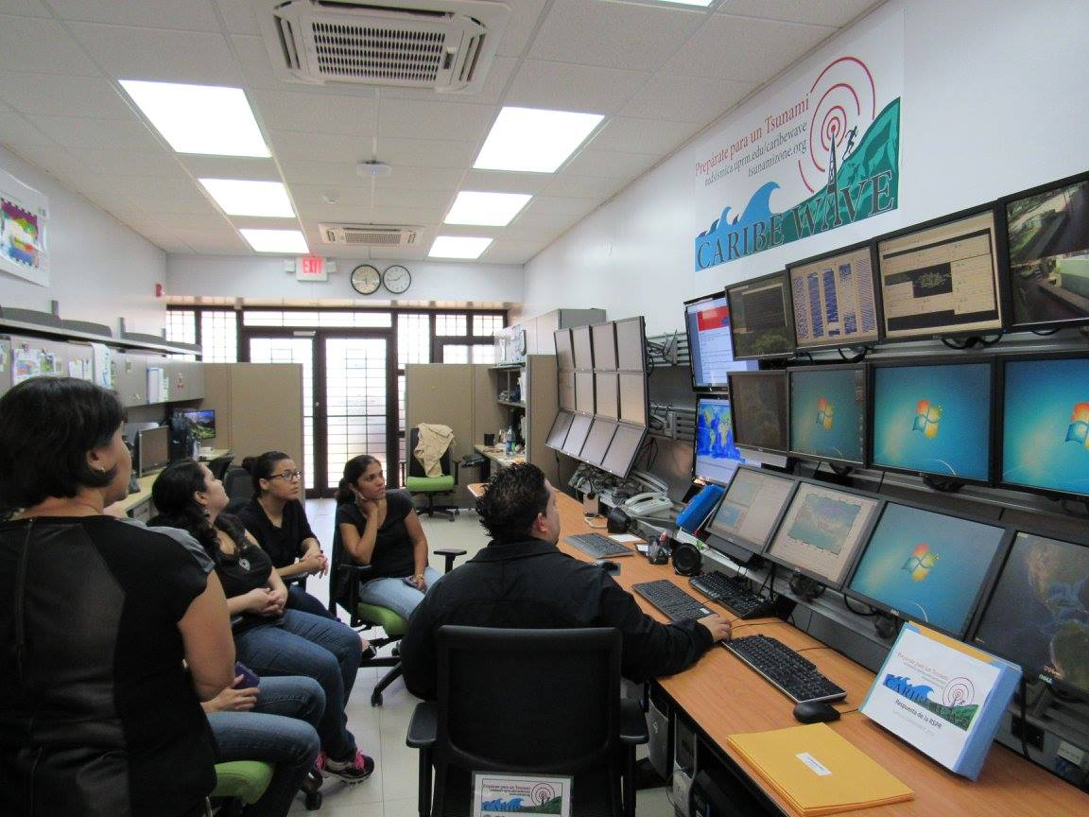
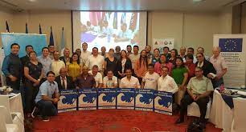
Capacity Development - Goals
  Ensure investment in capacity development for the different stakeholders including the generators and the users of the tsunami early warning system
    National, regional and local level initiatives to reach the objective of 100% at-risk communities to be prepared and resilient to tsunami
    Facilitate equitable access to data, information, knowledge, technology, and infrastructure, leaving no-one behind
    ICG-TICs and OTGA – STCs as the means for the delivery of capacity development
    Special consideration to be capacity requirements of SIDs and LDCs

Slide 10
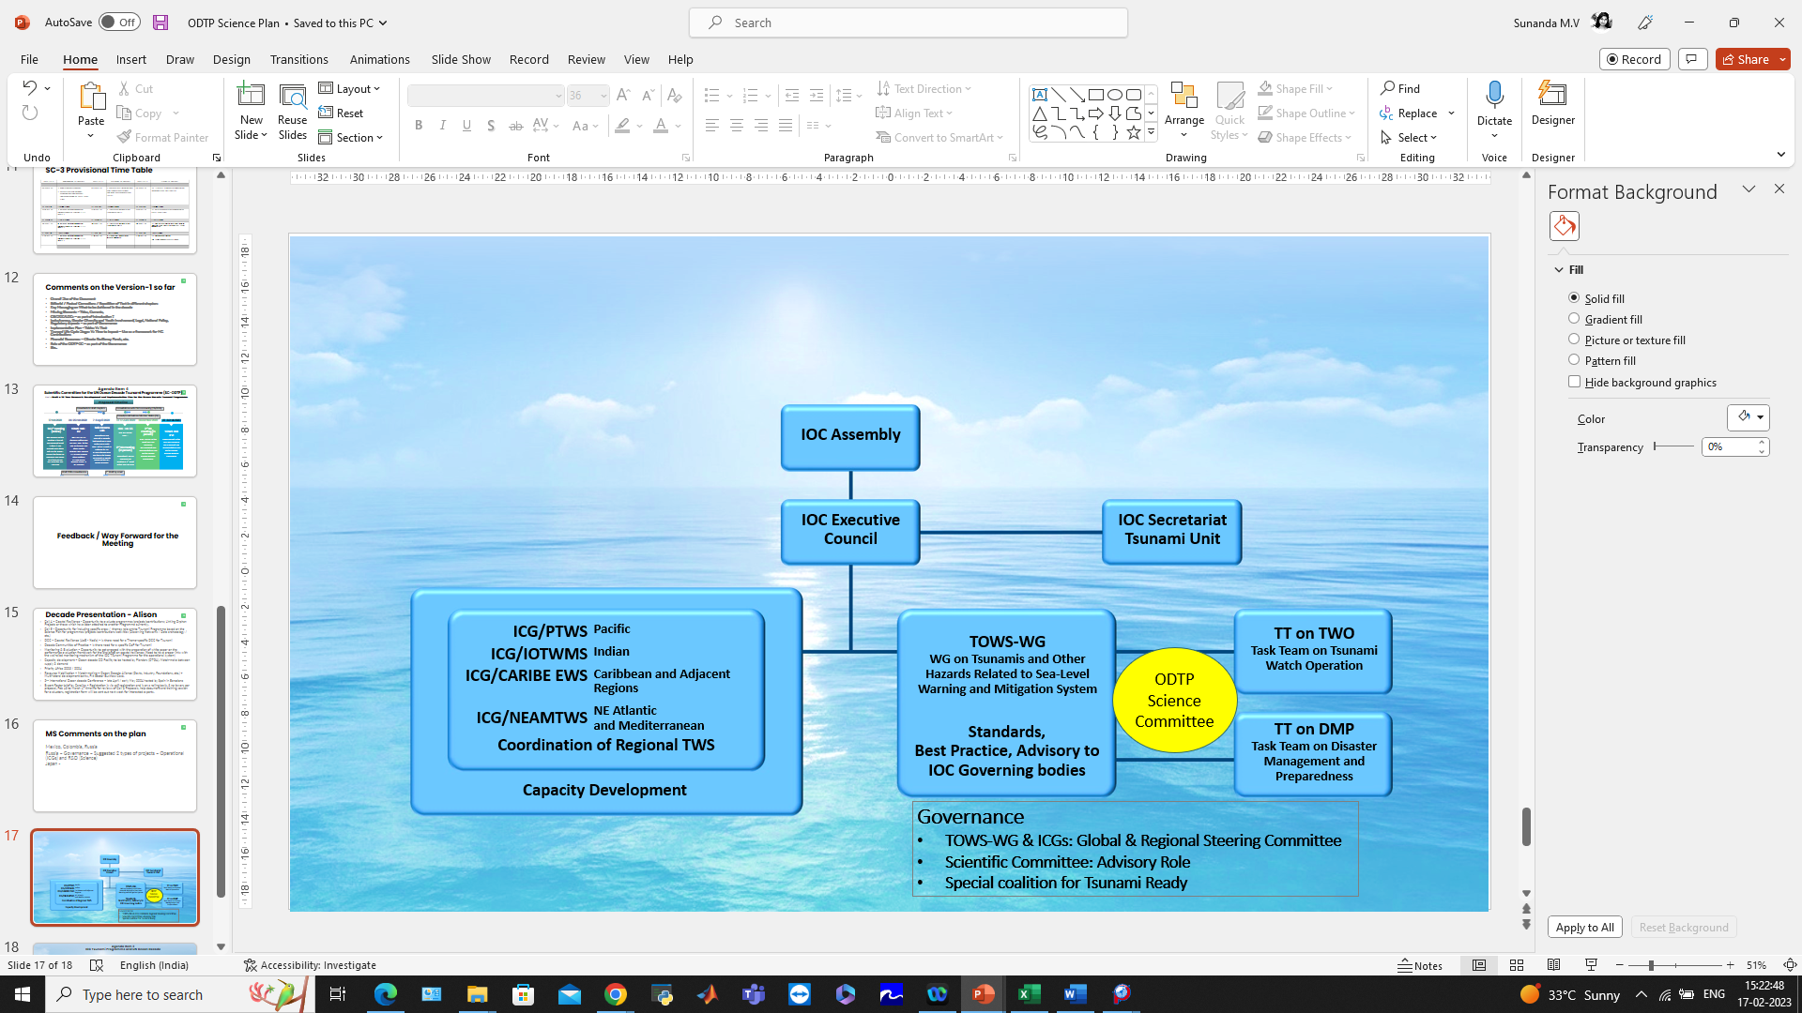
To explore opportunities and establish connections with Decade programmes, projects, contributions, DCCs and CoPs, Calls for Action
To align with international frameworks, call for action and multi-lateral environmental agreements – SFDRR, SDGs (3, 8, 11, 14), Paris Agreement on climate change, early warnings for all, UN Global Early Warning Initiative (2023-2027) etc.
To provide new cooperation opportunities by laying out the building blocks, through an international Science Committee and International Tsunami Ready Coalition while renewing and strengthen existing cooperation with partners
To encourage and promote inclusiveness and gender diversity, and that youth and early career professionals engage and involve in tsunami early warning systems and actions
To develop and operationalize a transparent performance monitoring system based on international norms, standards and agreements
Governance
ICG-TICS
  The IOC-UNESCO tsunami programme will oversee the overall implementation of the ODTP through contributions and engagement of Member States, in coordination with the ICGs, and with the collaboration of academic institutions, researchers, industry, philanthropic organisations and other stakeholders

Slide 11
Pathways to Implementation
  The ODTP provides a framework for identifying gaps, suggesting solutions, prioritise resources, and implementing actions within the timeframe of the Ocean Decade
  This plan outlines the pathways for achieving overall objectives of ODTP including challenges, solutions, performance indicators, milestones and target dates for the four main components of the tsunami early warning system
  Considering the nature of tsunami hazard, the optimal solutions should have a global design, address regional imperatives, and be implemented through contributions and actions of Member States and other stakeholders
  Scientific objectives of the tsunami warning enhancements will be achieved by maximizing and expanding current capabilities, identifying capabilities that exist but are not currently applied to tsunami, and developing new capabilities through innovation and research
  Member States should endeavour to dovetail their national tsunami warning system plans/programmes with the ODTP objectives
  Member states, academic institutions and industries will seek, possibly through ICG consultation to identify candidate proposals aimed at addressing the solutions
  R&D community and Industry has the opportunity to develop and contribute to scientific understanding, technological solutions, product development and capacity building.
  The intent of the plan is to offer contribution pathways that cover the full spectrum or financial commitment by targeting the objectives most important to advancing Member State capabilities

Slide 12
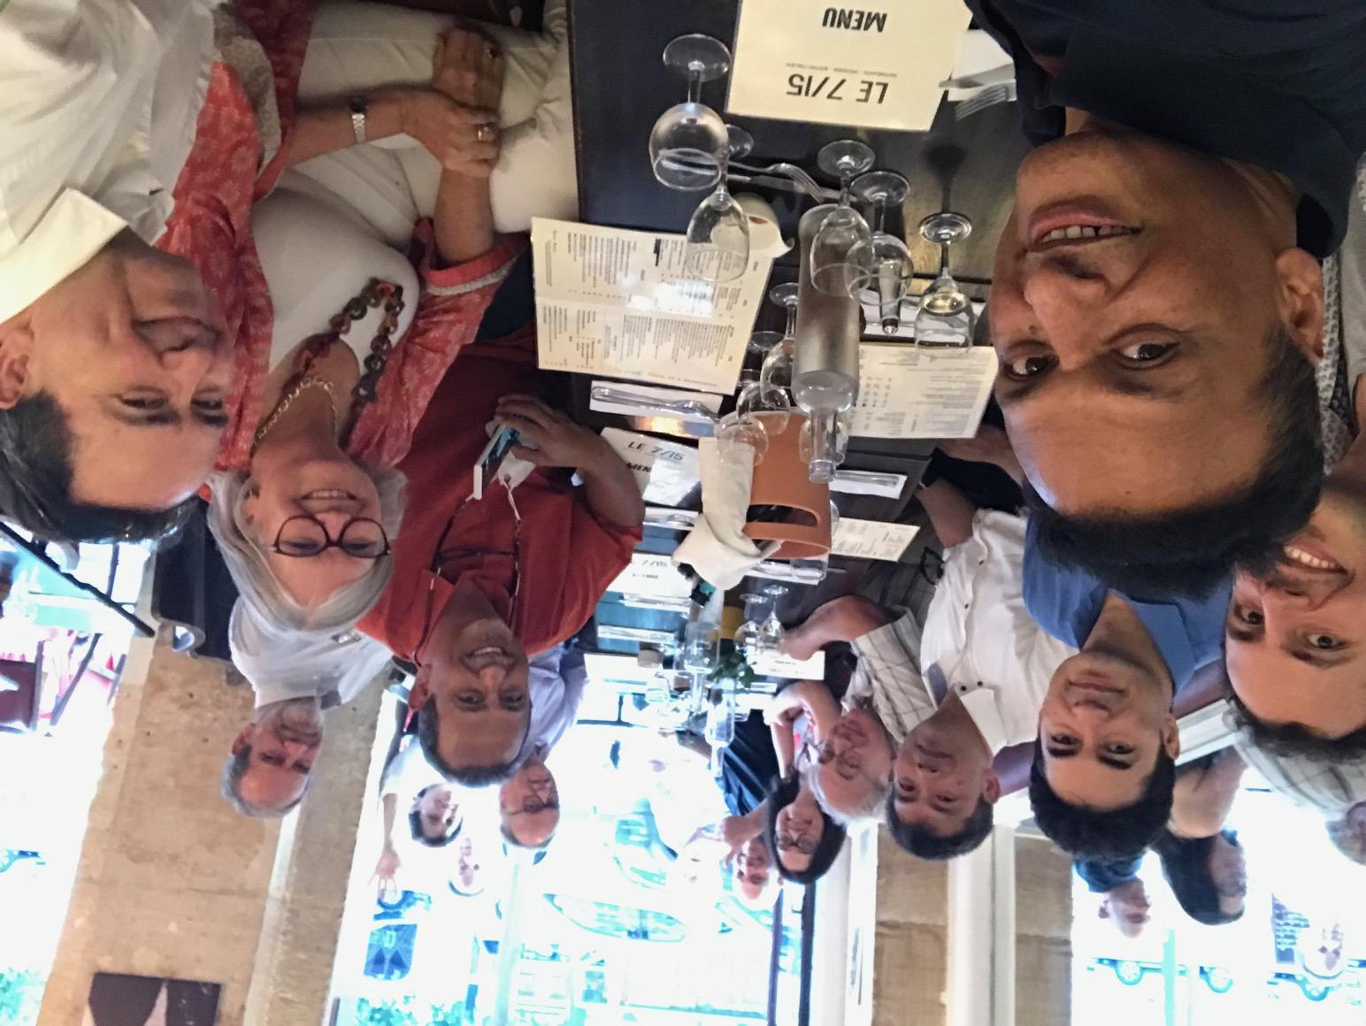
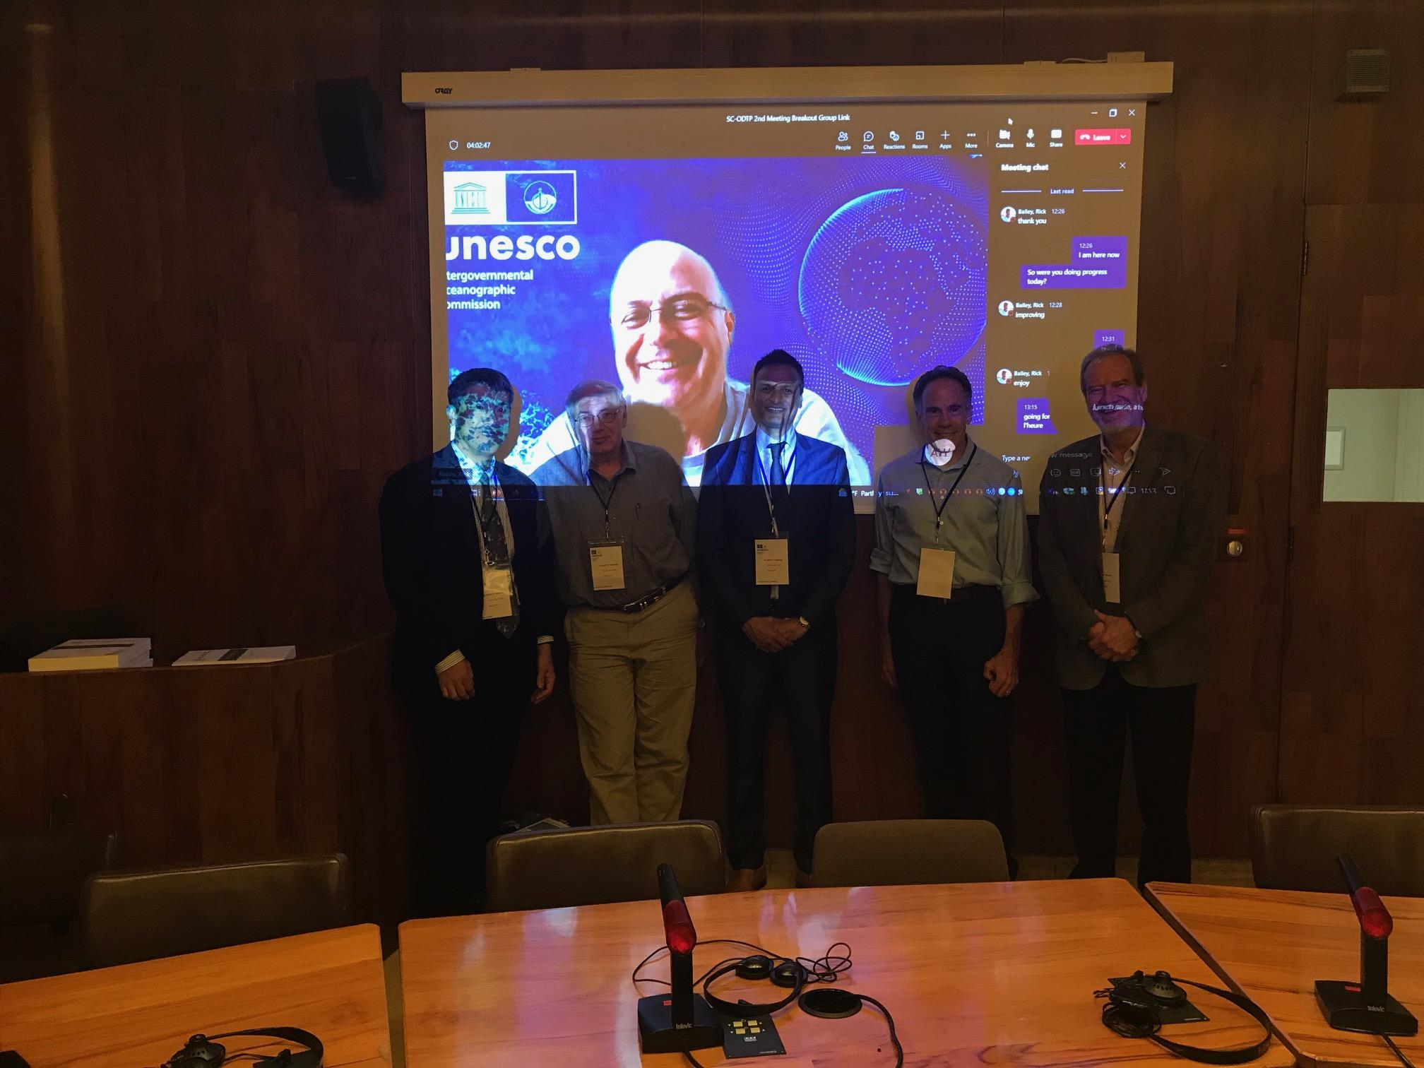
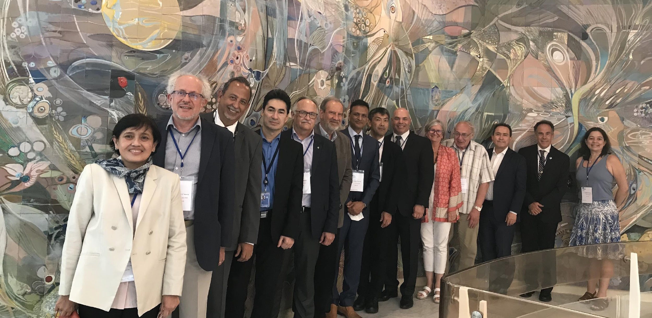
THANK YOU

Slide 13
Regional Implementation Plan—CARIBE EWS
Performance Goals
Risk Knowledge
Detection, Measurement and Forecasting
Preparedness and Response
Dissemination and Communications
Alignment within CARIBE EWS WG structure
Other relevant Decade Initiatives

Slide 14
PERFORMANCE GOALS ALIGNED TO UN ODTP OBJECTIVES
Mary Luz Rengifo Buitrago
CARIBE EWS ICG, 26 April, Costa Rica

Slide 15
1. GLOBAL GOALS KPI FRAMEWORK
  GOAL 1: Understanding and Managing Tsunami Hazard and Risk
  GOAL 2: Tsunami Detection, Warning & Dissemination
  GOAL 3: Enhancing tsunami preparedness for effective community response
  GOAL 4: Tsunami event response and recovery
  GOAL 5: Global ocean coordination, cooperation and partnerships (Working Group/ICG Leaders Only)

Slide 16
1. Tsunami Risk Knowledge:
TARGETS | 0% - 25% | 25% - 50% | 50%-75% | 75%-100%
Develop methodology and supporting guidance for the modelling, designation and mapping of tsunami inundation and evacuation zones, including multi-scenario, location-based risk assessment of tsunami hazard characteristics vulnerability, exposure, likelihood and consequences. | No methodology in place | Methodology in development stage | Methodology developed, no supporting guidance | All complete
Develop a catalogue of tsunami records | No tsunami records catalogue | Tsunami records catalogue based in observers memories compiled in a book or text | Tsunami records catalogue with cientific reserch, paleotsunami, sea level records, numerical modelling compiled in a book or text | Tsunami records catalogue with interactive viewer including cientific reserch, paleotsunami, sea level records, numerical modelling
Identify vulnerable groups and identify total and disaggregated numbers for population at risk in the tsunami hazard zone | Number of people at risk in the tsunami hazard zone is not estimated | 25-50% Of people at risk in the tsunami hazard zone estimated | 50-75% Of people at risk in the tsunami hazard zone estimated | 75-100% Of people at risk in the tsunami hazard zone estimated
Develop a dataviewer or catalogue of tsunami source scenarios available | No tsunami dataviewer or catalogue | Tsunami sources scenarios available compiled in a book catalogue in process | Tsunami source scenarios compiled in a book catalogue completed | Tsunami sources scenarios compiled in a boom catalogue and available online in a data viewer

Slide 17
2. Tsunami Detection, Analysis and Forecasting :
TARGETS | 0% - 25% | 25% - 50% | 50%-75% | 75%-100%
Build and sustain seismic, sea level and other observational network coverage necessary to rapidly detect and analyze all potential tsunami sources. | Seismic, sea level and other observational networks such as deep ocean, coastal sensors, coastal radars, GNSS are not in place | Seismic, sea level and other observational networks such as deep ocean, coastal sensors, coastal radars, GNSS up to 50% of required coverage in place | Seismic, sea level and other observational networks such as deep ocean, coastal sensors, coastal radars, GNSS up to 75% of required coverage in place | Seismic, sea level and other observational networks such as deep ocean, coastal sensors, coastal radars, GNSS full coverage of known sources and contributing to sustained ocean wide seismic network
Enhance, where appropriate, observational networks to rapidly detect and analyze all potential tsunami sources. | Tsunamigenic Earthquakes detection >5min ; No identification of potential atypycal tsunami sources | Tsunamigenic earthquake detection 2-5min; Potential atypical sources not identified | Tsunamigenic earthquake detection 2min; Potential atypical sources identified | Tsunamigenic earthquake detection <2 min; Instrumentation installed to detect atypical tsunami sources
Make seismic (real-time) and other observational seismic data needed for rapid tsunami source detection and evaluation, available freely from monitoring networks, accurately and timely to TSPs and NTWCs | Data is not shared | Select data shared (<50%) or Data shared but relies on a single communication line | Select data shared (<75%) or Data shared but relies on a single communication line | All data shared ; multiple comms lines for backbone/critical instruments
Make sea level (real-time) and other observational data needed for rapid confirmation, characterization, and monitoring of tsunami waves available freely from seismic monitoring networks, accurately and timely to TSPs and NTWCs from monitoring networks. | Data is not shared | Select data shared (<50%) or Data shared but relies on a single communication line | Select data shared (<75%) or Data shared but relies on a single communication line | All data shared ; multiple comms lines for backbone/critical instruments

Slide 18
3. Warning, Dissemination and Communication
TARGETS | 0% - 25% | 25% - 50% | 50%-75% | 75%-100%
Provide tsunami threat information to Tsunami Warning Focal Points (TWFPs) and NTWCs for each Member State with coastal communities at risk by TSPs. | No tsunami threat information is provide | TSP providing service, no regular testing of communication lines between TSP and TWFP/NTWC, contacts not regularly tested or updated | TSP providing service, regular testing and updating of communication lines between TSP and TWFP/NTWC | TSP providing service, regular testing and updating of communication lines between TSP and TWFP/NTWC
Issue timely and accurate products to TWFPs and NTWCs of Member States by TSPs. | TSP products not received or delayed, and threat information not accurate enough to be useful | TSP products often or occasstionally not received or delayed, and threat information often or sometimes not accurate enough to be useful | TSP products almost always received timely, and threat information most often accurate and trustworthy | TSP products almost always received timely, and threat information most often accurate and trustworthy
Issue timely products regarding potential and confirmed tsunami threats to at risk coastal communities, by TWFPs and NTWCs. | Inital threat message >10min; Detailed threat message >45min | Inital threat message <=10min; Detailed threat message <=30min | Inital threat message <5min; Detailed threat message <30min | Inital threat message <5min; Detailed threat message <30min
Develop national 24/7 capability to receive or generate tsunami threat information and issue tsunami warnings to coastal communities at risk. | No TWFP or NTWC in 24/7 capacity to receive TSP products. No ability to issue tsunami warnings | Have a 24/7 TWFP to receive TSP products but not 24/7 NTWC to issue timely tsunami warnings | Have a 24/7 TWFP and NTWC to issue timely tsunami warnings based on TSP threat information or independent means | Have a 24/7 TWFP and NTWC to issue timely tsunami warnings based on TSP threat information or independent means

Slide 19
4. Preparedness and Response Capabilities
TARGETS | 0% - 25% | 25% - 50% | 50%-75% | 75%-100%
Complete tsunami inundation and evacuation maps | No methodology in place | Methodology in development stage | Methodology developed, no supporting guidance | All complete
Identify vulnerable groups and identify total and disaggregated numbers for population at risk in the tsunami hazard zone | Number of people at risk in the tsunami hazard zone is not estimated | 25-50% Of people at risk in the tsunami hazard zone estimated | 50-75% Of people at risk in the tsunami hazard zone estimated | 75-100% Of people at risk in the tsunami hazard zone estimated
Identify and prioritize critical infrastructure, economic, political and social resources exposed to tsunami | Economic, infrastructural, political and social resources are not identified | 25-50% Economic, infrastructural, political and social resources identified | 50-75% Economic, infrastructural, political and social resources are not identified | 75-100% Economic, infrastructural, political and social resources are not identified
Establish multiple channels to receive 24-hour official tsunami warnings for coastal communities at risk | No channels | At least one proven dissemination channel available to at risk coastal communities to receive tsunami warnings. No comunications tests or exercises to check effectiveness. | At least 2 proven dissemination channels available to at risk coastal commjunities to receive tsunami warnings; ah hoc comunications tests or exercises to check effectiveness | 3 or more proven dissemination channels available to at risk coastal communities to receive tsunami warnings. Regular (at least once a year communities tests or exercises to check effectiveness

Slide 20
5. Capacity Development
Ensure investment in capacity development for the different stakeholders including the generators and the users of the tsunami early warning system.
A goal of the ODTP is to develop and operationalize a transparent performance monitoring system based on international norms, standards and agreements

Slide 21
6. Governance and Pathways to Implementation
TARGETS | 0% - 25% | 25% - 50% | 50%-75% | 75%-100%
Explore opportunities and establish connections with Decade Programmes, project, contributions, Decade Collaborative Centres (DCC) as well as Communities of Practice (CoP) | No opportunities explored or connections established | Opportunities explored and indentified | Connections established with Decade Programmes, project, contributions, Decade Collaborative Centres (DCC) as well as Communities of Practice (CoP) | Ongoing activities in the Decade Programmes, project, contributions, Decade Collaborative Centres (DCC) as well as Communities of Practice (CoP)
A goal of the ODTP is to develop and operationalize a transparent performance monitoring system based on international norms, standards and agreements

Slide 22
Tsunami Risk Knowledge
    Definition of inundation areas, flow depths and arrival times through Tsunami Hazard Assessments
Challenges | Solutions | Goals
Historical tsunami records are scarce or absent | Densify sea level networks, perform historical data research and perform paleo-tsunami studies | Each country to have their catalogue of historical tsunami records by 2025
Scenario definition (seismic and non-seismic) are required as input forcing for numerical models | Seismic, GNSS, Geophysical Volcanic Monitoring; Densify Sea level networks; Scientific Research; Experts Meetings | Each ICG to have a database of tsunami source scenarios, including non-seismic by 2025
High-resolution digital elevation data is required for numerical models but is lacking in many countries. Lack of qualified staff to conduct surveys; lack of equipment including boats. | Increase staff; Capacity building; Funding to buy/rent equipment | Each country has coastal digital elevation data in chosen communities by 2026 and each ICG has database of existing data and metadata
Lack of data to validate numerical models | Densify sea level networks; Perform historical data research; Perform paleo-tsunami studies | Each country has access to tsunami numerical models by 2026
Lack of qualified staff to conduct numerical modelling | Funding to hire and train staff | Each country has at least one person able to do tsunami modelling by 2025
 |  | Each country has defined the inundation area for the chosen community by 2026

Slide 23
Tsunami Risk Knowledge
    Definition of vulnerability and exposure
Challenges | Solutions | Goals
Inventories of critical infrastructure inside the inundation area (accessibility e.g., airport, ports) (telecomms, energy, food, fresh water & medical supply) | Multistakeholder resources (trained staff and funding) and coordination | Each Member State has critical infrastructure identified and prioritized by 2026
Ability to identify the vulnerable groups within the inundation area |  | Each country has identified vulnerable groups within tsunami inundation areas by 2026
Number of residents and visitors with their fluctuation (daily and seasonal) within the inundation area |  | Each country has identified number of populations at-risk within tsunami inundation areas by 2026
Identifying and prioritizing economic assets |  | Each country has identified and prioritized economic asset at land and ocean by 2026
Identifying and prioritizing critical infrastructure for economic impact |  | Each Member State has identified and prioritized critical infrastructure for economic impact at land and ocean by 2026
Identifying and prioritizing the built environment |  | Each Member State has identified and prioritized the built environment at land and ocean by 2026
Identifying and prioritizing the natural environment |  | Each Member State has identified and prioritized the natural environment at land and ocean by 2026

Slide 24
Tsunami Risk Knowledge
    Definition of capacity to respond
Challenges | Solutions | Goals
Definition of legal framework existing and desirable. Identifying gaps and priorities. | Strategy and funding to bridge the gap | Each Member State has bridged the gaps on legal framework by 2026
Definition of institutional framework existing and desirable. Identifying gaps and priorities. |  | Each Member State has bridged the gaps on institutional framework by 2026
Definition of EWS elements available and desirable. Identifying gaps and priorities. |  | Each Member State has bridged the gaps on EWS by 2026
    Definition of methodology to calculate risk
Challenges | Solutions | Goals
Develop methodologies for tsunami risk assessments including multi-scenario, location-based risk assessment of tsunami hazard characteristics, vulnerability, exposure, likelihood and Consequences | Document methodology (include multi-scenario, location-based hazard inundation mapping) | Each Member State has defined their tsunami risk assessment methodology by 2026
Multistakeholder definition of methodologies for tsunami risk Assessments | Developing and publishing of Supporting guidance and templates

Slide 25
Tsunami Risk Knowledge
    Using results from Tsunami Risk Assessments
Challenges | Solutions | Goals
Conduct and periodically review tsunami hazard risk assessments, using agreed methodologies | Resources (trained staff and funding) and coordination | Each Member State has performed TRA studies by 2026
Translate risk assessment findings to the appropriate stakeholders and sectors. | Coordination | Each Member State has developed tsunami risk reduction tools according with results from TRA studies by 2028

Slide 26
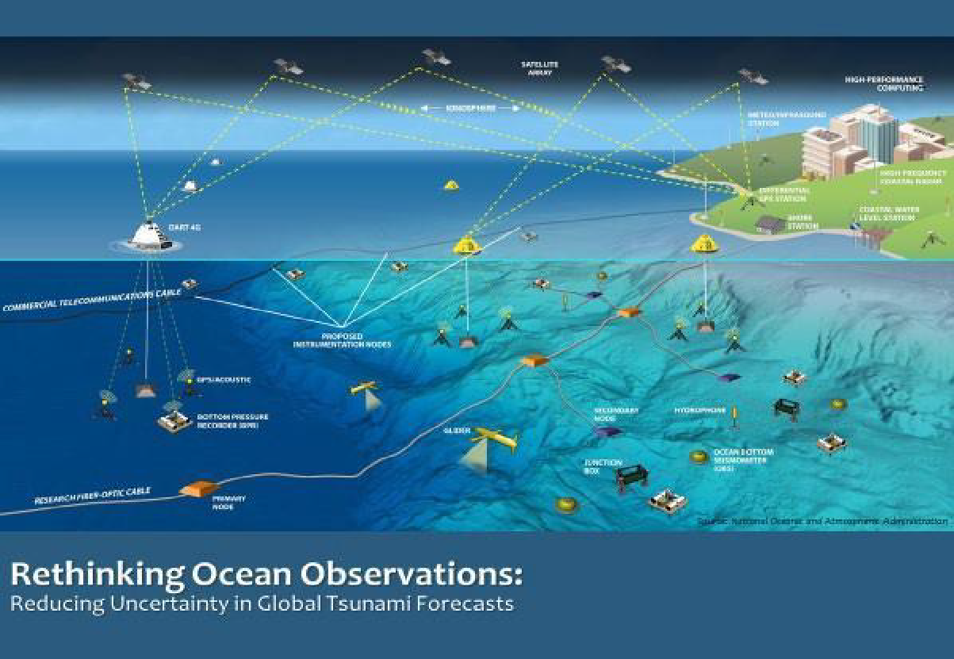
Tsunami Detection, Analysis And Forecasting
Detection and Measurement
Characterisation and forecasting
Database Applications and matching Schema
  Global Threat Database
  AI and Probabilistic Tsunami Forecasting
Dynamic Characterization
  Rapid update cycle models
  Maximize and expand current capabilities
    Seismic networks
    Tsunameters
    Coastal sea level gauges
    GNSS
    Dedicated observatories
    Supporting capabilities - Coastal bathymetry, Sensor siting analysis, Global digital synthetic database, Model codes, Potential tsunami sources including non-seismic, Science to practice, Training on tsunami warning operations
  Implementation of existing capabilities not being applied to tsunami operations
    Coastal RADARs
    Passive/Active Remote Sensing
    Infrasound
  Identification of new candidate capabilities
    Ionospheric tomography – TEC
    Fibre Optic Applications – Distributed acoustic sensing

Slide 27
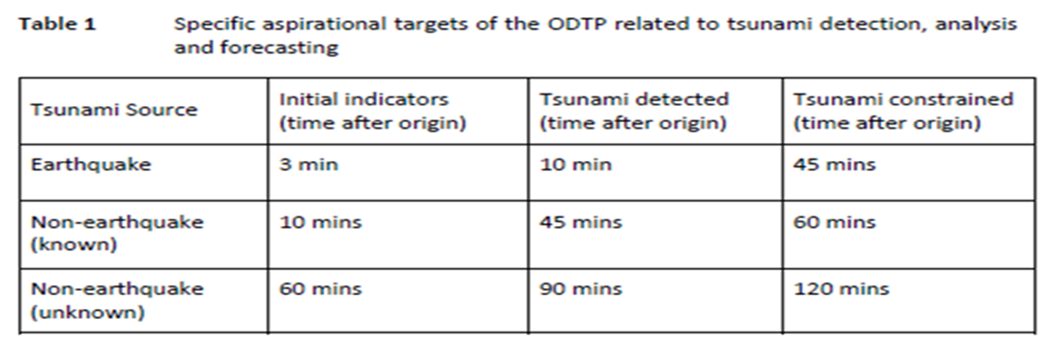
Tsunami Detection, Analysis And Forecasting
Overall
Challenges | Solutions | Goals
100 percent detection and measurement of all significant tsunamis within an actionable timeframe from generation (Table 1) | Optimal notional global network design consisting of a mix of observation platforms/types including seismographs, tide gauges, tsunameters, GNSS, SMART, research cables, interferometers, etc. | Optimal global network design in all ICGs by 2023
 | Optimal observing network implementation | Optimal network implementation in all ICGs from 2025 onwards
 | Enhanced data sharing | Enhanced data sharing in all ICGs by 2024
 | Coastal Bathymetry and Topography where necessary (GEBCO/2030) | High-resolution digital elevation data in all vulnerable coastal regions by 2030
 | High Performance Computing / modelling and impact forecasting / assimilation / analytics including AI-ML / uncertainty reduction | Advanced computational capabilities in all Tsunami Service Providers by 2027
 | Warning centres have access to the analysis (data, tools and communication platforms) for effective warning to impacted populations | Access to data, tools and communication platforms in all Tsunami Warning Centres by 2030

Slide 28
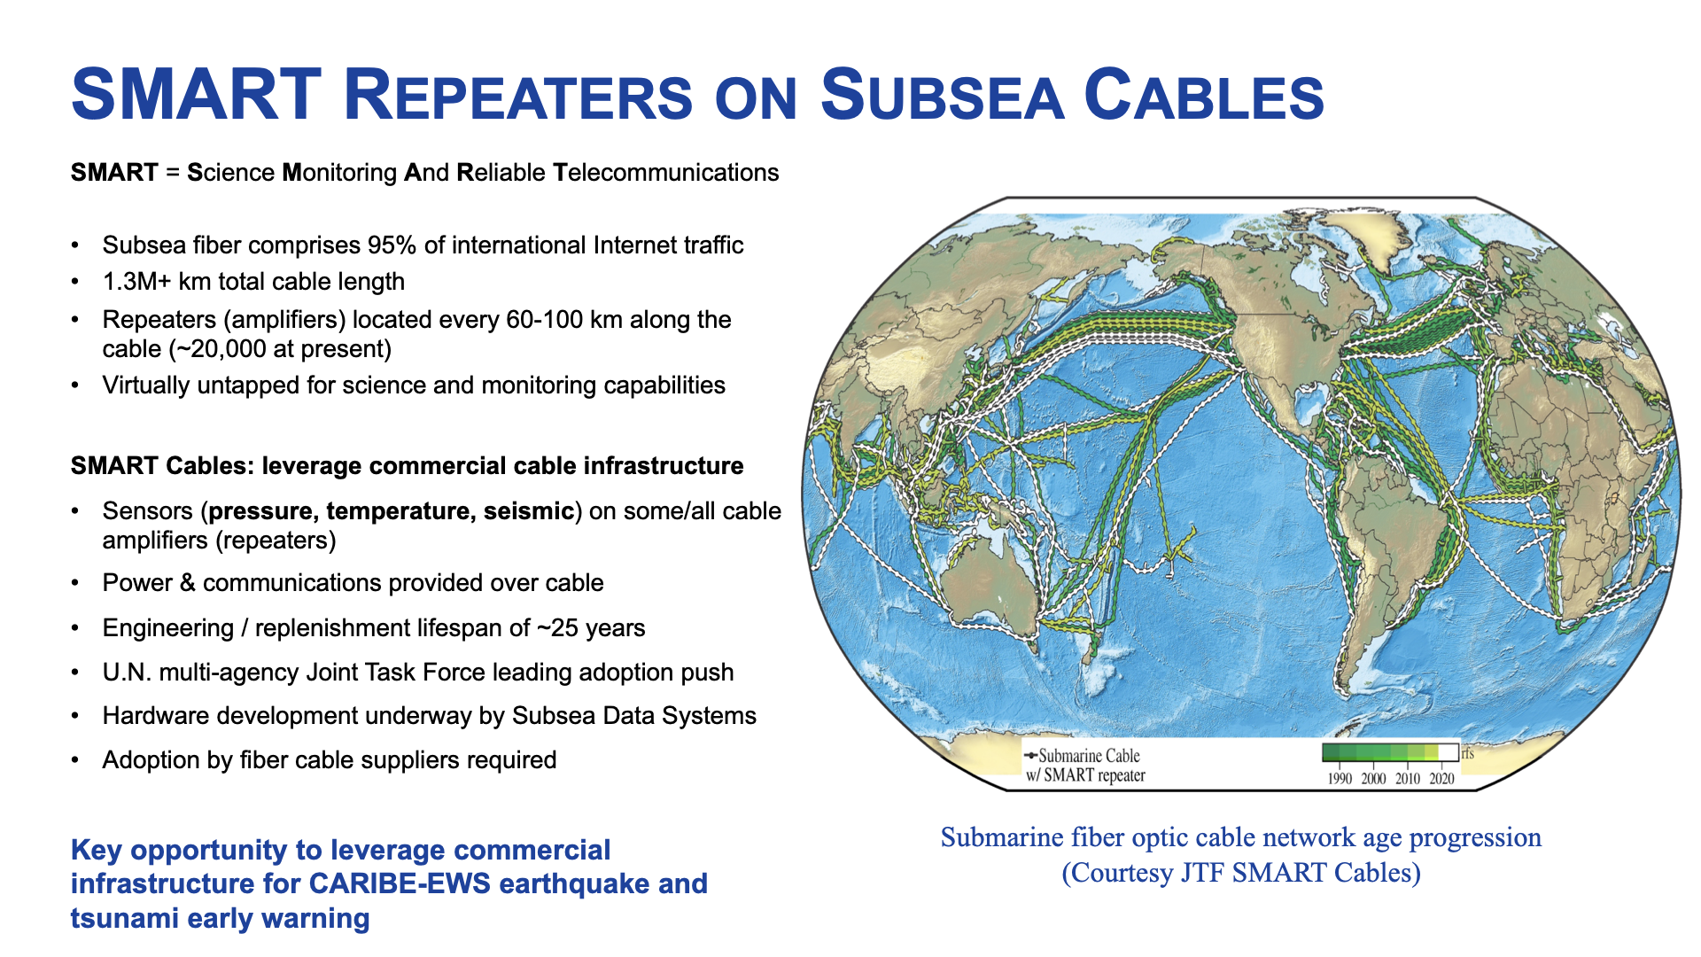

Slide 29
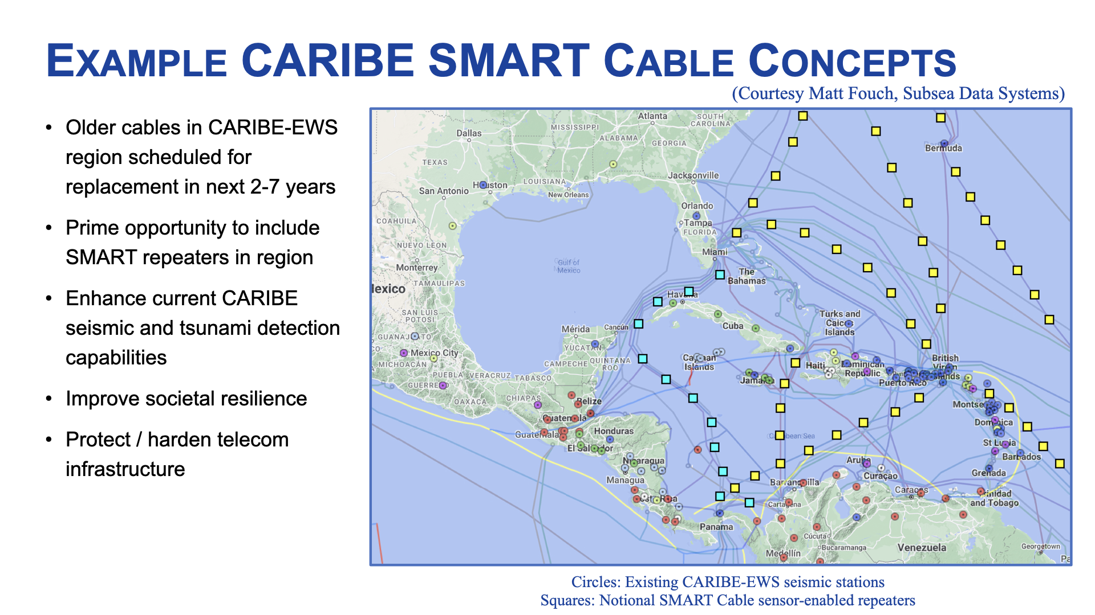

Slide 30
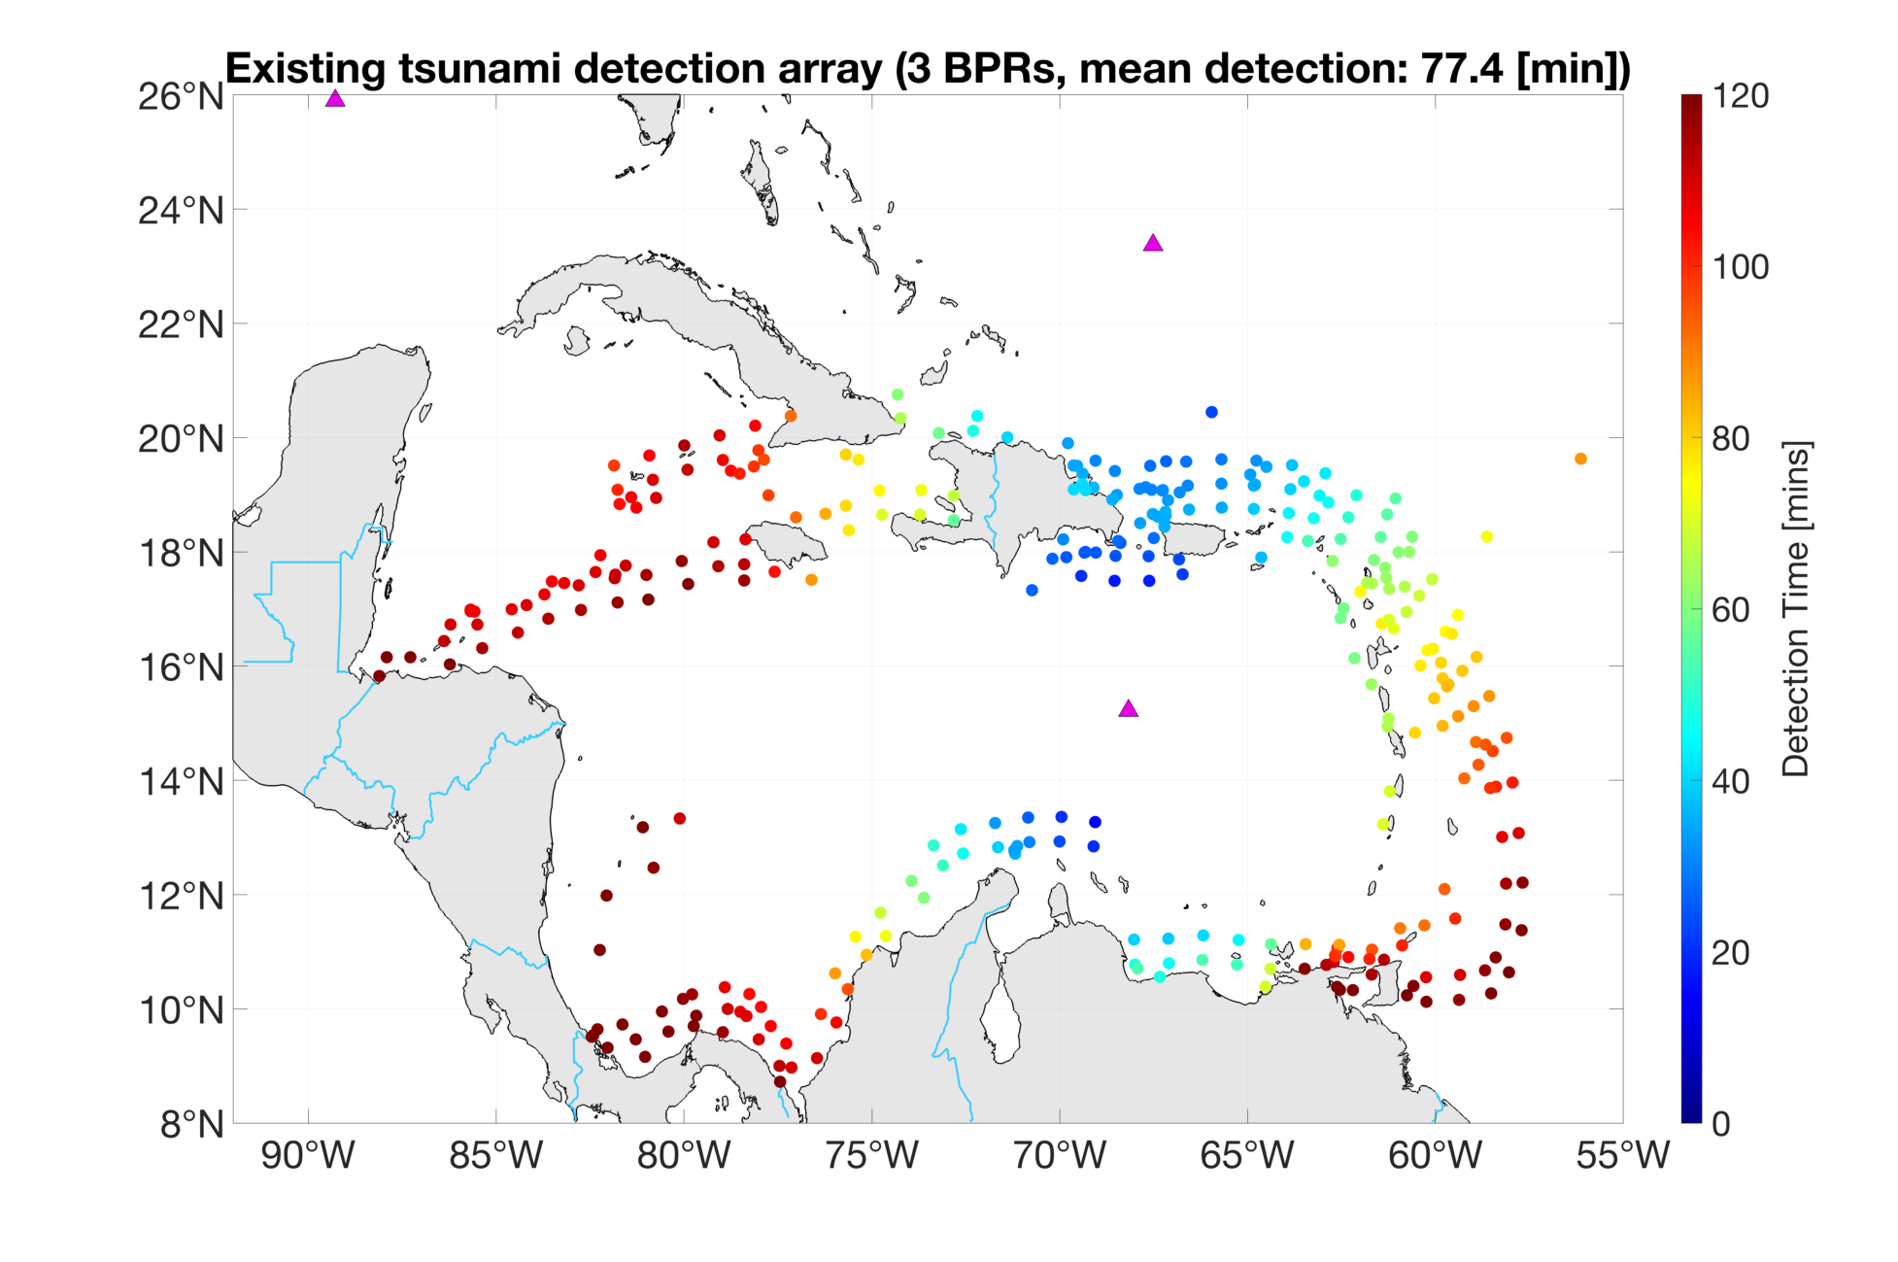
Tsunami Detection, Sensor Placement Strategy
Detection and measurement
  Tsunameters/BPRs
    Deep-water measurement necessary
    Current Buoy coverage minimal
    Events from historical and fault catalog
  Optimzed Sensor Placement
    10-minute detection goal
    2nd sensor needed for good source characterization
  Other Sensors can Offset
    Cable-based deep-water sensors
    GNSS sensors on land
    HF Radar, Ionosphere, etc

Slide 31
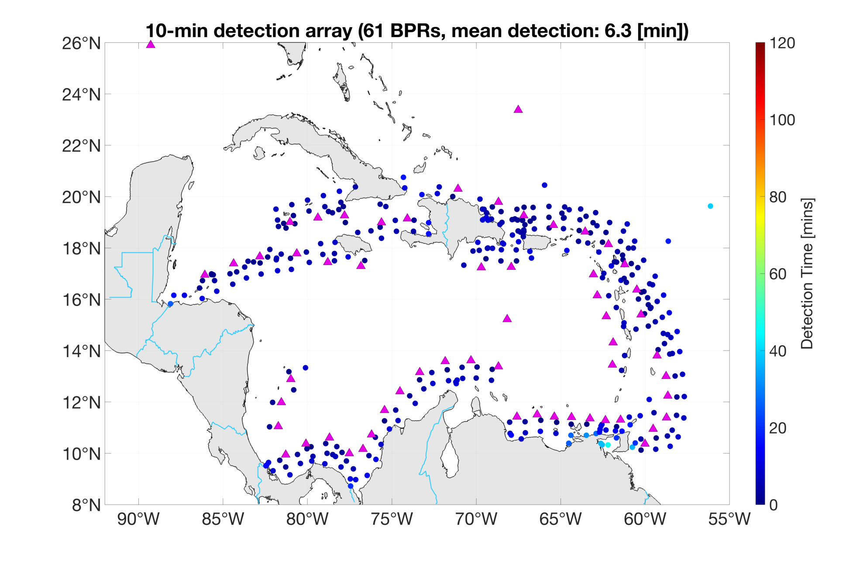
Tsunami Detection, Sensor Placement Strategy
Detection and measurement
  Tsunameters/BPRs
    Deep-water measurement necessary
    Current Buoy coverage minimal
    Events from historical and fault catalog
  Optimzed Sensor Placement
    10-minute detection goal
    2nd sensor needed for good source characterization
  Other Sensors can Offset
    Cable-based deep-water sensors
    GNSS sensors on land
    HF Radar, Ionosphere, etc

Slide 32
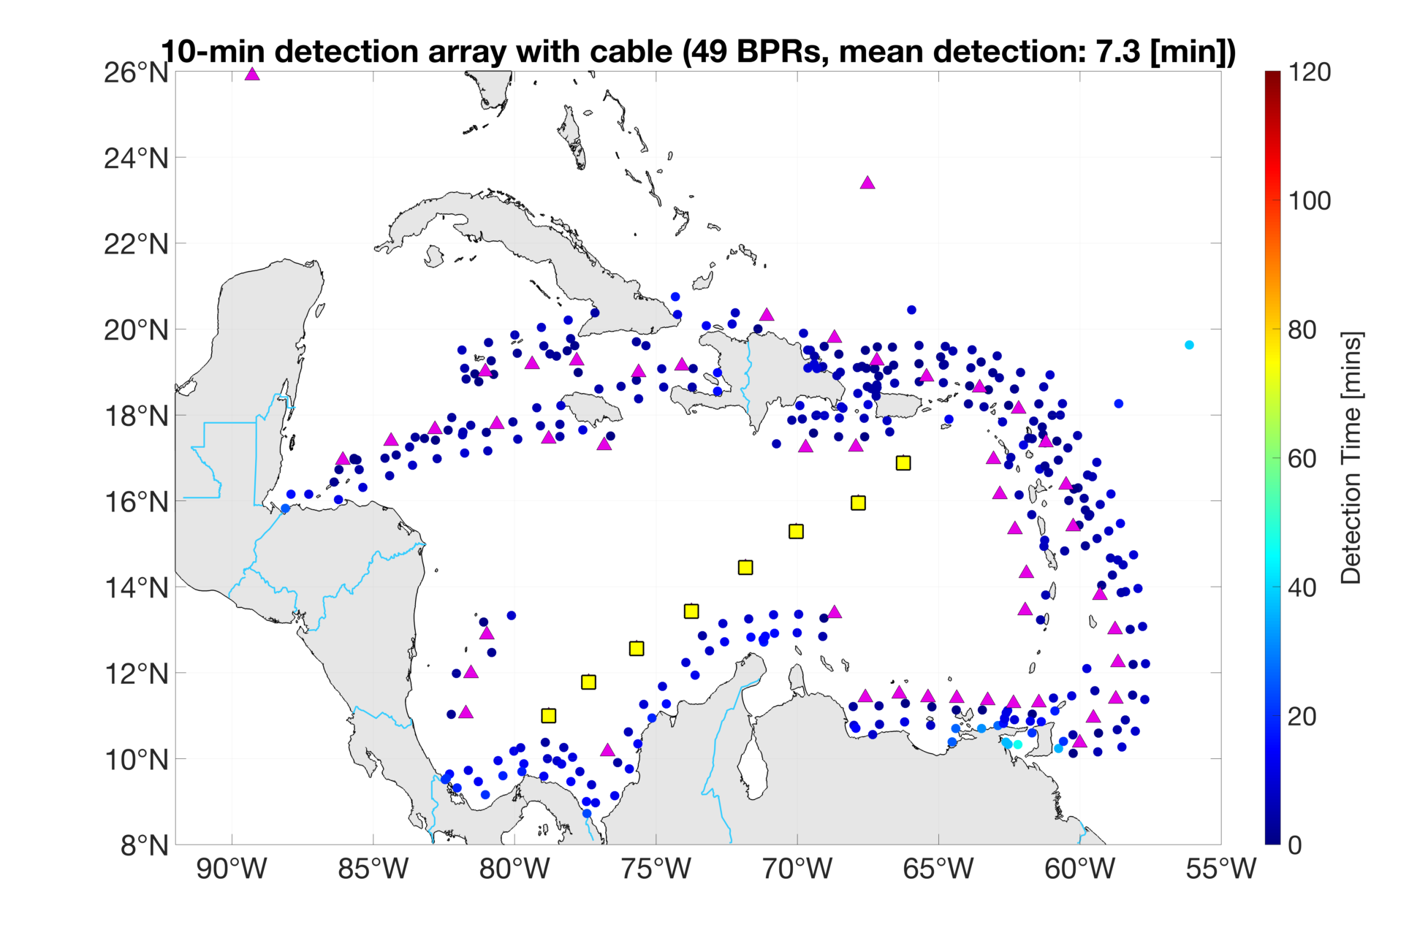
Tsunami Detection, Sensor Placement Strategy
Detection and measurement
  Tsunameters/BPRs
    Deep-water measurement necessary
    Current Buoy coverage minimal
    Events from historical and fault catalog
  Optimzed Sensor Placement
    10-minute detection goal
    2nd sensor needed for good source characterization
  Other Sensors can Offset
    Cable-based deep-water sensors
    GNSS sensors on land
    HF Radar, Ionosphere, etc

Slide 33

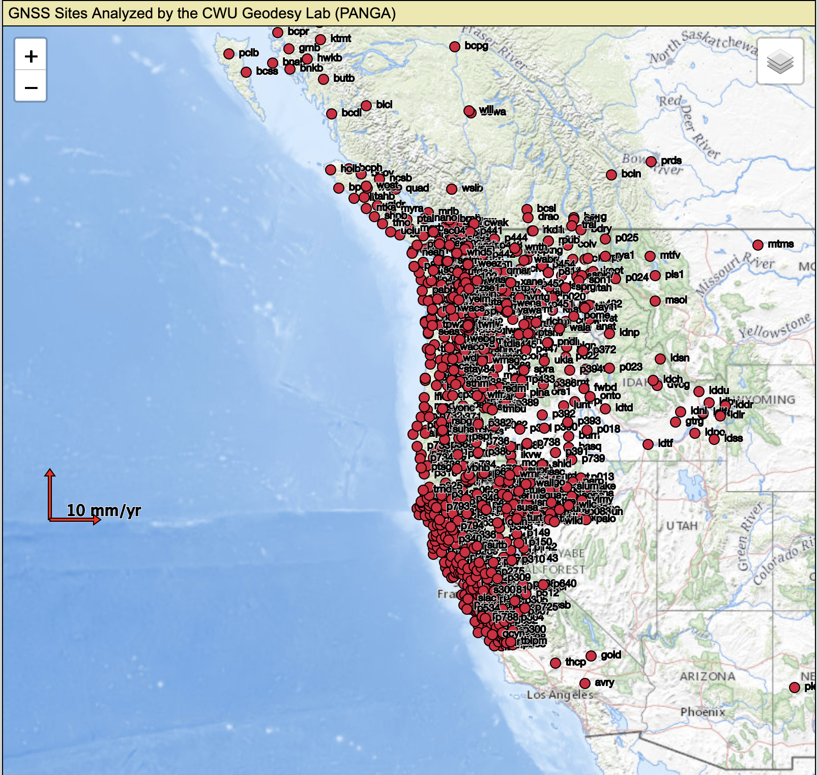
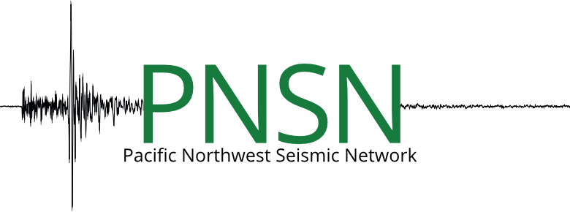
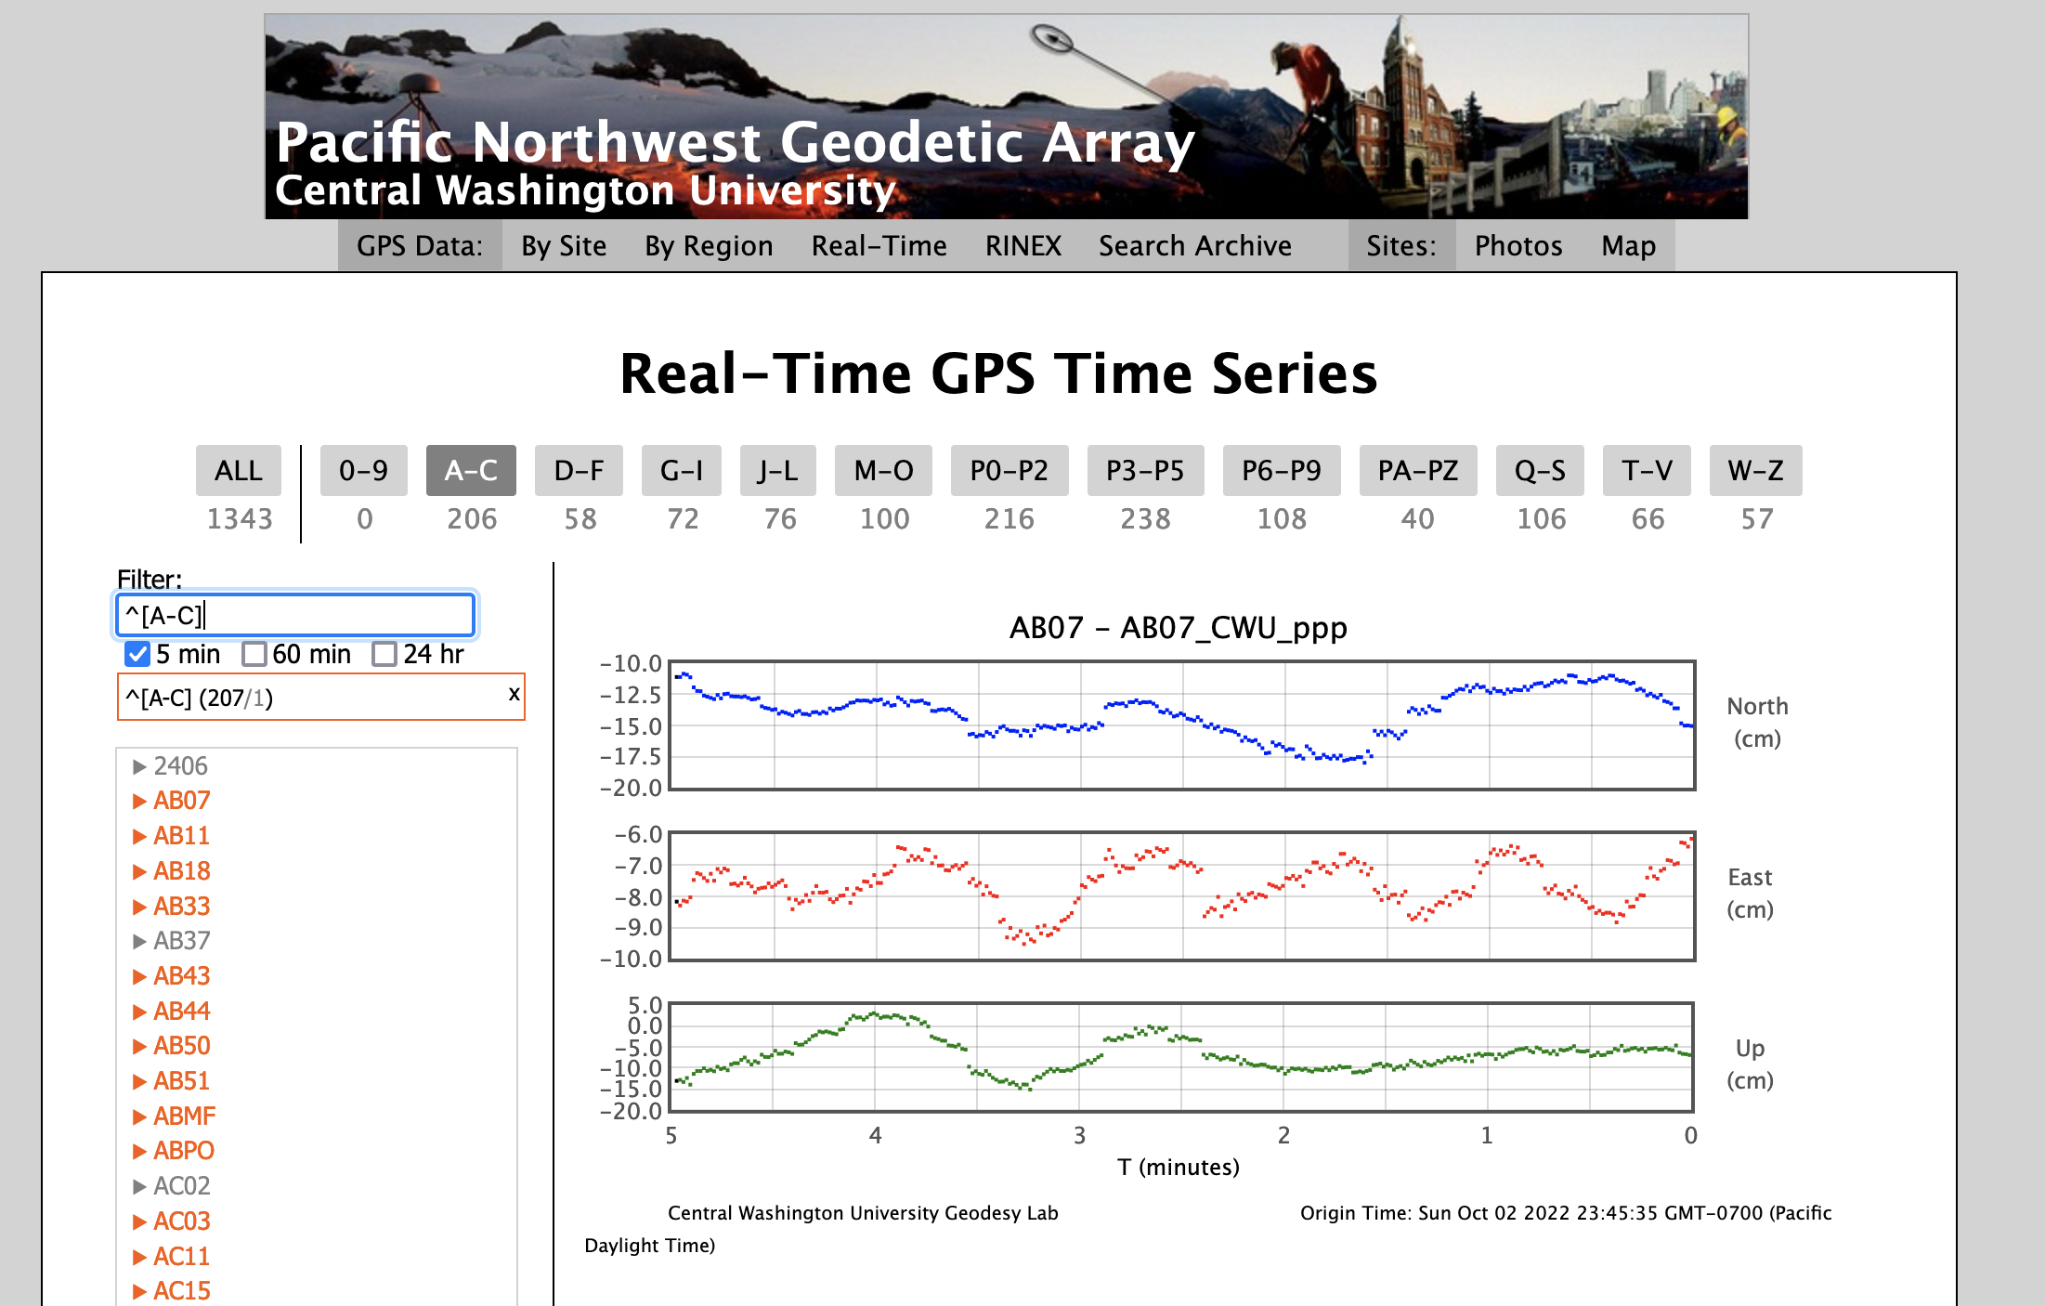
Tsunami Detection, GNSS Characterization in Operations
GNSS real-time data ingest, GFAST products trigger SIFT
  NOAA/NASA/Academia Effort:
    GNSS sensors through CWU
    GFAST developed at UW as part of California Earthquake Early Warning system
  Feeds Forecast in real-time
    Produces PGD magnitude estimate in 90 seconds
    CMT and Finite-fault estimate follow
    Fills event update gap between initial W-phase seismica analysis and deep-water measurements constraint

Slide 34
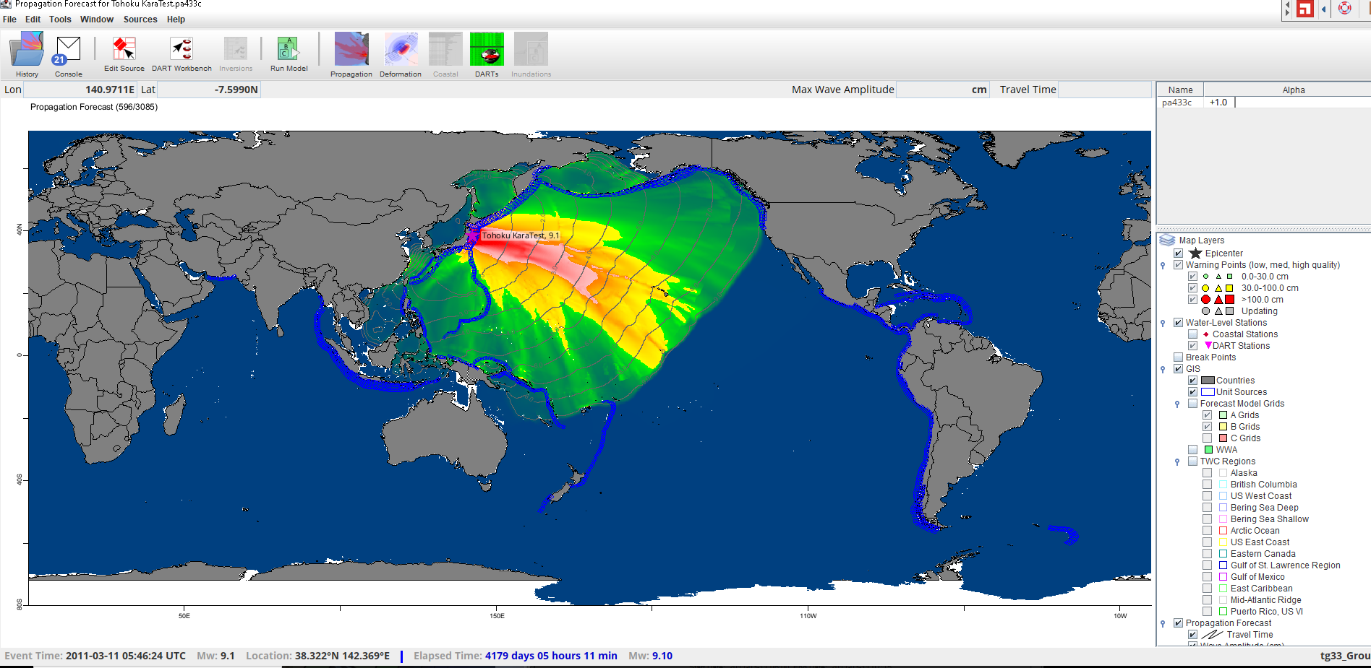
Tsunami Detection, GNSS Characterization in Operations
GNSS real-time data: SIFT
  Using results from GFAST, SIFT can run from PGD, CMT or finite-fault to produce on-the-fly forecast runs.
  Full global coverage or regional high-resolution output
  Inundation model guidance triggers automatically

Slide 35
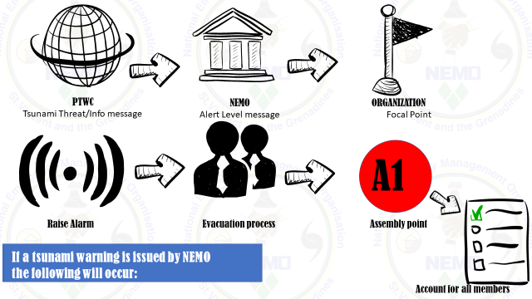
Tsunami Warning and Communication

Slide 36
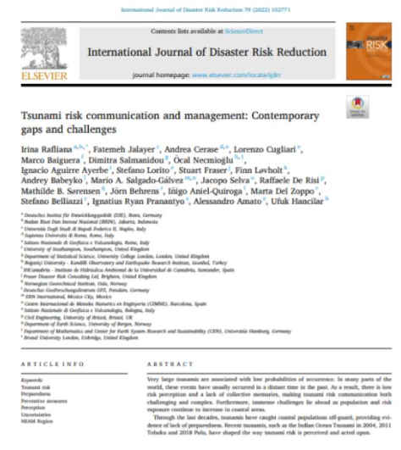
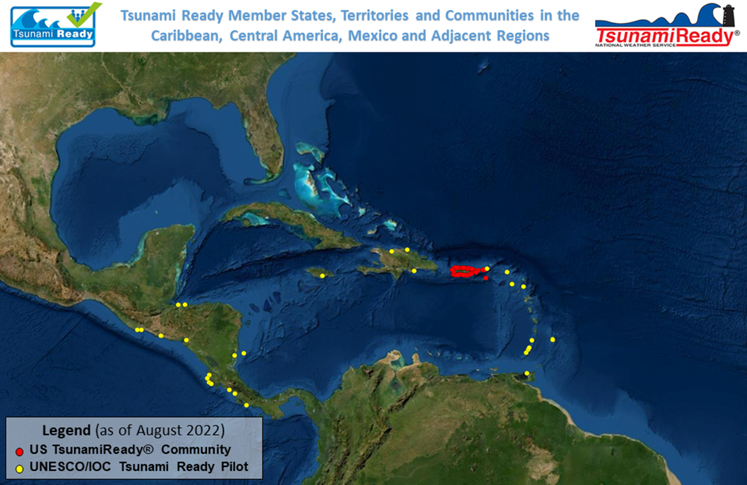
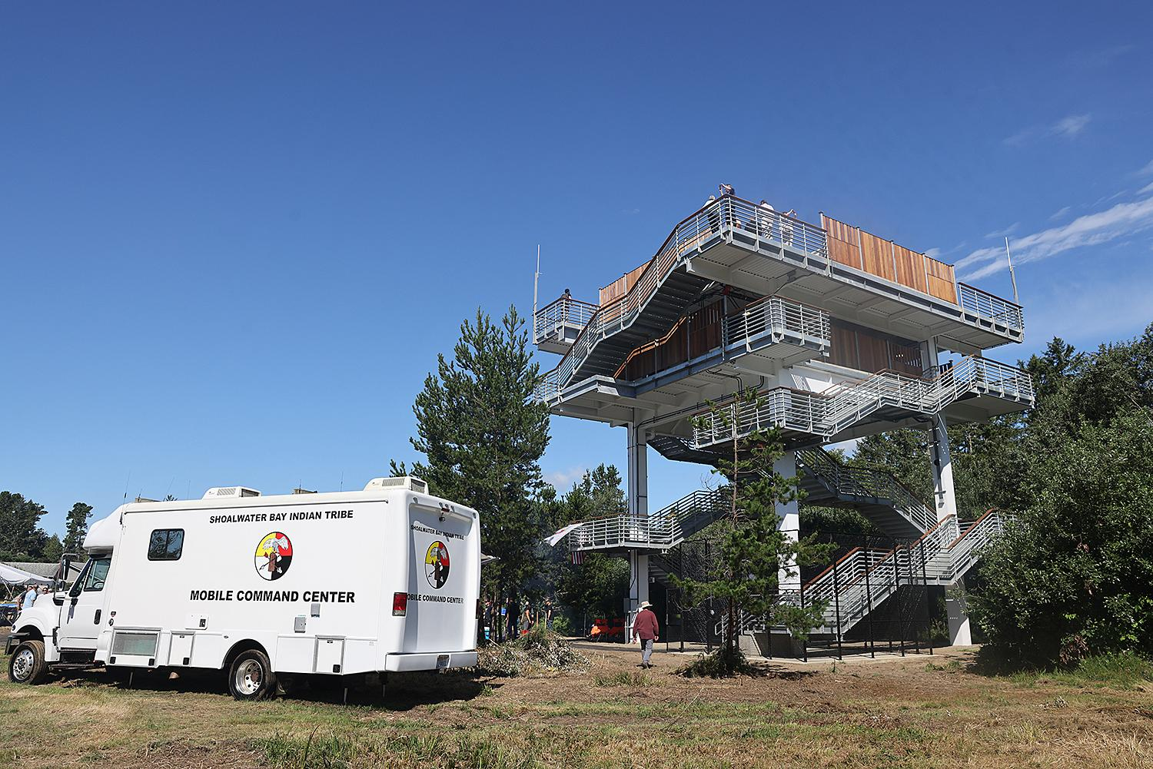
Preparedness and Response: Risk Perception, Tsunami Ready and Mitigation

Slide 37

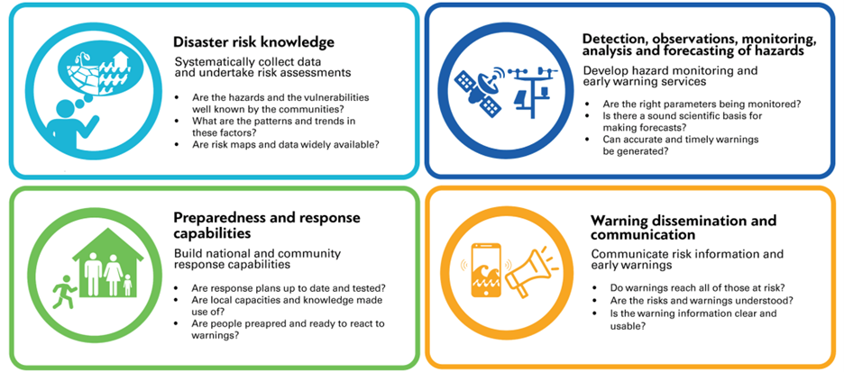
Other Notable Initiatives
IOCARIBE endorsed Ocean Decade Projet - Integrating Coastal Hazard Early Warning System in the Tropical Americas and Caribbean (iCHEWS) - under Coast Predict Programme, includes Tsunami Ready as a best practice
Sendai Framework, updated strategy for the Americas and the Caribbean
UN Early Warnings for All - whole world to be covered by an early warning system by the end of 2027

Slide 38
Regional Alignment Proposal
WG1 | Risk Knowledge (former WG2) | Chair ViceChair
WG2 | Detection, Analysis and Forecast | Chair ViceChair Tsunami Source Detection ViceChair Tsunami Detection (SL) ViceChair Tsunami Forecasting
WG3 | Warning Dissemination and Communication | Chair ViceChair
WG4 | Preparedness and Response Capabilities (former WG4) | Chair ViceChair Preparedness ViceChair Response Capabilities
New Terms of Reference would need to be defined

Slide 39
Recommendations
Relate CARIBE EWS Performance Goals to UNODTP Objectives
Re-align CARIBE EWS WGs to support UNODP Objectives
Establish CARIBE EWS Tsunami Test Bed
Recommend that a study should be conducted to demonstrate improvement in EEW and TEW times with 2-4 variations on SMART Cable designs for the CARIBE-EWS region.
Recommend that industry should be engaged to understand which telecom cables are scheduled for replacement or new installations in the CARIBE-EWS region.
Identify resources and strategy for scaling up the UNESCO/IOC Tsunami Ready Recognition Programme in the CARIBE-EWS region
Identify a mechanism to cross credit other Members States assessment, preparedness and response efforts with the UNESCO/IOC Tsunami Ready Programme.

Slide 40
Back-up

Slide 41
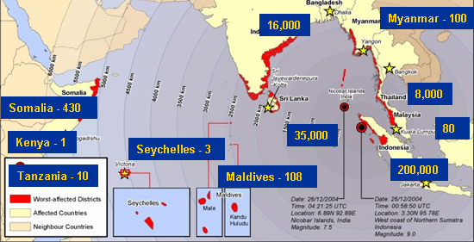
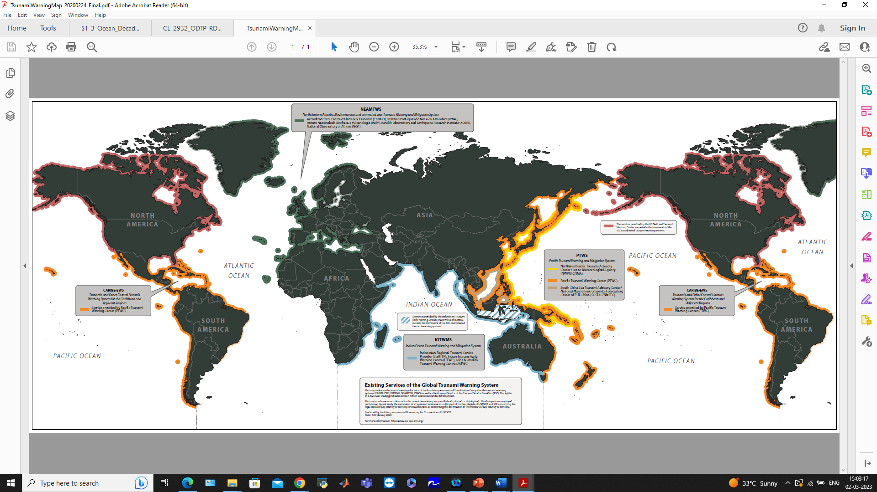
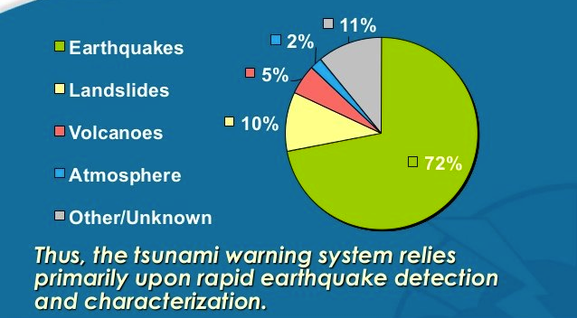
Global Tsunami Warning Systems
~230,000 Causalities
Over 1.6 people million displaced
Estimated economic losses of $14 billion
Great progress since 2004
    4 Regional Systems coordinated by the IOC UNESCO - PTWS, IOTWMS, CARIBE EWS, NEAMTWS
    Operate as inter-operable “system-of-systems”
Network of NTWC/TWFPs receiving tsunami forecast information from one/more TSPs
Sovereign responsibility of NTWCs/TWFPs to provide warnings, watches, and advisories to their citizens
Seismic & Sea Level Observing networks, models, computational, communication facilities, DSS and SOPs
Tsunami Ready
Successfully monitored and issued warnings for several events
Several challenges evidenced from recent events
Tsunami warning is race against time - Uncertainties in tsunami warning
Gaps in Warning and Response capabilities, specially for non-seismic and near-field sources
Gaps in SOPs and Early Warning Chains
Gaps in preparedness & response
Notes:
‹#›
‹#›

Slide 42
UN Ocean Decade Tsunami Programme Scientific Committee
Goal=Draft a 10-Year Research, Development and Implementation Plan for the Ocean Decade Tsunami Programme
Progress
Consultants to draft chapters
Consultations with TSU community (TTs/ICGS)
Consult/contributions Member States (CL)
17 Feb 2022
24-25 Feb 2022
7-8 April 2022
13-17 June 2022
18-20 January 2023
2–3 March 2023
SC 1st meeting
(online)
TOWS-WG
XV
Safe Oceans
Lab
IOC -EC 55
3rd SC meeting (in person)
TOWS-WG XVI
IOC Governing body
Laboratories are innovative formats that function as self-sustaining events. They act as a creative platform to link diverse stakeholders and topics to trigger collaborative efforts regarding the UN Ocean Decade.
2nd SC meeting
(in person)
2nd draft of the 10-Year Research, Development and Implementation Plan for the Ocean Decade Tsunami Programme
Final version of the 10-Year Research, Development and Implementation Plan for the Ocean Decade Tsunami Programme for the
Endorsement
The purpose of this meeting is to first and foremost meet (virtually) and present each other, but also to broadly discuss the terms of reference and agree on a timeline for delivering the 10-year plan
TOWS-WG is a standard setting and advisory body to the IOC on tsunami and other coastal hazards. This session will discuss among other matters, SMART Cable, Tsunami Ready & UN Decade
1st Draft of the 10-Year Research, Development and Implementation Plan for the Ocean Decade Tsunami Programme
Draft TORs consultancies
  4th Call for Decade Actions 31 Jan 2023 – Coastal Resilience
1st Draft to TNCs/TWFPs Dec2022
  2nd draft to TOWS-WG/ICGs/TTs Jan2023

Slide 43
Tsunami Detection, Analysis And Forecasting
Coastal Sea Level Measurements (Tide Gauges)
Challenges | Solutions | Goals
Current network is not adequate from the perspective of: a) Not all gauges measure time (1 min) /height (1mm) /spatial resolution that is optimal for operational warning and better scientific understanding of the hazard b) Not all existing gauges transmit data in real-time | Review and update TOWS WG report on requirements - recommendations on optimal core network for tsunami operations from the perspective of locations, sensors, telemetry, standardized formats, reporting units, etc. | Review and update TOWS-WG report by 2023
 | Ensure groups working on other sea level applications such as GLOSS take onboard the requirements of tsunami so that the stations address multi-hazard requirements | Engage with all relevant groups by 2025
 | Identify hotspots from tsunami / climate perspective for prioritization and redundancy of installations | In all ICGs by 2025
 | Advocacy and Awareness among Member States, Network Operators, International Organisations (IHO, etc) to install new or enhance existing tide gauge networks that comply with agreed standards recommendation; real-time data sharing and access | In all ICGs by 2025
 | Multi-purpose instrumentation and platforms | In all ICGs by 2030

Slide 44
Tsunami Detection, Analysis And Forecasting
Open Ocean Sea Level Measurements (Tsunameters)
Challenges | Solutions | Goals
The current networks of tsunameters are used primarily for tsunami warning validation and unit source inversion of seismic sources for limited range of locations and forecasting of tsunamis; The networks are not adequate for characterising tsunamis from all tsunamigenic zones and for all types of sources; Challenges with long-term maintenance; | Design a global optimal network of ocean bottom pressure sensors that can provide the capability for direct detection of tsunami wave fields from all sources in reasonable time for tsunami warning (not tied to unit sources) | In all ICGs by 2023
 | Technical solutions for better communication (acoustic modems, cable-connected, hybrid, etc.) | Pilot implementation by 2027
 | Technological solutions to implement sensors (pressure gauges and seismometers, etc.) to deep sea floors for high S/N, high reliability, and high durability of observations | Pilot implementation by 2027
 | New use cases of Tsunameter Data for other applications such as ocean circulation, climate, MJO, etc. and promote technologies for possible co-deployment of sensors (pressure gauges and seismometers) with met-ocean moorings to enhance network coverage and maintenance | Pilot implementation by 2025
 | Big data Analytics, High Performance Computing and Processing techniques for real-time data analysis and Forecasting | Pilot implementation by 2024
 | A workshop involving observing, data utilisation, analysis, modeling and data assimilation communities for tsunami and other ocean applications | In all ICGs by 2025

Slide 45
Tsunami Detection, Analysis And Forecasting
Seismic / GNSS
Challenges | Solutions | Goals
Lack of adequate offshore broadband seismic stations; Lack of adequate onshore GNSS stations for direct measurement of co-seismic displacement; Lack of adequate onshore low gain (strong-motion) broadband seismic stations as countermeasures for tsunami earthquakes and huge earthquakes; | Design a global optimal network of ground-based and offshore Broadband/Strong motion/GNSS stations with priority deployment areas identified that can provide the capability for detection of tsunamigenic earthquakes in all source zones within a reasonable time for tsunami warning | A global optimal observational network design document in all ICGs by 2023
 | Instrument/communications design | Pilot Implementation by 2025
 | Keep track of the new technology developments in geodetic observing systems and include them in the update of the plan | In all ICGs by 2027

Slide 46
Tsunami Detection, Analysis And Forecasting
SMART
Current networks (S-net, DONET) are targeting very limited seismic source zones; Lack of adequate network for detecting large non-seismic tsunami before arrival to coastal area; Currently not used for operational tsunami warning; Industry dependencies related to deployment locations, repeater design, etc; Significant upfront cost; | Design a global optimal network of SMART cables that can provide the capability for direct detection of tsunami wave fields from all sources in reasonable time for tsunami warning and other ocean applications | In all ICGs by 2023
 | Technical solutions for production of Commercially Off The Shelf (COTS) repeaters, sensors and allied components to be deployed on SMART cables that meet the purpose of tsunami warning and other ocean Applications | Pilot Implementation by 2024
 | Advocacy with all stakeholders including Private Industry, Intergovernmental organisations and Scientific Expert Teams for rapid development and implementation of SMART cables | Ongoing in all ICGs
Other future potential observing technologies (Coastal Radars, Altimeters, Infrasound & TEC Measurements, etc.)
Challenges | Solutions | Goals
Challenges with network coverage, data latency, accuracy, data analysis methodologies for implementation in operational tsunami warning | Promotion of Research & Development in potential future observing technologies and analysis methodologies that could enhance operational tsunami warning of tsunamis from all sources. | In all ICGs by 2027
 | Development and testing of instruments and methodologies to detect tsunami waves | Pilot Implementation by 2028

Slide 47
Tsunami Detection, Analysis And Forecasting
Characterisation and forecasting of all significant tsunamis within an actionable timeframe from generation
Challenges | Solutions | Goals
Challenges with integration of data from enhanced observing networks and new methodologies for defining the tsunami wave fields for operational tsunami warning including detection, verification, characterisation and impact | Research on the nature of tsunamis, source mechanisms and characterisation from various observation data | Contributing capabilities identified by 2024
 | Probabilistic Tsunami Forecasting Techniques - assign confidence level (0.0-1.0) to wavefield definition | Prototype wavefield predictor developed by 2023
 | Development of new forecast methods for operational impact forecasting of all significant tsunamis within an actionable timeframe from tsunami generation – Database applications and matching schema for updated global threat database including non-seismic sources AI-ML applications to relate, discrete or combine observations to potential outcomes Dynamic characterization using rapid update cycle models | Improved forecasting methods deployed and operationalised at the TSPs and NTWCs by 2030

Slide 48
Tsunami Warning, Dissemination and Communication
    Warning Dissemination and Communication Options
Challenges | Solutions | Goals
The lack of redundant mechanism in receiving and disseminating warning and Communication | Redundant mechanism in receiving and disseminating warning and communication | 100% countries at-risk of tsunamis by 2027
The lack of standard format for warning and Communication | Promote Common Alert Protocol (CAP) and Training of NTWC staff on CAP | 100% countries at-risk of tsunamis by 2030
The lack of national standard format and mechanism for warning and communication for people with disabilities | National standard format and mechanism for warning and communication for People with disabilities
Conflicting and multiple source of warning information | Effective use of Broadcast and Social Media. Media Training for NTWC staff and Training for Media Broadcaster and Social Media Influencers
Technology Gap and/or not fully utilized | New/emerging technologies (Digital and Communication) | In all ICGs by 2024
Lack / limited Interoperability | Multi-hazard Early Warning Alignment (resources, capacity, information, SOP, etc.) | 100% countries at-risk of tsunamis by 2027

Slide 49
Tsunami Warning, Dissemination and Communication
    National and local tsunami warning chains and SOPs
Challenges | Solutions | Goals
Parameters needed by the National and Local DMO to advice response | Co-design of warning information and SOP requirements among the TSPs, NTWC, N/L DMO, and other relevant stakeholders | Updated Global Service Definition Document for Tsunami Watch Operations by 2024
Decision Matrix on Warning | Competency training for NTWC and National and Local DMO staff | 100% countries at-risk for tsunamis have national tsunami warning response plans and SOPs by 2027
Construction of the Warning
Time Constrain | The use of IT | 100% countries at-risk of tsunamis by 2027
Languages and fit for audience (not inclusive) | Understanding the target audience (culture, education, capacity, abilities, inclusiveness, etc.) | 100% countries at-risk of tsunamis by 2027
The lack of actionable content of warning. | Develop impact based warning content (consequences) | 100% countries at-risk of tsunamis by 2025

Slide 50
Tsunami Warning, Dissemination and Communication
    Warning Dissemination and Communication Options
Challenges | Solutions | Goals
The lack of redundant mechanism in receiving and disseminating warning and Communication | Redundant mechanism in receiving and disseminating warning and communication | 100% countries at-risk of tsunamis by 2027
The lack of standard format for warning and Communication | Promote Common Alert Protocol (CAP) and Training of NTWC staff on CAP | 100% countries at-risk of tsunamis by 2030
The lack of national standard format and mechanism for warning and communication for people with Disabilities | National standard format and mechanism for warning and communication for People with Disabilities
Conflicting and multiple source of warning information | Effective use of Broadcast and Social Media. Media Training for NTWC staff and Training for Media Broadcaster and Social Media Influencers
Technology Gap and/or not fully utilized | New/emerging technologies (Digital and Communication) | In all ICGs by 2024
Lack / limited Interoperability | Multi-hazard Early Warning Alignment (resources, capacity, information, SOP, etc.) | 100% countries at-risk of tsunamis by 2027

Slide 51
Preparedness and Response Capabilities
Preparedness
Challenges | Solutions | Goals
Limited availability of easily understood tsunami evacuation maps | Training on Tsunami Evacuation Maps, Plans and Procedures (TEMPP) | 30% of community to have easily understood evacuation maps by 2025 75% by 2027 100% by 2030
 | Identification of Tsunami Hazard Zones and development of Tsunami Inundation Map
 | Enhancing GIS capacity within country
 | Data and information for evacuation maps (sensitive and critical infrastructures)
 | Inclusion and guidance on effectiveness of tsunami evacuation map (social and culture)
 | Community participatory approach in tsunami evacuation map
Limited public display of tsunami information in tsunami prone areas | Establish a national standard of Tsunami Signage (i.e. take ISO) | 100% by 2030
 | Inventory of the type of tsunami signages used by different countries, Engage local artist

Slide 52
Preparedness and Response Capabilities
Preparedness
Challenges | Solutions | Goals
Limited local context in tsunami awareness and education resources (language, culture, local threat, risk, etc.) | Adaptation of tsunami education resources to the local context (language, culture, local threat, risk, etc.) | 100% by 2030
 | Use local authority social media and website for public awareness and Education | Increment of 10% annually
Limited people with disabilities are included in preparedness and response actions | Development of specialized tsunami awareness education resources for people with disabilities | At risk communities have engagement and inclusion of people with people with disabilities 100% by 2030
 | Engagement and inclusion with People with disabilities (association, communities, authorities, etc.)
Limited inclusion of tsunami in school curricula | Institutionalizing tsunami education and awareness into school curricula | 100% by 2030
 | Share best practices and lessons learnt on tsunami education and awareness in school curricula
 | Engage with other global frameworks on School DRR, i.e. GADRRRESS

Slide 53
Preparedness and Response Capabilities
Preparedness
Challenges | Solutions | Goals
Limited effective outreach -activities for people in tsunami prone area | Community at risk to conduct at least three outreach activities annually conduct tsunami exercise | Community at risk engagement in World Tsunami Awareness Day 100% by 2030
Lack of validation of tsunami response capacity due to infrequent Tsunami |  | Community tsunami exercise at least once every two years 100% by 2030. Engagement of community at risk in ICGs wave exercises as well as other national tsunami exercises 100% by 2030
Response Capabilities
Lack of understanding of the Tsunami Ready Community, especially to scope and definition of community | Advocacy and promote Training of UNESCO-IOC Tsunami Ready Recognition Programme (i.e. OTGA)of Manual and Guide 74 on Tsunami Ready | 100 % Number of at risk community in each country by 2024

